Slide 1
L1T Upgrade Update #5
Brock Ewing
4.16.2024

Slide 2
Project Recap
Upgrade the L1T system to look for new Higgs signatures in background HL-LHC data
Analyze and select events from simulated data to train an NN for implementation onto the HL-LHC hardware
Create NN and generate accuracy and efficiency graphs, ROC graphs to show the ability of our NN.
Use Qkeras and hls4ml to reduce the size of our NN and transfer it onto FPGA hardware.

Slide 3
Progress
Currently training the NN and trying to get a good-looking ROC curve.
Adjusting input data to get the best training results

Slide 4
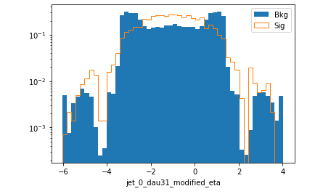
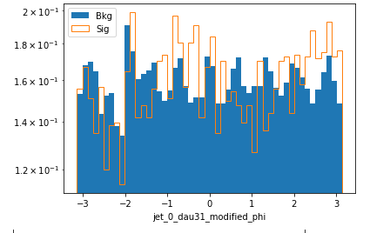
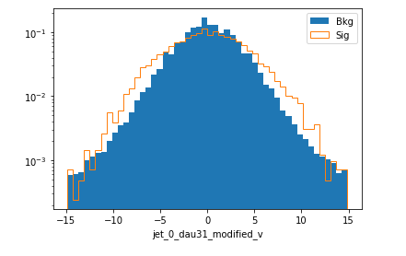
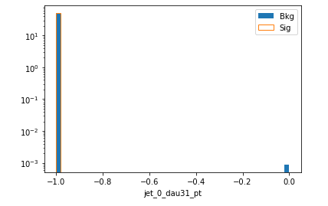
Input data and processing
Graphs of input data from background and signal datasets
Modified variables are the particle var – jet var.

Slide 5
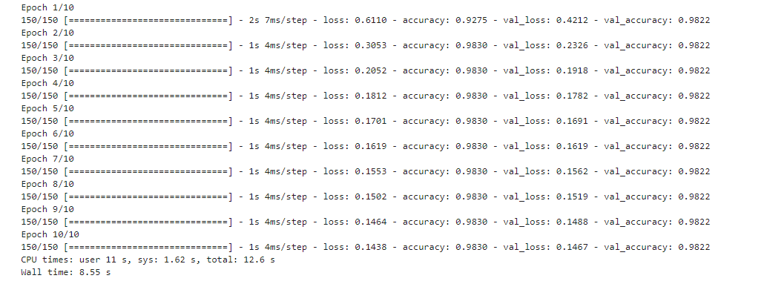
Neural Network creation
NN trained over 10 Epochs

Slide 6
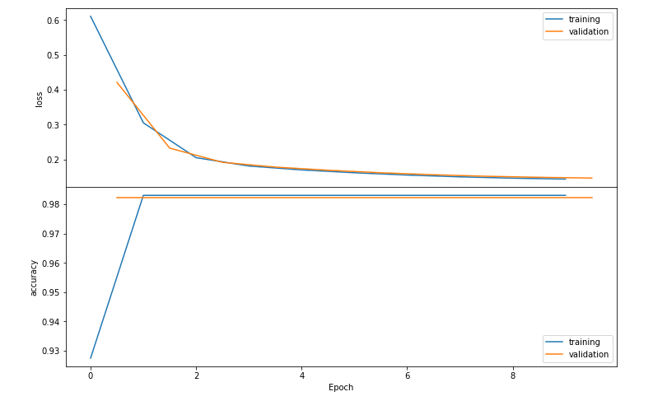
Neural Network creation

Slide 7
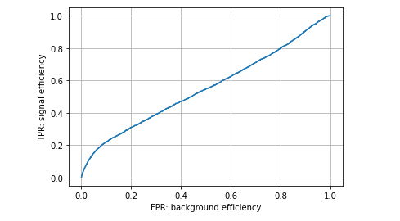
First ROC curve

Slide 8
Next Steps
Put cuts on Jet pt
Filter for only jets that are close to Higgs in deltaR

