Slide 1
CERN-GSI Collaboration Steering Board Meeting
Super-FRS Magnet Testing
Building 180 - Test facilities and CERN activities
Link to Indico
26 April 2024
G. Riddone, CERN
Contributions from D. Calcoen, M. Charrondiere, T. Dupont and C. Halbert

Slide 2
Content
KR3912/TE – Short reminder
Status of the cryogenic and QP/EE systems
On-site CERN coordination and test follow-up
CERN involvement in the joint task forces
Conclusions

Slide 3
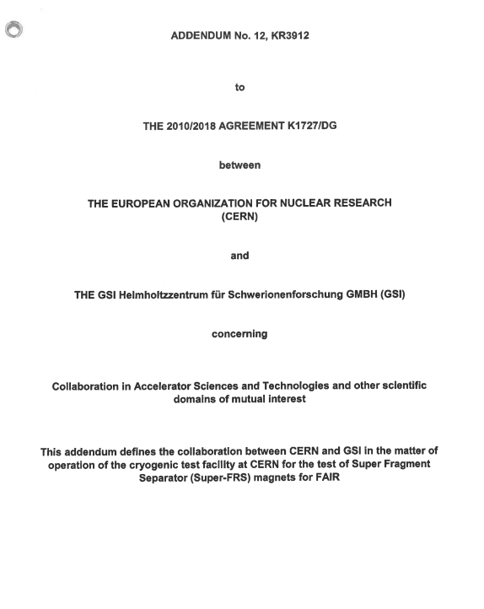
Collaboration agreement KR3912/TE
Test facility at CERN for the tests of Super Fragment Separator (Super-FRS) magnets for FAIR
GSI is leading the activity, and contributes to it with:
  4 FTE: operation team (2 eng. and 2 technical eng.)
CERN is contributing with:
  0.4 FTE: support with best –effort service from its equipment groups (cryogenics, survey, power converters, energy extraction, quench protection, data acquisition and control)
  1 FTE: on-site technical engineer - support and coordination with internal services and CERN contractors
Industrial support from other groups which is charged to GSI on cost-recovery basis
The total cost estimated at 5.4 MCHF for the two phases now until Q4/2026 (originally until Q1/2024).
Amendment on extension of duration: now until end 2026 (see also H. Simon presentation)
FTE for 2022: 0.8
FTE for 2023: 1.1
2 persons from industrial support (full time)
Logistics and storekeeper: 0.2

Slide 4
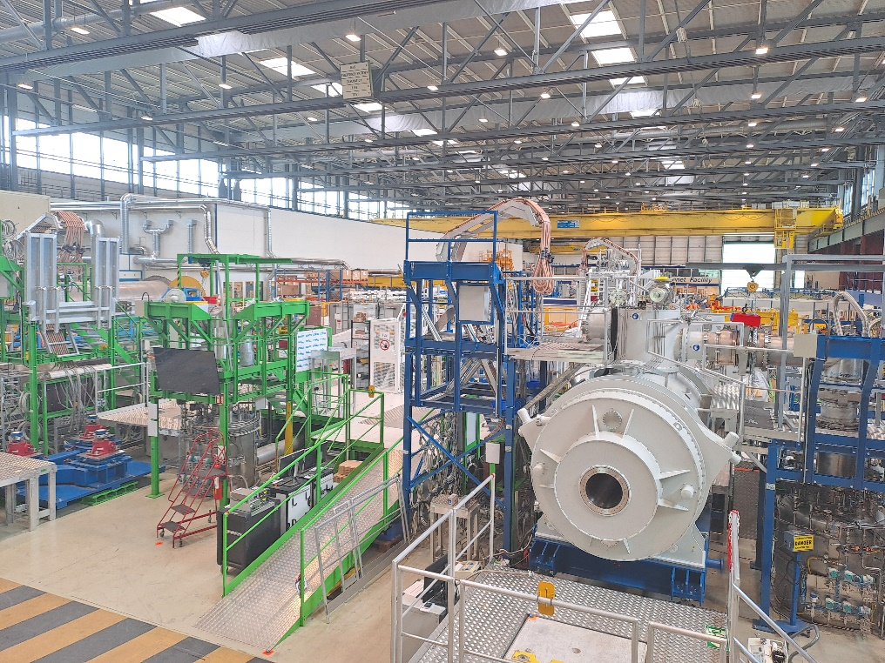
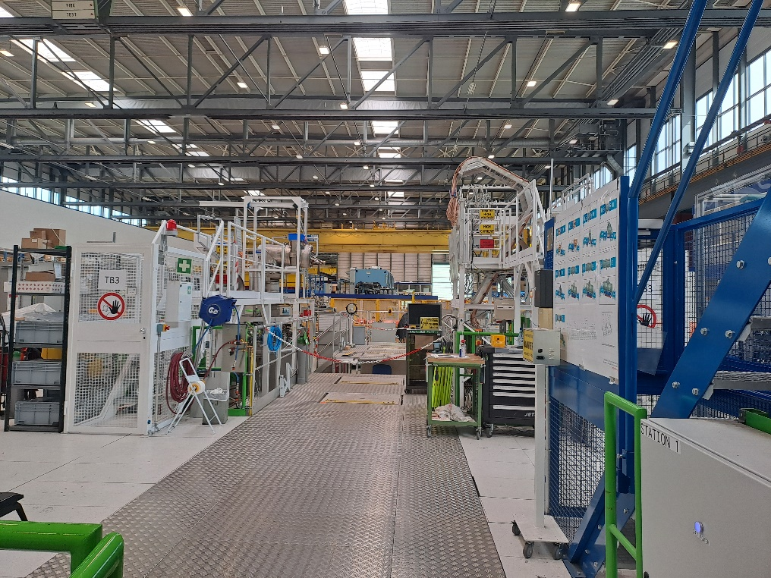
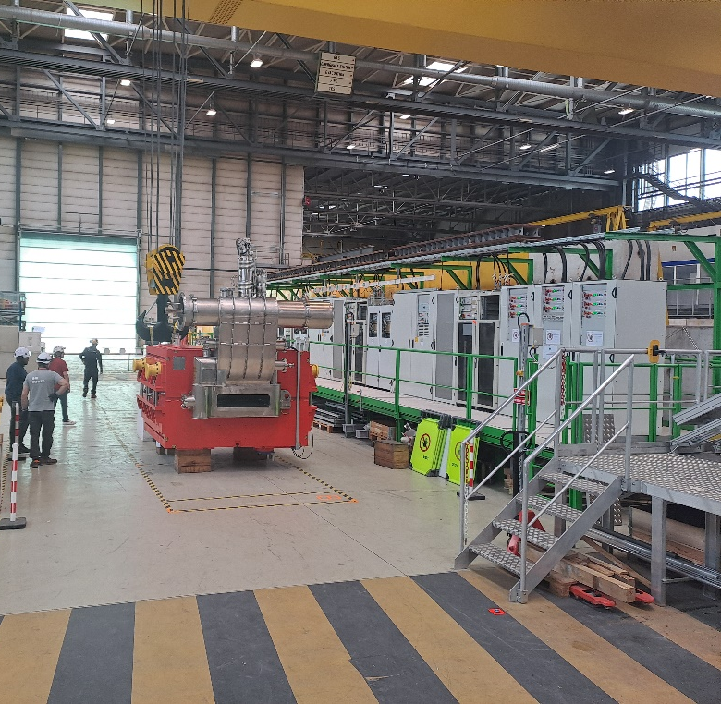
Test Facility in B180
Test benches and preparation area
Test Bench 1
Test Bench 2
Test Bench 3
Preparation area
(Dipole from Elytt)

Slide 5
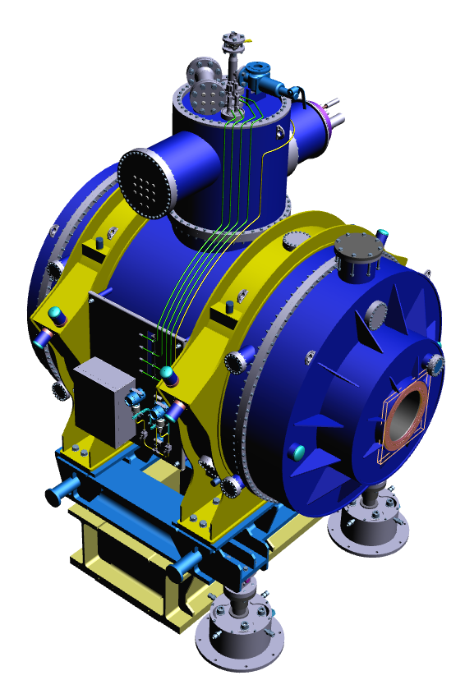
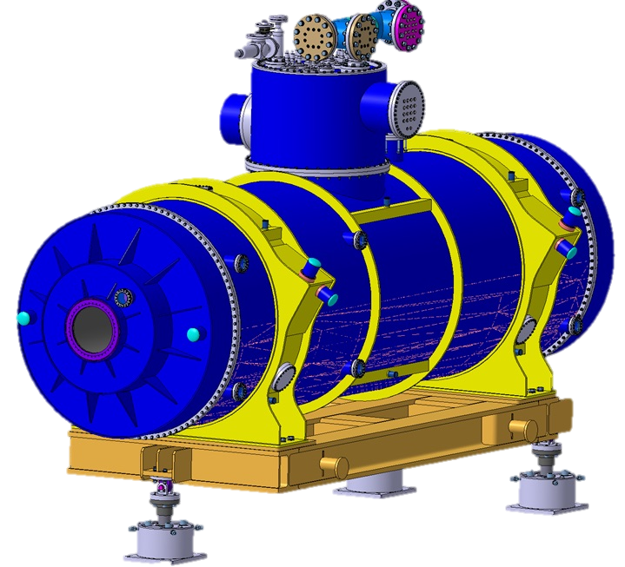
Cryogenic operation follow-up
Cryogenic service in 2023 (4.5K cryoplant only) :
Working hours: 6523 h
Total facility availability: 99.6% (Utilities default)
Cryo availability: 100%
ACTION | MAGNET | BENCH | START DATE 1
COOLDOWN | LM09 | 1 (BLEU) | 1/16/23 11:30
WARMUP | LM09 | 1 (BLEU) | 2/14/23 11:30
COOLDOWN | SM06 | 3 (WHITE) | 2/16/23 10:15
COOLDOWN | LM09 | 1 (BLEU) | 3/13/23 13:00
WARMUP | SM06 | 3 (WHITE) | 3/23/23 10:30
WARMUP | LM09 | 1 (BLEU) | 3/24/23 10:30
COOLDOWN | LM11 | 2 (GREEN) | 4/4/23 9:10
COOLDOWN | LM09 | 1 (BLEU) | 5/12/23 10:00
COOLDOWN | SM03 | 3 (WHITE) | 5/17/23 13:00
WARMUP | LM11 | 2 (GREEN) | 5/23/23 10:00
WARMUP | LM09 | 1 (BLEU) | 5/23/23 22:00
WARMUP | SM03 | 3 (WHITE) | 6/27/23 15:30
COOLDOWN | LM09 | 1 (BLEU) | 7/27/23 11:00
WARMUP | LM09 | 1 (BLEU) | 8/8/23 11:30
COOLDOWN | SM02 | 3 (WHITE) | 8/2/23 14:30
WARMUP | SM02 | 3 (WHITE) | 8/28/23 9:00
COOLDOWN | SM05 | 1 (BLEU) | 9/6/23 14:15
WARMUP | SM05 | 1 (BLEU) | 10/9/23 15:15
COOLDOWN | SM05 | 1 (BLEU) | 10/17/23 13:30
COOLDOWN | SM04 | 3 (WHITE) | 10/19/23 13:30
WARMUP | SM05 | 1 (BLEU) | 10/23/23 14:00
WARMUP | SM04 | 3 (WHITE) | 11/17/23 10:30
COOLDOWN | SM04 | 3 (WHITE) | 11/24/23 10:00
COOLDOWN | SM05 | 1 (BLEU) | 12/4/23 15:00
WARMUP | SM05 | 1 (BLEU) | 12/11/23 10:30
LM09, LM11
SM02,SM03,SM04,SM05,SM06
2 LM and 5 SM tested
Total 2023: 13 Cooldown & 12 Warm Up
 | 2019 | 2020 | 2021 | 2022 | 2023
LM |  |  | 1 | 2 | 2
SM | 1 |  |  | 2 | 5
Dipole |  |  |  | 1

Slide 6
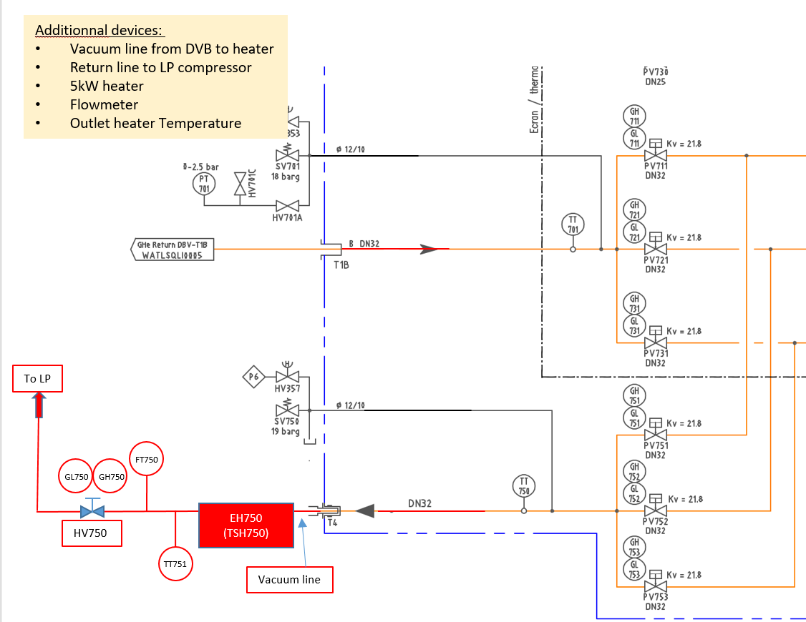
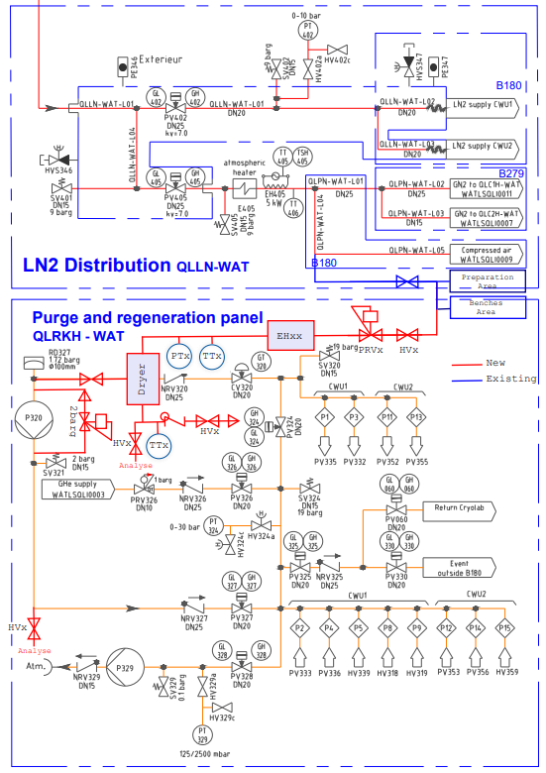
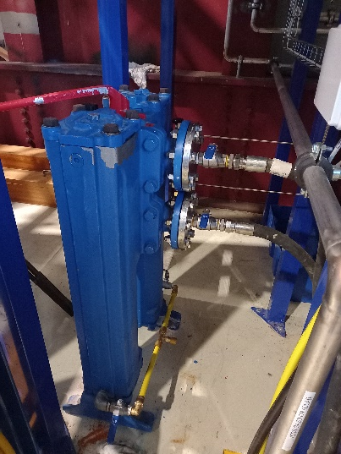
Cryo consolidations and maintenance
Consolidations
Bypass SVB to LP (Perturbations limitation between 80 k to 4.5 K)
Cold box water inlet filter upgrade (sized with respect to found impurities)
Process requirements upgrade (Automatic GSI changing modes following Cryo modes)
Under study: additional dryer, conditioning and circuit analyses
1. Bypass SVB to LP
Maintenance and Major Overhauling Cryo equipment deadline
Compressor station 4.5 K (from July 23 up to March 24: 3500 h of operation
  Compressor C120, PM (40000 h), Next major overhauling in ~12000 h
  Electrical Motor M120, PM (40000 h), Next major overhauling in ~12000 h
Precooler Compressor Station (from July 23 up to March 24: 3500 h of operation)
  Compressor C120, PM (40000 h), Next major overhauling in ~25500 h
  Electrical Motor M120, PM (40000 h), Next major overhauling in ~15500 h
2. Cold box water inlet filter
4. Project under study

Slide 7
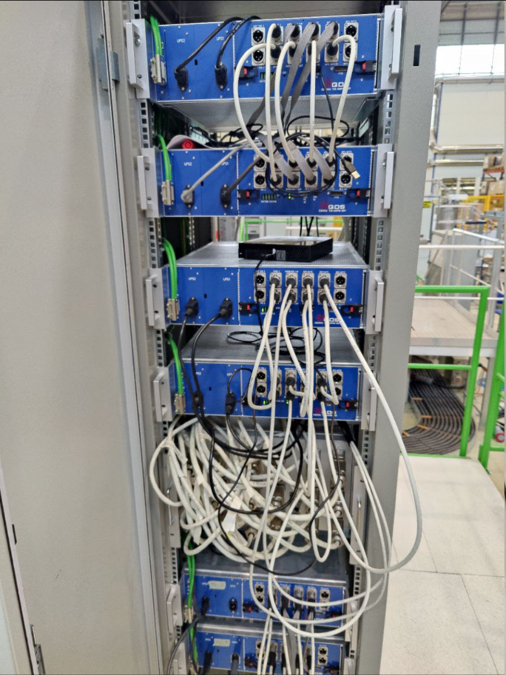
QP and EE systems
WP Quench Protection System (TE-MPE)
  Mandate: Provide the Quench Detection System
  + controls layer for the Test Benches.
WP Energy Extraction System (TE-MPE)
  Mandate: Provide the Energy Extraction System
  + controls layer for the Test Benches.
Status:
  TB1 : 6 x UQDS units installed and running
  TB2 : 6 x UQDS units installed and running
  TB3 : 6 x UQDS units installed and running
  3 x 600 A Energy Extraction system installed and running
  on 3 Nov 2023, GSI quench detection system was tested successfully (while CERN QDS was also active)
Reminder:
we did not have the opportunity to run TB2 nor TB3 with the 9 magnets multiplet (the final commissioning of the TB)

Slide 8
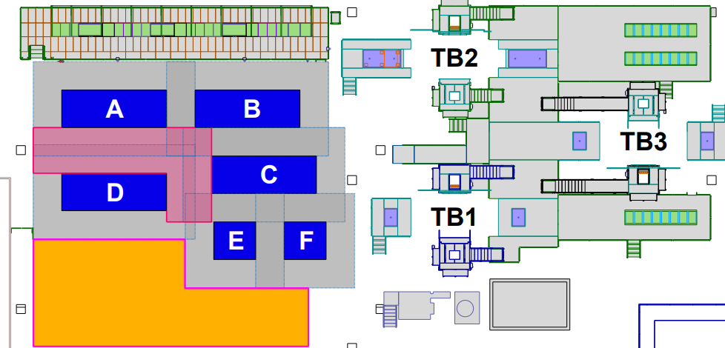
Preparation area improvements
Optimization was needed for magnet delivery, shipping and preparation
Integration of all possible delivery flow and tests
Allocated 5 zones for long magnets (included zone E-F that could be used for 2 short magnets)

Slide 9
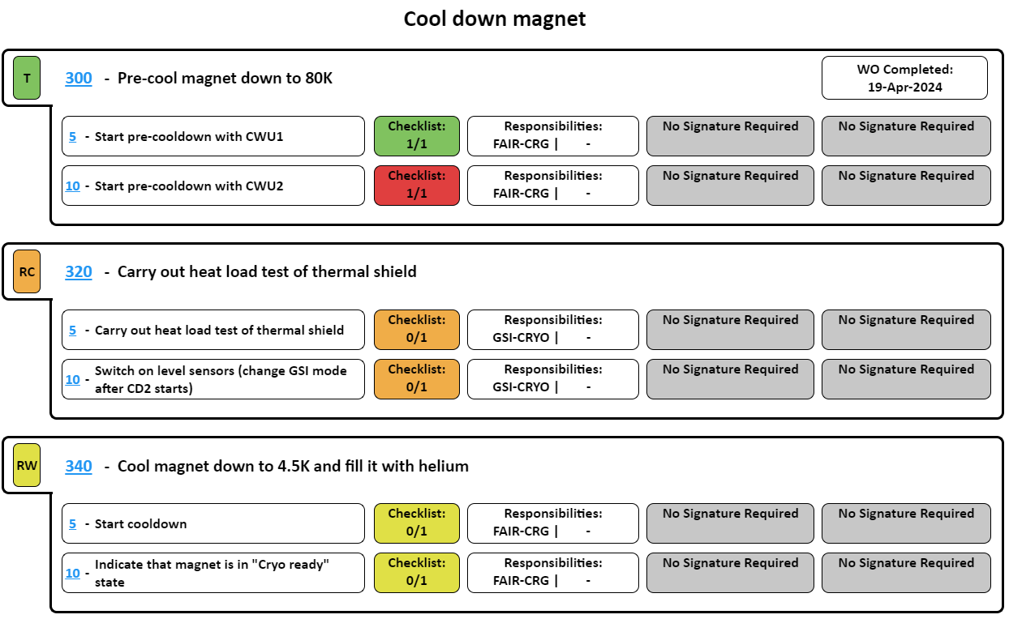
On-site coordination
EAM Light (cern.ch)
Weekly coordination meetings with GSI and CERN teams to prepare activities of coming week(s)
Magnet test workflow taken as a reference and implemented in a sequencer tool (ST)
Each task identified with responsibilities to avoid oversights - important from safety aspect
Once a task is completed and signed, ST sends automatically notifications to the following team to start their activity
➔ ST became a practice for every users, allowing for fluent interactions

Slide 10
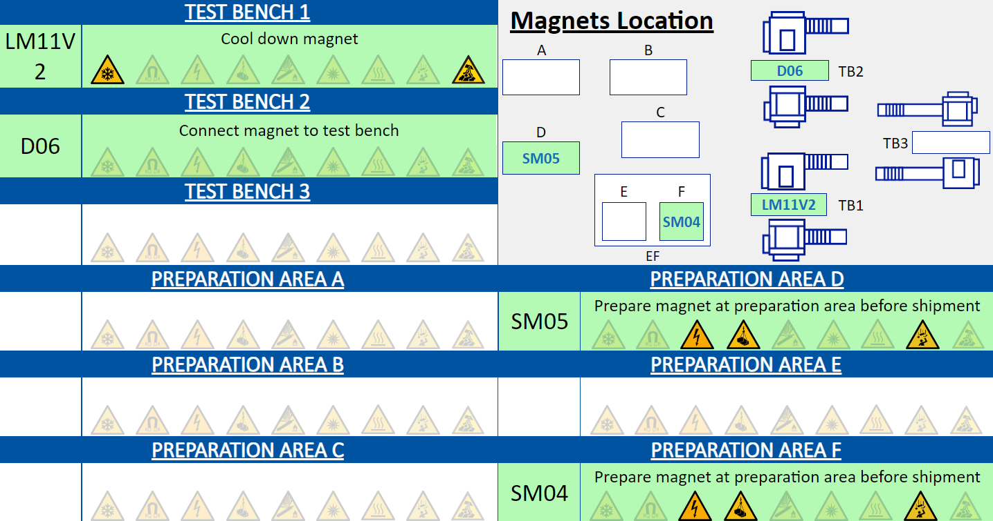
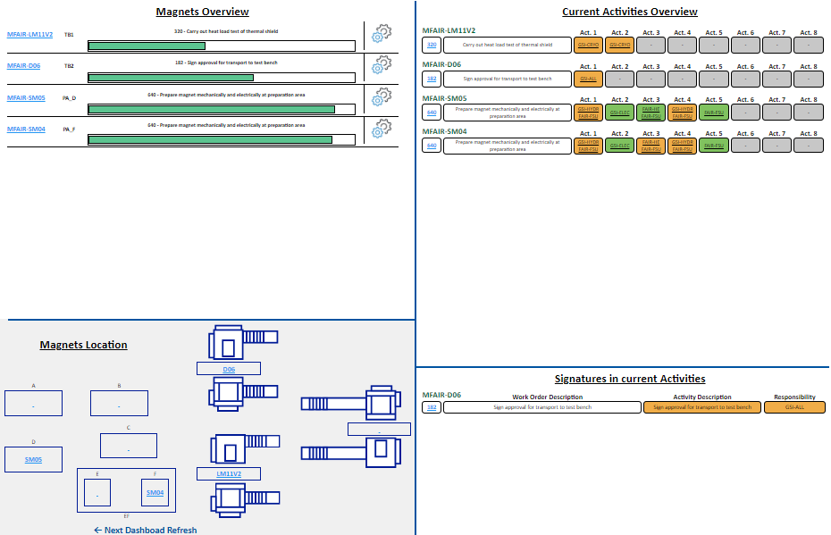
On-line dashboards
Overview of steps and signature upon completion
Overview of safety risks vs. ongoing tests

Slide 11
Joint task forces
CERN participated to the task forces organized by GSI with ASG and Elytt
CERN provided support and recommendations on:
  on-site leak localization
  brazing and x-rays (meetings every two weeks) on magnets to be repaired
  mechanical design and FEM simulations (monthly meetings)
CERN coordinated and performed the tests on samples as requested by GSI-ASG and GSI-Elytt (more details in the next slides)

Slide 12
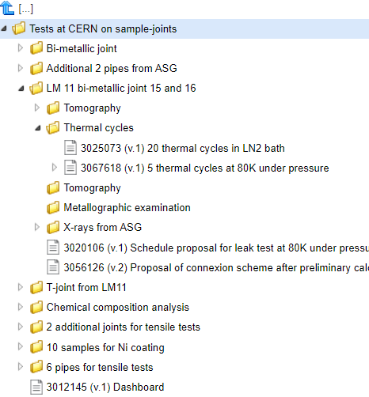
Joint task force CERN-GSI-ASG
All reports available in EDMS
47 samples at CERN - Dec 2023 - May 2024
CERN support: EN/MME, TE/CRG, TE/VSC, TE/RAS
  Tomography x13
  Metallographic analysis x3
  Thermal shocks on 14 samples
  Ni coating x10
  Chemical composition analysis x3
  Thermal cycles under pressure on 2 samples
  Tensile tests at ambient temperature and at 80 K x13

Slide 13
Joint task force CERN-GSI-ASG (dashboard)
Samples ASG | Description of sample | Objective | STATUS
1. Bi-metallic joint | Inox – Cu bimetallic, new design mock-up sample from workbench | Check ASG x-ray results and further analysis for qualification (Tomography and Metallographic examination) | Report published
2. Additional 2 pipes from ASG | 2 Cu-Cu socket joints – sample joints from the work bench | Confirm ASG x-ray results and further analysis qualification (Tomography | Report published
3. LM 11 bi-metallic joints 15 and 16 | Inox – Cu bimetallic, new design, prepared on workbench, extracted from LM11 | Confirm ASG x-ray results and further analysis/testing for qualification (tomography, thermal cycles, metallographic examinations, tensile tests at cold) | Sent to tomography after thermal cycles
4. T-joint from LM11 | Cu-Cu-Cu, leaking joint, tomography already performed at CERN and ASG | Further root-cause analysis of leakage (tomography) | Reports published
5. 3 samples for chemical composition analysis | stains collected from LM11 turret | identification of chemical compositions (no presence of flux) with SEM | Reports published
6. additional 6 pipes | 2 Cu-Cu socket joints – sample joints from the work bench | Check mechanical strength after thermal shocks (tensile tests after thermal shocks) | Tensile tests in preparation
7. Ni coating on stainless steel pipes | 10 x commercial stainless steel pipes (316L), L = 100 mm, OD= 18 mm, d=1.5mm | to improve brazing quality by prevent re-passivation of the SS pipe | Samples coated. Delivered to ASG
8. Additional 6 pipes | annealed Cu pipes (DHP R200) | Check mechanical strength after thermal shocks ((tensile tests after thermal shocks) | Tensile tests in preparation
9. 5 x Cu-Cu brazed joint from LM09/SM02 | selected Cu-Cu brazed joints after X-ray scan at ASG. Cold leak test done at ASG. | Root-cause analysis of cold leak from a thermal shield of LM09 and SM02 (tomography) | Received at CERN on 24.04

Slide 14
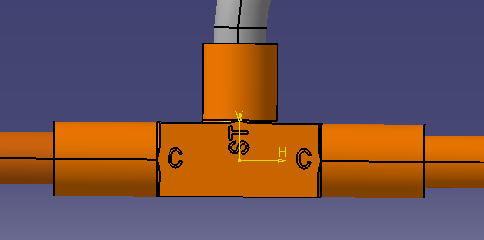
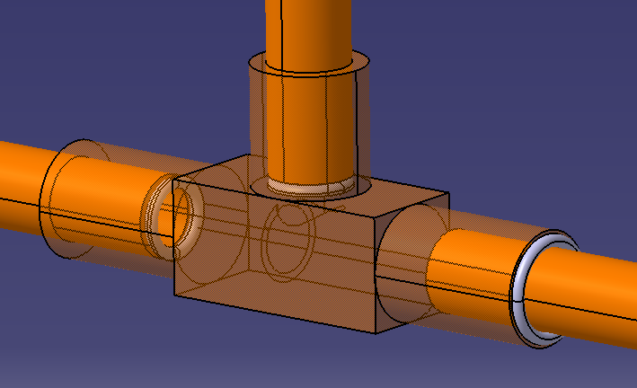
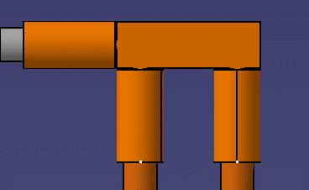
Joint task force CERN-GSI-Elytt
Samples Elytt | Description of sample | Objective | STATUS
11 joint types | Various configuration of Cu-Cu-SS joints | Check joints by x-rays Ultrasound and microtomography | Final reports to be prepared

Slide 15
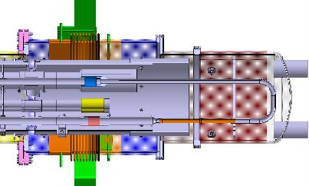
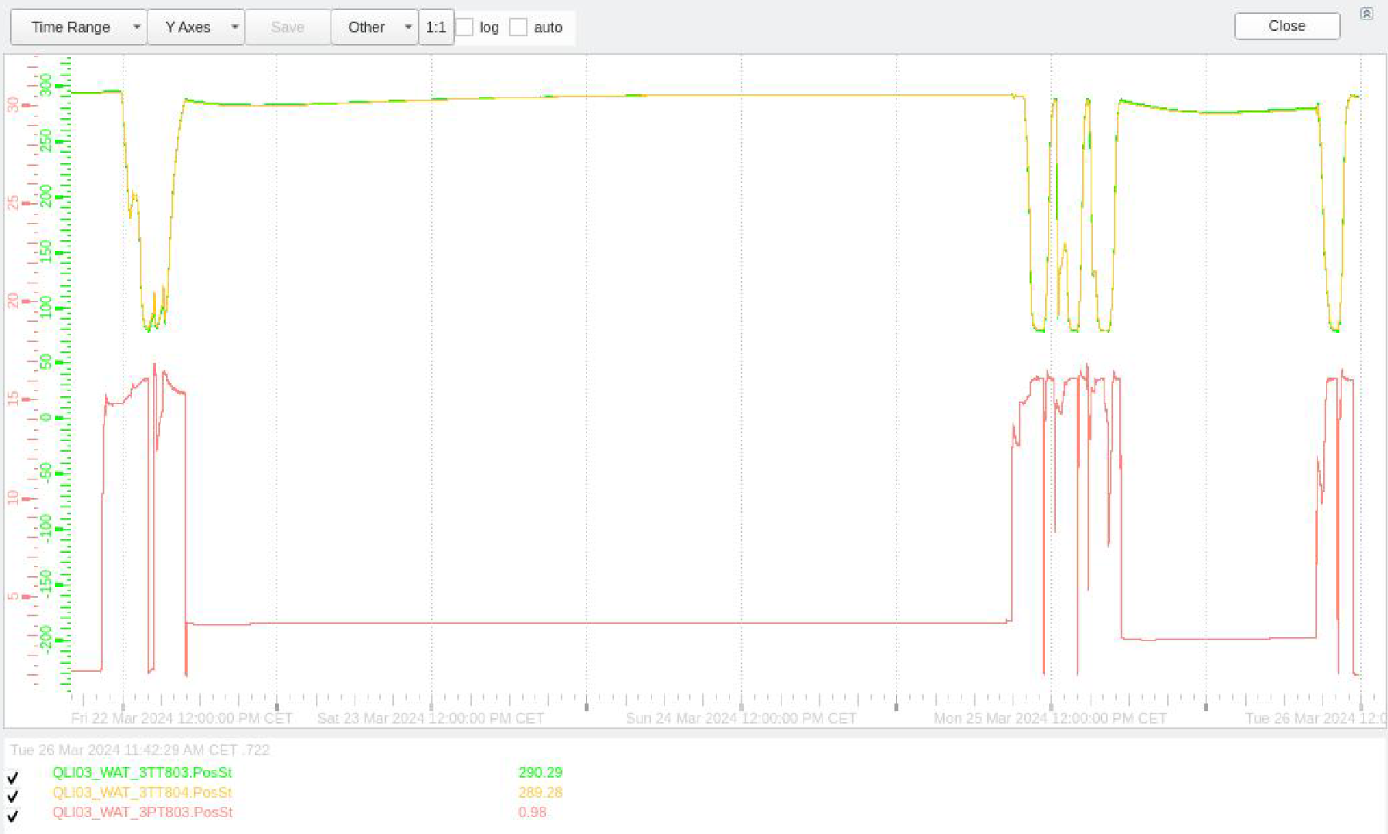
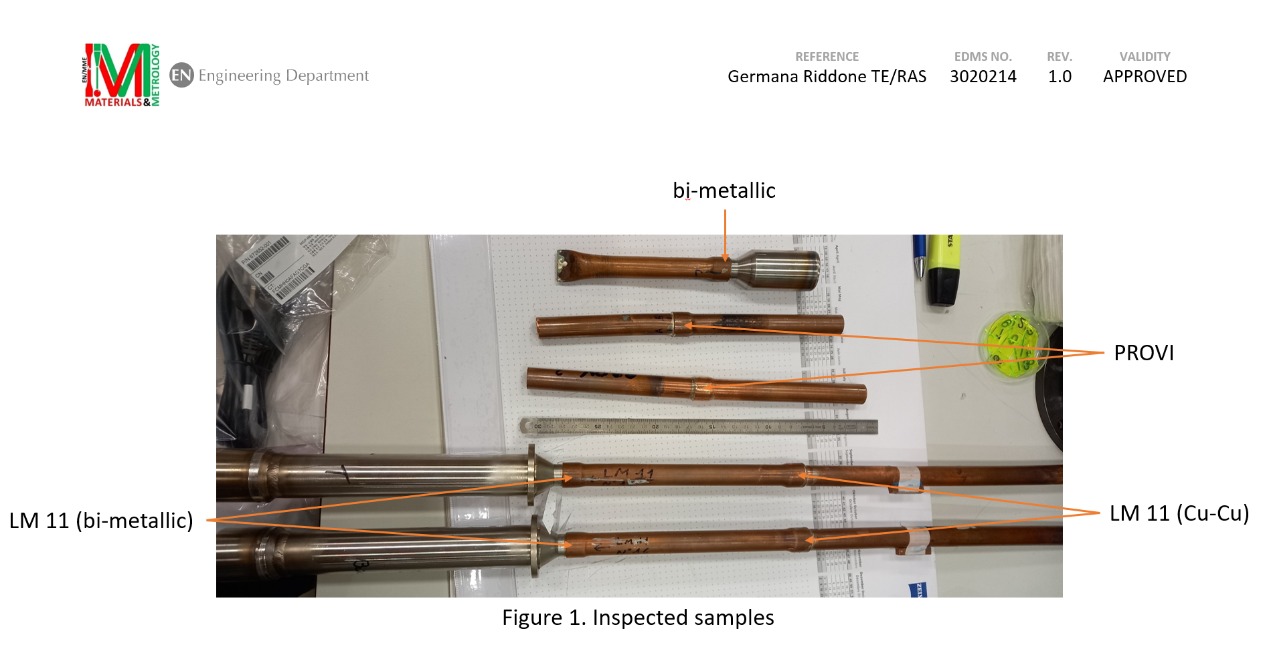
Thermal cycles at cold and under pressure
Tests in-situ: sample installed in the jumper (design validated by dedicated structural analysis)
No leaks detected after the thermal cycles

Slide 16
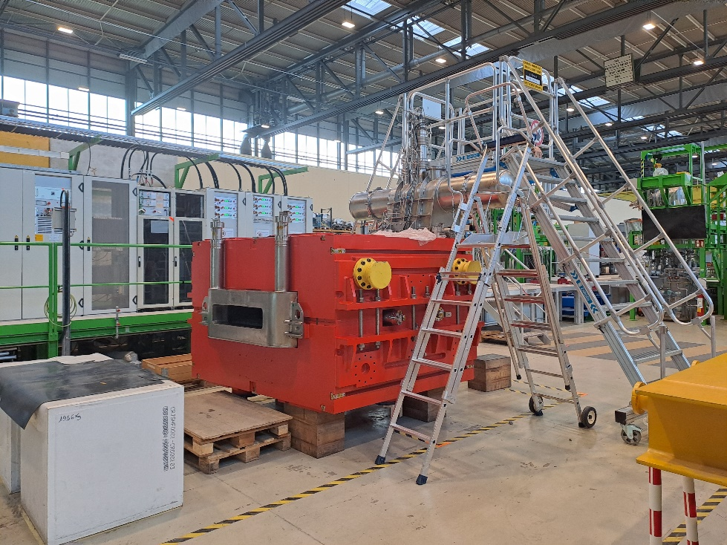
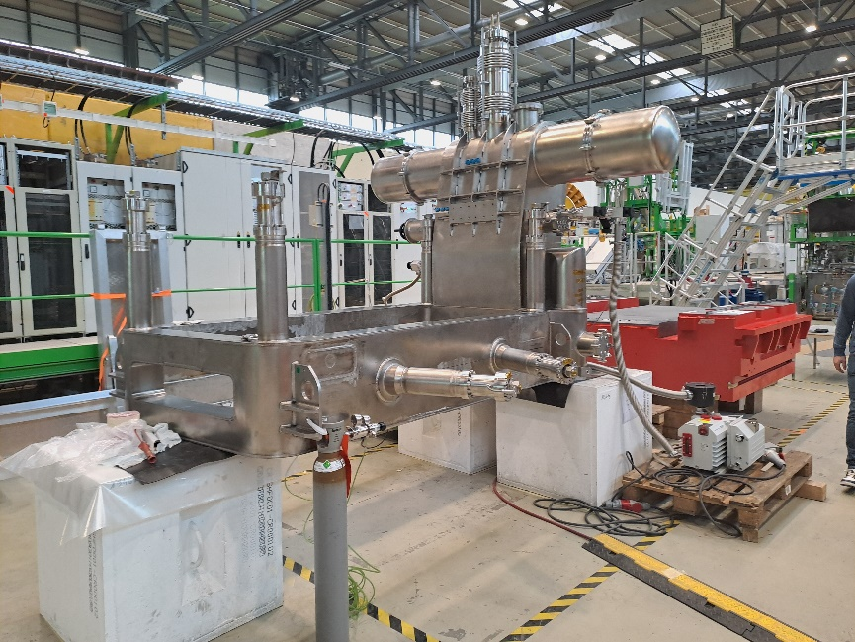
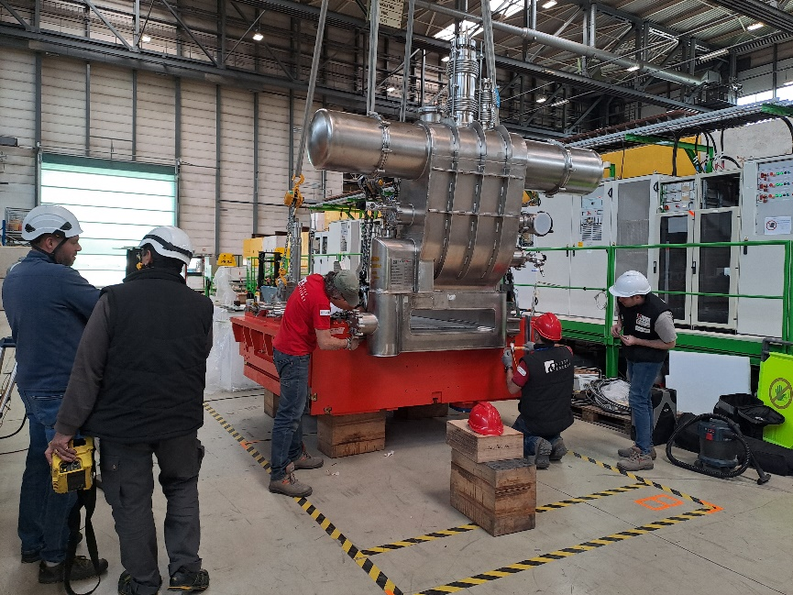
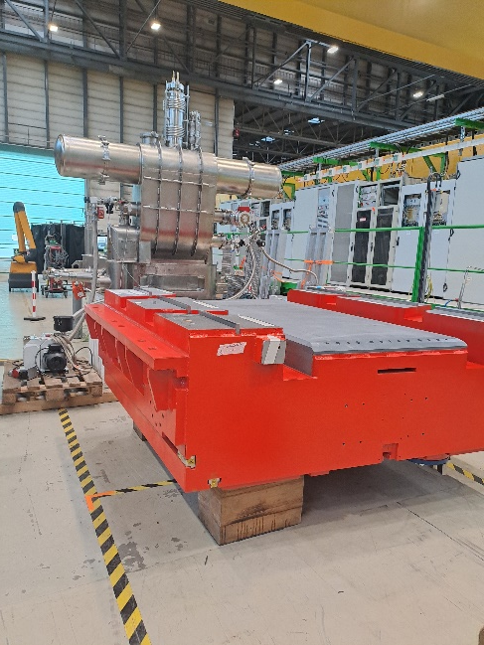
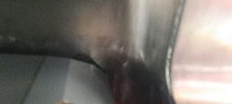
Dipole D06 repair
4
Intervention started on 17.04 and lasted for about 7 days
CERN support for handling, welding and leak testing
Final leak test (cryostat integrated in the yoke) on 24.04.2024
showing no leaks on the vacuum vessel
Ready to be moved to the dedicated test bench for electrical tests
1
2
3
Leak location

Slide 17
Conclusions
CERN systems commissioned and test facility fulfills the requirements
Transition phase towards series productions started in 2022, but slowed down due to non-conformities on both ASG and Elytt magnets (internal leaks)
Currently, we are in the validation phase of the new design, being the highest priority the LM11 (ASG) and D06 (Elytt) tests
2023: CERN resources were higher than expected
Fruitful collaboration between CERN and GSI (and ASG/Elytt) has been demonstrated in the dedicated task forces
At present, the preliminary planning shows the end of the tests in 2028 (see K. Sugita presentation). If testing of the additional Energy Buncher magnets is confirmed, the end of the tests will then occur in 2029.
Amendment to the contract will be prepared in 2025 with evaluation of CERN impact.

Slide 18
Thanks to GSI colleagues for the nice and fruitful collaborations
Thanks for your attention

