Slide 1
CERN-FAIR-GSI Collaboration Meeting
26th April 2024
FAIR & GSI Status - April 2024
Jörg Blaurock
Technical Managing Director FAIR GmbH & GSI GmbH

Slide 2
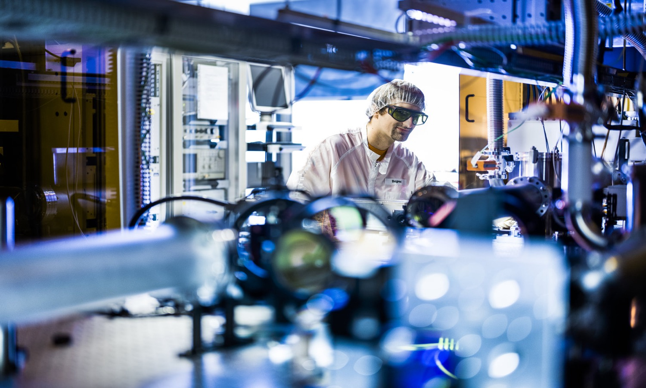
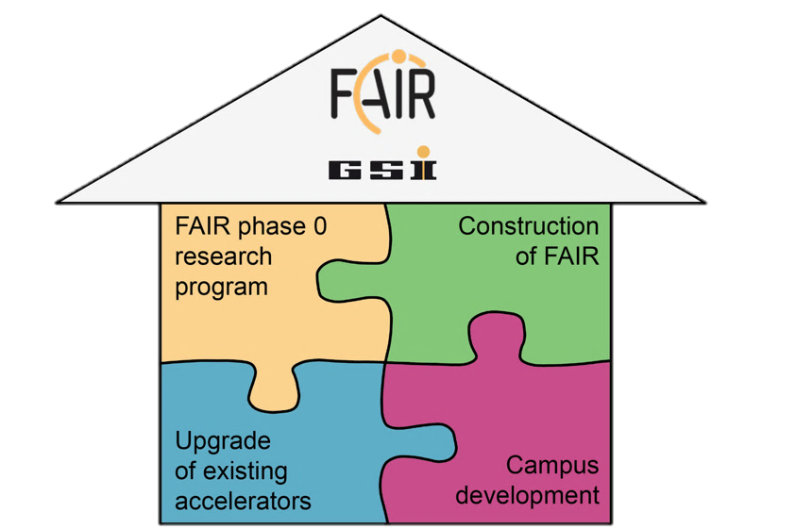
Agenda
FAIR Phase 0
Beamtime 2024
Development on campus
Campus Infrastructure
Construction of FAIR
FAIR in 2028
FAIR Highlights
FAIR in Construction
FAIR Outlook 2024
Upgrade of existing accelerators

Slide 3
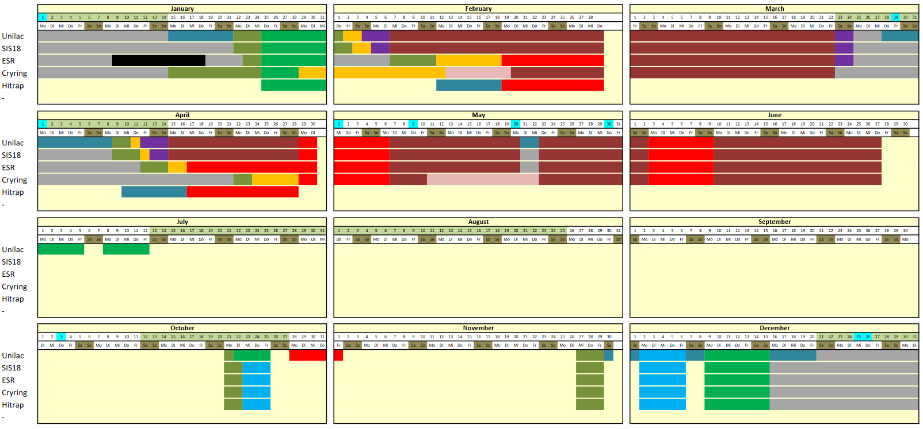
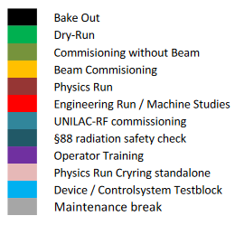
FAIR phase 0 beamtime 2024
102 days of user beamtime incl. HITRAP commissioning + 15 days for machine studies

Slide 4
FAIR phase 0 beamtime 2024
physics run started on February 7th and ends on June 27th
  Available machines: UNILAC, SIS18, FRS, ESR & Cryring
  total 2448 hours of user operation
  plus 15 days dedicated to machine studies
  including 2 x 11 days for commissioning of HITRAP
4

Slide 5
Beam time 2024/2025/2026
2024
J |  | F |  | M |  | A |  | M |  | J |  | J |  | A |  | S |  | O |  | N |  | D
 |  |  |  |  |  |  |  |  |  |  |  |  |  |  |  |  |  |  |  |  |  |  |  |  |  |  | Machine Commissioning
 |  |  |  |  |  |  |  |  |  |  |  |  |  |  |  |  |  |  |  |  |  |  |  |  |  |  | Beam Time
2025
J |  | F |  | M |  | A |  | M |  | J |  | J |  | A |  | S |  | O |  | N |  | D |  |  |  |  | Physics Beam Time
 |  |  |  |  |  |  |  |  |  |  |  |  |  |  |  |  |  |  |  |  |  |  |  |  |  |  | Commissioning FCC &
 |  |  |  |  |  |  |  |  |  |  |  |  |  |  |  |  |  |  |  |  |  |  |  |  |  |  | UNILAC Controls Upgrade
 |  |  |  |  |  |  |  |  |  |  |  |  |  |  |  |  |  |  |  |  |  |  |  |  |  |  | Best Effort User Operation
2026
J |  | F |  | M |  | A |  | M |  | J |  | J |  | A |  | S |  | O |  | N |  | D

Slide 6
Agenda
FAIR Phase 0
Beamtime 2024
Development on campus
Campus Infrastructure
Construction of FAIR
FAIR in 2028
FAIR Highlights
FAIR in Construction
FAIR Outlook 2024
Upgrade of existing accelerators

Slide 7
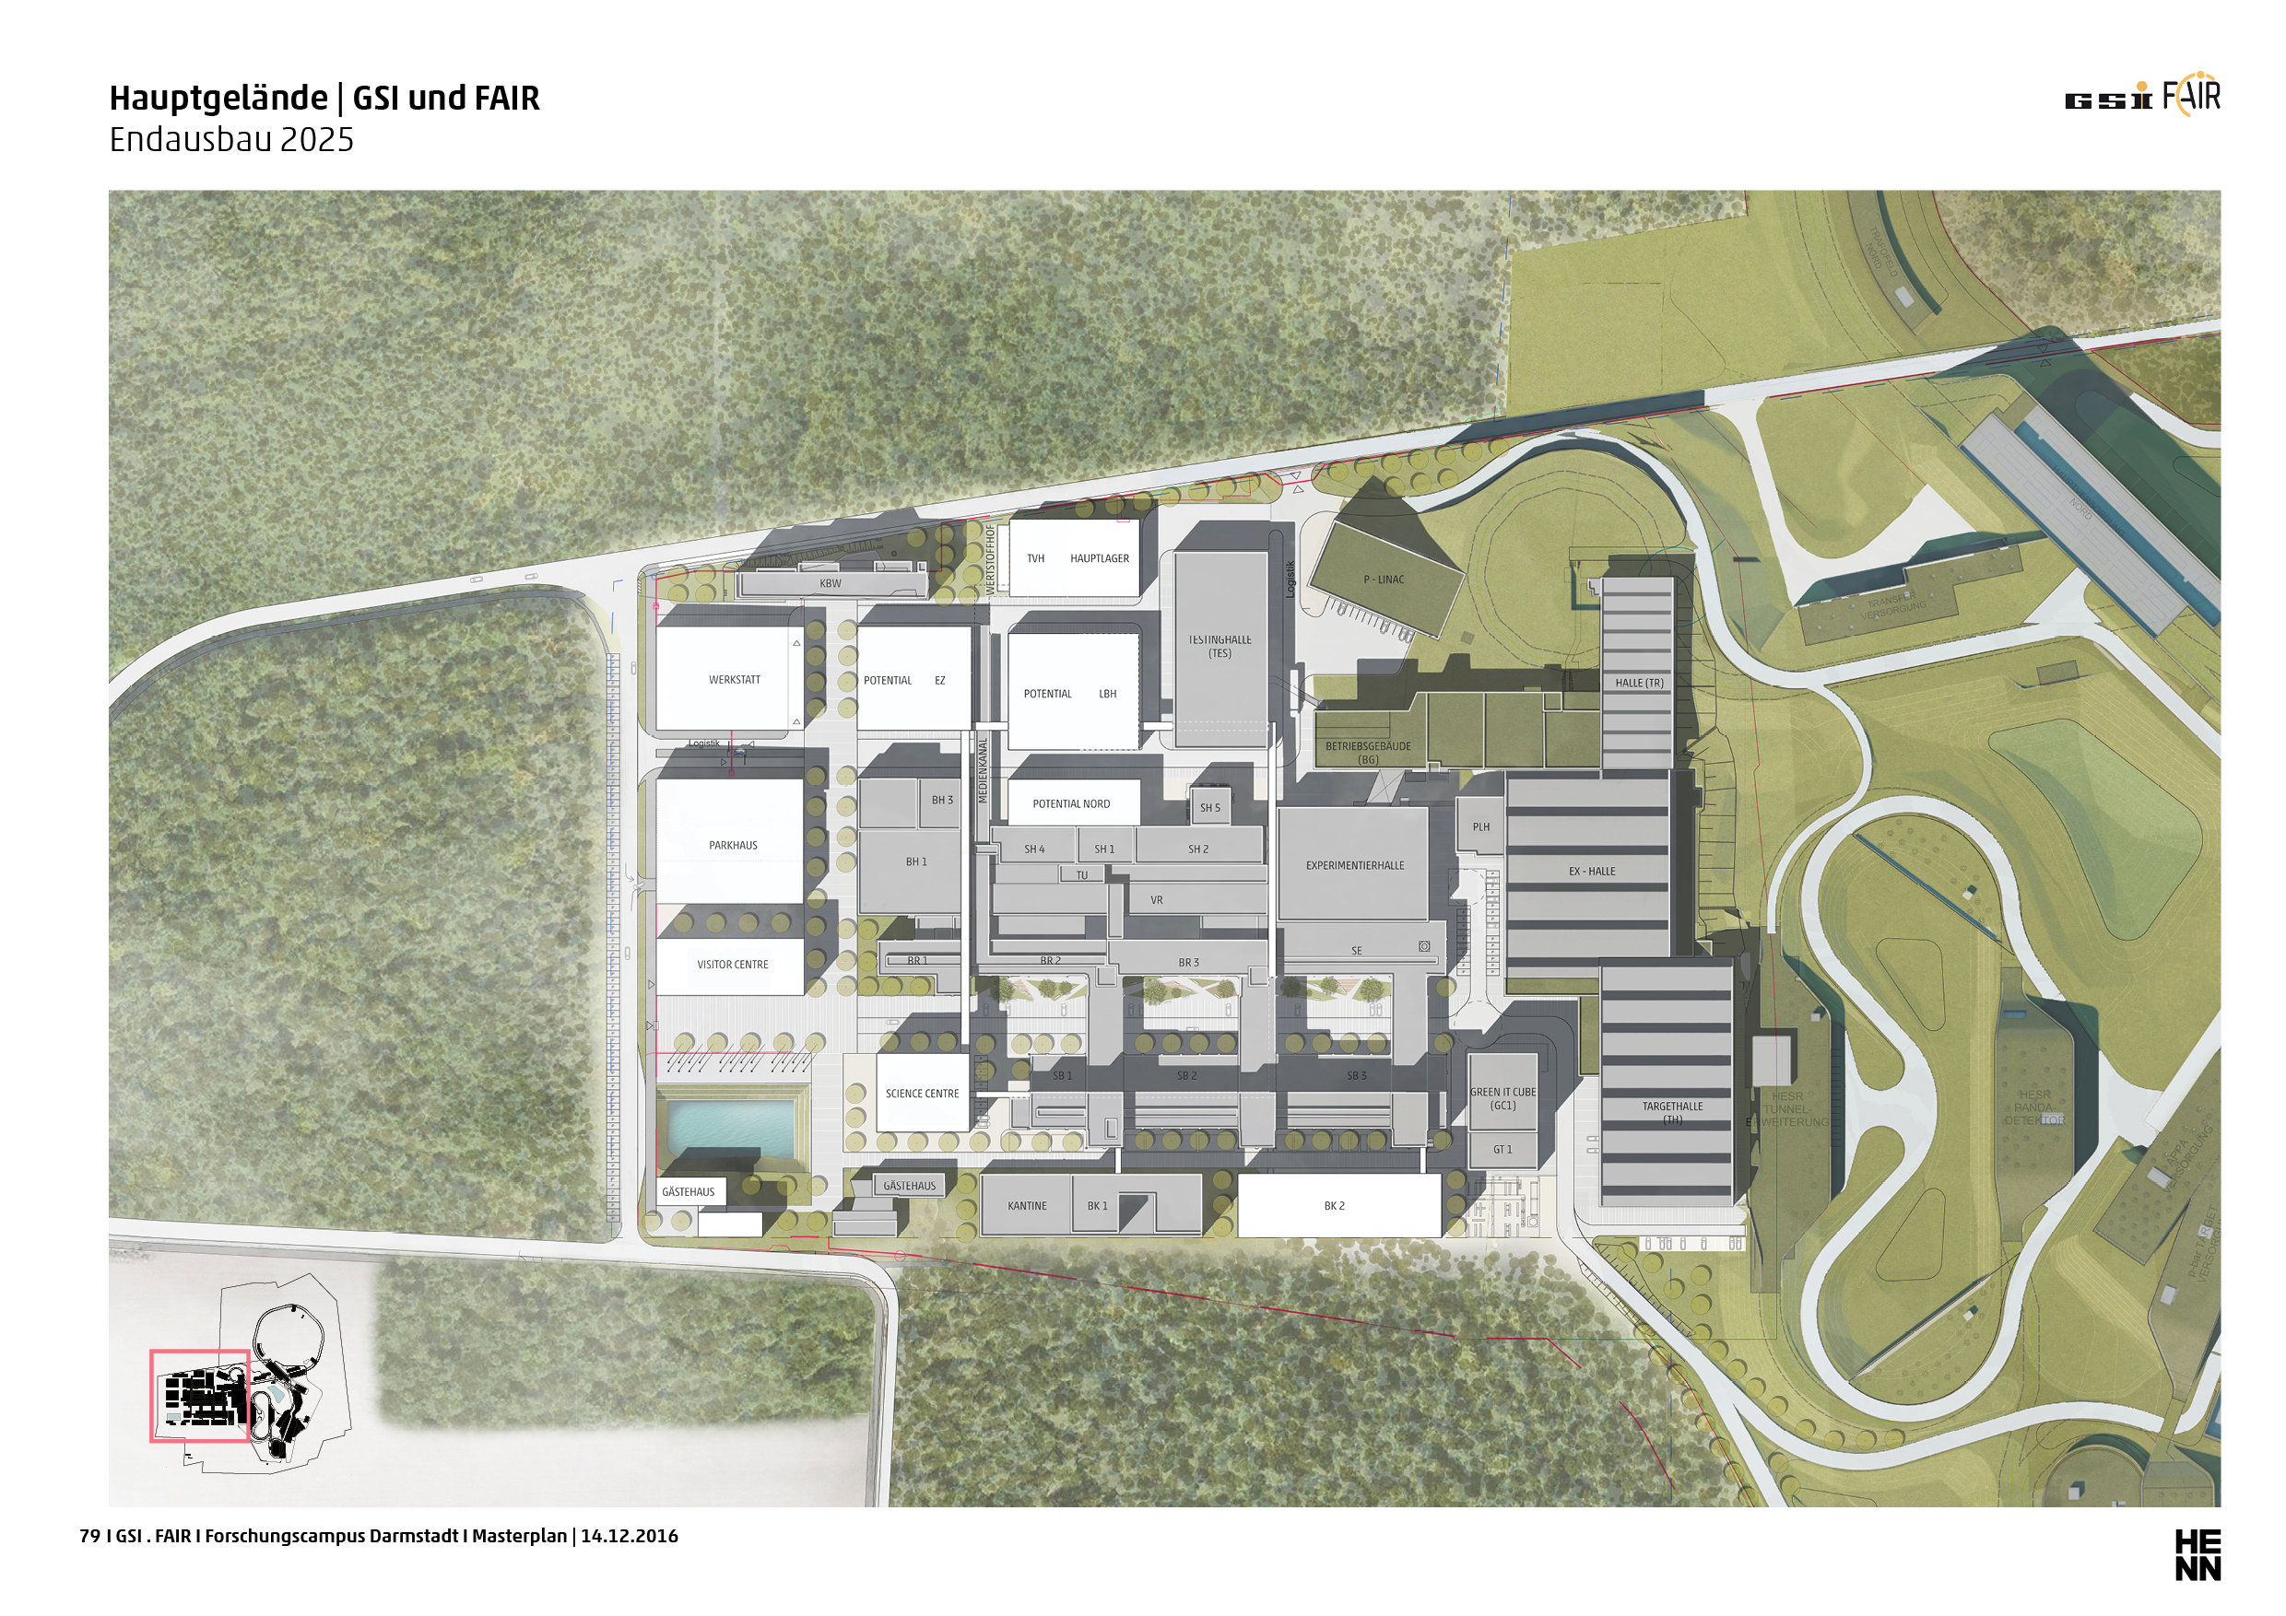
Campus Master Plan - Infrastructure
Perspektive für Endausbau 2030

Slide 8
FAIR Highlights - FAIR Control Center (FAIR CC)
In accordance with the Campus Master Plan (CMP) the FAIR Control Center building will house the new Main Control Room (MCR) and scientific & technical office workplaces.
Use: MCR, Visitor access
206 Office workplaces
5 levels plus one undergroud level
Constr. period: Q2/2021 – Q3/2025
Commissioning: Q4/2025
FCC

Slide 9
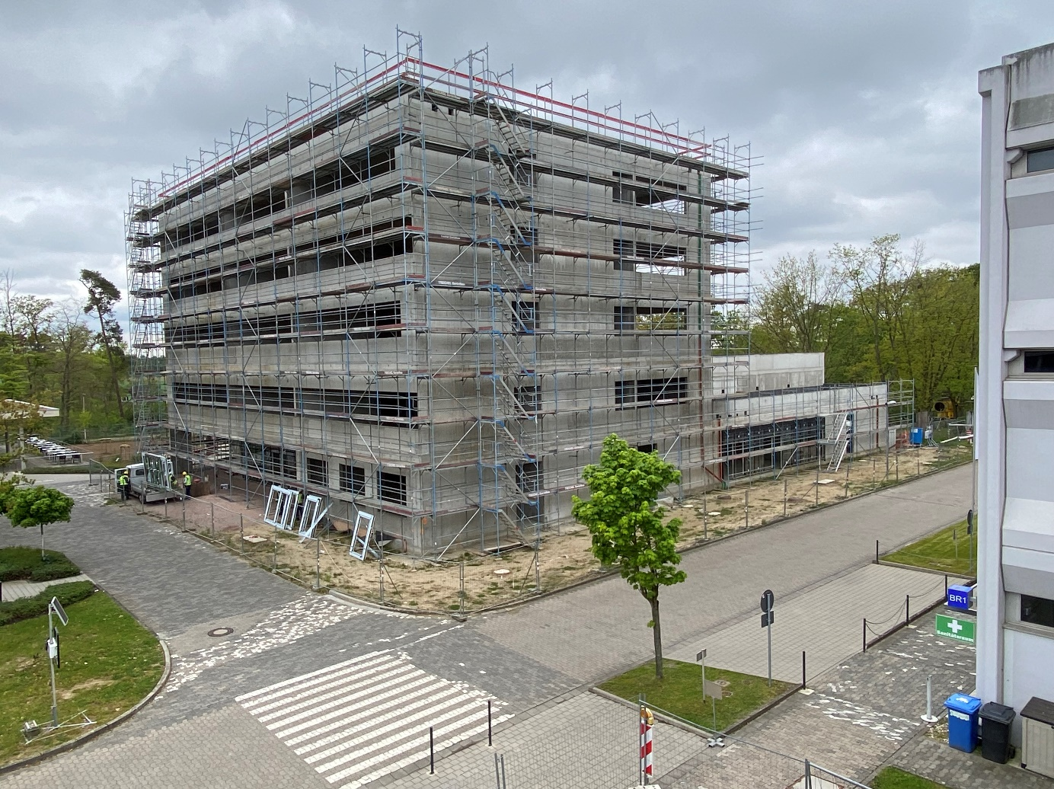
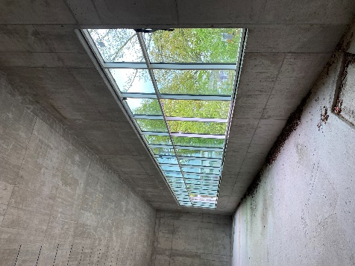
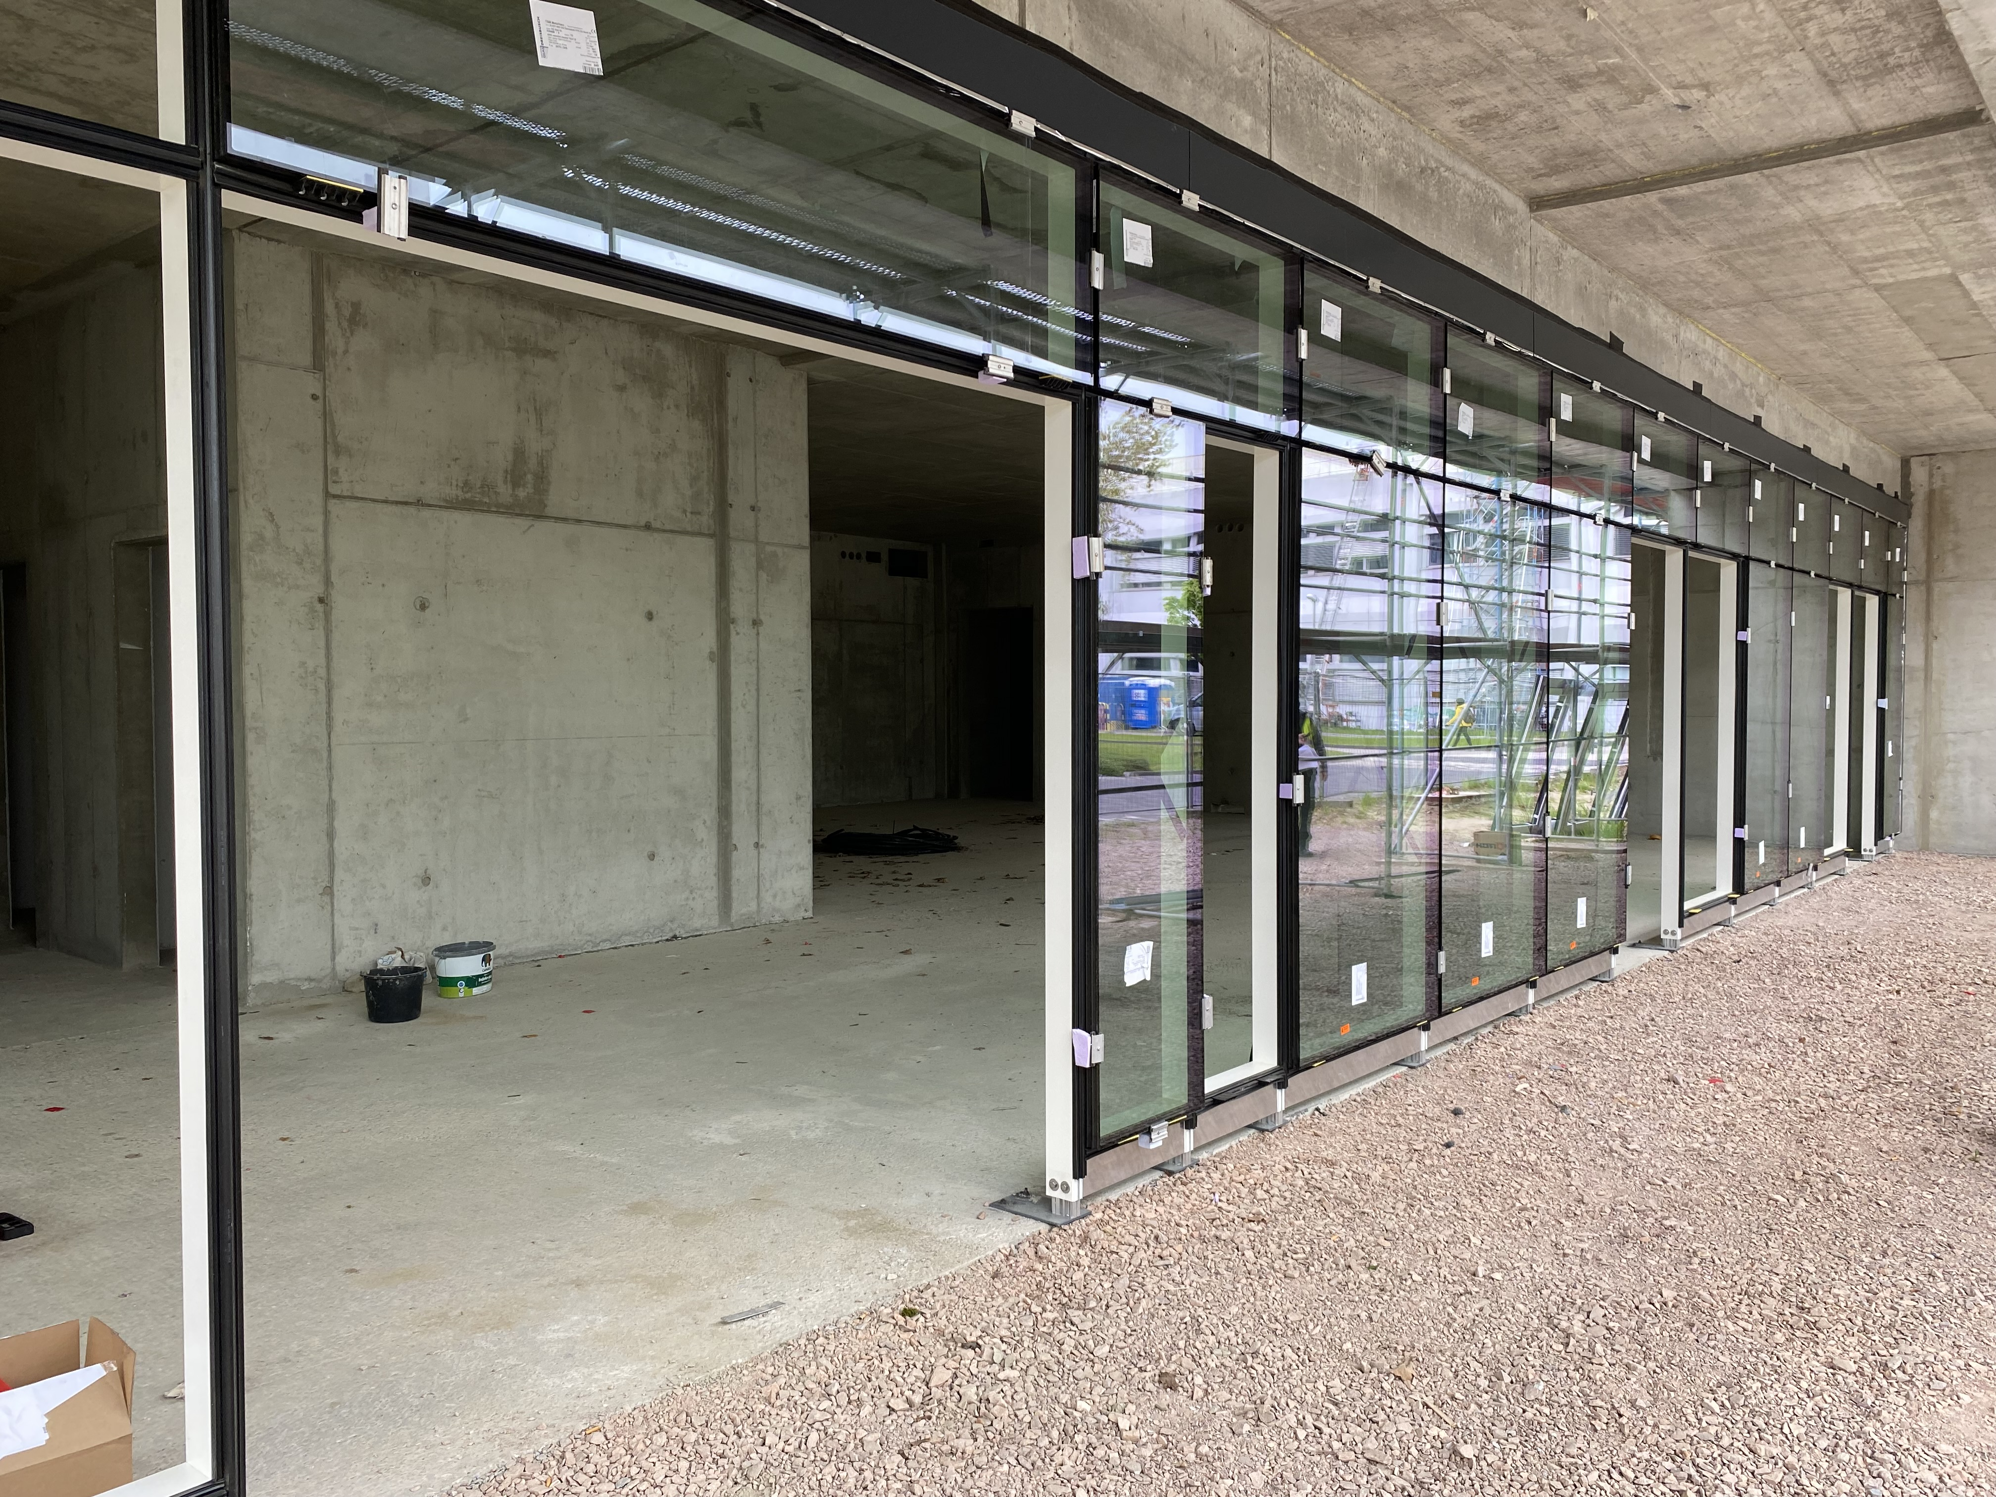
FAIR Highlights - FAIR Control Center (FAIR CC)
View on the façade in the MCR
View on the north and south facade View on the main entrance

Slide 10
Agenda
FAIR Phase 0
Beamtime 2022
Development on Campus
Campus Infrastructure
Construction of FAIR
FAIR in 2028
FAIR Highlights
FAIR in Constrcution
FAIR Outlook
Upgrade of existing accelerators

Slide 11
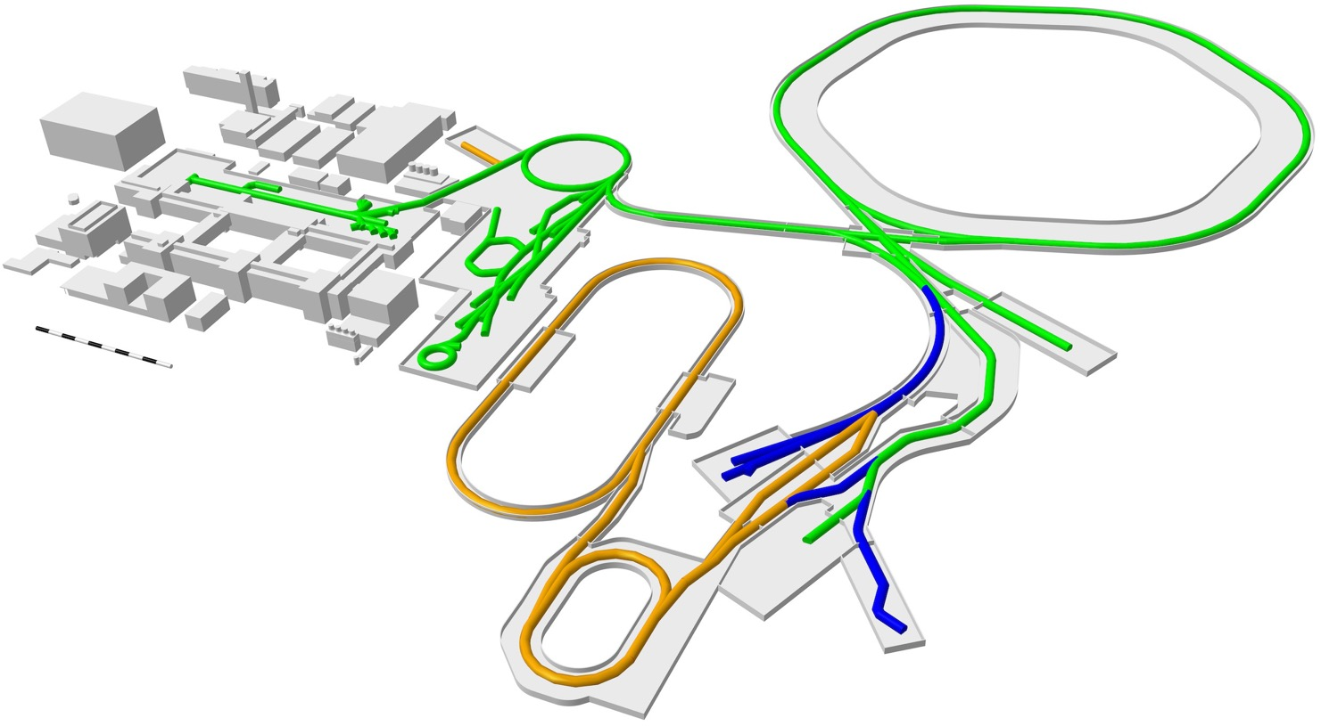
FAIR in 2028
SIS100
UNILAC
SIS18
HITRAP
ESR
CBM
CRYRING
Super-FRS
First Science +
Next steps
MSV completion
NUSTAR HEB
Thank you for your attention !
APPA, NUSTAR and PANDA investigate options for further experiments at green lines
Thank you for your attention !
Continuation of APPA, CBM and NUSTAR experiments in existing facility

Slide 12
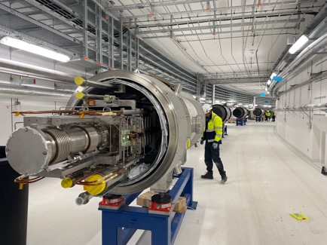
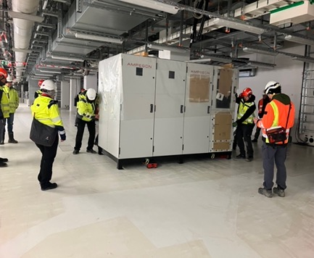
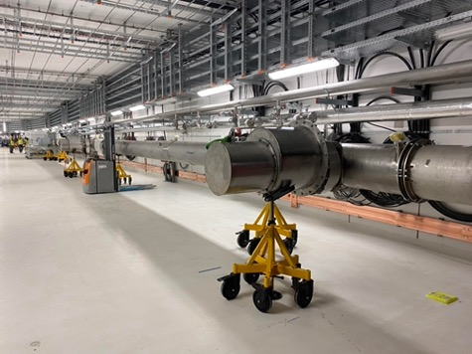
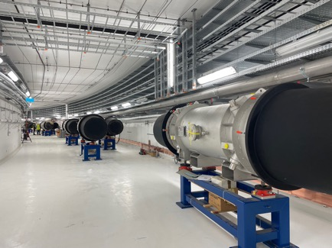
FAIR Highlights - SIS100
  January 2024
  First Power Supply Units placed in the SIS100 tunnel
  April 2024
  First cryogenic bypass lines SIS100 placed in SIS100 tunnel
  April 2024
  Delivery of SIS100 Dipole magnets in SIS100 tunnel

Slide 13
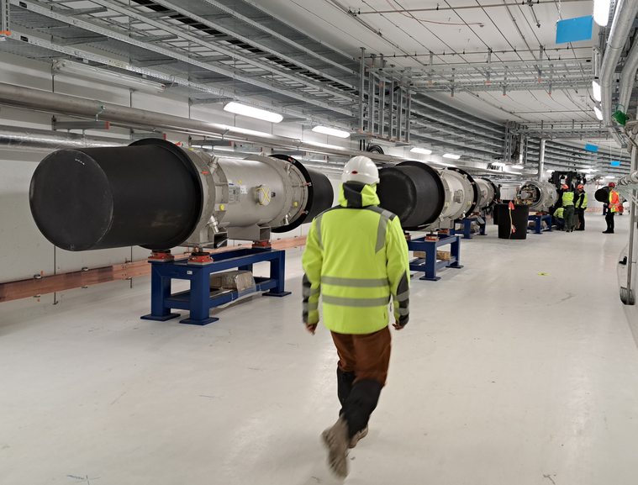
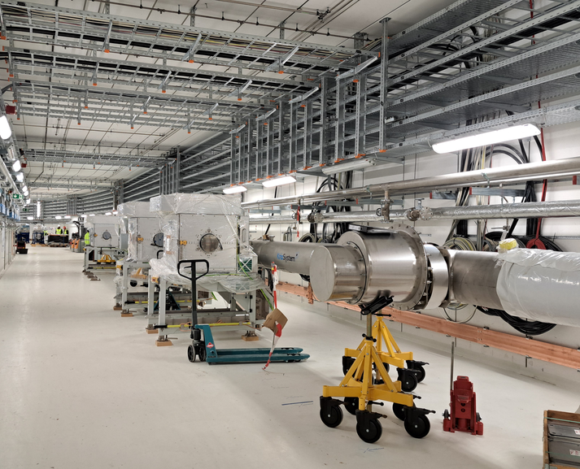
FAIR Highlights - SIS100
April 2024: First superconducting dipoles and cryo bypass lines were placed in the SIS100 tunnel
© Beata Walasek-Höhne

Slide 14
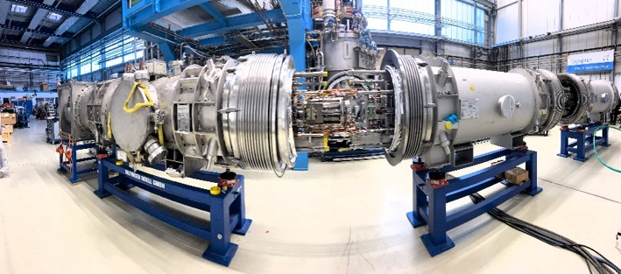
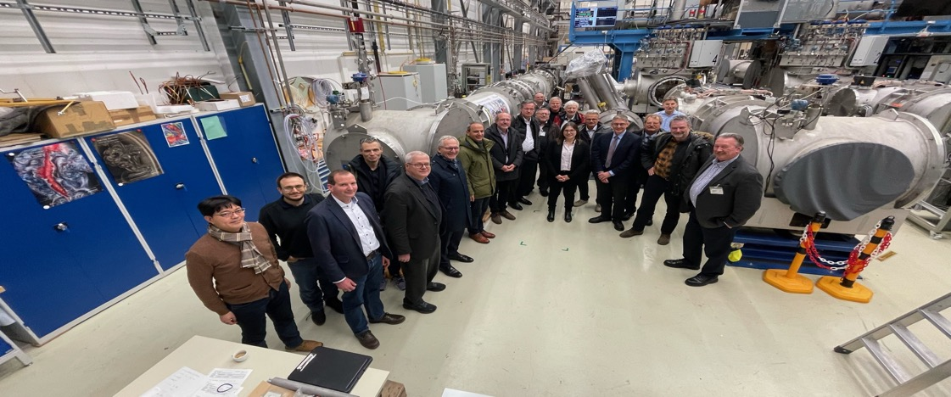
FAIR Highlights - SIS100
  December 2023
  Successfull completion of the first thermal cycle of the SIS100 string.
26th FAIR Machine Advisory Committee took place from 11th - 13th December, 2023.

Slide 15
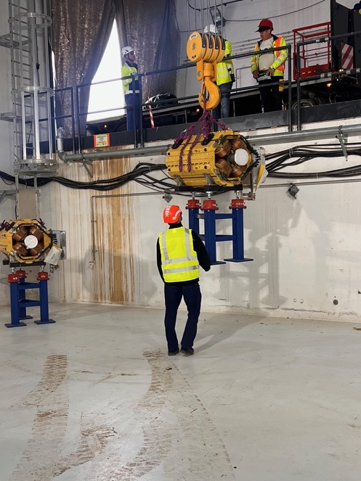
FAIR Highlights - HEBT
  March 2024
  Transport of Quadrupole magnets for beam line section T1S2

Slide 16
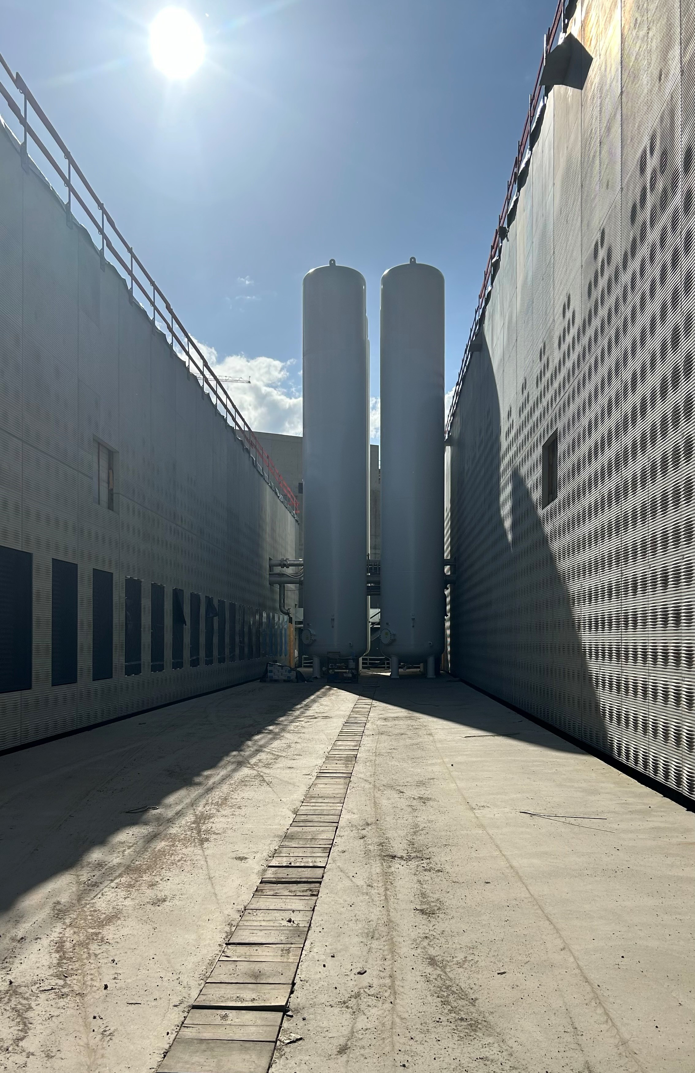
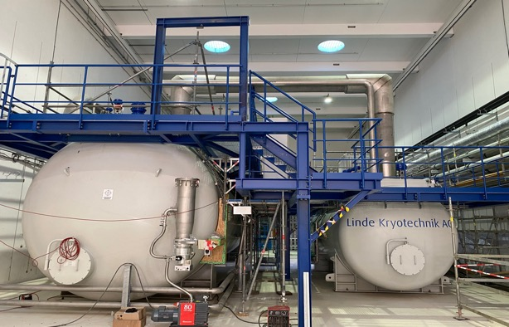
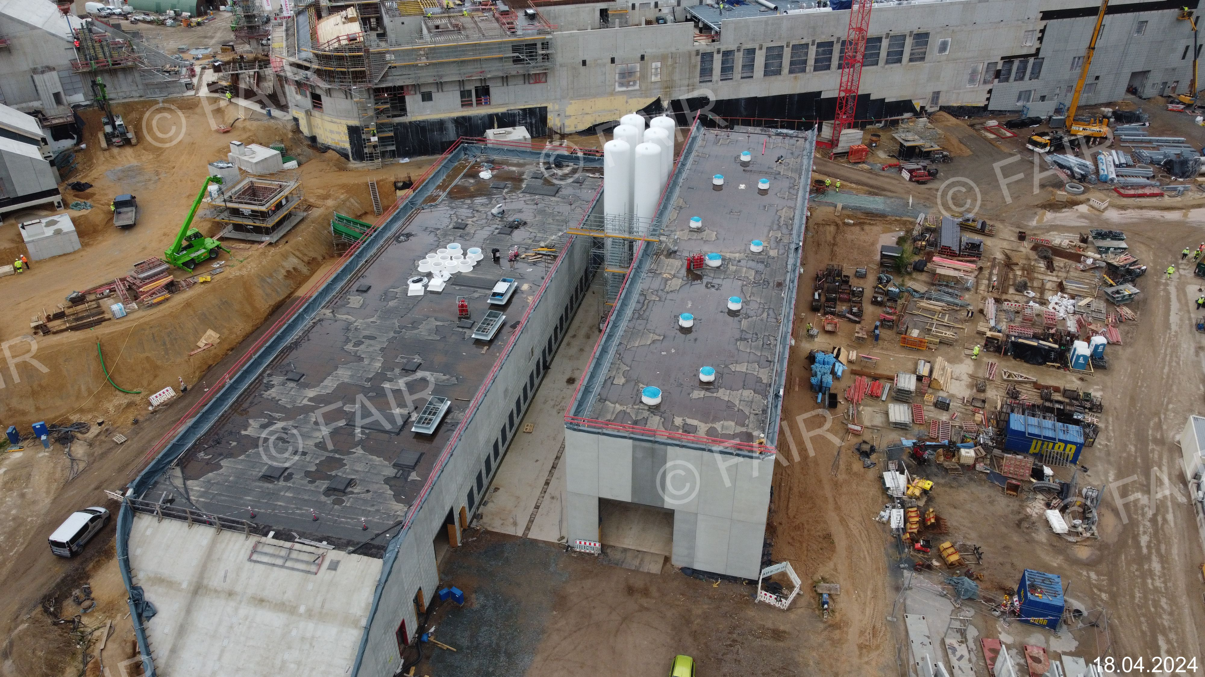
FAIR Highlights - Cryo Facility
  April 2024
  Center piece Cold Box of the cooling system for the superconducting magnets. Start of Commissioning in 2025
  April 2024
  6 Helium tanks of the Cryo facility
  were installed on construction site

Slide 17
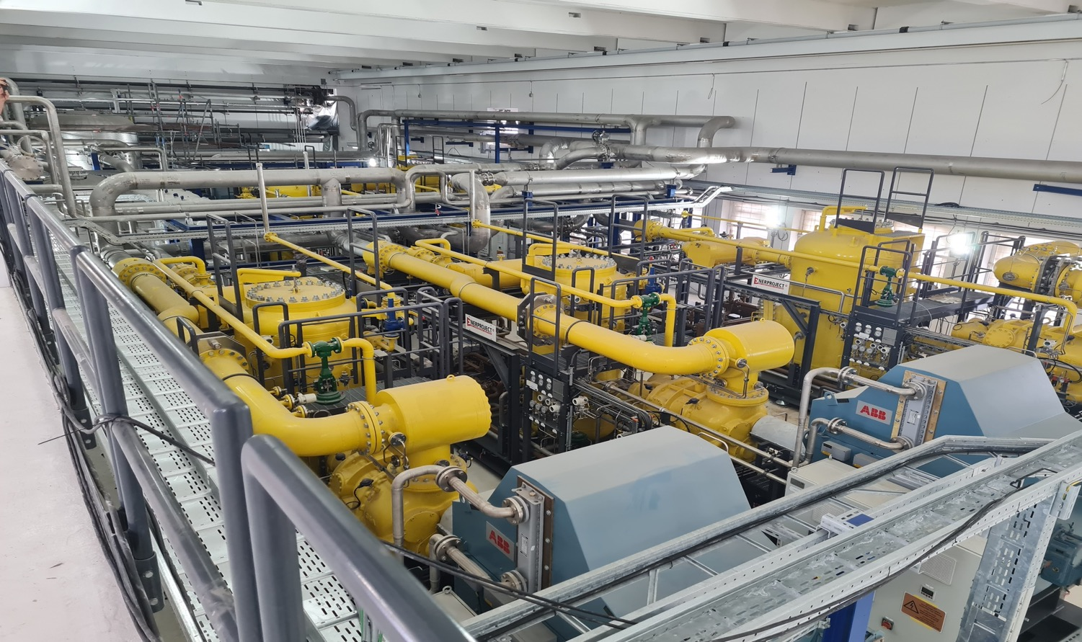
FAIR Highlights - Compressor room

Slide 18
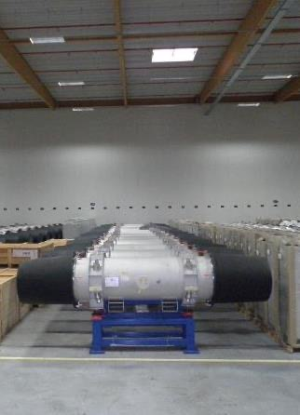
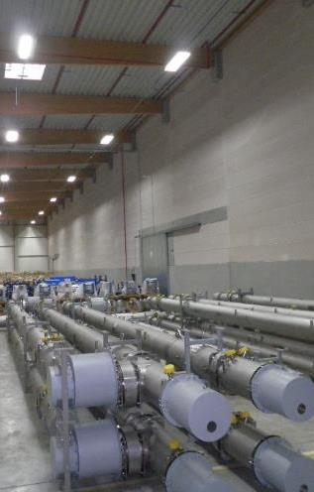
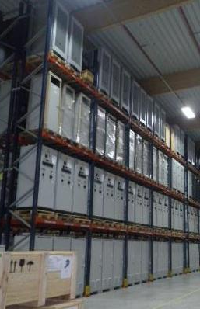
FAIR Highlights - Storage and Logistics
  completed and delivered high-tech components for accelerator & experiments
SIS100 Dipoles complete
He-Bypass lines from Poland
Racks from India
Storage area Weiterstadt: approx. 9.900 m²
4.195 objects (Components, assemblies, boxes)
50% of SIS100 components stored
90% of HESR components stored

Slide 19
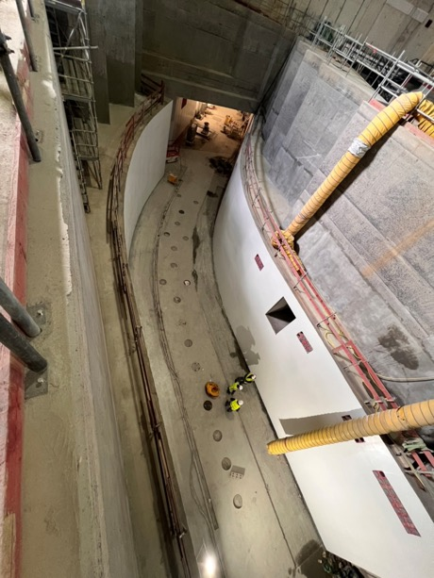
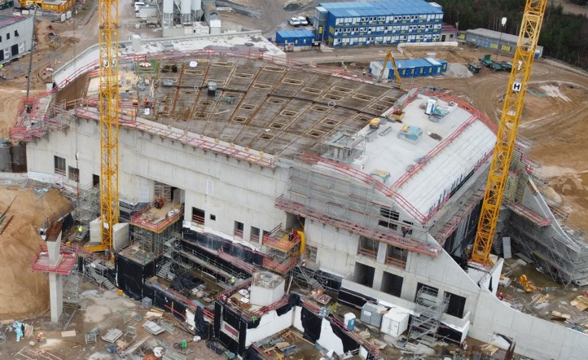
FAIR Highlights - Civil
  March 2024
Shell construction of Super-FRS Building “L0516A” completed
  February 2024
Start of Interior coating work in Super-FRS Building “L0516A”

Slide 20
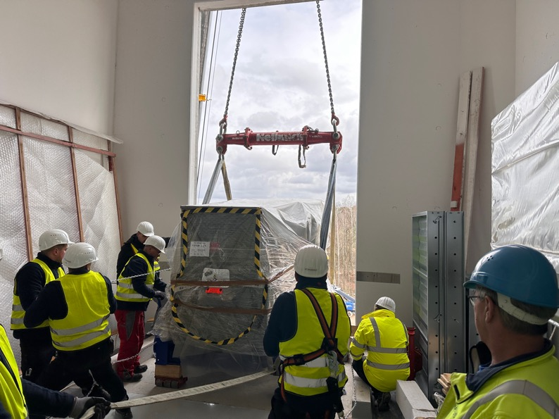
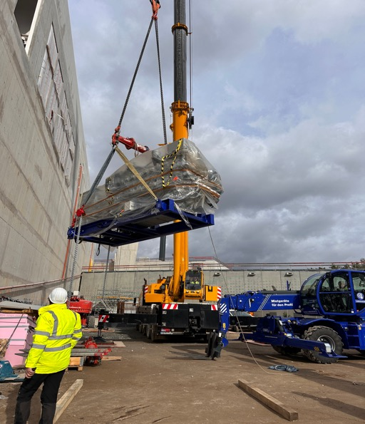
FAIR Highlights - Technical Building Installation
  February 2024
  Integration of the emergency power supply units NEA by Natus

Slide 21
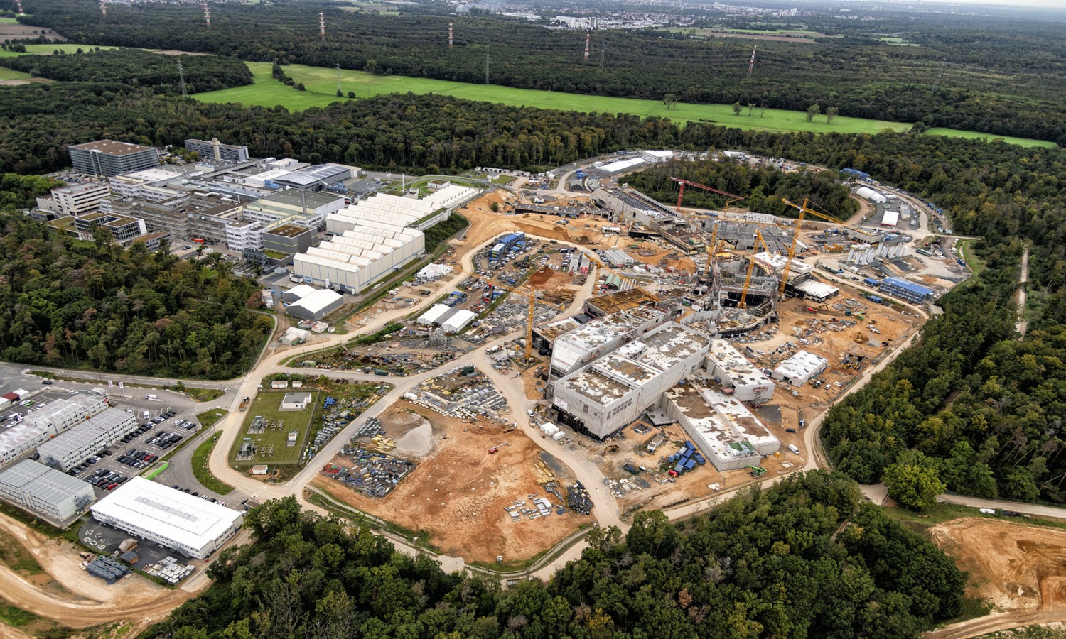
FAIR in construction
SIS100
CRYO 2
APPA
S-FRS
NUSTAR LEB
NUSTAR HEB

Slide 22
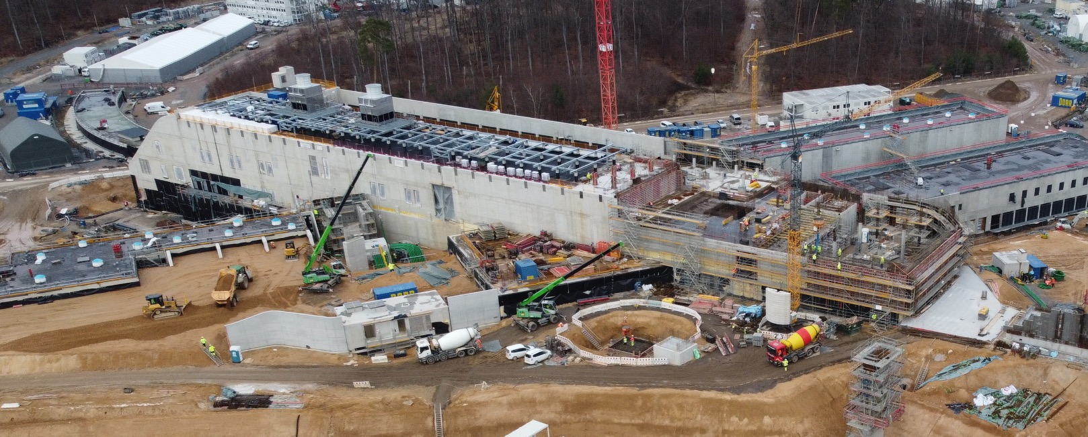
FAIR in construction
Area North

Slide 23
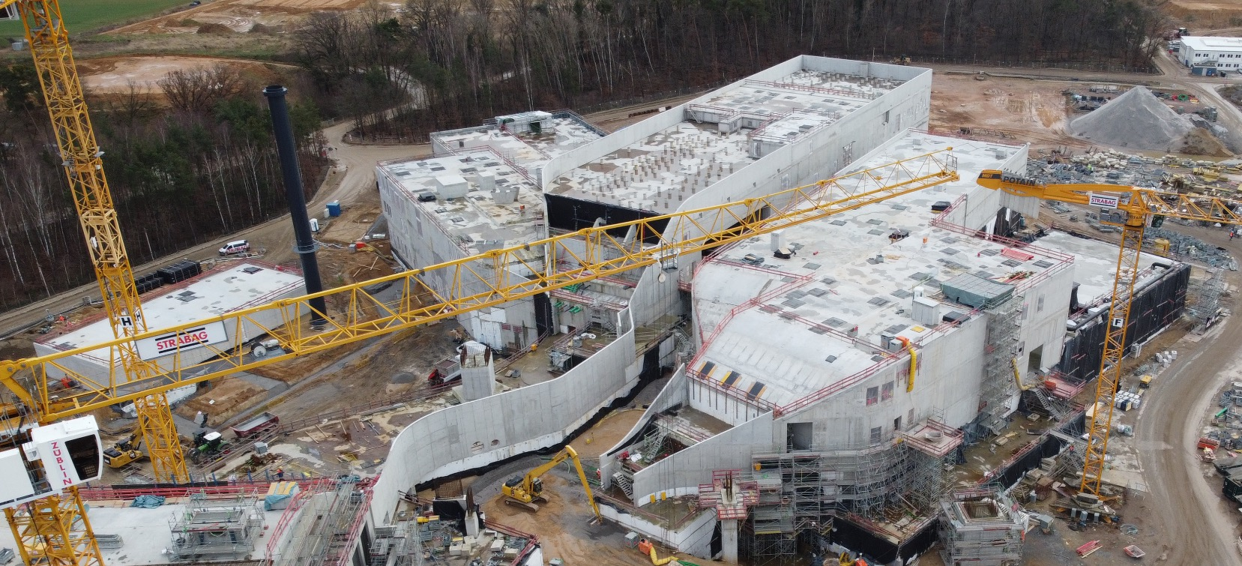
FAIR in construction
Area South

Slide 24
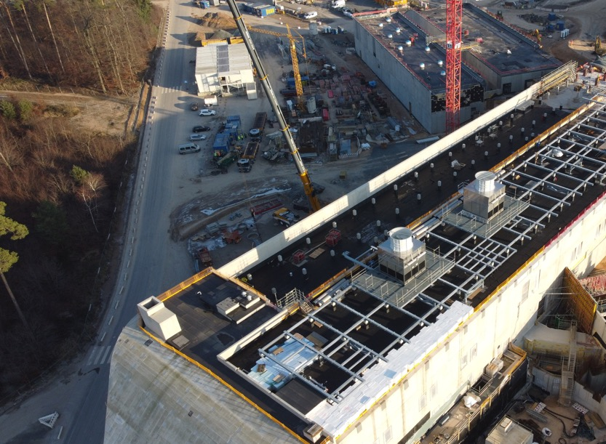
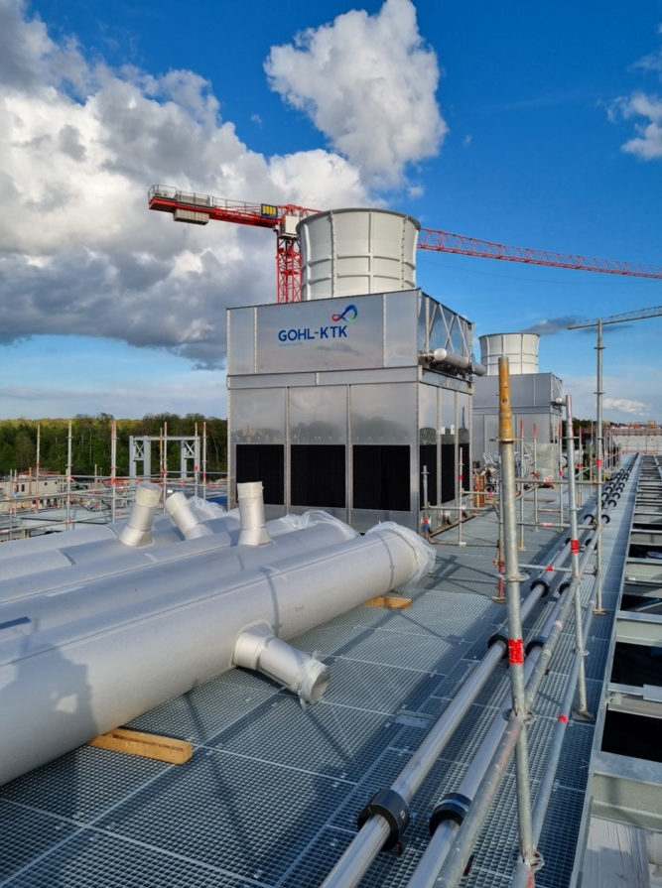
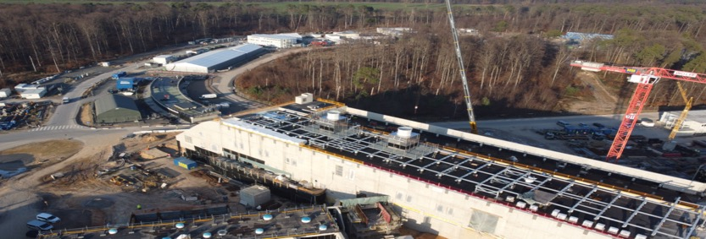
FAIR in construction
First 2 air coolers installed on the building H0719 A

Slide 25
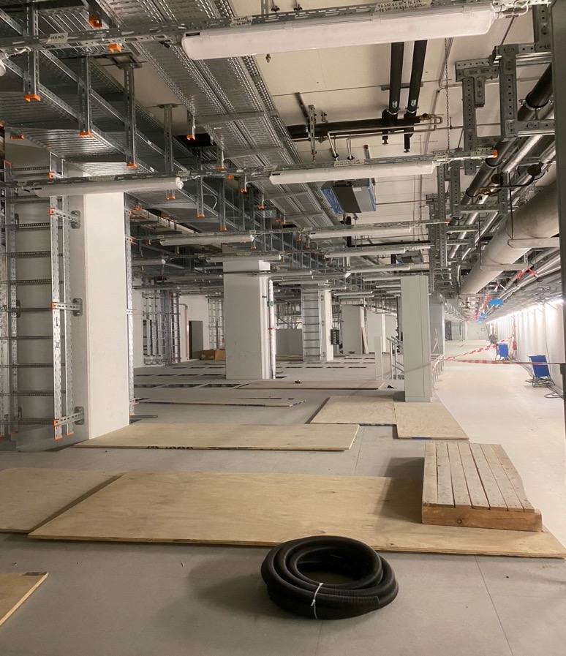
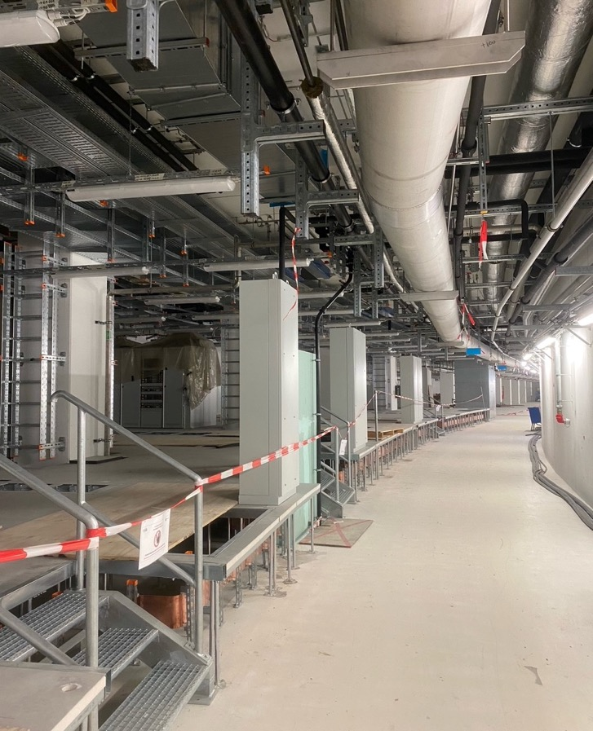
FAIR in construction
SIS100 Tunnel – Technical Building Installation

Slide 26
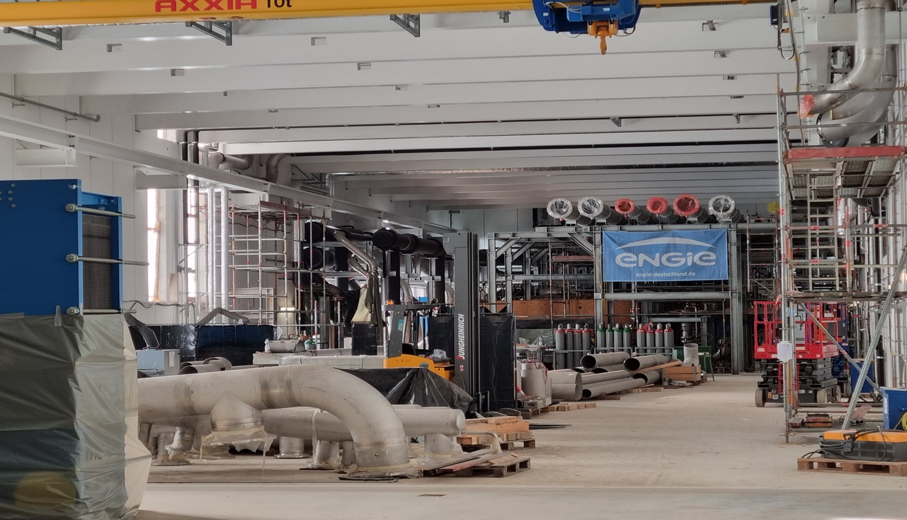
FAIR in construction
Transfer building – massive delivery of components
of the cooling water system

Slide 27
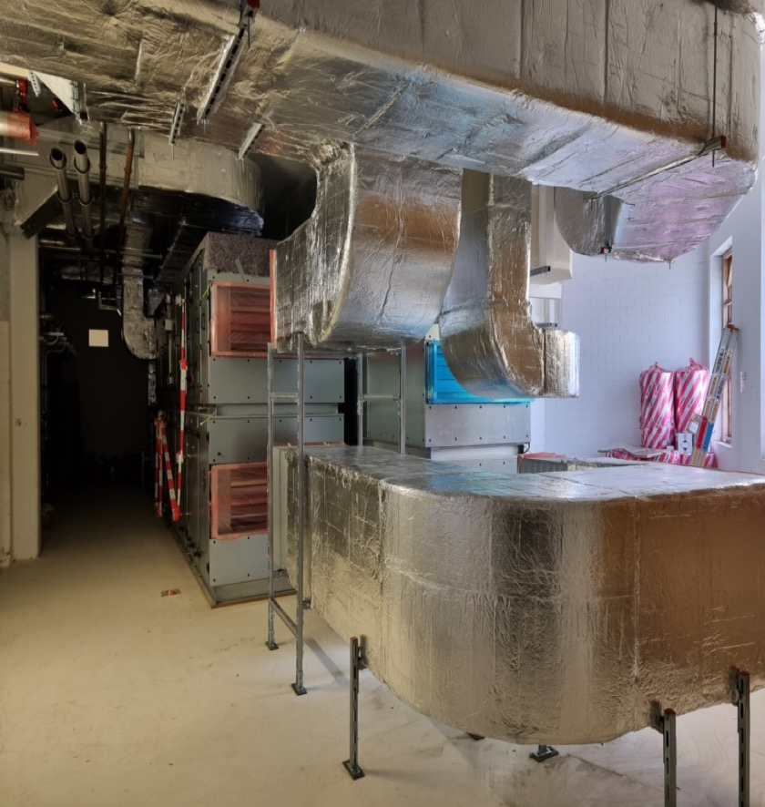
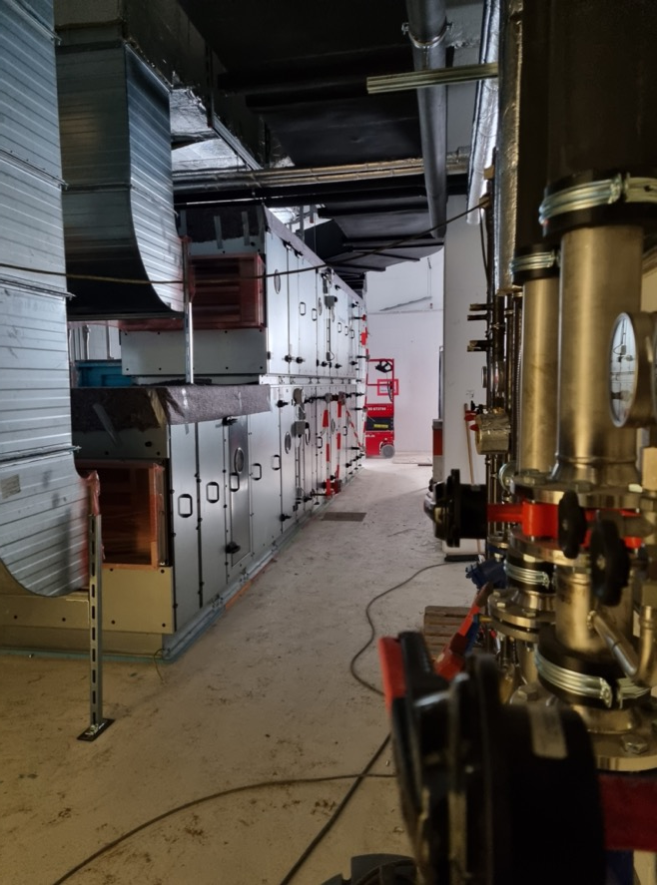
FAIR in construction
Transfer building – ventilation system installation

Slide 28
FAIR Outlook
ACC installation started in January 2024
TBI installation works in buildings progressing well aiming at completion and commissioning in 2026
Essential for the ACC installation progress: Continuous delivery of ACC components to secure the timely completion of ES/FS
Essential: Further international Shareholder contributions for the realization of First Science + (Poland, France, Sweden, Romania, India)
Decision in July 2024 on new budget line for commissioning in the years 2025 to 2028 and operation from 2029 onwards as well as on the company model

Slide 29
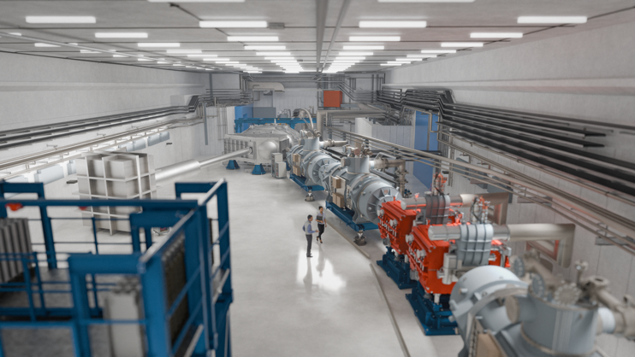
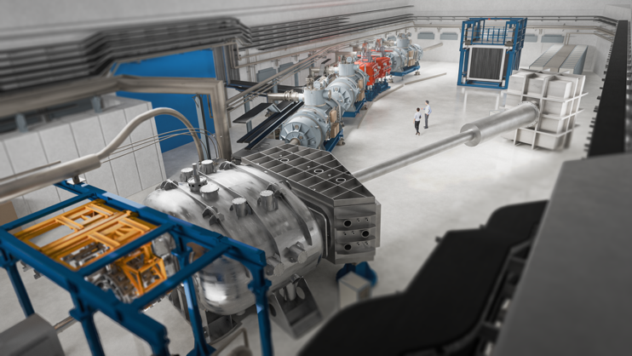
3D models - NUSTAR HEB cave

Slide 30
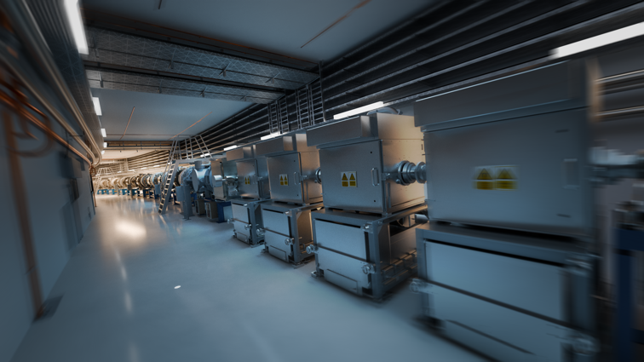
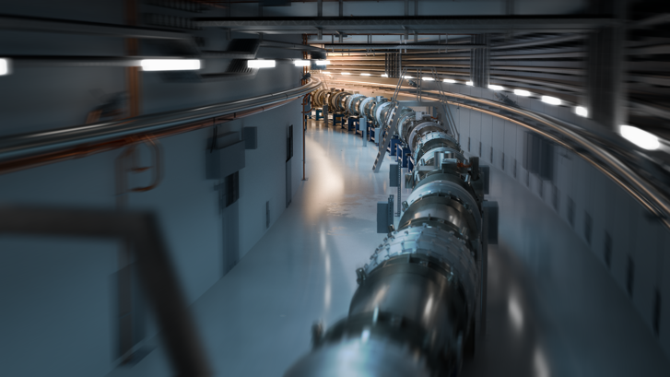
3D models - SIS100 tunnel

Slide 31
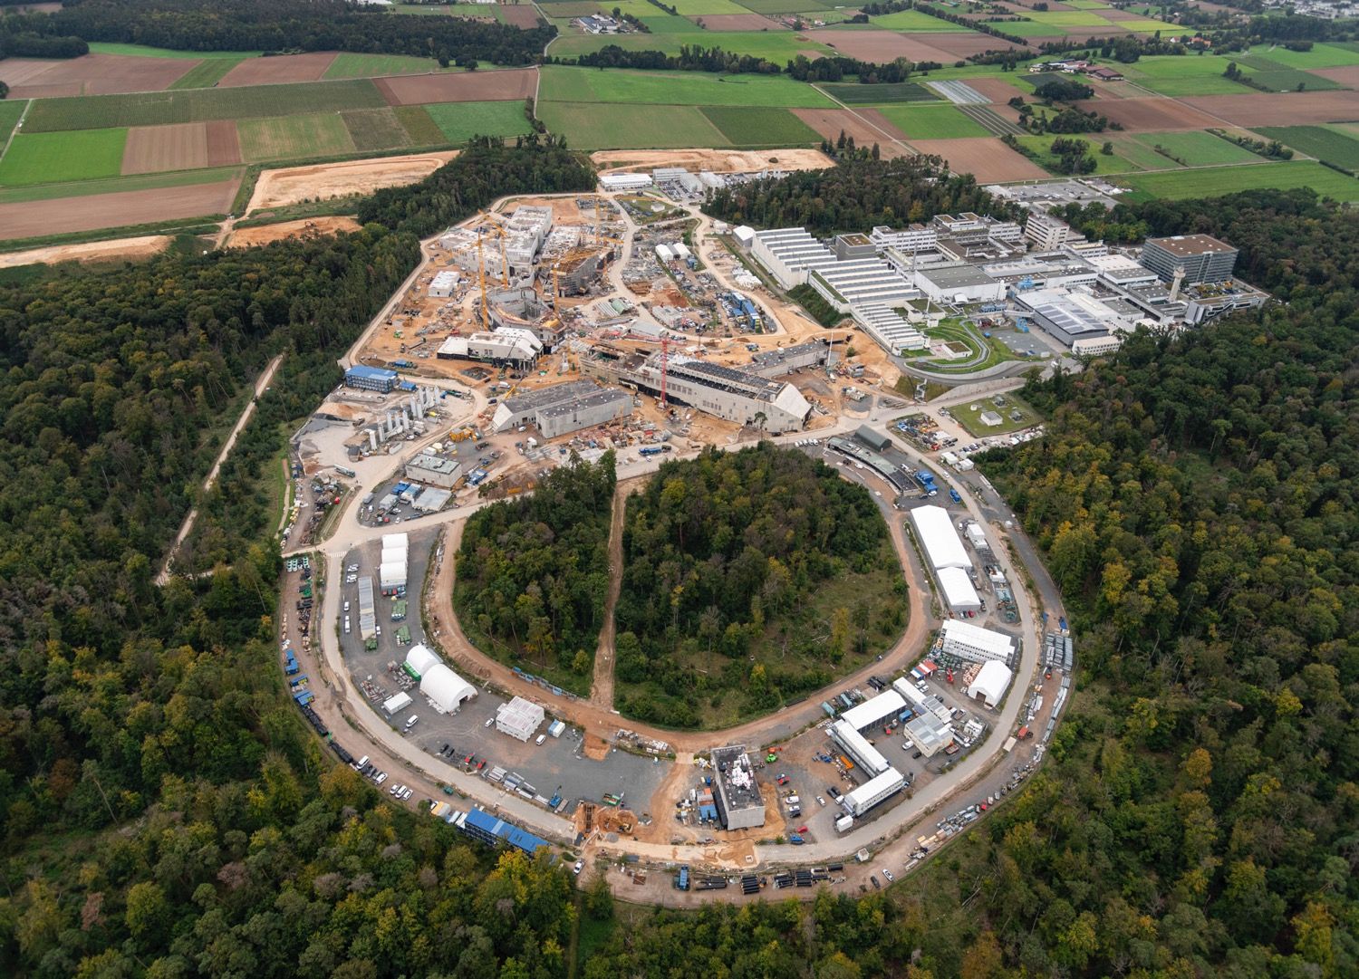
Thank you for your attention !

