Slide 1
Support for realizing a new magnetic field measurement systems
P. Spiller, A. Szwangruber, C. Roux, S. Russenschuck

Slide 2
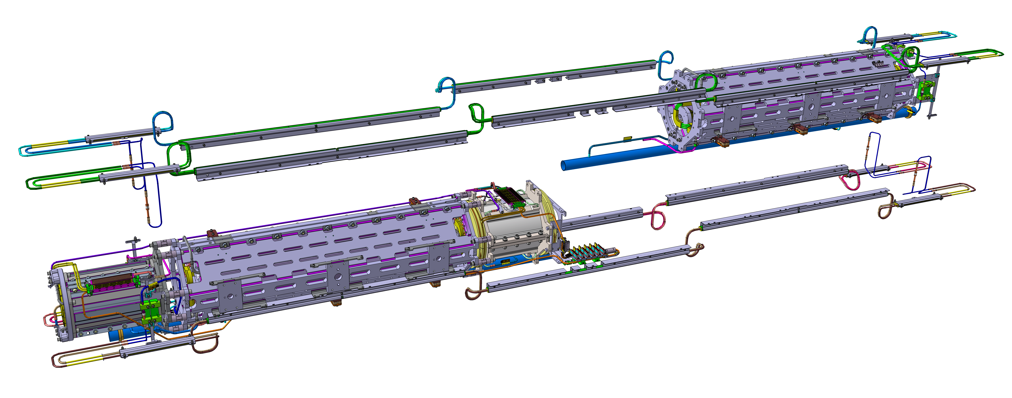
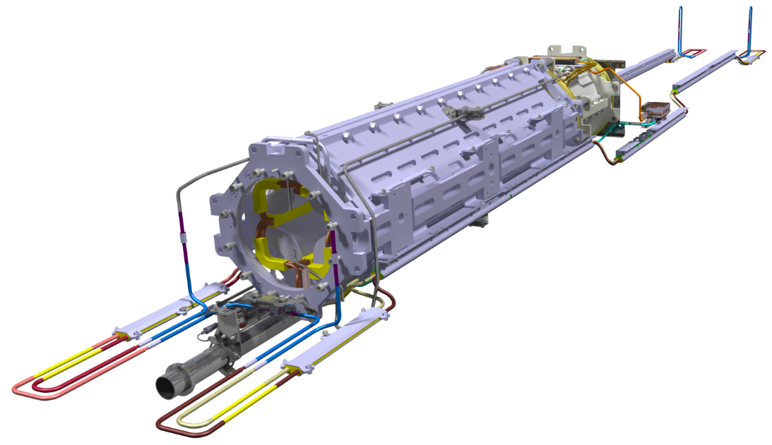
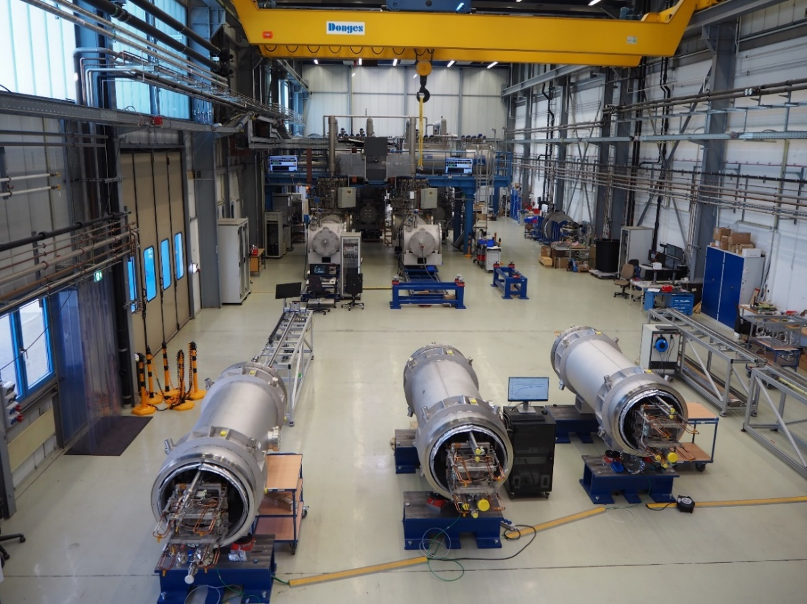
S.C. Quadrupole Units for FAIR SIS100
The s.c. quadrupole units is a Russian contribution to FAIR.
The collaboration has been interrupted with the start of the Ukraine crisis in March 2022.
Considering the fact that FAIR and JINR are both international organizations, the collaboration has been re-established in December 2023 after the approval of the German export control, ministries and authorities.
Production and cold testing of the s.c. Quadrupole Units are carried out by JINR, Dubna → critical path for SIS100
A plan B has been developed and established with contracting of four prototype units with Bilfinger, including the manufacturing of all tooling required for a potential series production.
The FAT and SAT are assumed to be completed until end (latest) of 2025.
Qualification (SAT) of quadrupole units from industrial production will be carried out at the GSI series test facility (STF).
The testing equipment (rotating coil probes, stretched wire system, control and data acquisition systems) to be developed and set-up shall serve a potential series production in industry.
quadrupole units (BQD,SF1H)
Series test facility (STF) at GSI

Slide 3
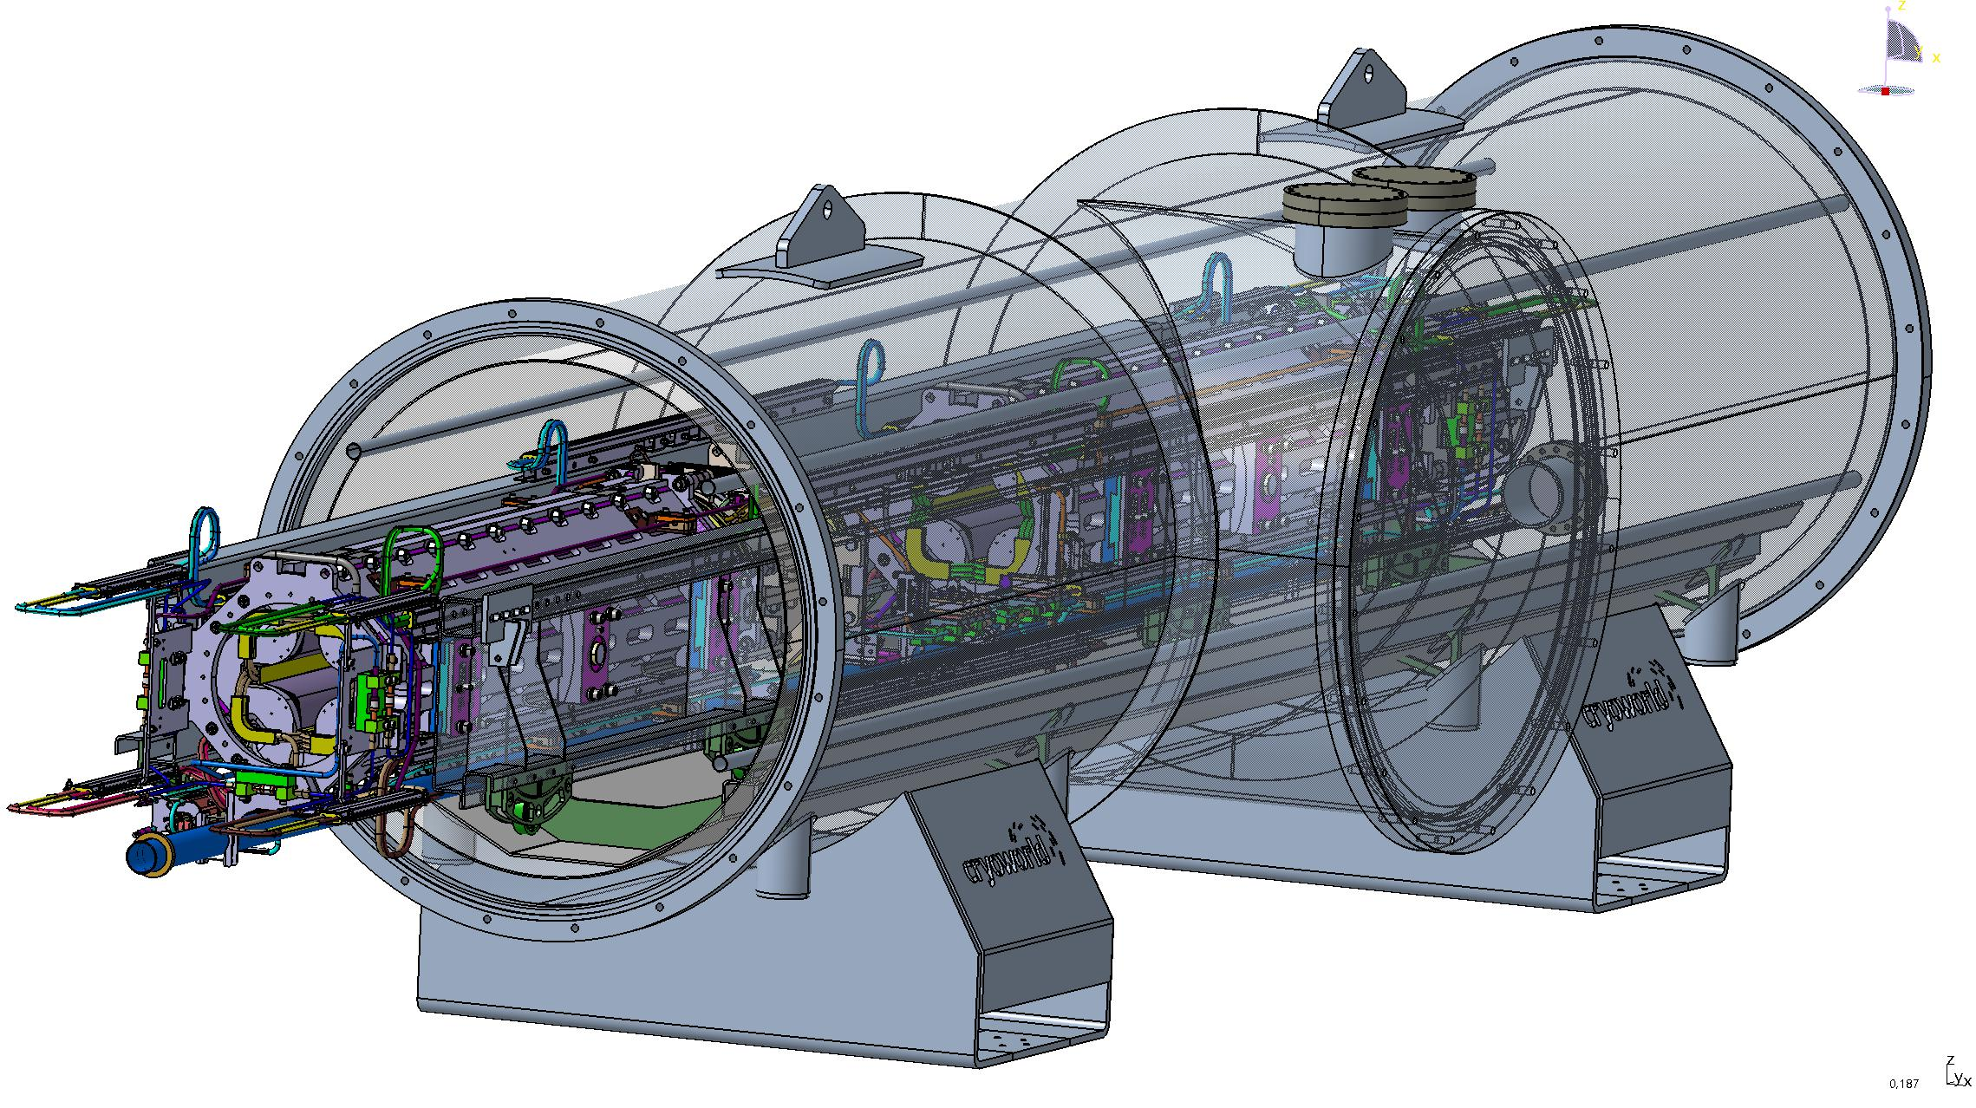
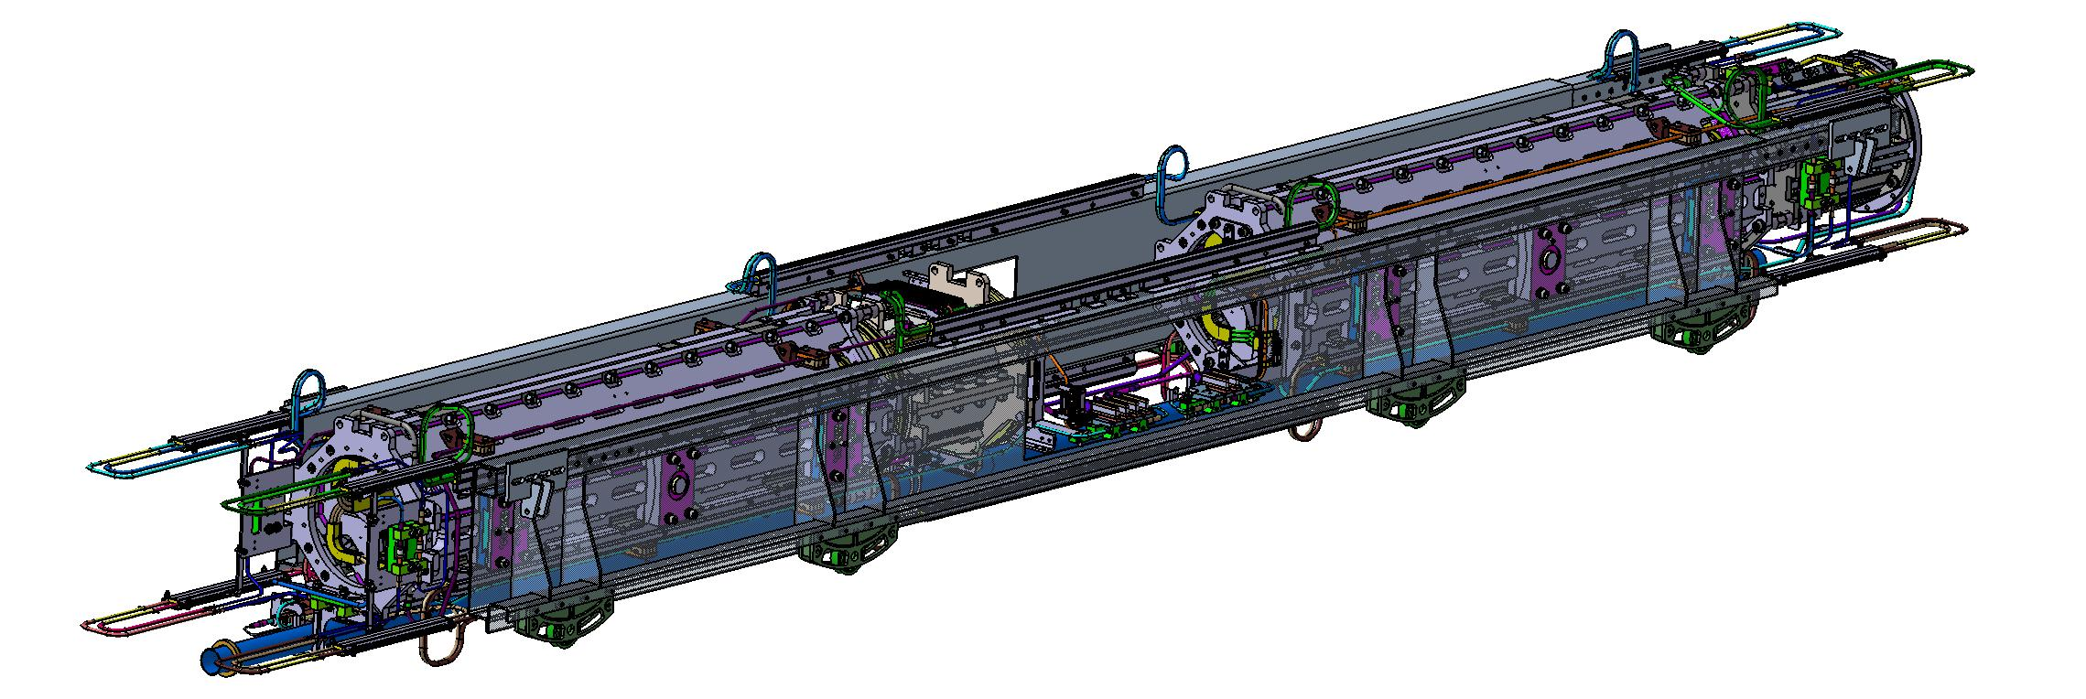
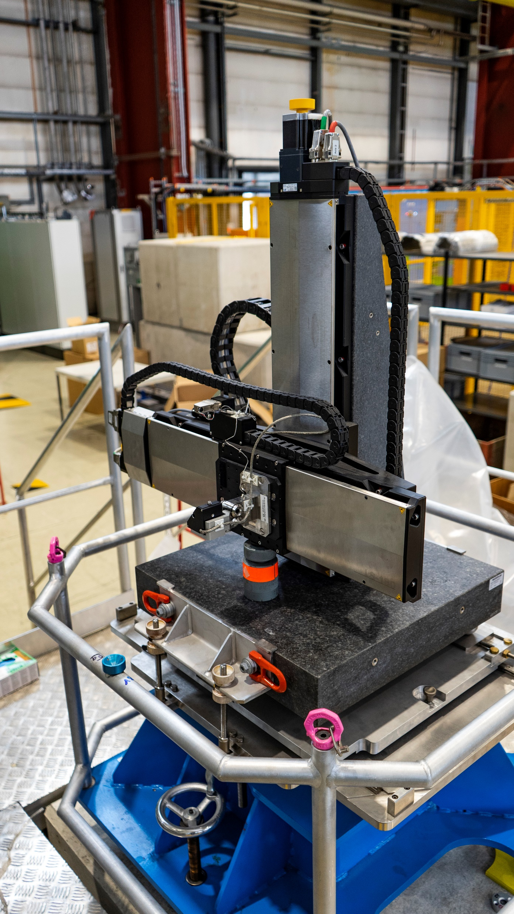
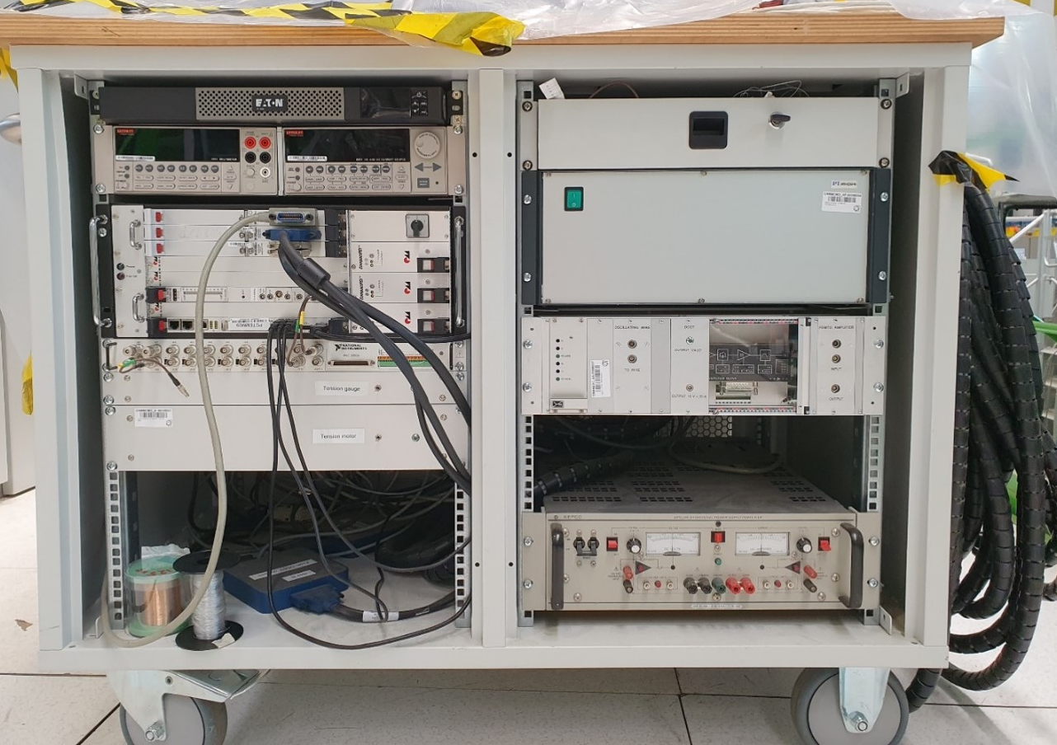
Steps towards Quadrupole Unit Testing at GSI
Required upgrade of the existing series test facility (STF):
Test cryostat with quadrupole units on a test girder. Design study at Cryoworld. Courtesy Cryoworld.
test cryostats for QD-units
bench and tooling for a fast mounting of the cold mass into the test cryostat (preparation towards series testing)
systems for magnetic field measurements
anti-cryostat for magnetic field measurements
optimisation of the existing testing infrastructure
Quadrupole units on a test girder. Courtesy Cryoworld.
Procurement strategy:
Test cryostats and installation benches - design and production in industry
Systems for magnetic field measurements - design and procurement and implementation with support from CERN.
Components for the infrastructure upgrade – GSI (SCM, CRY)
Stretched wire system SSW6, magnetic axis measurements FAIR Super-FRS multiplets. Courtesy P.Kosek

Slide 4
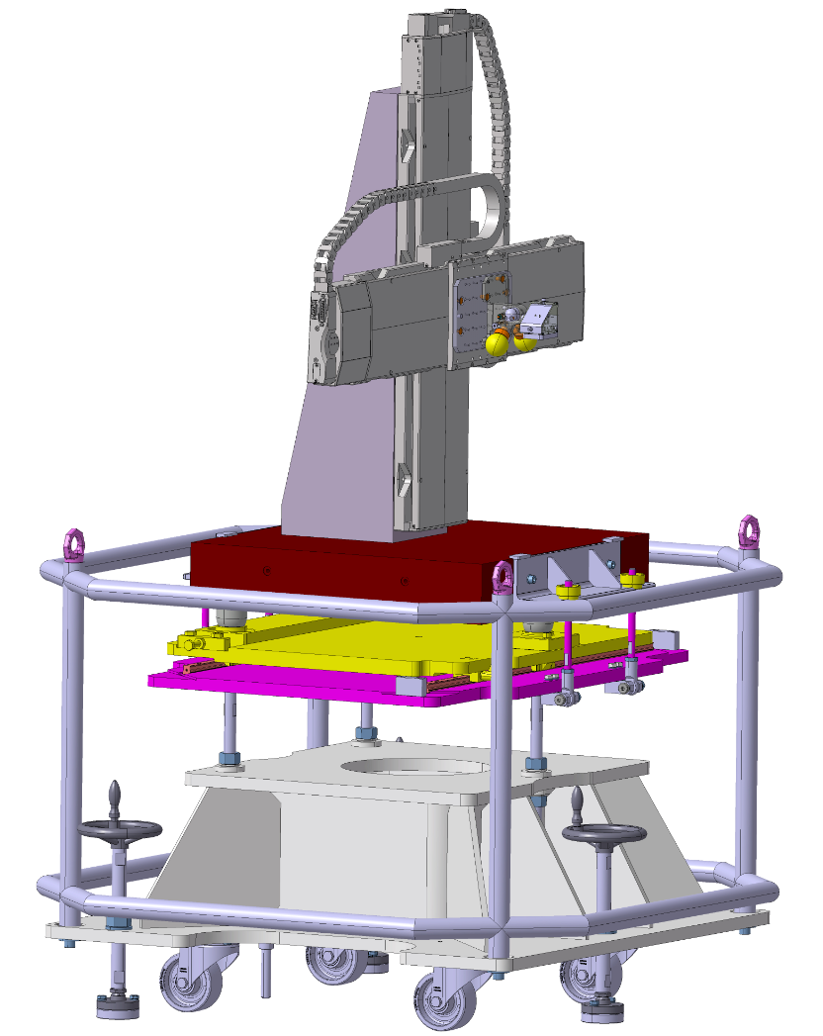
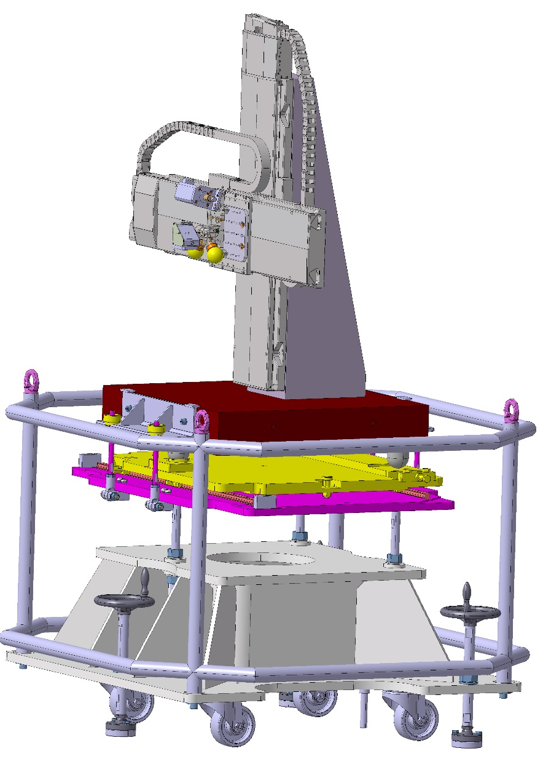
CERN Support for Realization of a new magnetic field measurement systems
Single Stretched Wire (SSW) measurement system:
  Position of the magnetic axis
  Integral field gradient
  Applicable for SIS100 units and doublets
Scope and contributions:
GSI | CERN
System development (in particular for the FFMM software (controls, DAQ) based on the CERN-SSW5 design
Hardware procurement ~ 170.000 € (if integrators are available) | Training of GSI personnel
Final assembly and commissioning of the system
1 FTE (working at CERN magnet laboratory) + 0.5 FTE | 0.4 FTE
Model of a stretched wire system SSW6, magnetic axis measurements FAIR Super-FRS multiplets. Courtesy P.Kosek
Expected readiness for QU testing equipment – middle 2025

Slide 5
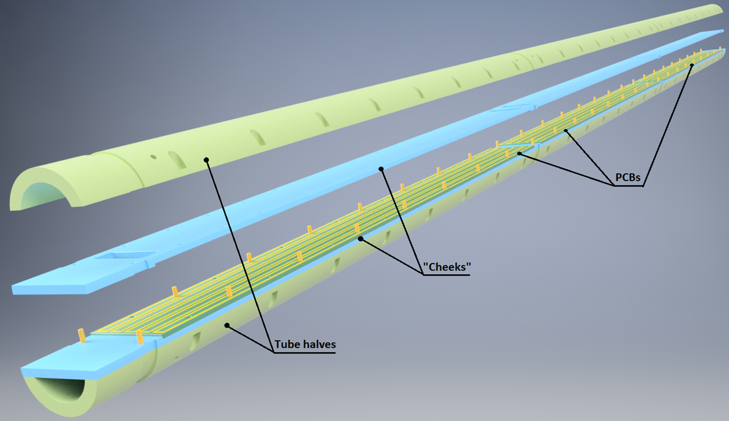
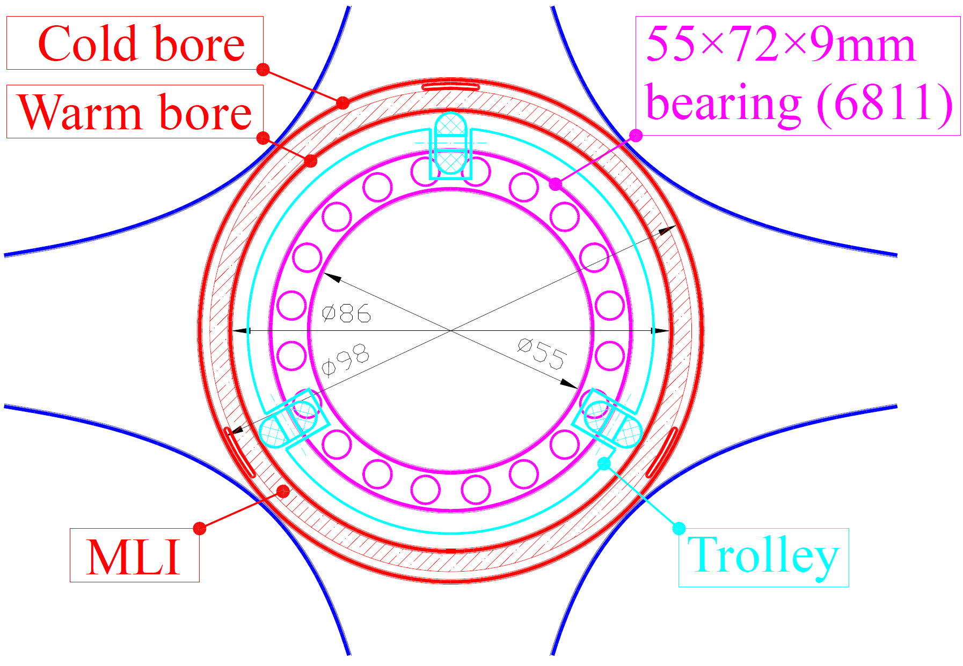
CERN Support for Realization of a new magnetic field measurement systems
Rotating coil system:
  Field homogeneity
  Integral field gradient for main quadrupole
  Integral field strength for corrector magnets
  Applicable for SIS100 quadrupole units
Only two rigid support points to avoid forced bending
Support points do not coincide with gaps between PCBs
Therefore, PCBs must fit inside the bearings
Collaboration scope and contributions:
GSI | CERN
Development of the measuring system based on PCB coils
Mechanical design and electrical layout for the PCB | PCB manufacturing and calibration
Procurement and assembly of components for measuring heads and motor units | Calibration of the PCBs (in dipole) and measuring heads (in quadrupole)
Assembly of motor units (BEA)
Adjustment of the control and data acquisition software for operation at GSI
2.5 FTE | 0.4 FTE
~ 120.000 €
Tentative magnetometer design. Courtesy V. Marusov
Expected readiness for QU testing equipment – Q3/Q4 2025

Slide 6
To Do
SSW system: Motor controller type not commercially available anymore. Qualification of a new supplier for the precision stages may be required (count 12 months). CERN can make available drawings of the auxiliaries.
Rotating-coil magnetometer: Qualification of other suppliers (shells and PCB) would be welcome. Shaft calibration at CERN is limited to 100 mm in diameter and 1.2 m in length. Also possible: In situ calibration with SSW at GSI.
Electronic rack: The electronic rack could be made compatible for the two measurement systems. If fast digital integrators need to be replaced, new integrators or commercially available DAQ systems must be developed.
Software (FFMM): A license agreement (black box versus open source) needs to be drafted. Both new systems require software updates (could be assigned to a TECH student at CERN) and licenses for the operating systems.
On the CERN side, resources of different competencies are required for system development, assembly, calibration, and testing. GSI to make available (or hire) an experienced measurement engineer.
Consider 24 months for completion of tasks; so t₀ is now. Decisions to be taken as soon as possible.

