Slide 1
GSI Accelerator Complex
R. Assmann
Head „Accelerator Operations & Development“
CERN-GSI Collaboration Steering Committee
26.04.2024

Slide 2
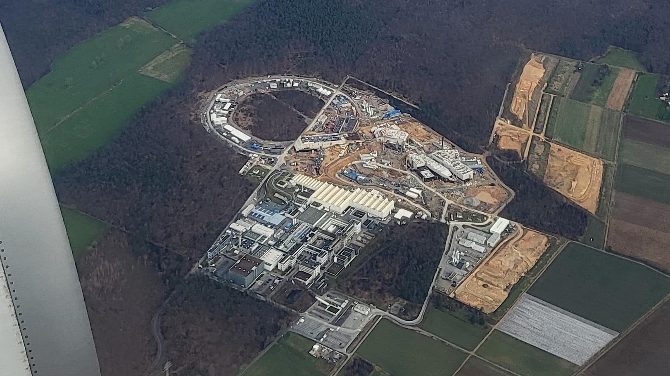
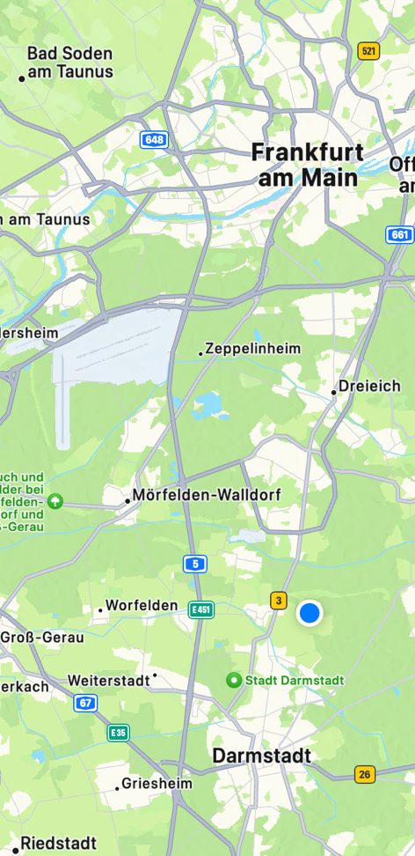





GSI and FAIR
Aerial View on 25 Feb 2024

Slide 3
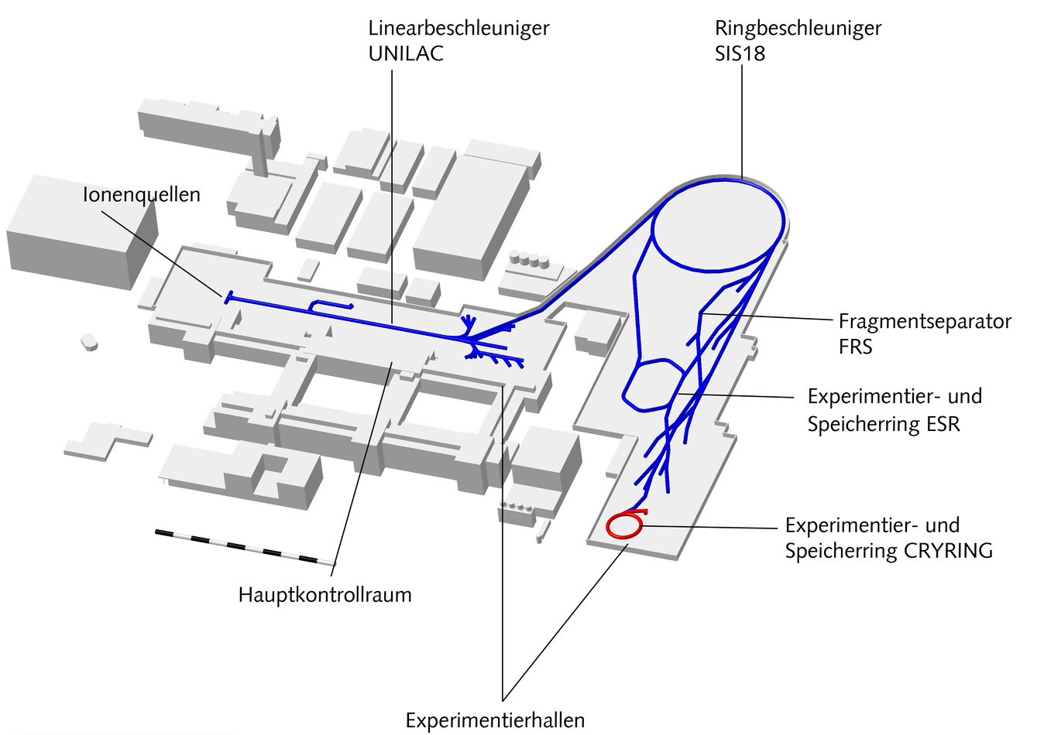

Present GSI Complex
1 GeV/u
World-class ion accelerator facilities
  Ion linac
  Storage ring
  Synchrotron
  Beam cooling
  Ion traps
  Decelerators
55 years and getting stronger
→ plus FAIR
Heavy Ion Trap
HiTRAP
High Energy Transfer
Lines HEST

Slide 4
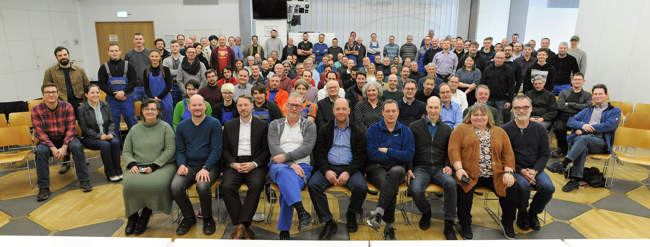
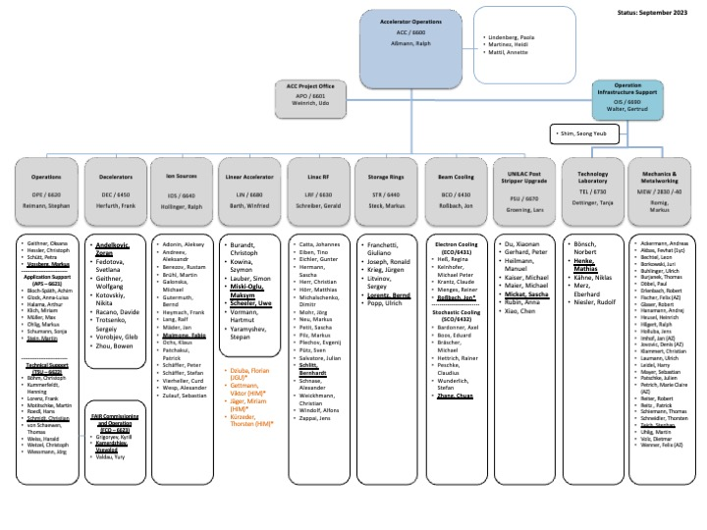
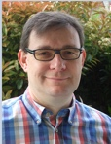

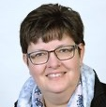
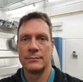
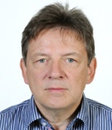
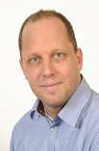
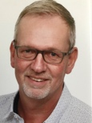

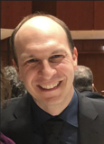
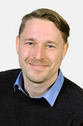
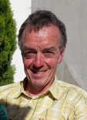

Mission “Accelerator Operations and Development”
Operation of GSI accelerators and delivering beams for world-class heavy ion research
Development of GSI accelerators and preparing them step-wise for the future
Supporting the FAIR project and its completion
Preparation and organization of FAIR accelerator commissioning (headed by S. Reimann)
Operating costs working group (headed by U. Weinrich)
Merging of certain GSI/FAIR accelerator-related activities – work with regional universities and international labs
Leadership team (see photos) and young talents in depts → excellent options for future shaping of world-class GSI/FAIR accelerator area
At the moment: 153 staff
present GSI/ACC structure

Slide 5
Our Ion Beams at GSI (Nominal Intensities 13.03.2024)

Slide 6
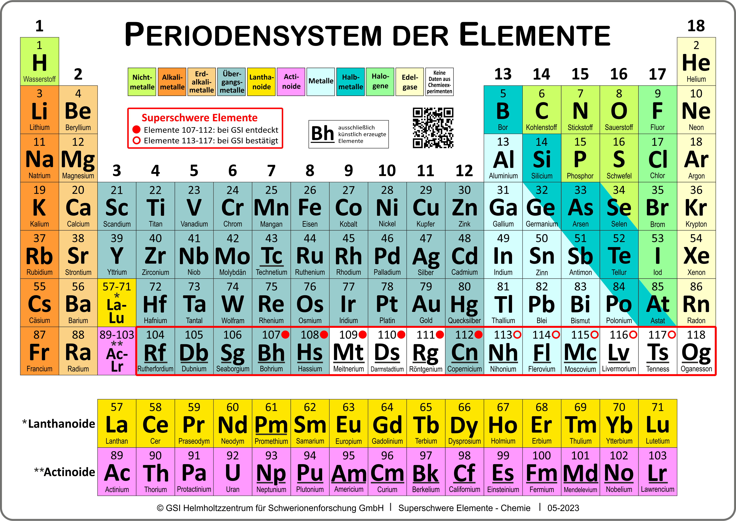
Did You Hear about Bohrium, Hassium, Meitnerium, Darmstadtium, Roentgenium, Copernicium?
Use ion beams from accelerators to discover new heavy elements!
Study properties of heavy elements!
  How did our universe form from the big bang?
  Where do heavy elements on earth come from (not from the sun)?
New push from gravitational wave detectors
→ detection of neutron star
collisions
→ forming of heavy elements
observed in nature

Slide 7
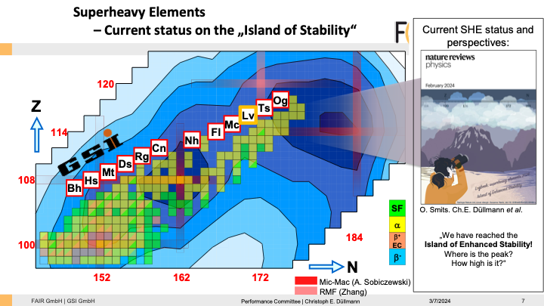
The Island of Stability
Groups of super heavy elements with the potential to have longer half-lives, in the order of several minutes, than their place on the periodic table would suggest.
This is due to these elements having 'magic numbers' of protons and neutrons.
Royal Society of Chemistry
Performance Committee | Christoph E. Düllmann

Slide 8
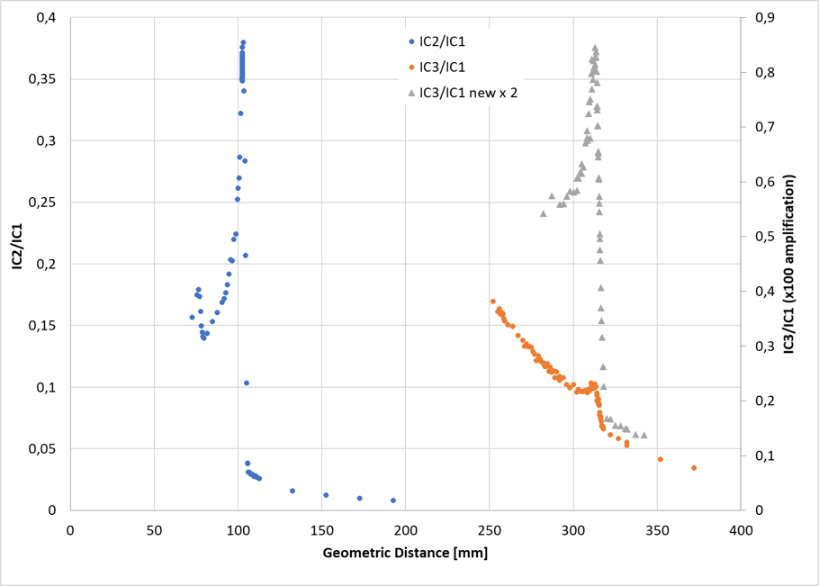
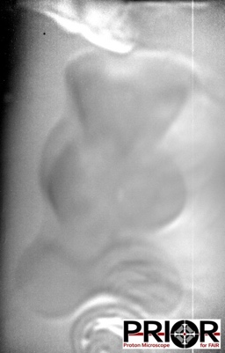
Courtesy F. Maimone et al
Dual Ion Beam for Tumor Therapy (new, world-wide first)
Carbon used for tumor irradiation. Helium penetrates through body and is used for real time imaging.
Integrals over one spill for the depth dose
Ion mass He + C ( 5-20% He)
Ion charges ⁴He⁺ und ¹²C³⁺ from CH₄
Energy 225 MeV/u
Beam intensity 10⁸, Slow extraction
Stability No variation of He, C and O
Contamination of ¹⁶O⁴⁺ As low as possible
O, C
20% He
Possible contrast at low-density differences
A gummy bear in addition to other density calibration targets in a gelatin block (edge length 6 cm), can be imaged exclusively with the helium portion of the beam.
Two ‘working points‘: 5% He and 20% He (relation to C), 7% O throughout
5% He
Measurements with a matrix IC detector (also time-resolved) and films providing location information collected as well.
- IC2: front chamber with O and C peak
- IC3 : back chamber with 5% He concentration
- IC3 : back chamber with 20% He concentration
Measured ion contributions to image:
12C⁶⁺: 0.167%
4He²⁺: 99.833%

Slide 9
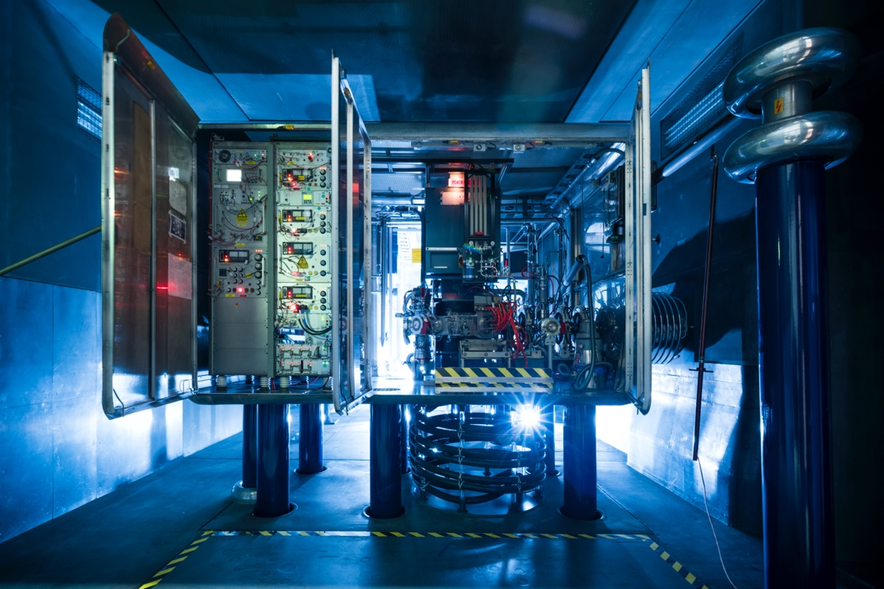
Where do we work together
and
where could we work together
on GSI-related topics
?
Ion source
Courtesy
R. Hollinger

Slide 10
GSI Accelerator Competences, Challenges and Collaboration Opportunities
Operating and consolidating 50 years old accelerators
Building equipment for RF accelerators: wide aperture, high intensity, high rate, large components
Facility design and beam dynamics for high intensity hadron accelerators
Modern and efficient control systems
Commissioning (HW, beam) of a new facility (FAIR)

Slide 11
GSI Accelerator Competences, Challenges and Collaboration Opportunities
Operating and consolidating 50 years old accelerators
Building equipment for RF accelerators: wide aperture, high intensity, high rate, large components
Facility design and beam dynamics for high intensity hadron accelerators
Modern and efficient control systems
Commissioning (HW, beam) of a new facility (FAIR)

Slide 12
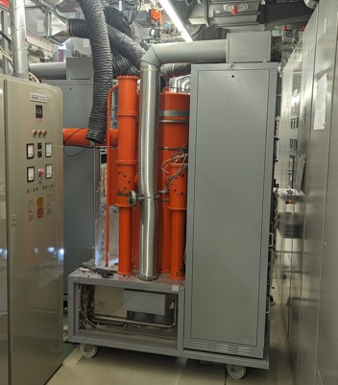
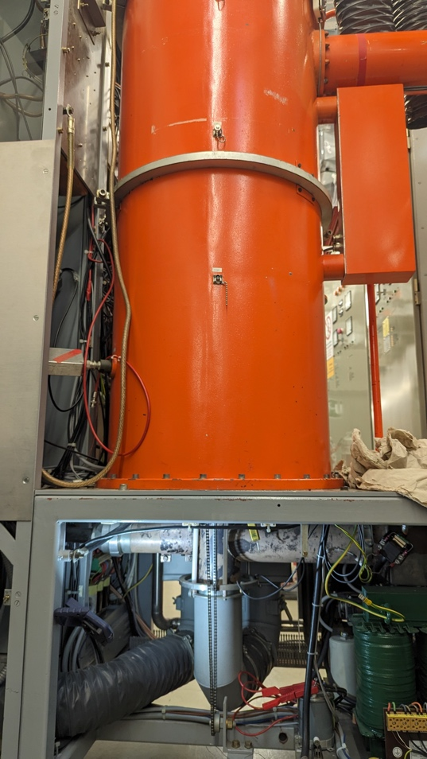
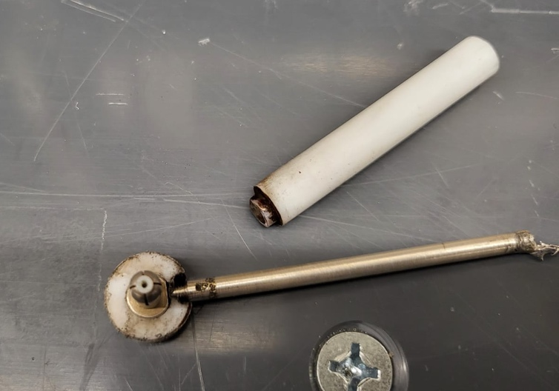
Operating and consolidating 50 years old accelerators
Fast response repairs → workshop capabilities
Project management (CERN Consolidation)
Procedures in shutdowns, installations, …
Example: Maintaining and optimizing the
quite outdated RF system at the UNILAC
linear accelerator. No spares, age-related
failures.
Last week: fault in 400 V line
& crumbling insulation of cables
during repair.
Repaired but 1.5 days lost.
→ Defining technical roadmap, we
will then discuss common interests

Slide 13
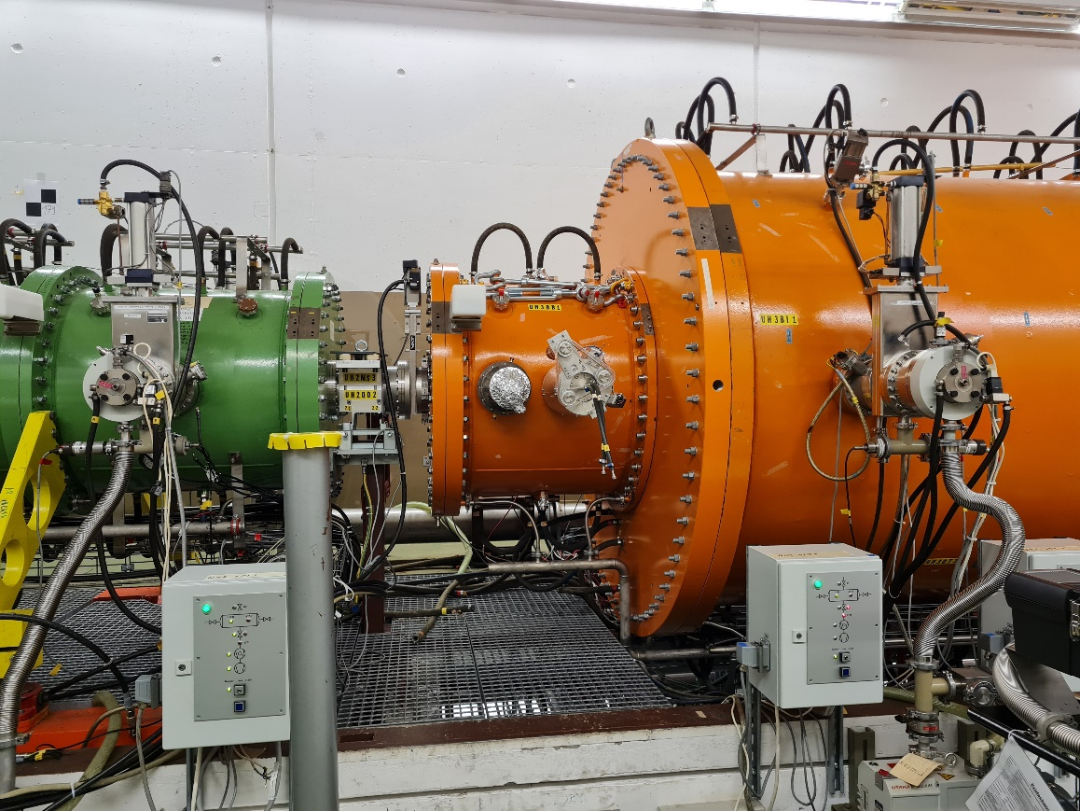
UNILAC – Superlens Repair & Upgrade (2022/23)
Courtesy W. Barth et al
Operating issues
Unacceptable beam losses
Performance degradation
Increased reflected power @high current operation
Measures
Replacing old rods
New rods
            massive copper
            galvanic copper coated
Advanced plunger design
            enlarged size
            closer positioned to the girders
            w/o tuner extensions
compensate (unwanted) shift of rf- frequency
IH-Tank 1
RFQ
Superlens

Slide 14
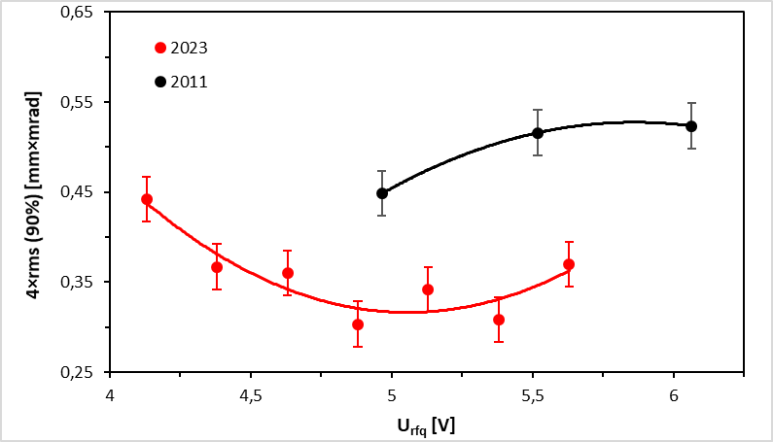
UNILAC Short Pulse Heavy Ion Operation
→ New Records
about 50% of FAIR intensity goal reached
Result courtesy W. Barth et al
50% reduction of beam emittance!

Slide 15
GSI Accelerator Competences, Challenges and Collaboration Opportunities
Operating and consolidating 50 years old accelerators
Building equipment for RF accelerators: wide aperture, high intensity, high rate, large components
Facility design and beam dynamics for high intensity hadron accelerators
Modern and efficient control systems
Commissioning (HW, beam) of a new facility (FAIR)

Slide 16
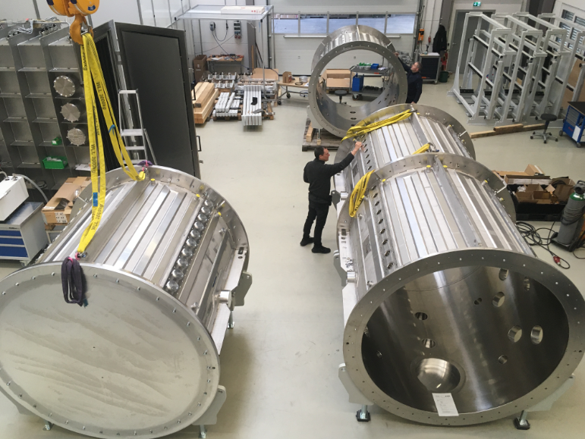
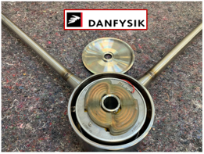
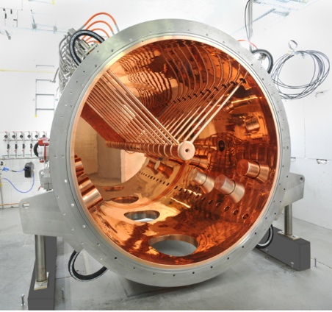
Building equipment for RF accelerators: wide aperture, high intensity, high rate, large components
Large parts galvanic workshop at GSI
Availability RF equipment: tubes, klystrons, …
Fast ramping dipoles (4T/s), s.c. magnets
Copper-plating of drift tubes
at CERN
Copper-plating of drift
tubes at CERN:
Signed Dec 2023. Working
visit on 18.5. at CERN. Well
on track.
Many thanks for CERN
support.

Slide 17
Building equipment for RF accelerators: wide aperture, high intensity, high rate, large components

Slide 18
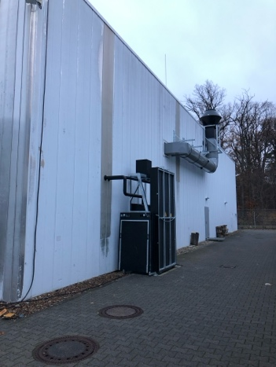
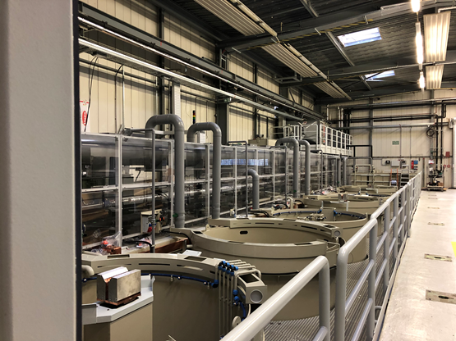
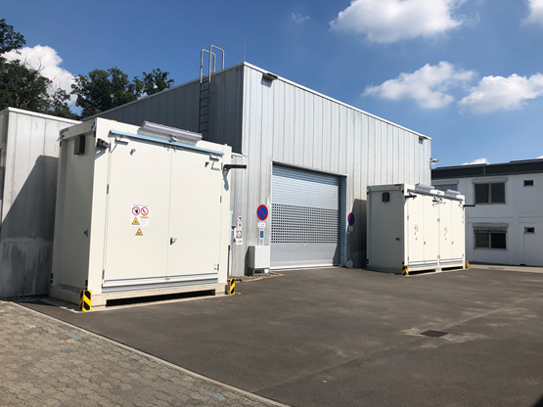
GSI Galvanic
Refurbishment is completed – addressing last non-conformities
Next steps towards series plating:
  Hiring 2 additional staff for reinforcing team.
  Preparation of electroplating chemicals and set-up of system
  → next week
  Cu plating of test tank – last step of site acceptance → end of June
  Cu plate an additional p-linac structure to orderly freeze this project
  start series tanks for Alvarez upgrade planned in Q4 2024 (monitoring delays)
  Faster: additional space for pre- and post-treatment of series tanks needed

Slide 19
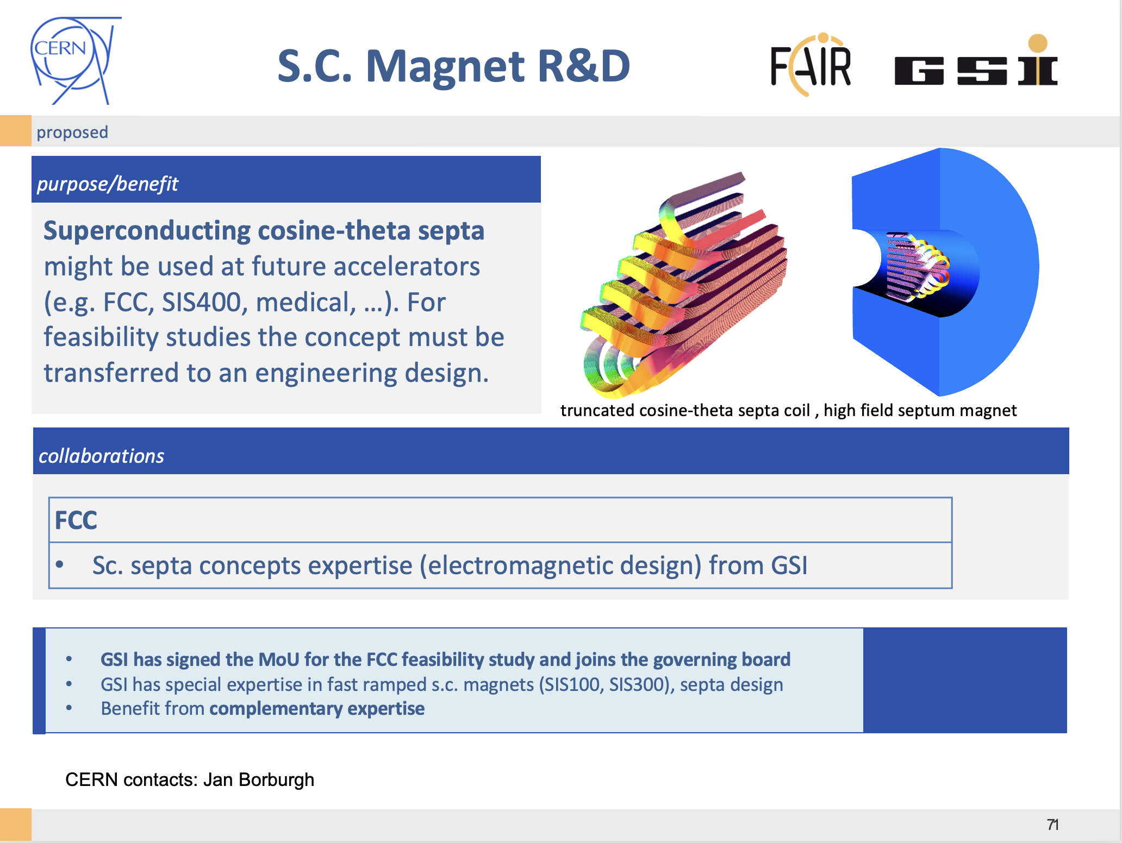
GSI contacts:
Kei Sugita
Group Leader: Superconducting Magnet Technology
Peter Spiller
Christian Roux

Slide 20
GSI Accelerator Competences, Challenges and Collaboration Opportunities
Operating and consolidating 50 years old accelerators
Building equipment for RF accelerators: wide aperture, high intensity, high rate, large components
Facility design and beam dynamics for high intensity hadron accelerators
Modern and efficient control systems
Commissioning (HW, beam) of a new facility (FAIR)

Slide 21
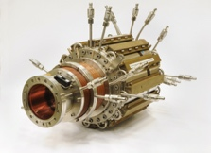
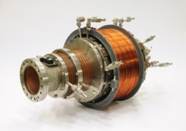
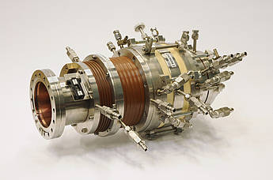
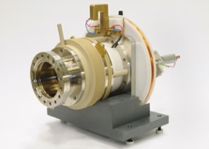
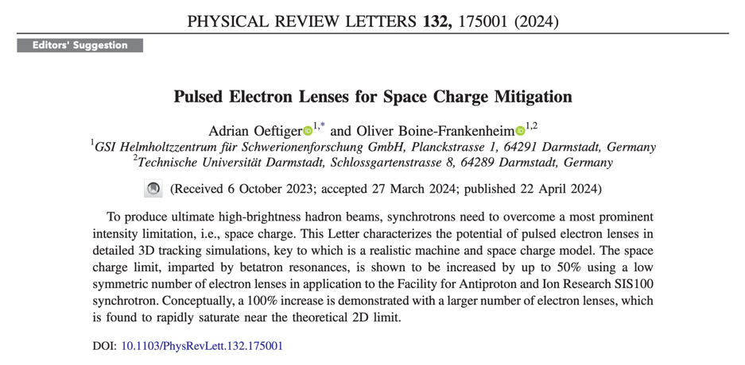
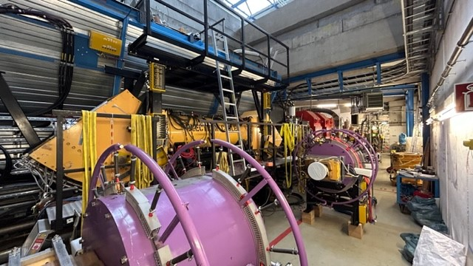
Facility design and beam dynamics for high intensity hadron accelerators
Ion sources
Ion beam dynamics: space charge, space charge compensation, simulation, theory, cooling theory, decelerator theory, …
Beam cooling technology (e-beam cooling, stochastic cooling)
Fast and slow extraction techniques
ESR electron cooler during Dec 2023 reassembly

Slide 22
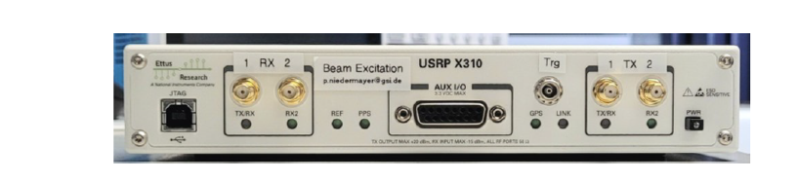
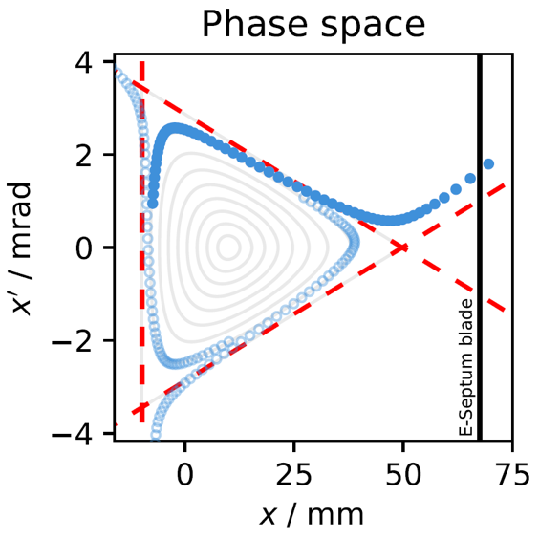
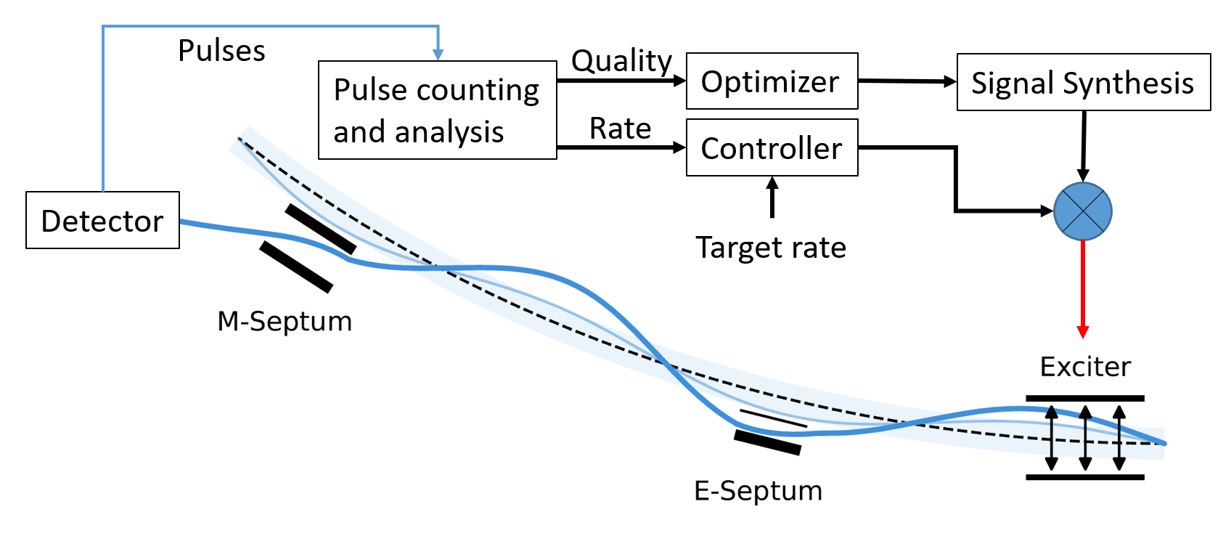
Knock-Out (KO) slow beam extraction
Machine tune near 3rd order resonance and transverse excitation "around" beam eigenfrequencies
KO → constant optics during extraction, minimal beam movement on target, fast stop (medical application)
Excitation signal amplitude (deflection) provides a control over extraction rate (a.k.a. macrospill feedback)
Excitation frequency spectra gives control over particle rate fluctuation (a.k.a. microspill optimization)
Slide Philipp Niedermayer et al

Slide 23
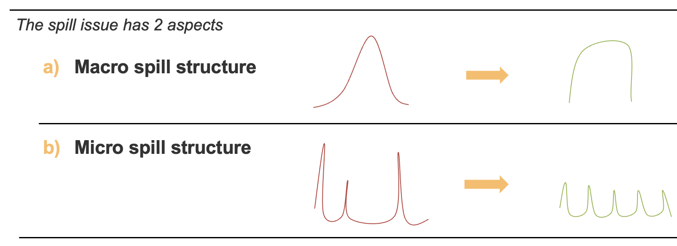
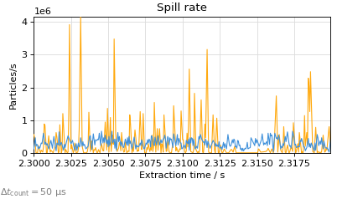
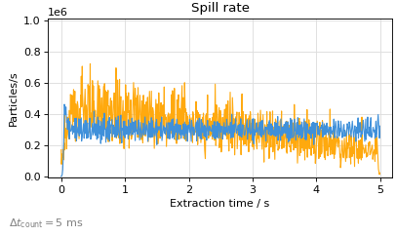
Major Improvement of Ion Beam Quality at GSI
“Digital Spill Optimization System (SOS)”
without SOS System
with SOS System
high resolution (50 µs)
Spill quality
(“micro”)
Spill shape (“macro” – 5 s spill length)
Results Philipp Niedermayer et al

Slide 24
GSI Accelerator Competences, Challenges and Collaboration Opportunities
Operating and consolidating 50 years old accelerators
Building equipment for RF accelerators: wide aperture, high intensity, high rate, large components
Facility design and beam dynamics for high intensity hadron accelerators
Modern and efficient control systems
Commissioning (HW, beam) of a new facility (FAIR)

Slide 25
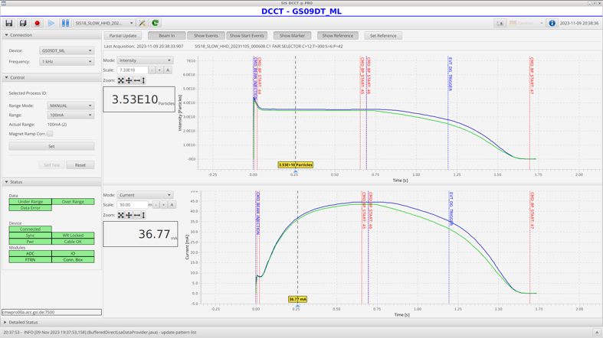
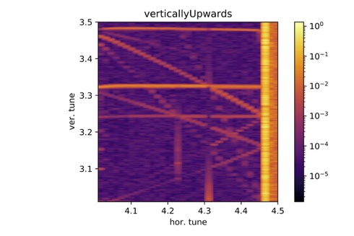
Modern and efficient control systems
Setting management and loading. Reproducibility of machine.
Feedbacks, machine learning, automatic algorithms, AI
FAIR/GSI is using the architecture of the CERN control system
GSI accelerators are being upgraded to FAIR controls standard
We already start profiting from enhanced features
Planning a FAIR/GSI controls review in June 2024. Thanks to Jörg Wenninger for accepting to chair it.
Further collaborations and synergetic efforts easily imagined. The review will help identifying areas of common interests.
Courtesy S. Reimann et al
factor 10 improved C beam for users
(Dec 2023)
python bridge
S. Appel
O. Boine-Frankenheim
et al

Slide 26
GSI Accelerator Competences, Challenges and Collaboration Opportunities
Operating and consolidating 50 years old accelerators
Building equipment for RF accelerators: wide aperture, high intensity, high rate, large components
Facility design and beam dynamics for high intensity hadron accelerators
Modern and efficient control systems
Commissioning (HW, beam) of a new facility (FAIR)

Slide 27
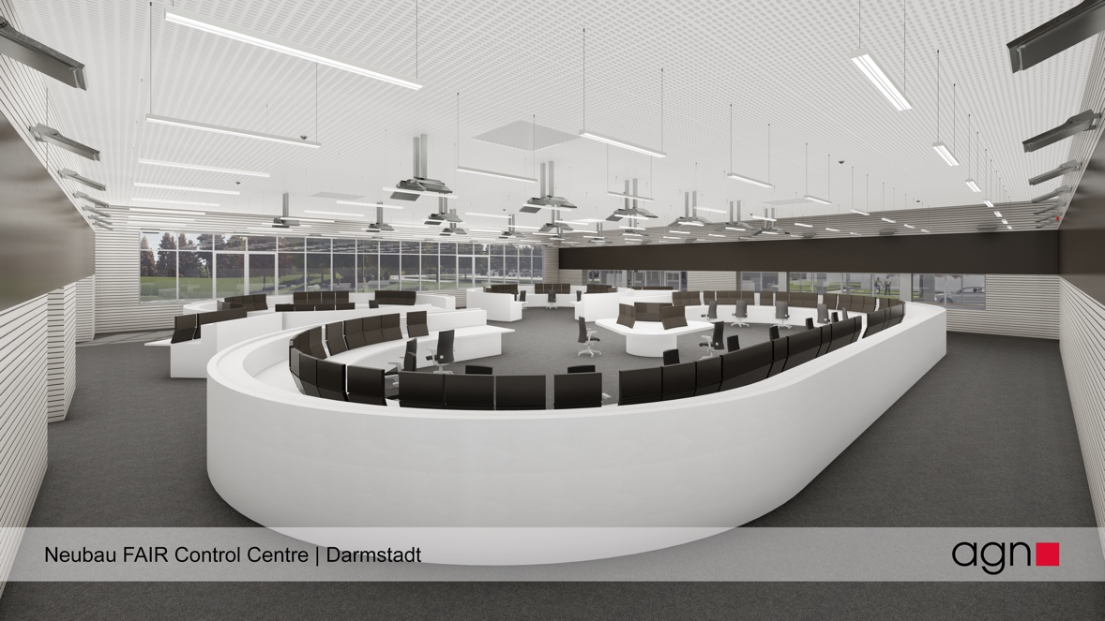
Commissioning (HW, beam) of a new facility (FAIR)
Procedures and documentation
Control room organization (FCC)
Expectation management and communication with experiments
Work ongoing for preparing commissioning workshop in November → S. Reimann
Performance committee studying performance (present and future) and establishing a technical roadmap.

Slide 28
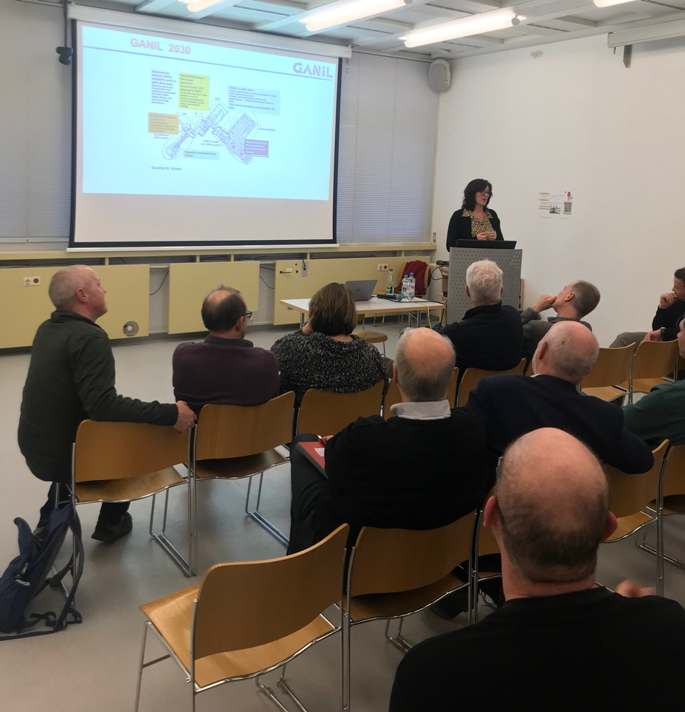
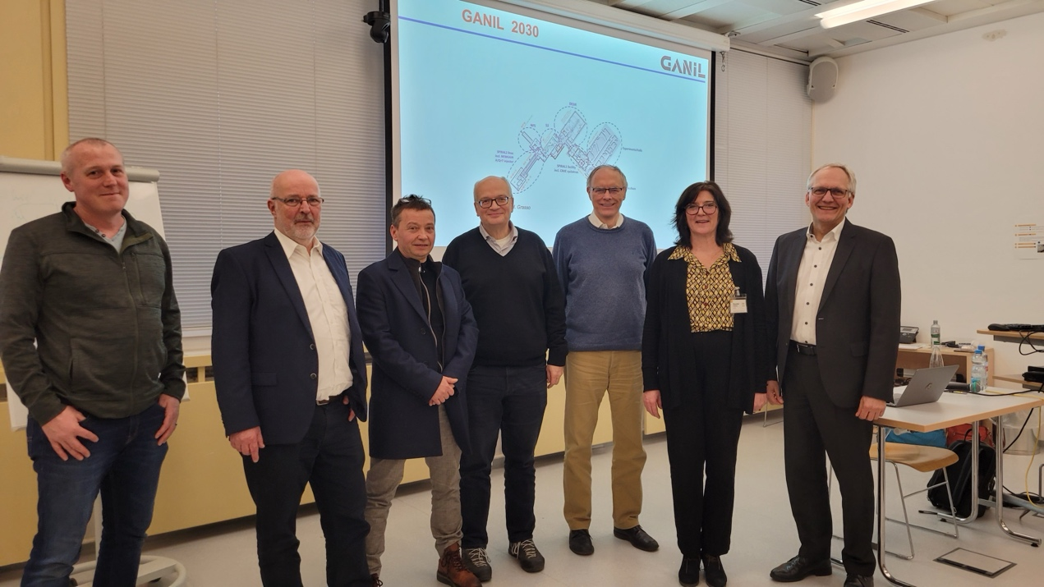
Collaboration & Scientific Exchange are Crucial
GSI Accelerator Seminar Series
Re-establishing a more active series – here with Fanny Farget from GANIL at GSI

Slide 29
Conclusion
CERN and GSI have a very close historic and present collaboration.
For me personally (with my CERN history) a pleasure to be here.
Very important collaborations ongoing, in addition to other topics:
  CERN collaborates with us, performing copper-coating of the drift tubes for the Alvarez 2.0 project.
  CERN collaborates with us, supplying us with controls technology, algorithms and help for a review.
  CERN collaborates with us, advising on facility commissioning and organization.
GSI/FAIR brings into our collaboration expertise and technologies in ion accelerators but also in large facilities and RF accelerator technology:
  Long-standing interest in CERN´s accelerator complex and its technologies – several ex-CERN persons at GSI/FAIR
  We are interested in CERN´s FCC project and in collaborating in concepts, schemes and technologies (SC septum, …).
We are also considering collaboration on future projects or R&D through our connected universities (e.g. Frankfurt) and Genthner PhD students.

Slide 30
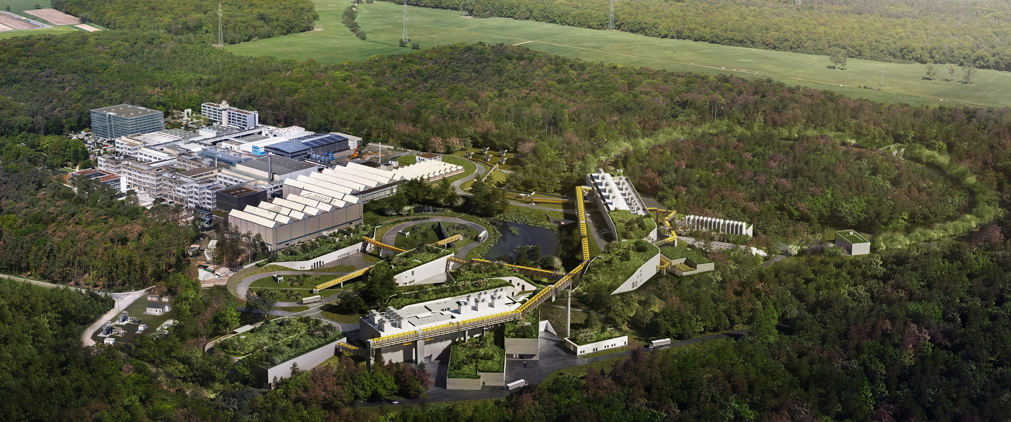
Thank You for Your Attention

