Slide 1
FAIR Control Center & Operational Models
S. Reimann
Head of Operations Department GSI
Subproject Leader FAIR Commissioning
CERN-GSI Collaboration Steering Board Meeting - 26 Apr 2024

Slide 2
Outline
Early Science – Overview & integrated Timeline
FAIR Control Center
Main Topics on the Way to first Beam
Commissioning Workshop

Slide 3
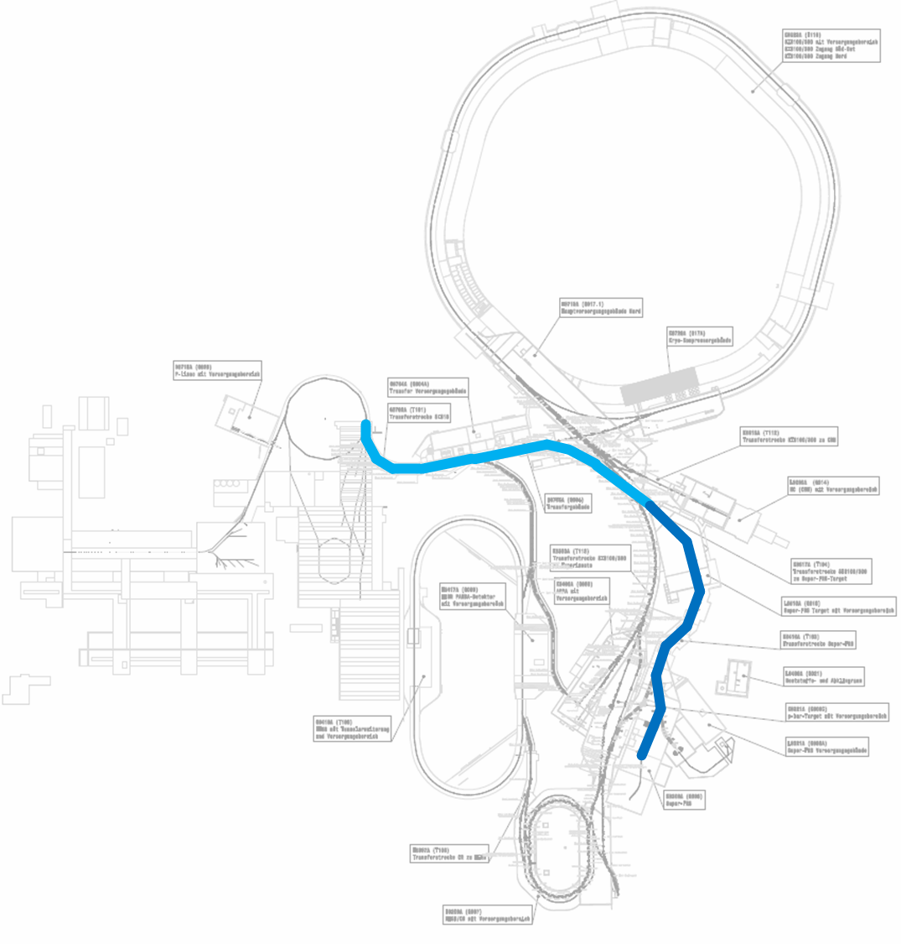
Scope: FAIR Early – Science (ES)
GSI Injector
high current source
high current injector
UNILAC
SIS18
GSI HEBT
HEBT (ES)
SFRS
NUSTAR
GSI Experiment Areas
UNILAC Target
SIS18 Targets
ESR
FRS
Cryring

Slide 4
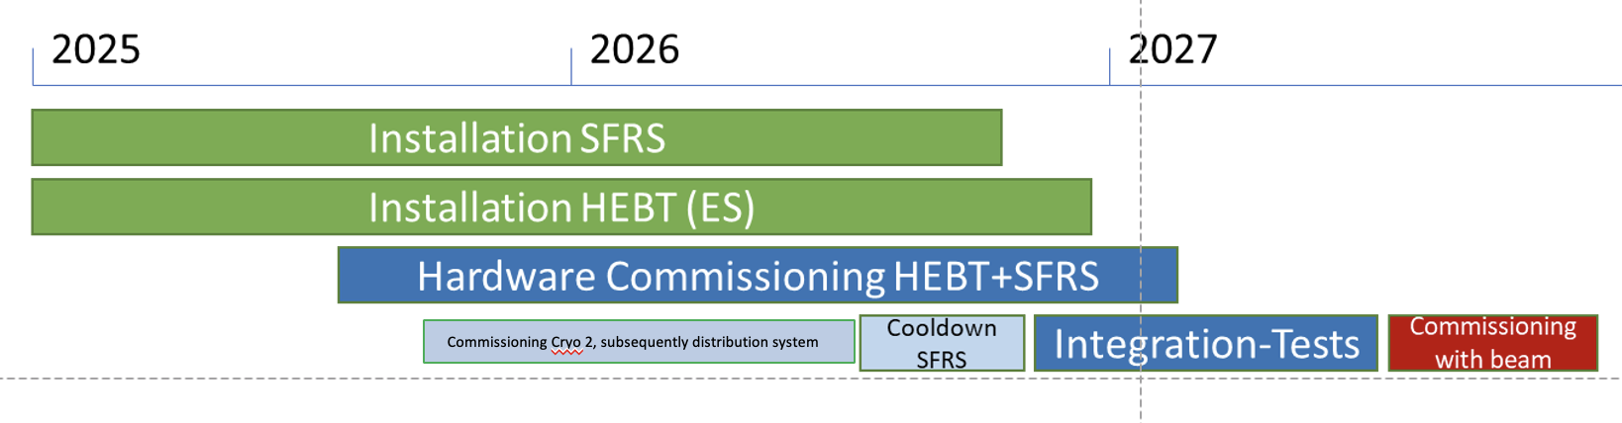
Timeline
!
FAIR-CC
commissioning
GSI user beamtime
GSI shutdown
engineering run
GSI shutdown
GSI user beamtime
FAIR First Beam – Splash-Event
ES Commissioning done

Slide 5
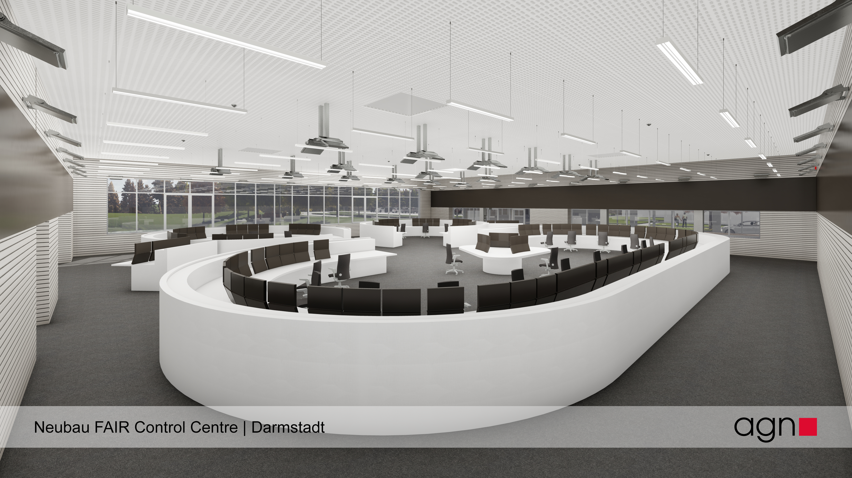
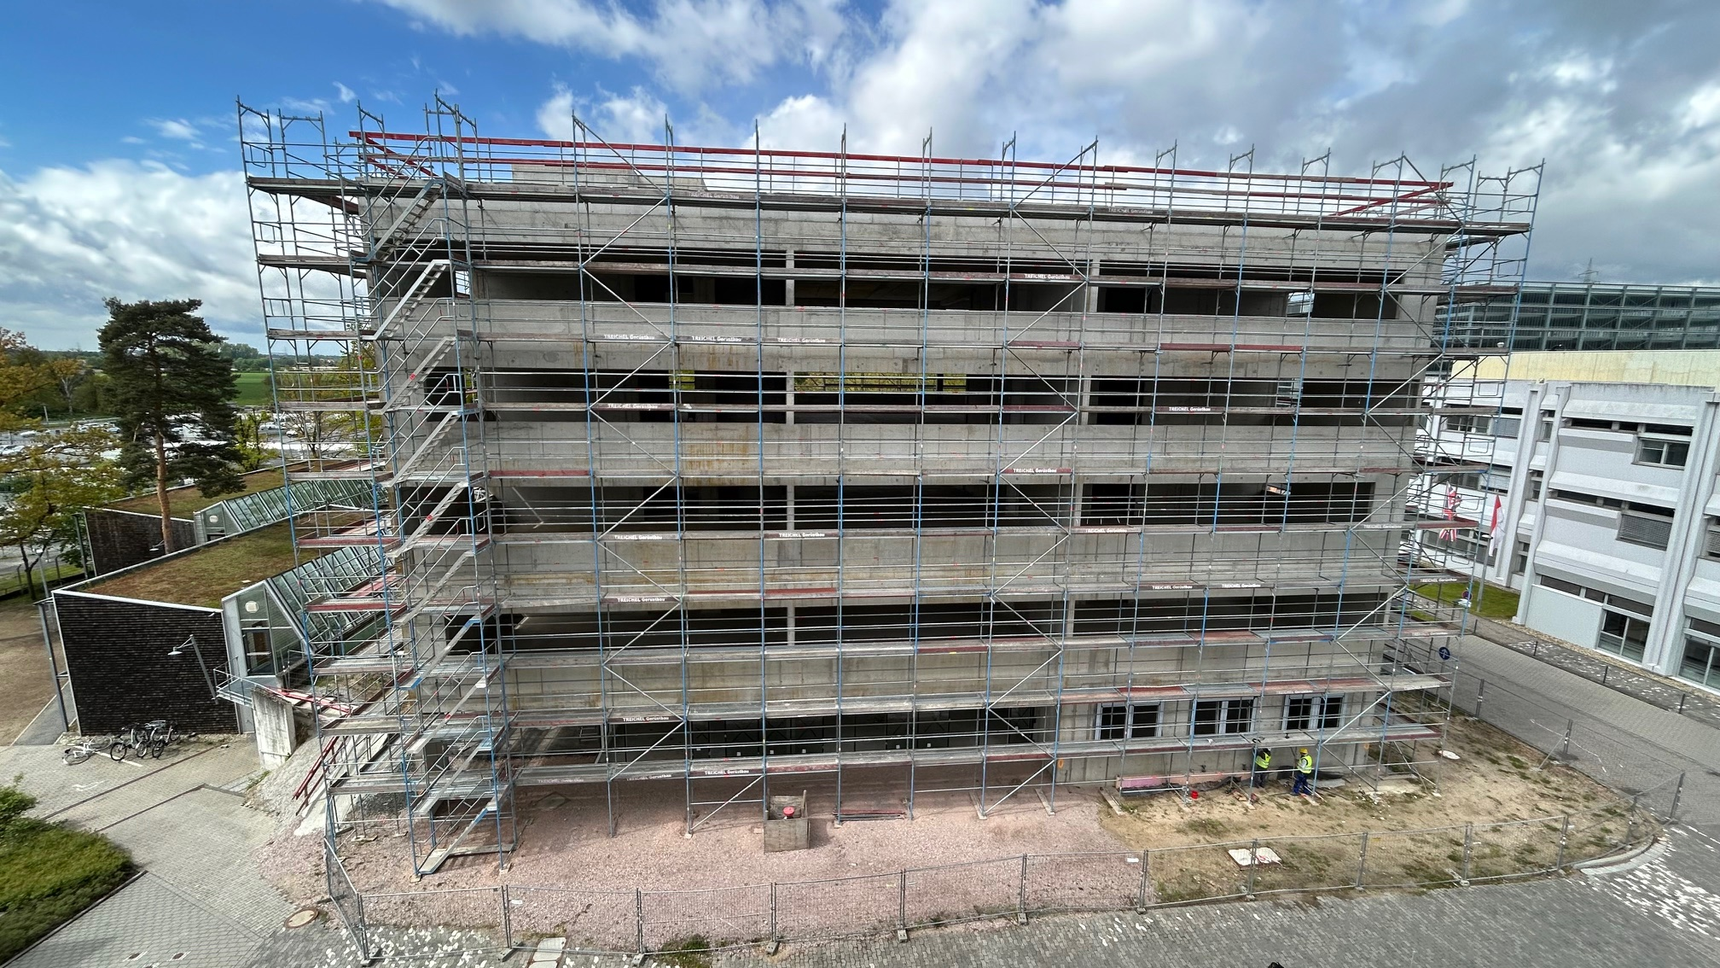
FAIR Control Center
fully digital central control room for all GSI&FAIR accelerators
25 freely configurable work stations @ 643m² + visitors gallery,
kitchen, conference room, meeting room on same level
construction ongoing
2025: installation of equipment
2026: commissioning
2027: regular use in user beam time

Slide 6
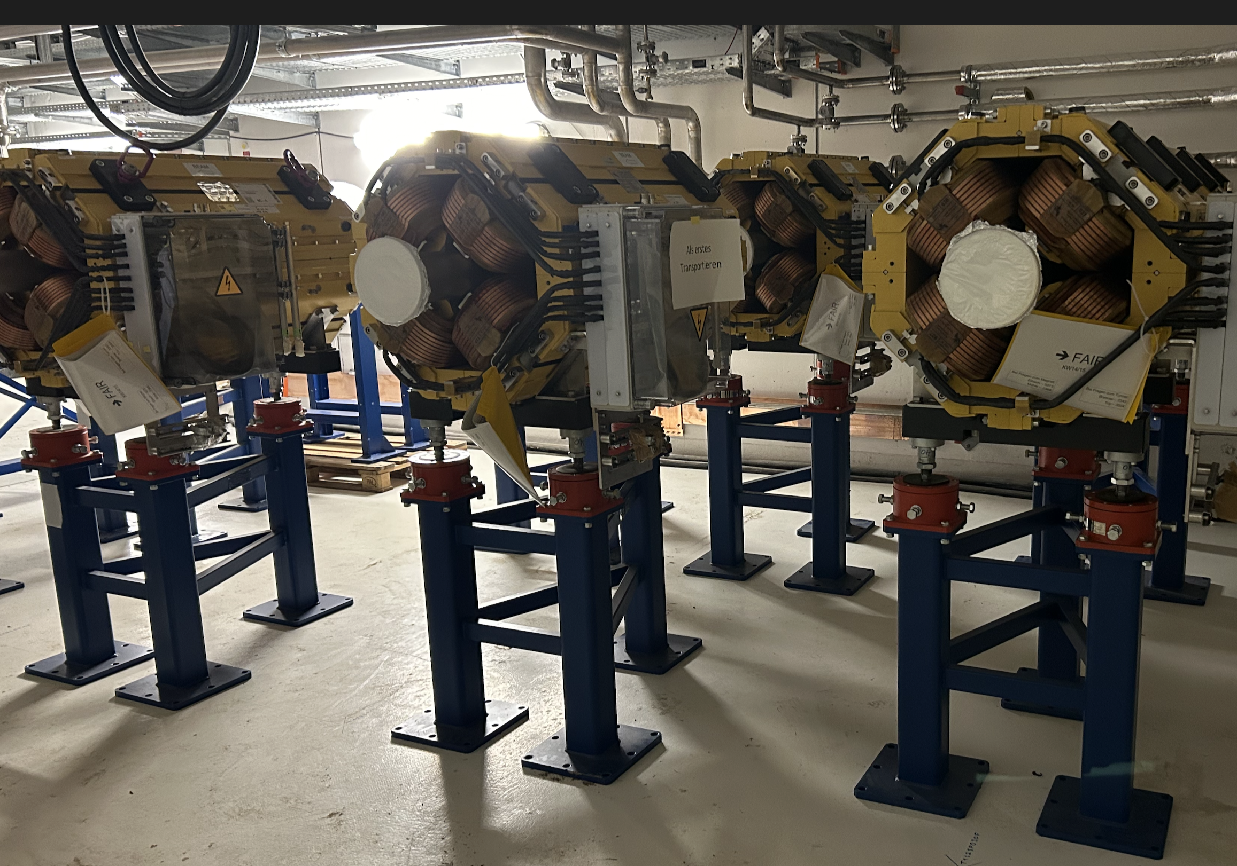
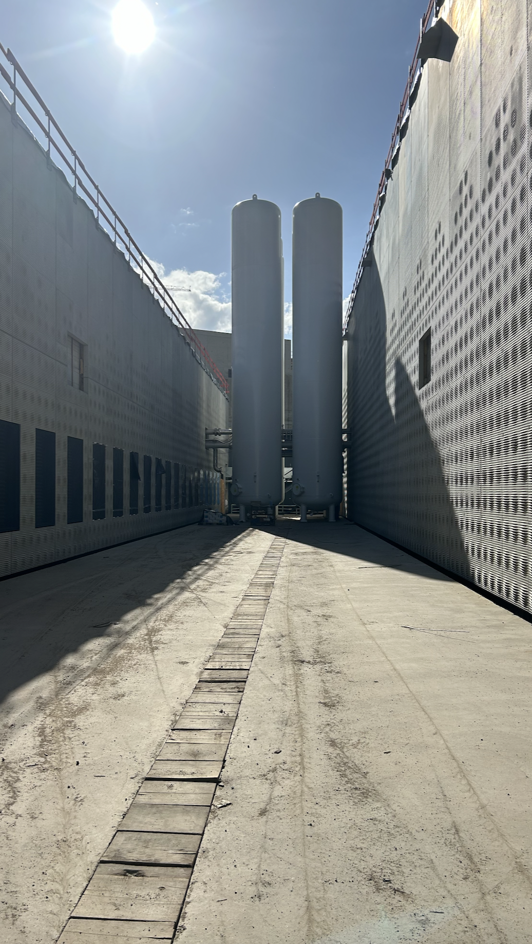
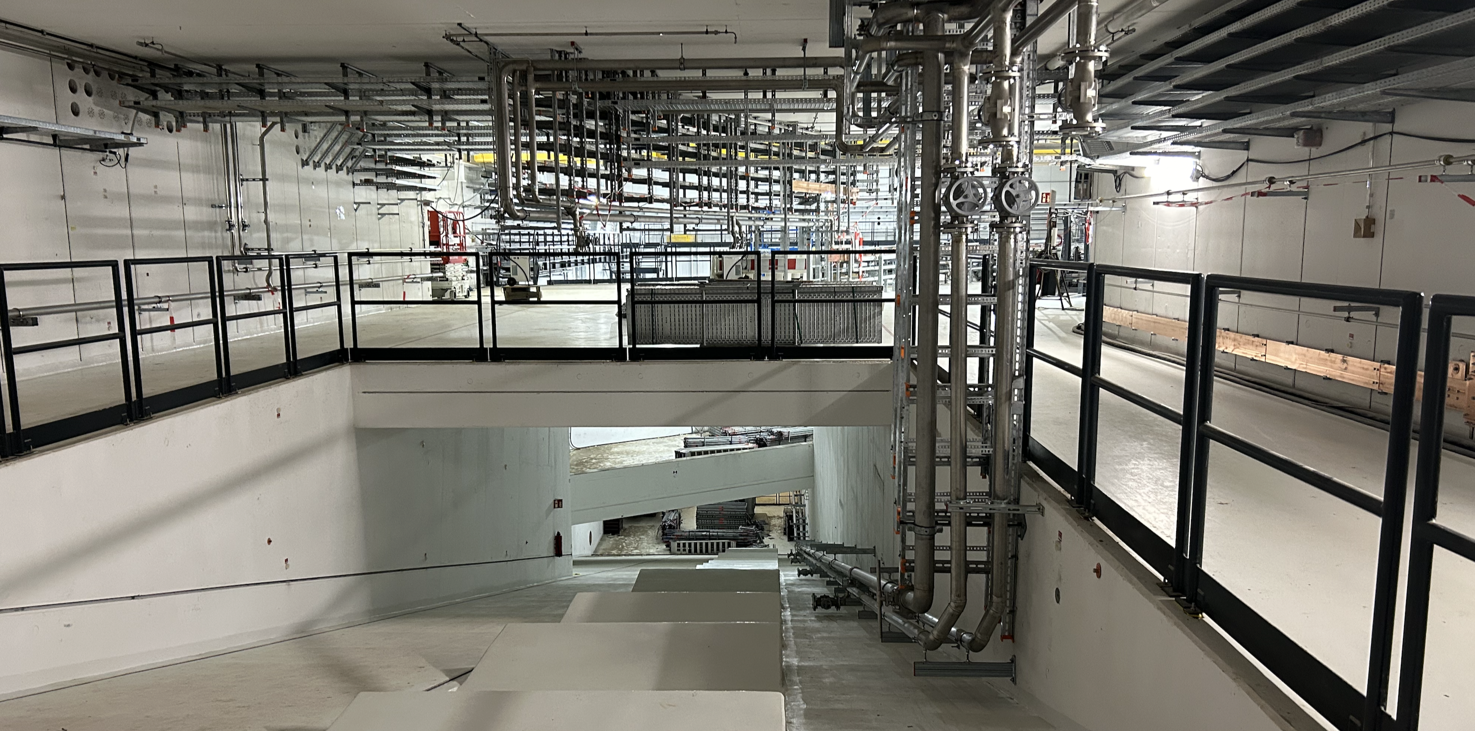
Main Topics on the Way to first Beam
Commissioning concept and schedule
TBI commissioning
Commissioning Cryo-Distribution
Hardware Commissioning & Test Automation HEBT & SFRS
Safety organization during commissioning
Commissioning FAIR Control Center
Re-Commissioning UNILAC with FAIR control system
1st beam event
Strategy for beam commissioning (HEBT & SFRS)
Operational organization, processes in the FAIR-CC
Coordination FAIR commissioning/GSI user operation
Commissioning targets
parameters for project completion

Slide 7
Dedicated Commissioning Workshop 11/2024
Format:
2-day workshop, to be organized annually with a scope and group
of participants appropriate to the current commissioning phase
Participants: (tech. Director + Head of Accelerator Division + 25 internal, 3 external)
Scope 2024:
  Commissioning FCC in 2026
  „FAIR First Beam Event“ towards T1S1 in 2026
  Start HW-Commissioning HEBT & SFRS for Early Science (up to 2027)
Goals and Deliverables of 2024 Edition
Agreement on steps towards full operation from FCC: to be done until 12/2025, teams, responsibilities
Plan on a first FAIR beam event from FCC: 2026 date, concept (“splash events”), roles, responsibilities
Alignment of the understanding of objectives and procedures in the preparation and implementation of FAIR commissioning up to first beam on target
Commitment to a common schedule.
Review of the processes and schedules developed to date. Identification of gaps and risks.

