Slide 1




Advancements in Accelerator Operation
Automation and AI integration
S. Appel, O. Boine-Frankenheim, V. Isensee, N. Madysa, A. Oeftiger
GSI, Darmstadt, Germany
V. Kain, C. Roderick, M. Schenk, F. Velotti
CERN, Geneva, Switzerland
CERN-GSI Collaboration Steering Committee 2024 26. April 2024

Slide 2
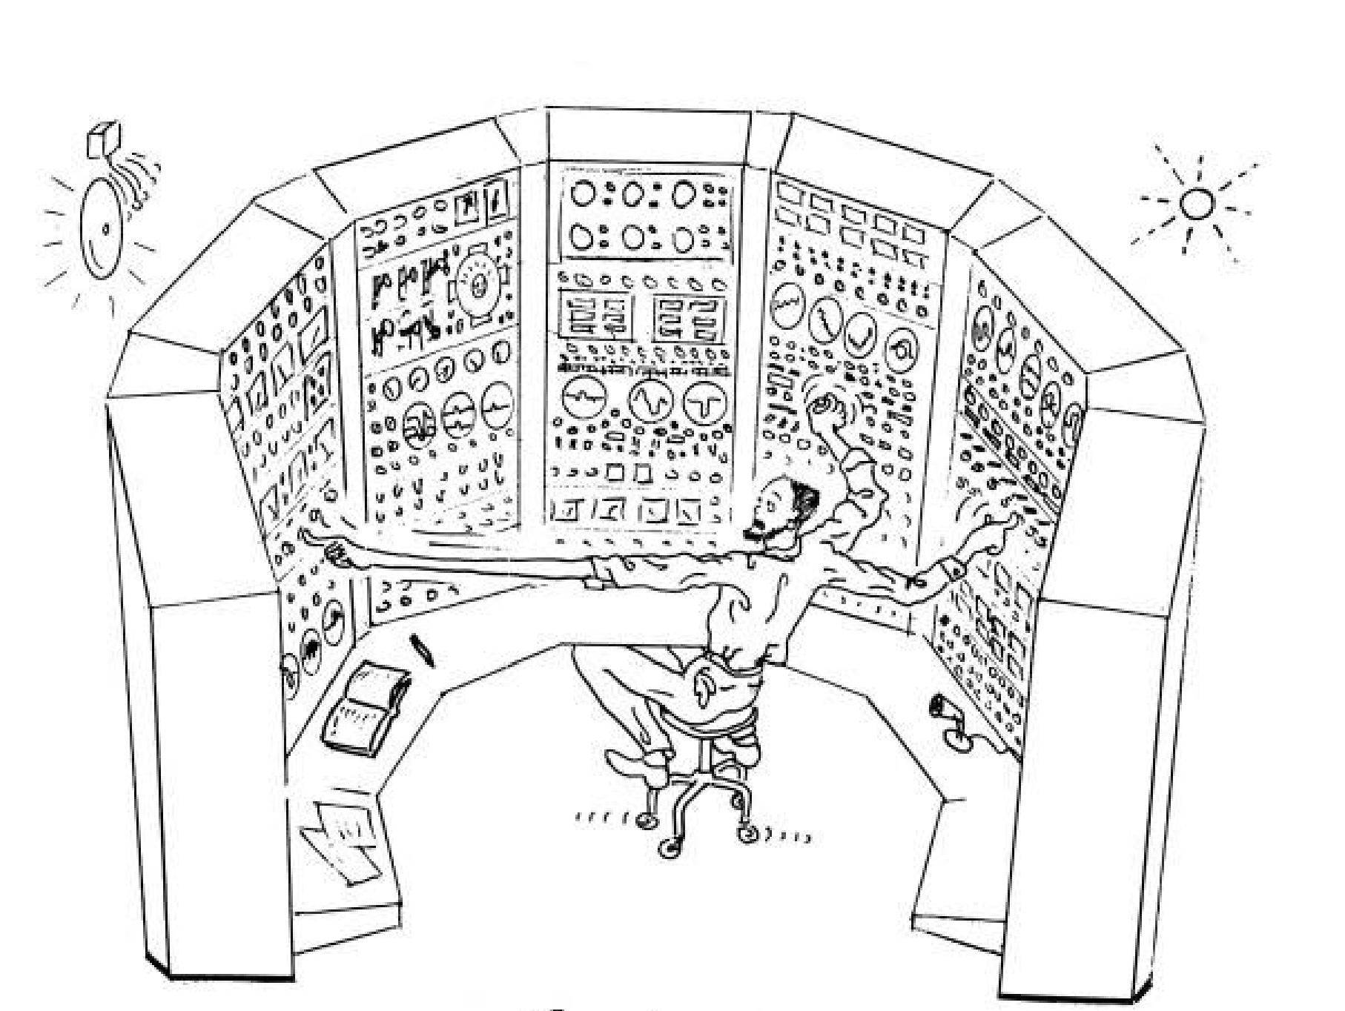
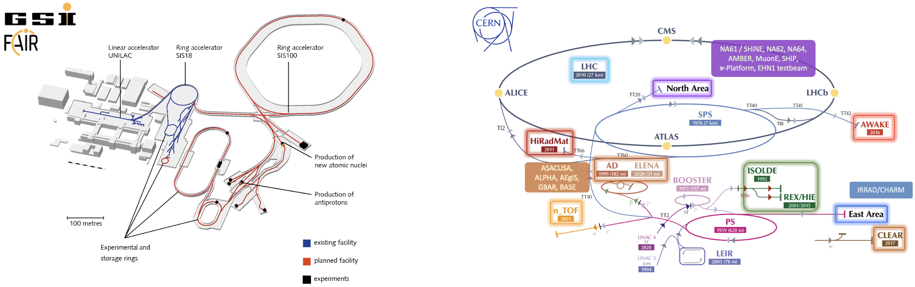
Beam operation challenges
Motivation
Machine availability & beam quality are essential to reach physics objectives
parameter drifts, fault recovery & prediction, testing, …
Broad spectrum of machine & beam types with multi-destination operation
beam commissioning & preparation, hysteresis & eddy-currents, scheduling, …
Exploit automation & technological advances (ML / AI) where possible

Slide 3
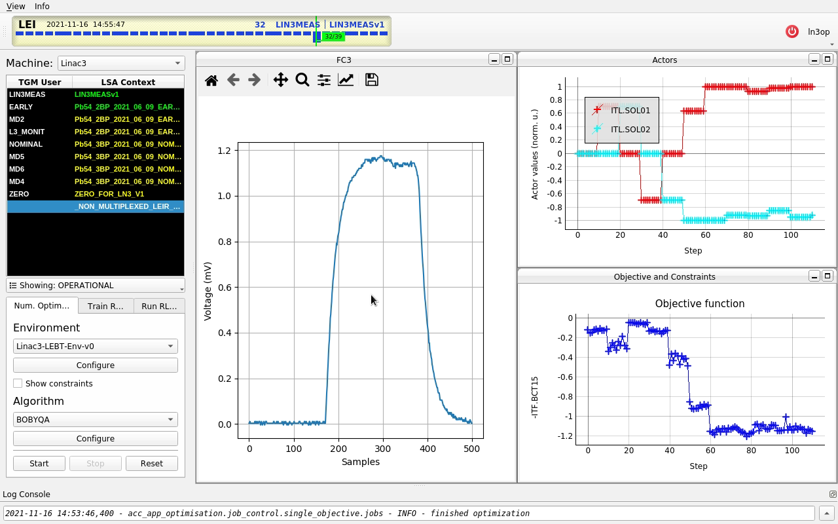
GeOFF Collaboration
History & scope
Focus on parameter optimization & drift compensation here
Address in generic & flexible manner framework
Generic Optimization Framework & Frontend (GeOFF)
  Python framework to unify different optimization approaches
  Classical Black-Box & Bayesian Optimization, Reinforcement Learning, Continuous Optimal Control
  Standardized interfaces, tools for developers & docs
  GUI application that wraps everything together
  “Facilitate implementation of parameter optimization task with primary focus on problem itself”
Initiated and originally developed at CERN
Since 2022 informal, yet effective collaboration with GSI
focus on AI, optimization algorithm & tools development, knowledge sharing
Example: CERN Linac3
Example: GSI SIS18

Slide 4
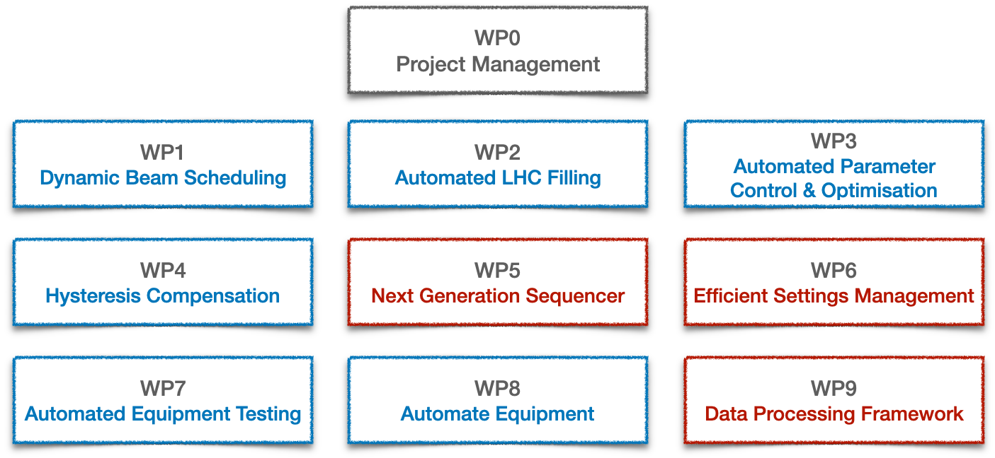
GeOFF: status & plans
… at CERN & GSI/FAIR
GSI/FAIR
EURO-LABS finances a scientific staff member for three years in the Accelerator Physics Group
Maintenance and co-development of GeOFF
Participation of several Master / PhD students from TU Darmstadt
CERN
GeOFF one of core products of DSB section in BE-CSS
  Two staff part time for maintenance, improvements, and evolution
Efficient Particle Accelerators project (EPA)
  Goal: explore and exploit automation & ML/AI systematically across complex
  Approved in autumn 2023 for a 5-year period
GeOFF

Slide 5

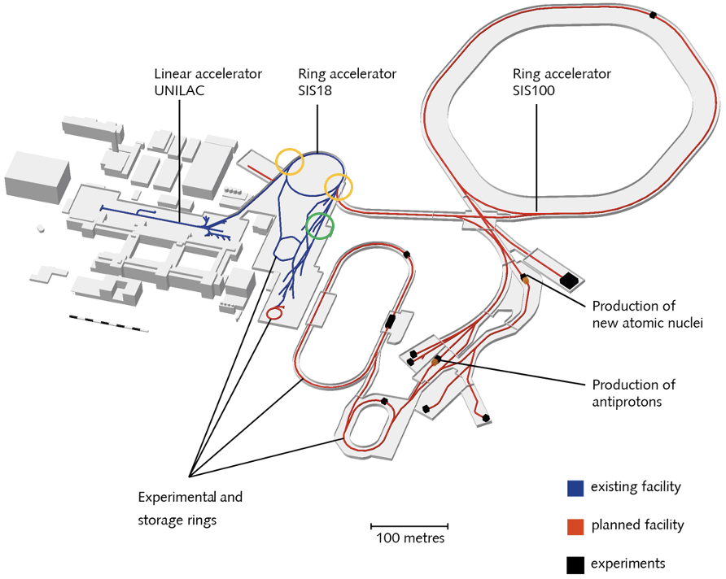
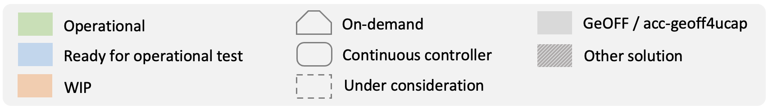
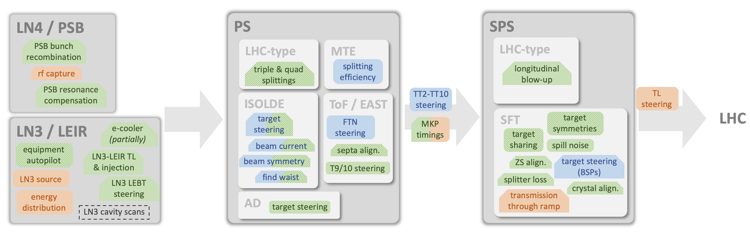
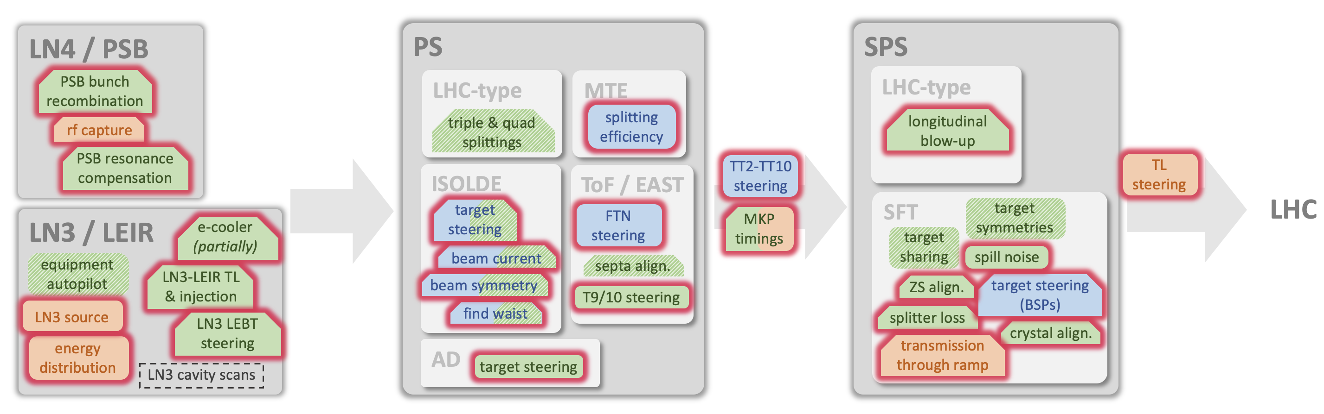
GeOFF: status & plans
… at CERN & GSI/FAIR
November 2023: successful optimization runs using GeOFF at TK, SIS18 & FRS
Introduction of Python Bridge to access LSA & FESA via Python
Investigation of safe deployment of Python applications in control room
topic for the FAIR Mini-MAC controls review
GeOFF since LS2 main optimization framework in use
beam commissioning & day-to-day operation, further auto-pilots under development
Trend from on-demand to continuous control
Ported GeOFF concept to server: UCAP* infrastructure with Python & GPU support is key
* Unified Controls Acquisition and Processing: data processing pipelines on server

Slide 6
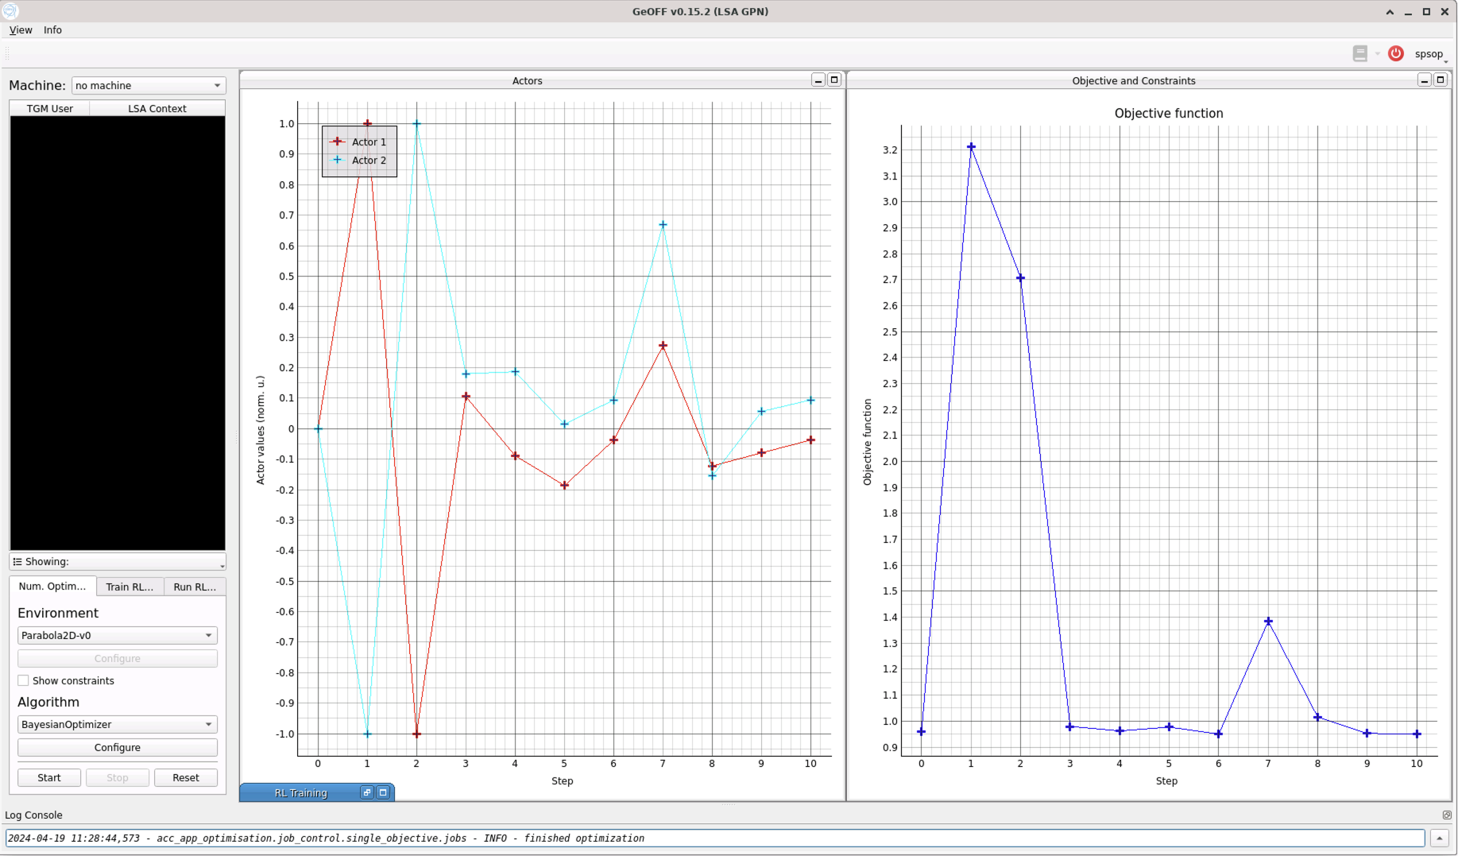
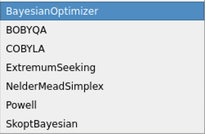
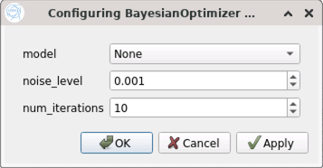
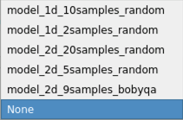
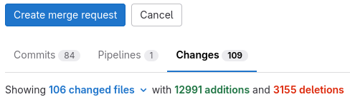
GeOFF: recent developments
Custom algorithms, upgrades, and maintenance
Features & algorithms
  Optimization tasks can have custom configurable algorithms
  e.g.: model-based controller with prior knowledge
  GSI: preparing proof-of-concept of Multi-Objective Bayesian Optimization (BO)
  CERN: resonance compensation with pre-conditioned BO ongoing tests at PSB
Upgrades and maintenance
  Repayment of technical debt by upgrading dependencies, adjusting all interfaces and fixing bugs
        GeOFF is heavily based on OpenAI Gym
        OpenAI ceased development:
        Farama Foundation took it over as Gymnasium
        Many backwards-incompatible changes since then
      Update documentation

Slide 7
GeOFF: next steps
Highest priority items and common interests
Improve Bayesian Optimization (BO) support
  CERN: Adaptive BO, BO with non-constant prior
  GSI: Multi-Objective BO
Improve integration of Reinforcement Learning
Evolution of GUI application
  CERN: distribute maintenance work between accelerators
  GSI: use outside CERN is EURO-LABS requirement

Slide 8
Conclusions
GSI-CERN collaboration on GeOFF has been highly successful and will continue
  Labs are in direct collaboration and through EU-projects
  CERN has a lot of experience in automation and AI
  GSI is making progress in the field, and offers valuable contributions in terms of algorithms
  e.g.: Multi-Objective Bayesian Optimization
  Both labs are facing similar control problems
  e.g.: resonance compensation, spill noise cancellation, drift compensation in general
GeOFF is a great example where GSI & CERN profit from common infrastructure and share expertise
Strengthening collaboration further is goal of the Artificial Intelligence for Accelerators,
User Communities and Associated Technologies project (ARTIFACT)*
*pending approval
Thank you

Slide 9
Backup

Slide 10
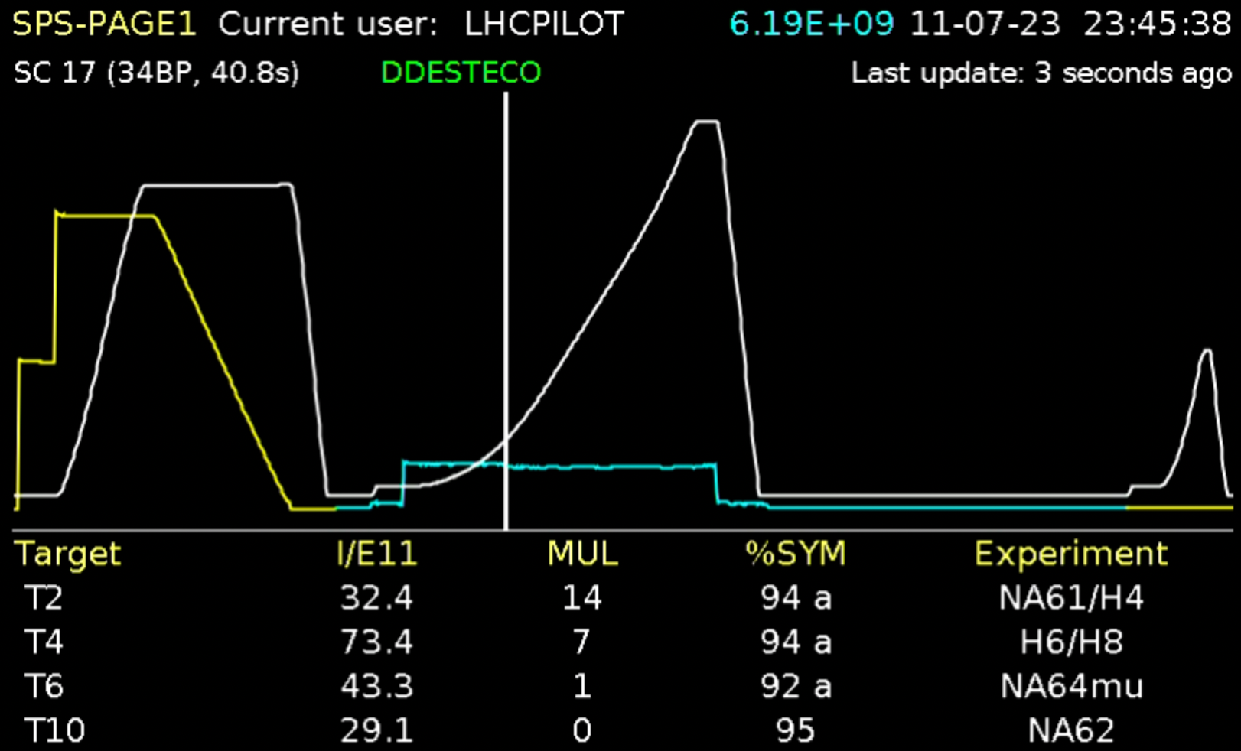
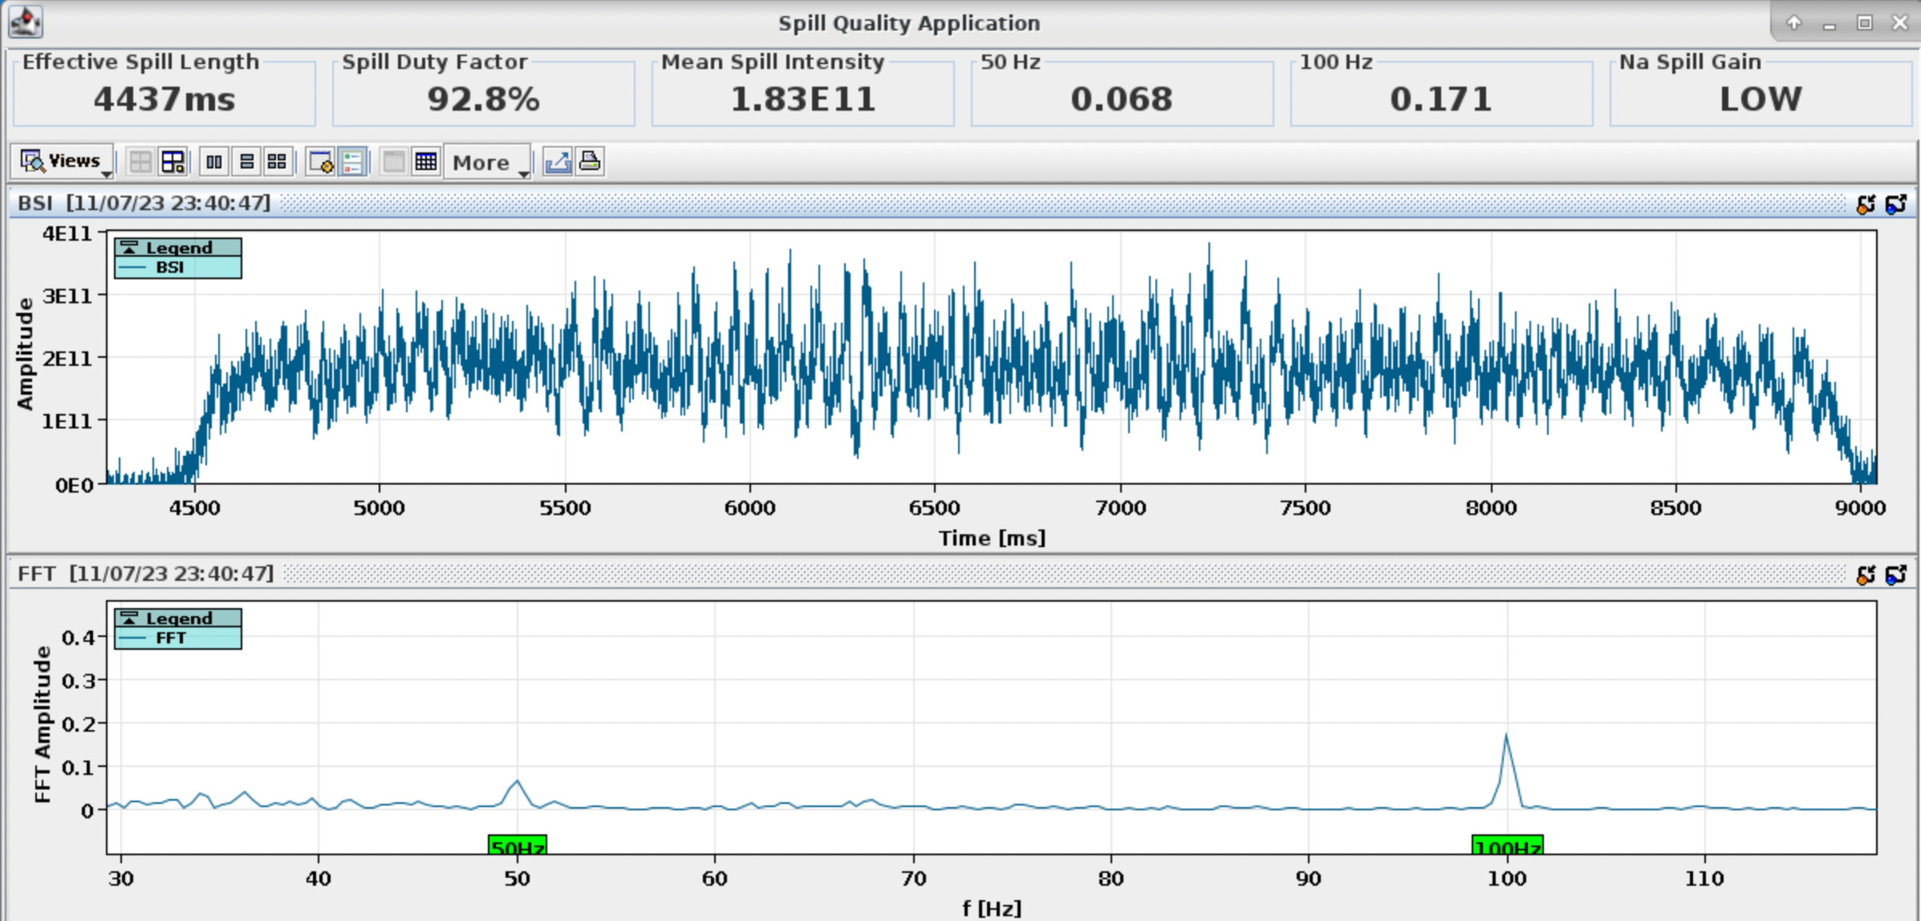
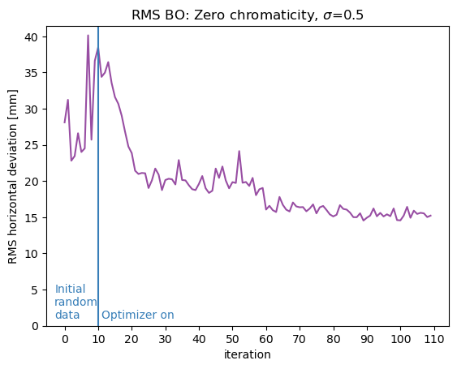
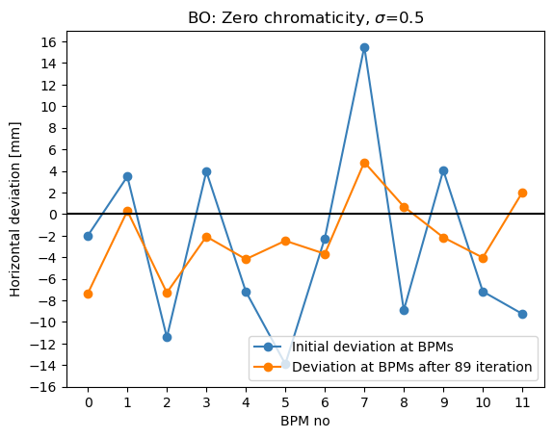
Next Steps in GeOFF
Highest Priority Items and Common Interests
Improve Bayesian Optimization support
  CERN: Adaptive Bayesian Control
  GSI: Multi-Objective Bayesian Optimization
Improve integration of RL
Evolution of GUI application
  CERN: distribute maintenance work between accelerators
  GSI: use outside CERN is EURO-LABS requirement
V. Isensee (TU Darmstadt), C. Caliari (TU Darmstadt), A. Oeftiger (GSI)

Slide 11

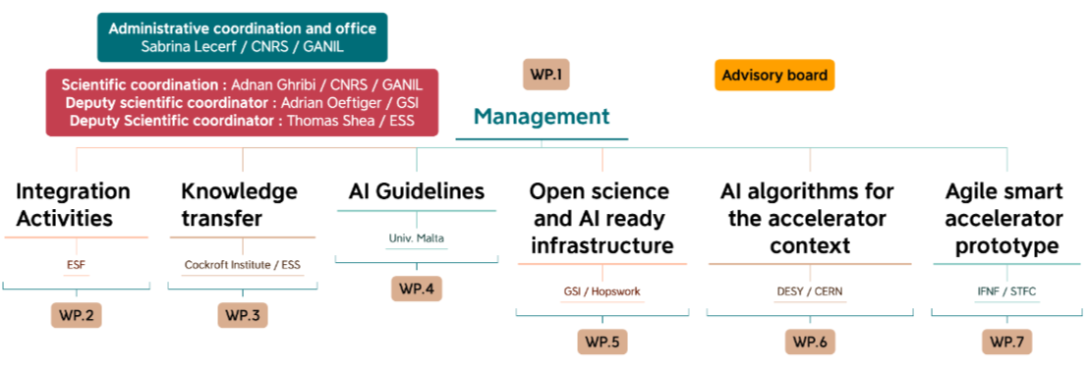
ARTIFACT
Artificial Intelligence for Accelerators, User Communities and Associated Technologies
15 research infrastructures
10 M€ overall
Time period: Jan 2025 – Dec 2028
WP5/WP6 offer more opportunity for collaboration between CERN and GSI
WP6 Deputy Leader:
V. Kain (CERN)
Subtask 6.4.4:
S. Appel (GSI)
WP5 Package Leader:
A. Mistry (GSI)

Slide 12


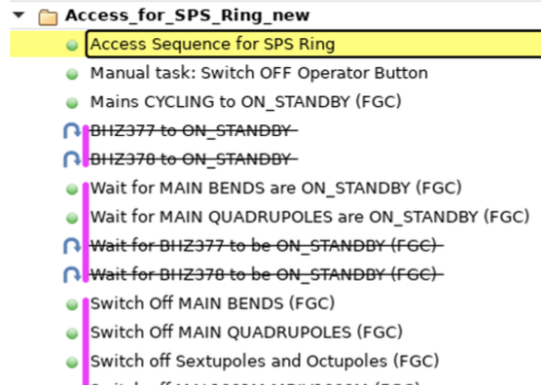
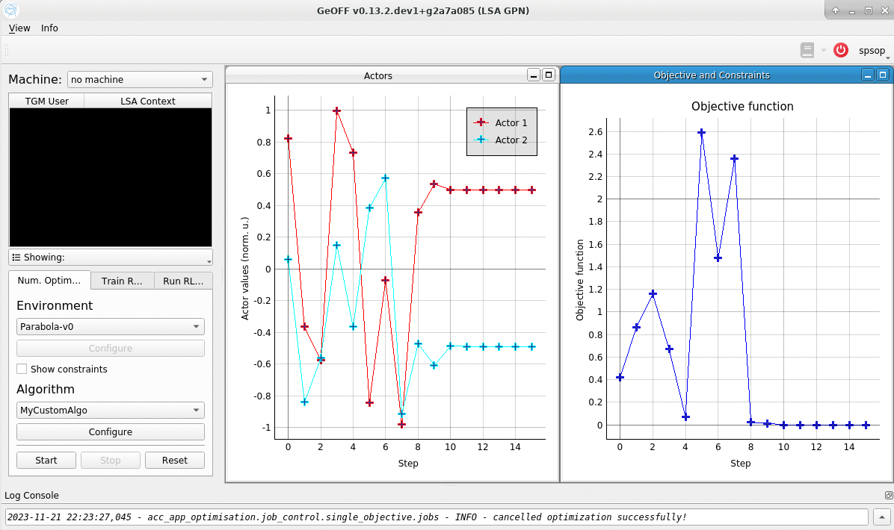
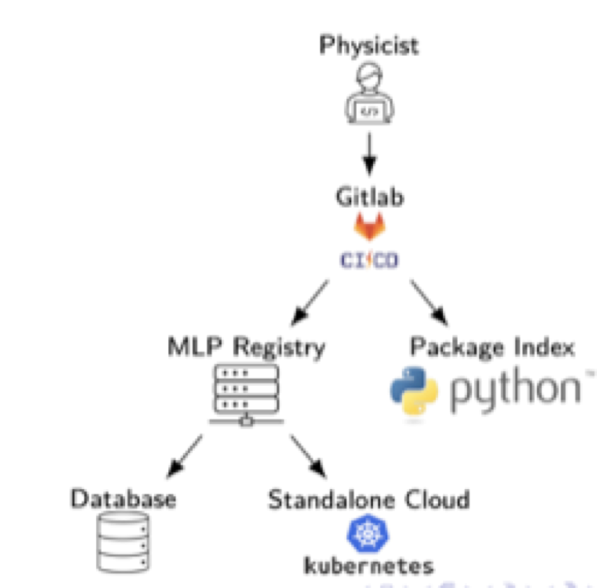
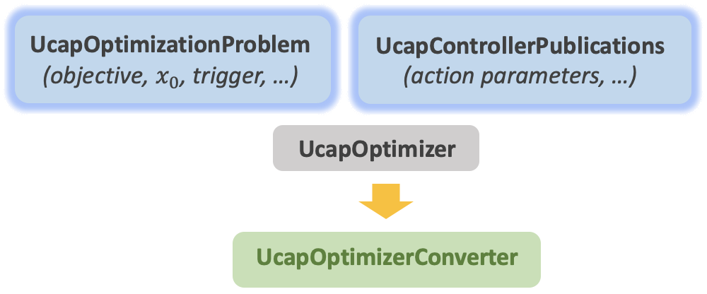
Infrastructure
Frameworks & building blocks
Acc-Py
“accelerating Python”
Full integration of Python
with control system
Online data acquisition, equipment access (set / get), app development, …
Python package index
Classical automation concepts
UCAP
Unified Controls Acquisition & Processing
Sequencer: programmatic execution of tasks
High-level parameter models
AccTesting
Virtual device service
Event-based, online data transformations
Further evolution with EPA
EPA: sequencer 2.0, equipment testing, efficient settings management
Enabling automation with AI / ML
Auto-pilots & optimizers
GeOFF
Generic Optimization Framework and Frontend
Machine Learning Platform
Deployment & inference of
(ML) models
        Facilitate implementation of control problems
        Exploit & expose features of control architecture
        Maintain uniformity across complex
Train, store & share ML models with VC
Language agnostic
Available in control room
acc-geoff4ucap
Framework for optimization & control via UCAP

Slide 13

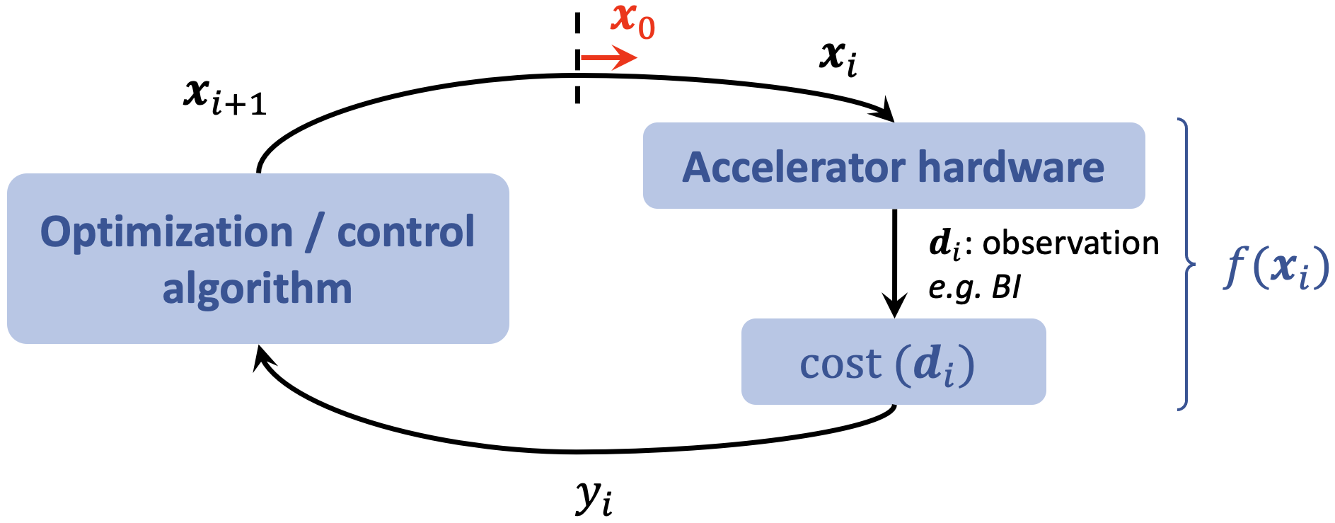
Infrastructure
UCAP & acc-geoff4ucap
UCAP
Framework & service to implement & run online data processing pipelines
acc-geoff4ucap
Use UCAP to implement the optimization / control loop on server
Acquire
Subscribe to data sources
Group data via EventBuilder
Transform
Process incoming data
Java or Python
GPU support
Publish
Publish results
Can be hardware “sets”
UCAP pipelines can be chained and built into hierarchies
Conceptually simple, and very powerful
Great infrastructure to run auto-pilots
continuous controllers or auto-launching optimizers

Slide 14
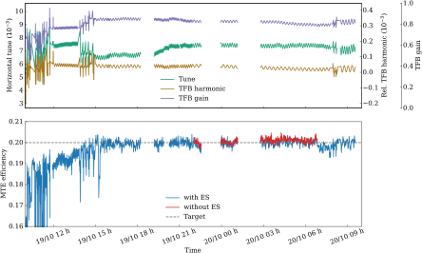
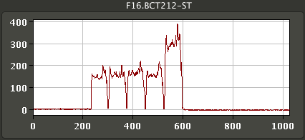

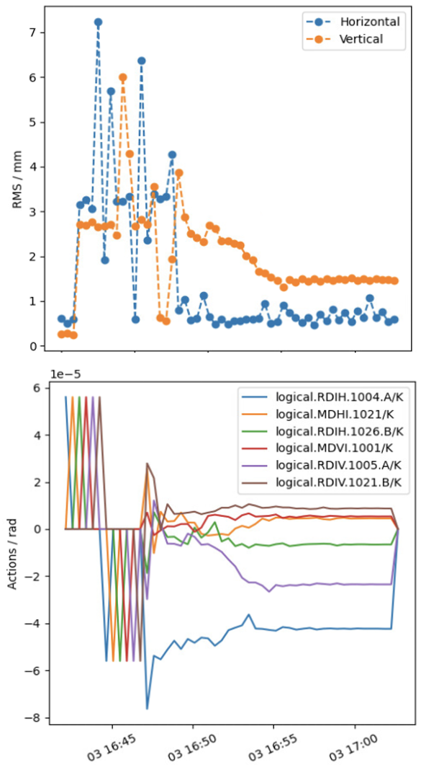
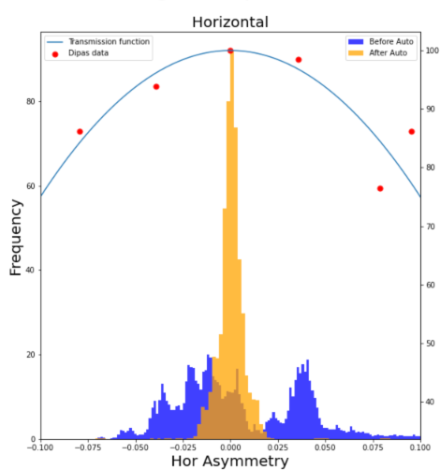
Status & results
Auto-pilots: a selection
PS Multi-Turn Extraction
  Automatic drift compensation
  Successfully tested and tuned in MDs with controllers on UCAP
  Hybrid agent: continuous controller interleaved with optimizer when far off
  Upcoming operational test
supercycle change
ES
BOBYQA
ES
A. Huschauer, M. Schenk, C. Uden
Trajectory steering framework
using acc-geoff4ucap
PS EAST: fixed target beam steering
  PID regulator on UCAP
  Simple & effective
  2024: integrate with acc-geoff4ucap
  Similar controller for TL towards AD
    Versatile objective
    Beam position, beam loss, …
    Generic settings & actors
    Various algorithms
    incl. Micado / SVD
    In 2024: PS2SPS, SPS2LHC
G. Trad, F. Velotti
J. McCarthy

Slide 15
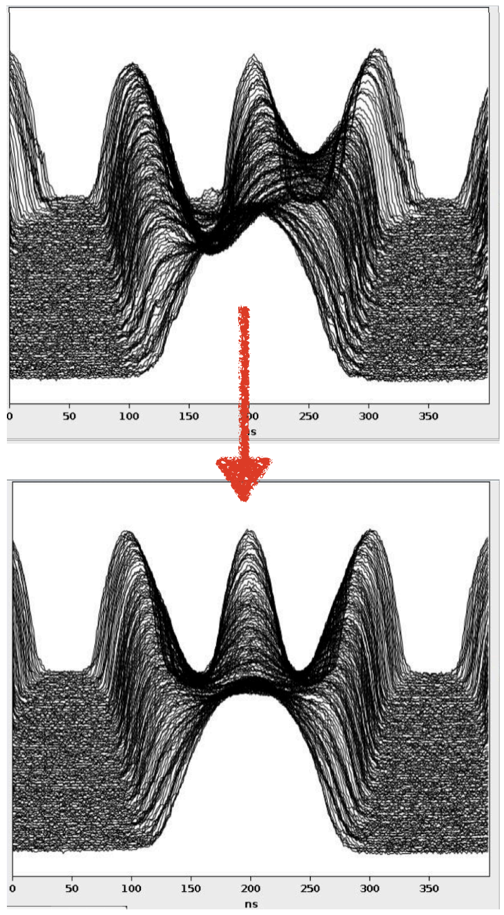
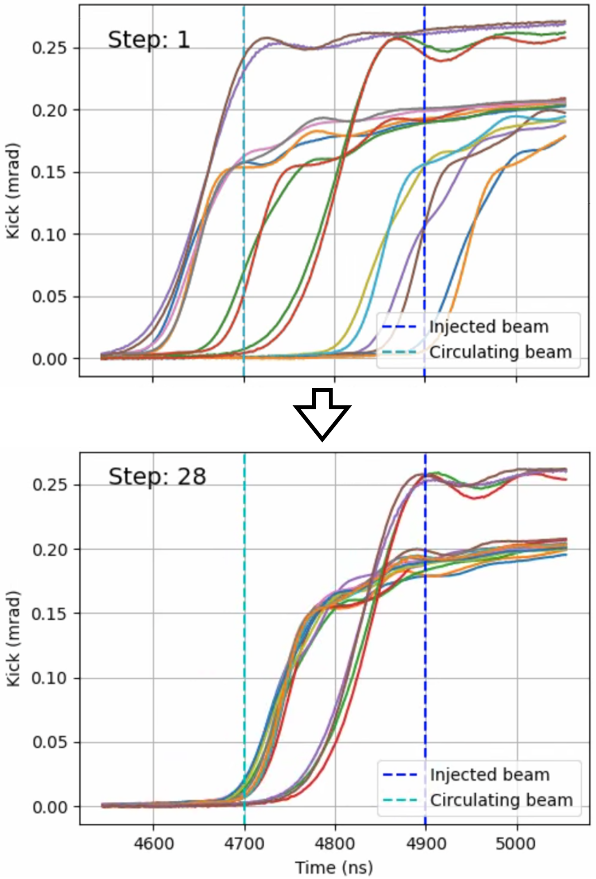
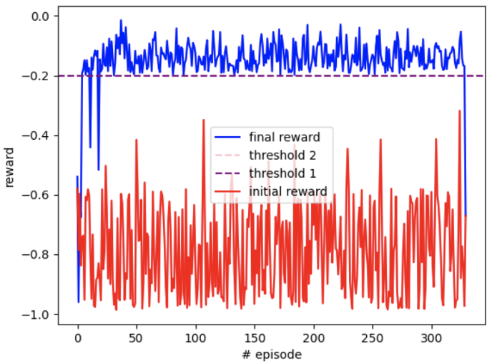
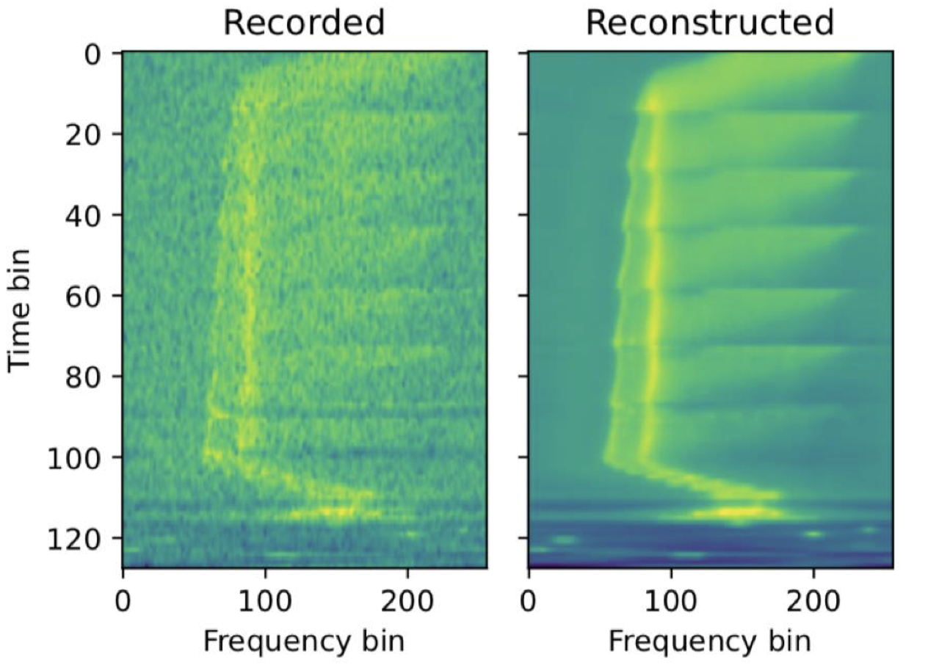
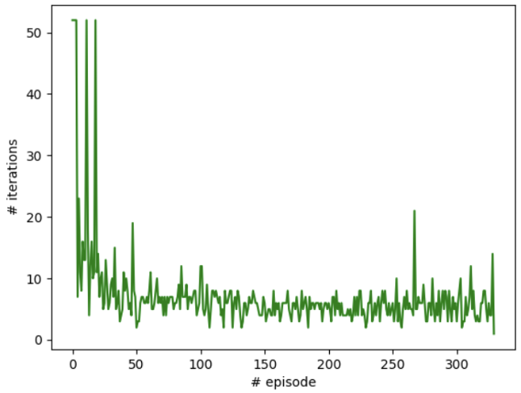
Status & results
Reinforcement learning: a selection
PS
PS to SPS
Correct RF phase & voltage for uniform bunch splitting (LHC beams)
Successful sim2real & fully operational
Multi-agent (SAC) & CNN for initial guess
Next: continuous controller (UCAP)
Adjust fine delays of SPS injection kicker
RL agent (PPO) trained on data-driven dynamics model
Ready for sim2real test
A. Lasheen, J. Wulff
M. Remta, F. Velotti
LINAC3 / LEIR
SPS
PhD project (B. Rodriguez):
control LINAC3 cavities for optimal injection efficiency into LEIR
RL state based on VAE-encoded Schottky spectra
Agent trained on data-driven dynamics model
Steer DC beams in TT20 TL using split-foil secondary emission monitors
Works well in simulations, with noise and varying emittances
Ready for sim2real test
V. Kain, N. Madysa
N. Bruchon, V. Kain

