Slide 1
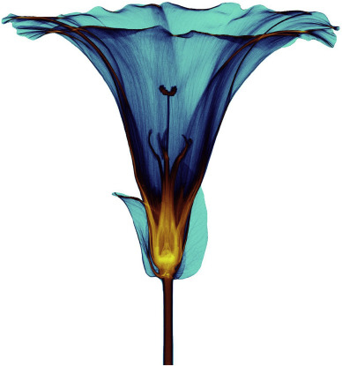
MEDIPIX
DETECTORS

Slide 2
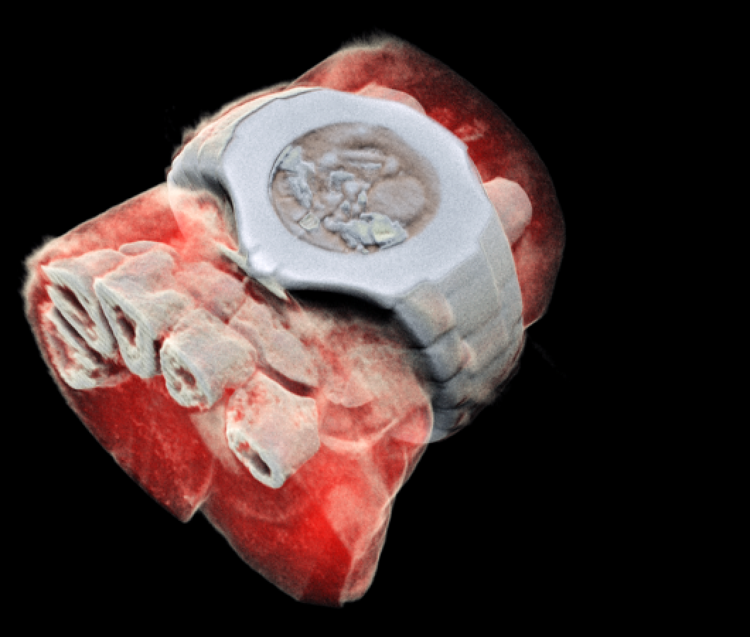
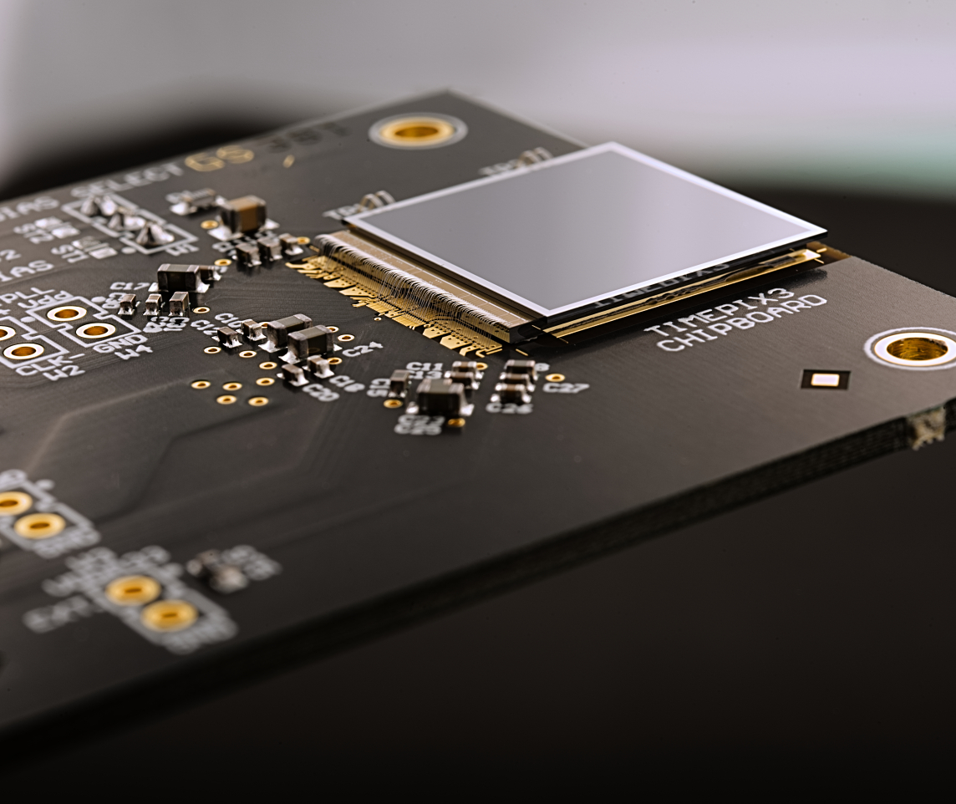
Outline
Interaction of radiation with matter
Photon counting detectors
Medical applications

Slide 3
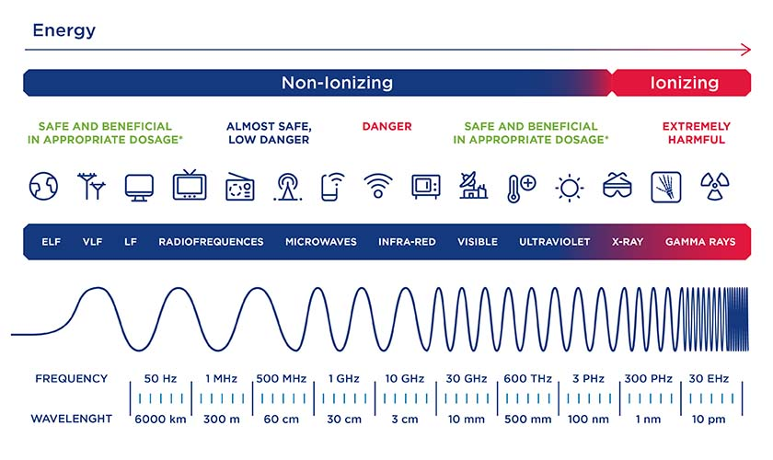
Introduction about Radiation
What is radiation?
Radiation is the emission or transmission of energy in the form of waves or particles through space or through a material medium.
Radiation is often categorized as either ionizing or non-ionizing
https://www.safework.nsw.gov.au/hazards-a-z/ionising-and-non-ionising-radiation

Slide 4
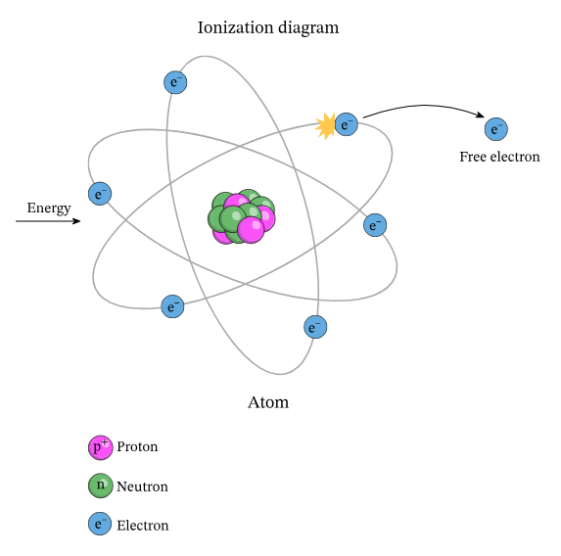
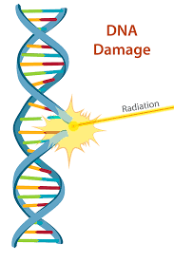
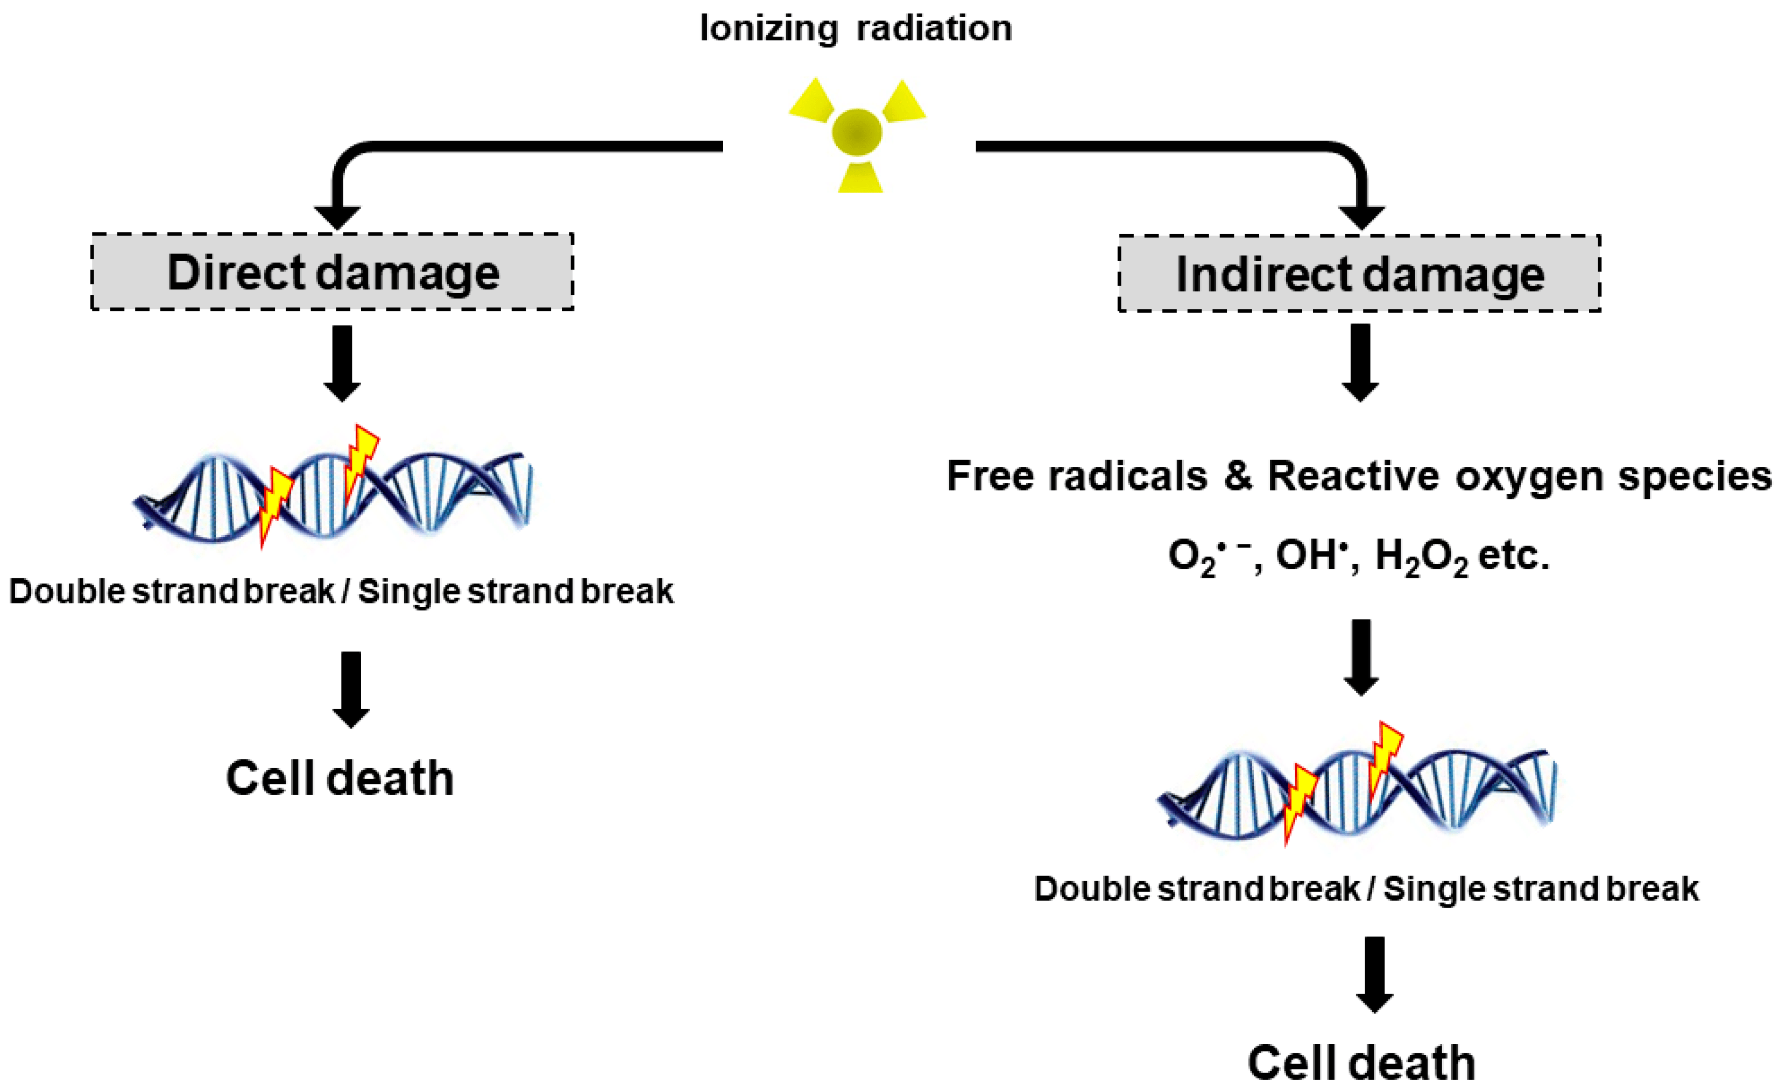
What is Ionization?
Ionization is the ejection of one or more electrons from an atom or molecule to produce a fragment with a net positive charge (positive ion)
Effects of Ionization to the body!
https://www.nagwa.com/en/explainers/840185315807/
https://www.cnsc-ccsn.gc.ca/eng/resources/radiation/radiation-health-effects/
https://www.mdpi.com/1422-0067/18/12/2749

Slide 5

Photon counting detectors

Slide 6
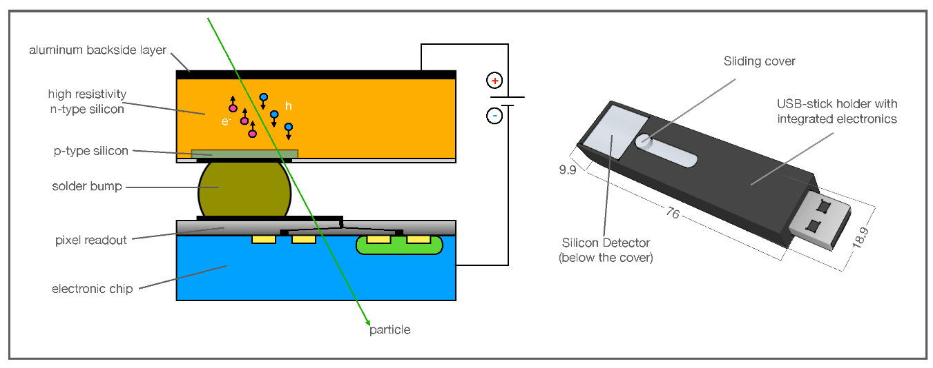
Minipix-EDU: a photon counting detector. How does it work?
Cross section view of the Minipix Edu chip.
Rizzo, A.; Cardellini, F.; Poggi, C.; Borra, E.; Ciciani, L.; Narici, L.; Sperandio, L.; Vilardi, I. Novel Algorithm for Radon Real-Time Measurements with a Pixelated Detector. Sensors 2022, 22, 516. https://doi.org/10.3390/s22020516

Slide 7
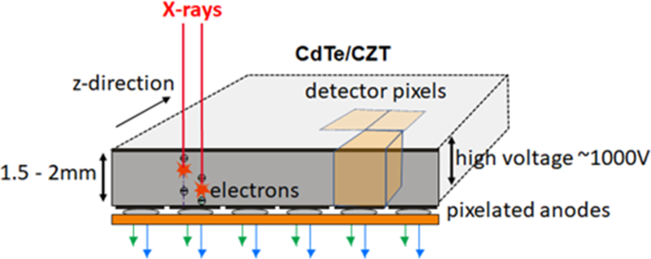
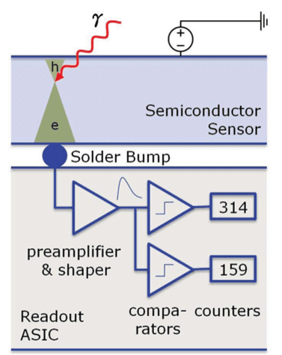
Sensor in hybrid pixelated detectors
When ionising radiation strikes the detector its energy is deposited in the sensor material (Silicon or Cadmium (Zinc) Telluride).
This is then converted into an electrical signal and amplified.
https://link.springer.com/article/10.1007/s00330-023-09545-9
https://ebrary.net/135261/engineering/introduction

Slide 8
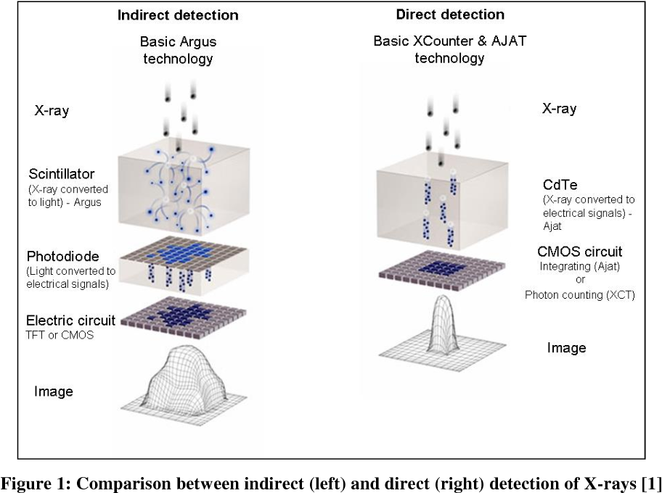
Comparison between indirect and direct detection
https://www.semanticscholar.org/paper/Photon-counting-and-energy-discriminating-x-ray-and-Schumacher-Zscherpel/7c7035c31b1f6fb3cdbddd6b01e945e6f5dc4e9c

Slide 9
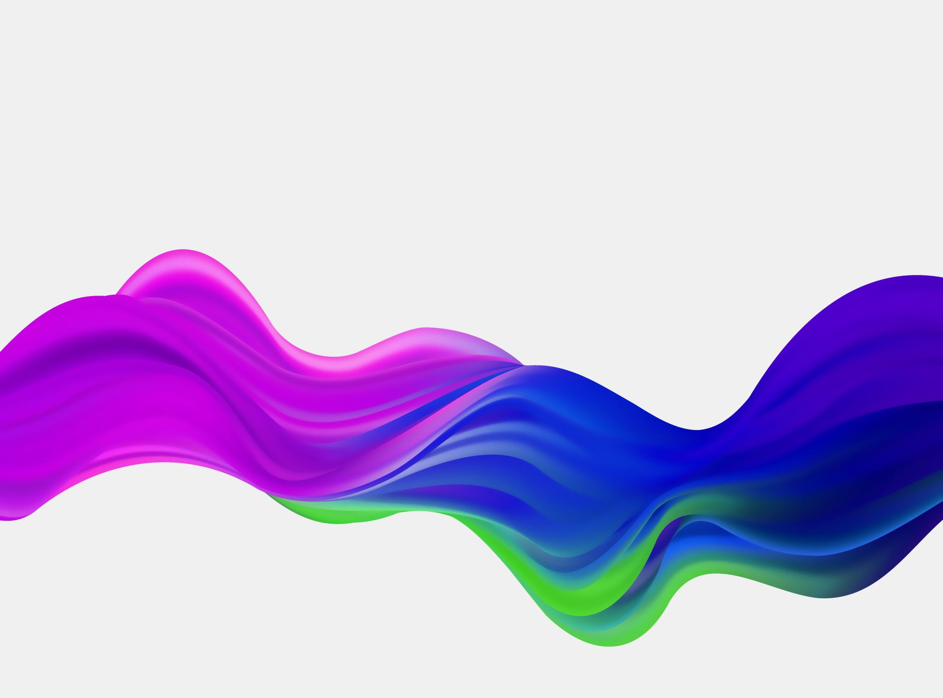
Medical applications of photon counting detectors

Slide 10
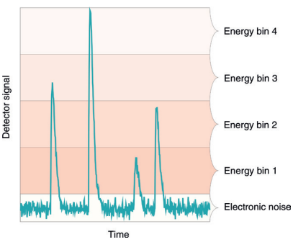
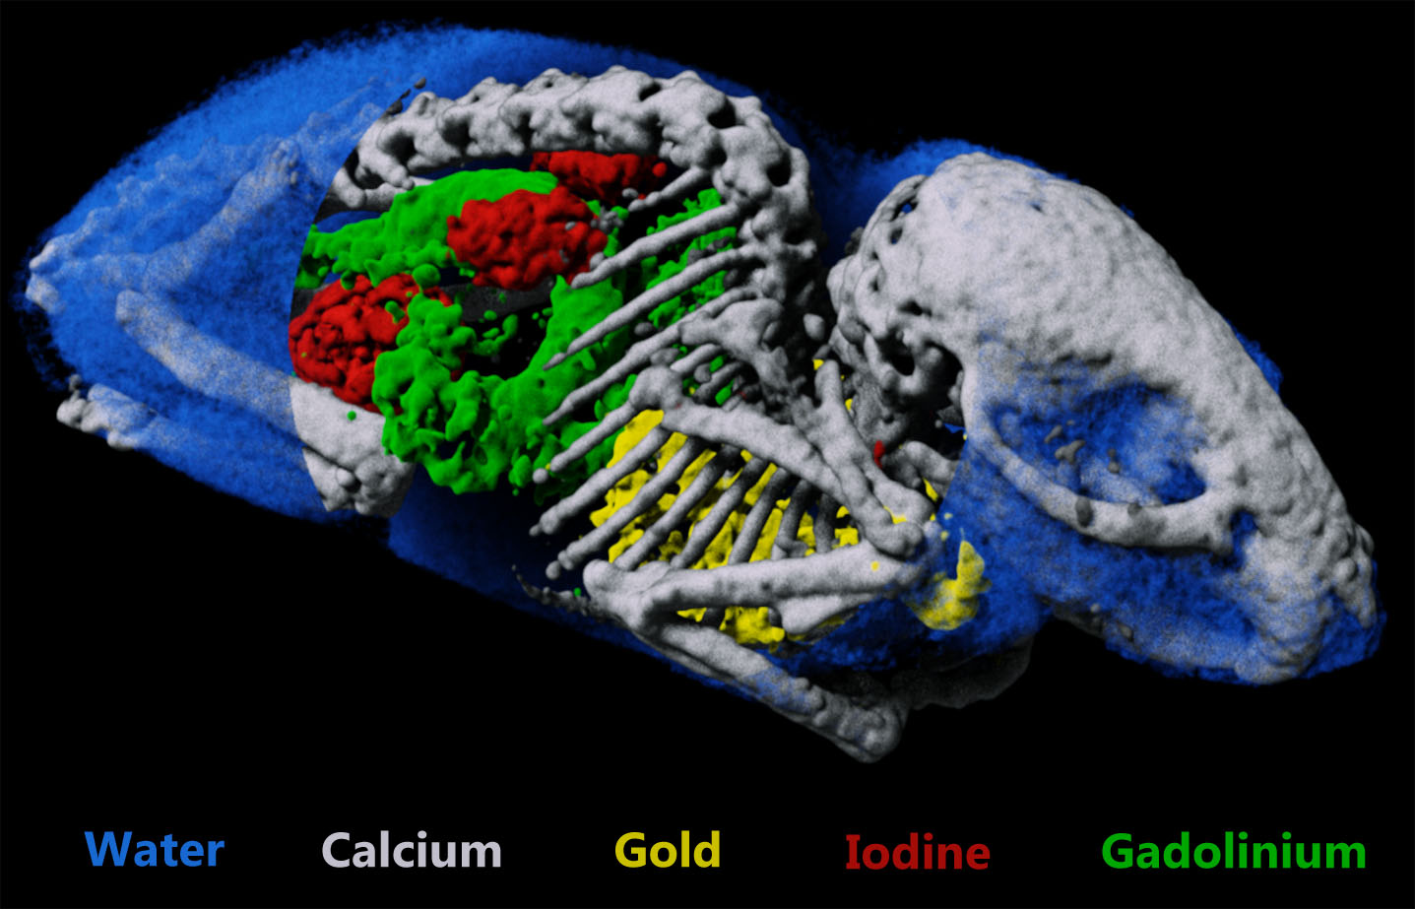
Colour X-ray imaging
The PCD is able to discriminate the energy of each incident x-ray photon and then assign a colour to it.
https://md-innovationtech.com/products/spectral-ct-scanner/mars-spectral-ct-scanner-research/mars-spectral-ct-scanner-applications/

Slide 11
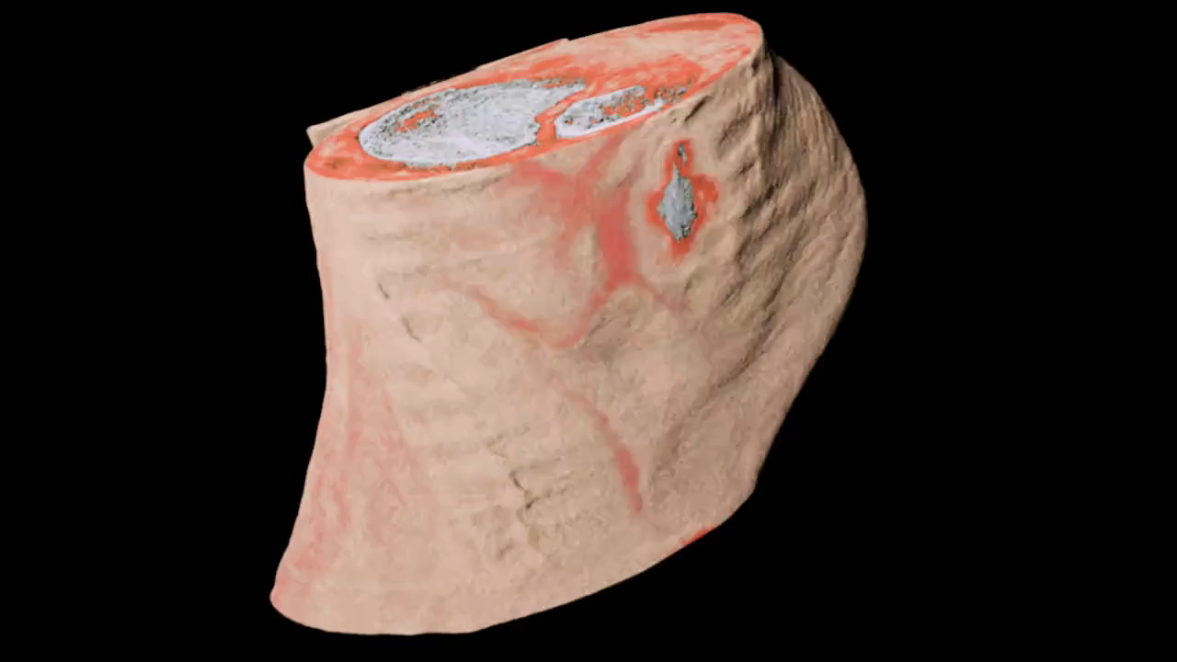
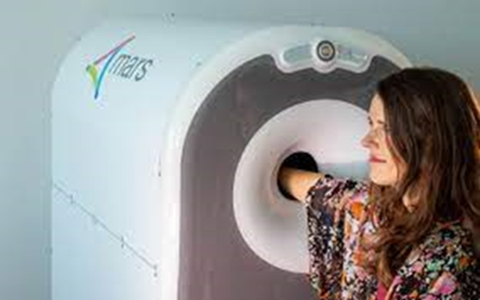
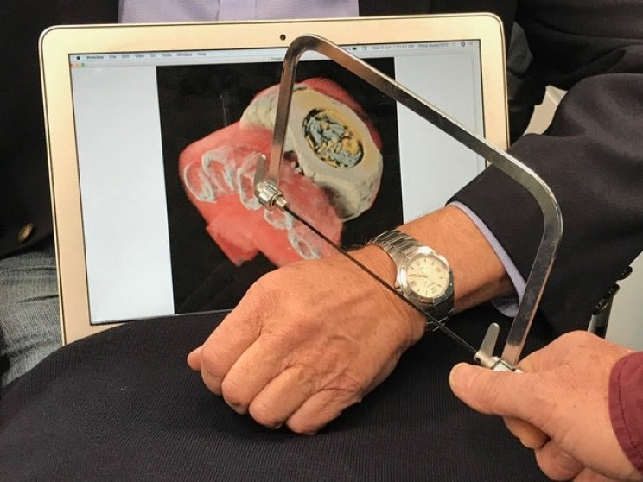
Spectroscopic (Color) X-ray imaging
Notes:
MARS Bioimaging’s 3D colour X-ray wrist scanner is awaiting approval to start clinical trials at Lausanne University Hospital (CHUV, Switzerland) and is the subject of ongoing clinical trials within the Pacific Radiology Group, New Zealand's largest radiology service provider. CERN and the New Zealand company MARS Bioimaging teamed up in 2008 to develop this 3D colour X-ray scanner based on the Medipix3 technology.
The X-ray beams used in medical equipment contain a wide spectrum of X-ray energies, which can be thought of as different X-ray colours. In conventional detectors, the image taken is based on the total X-ray energy absorbed by each pixel, forming a kind of black and white image. When spectroscopic detectors are used, the images also contain the “colours” of the incoming X-rays, providing better, clearer images at optimised doses with significant benefits when diagnosing disease. In some circumstances, MRI (magnetic resonance imaging) may even become superfluous. In other cases, where metal contrast agents attached to bio-markers are injected into the body, expensive PET–CT (positron emission tomography – computed tomography) scans, may be avoided.

Slide 12
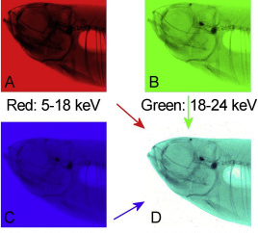
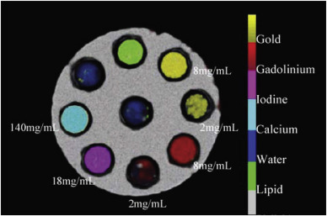
Coloured X-ray imaging using the head of a small fish
https://www.sciencedirect.com/science/article/pii/S1350448719300599
Notes:
The swim bladder is white as the air around the fish because the photons of all energy ranges are almost not absorbed here. The low energy photons are not able to penetrate the tissue and the remaining photons of the medium and high energy range appear cyan colored. The bones are blue-black colored because only the high energy photons are able to penetrate them.

Slide 13
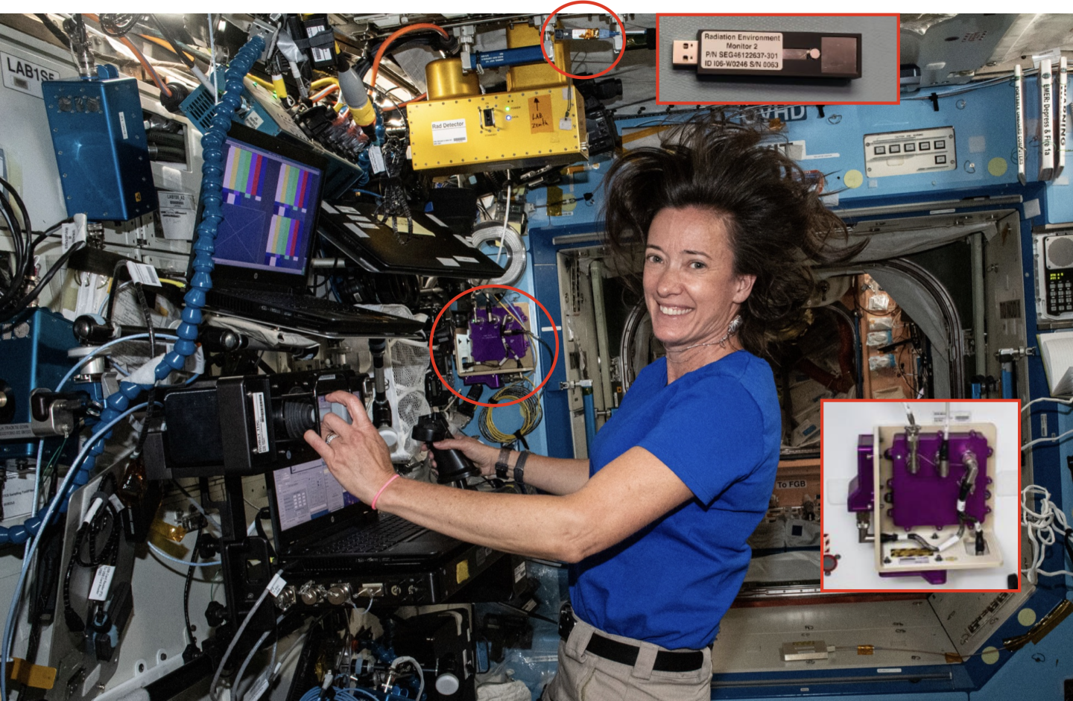
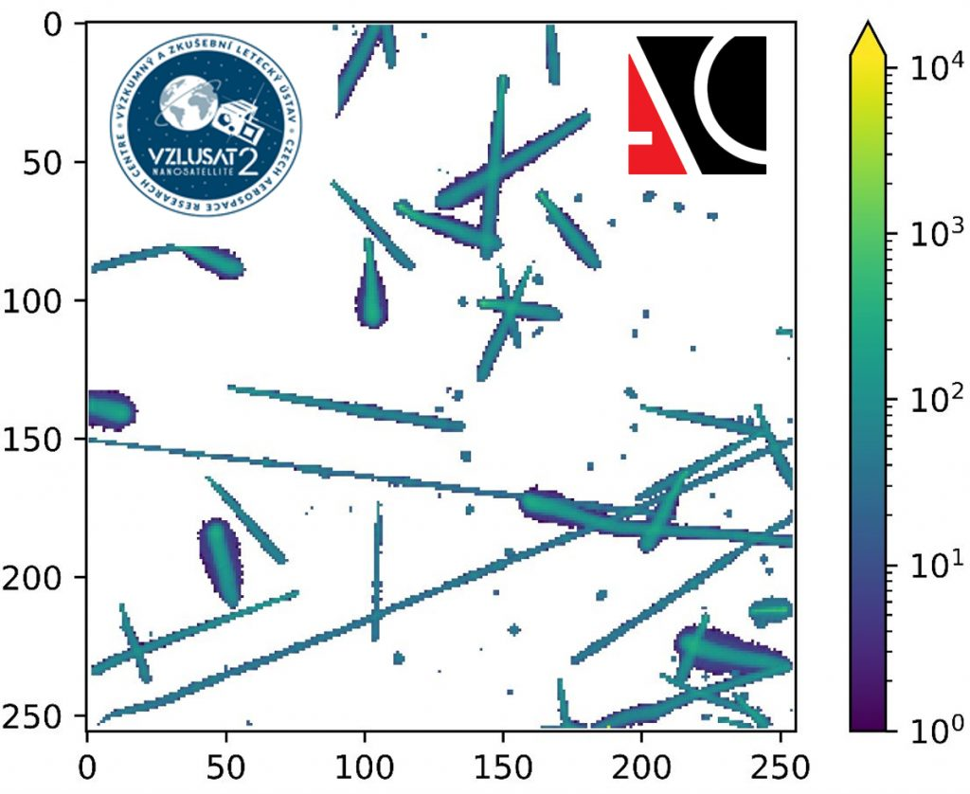
The detector in SPACE!
NASA astronaut Megan McArthur in the International Space Station - along with the HERA detector (purple box in the back) (Image: NASA)

Slide 14
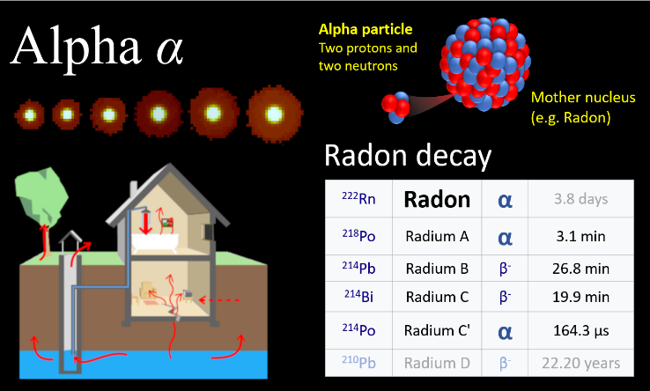
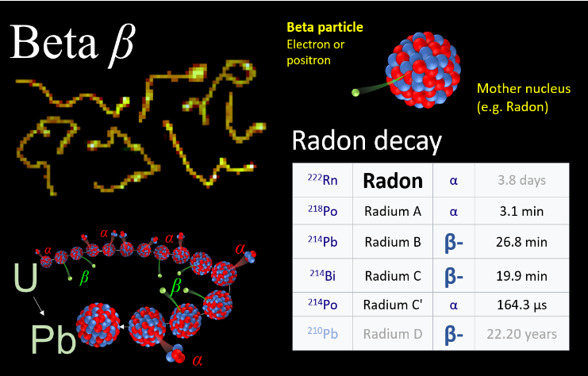
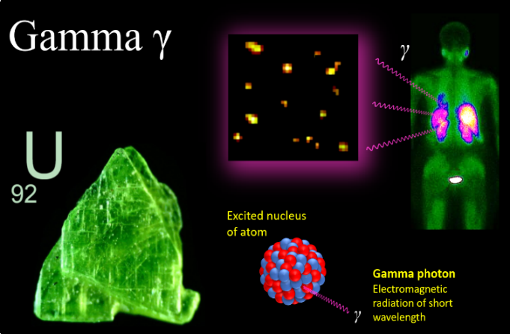
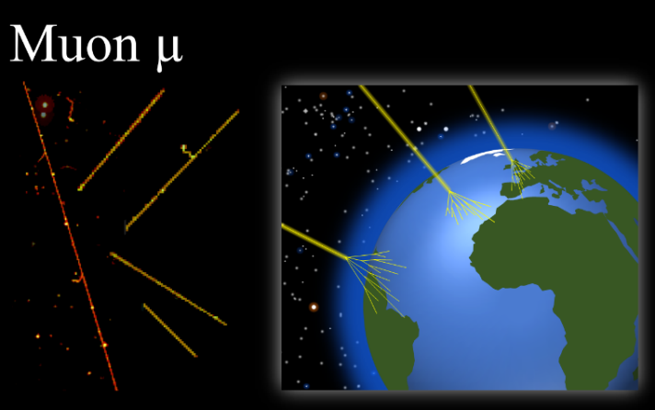
Different types of particles!
Notes:
https://www.linkedin.com/pulse/fascinating-patterns-drawn-radiation-particle-physics-jan-jakubek/

Slide 15
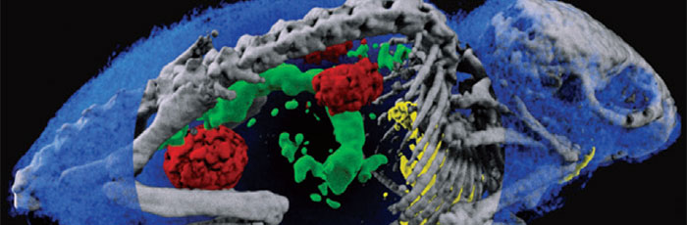
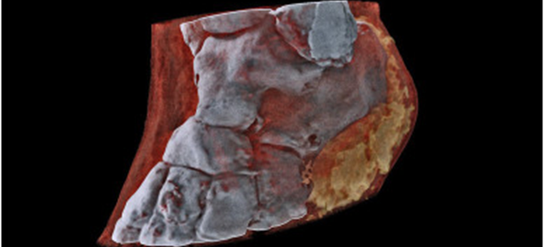
Thank you

Slide 16
USEFUL LINKS
• https://medipix.web.cern.ch/home
• ADMIRA PROJECT: https://serviparticules.ub.edu/en/projects/admira-project
• Really interesting article about educational use of Timepix detectors: https://cds.cern.ch/record/2801427/files/document.pdf
• Knowledge transfer success story: https://knowledgetransfer.web.cern.ch/success-stories/medipix-chips-and-collaborations-medical-imaging-space-dosimetry
• Minipix edu from ADVACAM: https://advacam.com/camera/minipix-edu/
• SESTRA KIT and book with experiments: http://www.utef.cvut.cz/cms_files/original/cms_data/00099/SESTRA_flyer_-_2022-06-02_-_EPS_forum_Paris.docx_compressed.pdf

Slide 17
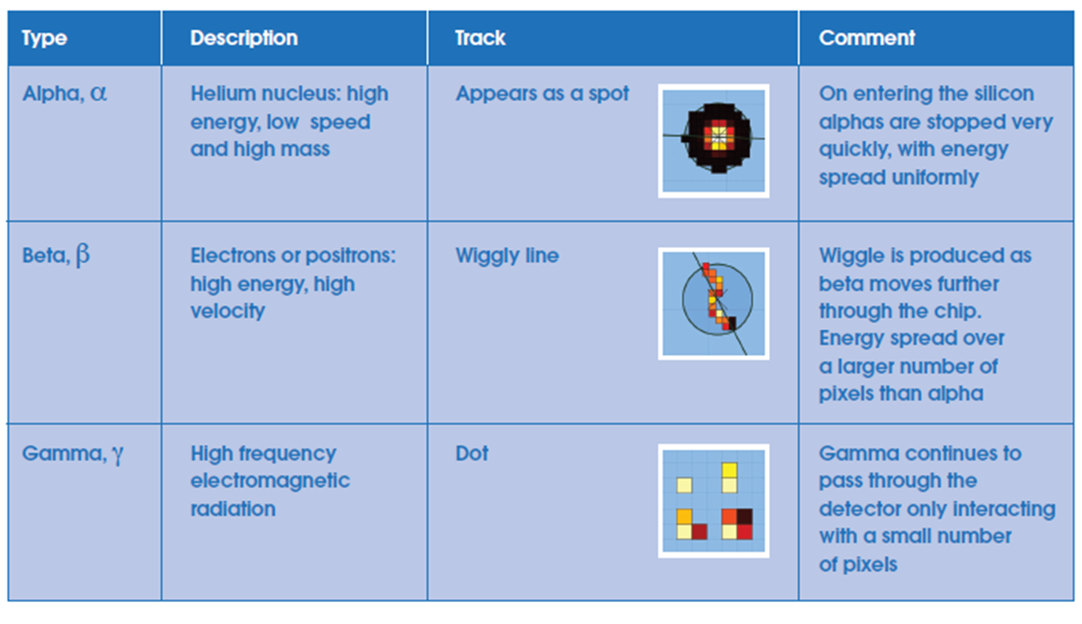
Application: school projects Particle identification

Slide 18
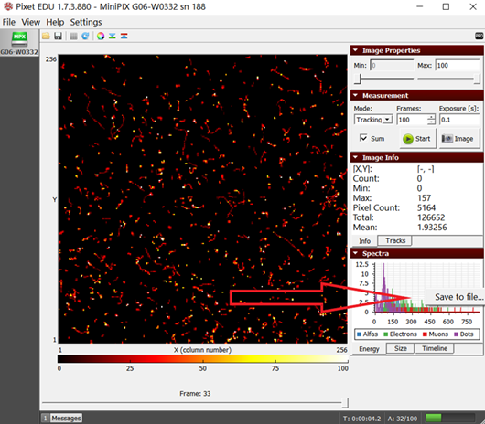
Data analysis with Pixet Basic software
https://hawkeyesi.com/experiments/introduction-to-pixet-basic-software/

Slide 19
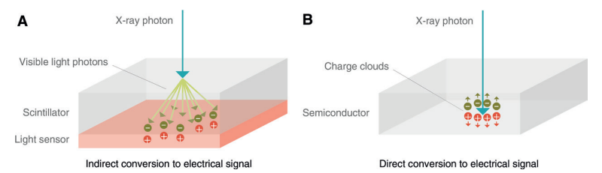
Photon counting detectors
1. Direct conversion
Conventional energy-integrating detector
Photon-counting detector
https://doi.org/10.1148/radiol.2018172656
Notes:
The spectroscopic information enables various advantages:-The image contrast and signal-to-noise-ratio can be enhanced
-A reduction of radiation dose is possible while preserving the same image quality
-A more accurate dose calculation, derived from the actual energy spectrum, is possible
-Identification and quantification of multiple contrast agents with just one examination is feasible
-A reduction of beam hardening artifacts, including lowering of artifacts caused by metal parts, is obtainable
-A detailed material identification can be achieved

Slide 20
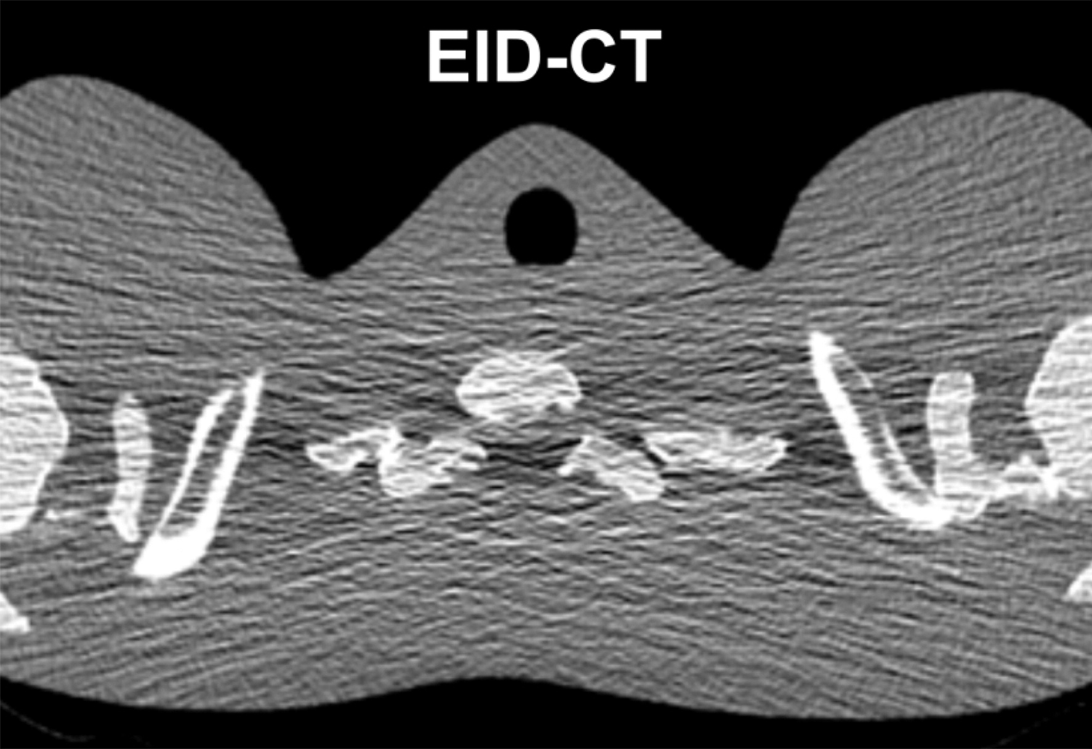
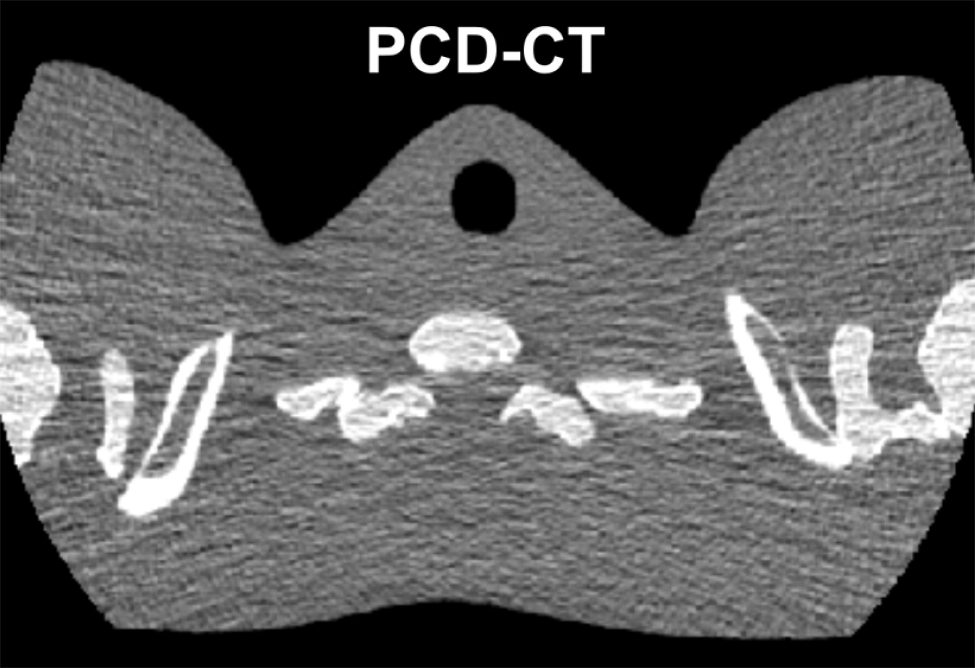
Medical applications: Computed tomography
“Conventional” Energy Integrating Detectors (EID)
Photon Counting Detectors (PCD)
Give less noisy image!
The shoulder section of a thorax phantom reconstructed from data acquired with EID CT (a) and with PCD CT (b) using the same x-ray tube potential and radiation dose
Notes:
common x-ray tube produces a broad spectrum of x-rays, and the conventional x-ray CT detector is a photon-integrating sensor whose output is proportional to the energy fluence over the entire x-ray spectrum. Given that x-ray attenuation is dependent both on the object material and photon energy, a conventional x-ray CT detector loses spectrally varying attenuation information due to the energy integration. In contrast, an energy-discriminative photon-counting detector has the capability to resolve the energy levels of incident photons, which helps identify additional information.

