Slide 1
FCC-ee sextupole BBA - updated
4/10/2024
Xiaobiao Huang
SLAC National Accelerator Laboratory

Slide 2
Outline
  A new approach for sextupole PBBA
    Solve for x/y centers from kicks by sextupoles
  Simulation for FCC-ee sextupoles
  Error estimate
  Summary

Slide 3

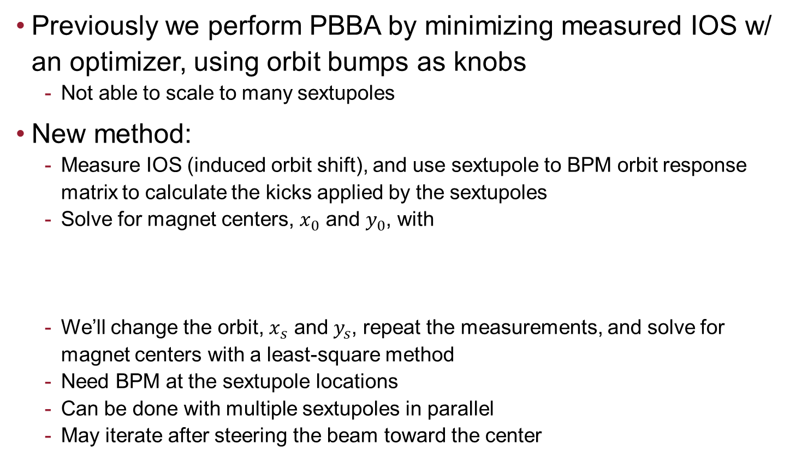
Sketch of the new sextupole PBBA method
  Previously we perform PBBA by minimizing measured IOS w/ an optimizer, using orbit bumps as knobs
    Not able to scale to many sextupoles
  New method:
    Measure IOS (induced orbit shift), and use sextupole to BPM orbit response matrix to calculate the kicks applied by the sextupoles
    Solve for magnet centers, $x_{0}$ and $y_{0}$, with
    We’ll change the orbit, $x_{s}$ and $y_{s}$, repeat the measurements, and solve for magnet centers with a least-square method
    Need BPM at the sextupole locations
    Can be done with multiple sextupoles in parallel
    May iterate after steering the beam toward the center

Slide 4
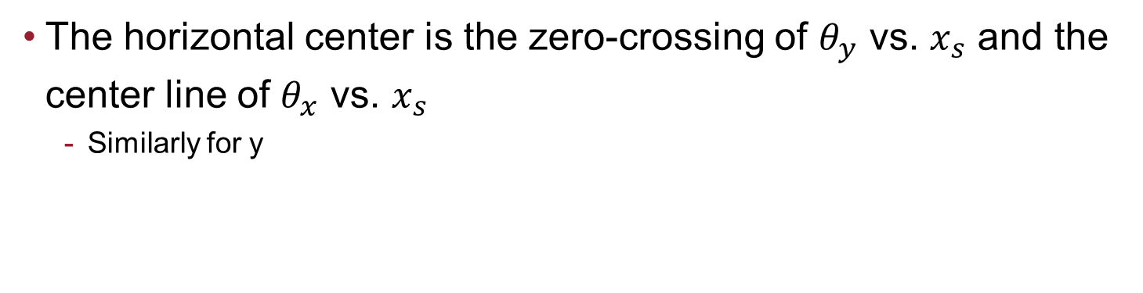
Kicks (by sextupoles from IOS) vs. position
  The horizontal center is the zero-crossing of $θ_{y}$ vs. $x_{s}$ and the center line of $θ_{x}$ vs. $x_{s}$
    Similarly for y
Two sextupoles are modulated in the same time (s10, s20)

Slide 5
Solve for x0 and y0 (sextupole centers) – sext s10
Initial x0=0,y0=0
initial
fitted
sext 1, x0: [fitted, target] um
-95.5002, -111.1482
sext 1, y0: [fitted, target] um
150.0212, 131.0408
fitted

Slide 6
Solve for x0 and y0 (sextupole centers) – sext s20
initial
Initial x0=0,y0=0
fitted
fitted
sext 2, x0: [fitted, target] um
-80.0129, -87.9535
sext 2, y0: [fitted, target] um
-58.4125, -58.0917

Slide 7
Same sextupoles, using a 3x3 grid to sample data
  With 3 points in x, and 3 points in y, 9 measurement total

Slide 8
Fitting for x0 and y0, for sextupole s10
initial
Initial x0=0,y0=0
sext 1, x0: [fitted, target] um
-105.1303, -111.1482
sext 1, y0: [fitted, target] um
144.2204, 131.0408
fitted

Slide 9
Fitting for x0 and y0, for sextupole s20
initial
Initial x0=0,y0=0
fitted
sext 2, x0: [fitted, target] um
-82.3799, -87.9535
sext 2, y0: [fitted, target] um
-56.5837, -58.0917

Slide 10
Group of 6 sextupoles
  Modulate 6 sextupoles simultaneously
    qspos: [1.3746e+03 3.9801e+03 6.5857e+03 9.1912e+03 1.4070e+04 1.6676e+04]
    qKL2: [0.1391 0.2834 -0.1196 0.2627 -0.0388 0.2089]
    SIndex: [357 818 1278 1738 2374 2834]
  Use 5x3 grid points: 5 points in x, 3 points in y

Slide 11
Fitting for centers – s20 as an example
initial
Initial x0=0,y0=0
sext 2, x0: [fitted, target] um
138.4273 138.4844
sext 2, y0: [fitted, target] um
3.5249 -1.8008
fitted

Slide 12
Group of 6 sextupoles – fit for centers
SIndex: [357 818 1278 1738 2374 2834]
 | (no noise) | BPM sigma = 1 um
x target | case 0 | case 1 | case 2 | case 3 | case 4 | case 5 | case 6
-111.15 | -99.46 | -93.74 | -102.90 | -106.509 | -100.03 | -97.9858 | -96.3421
138.48 | 138.43 | 135.40 | 135.20 | 146.8128 | 132.87 | 140.4216 | 131.7207
-189.89 | -177.10 | -189.09 | -179.61 | -163.698 | -170.413 | -176.369 | -183.17
-394.24 | -393.03 | -394.44 | -391.31 | -395.076 | -393.856 | -392.682 | -386.488
4.52 | 6.80 | -4.59 | 7.27 | -43.2988 | -10.0256 | 16.1416 | -18.322
72.98 | 75.87 | 80.72 | 73.03 | 79.0969 | 73.5811 | 73.9379 | 79.8834
y target | case 0 | case 1 | case 2 | case 3 | case 4 | case 5 | case 6
131.04 | 91.80 | 78.04 | 78.51 | 79.8353 | 106.2468 | 91.727 | 99.9717
-1.80 | 3.52 | 4.33 | 7.04 | 6.4534 | 2.8601 | 4.1744 | 3.9815
-93.03 | -73.32 | -63.99 | -76.37 | -74.7009 | -78.1707 | -67.3611 | -62.017
-167.85 | -172.72 | -176.98 | -167.45 | -177.095 | -183.843 | -172.025 | -167.397
-307.15 | -261.35 | -301.21 | -267.13 | -268.546 | -226.453 | -245.365 | -284.867
261.50 | 260.46 | 266.55 | 257.86 | 259.0894 | 260.0853 | 265.7821 | 254.787
Larger error bar for y-plane because we only have 3 points?

Slide 13
Summary
  A new method is approached, which can find sextupole centers in parallel
  It is demonstrated in simulation
    Currently calculation depends on sextupole strength. But it can be fitted in the future
    We can also iterate to converge to the center, and thus eliminate the dependence on absolute strength
  Error sigma would be 20-50 um

