Slide 1
Benchmark of commissioning simulations with errors and corrections: AT vs MADX vs MADX-PTC
+ optics correction
+ simulations without IP errors
S.Liuzzo (ESRF), T.Charles (ANSTO), E.Musa (DESY), R.Tomas (CERN), I.Agapov (DESY)
FCC-ee tuning meeting 10th April 2024

Slide 2
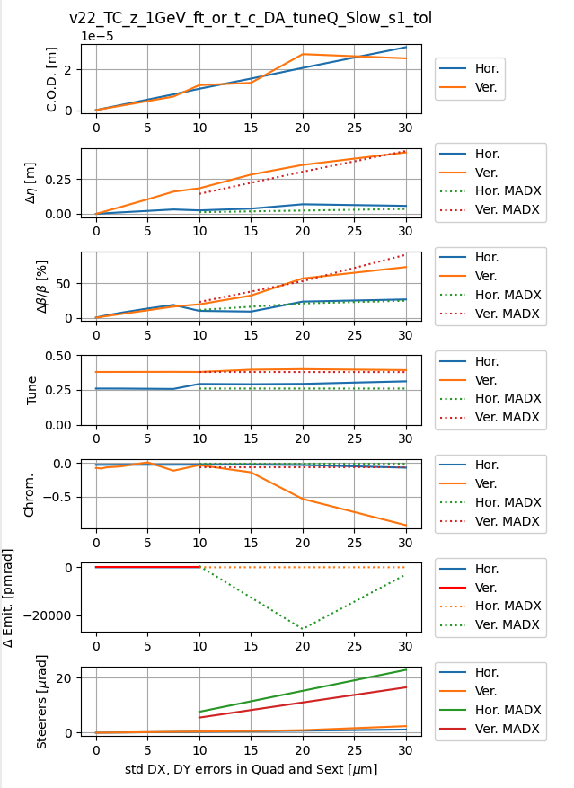
MADX – AT comparison, slow sextupole gradients ramp, QR[FD]R quad for tune
The agreement among our codes seems rather good in my opinion!
I did not use SY sextupoles for chromaticity. Evidently including them does help. However the difference is not enormous.
MADX computes rather large (500pm at 10um) or negative vertical emittances. For those cases AT refuses to give numbers. We may see also this as an agreement point.
Last slide FROM PREVIOUS TUNING MEETING: 15th March 2023
AT and MADX (MADX-PTC?) simulations with errors and correction of orbit, tunes and chromaticity are in good agreement

Slide 3
Include optics correction
First tests:
RDT + dispersion + tunes correction (normal and skew)
Using analytic formulas, linear.
Alignment and orbit errors are translated to normal and skew quadrupole errors to compute RDTs
Weigths to be optimized are:
Number of singular values
Dispersion weight
For both normal and skew quad correction
This approach did not give the wished results immediately. Instead of investigating (no time) I switched to use the more realistic but more complicated tools : FIT ORM and use FITTED quadrupole errors for correction.
Finally I think errors in the IP are the issue in any case.

Slide 4
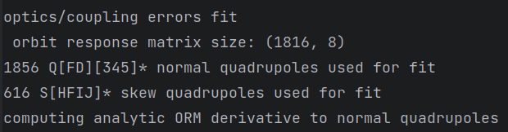
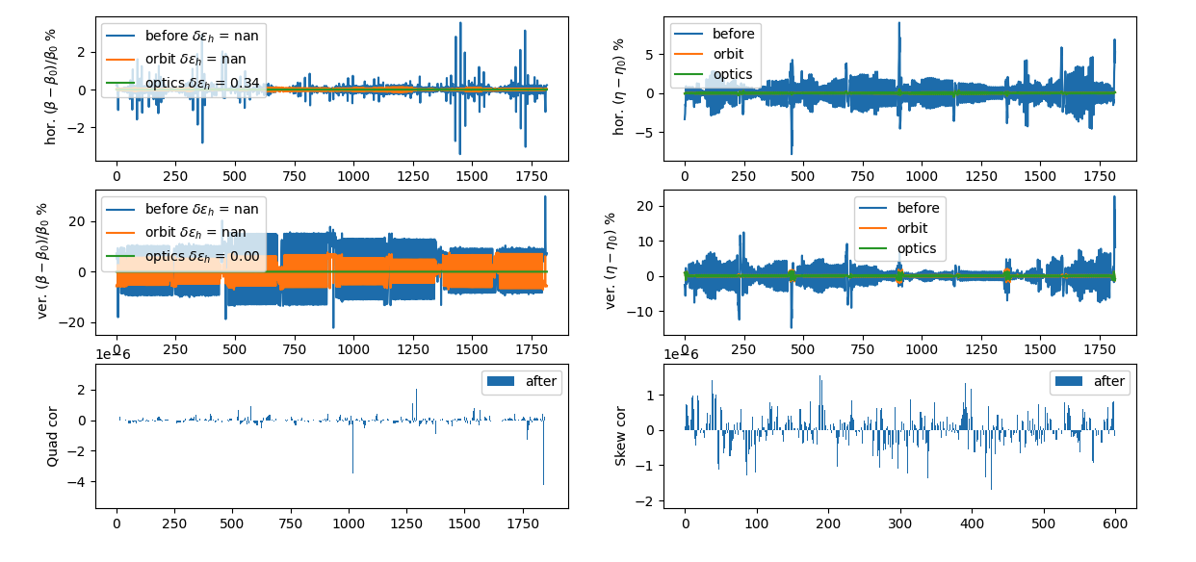
ORM optics correction
Roughly tuned ORM (8 steerers) fit parameters for optimal optics correction:
Number of singular values
Dispersion weight
For both normal and skew quad cor.

Slide 5
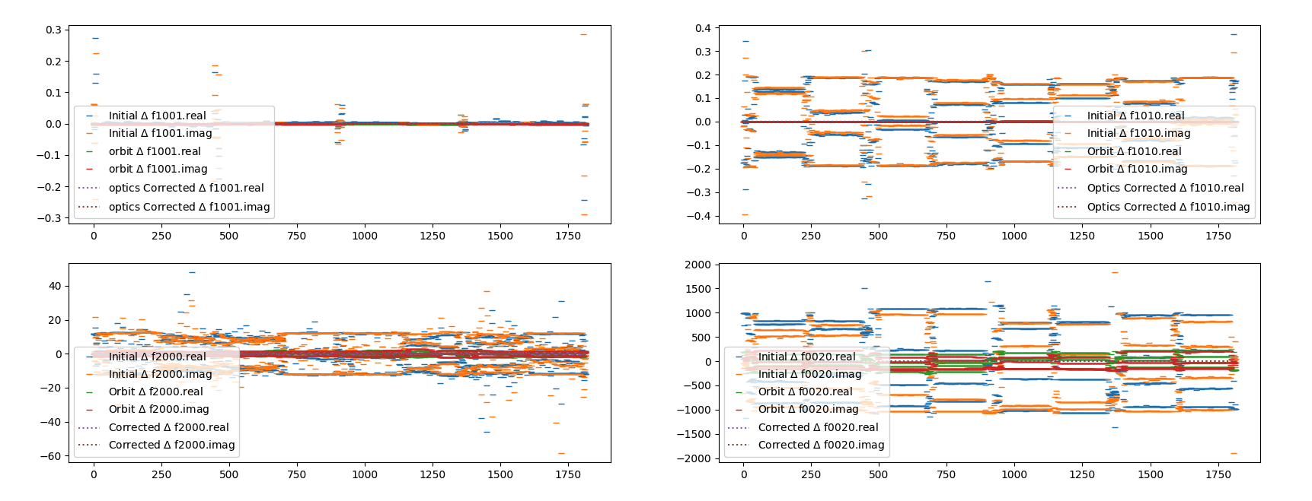
ORM optics correction: RDTs
ORM fitted quadrupole errors results also in well corrected quadrupole RDTs

Slide 6
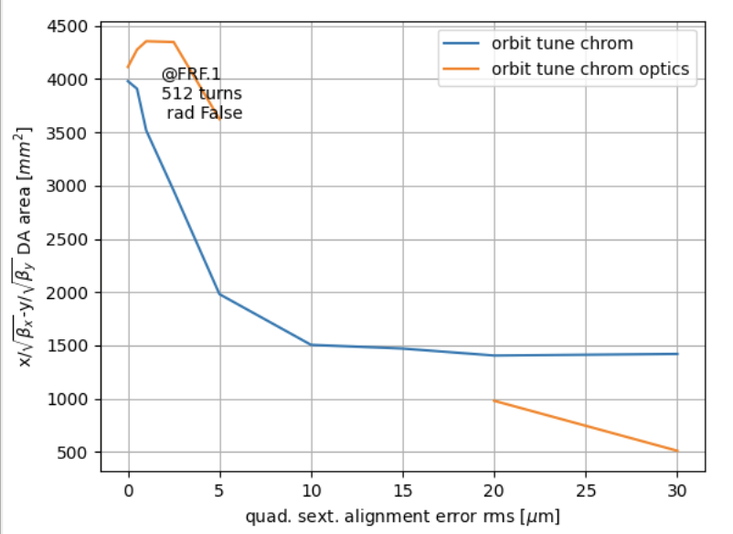
Failed for 10 and 15 um rms errors, restarted with smaller sextupole ramp steps (5% instead of 10%)
Recovered point at 15, but still bad optics. Orbit 1000 eig fails, reduced to 600.
Some sextupole gradient ramp steps make the correction fail: modified script to skip to next point of gradient ramp.
?
?

Slide 7
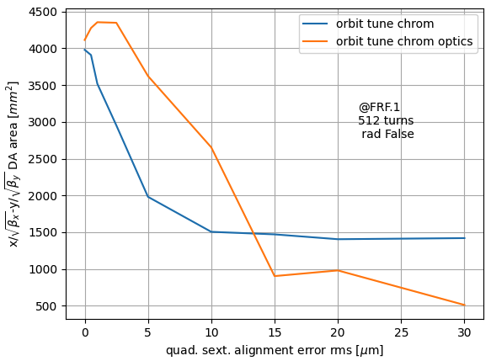
Optics correction added to the loop
Optics correction helps.
Still needs ad hoc tuning and detailed studies.
Would be nice to see what MADX-PTC, OCM-3, etc are able to do.
Enough work for a PhD thesis in my opinion.

Slide 8
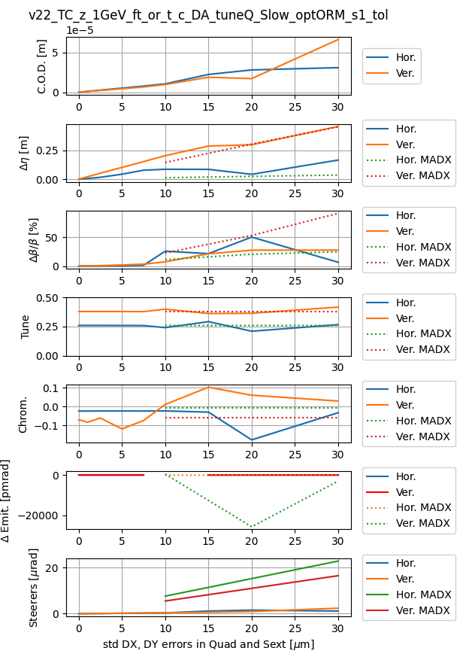
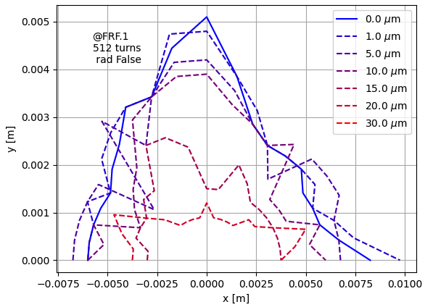
Optics correction added to the loop
Better vertical beating, better DA. Still optics correction not working fully as expected (correcting well both planes and dispersion), parameters (iterations, singular values, correctors locations, etc…) to be further investigated

Slide 9
Further tests
Exclude IP quad from correction/fit ← for future tests
Increase dispersion weight ← I try this option, but it is no better then parameters fund above

Slide 10
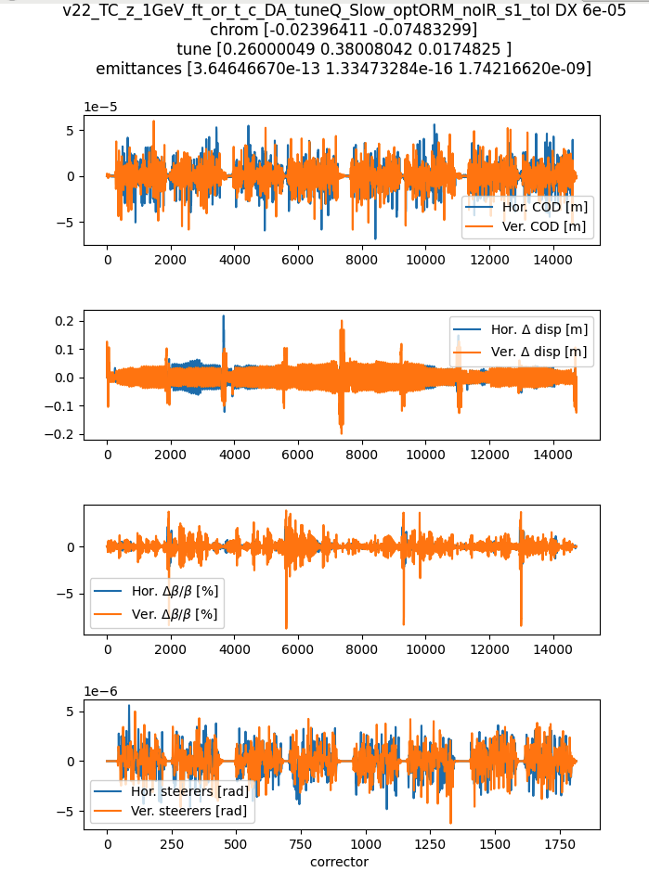
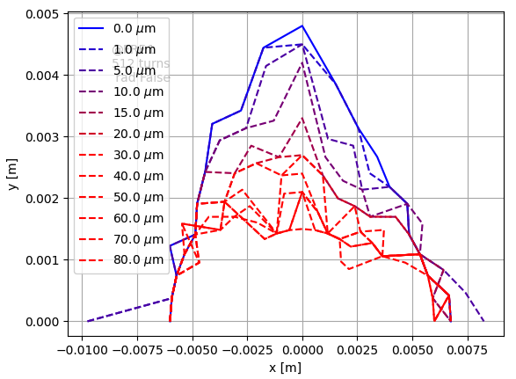
No errors in the IP
From our test errors seed file I simply set to zero all errors in magnets that are not Q[FD][1234] and S[FD]

Slide 11
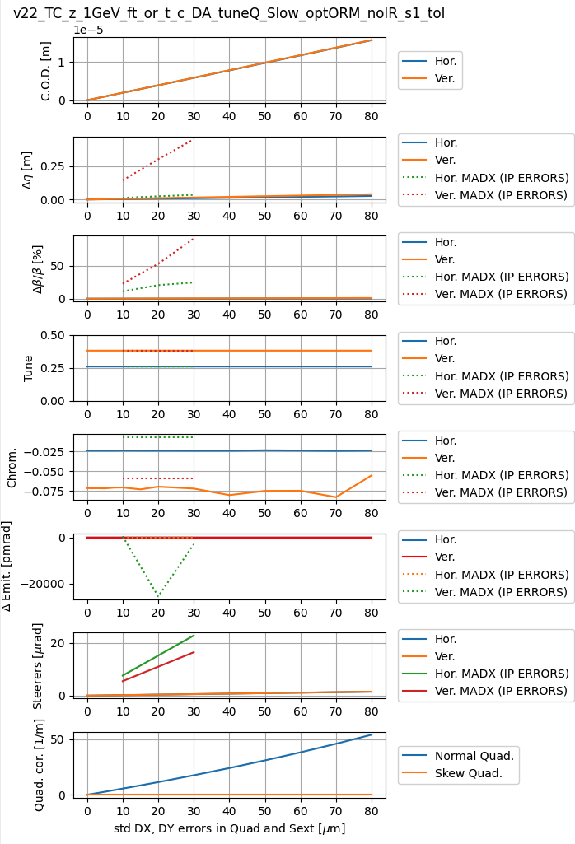
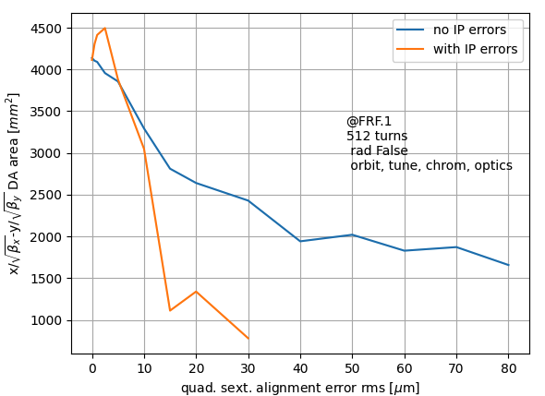
No errors in the IP
-10% DA area

Slide 12
Conclusions
Optics correction added to the comparison AT-MADX tests for the AT curves.
In AT, including optics correction, DA is improved for alignment errors <15um rms @ all quad and sext
As expected, running the same (identical) tuning simulations without errors in the IP the impact on DA is decreased and all optics parameters have a much less steep variation.
For future studies:
Add MADX or MADX-PTC or Xsuite or ?? curved for optics parameters and DA vs errors.
Test more accurate – ad hoc IP tuning procedures / correction schemes.
Run more statistics to provide a table to tolerated alignment errors distinguishing ARCS and IP errors.
Add gradient errors.

