Slide 1

FCC-ee IP Tuning Simulations
Satya Sai Jagabathuni
with inputs from Frank Zimmermann, Felix Simon Carlier, Tessa Charles and Leon Van Riesen-Haupt
FCC-ee Optics Tuning Meeting, 10 April 2024

Slide 2
Introduction
IP tuning knobs developed for Oide’s ttbar (182.5GeV) 4IP lattice
Knobs to be tested on the perturbed lattice
Tessa’s globally corrected lattice is considered and the circumference is ~95km
Contains realistic errors such as misalignments and strength errors
No BPM errors included in the lattice
10 Apr 2024
S.S.Jagabathuni | FCC-ee IP Tuning Simulations
2

Slide 3
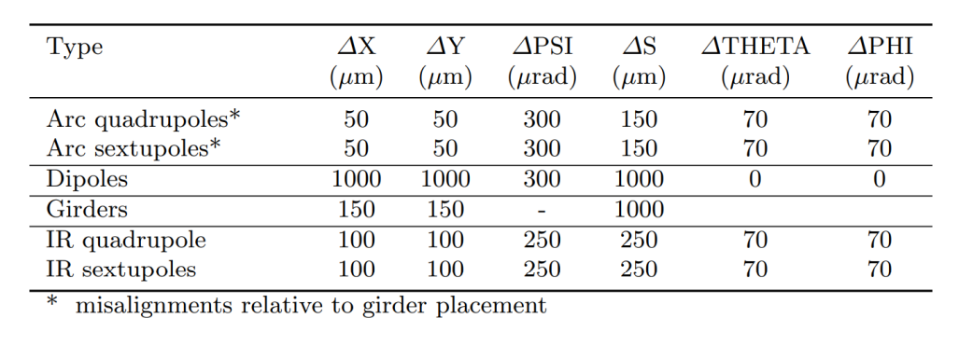
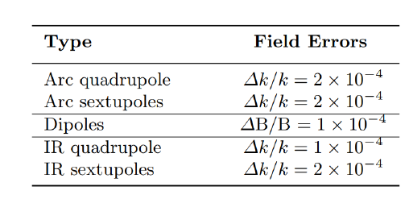
Errors assigned to Magnets
https://indico.cern.ch/event/1384058/
Please refer to the Tessa’s presentation
https://indico.cern.ch/event/1384058/
10 Apr 2024
S.S.Jagabathuni | FCC-ee IP Tuning Simulations
3

Slide 4
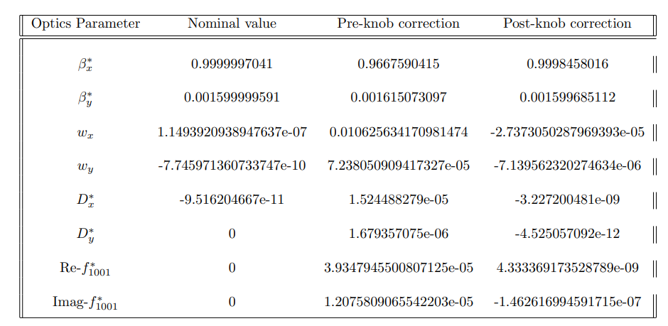
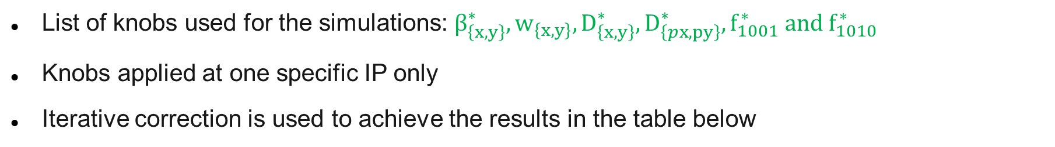
IP tuning with knobs
List of knobs used for the simulations: $β_{\left\{x,y\right\}}^{∗}, w_{\left\{x,y\right\}}, D_{\left\{x,y\right\}}^{∗},D_{\left\{px,py\right\}}^{∗}, f_{1001}^{∗} and f_{1010}^{∗}$
Knobs applied at one specific IP only
Iterative correction is used to achieve the results in the table below
Note: correction applied only at IP1
10 Apr 2024
S.S.Jagabathuni | FCC-ee IP Tuning Simulations
4

Slide 5
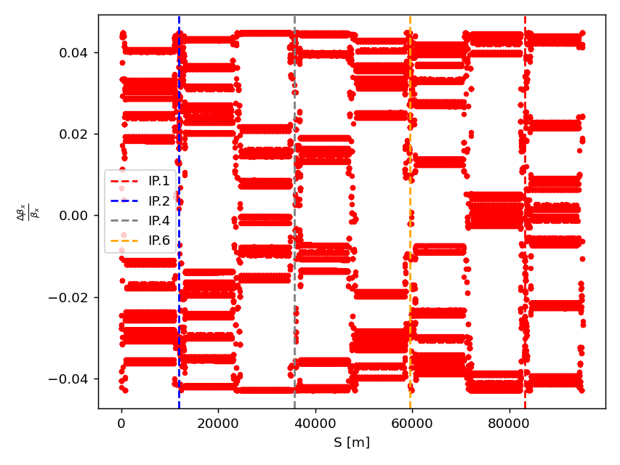
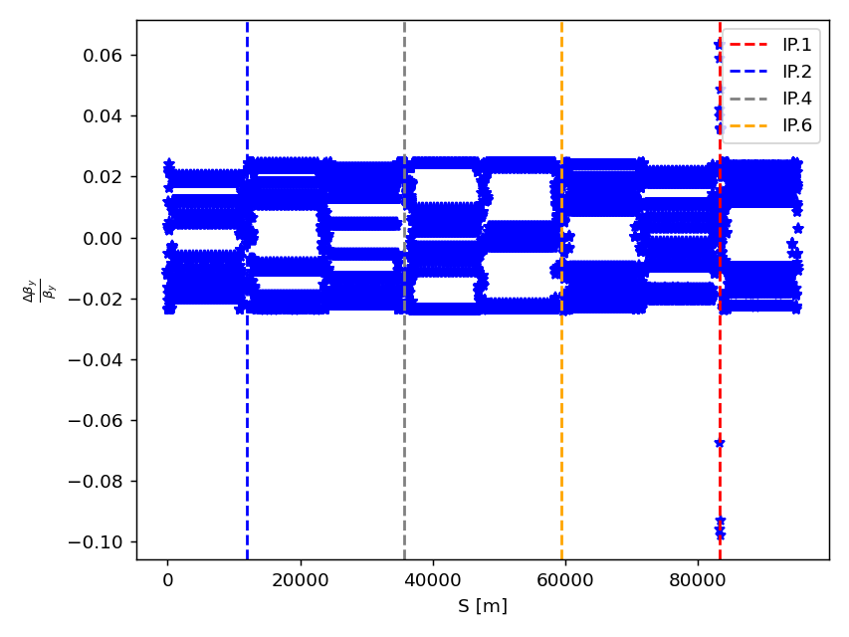
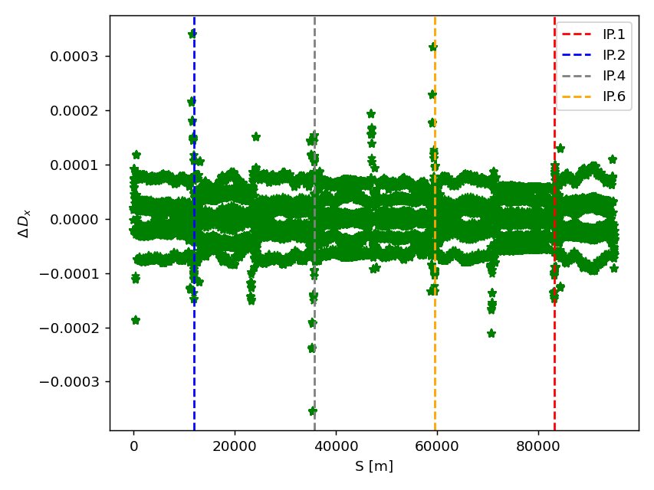
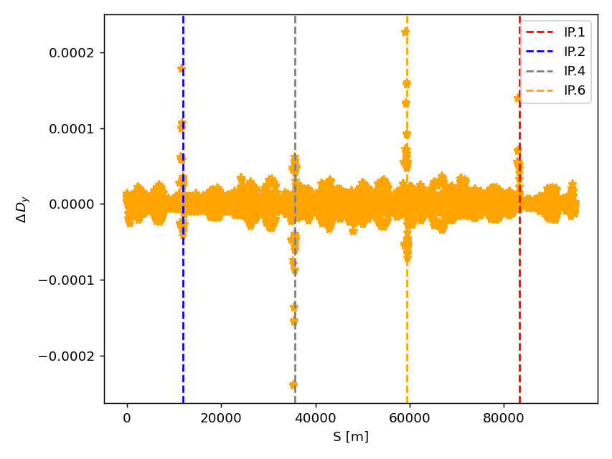
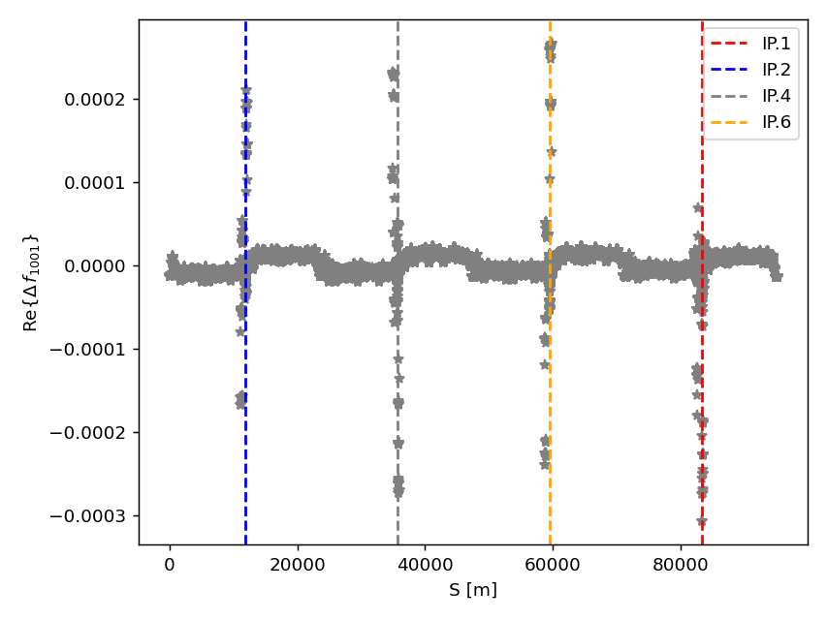
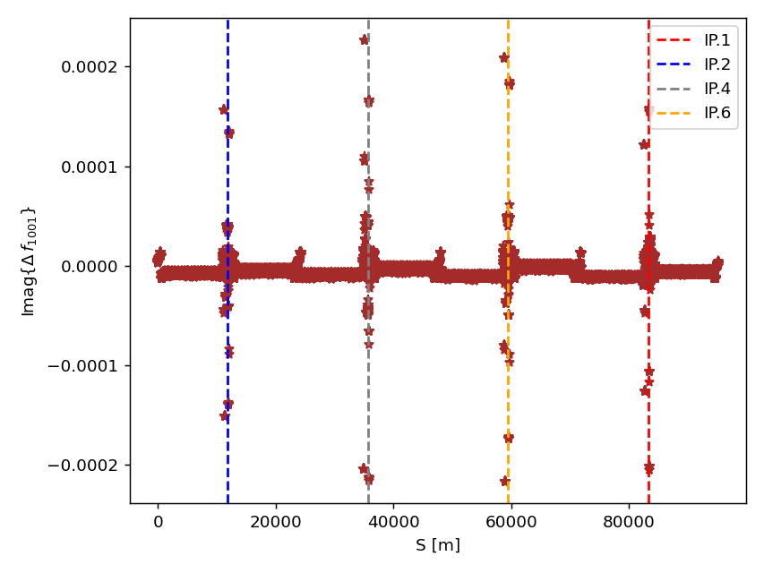
Optics distortion along the ring
Below plots explain the optics variation after applying the knobs, with respect to Tessa’s corrected lattice
10 Apr 2024
S.S.Jagabathuni | FCC-ee IP Tuning Simulations
5

Slide 6

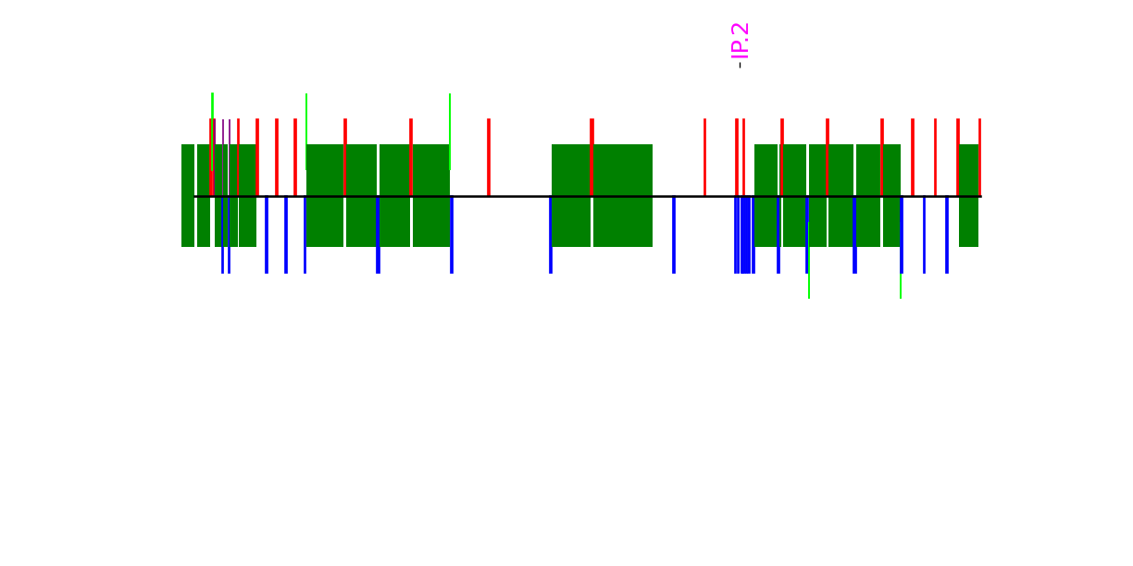
Optics distortion along the ring
10 Apr 2024
S.S.Jagabathuni | FCC-ee IP Tuning Simulations
6

Slide 7
Optics distortion along the ring
10 Apr 2024
S.S.Jagabathuni | FCC-ee IP Tuning Simulations
7

Slide 8
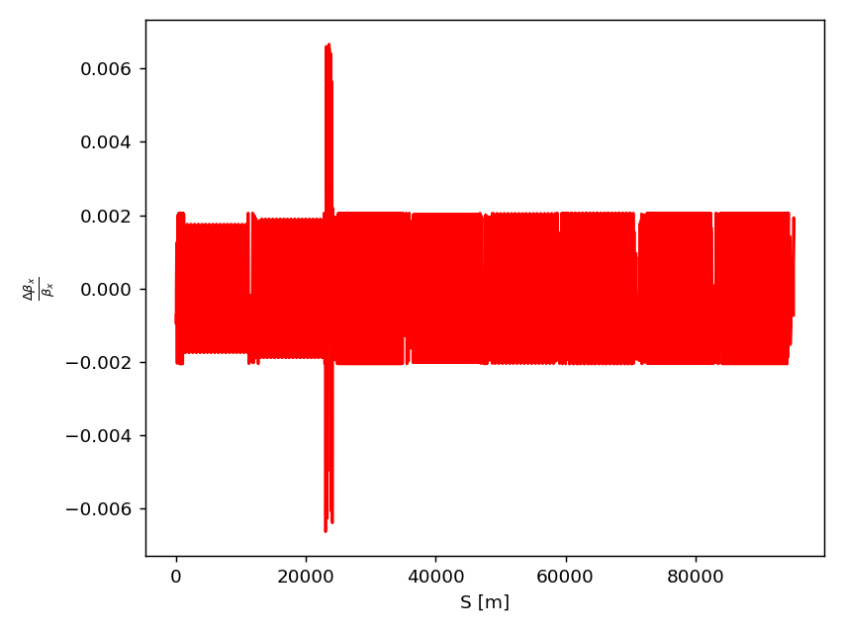
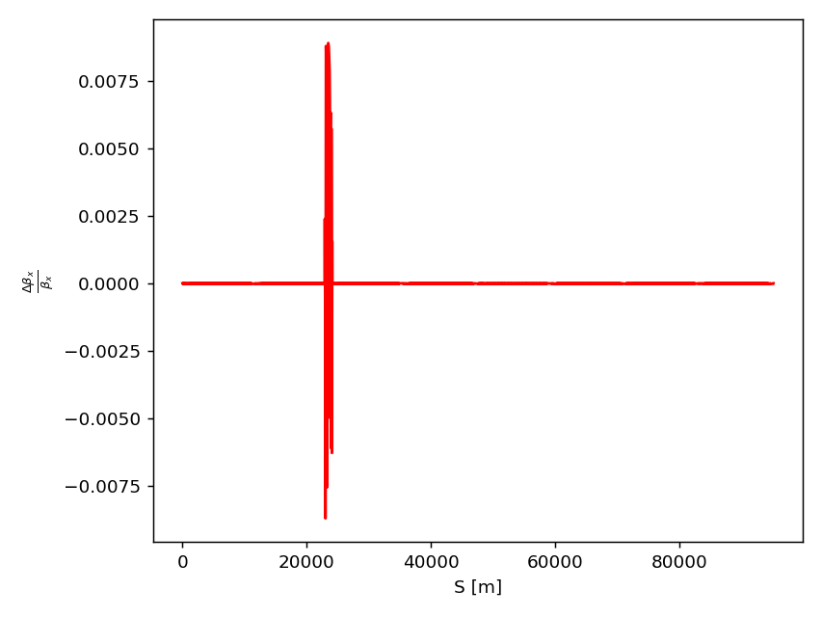
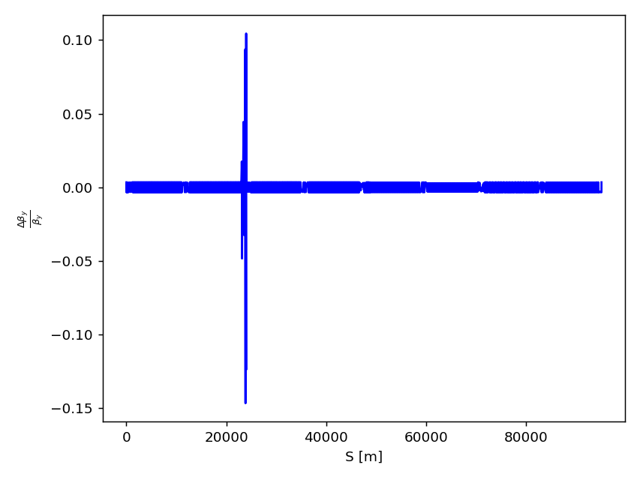
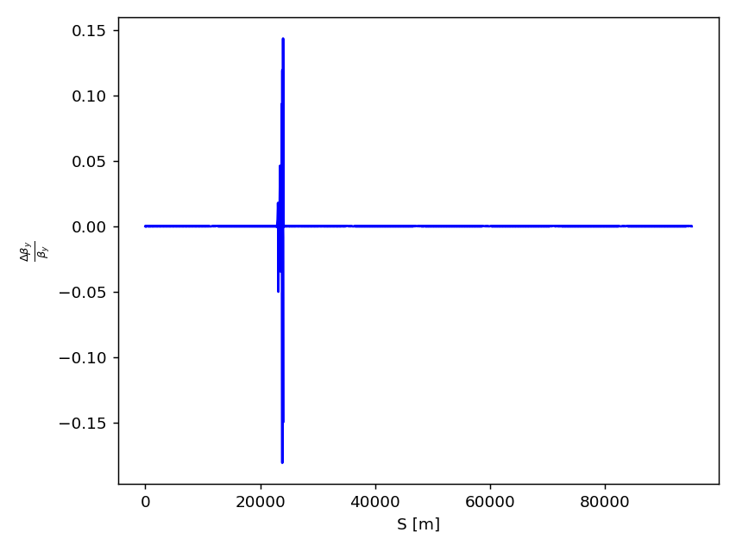
Ideal case: Knobs leakage to outside
Optics distortion should be localized and must be closed within the knob region
If not properly closed, Any leakage to the outside will be propagated to the other IP’s
Thus, resulting in knobs failure
Before closing
After closing
Before closing
After closing
10 Apr 2024
S.S.Jagabathuni | FCC-ee IP Tuning Simulations
8

Slide 9
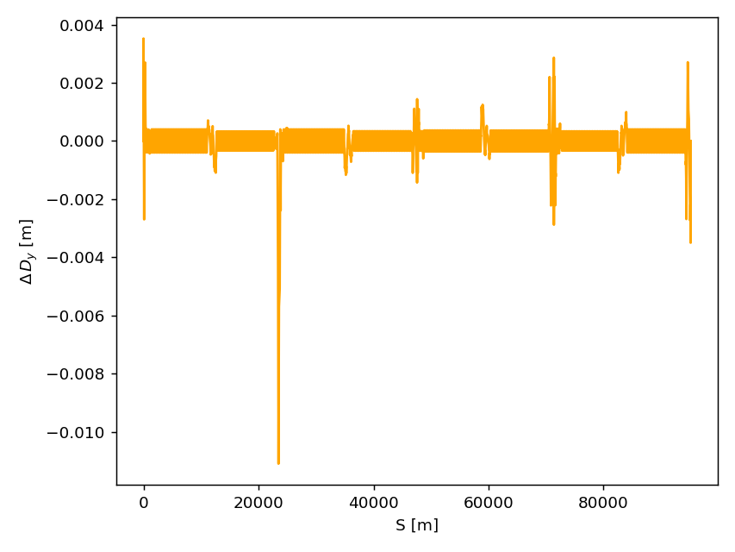
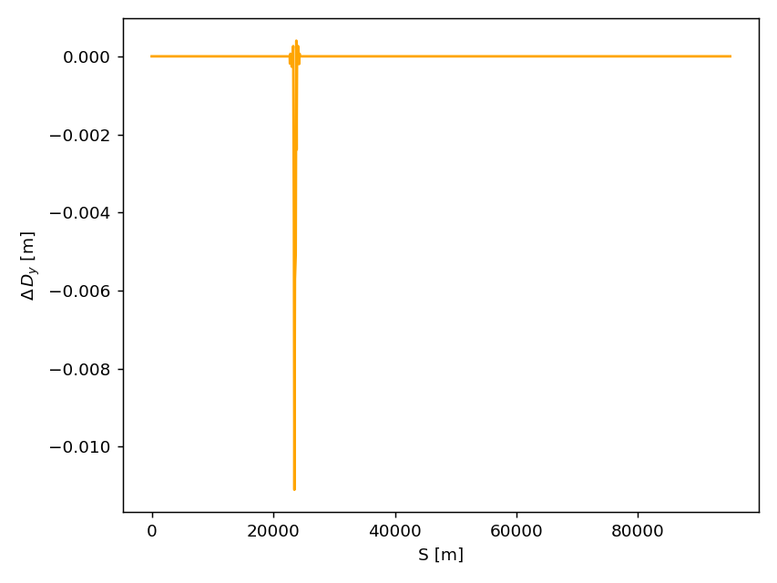
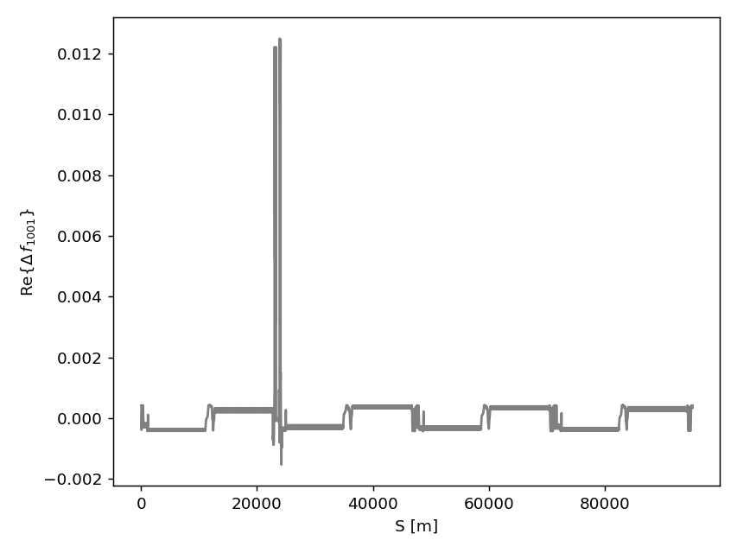
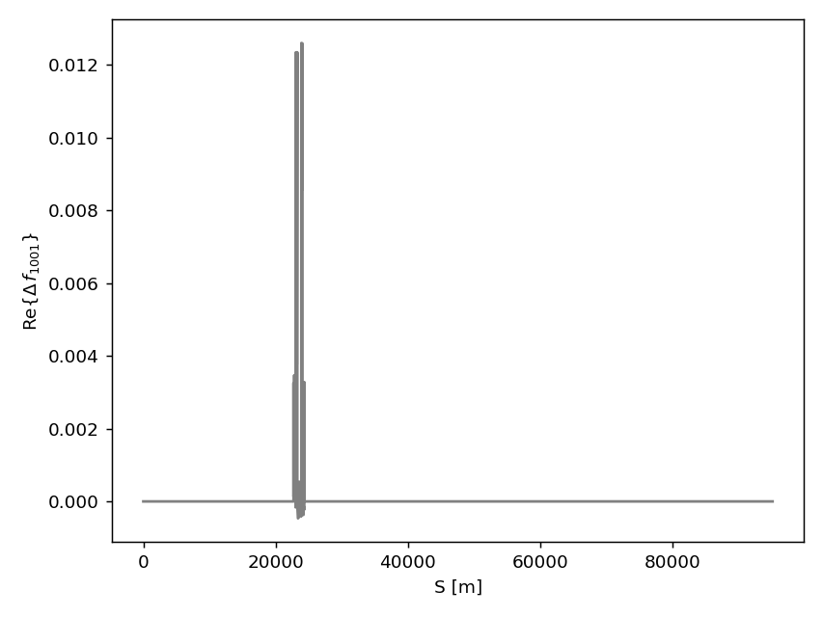
Ideal case: Knobs leakage to outside
Optics distortion should be localized and must be closed within the knob region
If not properly closed, Any leakage to the outside will be propagated to the other IP’s
Thus, resulting in knobs failure
Before closing
After closing
Before closing
After closing
10 Apr 2024
S.S.Jagabathuni | FCC-ee IP Tuning Simulations
9

Slide 10
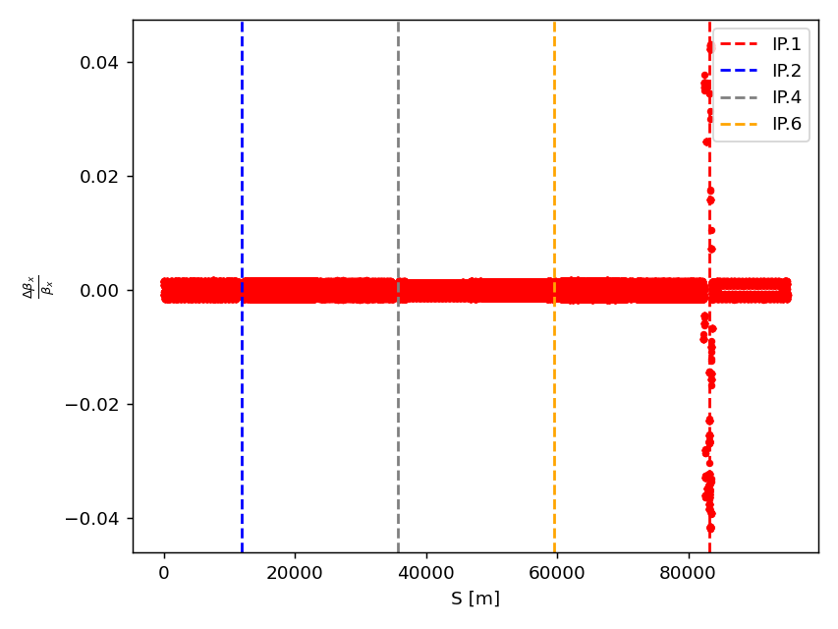
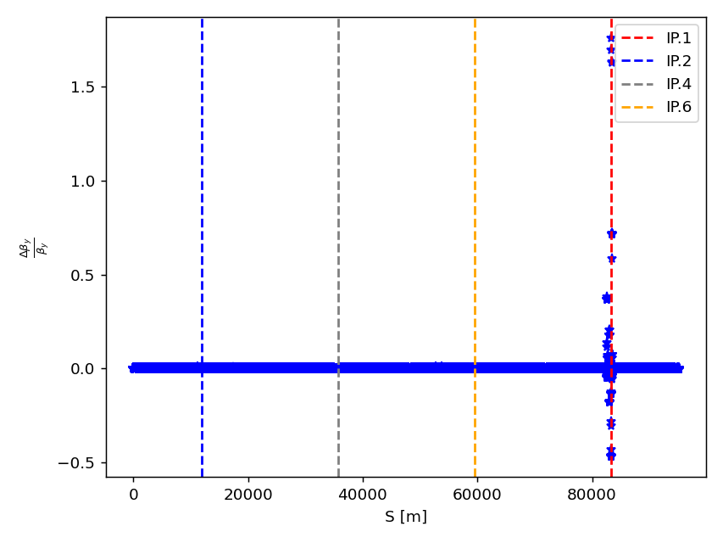
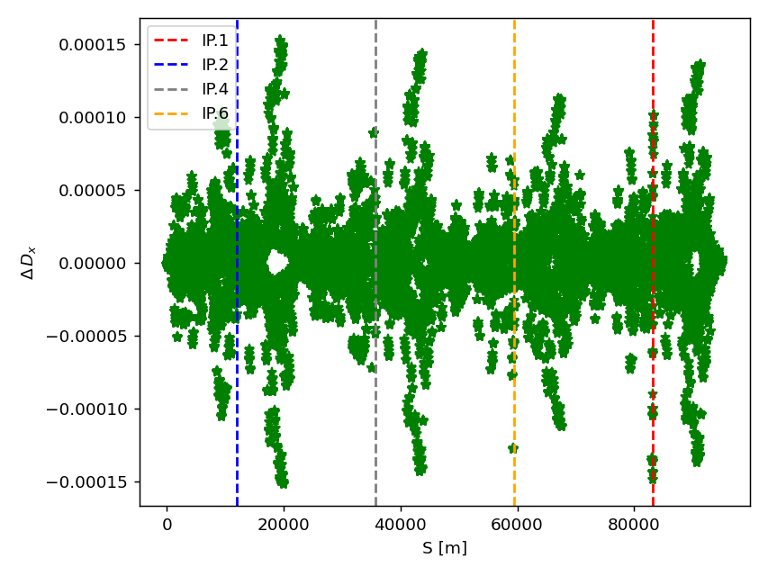
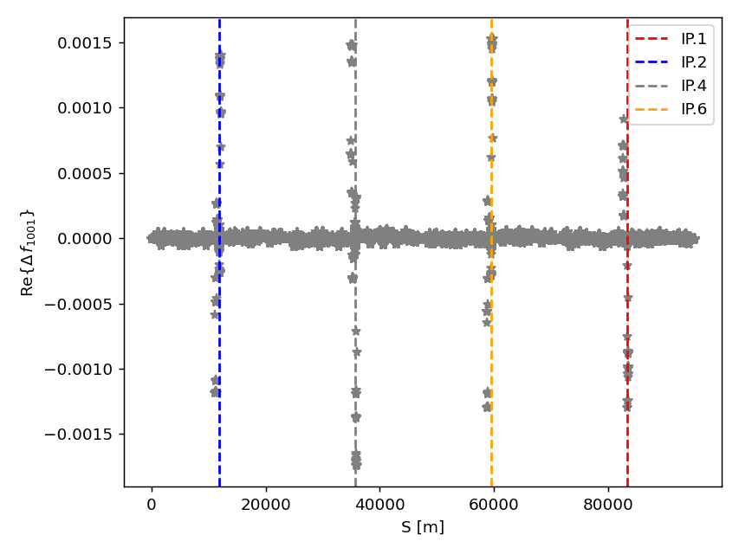
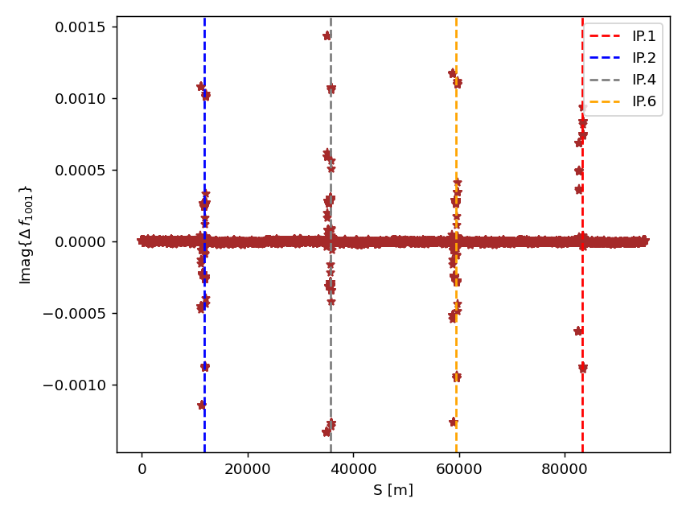
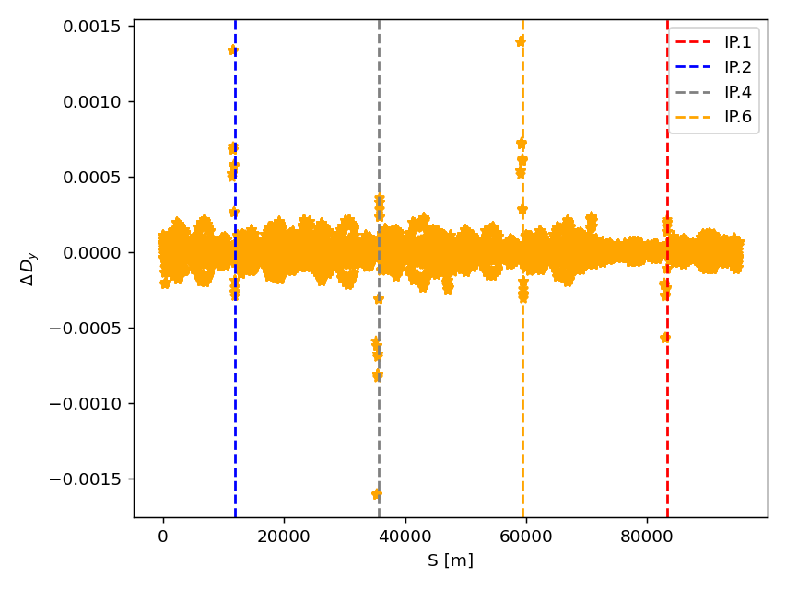
Optics distortion along the ring
Below plots explain the optics variation with respect to Tessa’s corrected lattice after applying the knobs
10 Apr 2024
S.S.Jagabathuni | FCC-ee IP Tuning Simulations
10

Slide 11
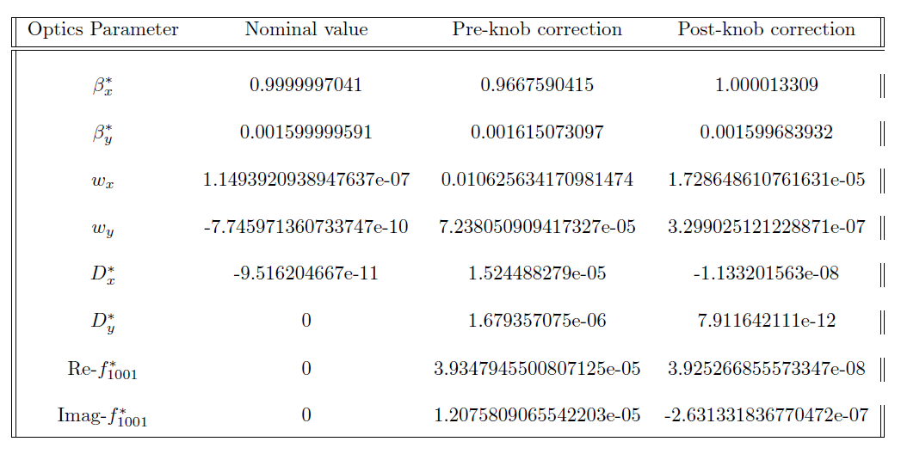
IP tuning with knobs
List of knobs used for the simulations: $β_{\left\{x,y\right\}}^{∗}, w_{\left\{x,y\right\}}, D_{\left\{x,y\right\}}^{∗},D_{\left\{px,py\right\}}^{∗}, f_{1001}^{∗} and f_{1010}^{∗}$
Knobs applied at one specific IP only
Iterative correction is used to achieve the results in the table below
Note: correction applied only at IP1
10 Apr 2024
S.S.Jagabathuni | FCC-ee IP Tuning Simulations
11

Slide 12
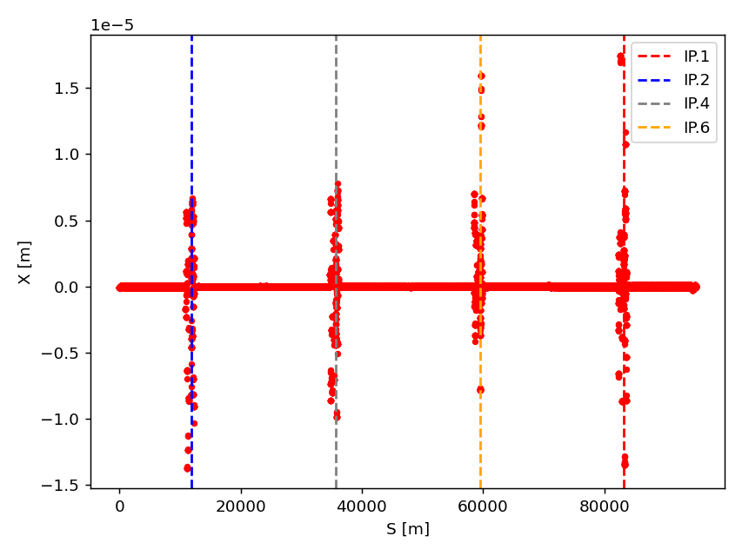
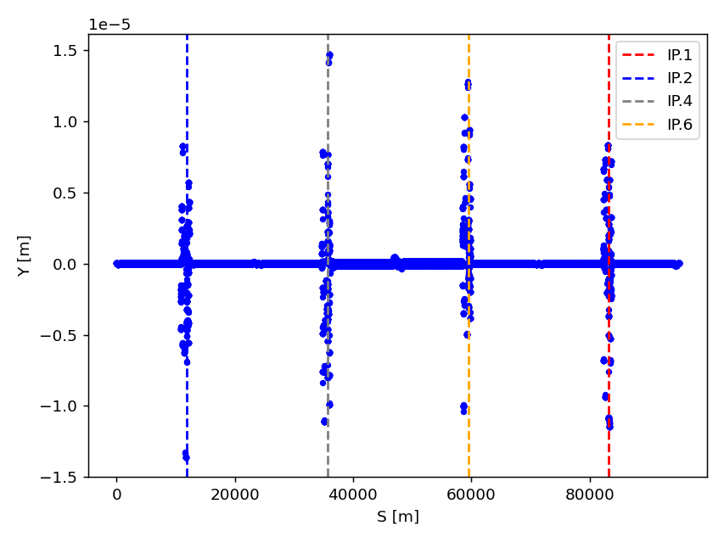
Orbit along the ring
Coupling stays almost unchanged even the knob is closed
Additional orbit correction is needed to reduce the feed-down effects
10 Apr 2024
S.S.Jagabathuni | FCC-ee IP Tuning Simulations
12

Slide 13
Conclusions & Further tasks
Summary:
IP tuning knobs tested on Tessa’s lattice with all global corrections done
Knobs struggling to correct the errors at all IP’s at once
Found out that there is a leakage outside, resulting in the distortion of optics at all other IP’s
Need to understand why the coupling stays the same as before
Next steps:
Tuning simulations with tools (pyAT) developed by Simone
Integrate the IP tuning knobs into the pyAT framework
10 Apr 2024
S.S.Jagabathuni | FCC-ee IP Tuning Simulations
13

Slide 14
Thank you for your attention
10 Apr 2024
S.S.Jagabathuni | FCC-ee IP Tuning Simulations
14

