Slide 1



SPAD optimization – the next frontier
Fabrice Retiere (TRIUMF)

Slide 2
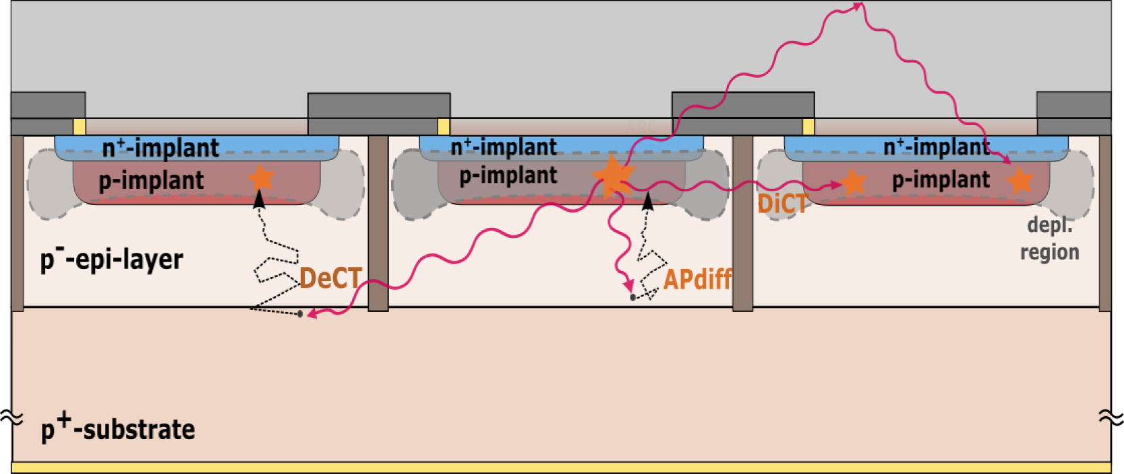
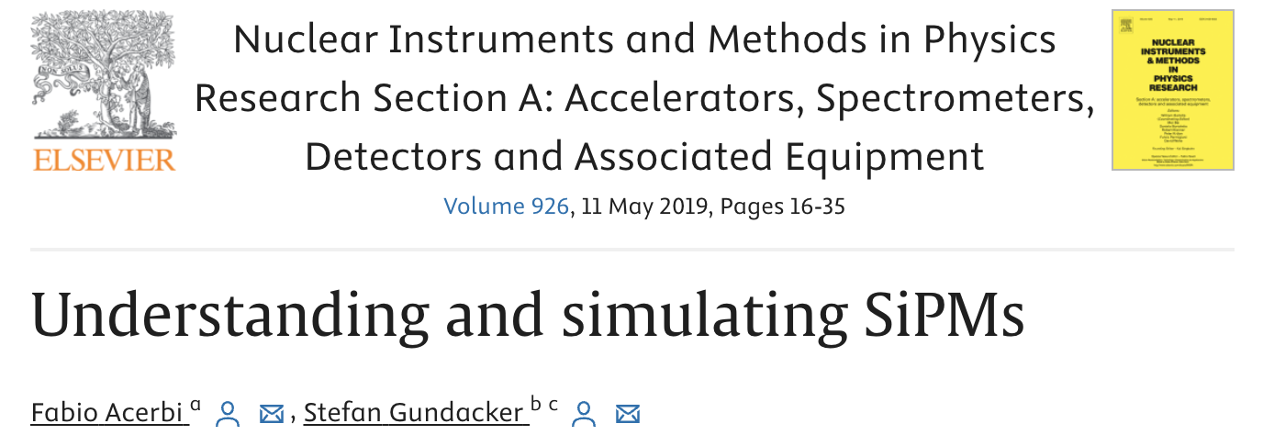
SPAD parameters
Example of n-on-p (not most common)
Efficiency
”Gain”
Single Photon Timing Resolution
Nuisance
  Dark noise
  Trapping – after-pulsing
  Light production – cross-talk

Slide 3
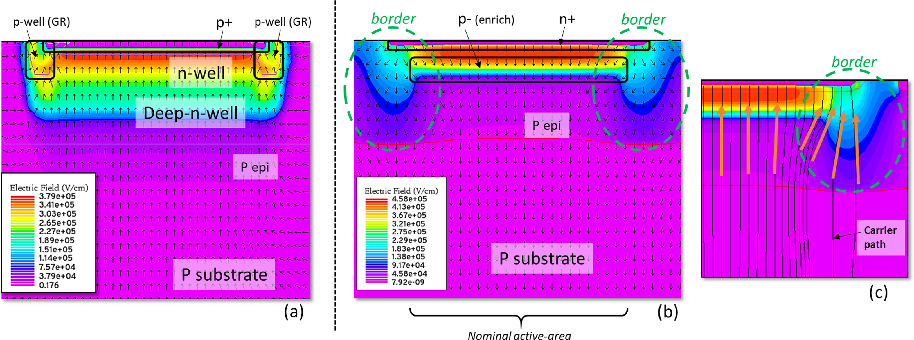
Electric field configuration examples

Slide 4
Avalanche development, onset and time development
Is this understood quantitatively? It is not obvious to me
Monte-Carlo model + SPICE integration is the solution
  Shown at ISSW by Denis Rideau from Stmicroelectronics, but I don’t have the slides
  Need Electric Field and model carrier transport and impact ionization
  Use Ramo theorem to calculate current induced current on electrodes
  Reduce the electric field due to space charge (e- and hole)
  Integrate with SPICE and account for voltage drop across quenching circuit
  Keep going until convergence
  Sounds complicated! But it has been done
Why doing that?
  Understand probability of triggering avalanche vs DV and Temperature
  Predict timing evolution of avalanches
  Optimize quenching

Slide 5
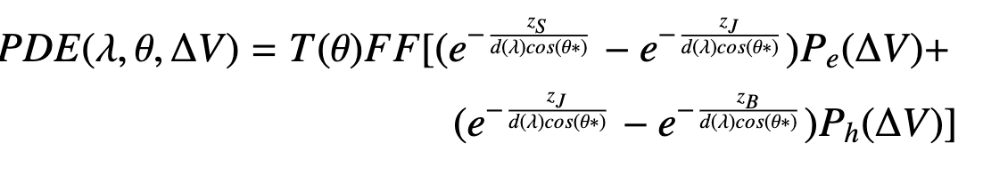
Optimizing efficiency
T → 1. Transmittance. Doable with Anti-Reflective Coating in a limited range of wavelength
FF → 1. Fill Factor. Use lenses (for parallel light) or BSI without through trenches
First exponential difference → 1. Fraction of photons that create an electron. Maximize this by limiting surface loss and fine tuning the pn junction depth for the desired wavelength.
Pe → 1. Probability that an electron triggers an avalanche. Electric field design without generating lots of dark noise.

Slide 6
Dark noise
Have we reached the minimum possible?
  It may depend on temperature
Field enhanced can dominate
  Trade-off between probability of triggering avalanche and dark noise
300K
Sherbrooke 2D SPAD
Sherbrooke 2D SPAD

Slide 7
Cross-talk. Light production and transport
FBK VUV-HD3 emitted photon within NA<0.45
Cross-talk is the dominated correlated nuisance
  May be worse in BSI
How to mitigate?
  Minimize gain
  Understand the sources
  Trenches but does not help external cross-talk

Slide 8
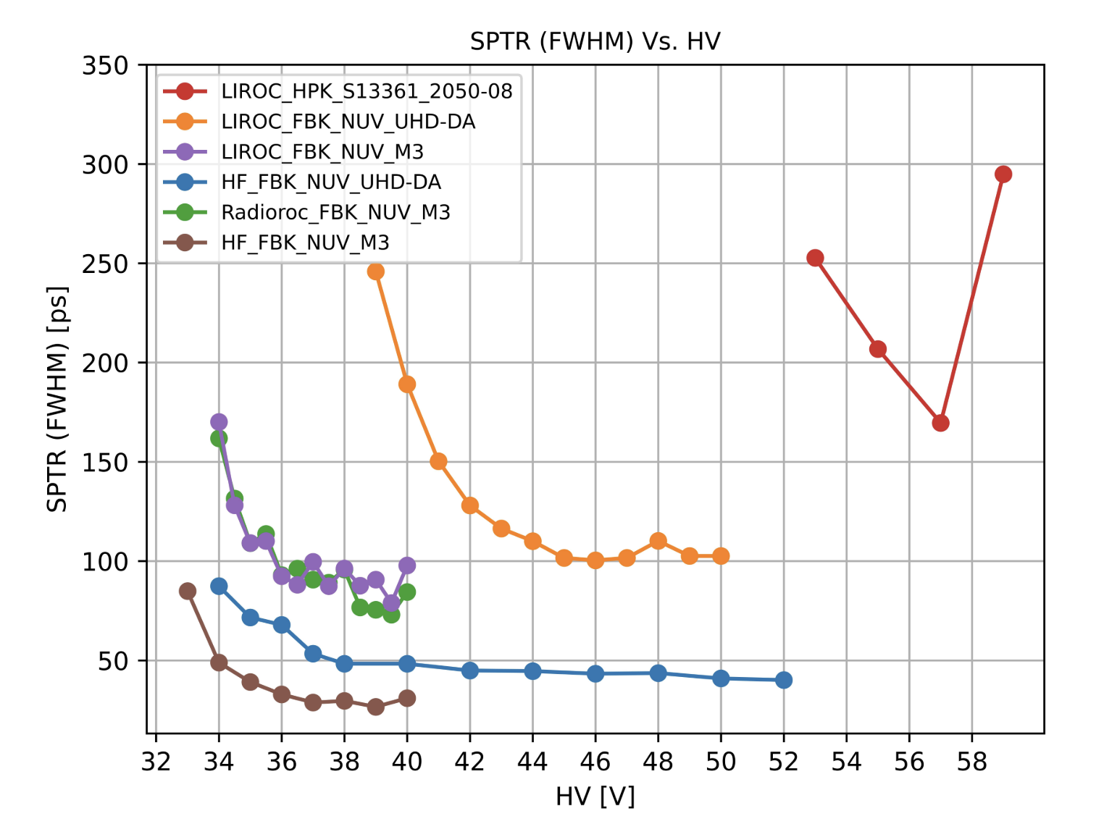
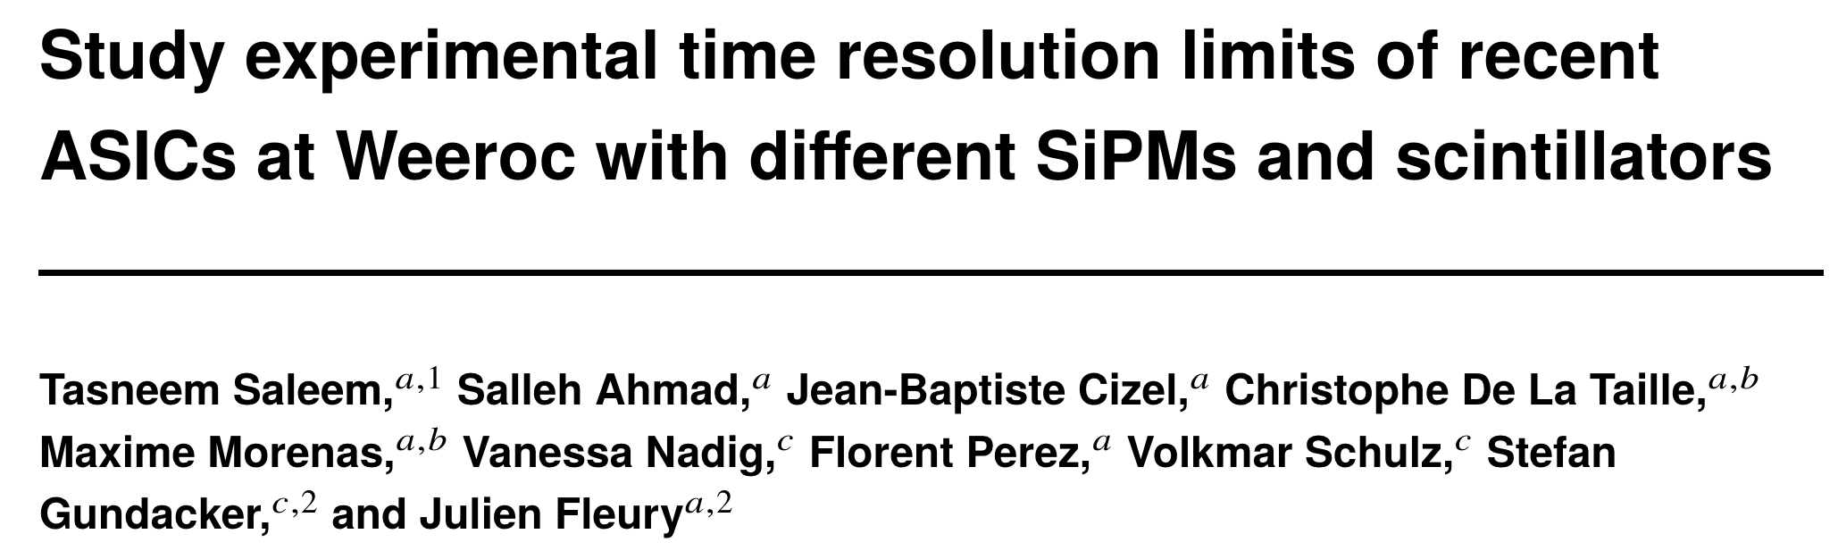
Single Photon Timing Resolution
The electronics matters a lot
Does 3D integration provide best results
  May be for the same power dissipation
What about the SPAD avalanche evolution time?
  Is it worth studying?
What about tails?
  Probe region of low field?
  Mask such regions?
In BSI the electron transit time may matter

Slide 9
3D integration and FSI vs BSI configuration

Slide 10
BSI for other things than photon detection
p+
p
p-epi
p-epi
Even dark matter search
n+
n
Poly
SiO2
100-500 um
Electron trajectories
Geiger mode avalanche
Hole trajectories
Linear avalanche
VUV – Blue photon
Charged particle
Neutron or dark matter
5-50um
Un-depleted
depleted
80um
5-20um
CMOS
CMOS
CMOS
CMOS
Front side avalanche diode
Back side avalanche diode
Extended
Ultra-thick

Slide 11
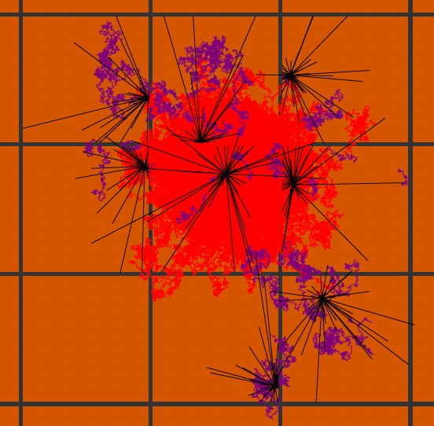
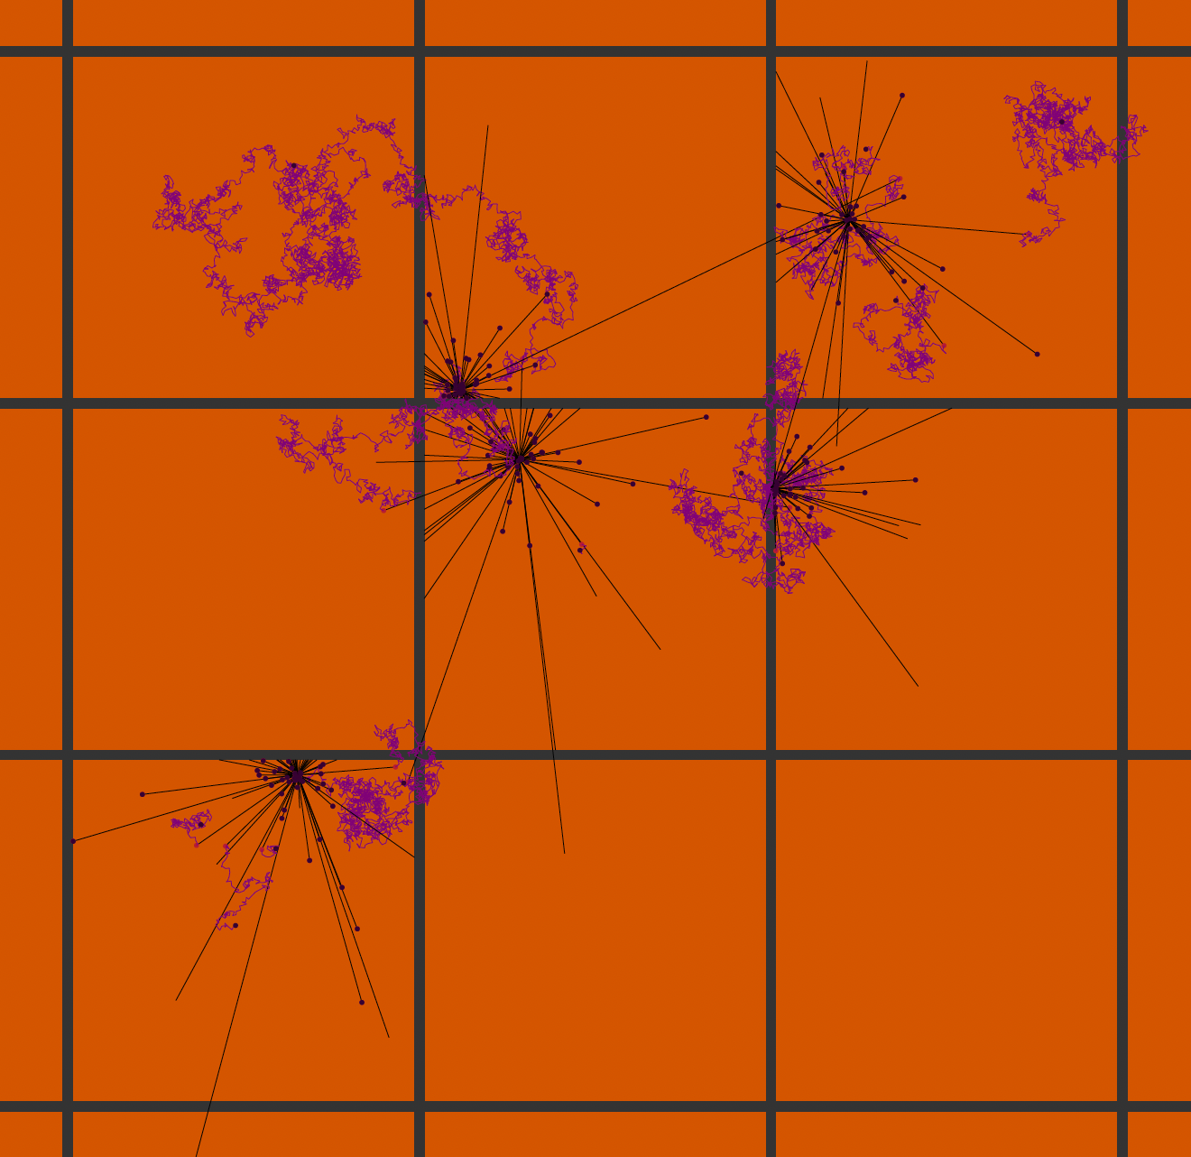
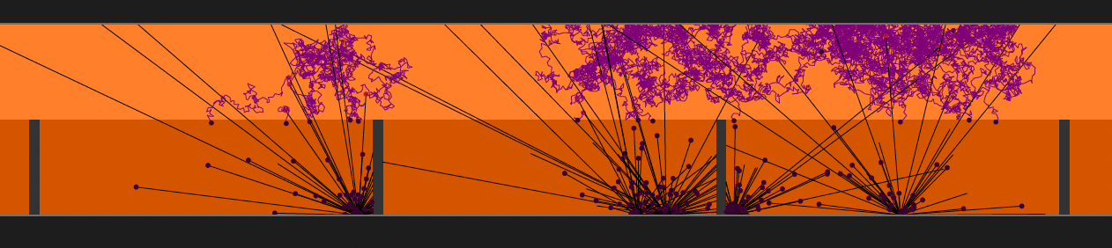
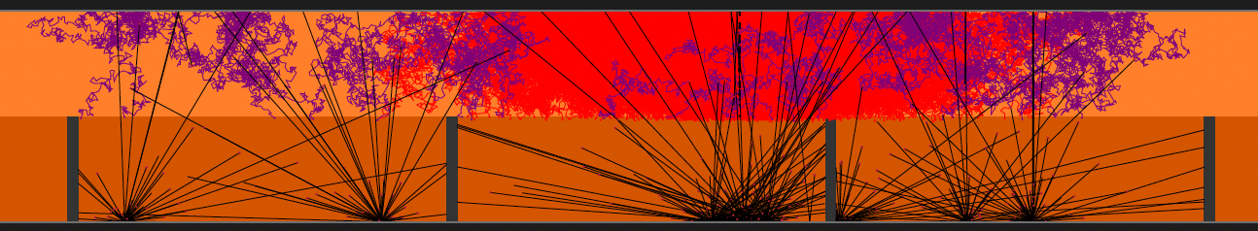
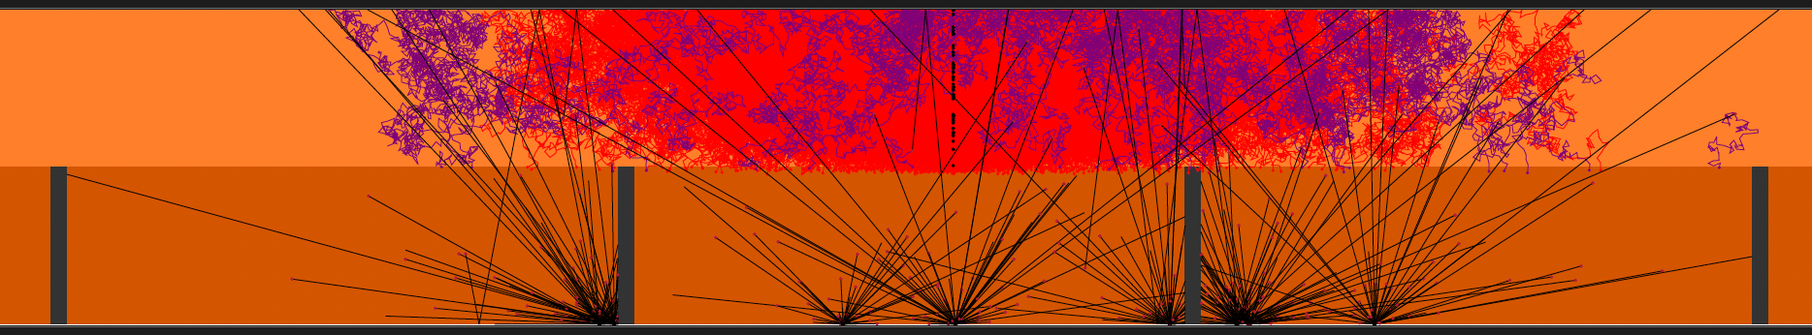
Event display
Sam de Jong (UVic)
Primary e⁻ in red
e- from photons in purple
MIP
Single seed avalanche

Slide 12
WG1 supporting development of next generation SPADs
Characterization for performance validation
  What most group do…
Also need models
  Avalanche development
  SPICE
  Charge carrier and photon transport
    Not only ray-tracing also interference (Lumerical)
  Light production sources
  Dark noise sources
And detailed characterization
  Efficiency vs wavelength and angle
  Reflectivity vs wavelength and angle
  Avalanche on-set
  Timing distribution vs wavelength and voltage
  New techniques: Two-photon absorption, measure cross-talk photon vs angle

Slide 13


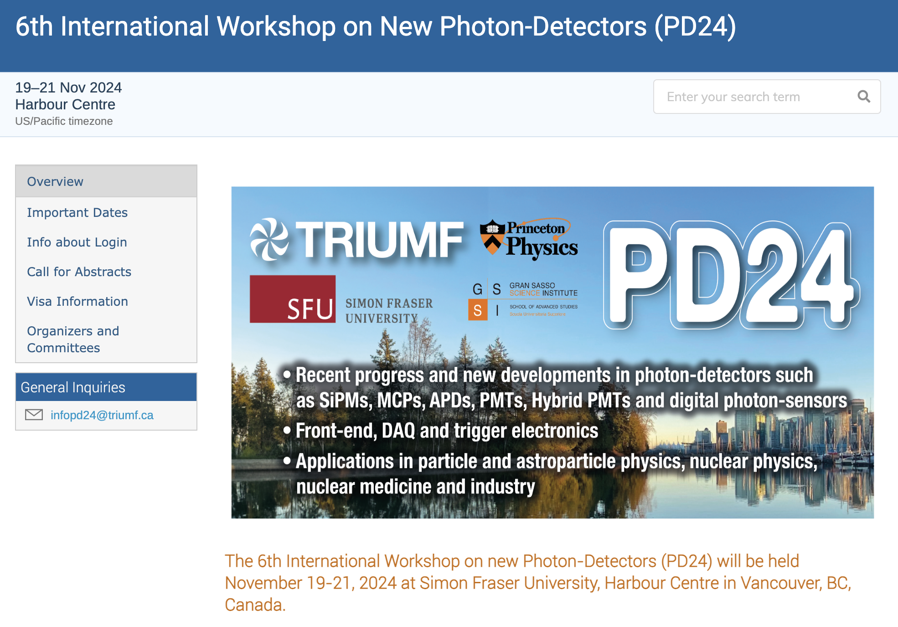
The end
https://indico.cern.ch/event/1404192/

Slide 14
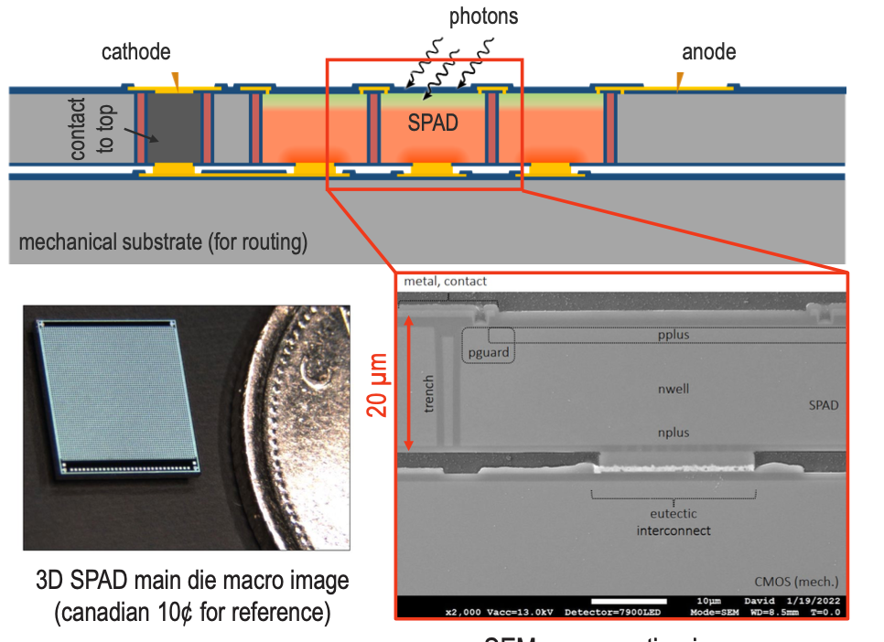
Building upon Photon to Digital Converter
PDC developed for Astro-particle physics
“Front-side” illuminated single photon detector
Designed at U.Sherbrooke (QC, Canada)
Built at Teledyne-DALSA (QC, Canada)
Parent, Samuel, et al. "Single photon avalanche diodes and vertical integration process for a 3D digital SiPM using industrial semiconductor technologies." 2018 IEEE Nuclear Science Symposium and Medical Imaging Conference Proceedings (NSS/MIC). IEEE, 2018.
JF Pratte NSS 2022 plenary talk

Slide 15
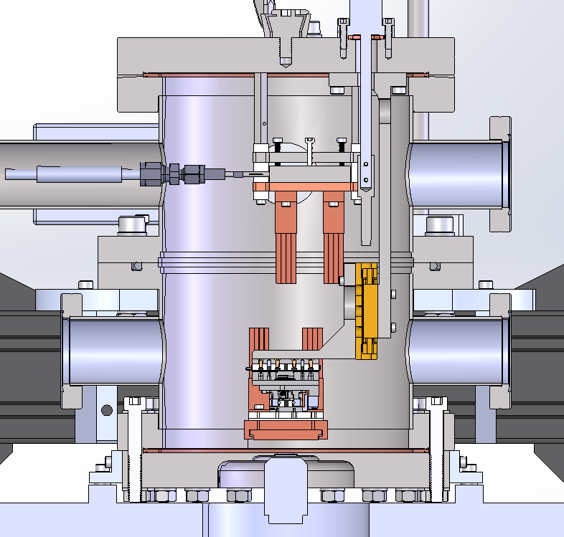
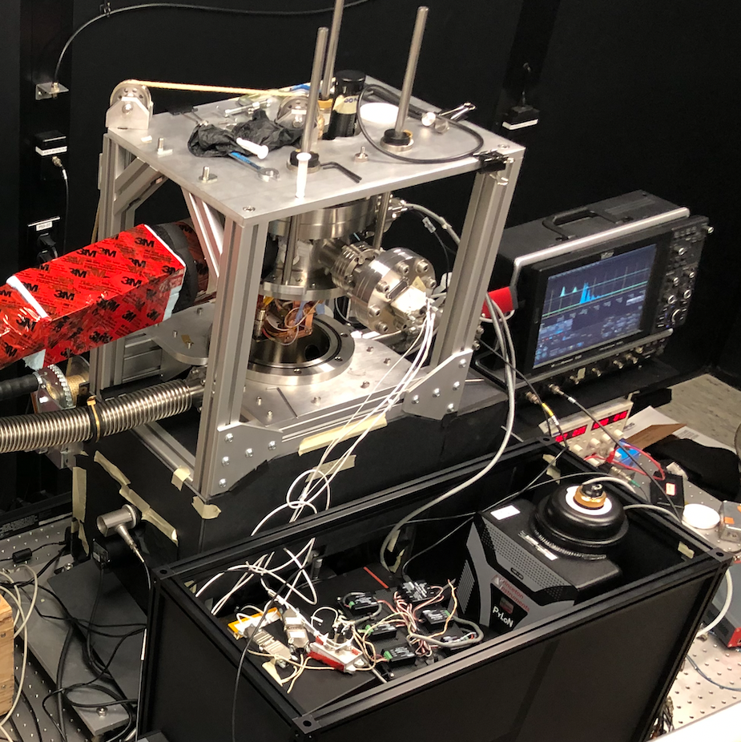
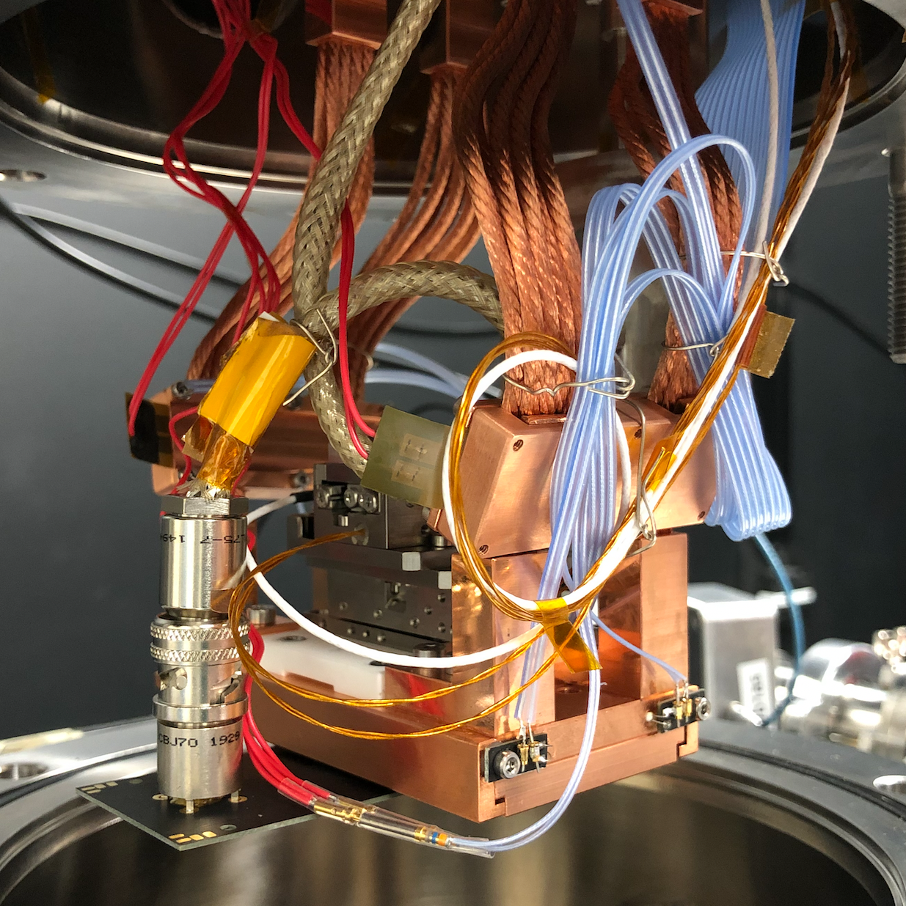
MIEL
Microscope for the Injection and Emission of Light
Cooled X-Y Stage
SPAD
DAQ
Vacuum Window
SiPM Surface
Upper Cold Stage
Vacuum Chamber
Objective
Copper Braided
Cold Fingers
Sync
Dichroic Mirror
X-Y Stage Motors
Laser
LASER
(405 nm)
SiPM Position
Microscope Objective
Emission Filter
Emitted Light
IX-83 Microscope
Diffraction Grating
B)
A)
Spectroscopy
Imaging
Spectrometer and Cryogenically Cooled Camera
The MIEL Experiment
Cryogenically Cooled X-Y Stage with SiPM Mounted

Slide 16
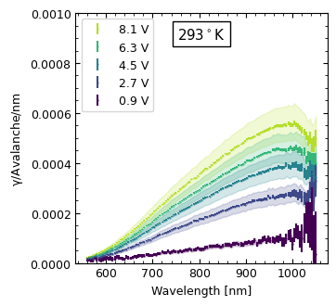
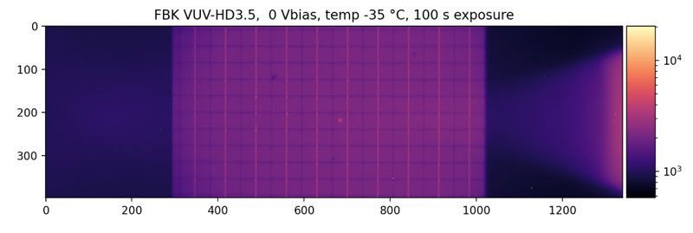
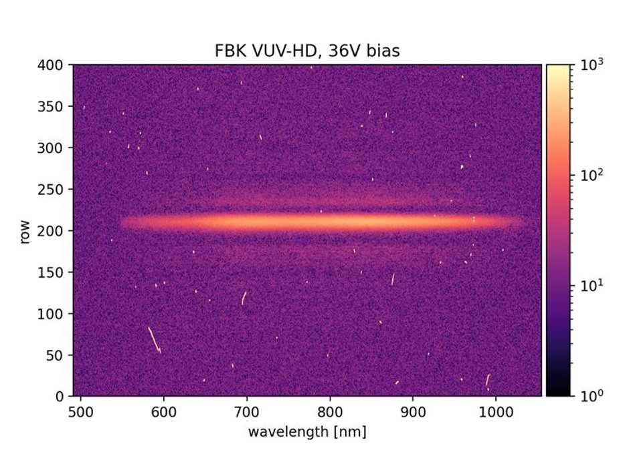
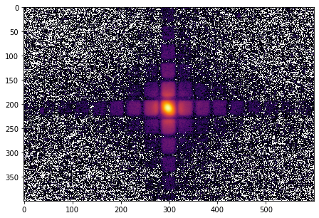
MIEL
Cooled X-Y Stage
Two basic modes
SPAD
SiPM Surface
B)
Vacuum Window
A)
Vacuum Chamber
Objective
FBK Reflected Light and Laser Spot
Dichroic Mirror
Laser
(405 nm)
Emission Filter
Emitted Light
IX-83 Microscope
Diffraction
Grating
B)
A)
Spectroscopy
Imaging
Spectrometer and Cryogenically Cooled Camera
2D Emission Map

Slide 17
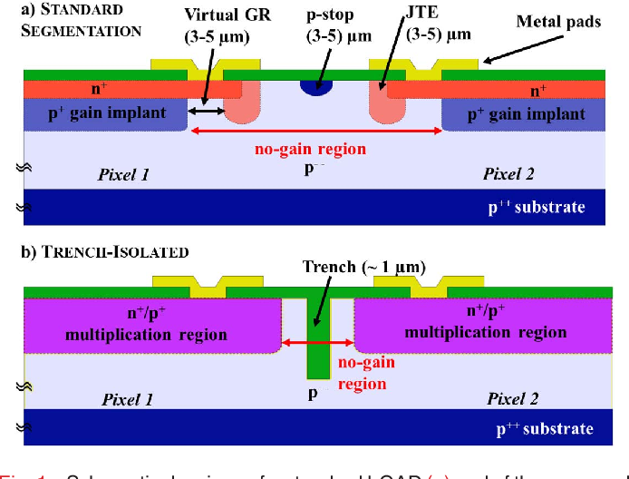
From trench isolated LGAD to Single Photon Avalanche Diode
Picture of a SPAD from the Photon to Digital Converter system
G. Paternoster et al. 10.1109/LED.2020.2991351

Slide 18
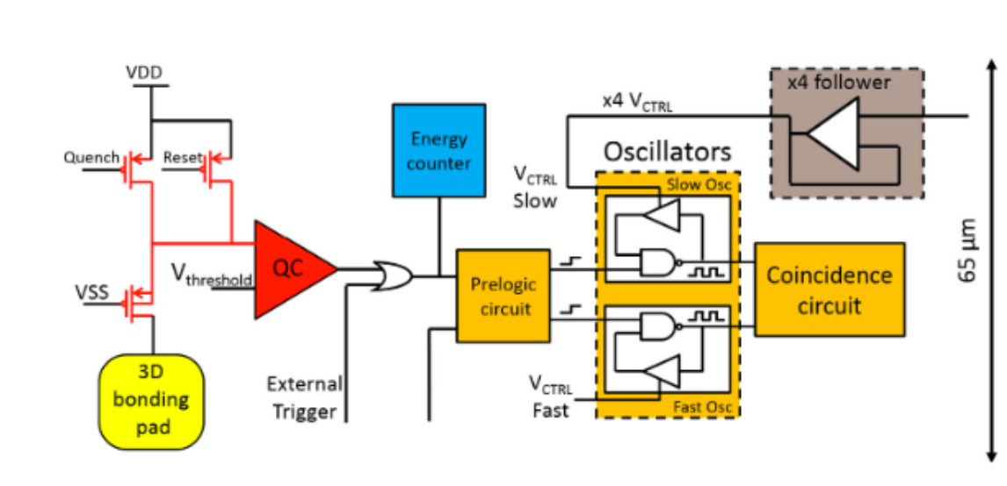
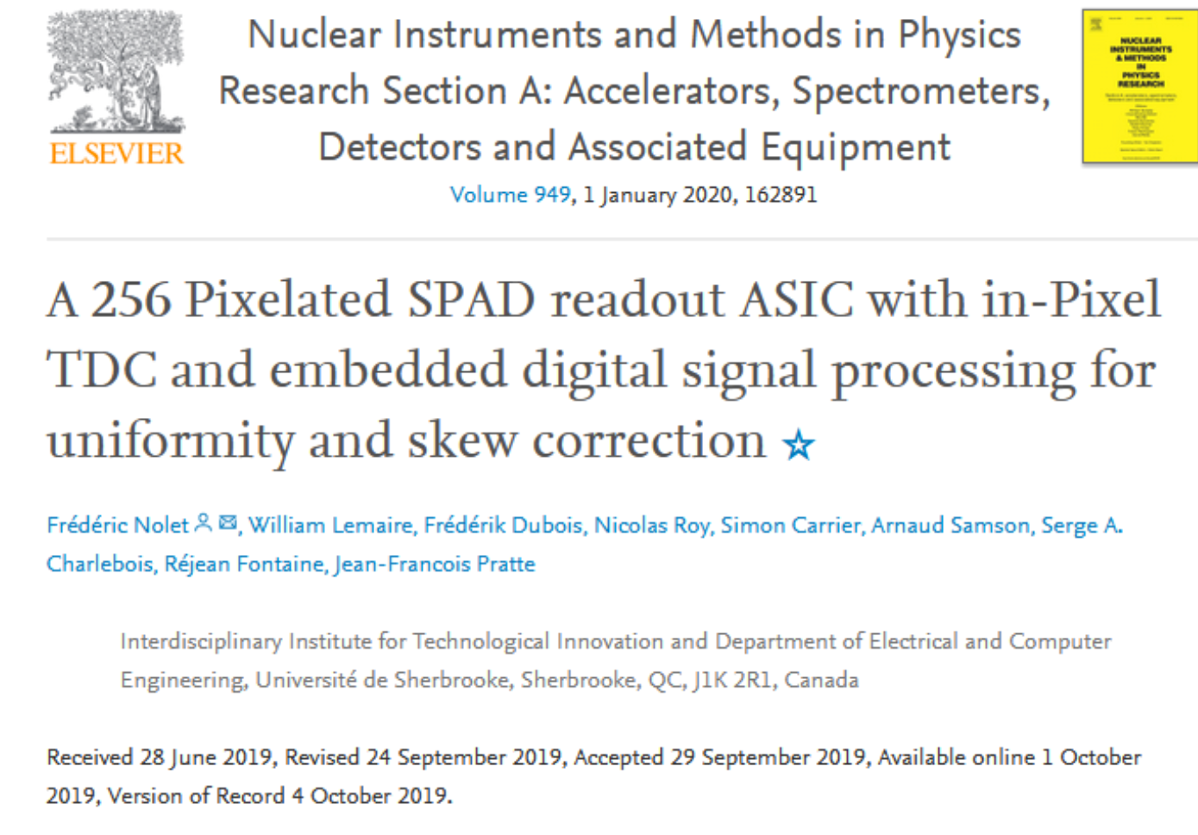
TDC integrated in each Single Photon Avalanche Diode (SPAD)

Slide 19
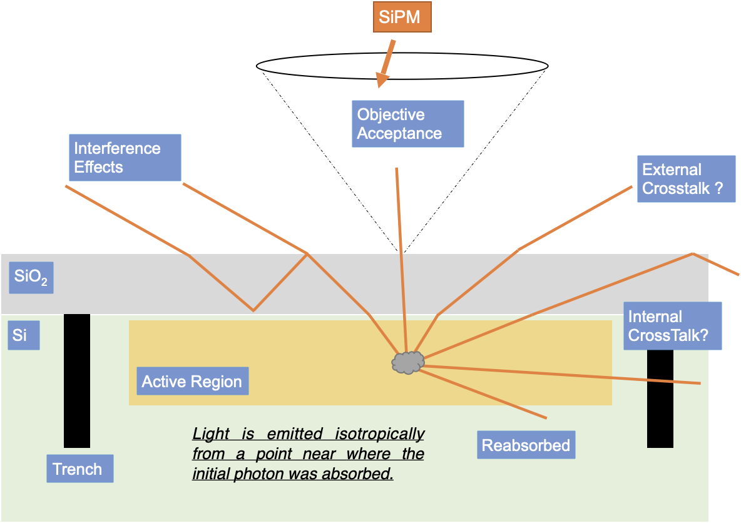
Light emission to crosstalks
Single Photon Avalanche Diode
Light emission assumptions:
  At p-n junction – maximum field
  Isotropic
External cross-talk
  Photon escaping the SiPM surface
Internal cross-talk
  Photons being absorbed in a neibhoring SPAD
We measure photons escaping with objective acceptance

