Slide 1

RICH simulation using GPUs
DRD4-WG4 meeting
Sajan Easo
19-06-2024

Slide 2
Introduction
Graphics Processing Units (GPUs) are already used for various applications in HEP in recent years.
In this context, I focus on the usefulness of GPUs for the software related to Cherenkov detectors.
In the coming years experiments need to simulate and reconstruct billions of events which have RICH data.
This is especially important for experiments at the LHC.
If one uses the standard CPUs, the cost of running these programs will become prohibitively expensive.
Simulation:
RICH simulation requires single photon transport.
Until recently, RICH simulation consumed ~30% of the CPU time of LHCb simulations.
GPUs are used efficiently by the industry for ray tracing optical photons.
Example: OptiX from NVIDIA is used in video games.
Optical photon simulation is well suited for GPUs
We would like to reduce the fraction of time taken up by the RICH
Reconstruction:
The parallelization offered by the GPUs can be useful for various parts of the particle identification
procedure in the context of large number of track-hit combinations.

Slide 3

Ray tracing overview
Rendering : Generate an image using a computer program from a 2D or 3D model
‘Ray tracing’ and ‘Rasterization’ are two of the techniques used for rendering images using computer graphics
Mathematical basis : Examples:
https://dl.acm.org/doi/10.1145/1468075.1468082
( from 1968)
https://dl.acm.org/doi/10.1145/15922.15902
(from 1986)
In recent decades this was used in films : Example Cars (by Pixar)
These days, it is used in video games that use GPUs.
Your smartphone also may be using it.
There are many ‘Ray tracing’ packages in the market, adapted for different uses.
The industry has lot more resources than HEP in terms of developing new packages for this.
The GPUs offer significant improvement in computing power, over CPUs.
Recent examples are NVIDIA RTX series and AMD XT series.
OptiX uses CUDA API which is an extension of C. It is designed to work with C++ and
is a software layer that gives direct access to GPU instruction set and compute kernels, for the NVIDIA GPUs.

Slide 4
HEP detector simulation
On a CPU, the simulation can be speeded up by techniques that are already available:
Recent versions of GEANT4 has ‘multithreading’ . It is already being used
In LHCb, there is GaudiHIVE which is for processing events in parallel
However, the typically the effective speed-up factor so far is very low.
The optical photon simulation is quite specific. Considering that GPUs offer a significant speedup factor
compared to what is achievable by other means, it would reduce the fraction of time taken for
RICH simulation to a negligible value.
In GEANT4, particle transport is done by ‘G4Navigator’ for all particles including optical photons.
In order to speed-up RICH simulation, ‘G4Navigator’ is replaced just for the optical photons,
with the ray tracing done by ‘OptiX’ in a GPU .
CELERITAS: Project to convert simulation of all particles using GPUs : interface to GEANT4, ROOT etc.
As I understand, for now, it is not specialized for optical photons.
arXiv:2203.09467v2

Slide 5
Outline
Pioneering work in JUNO for using GPUs
General structure of the program for simulation using GPUs
Proof-of-principle implementation in LHCb.
RICH reconstruction: usefulness of GPUs
Another implementation
Not covered in this presentation.
This is covered in other presentations, for example DRD4 preparation meeting on May16- 2023.
Geometry created for simulation using GPUs could also become useful for reconstruction.
Acknowledgments to colleagues

Slide 6
JUNO Simulation
The Dayabay and JUNO neutrino experiments have large water Cherenkov detectors.
The detector simulation is based on the GEANT4 package.
GEANT4 is used for the simulation of all the particles other than optical photons
An interface package named Opticks was developed to provide the interface between GEANT4 and OptiX
Simon Blyth is author and maintainer of this interface package.
This was the first attempt to use the OptiX for simulating optical photons in a HEP experiment.
At present many HEP groups are using this method for photon simulation
Examples:
Fermilab CaTS (Calorimeter tracker simulation) project uses Opticks+OptiX
LUX-ZEPLIN (dark matter experiment) uses Opticks+Optix
(https://www.epj-conferences.org/articles/epjconf/abs/2021/05/epjconf_chep2021_03037/epjconf_chep2021_03037.html )
IceCube experiment (neutrino telescope in Antartica) also uses OptiX in collaboration with NVIDIA
( https://link.springer.com/article/10.1007/s41781-022-00080-8)

Slide 7
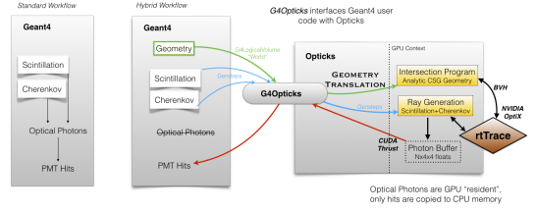
General structure
Ref: S.Blyth,
EPJ Web Conf, 251 (03009) , 2021
Recently this structure is modified with OptiX7. See backup slide
Optical processes: For the creation and transport of optical photons in the standard GEANT4 workflow
Hybrid Workflow:
Instead of using GEANT4 optical processes, the corresponding methods in OptiX are used
All other particles are tracked by GEANT4 as in the standard workflow.
Opticks
This enables to translate the required parts of geometry and optical properties, into a format needed by OptiX
This also facilitates copying the information on the ‘hits’ in photon detectors, back into GEANT4.

Slide 8
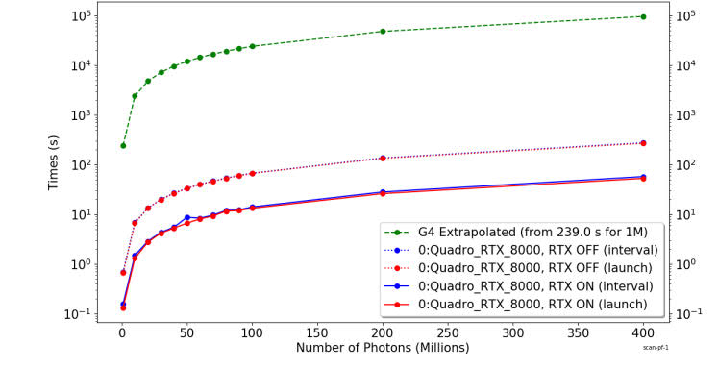
Performance in JUNO
Simulation time versus number of photons
Ref: S.Blyth,
EPJ Web Conf, 251 (03009) , 2021
Green: GEANT4 alone
Solid Red: GPU with RTX option
Dotted Red: GPU without RTX option
Red: Without overhead for upload/download each event
Blue: With overhead for upload/download each event
(Difference between Red and Blue is small on the
scale of these plots, with log scale along the vertical axis)
In this illustration, for 400 million photons
Time taken by GEANT4 : 95600 seconds ( Using GEANT4 version 10.4.2 in single threaded mode)
Time taken by OptiX (with Opticks) : 58 seconds ( Using a single GPU )

Slide 9
Development in LHCb
An R&D project started within the scope of LHCb
Goals of the R&D project :
Use the Opticks and OptiX in a simple RICH system as proof-of-principle
Compare the results from this new system with those from running GEANT4 alone.
Transform the full LHCb-RICH simulation to be able to use the GPUs
Integration into the LHCb software framework, which uses DD4HEP and Gaussino
Achieved by 2023
Results from the prototype implementation published in :
“Gpu based optical photon simulation for LHCb RICH1 detector” :
Eur. Phys. J.C 83 (2023) 11.
(Collaboration between RAL and Manchester groups)
Short description of this implementation : Following pages

Slide 10
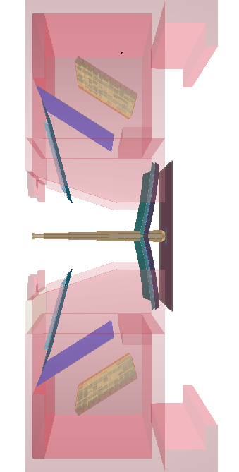
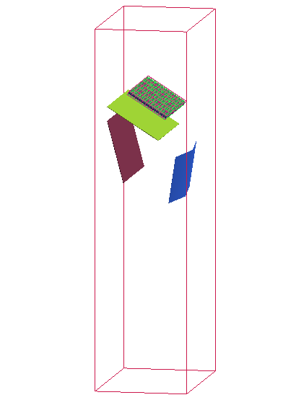
Full and simplified RICH description
Simplified RICH description :
It has the same optical geometry, radiator and
photon detector system as that of LHCb-RICH1
The optical properties (Mirror reflectivities, QE etc )
are same as those used for LHCb-RICH1
However, there is only a single set of spherical and ‘flat’ mirrors
in the top half, without their supports.
There is no beam pipe, exit window and magnetic shielding
Simplified RICH
LHCb-RICH1

Slide 11
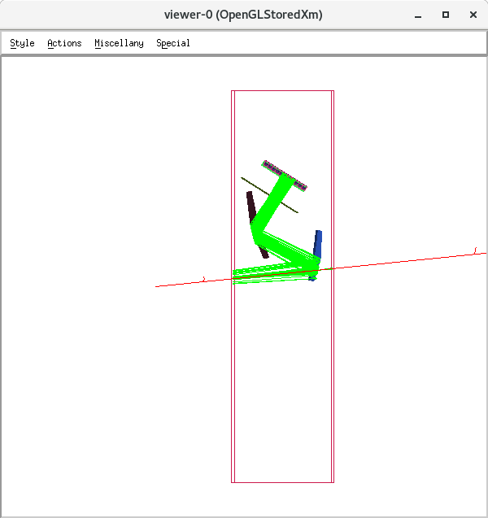
Simplified RICH
Many issues were solved in translating the geometry from the GEANT4 into Opticks.
This enables CSG (constructive solid geometry) → BREP (Boundary representation)
Workflow:
Data for detector description
in C++ files
GEANT4 geometry
Opticks
GEANT4 simulation
OptiX simulation
Y
GEANT4 Output
X
Z
Particle gun used in simplified RICH
GEANT4 : OpenGL graphics

Slide 12
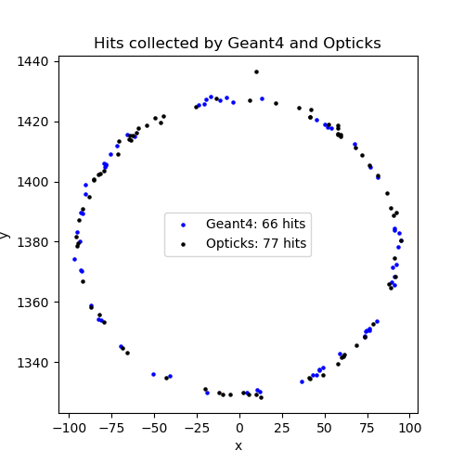
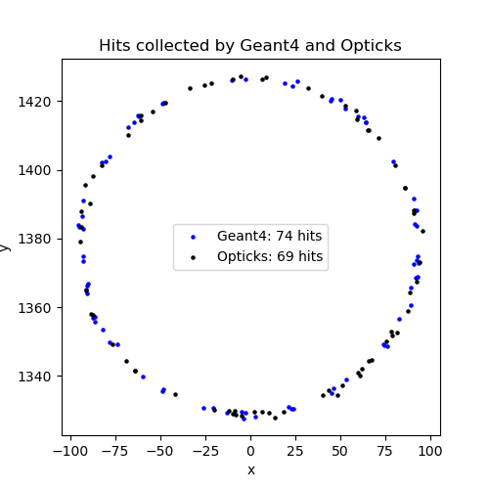
Simplified RICH
Comparison between GEANT4 and Opticks+OptiX simulations
Detailed comparisons of the various steps of the simulation were done
A few problems in using Opticks were solved, along the way
Example Event 1
Example Event 2
XY coordinates of hits on the
detector plane from single events
from GEANT4 simulation and
Opticks+OptiX simulation
Hit distributions obtained from the two
simulations are similar to each other
Hits obtained from using a particle gun with 4 GeV/c electron

Slide 13
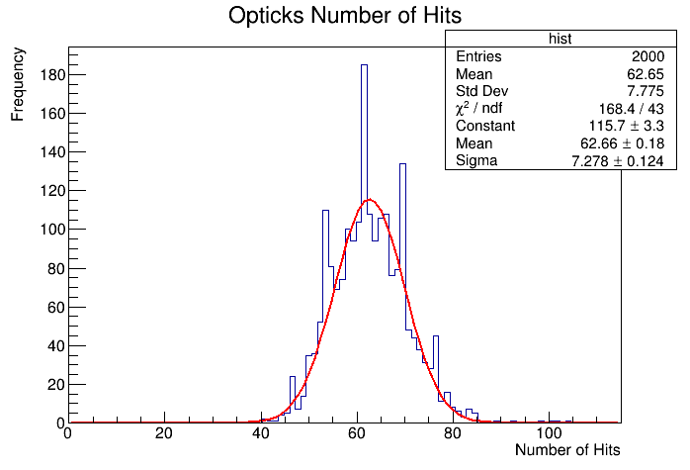
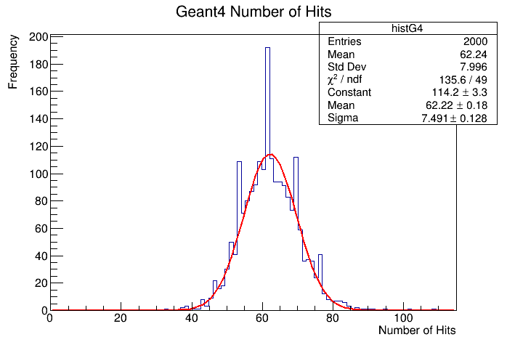
Simplified RICH
Yield comparison between GEANT4 and Opticks+OptiX simulations
Yield obtained from running 2000 events with particle gun
 | Simplified RICH: GEANT4 | Simplified RICH: Opticks+OptiX | Full LHCb-RICH1: GEANT4
Mean yield | 62.2 | 62.7 | 62
Opticks+OptiX produces a yield
similar to that from GEANT4 for the
Simplified RICH configuration.
Some variations of the final yield seen, depending on the tuning of the optical processes used in GEANT4 and Opticks. .

Slide 14
Measurement of timing
For this, generate very large events from effectively re-sampling single events
Using the simplified geometry, for now.
Plot the execution time as a function of the number of photons
Computers used for these studies:
Intel ( R) Xenon (R) Silver4210 R 2.4 GHz for CPU
Two NVIDIA Tesla T4 GPUs
Timing measured using :
Built-in capabilities of the GEANT4 application program we used, and
NVIDIA Nsight tool (https://developer.nvidia.com/nsight-systems )
Measurements made using a single core and the propagation times quoted are for ‘single GPU’ used.

Slide 15
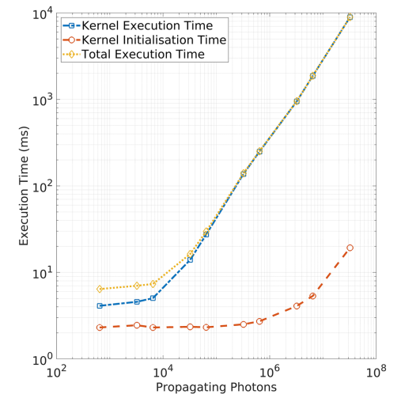
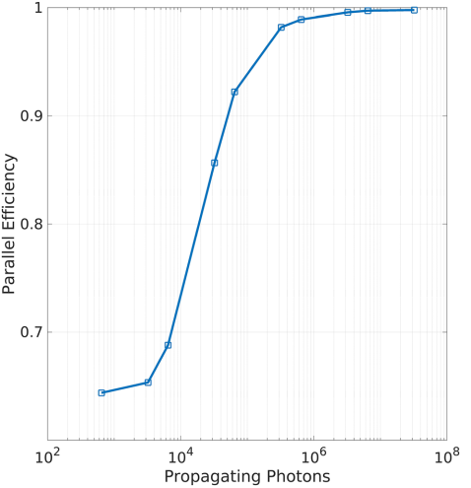
Measurement of timing
Kernel execution efficiency
Efficiency= Time used for propagation / total execution time
When there are too few photons, the significant fraction of the time is taken up for ‘overhead’ from device (GPU) initialization.
Above 10⁵ photons efficiency is above 95% . In this case, most of the time is taken up for photon propagation.
This makes the LHCb RICH system suitable for using the GPUs, already in LHCb-RUN3.
It would become essential in the high luminosities that are expected to be simulated in the LHCb-Upgrade2

Slide 16
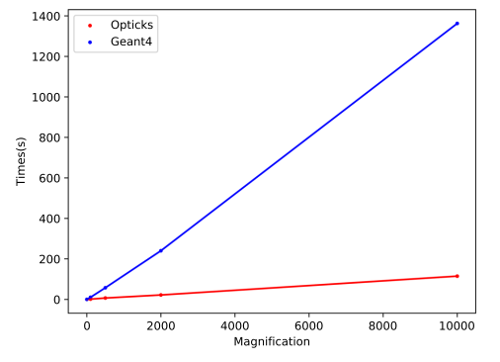
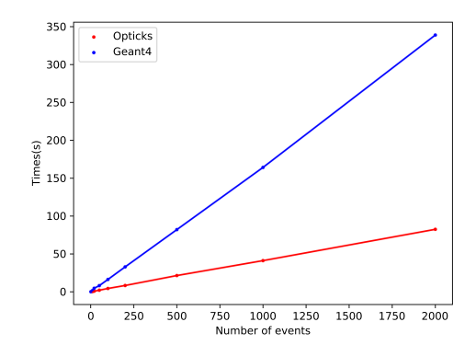
Measurement of timing
Example of comparison : GEANT4+Opticks+OptiX vs. pure GEANT4
Scale up the number photons generated by a ‘Magnification factor’ in an event or
use multiple events in a single run. The former is expected to be a better comparison for ‘pure photon’ simulation.
The first method results in the Opticks simulation to be 10 times faster than pure GEANT4 simulation.
The second method results in the Opticks simulation to be 5 times faster than pure GEANT4 simulation.
Here the geometry is not yet optimized for usage in Opticks and there is considerable overhead from aspects
other than those for photon propagation.

Slide 17
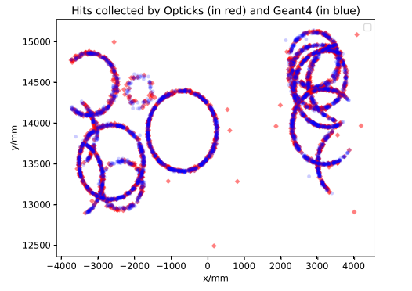
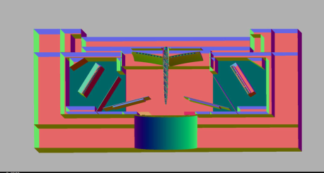
Prospects for integration into LHCb system
Example of sending multiple charged
particles through full LHCb-RICH1 geometry.
There is scope for adapting the LHCb geometry description
for Opticks in order to improve the speed-up factor.
Performing this and verifying all the results would be a
major project.
Distribution of hits on the photon detector plane
which has an array MaPMTs
Opticks uses many external packages
such as GEANT4, XercesC, CLHEP,Boost and are
installed through an automated command for
‘standalone’ usage.
A script was developed to install them
based on LHCb-nightly system. This could provide the
foundation for a future integration into the LHCb framework
As I undertstand, GEANT4 is willing to support Opticks in the future.
In this case, Opticks+OptiX may become part of GEANT4 distribution. They may also become part of
the ‘external packages’ supported by LHCb.
Migration to OptiX 7
LHCb RICH1
geometry using OptiX7
This is major change, compared to the OptiX6.5 that we were using the in the past.
Opticks has migrated to this new version and hence our programs also need to be adapted for this.

Slide 18
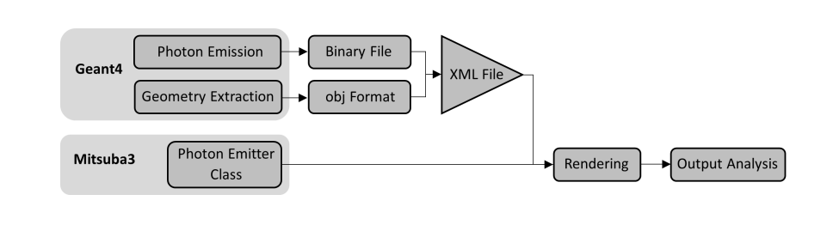
Another implementation : Mitsuba 3
This developed at RGL at EPFL. It uses C++17 on top of Dr.JIT just-in-time compiler.
Backends:
Scalar: Performs computations on a CPU. Used mainly for debugging.
CUDA : Offloads computation to a GPU. In this case the ray tracing is delegated to OptiX.
LLVM : Generates code for different CPU architectures.
This is useful, if you do not have NVIDIA GPUs.
Scalar and LLVM backends use ‘Intel Embree’ as default.
Instead of ‘single photons’, it uses ‘light rays’ with a specified ‘radiant intensity’
It also simulates bloom (shader) effects used by computer graphics in some video games.
Therefore, one needs to select ‘pixel values’ above a threshold to get ‘hits’.
This is not integrated to GEANT4.
As result, for the current prototype implementation: (done by the Manchester group )
Photons created in GEANT4 are copied to a BIN file.
‘Simplified Geometry’ exported to an OBJ flle
An XML program reads these files.
A new photon emitter class re-creates the photons
Output of ray tracing stored into a file in ‘Numpy’ format.
For the geometry, the array of PMTs were replaced by a ‘single film’.

Slide 19
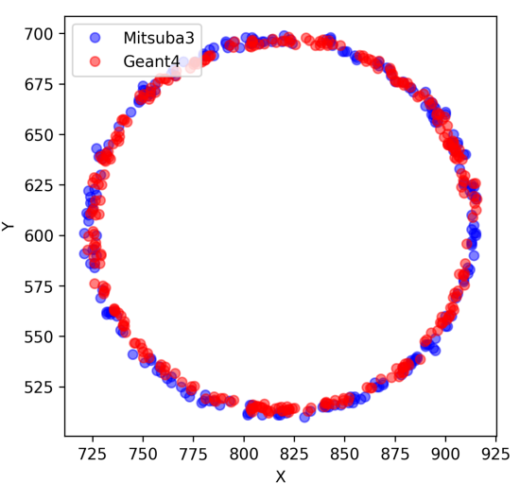
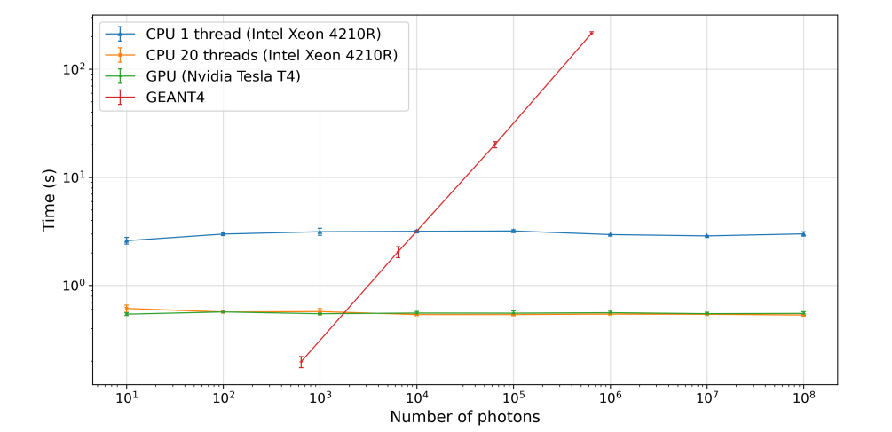
Another implementation : Mitsuba 3
For photons produced by a particle gun, the prototype
implementation achieved the creation of hits
Timing studies: Created large number of photons by
re-sampling the photons created by GEANT4.
The speed-up factor compared to GEANT4 is
from 70 (1 core) on a CPU to 400 on a GPU (20 cores).
However, before considering to use this in a HEP experiment, further work is needed in many aspects including:
Automatic conversion of geometry in memory resident structures.
Being able to implement the wavelength dependent properties in a convenient way. Ability to use multiple photon detectors.
Integration with GEANT4 so that one can simulate the full event, with all detectors.
More information on the prototype implementation at : https://arxiv.org/abs/2309.12496

Slide 20
Summary
GPUs will be needed to simulate RICH detectors in the future.
Prototypes were implemented as proof-of-principle
Opticks :
Developed over the years as the interface between GEANT4 and OptiX.
This is being used in some HEP experiments .
With some optimizations in geometry description, this can be integrated into LHCb
For this to be successfully developed and maintained,
one needs more people to gather expertise in these packages.
Mitsuba 3:
Preliminary studies were conducted in the usage of this, for ray-tracing.
This option will need further developments, before it is ready to be used in a HEP experiment.
This option is useful for mostly for the situation where, the GPUs are not available or CUDA cannot be used etc.

Slide 21
Acknowledgements to colleagues
Usage of Opticks:
Y.Li, A.Pointer, K.Evans, L.Girardey, A.Davis, M.Gersabeck, E.Gersabeck, N.Nandakumar, S.Easo,
and many others in LHCb.
S.Blyth for the continued support on Opticks
Usage of Mitsuba 3:
A.Davis, A.Barre, Y.Cui, K.Evans, M.Gersabeck, A.Rat,A.Montazeri and many others

