Slide 1
ECFA DRD4
Work-Package(s) 4.5
Blake Leverington¹, Guido Haefeli²
¹Heidelberg Universitaet, ²EPFL

Slide 2
WP 4.5.1
Currently only 1 work package, WP 4.5.1 in Scintillating Fibres
Desired inclusion of Luxium and Kuraray as Industrial Partners
  We would like to advance further in our development/selection of new materials
  (would they help us advance faster? How much basic R&D would they do?)
  Need the document from the DRDC/CERN Knowledge Transfer Office clarifying this for MOUs.
Strong synergy with DRD6 WP3 (Optical Calorimeters) (TASK 3.4 MATERIALS)
New groups are welcome, but will need to commit resources. The Working Group is open.
  Contributions without commitment?
  Presentation by Vilnius, Lithuania group today regarding their labs

Slide 3
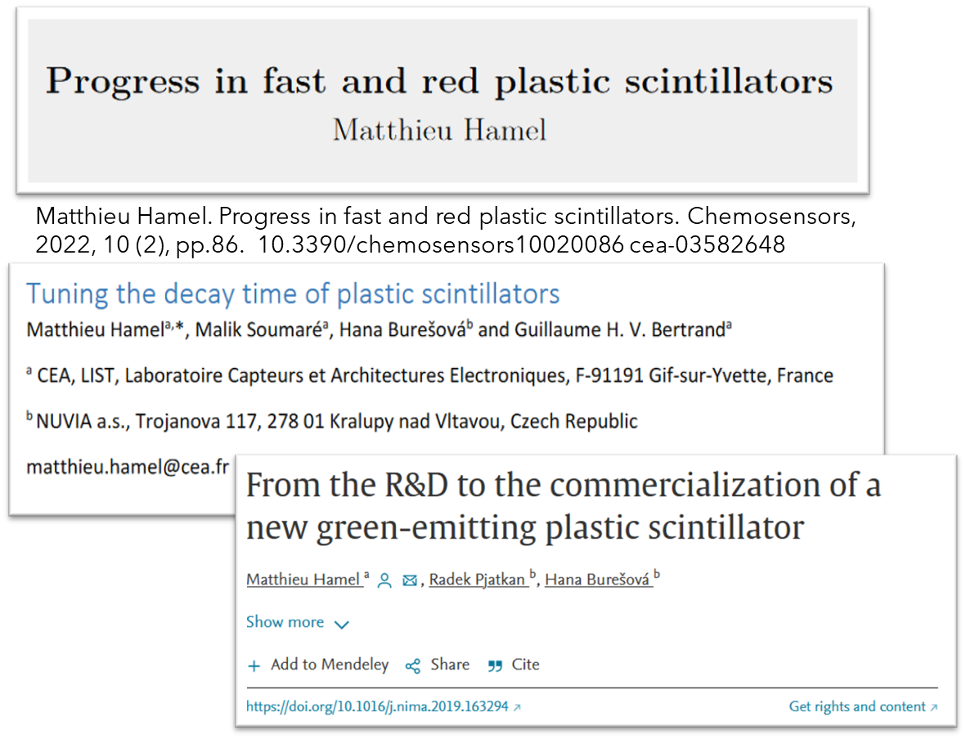
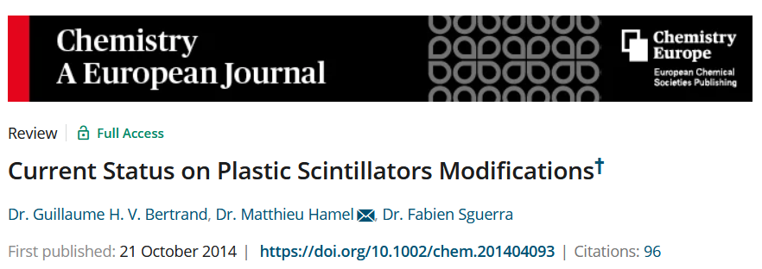
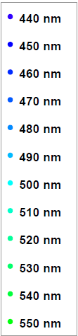
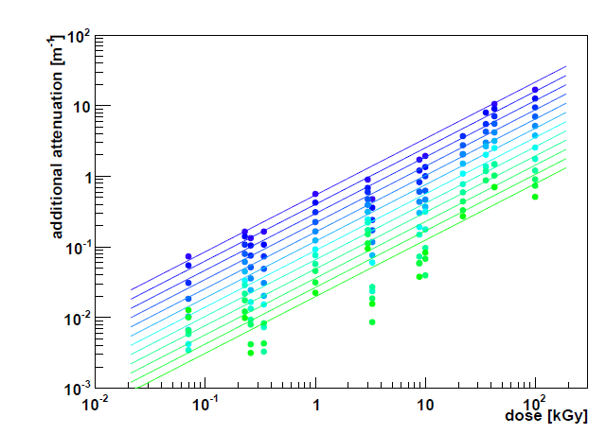
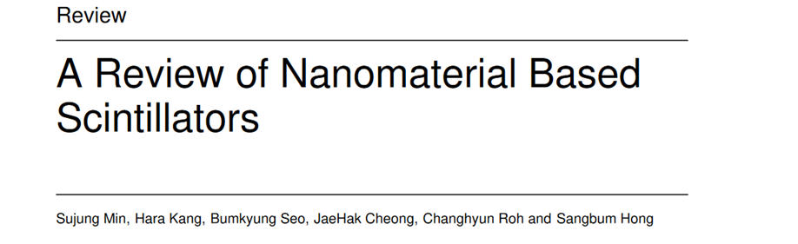
WP 4.5
Task 4.5.1:
“Develop an improved radiation hard scintillating fibre with a fluorescence decay time less than 4 ns.”
The standard fast fibre is over 25 years old (SCSF-78M and -78MJ from Kuraray)
  Peaks at 450nm, 3.5m attenuation length, 2.8ns decay time
  3HF has a decay time of 8ns, but peaks at 550nm.
Goal: A new fibre with larger Stoke’s Shift (to >500nm ) would improve the transmission after irradiation of the fibre
  Should have same or better light yield, attenuation, decay time, and stable in time.
Approx. Operational range of 78MJ
Intrinsic attenuation length 3.5m
Lots of “promising, but…”
From the thesis of R. Ekelhof, 2016. TU Dortmund

Slide 4
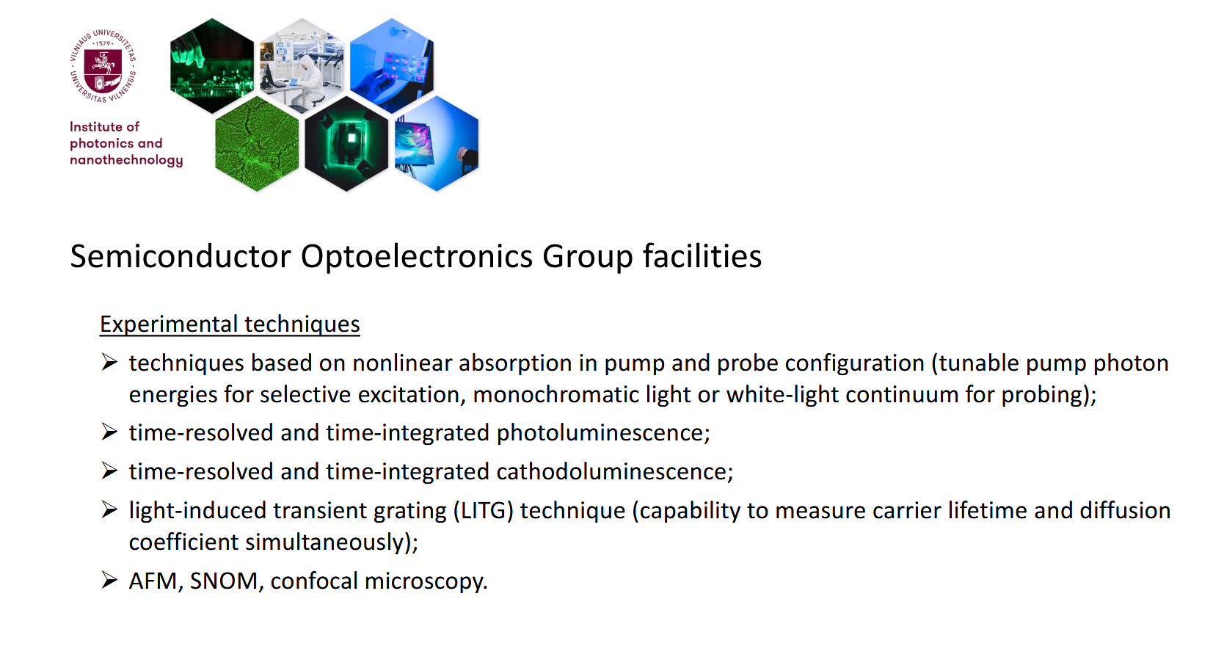
Vilnius (observer to WP?)

Slide 5
Participating Groups
WP 4.5 | 4.5.1
CERN SY-BI | x
CERN-EP | x
CERN-LHCb | x
Clermont-Ferrand | x
Heidelberg | x
Lausanne - EPFL | x
No. of groups | 6
EPFL
  Has produced a few fibre based trackers and telescopes for various experiments and projects
  SiPM development with Hamamatsu and FBK; microlenses; irradiation studies
  Fibre winding for LHCB SciFi Tracker
  Cryo-cooling of SiPMs for LHCb Upgrade 2
  Investigating new scintillators with polymer chemists at EPFL
  Good connection with Kuraray (fibres)
Heidelberg
  Module production for LHCb SciFi Tracker
  Irradiation studies of Fibres
  Development of LHCb Upgrade 2 Fibre and Pixel Tracker
  Ion-beam profile monitor for HIT clinic
  Investigating new scintillators for fibres
CERN-LHCb + -EP + SY-BI
  SPACAL for LHCb ECAL LS3 and Run5/6 Upgrades
  Irradiation of Scintillators
  LHCb SciFi QA
  Scintillator irradiation and characterization
  Beam Instrumentation
Clermont-Ferrand (Pascal Perret et al.)
  LHCb SciFi Tracker Electronics
Other groups expressed interest in the WG, but not willing to commit to the WP

Slide 6
4.5.1 Work in Progress
Nuvea SP32 & SP33 samples confirmed to be irradiated in July 2024 at IRRAD facility
  Cube samples irradiated in November 2023 showed large brown regions in the inner regions, but not the edges.
  Now sliced in 1mm samples; more similar to a fibre mat than the cube samples
Existing and any new fibres and scintillator should have their time characteristics consistently and precisely measured
  Fast Light yield is more important for efficiency
  long tails are important for noise/spillover clusters when you have 1-2 p.e. thresholds
  Presentation by Vilnius, Lithuania group today regarding their labs
EPFL ordered fibres from Luxium (4km each of 3 types)
  Luxium is interested as an Industry Partner, waiting for feedback from us on the process to join and legal aspects.
  We should discuss industry partners in the Round Table

Slide 7
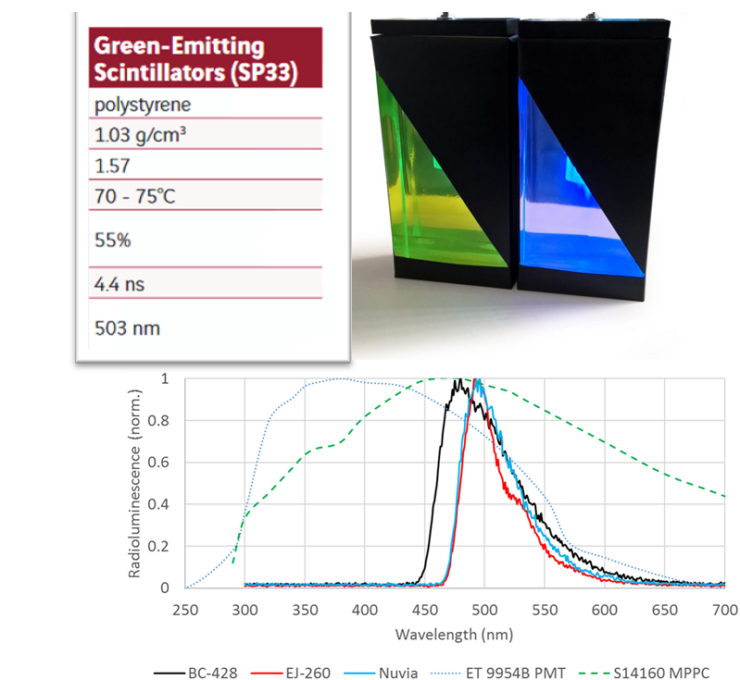
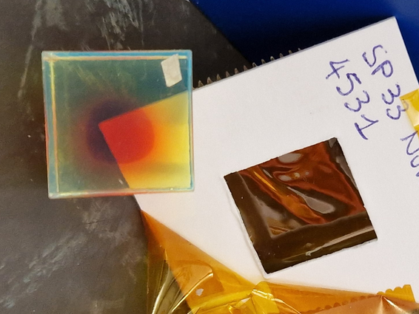
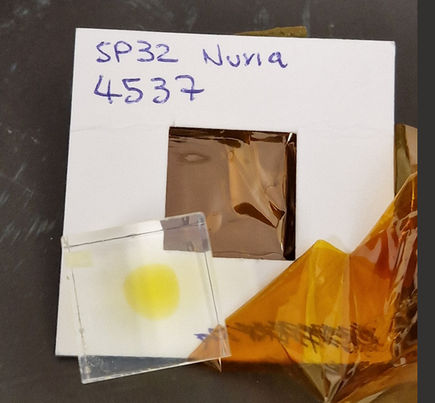
WP 4.5
Task 4.5.1 Milestones:
First, identify new scintillators, fluorescent dyes, or fibre modifications
  Market, literature (organic chemistry journals), simulation. Make contacts.
Obtain samples and characterize the bulk scintillator material → Possibly the hardest part. We can’t produce our own.
  Radiation hardness, timing, wavelength
  Irradiating thin slices of Nuvea SP32/33 in ~May
Production of fibre samples (a few km) with Kuraray
  In contact with positive response. Production facility closed until mid-2024.
Testing and qualification of prototype fibre samples
  Light yield, attenuation length, timing, radiation hardness
Task 4.5.1 Deliverables:
  Report on candidates (between 2 and 3)
  Report on any produced prototype. Not guaranteed to find any.
SP32 and SP33 Sample 2 months after irradiation at CERN (~50kGy).

