Slide 1

Characterization of pixelated high-Z sensor for X and gamma-ray detection
Petr Smolyanski & Benedikt Bergmann
Institute of Experimental and Applied Physics, Czech Technical University in Prague
Petr.smolyanskiy@utef.cvut.cz
Benedikt.bergmann@utef.cvut.cz

Slide 2
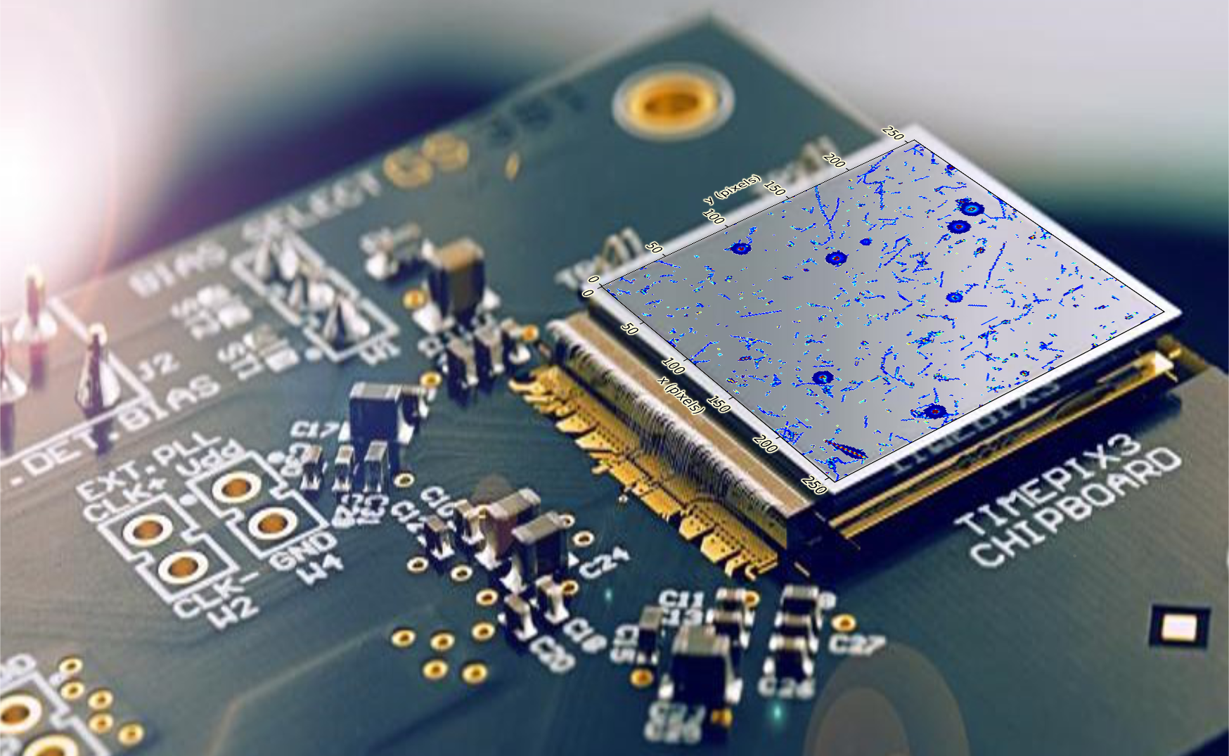
Radiation imaging detector

Slide 3
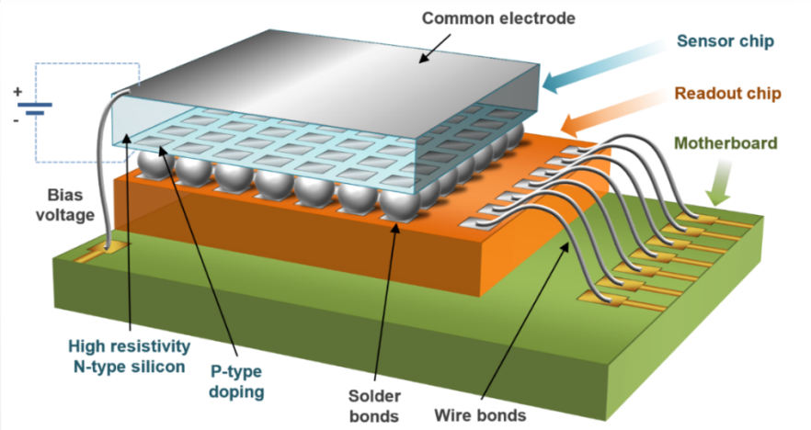
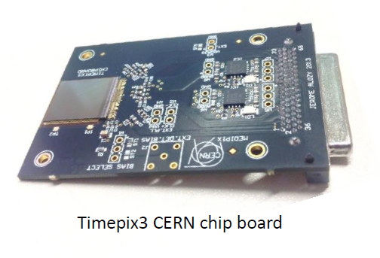
Timepix3 and Timepix4
  Sensor layer (Silicon, GaAs, CdTe, ...) flip-chip bump bonded to the ASIC
Timepix3:
256 x 256 pixels with 55 µm pitch (1.98 cm²)
Data-driven readout (Max. count rate 40 Mpix/s)
Per-pixel dead time of 475 ns
Measurement of energy and time (Δt = 1.56 ns)
Minimal detectable energy per pixel 2.4-3.5 keV
Timepix4:
512 x 448 pixels with 55 µm pitch
Data-driven readout (Max. count rate 640 Mpix/s)
Measurement of energy and time (Δt = 200 ps)
Minimal detectable energy per pixel ~2 keV (?)
Timepix3 with chipboard.

Slide 4
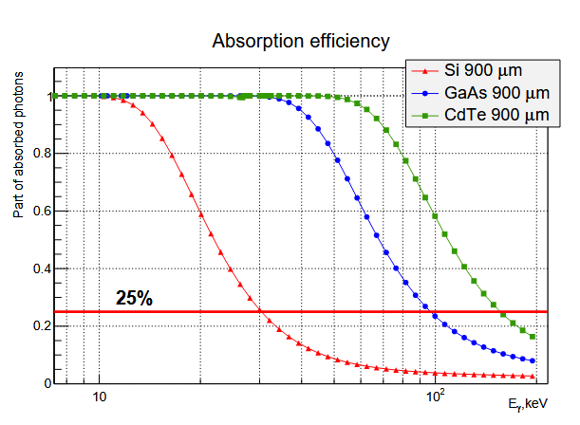
Selection of the sensor material
Physics of interaction with matter
  Detection efficiency vs photon energy
  Compton vs photoabsorption
Semiconductor properties, in particular for high-Z
  Charge carrier drift → shaping times of amplifiers
  Charge trapping → signal loss and deformation of energy peaks in spectra
  Polarization effects → time/radiation dependence of energy measurement
  Internal flourescence & their range → escape peaks or image smearing (imaging application)

Slide 5
Characterization of high-Z sensors in charged particle beams

Slide 6
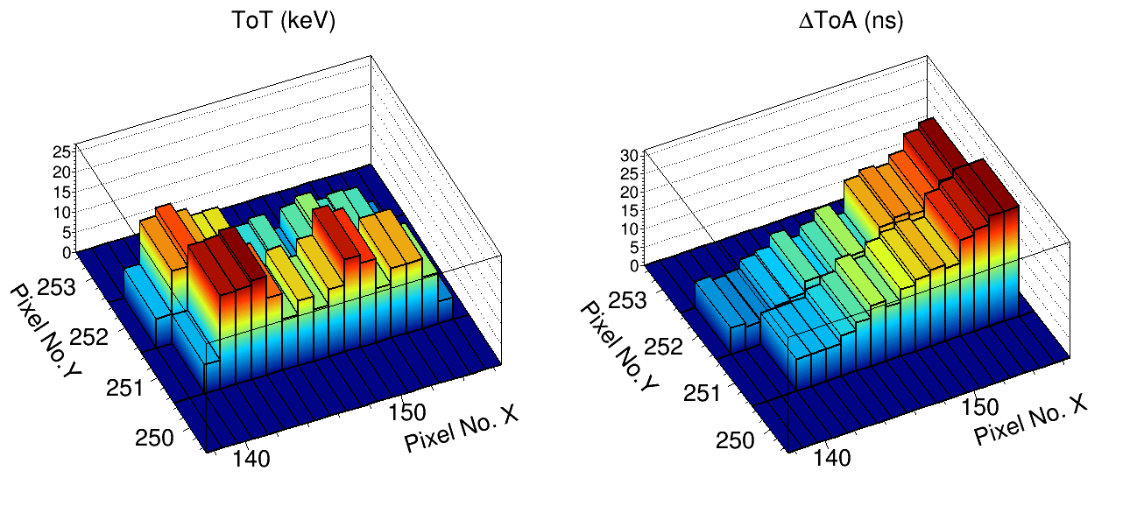
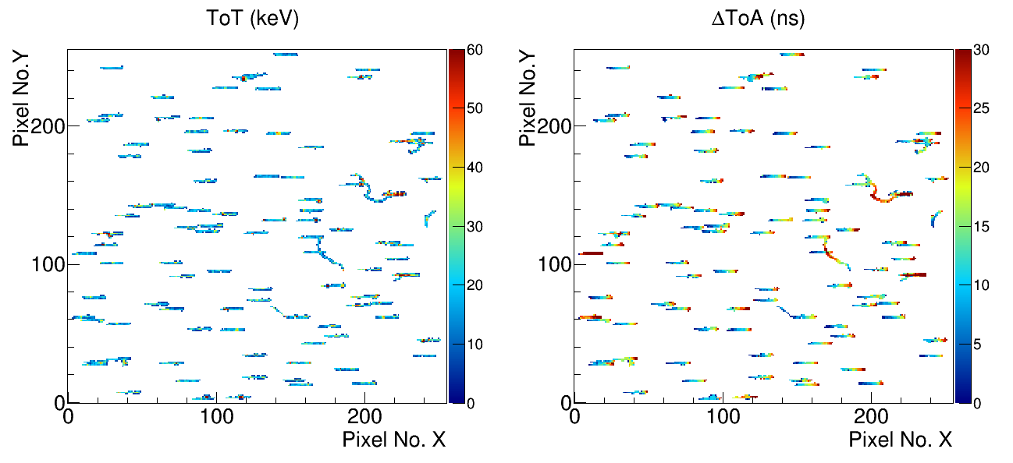
Measurement principles:
Experiment design
Simultaneous measurement of time and energy in each pixel together with the tracking allows a determination of
Charge carrier drift times → mobility µ
Charge losses during drift across the sensor thickness → CCE
Measurement of the lateral spread → Models for diffusion and repulsion
as a function of z

Slide 7
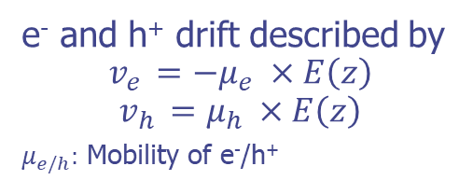
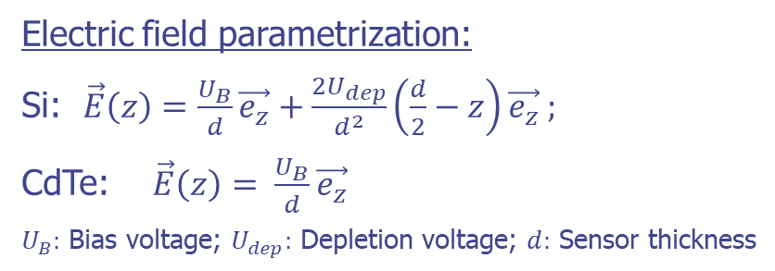
Grazing angle irradiation:
Sensitivity to charge carrier properties
+
-
-
-
z
Charge carrier drift motion:
+
-
+
-
-
-
+
e⁻ and h⁺ drift described by
$$v_{e }=−μ_{e} ×E\left(z\right)$$
$$v_{h }=μ_{h} ×E\left(z\right)$$
$μ_{e/h}:$ Mobility of e⁻/h⁺
+
-
-
+
+
-
+
-
+
-
+
-
+
+
+
-
+
+
+
+
+
+
-
-
+
+
+
+
+
-
+
+
+
t ~ 25 ns
t ~ 15 ns
t = 0 ns
Electric field parametrization:
Si: $\vec{E}\left(z\right)=\frac{U_{B}}{d}\vec{e_{z}}+\frac{2U_{dep}}{d^{2}}\left(\frac{d}{2}−z\right)\vec{e_{z}}$ ;
CdTe: $\vec{E}\left(z\right)= \frac{U_{B}}{d}\vec{e_{z}}$
$U_{B}:$ Bias voltage; $U_{dep}:$ Depletion voltage; $d:$ Sensor thickness
Ramo-Theorem:
Q_{ind} = [Φ(z(t_{i})) - Φ(z(t₀))] x Q₀
Small pixel effect:
Measureable signal if charge carriers are in close vicinity to the pixel electrodes
→ Look-up table: z(t_{meas.},E_{meas.})
Bergmann et al. Eur. Phys. J. C (2017) 77: 421. https://doi.org/10.1140/epjc/s10052-017-4993-4
Bergmann et al., Eur. Phys. J. C (2019) 79: 165. https://doi.org/10.1140/epjc/s10052-019-6673-z

Slide 8
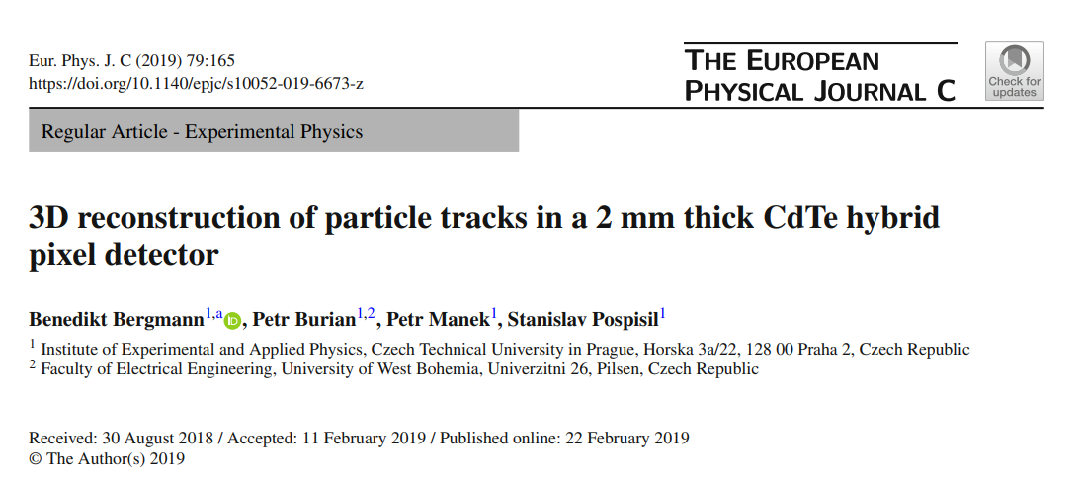
https://link.springer.com/article/10.1140/epjc/s10052-019-6673-z

Slide 9
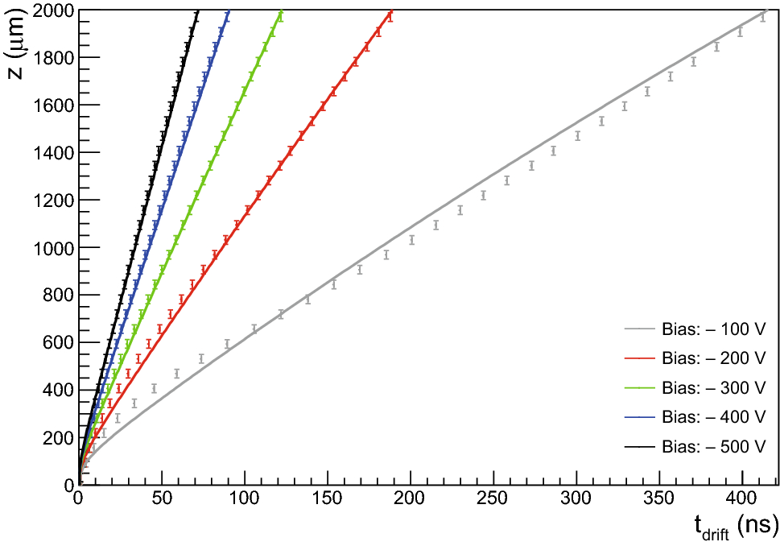
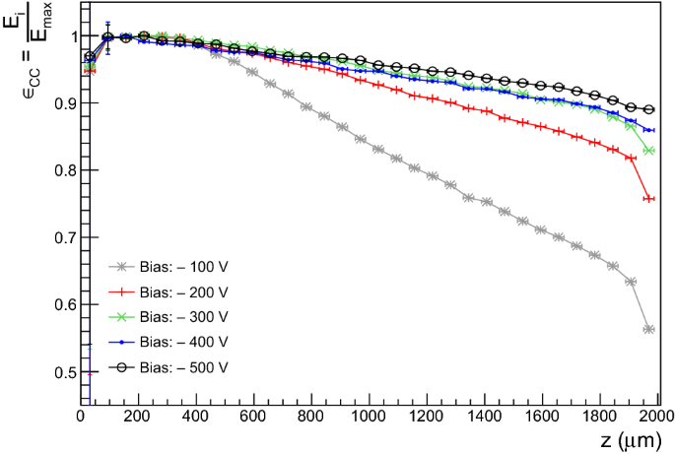
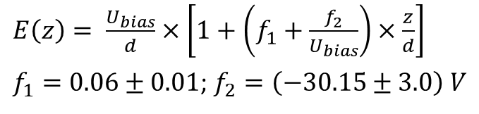
40 GeV/c pion beam:
2 mm thick CdTe (Acrorad) sensor
Drift time as a function of interaction depth
$E\left(z\right)= \frac{U_{bias}}{d}×\left[1+\left(f_{1}+\frac{f_{2}}{U_{bias}}\right)×\frac{z}{d}\right]$
$f_{1}=0.06±0.01$; $f_{2}=\left(−30.15±3.0\right) V$
Negligible signal loss at bias above 300 V

Slide 10
40 GeV/c pion beam:
3D track reconstruction – 2 mm CdTe
Trajectory reconstruction precision <200 µm at 1 m distance
e^{-/+} like event
pair production (!?)
cosmic µ
Bergmann et al., Eur. Phys. J. C (2019) 79: 165. https://doi.org/10.1140/epjc/s10052-019-6673-z
fragmentation
z-resolution: σ_{z} ~ 60 µm
Improved determination of track directions
Improved separation of different particle classes
Notes:
Here you can see the methodology applied to real-world data from a measurement with 120 GeV/c pions at SPS. The sensor used here was a 2 mm thick CdTe.
Analysing the cosmic muon track (measured in my office) which is fitted with a 3D line, we can estimate that the extrapolation error at a distance of 1 m amounts to below 200 µm.
The presented track reco does not only improve particle tracking and identification, it also provides means to utilize Timepix3 as a single-layer Compton camera (and polarimeter). This is currently used by several groups mainly in the medical sector and for environment monitoring.
Compton camera in particular in combination with high-Z sensors

Slide 11
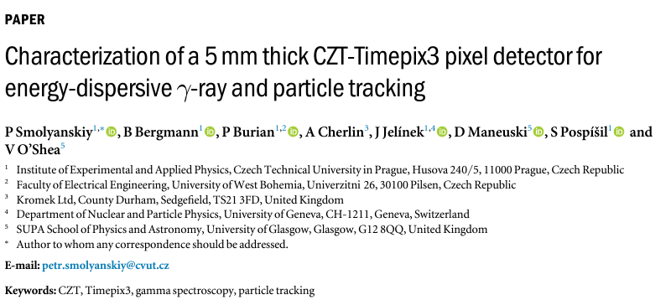
CZT from Kromek
https://iopscience.iop.org/article/10.1088/1402-4896/ad10dd/meta

Slide 12
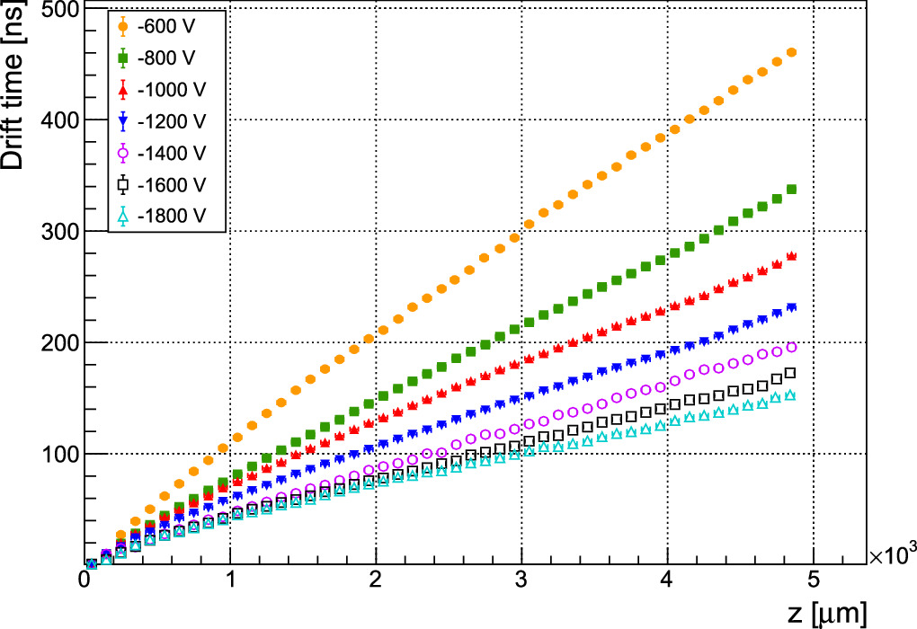
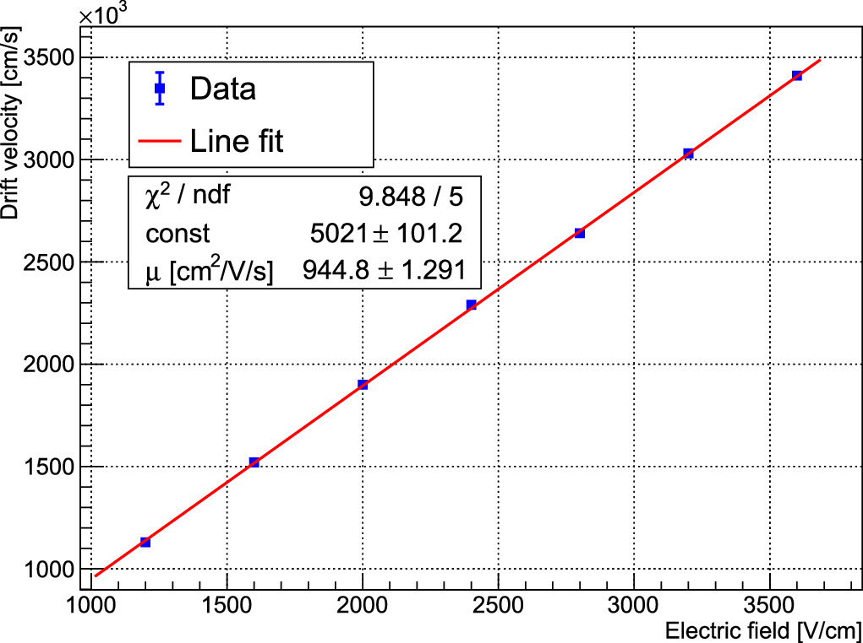
5 mm CZT:
Drift time and drift velocity vs electric field
Bias up to 1.8 kV
Slope is the drift velocity
μ_{e} = (944.8 ± 1.3) cm²/V/s

Slide 13
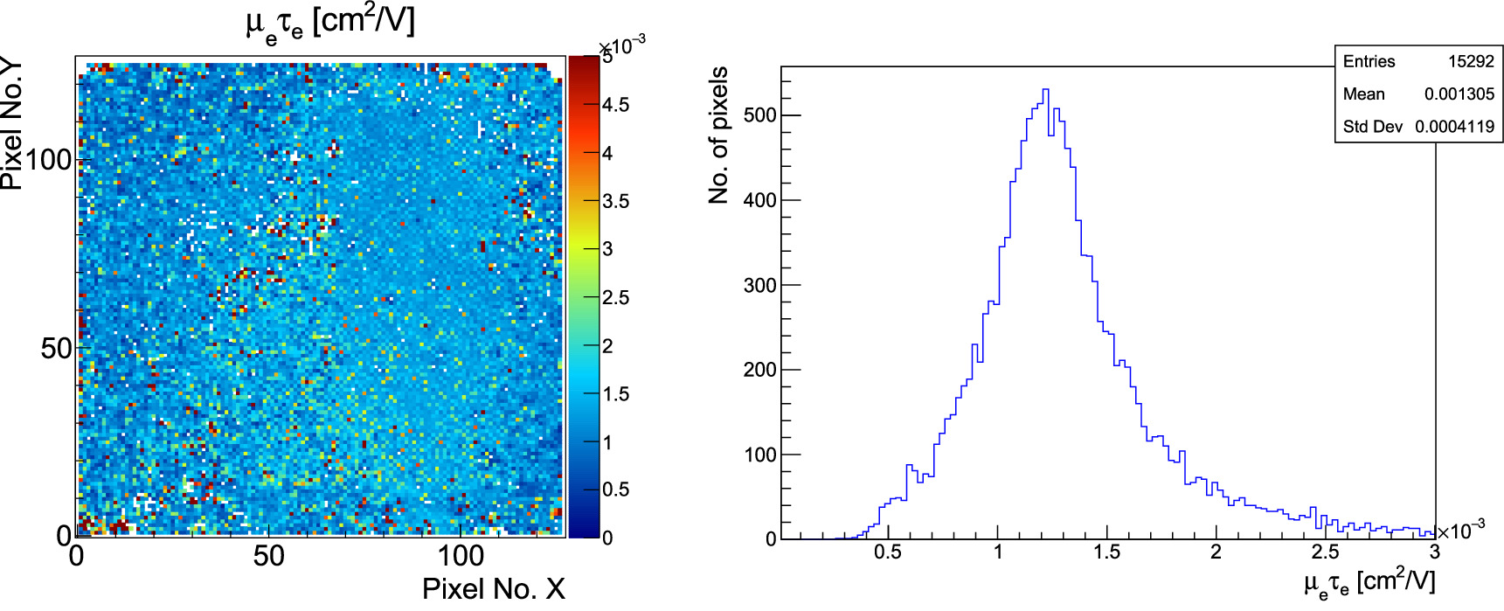
5 mm CZT:
Determination of µτ_{e} and the τ_{e}
Iraddiate of the sensor with 60 keV gammas from ²⁴¹Am (interacting shallowly in the sensor) from the backside at different bias voltage
Fit the 60 keV peak position vs bias in each pixel
<µτ_{e}> = 1.3 x 10⁻³ cm²/V
μ_{e} = (944.8 ± 1.3) cm²/V/s
→ τ_{e} = (1.38 ± 0.31) µs

Slide 14
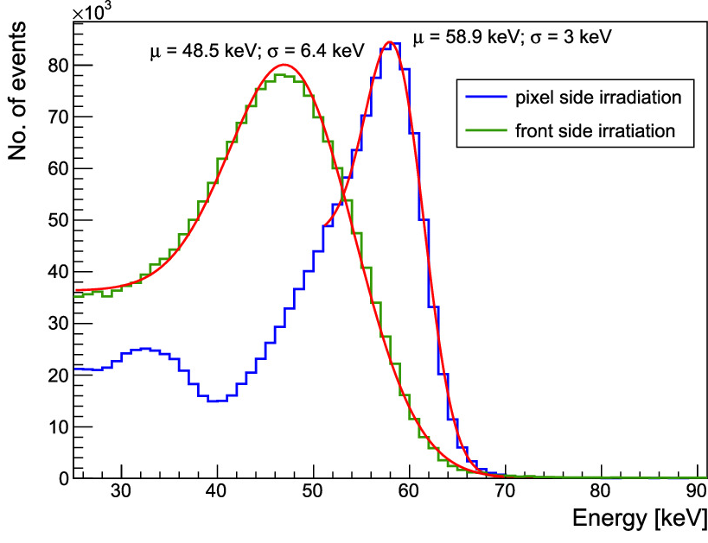
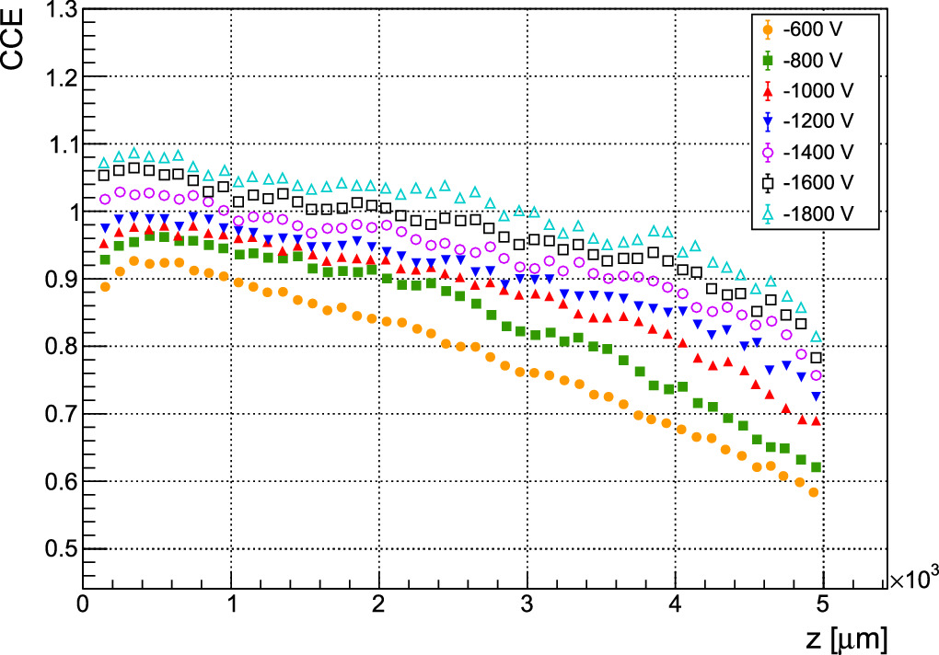
5 mm CZT:
Charge collection efficiency and gamma spectrum measurement
²⁴¹Am source
Due to charge trapping energy the energy for photons aborbed at the common electrode (backside) is underestimated below 130 keV.

Slide 15
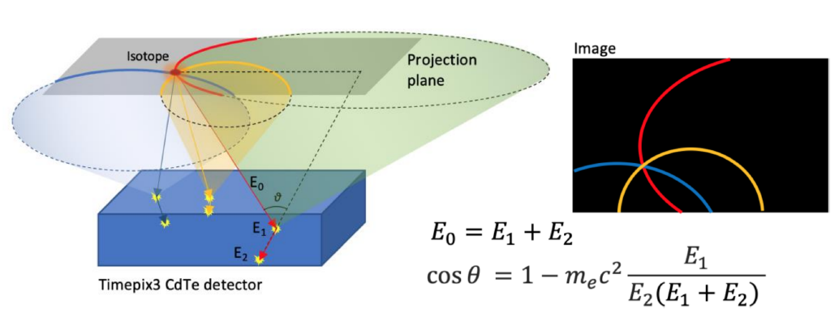
3D reconstruction and gamma-spectroscopy:
Application as a single-layer Compton Camera
D. Turecek et al 2020 JINST 15 C01014
5 mm CZT Timepix3 (110 µm pitch) irradiated with a ²²Na source at a distance of 10.5 cm at different lateral positions (separated by 5 cm)

Slide 16
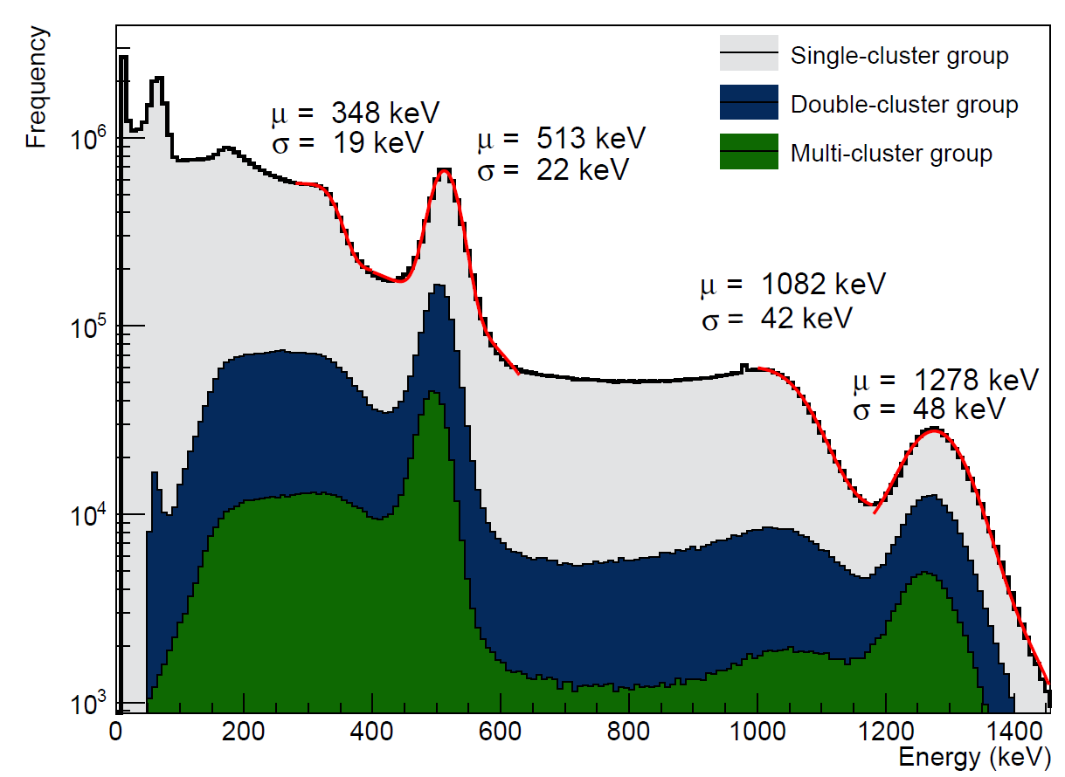
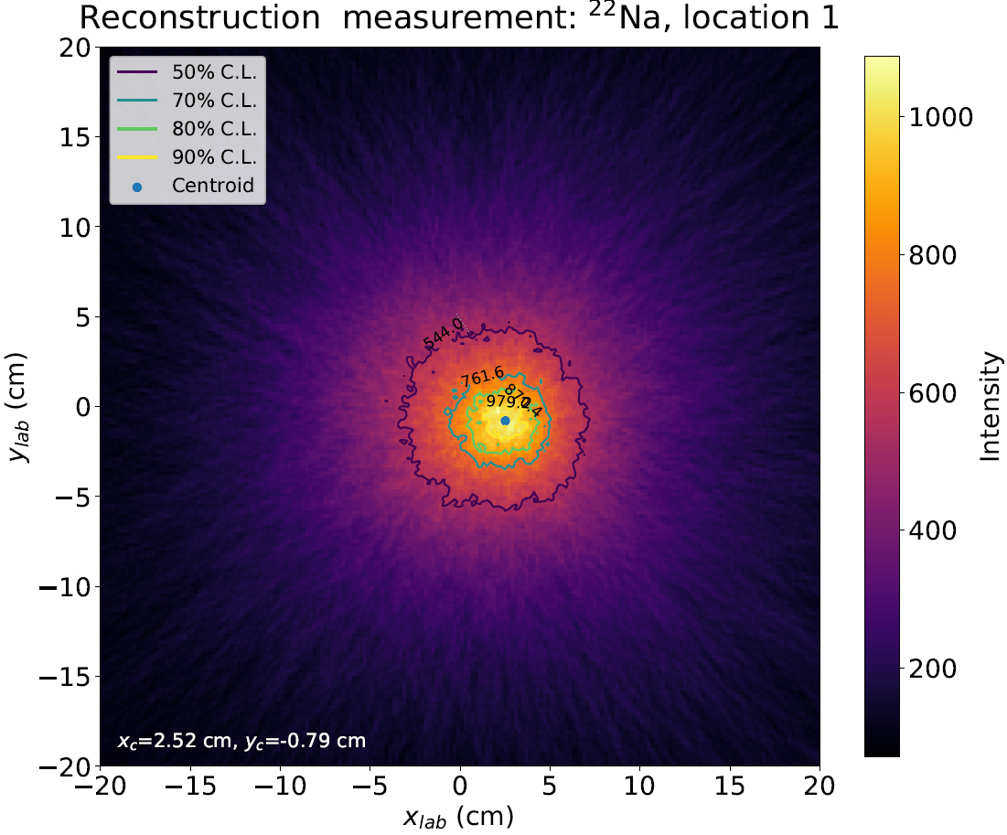
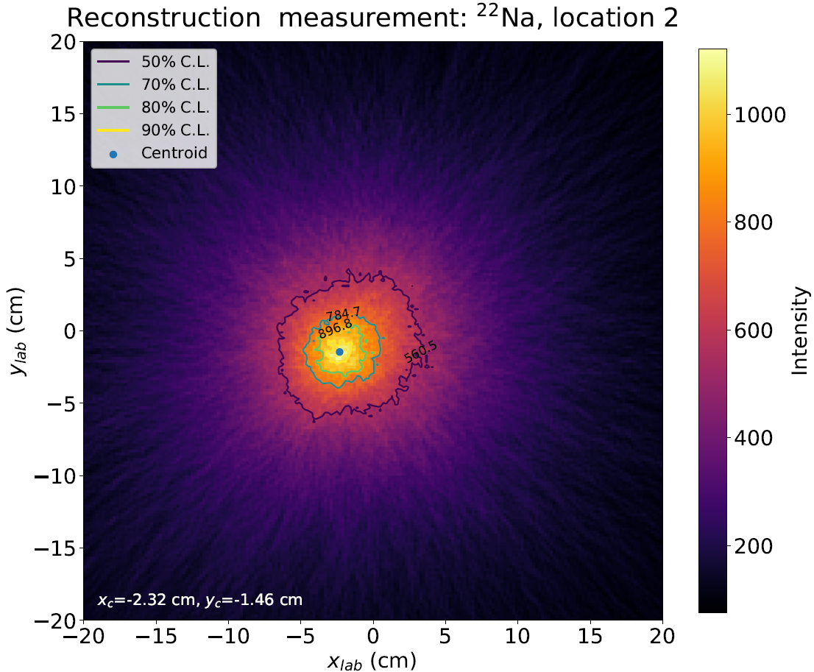
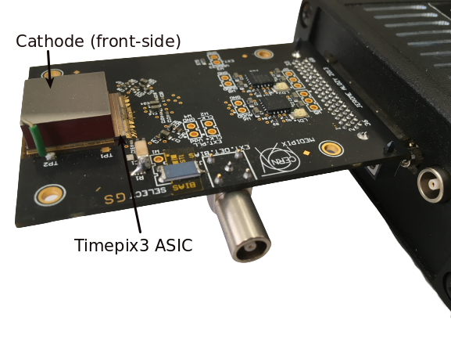
3D reconstruction:
Single-layer Compton Camera - Experiment
P Smolyanskiy et al 2024 Phys. Scr. 99 015301
5 mm CZT Timepix3 (110 µm pitch) irradiated with a ²²Na at different lateral displacement.
Source position 2
5 cm
Source position 1
Measured detection efficiencies:
10.5 cm
Energy (keV) | ε_{overall} (%) | Ε_{photo} (%)
511 | 24.4 ± 1.2 | 7.00 ± 0.50
1275 | 6.80 ± 0.4 | 0.53 ± 0.03

Slide 17
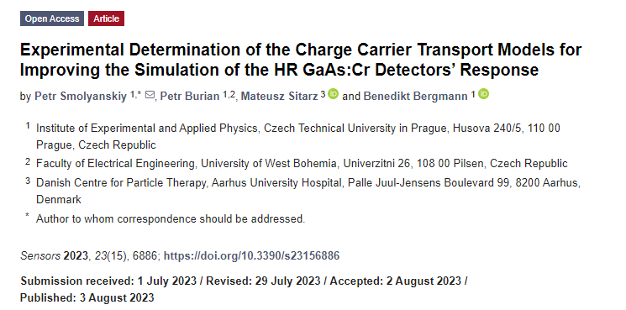

Slide 18
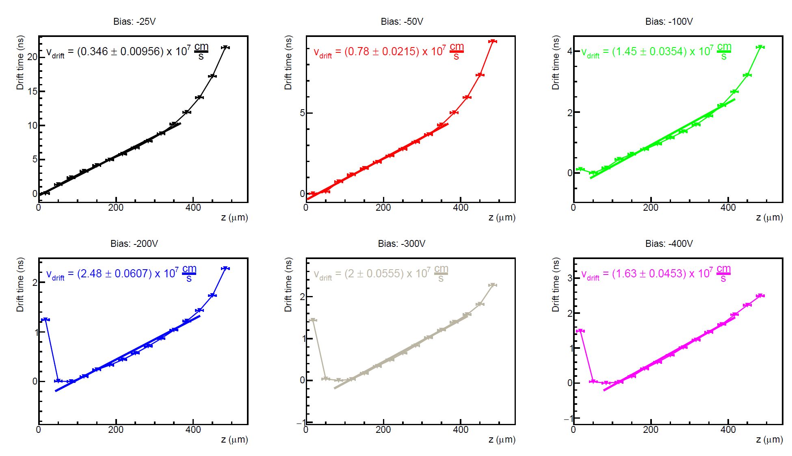
Timepix3 with 500 µm thick GaAs
Drift time analysis in negative polarity
B. Bergmann et al 2020 JINST 15 C03013
Maximal Drift time differences ~2 ns
→ GaAs as sensor material is fast enough to fully utilize Timepix3 time resolution

Slide 19
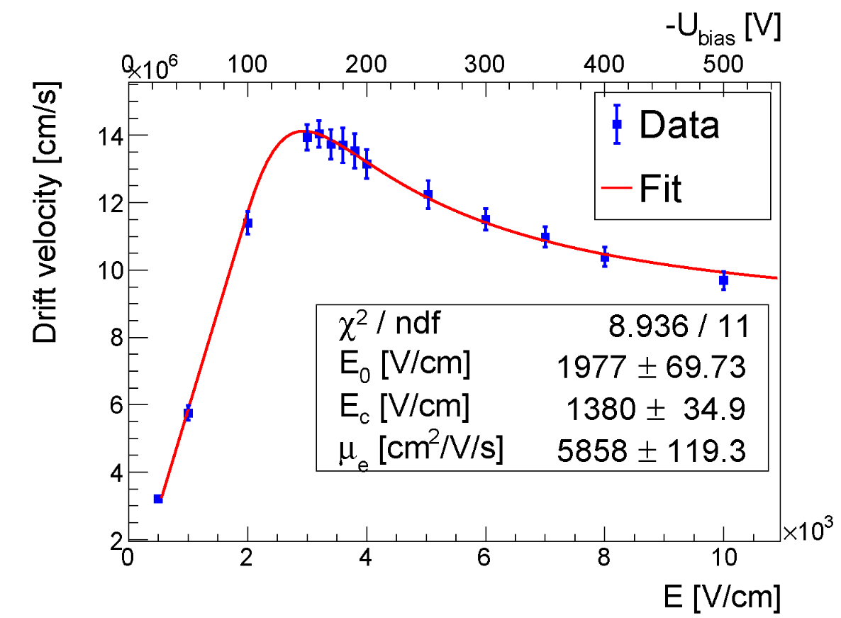
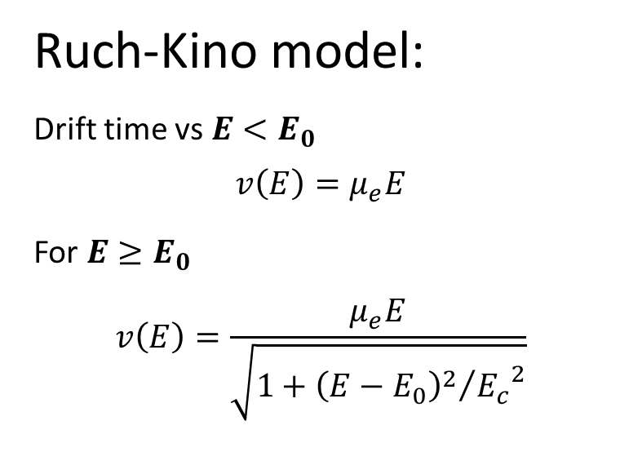
Timepix3 with 500 µm thick GaAs
Drift time analysis in negative polarity
B. Bergmann et al 2020 JINST 15 C03013
Ruch-Kino model:
Drift time vs $E<E_{0}$
$$v\left(E\right)=μ_{e}E$$
For $E≥E_{0}$
$$v\left(E\right)=\frac{μ_{e}E}{\sqrt{1+{{\left(E−E_{0}\right)}^{2}}/{{E_{c}}^{2}}}}$$

Slide 20
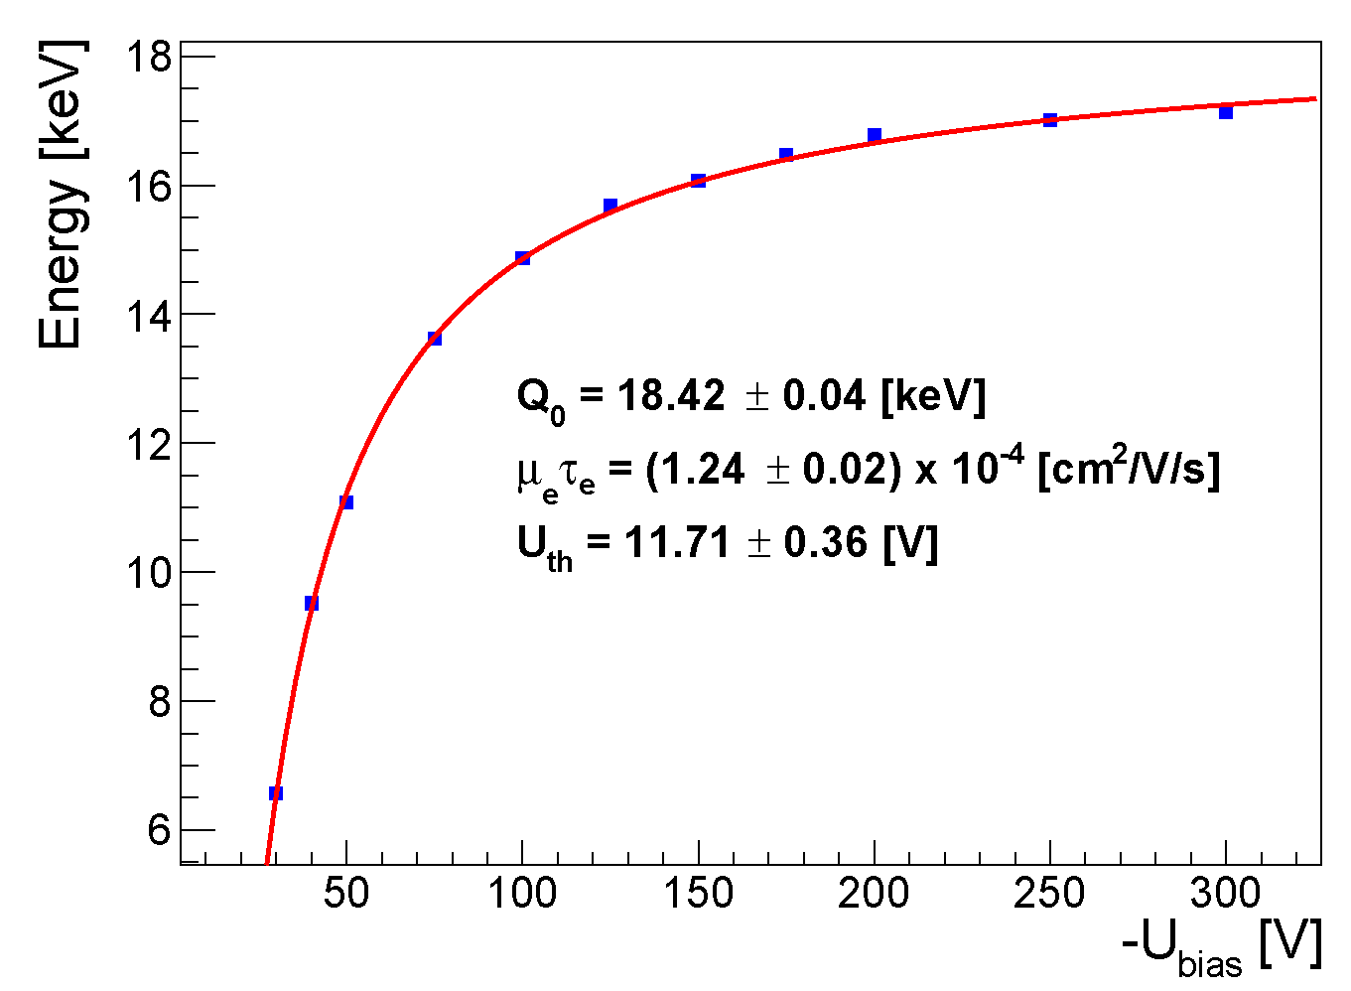
Timepix3 with 500 µm thick GaAs µτ_{e} measurement in negative polarity
Irradiation of the sensor with 15.8 keV XRF from Zr (shallow interaction depth)
Measure the peak position as a function of the bias

Slide 21
Timepix3 with 500 µm thick GaAs
Drift time analysis in negative polarity
B. Bergmann et al 2020 JINST 15 C03013
Ruch-Kino model:
Drift time vs $E<E_{0}$
$$v\left(E\right)=μ_{e}E$$
For $E≥E_{0}$
$$v\left(E\right)=\frac{μ_{e}E}{\sqrt{1+{{\left(E−E_{0}\right)}^{2}}/{{E_{c}}^{2}}}}$$

Slide 22
Timepix3 with 500 µm thick GaAs µτ_{e} measurement in negative polarity
Irradiation of the sensor with 15.8 keV XRF from Zr (shallow interaction depth)
Measure the peak position as a function of the bias

Slide 23
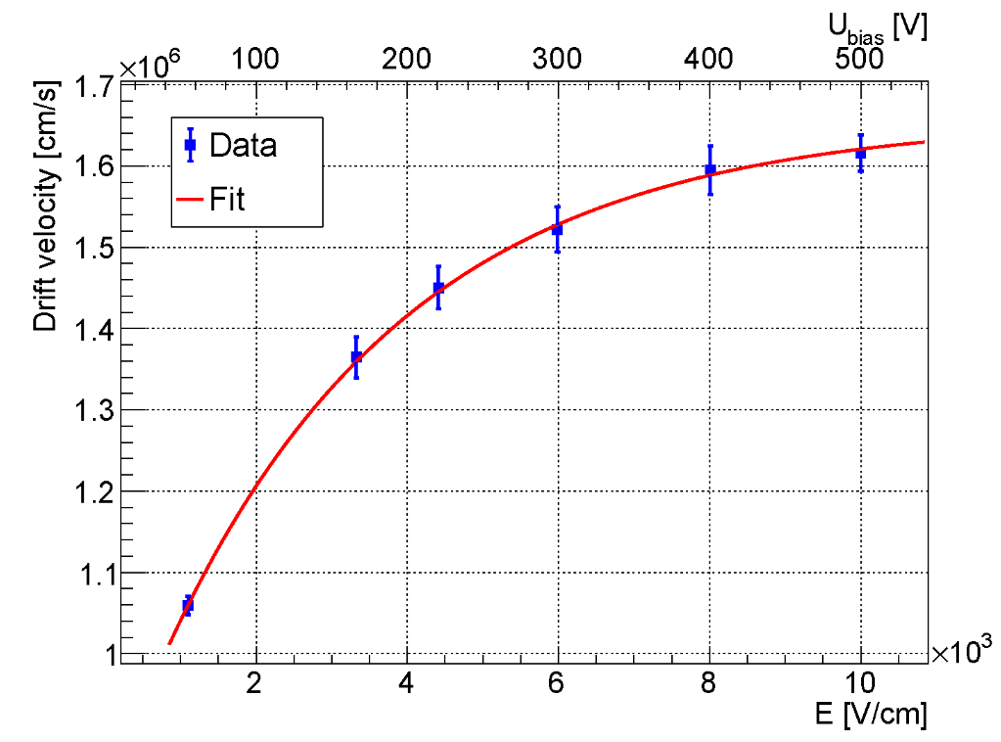
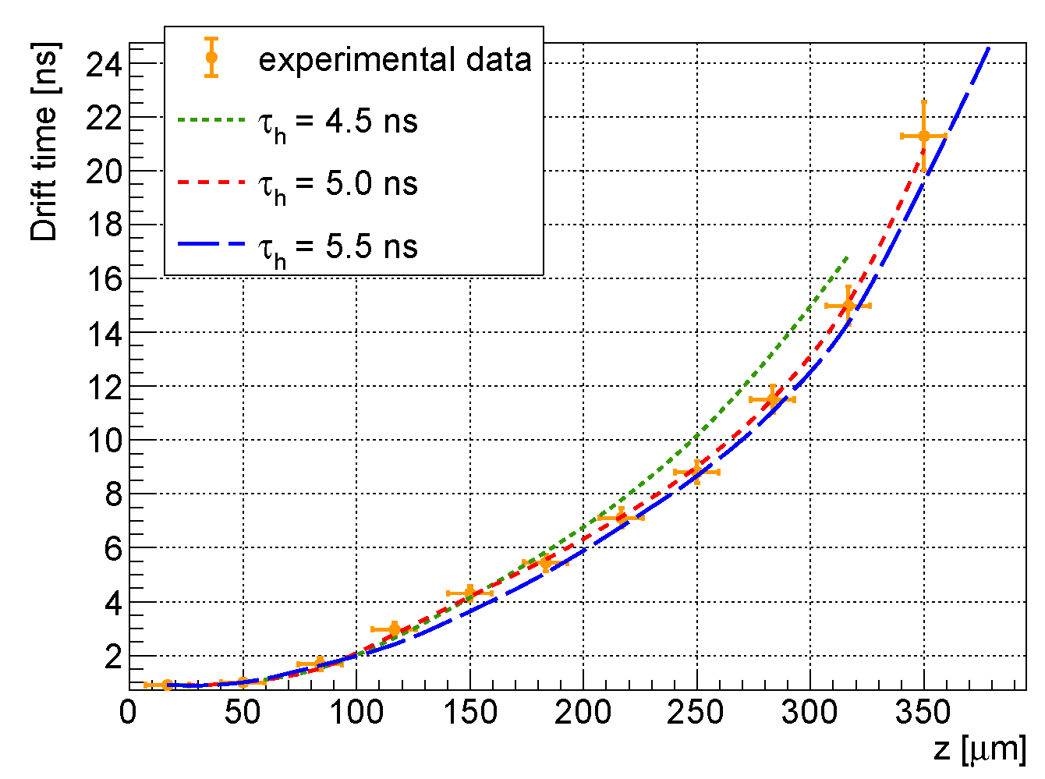
Timepix3 with 500 µm thick GaAs µτ_{h} measurement in positive polarity
Hole lifetime is too short to see the signal created far from the pixel side
→ Lifetime determination through comparison with simulation (drift time, track length)

Slide 24
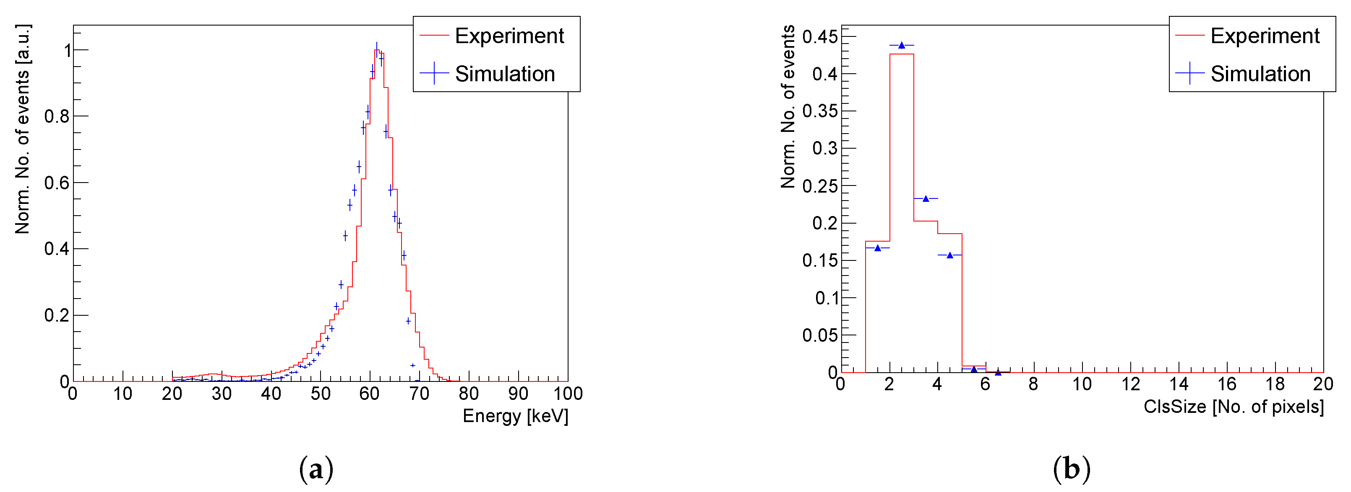
Implementation into the simulation and comparison with measurement
Implementation of determined charge carrier properties into Allpix2
→ Satisfactory agreement of energy and cluster size distribution

Slide 25
Some words on silicon ...

Slide 26
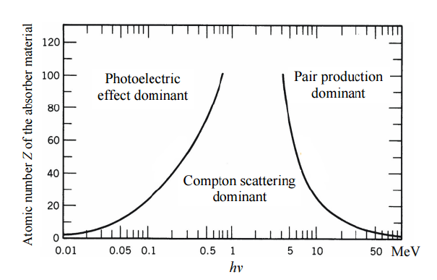
Timepix3 with a silicon sensor as Compton imager and polarimeter
Astrophysical gamma source emit in the energy range from 0.1 – 1 MeV
For polarimetry Compton scattering and subsequent photoabsorpion are needed
Silicon has better ration of Compton/Photo
Silicon has better spectroscopic performance

Slide 27
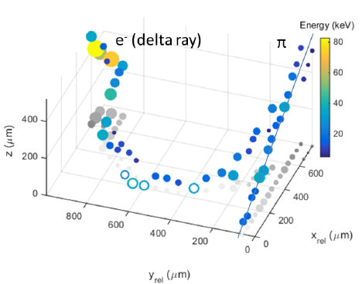
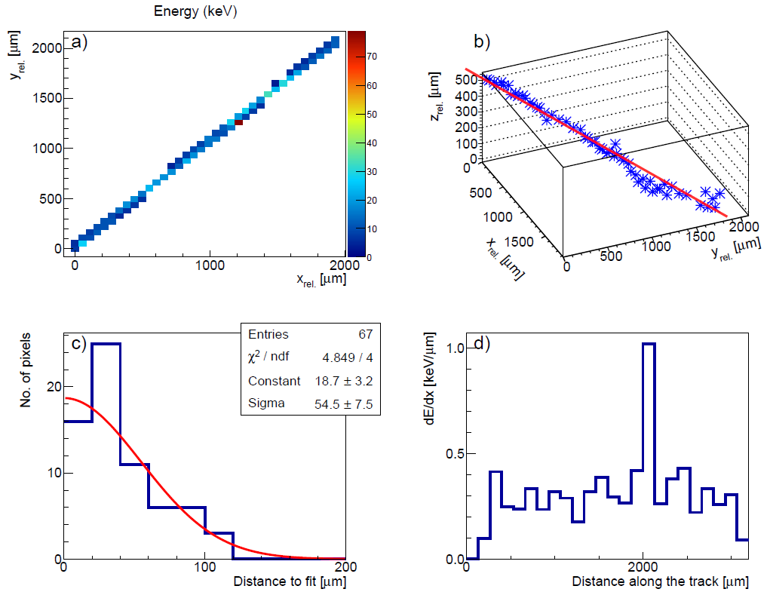
Test measurements:
3D track reconstruction in silicon
120 GeV/c pion tracks accompanied by δ-rays:
A cosmic µ measured in the Prague laboratory:
z-resolution:
σ_{z} ~ 30 µm
Bergmann et al. Eur. Phys. J. C (2017) 77: 421. https://doi.org/10.1140/epjc/s10052-017-4993-4

Slide 28
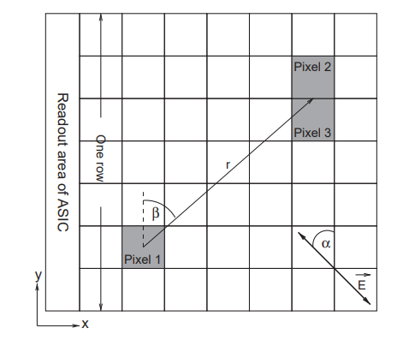
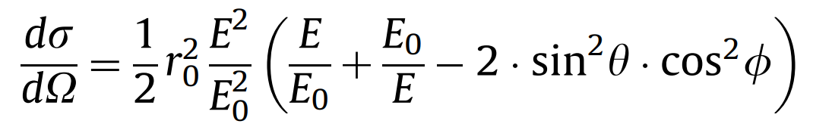
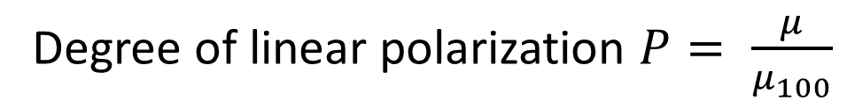
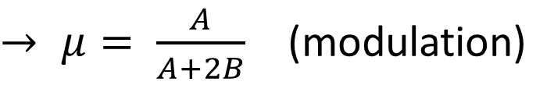

Timepix3 Compton polarimeter - principle
T. Michel, J. Durst, J. Jakubek, “X-ray polarimetry by means of Compton scattering in the sensor of a hybrid photon counting pixel detector,” NIMA 603, Issue 3, pp 384-392 (2009) https://doi.org/10.1016/j.nima.2009.02.032
Detected Compton-scatter pair
Differential cross section for Compton scattering off an electron is described by the Klein-Nishina formula:
Ф is the angle between the electric field vector of the incoming photon and the scattering plane
$$M\left(β\right)=A\cos^{2}\left(β−{\text{Ф}}_{0}\right)+B$$
$→ μ= \frac{A}{A+2B}$ (modulation)
Degree of linear polarization $P= \frac{μ}{μ_{100}}$
$$β=\text{Ф}−{\text{Ф}}_{0}$$
Notes:
T. Michel, J. Durst, J. Jakubek, “X-ray polarimetry by means of Compton scattering in the sensor of a hybrid photon counting pixel detector,” NIMA 603, Issue 3, pp 384-392 (2009)
https://doi.org/10.1016/j.nima.2009.02.032

Slide 29
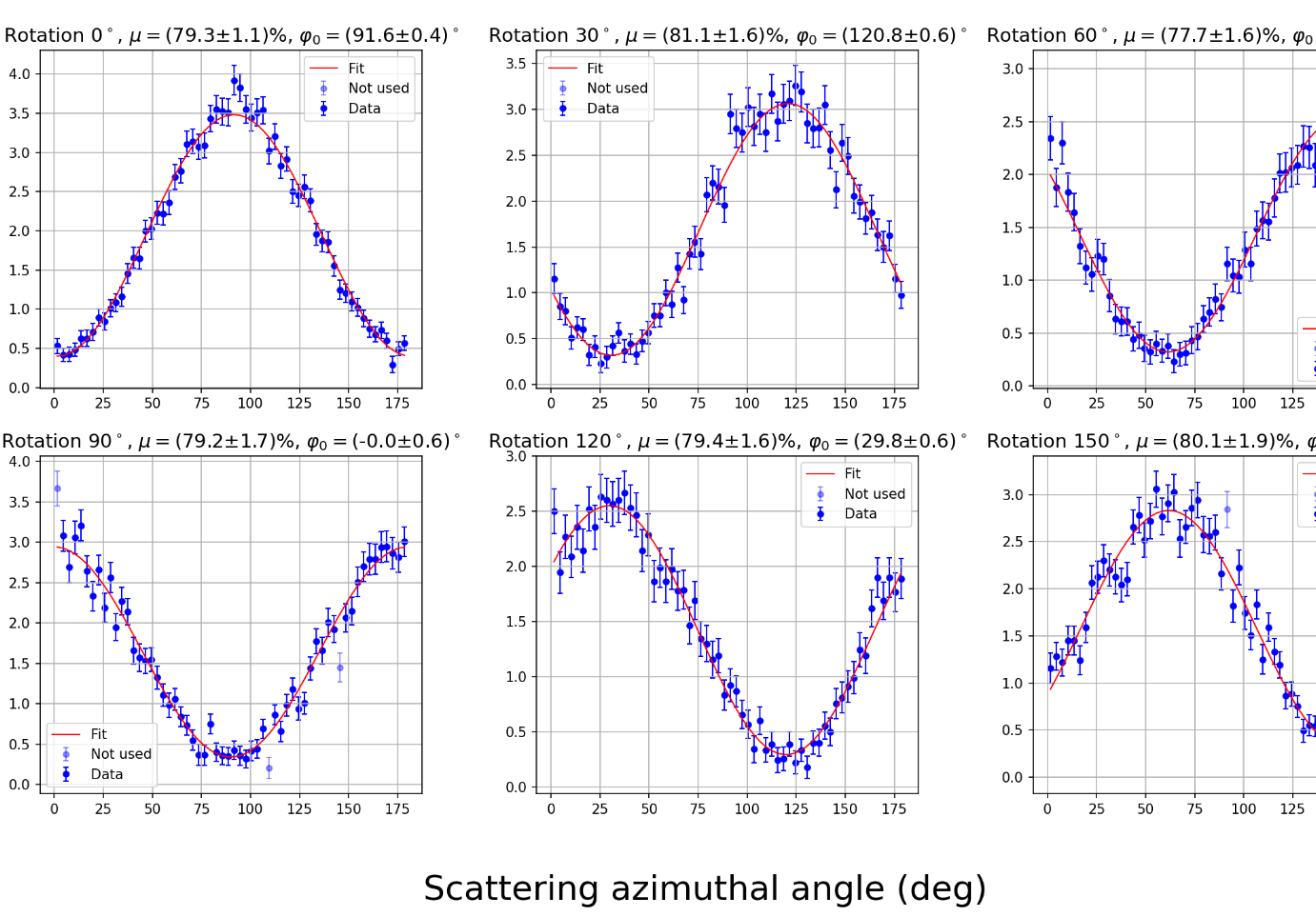
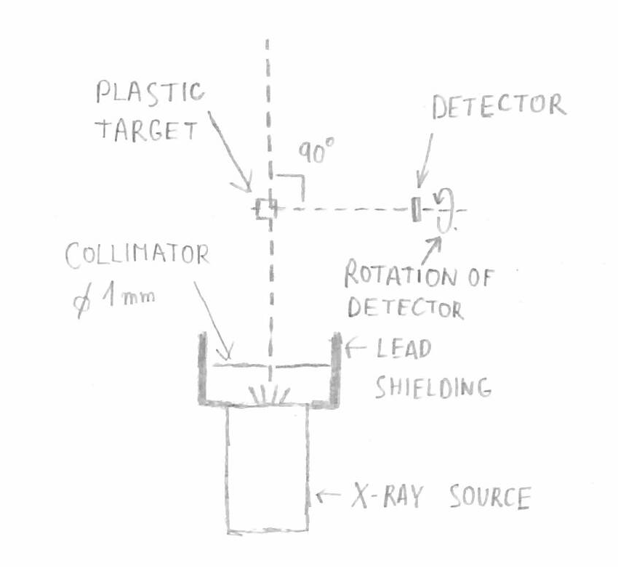
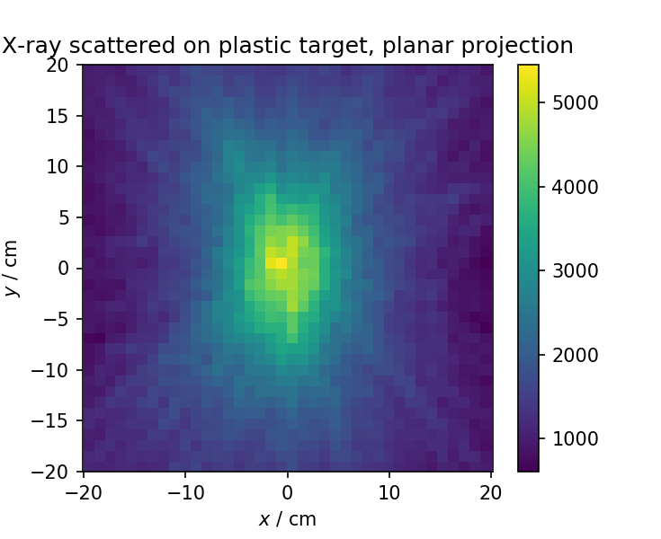

Timepix3 Compton polarimeter
$$M\left(β\right)=A\cos^{2}\left(β−{\text{Ф}}_{0}\right)+B$$
Timepix3 with a 1 mm thick silicon sensor
$μ_{meas}=80\%$
U=75 kV I=60 μA
Detector was rotated around target-detector line to show that the cosine-squared curve is fixed in laboratory frame
B. Bergmann et al. “Results and Perspectives of Timepix Detectors in Space—From Radiation Monitoring in Low Earth Orbit to Astroparticle Physics.” Instruments 2024, 8, 17. https://doi.org/10.3390/instruments8010017

Slide 30
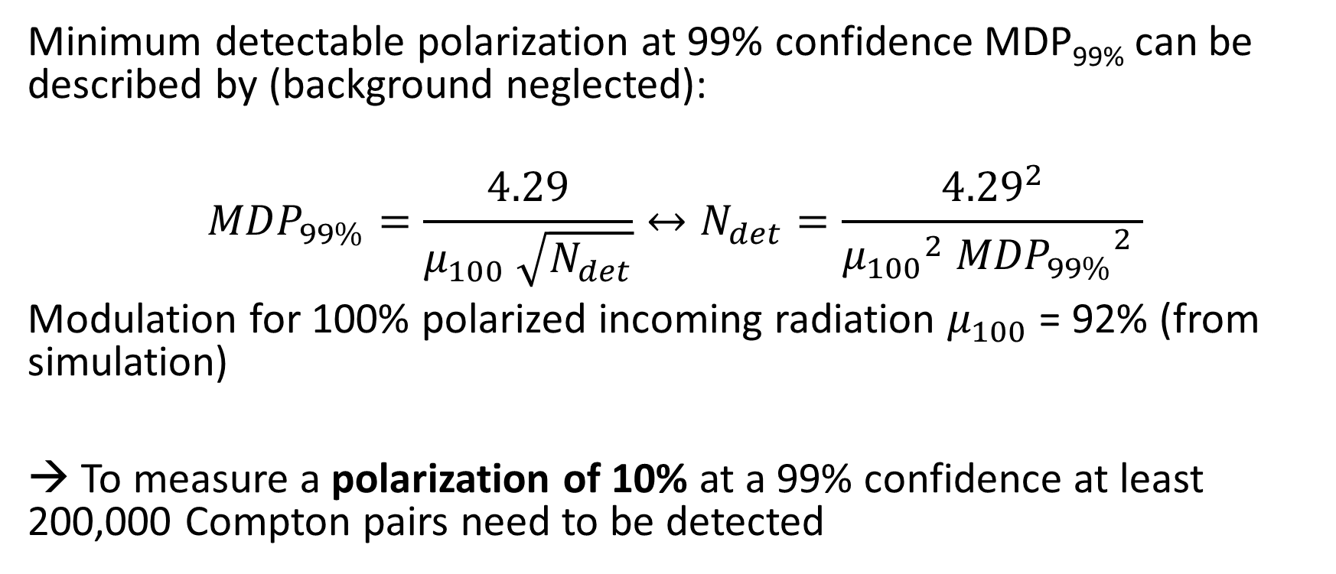
Timepix3 Compton polarimeter:
Figure of merit – MDP_{99%}
Minimum detectable polarization at 99% confidence MDP_{99%} can be described by (background neglected):
$${MDP}_{99\%}=\frac{4.29}{μ_{100} \sqrt{N_{det}}}↔N_{det}=\frac{{4.29}^{2}}{{μ_{100}}^{2} {{MDP}_{99\%}}^{2} }$$
Modulation for 100% polarized incoming radiation $μ_{100}$ = 92% (from simulation)
→ To measure a polarization of 10% at a 99% confidence at least 200,000 Compton pairs need to be detected

Slide 31
Conclusion
Pixelated high-Z sensor are available for hybridization with Timepix3/Timepix4
The sensor materials have been characterized to allow for proper modelling of the response in simulation
Choice of the sensor material strongly depends on application

Slide 32
Thank you very much for your attention!
The research activities can be partly funded from the Czech Science Foundation Junior Star Grant with No. GM23-04869M.

