Slide 1
Introduction to Particle Physics
Swedish physics teachers 2024

Slide 2

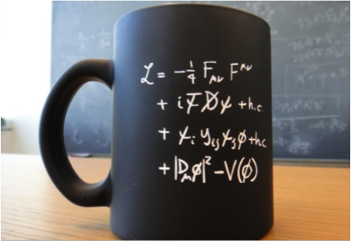
Lecture 2
Overview of the SM
Classical and SM Lagrangian
Symmetry, invariance and conservation laws
Higgs field and experimental results
Credits to:
C. Grosjean and D. Tong : https://indico.cern.ch/event/1254879/timetable/
Notes:
Digress a bit with philosophy

Slide 3
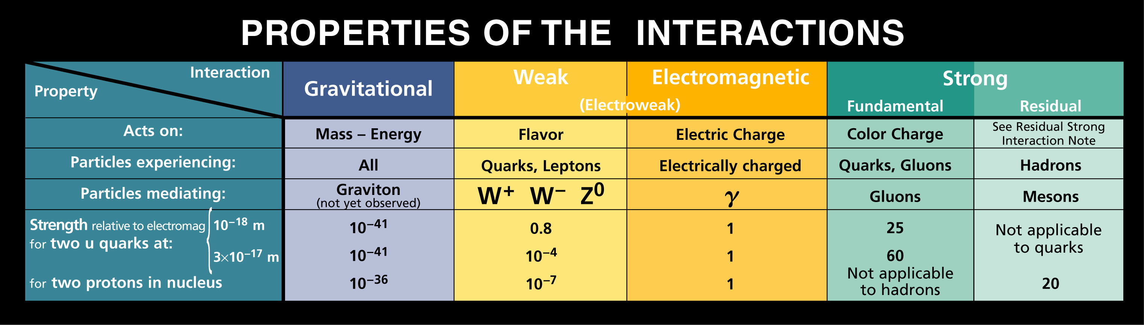
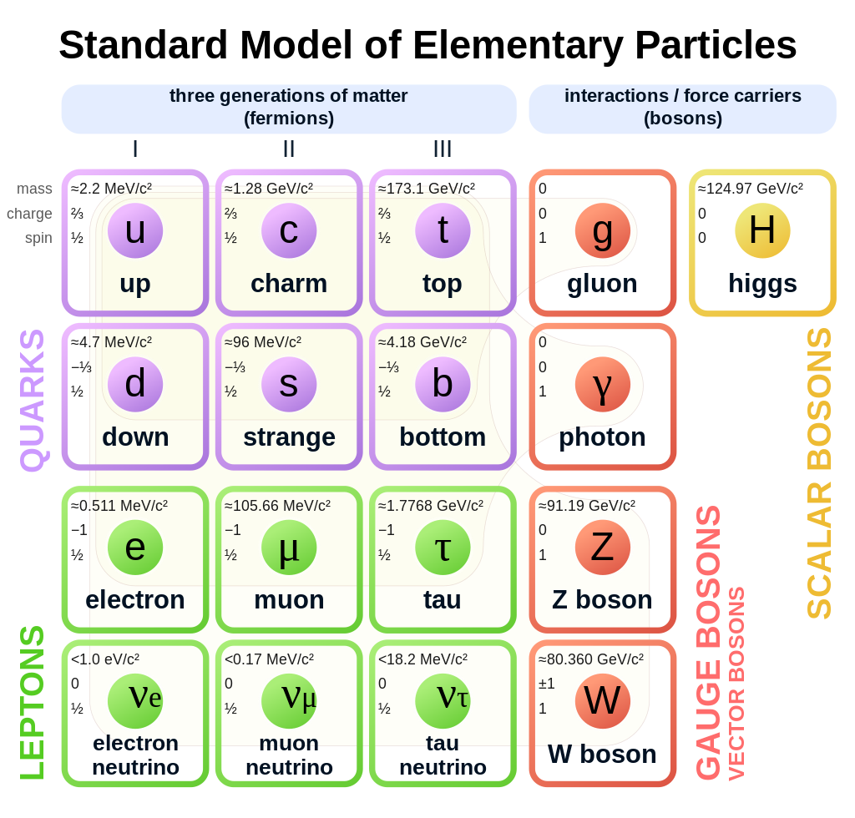

Overview of the Standard Model
Unification

Slide 4

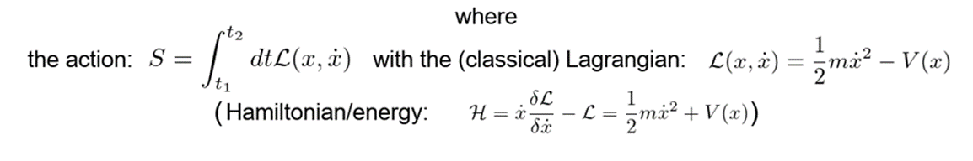
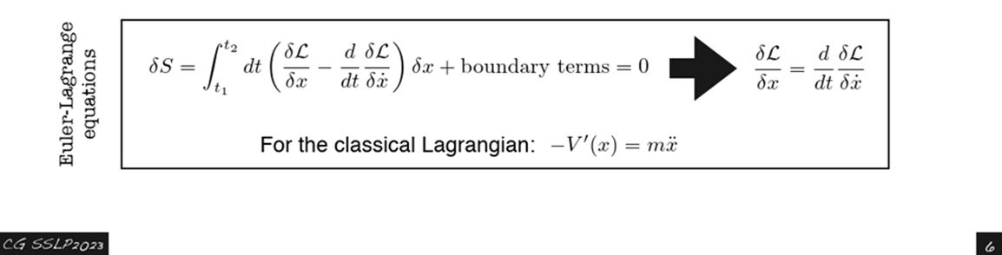
Lagrangian in the classical Mechanics
Potential term
Kinetic term

Slide 5
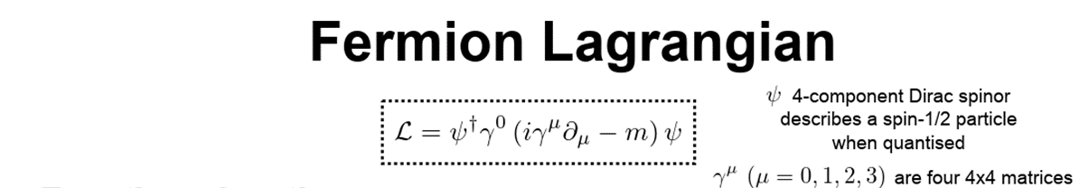
Lagrangian for particle physics
Kinetic term
Notes:
REM: dL=0?… example of Shoreline!

Slide 6

Lagrangian of the SM
Kinetic term of all gauge bosons fields
(W’s, Zº, photon and gluons)
Kinetic term of fermion fields
(quarks and leptons)
Interaction with H field giving mass to
the q’s and leptons
kinetic term for Higgs boson and H potential
!!
Notes:
kinetic term for Higgs boson and H potential that enter that minimum different from 0 that break SU(2) x(U1) in U(1)

Slide 7
Invariance of the physics laws
The laws of nature should be invariant under certain transformations since “nature does not know” how we observe it!
For example, the physics laws should be invariant in any inertial reference frame ☺ (Special Relativity)
Abandon the anthropocentric view and move towards a more abstract mathematical view, universally valid!
Notes:
That means the physics laws have to have the same space-time structure (covariance) in all the reference systems connected via the Lorentz transformations,

Slide 8
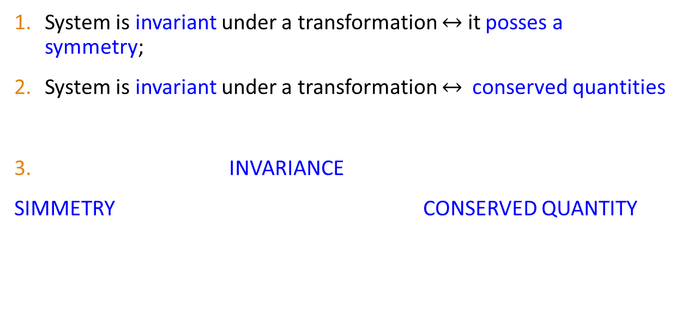
Symmetry, invariance and conservation laws
System is invariant under a transformation $↔$ it posses a symmetry;
System is invariant under a transformation $↔$ conserved quantities
INVARIANCE
SIMMETRY CONSERVED QUANTITY
(A.E. Nother Theorem)
(A.E. Nother Theorem)
Notes:
Example: norm invariance of four-vectors
1) The fundamental space-time symmetry requires the equations of the evolution of a physical system or its Lagrangian, to be invariant (covariant) under the transformation of the Poincaré group (Lorentz plus rotation transforms)
2) Conservation law: The Noethern theorem establishes that the invariance(/covariance) of the of the equations of motion under continuous transformations with n parameters, implies the existence of n conserved quantities,

Slide 9
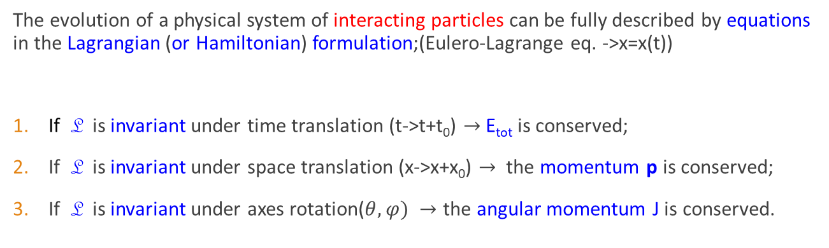
Classical invariance and conservation laws
The evolution of a physical system of interacting particles can be fully described by equations in the Lagrangian (or Hamiltonian) formulation;(Eulero-Lagrange eq. ->x=x(t))
If L is invariant under time translation (t->t+t₀) $→$ E_{tot} is conserved;
If L is invariant under space translation (x->x+x₀) $→$ the momentum p is conserved;
If L is invariant under axes rotation($θ,φ) →$ the angular momentum J is conserved.

Slide 10
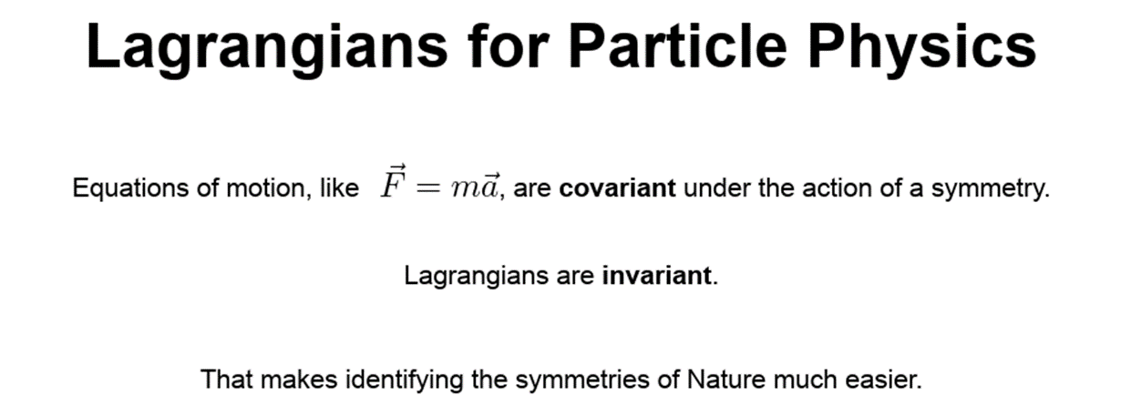
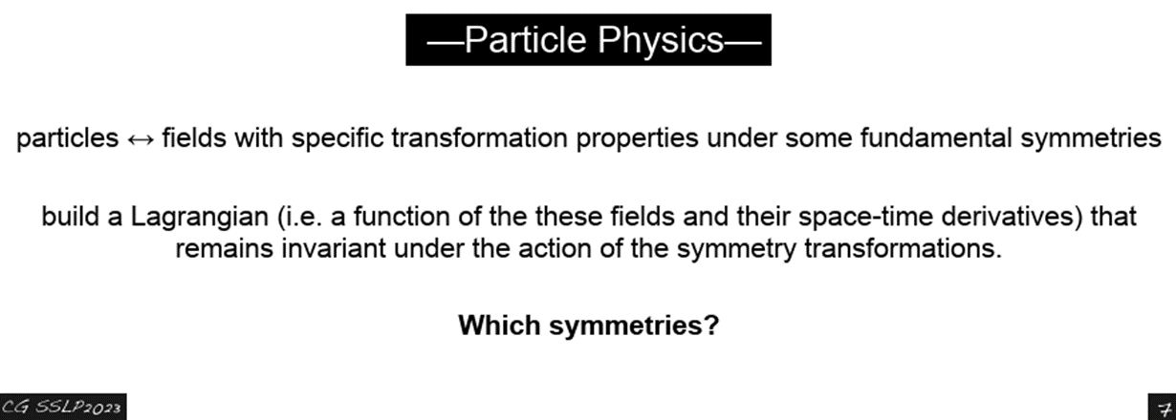

(Under the Transformation of Galileo between two reference systems) gdc
1) L must be invariant under the Special Relativity space-time transform (Lorentz invariant)
2) L must be invariant under (local)transformations of the particle fields and of the potentials (gauge invariant…->charge conservation)

Slide 11
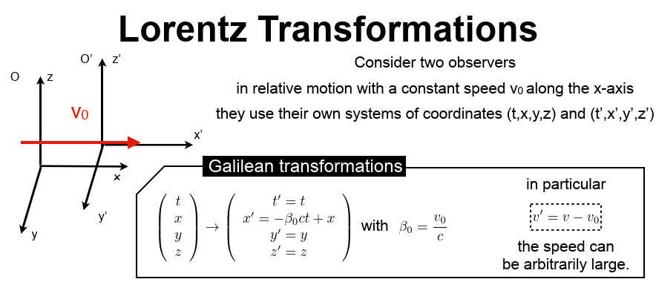
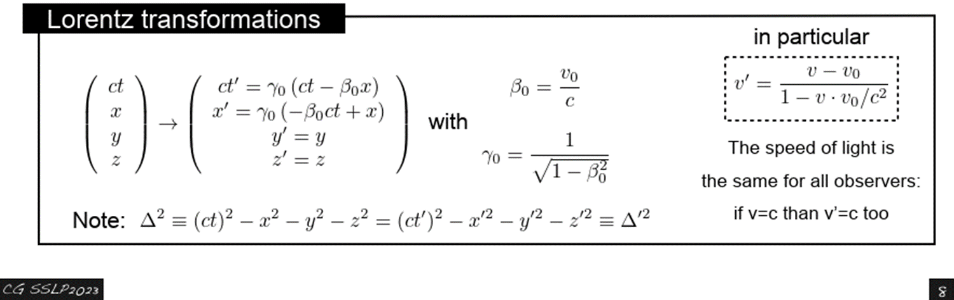
Galilean and

Slide 12
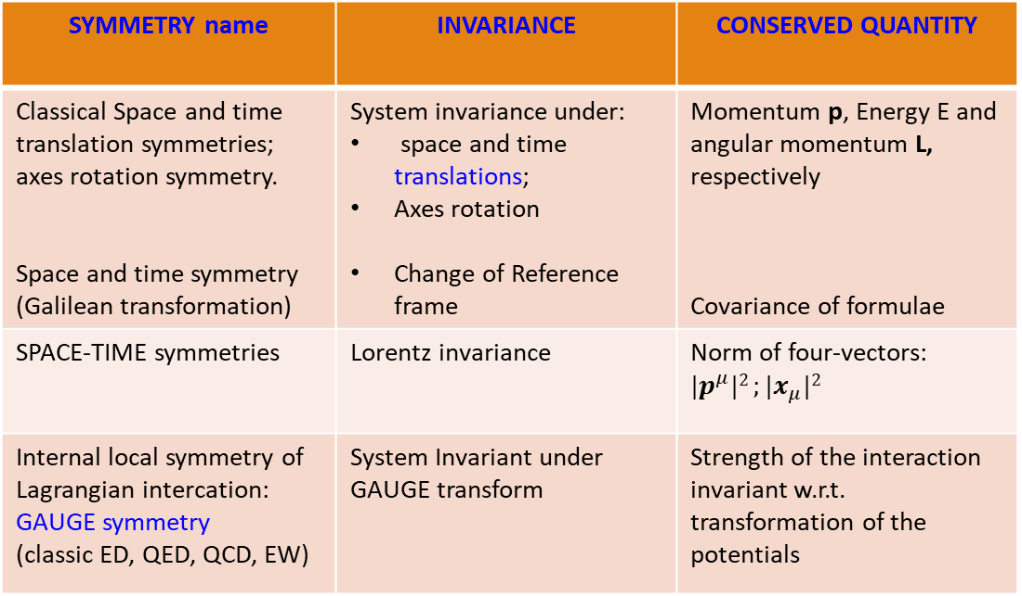
Summary on Simmetries
SYMMETRY name | INVARIANCE | CONSERVED QUANTITY
Classical Space and time translation symmetries; axes rotation symmetry. Space and time symmetry (Galilean transformation) | System invariance under: space and time translations; Axes rotation Change of Reference frame | Momentum p, Energy E and angular momentum L, respectively Covariance of formulae
SPACE-TIME symmetries | Lorentz invariance | Norm of four-vectors: ${|p}^{μ}|2 ;|x_{μ}|2$
Internal local symmetry of Lagrangian intercation: GAUGE symmetry (classic ED, QED, QCD, EW) | System Invariant under GAUGE transform | Strength of the interaction invariant w.r.t. transformation of the potentials

Slide 13
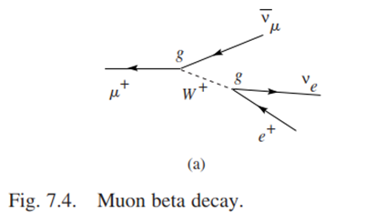
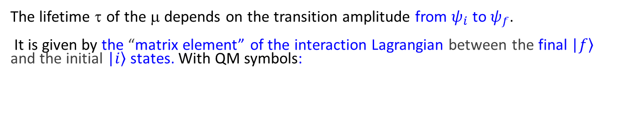



The SM elements
Feynman diagram of the muon beta decay
$$ψ_{i}$$
$$ψ_{f}$$
The lifetime τ of the μ depends on the transition amplitude from $ψ_{i}$ to $ψ_{f}$.
It is given by the “matrix element” of the interaction Lagrangian between the final |$\left.f\right\rangle$ and the initial |$\left.i\right\rangle$ states. With QM symbols:
$M_{fi}= \left\langle ψ_{f} | L_{int} | ψ_{i}\right\rangle$
$${{\left|M_{fi}\right|}^{2}→τ}_{μ}={10}^{−6}s that is the experimental value!$$
Any disagreement SM-experiments, leads to the SM corrections

Slide 14
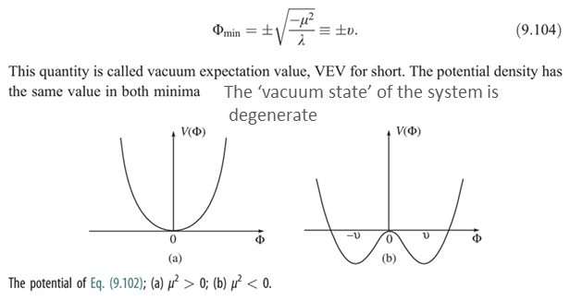
The Higgs mechanism
The Higgs mechanism was proposed (1960) to provide mass to the weak gauge bosons W± and Z°, the interaction carriers, without destroying the gauge invariance of the EW Lagrangian!
this was to unify the Weak and EM interactions in a gauge QFT (Electroweak interaction);
After about 50 years, The Higgs boson was observed at the LHC and presented on the 4th July 2012 at CERN;
The Higgs field fills the Universe with a nonzero value and provides mass to the fundamental particles as leptons, quarks and of course the bosons the force carriers;
~ 10⁻¹² s after the Big-Bang

Slide 15
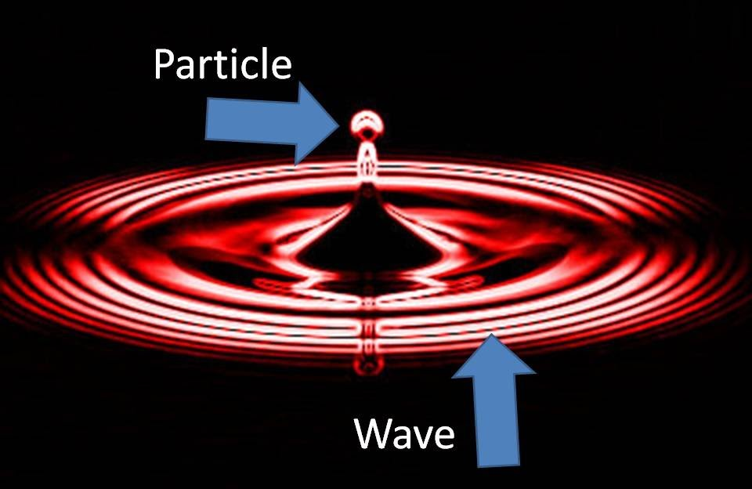
Observation of the Higgs boson
Two protons interacting in the LHC excite the Higgs field that manifests itself with the emission of the boson with a mass of 126 GeV.

Slide 16
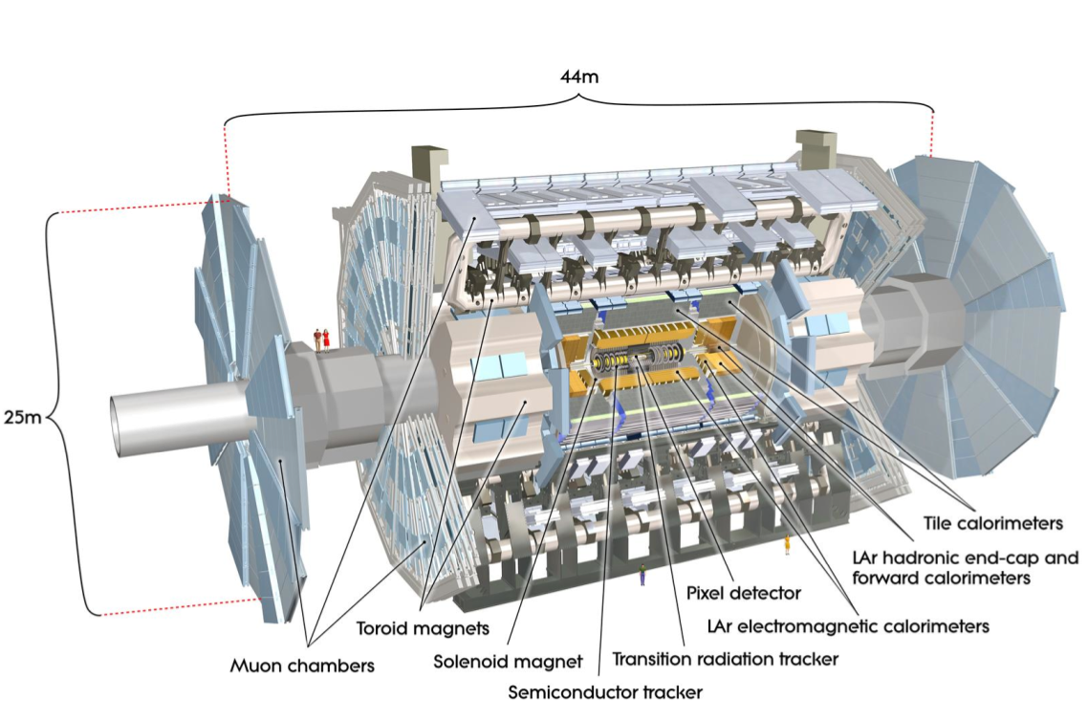
The “giant” of LHC: ATLAS
16

Slide 17
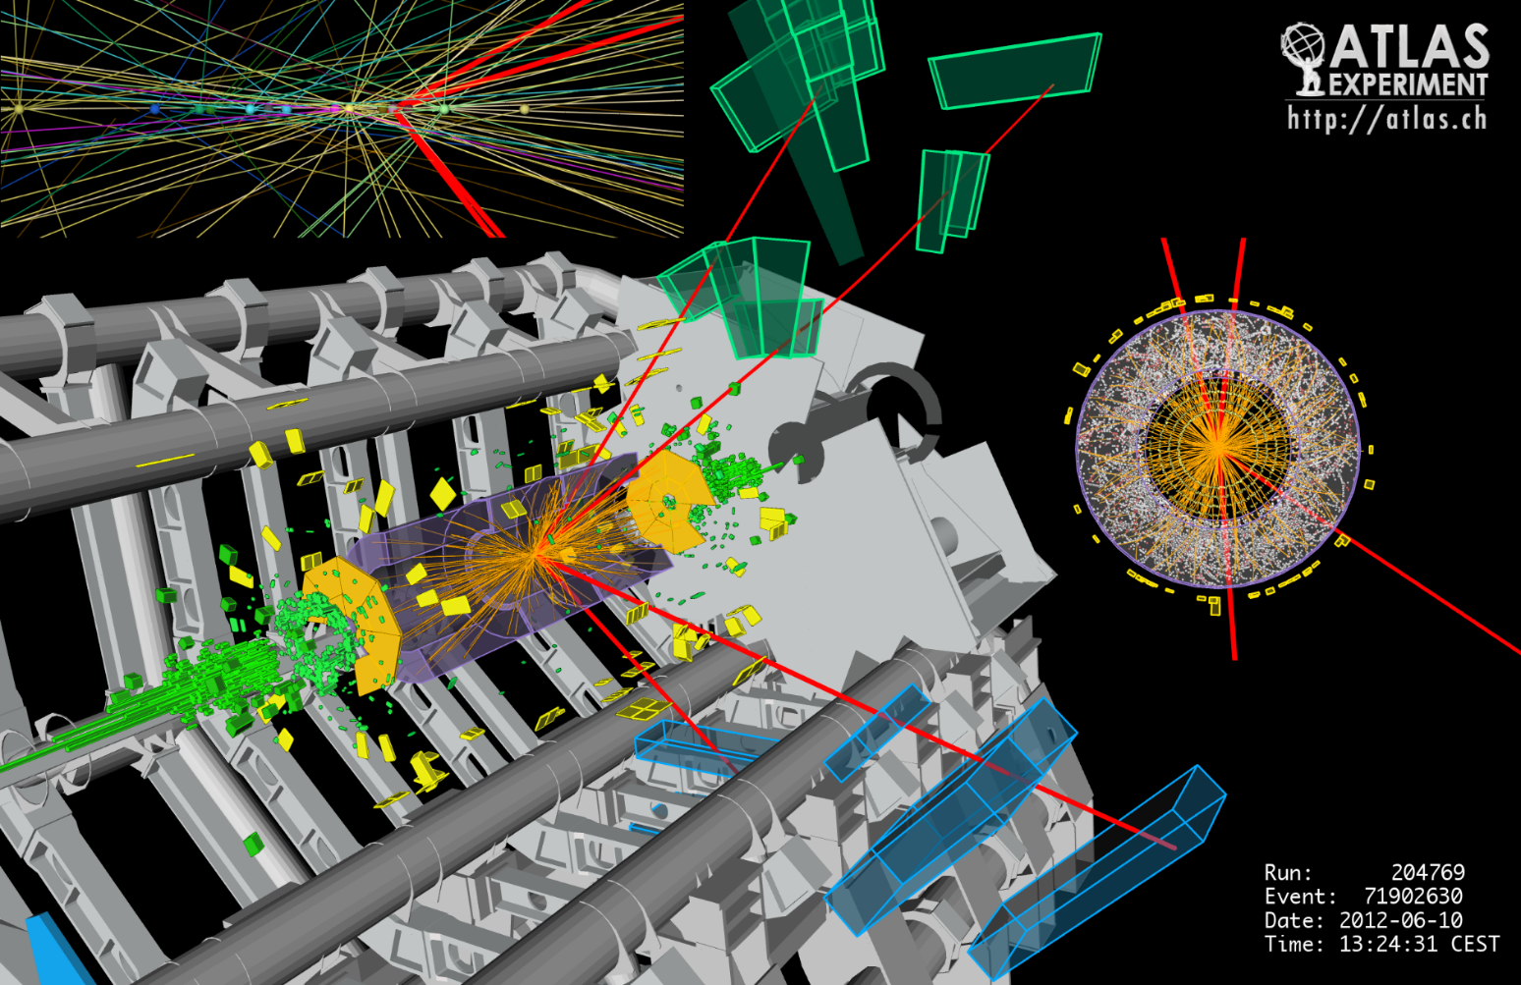
H→Z⁰Z⁰→4 leptons

Slide 18
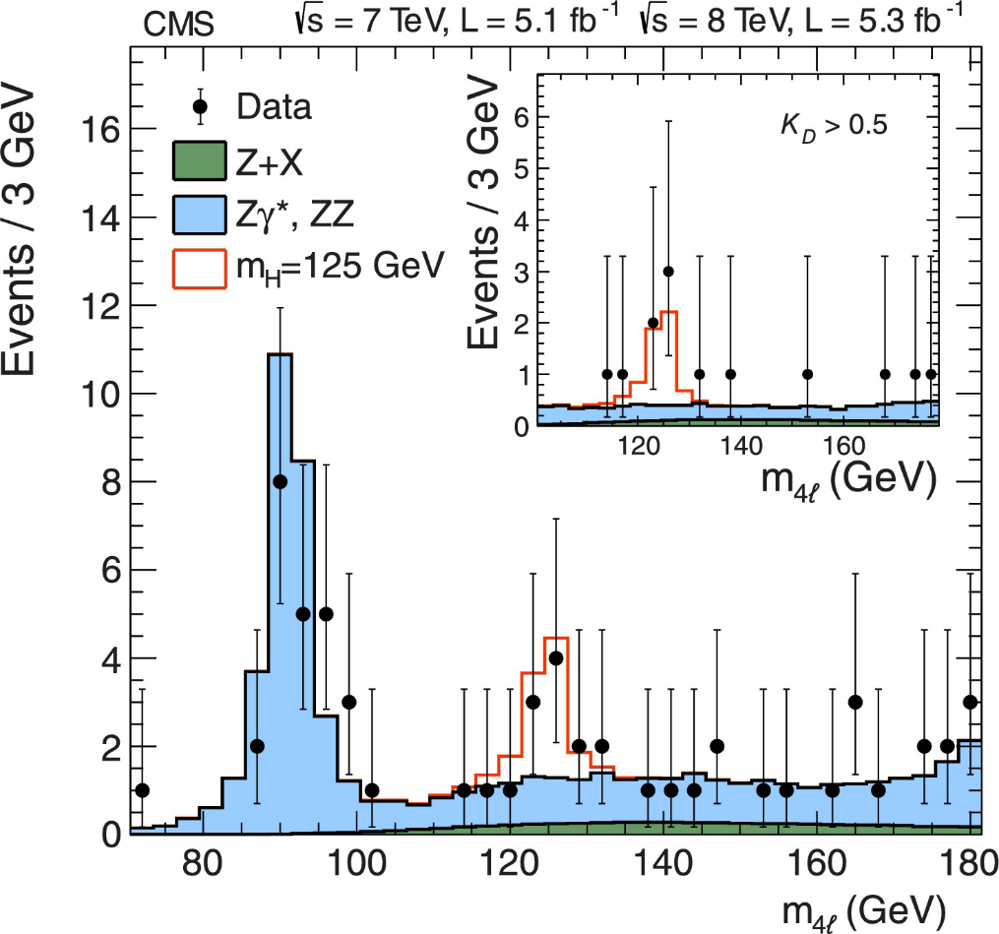
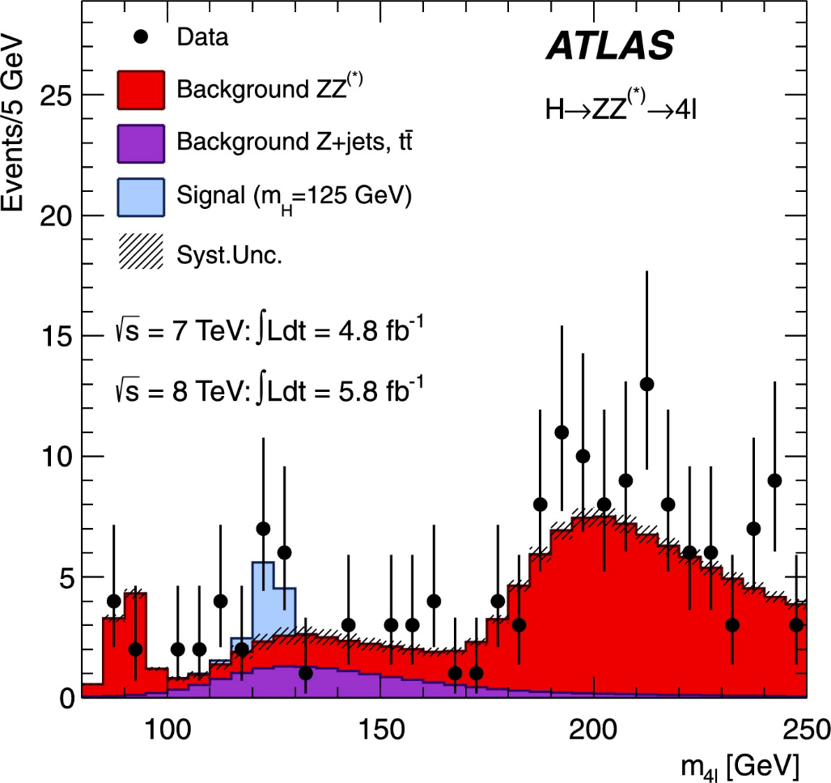
Invariant mass plot H→ZZ→4 leptons

Slide 19
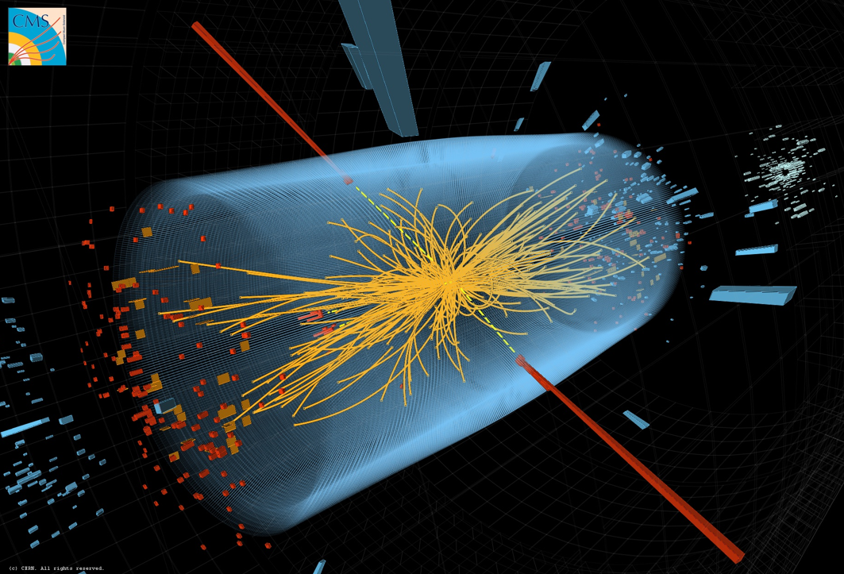
H→γγ

Slide 20
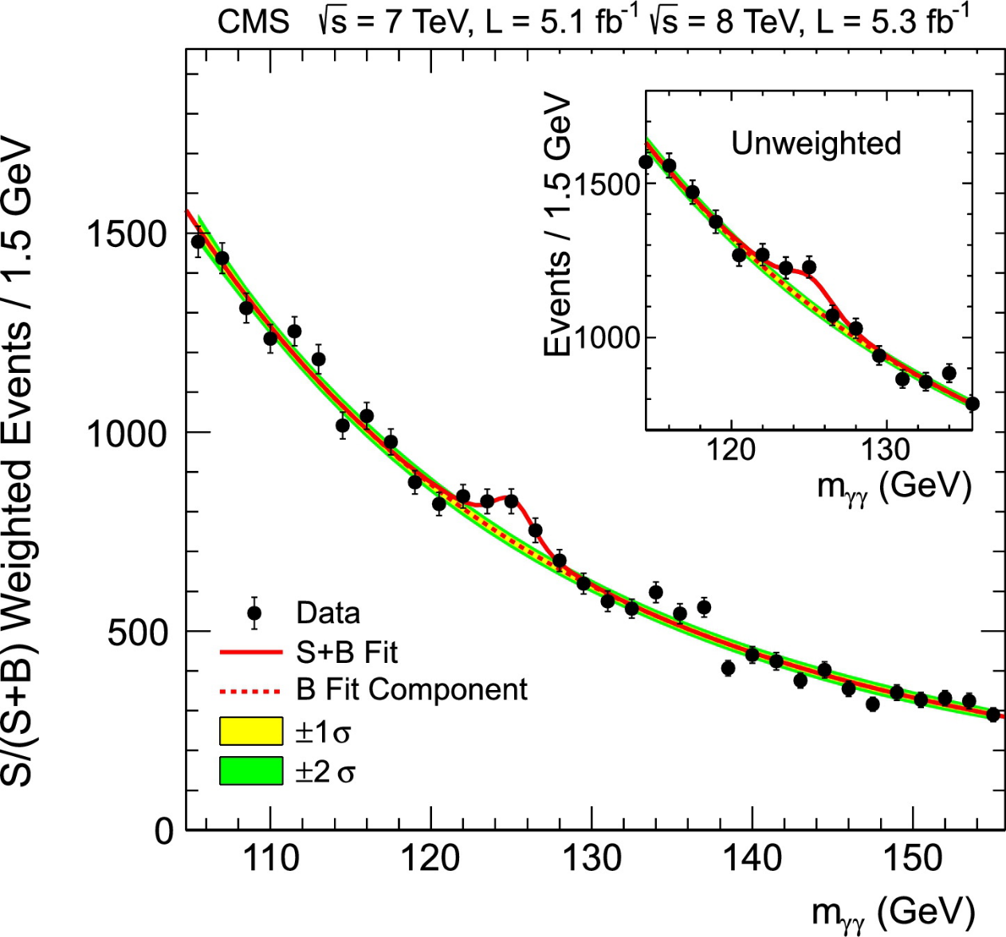
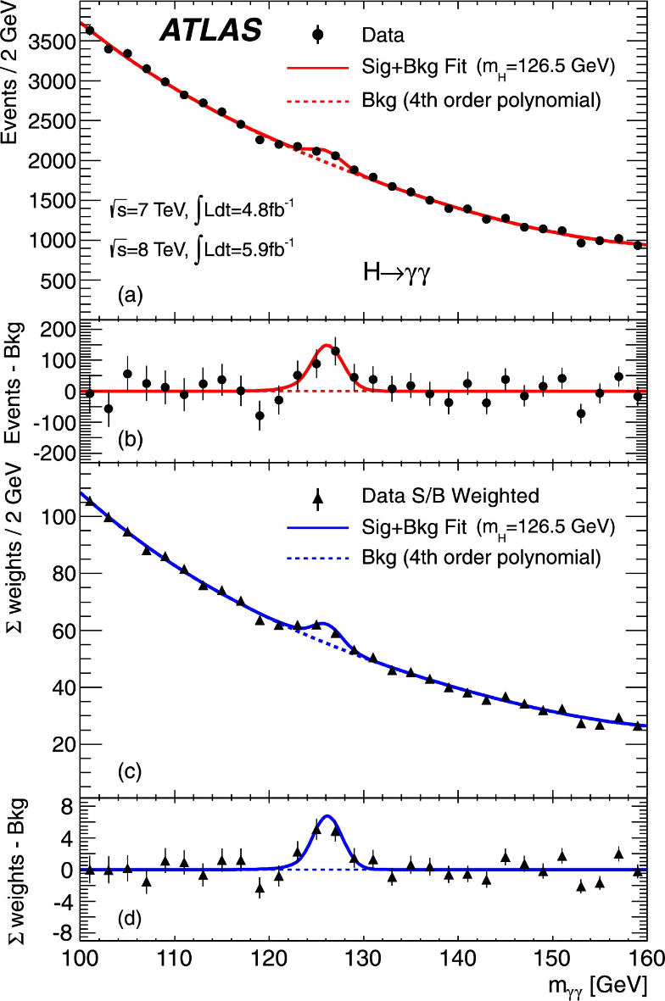
H→γγ

Slide 21
Summary
From the classical Lagrangian to the particle physics Lagrangian;
Invariance, conserved quantities and symmetries;
Elements of SM: Feynman diagrams and the computation of the muon life-time;
The Higgs boson and the experimental results

