Slide 1
Introduction to Particle Physics
Swedish physics teachers 2024

Slide 2
Lecture 1
Particles and Interactions
Glimpses on the Standard Model
Quarks and Particle spectroscopy
Notes:
Glimpses on….

Slide 3
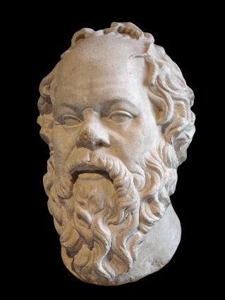
Socrate, (470-399 B.c.)
(Plato, Apology )
So di non sapere – Wikipedia
«So di non sapere»
(consapevolezza della propria ingnoranza)
https://en.wikipedia.org/wiki/Socrates
Socrates, aware of his own leak of knowledge, professes his own ignorance...and me as well !!
At the end, I’ll share with you my ignorance!! ☺
By Sting, CC BY-SA 2.5, https://commons.wikimedia.org/w/index.php?curid=96296061
Notes:
Credits to Socrate!!

Slide 4

Introduction
  Particle Physics: study of fundamental particles and interactions of the “subnuclear world”
  And what about dark matter and dark energy?
  ??

Slide 5

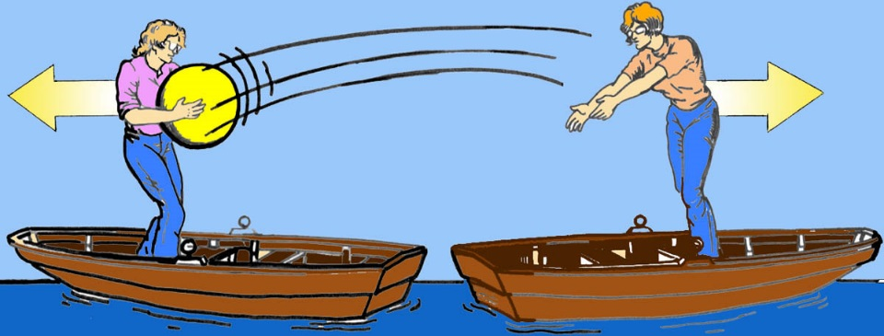

Metaphors of
Fundamental interactions:
Interaction: exchange of energy and momentum between particles, or the possibility of creation/annihilation of particles;
particles
particles
Repulsive force
Vector Bosons
Attractive force
Notes:
(2) forces.

Slide 6
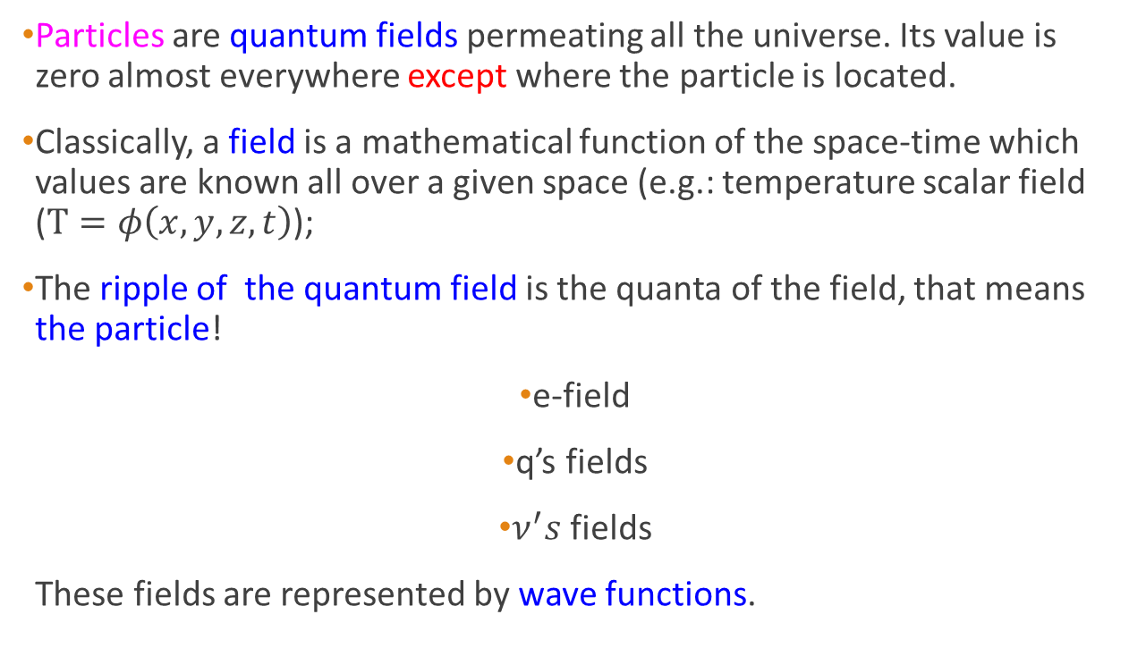
Particles and Interactions
Particles are quantum fields permeating all the universe. Its value is zero almost everywhere except where the particle is located.
Classically, a field is a mathematical function of the space-time which values are known all over a given space (e.g.: temperature scalar field ($T=φ\left(x,y,z,t\right)$);
The ripple of the quantum field is the quanta of the field, that means the particle!
e-field
q’s fields
$ν^{′}s$ fields
These fields are represented by wave functions.

Slide 7
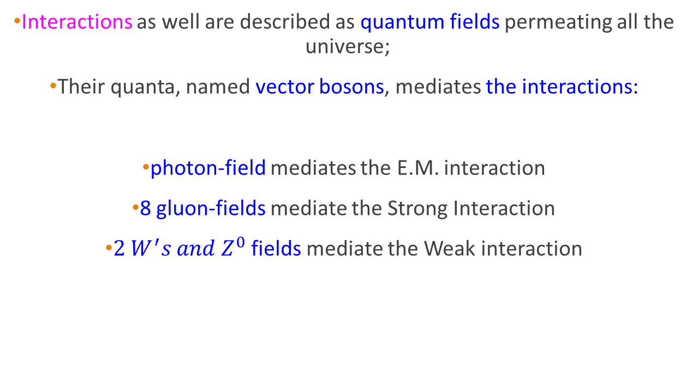
Particles and Interactions
Interactions as well are described as quantum fields permeating all the universe;
Their quanta, named vector bosons, mediates the interactions:
photon-field mediates the E.M. interaction
8 gluon-fields mediate the Strong Interaction
${2 W}^{′}s and Z^{0}$ fields mediate the Weak interaction

Slide 8
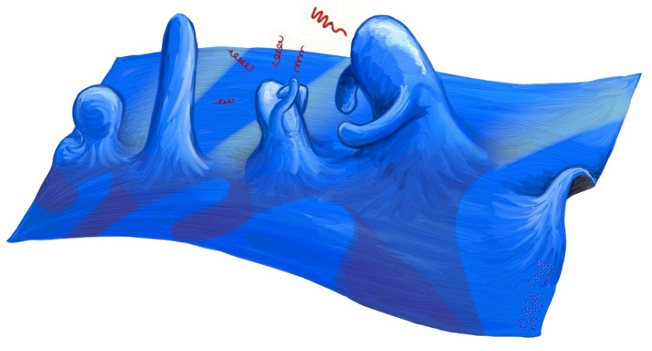
Pictorial view of a quantum field
Credits: David Tong image
Notes:
https://www.google.com/url?sa=i&url=https%3A%2F%2Fwww.discovery.com%2Fscience%2FEmpty-Space-Quantum-Researchers-Have-Direct-Evidence&psig=AOvVaw1Ch3dY4QpHiqSJCxx0hj_-&ust=1697727683879000&source=images&cd=vfe&opi=89978449&ved=0CA8QjRxqGAoTCNiOvtju_4EDFQAAAAAdAAAAABCdAQ

Slide 9
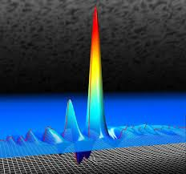
QM for quantum fields
…just to figure out the ripple…
Particle and Field: in 1924, L. de Broglie proposed that a particle of energy E and momentum p, has an associated matter field with frequency ν = E/h and wavelength λ = h/p.
Wave-particle duality!
Heisenberg’s uncertainty principle
ΔEΔt ≥ h and ΔxΔp ≥ h
https://www.google.com/... See the note
Quantum Mechanics!!
- Quantized values of Energy;
-interaction radiation-matter via the photon;
-………..
Notes:
https://www.google.com/url?sa=i&url=https%3A%2F%2Fwww.discovery.com%2Fscience%2FEmpty-Space-Quantum-Researchers-Have-Direct-Evidence&psig=AOvVaw1Ch3dY4QpHiqSJCxx0hj_-&ust=1697727683879000&source=images&cd=vfe&opi=89978449&ved=0CA8QjRxqGAoTCNiOvtju_4EDFQAAAAAdAAAAABCdAQ

Slide 10
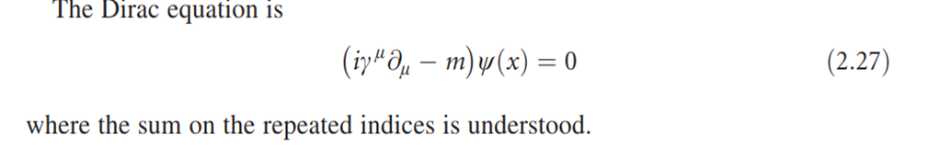
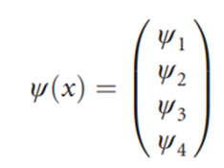

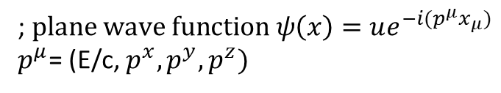
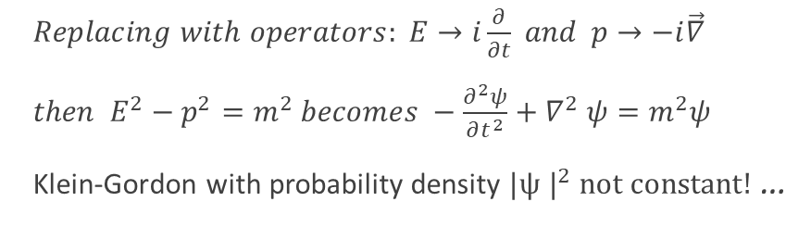
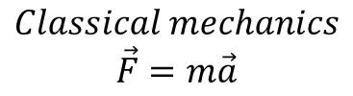
QM: the Relativistic wave equation
$Replacing with operators: E→i\frac{∂}{∂t} and p→−i\vec{∇}$
$then E^{2}−p^{2}=m^{2} becomes −\frac{∂^{2}ψ}{∂t^{2}}+∇^{2}$ $ψ=m^{2}ψ$
Klein-Gordon with probability density $|{ψ |}^{2} not constant!$ …
$$Classical mechanics$$
$$\vec{F}=m\vec{a}$$
The (2.27) contains first order, time partial derivative. Its solutions have the probability density$|{ψ |}^{2}$ conserved.
; $plane wave function ψ\left(x\right)=ue^{−i(p^{μ}x_{μ})}$
$p^{μ}$= (E/c, $p^{x},p^{y},p^{z})$

Slide 11

Glimpses on the Standard Model
THE STANDARD MODEL OF PARTICLE PHYSICS (SM)
-It is a mathematical framework for a unified description of three interactions:
  The Electromagnetic interaction,
  The Weak Interaction (particle decay, radioactivity),
  The Strong Interaction (interaction binding quarks),
-Plus, the Higgs field (providing the mass to the particles).
-The SM is based on Quantum Field Theory.

Slide 12

Glimpse on Quantum Field Theory
QFT = QM+ quantum Fields = Quantum Field Theory
QM = Quantum Mechanics, incorporating the Special Relativity, predicts the existence of the anti-matter: Dirac equation;
Quantum Fields = mathematical functions describing particles and interactions.

Slide 13
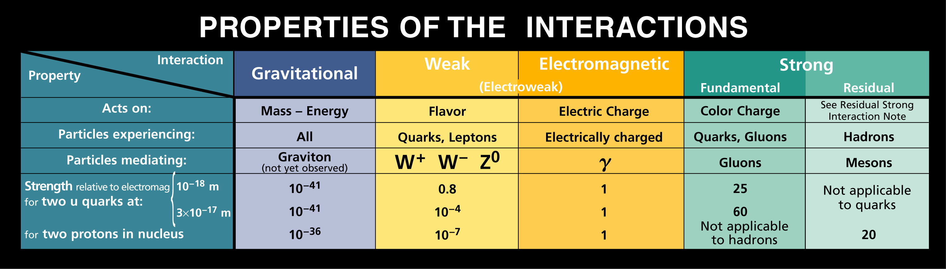
Fundamental Interactions

Slide 14
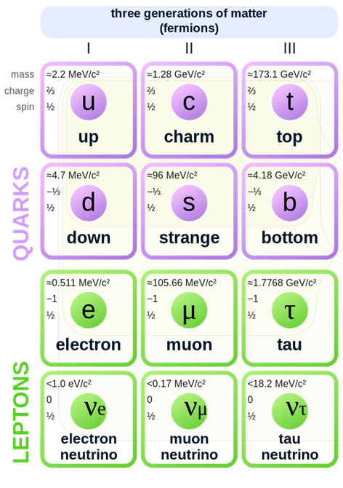
Keystones of the Standard Model
Matter fields (aka fermions)
- Corresponding 6 anti-matter families exist!
  3 Anti-quarks families;
  3 Anti-leptons families.
- A total of 24 fundamental fermions, exists.

Slide 15
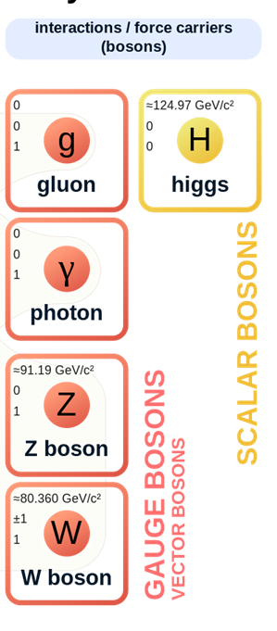
Keystones of the Standard Model
Interaction fields (aka vector bosons)
mass
charge
spin

Slide 16
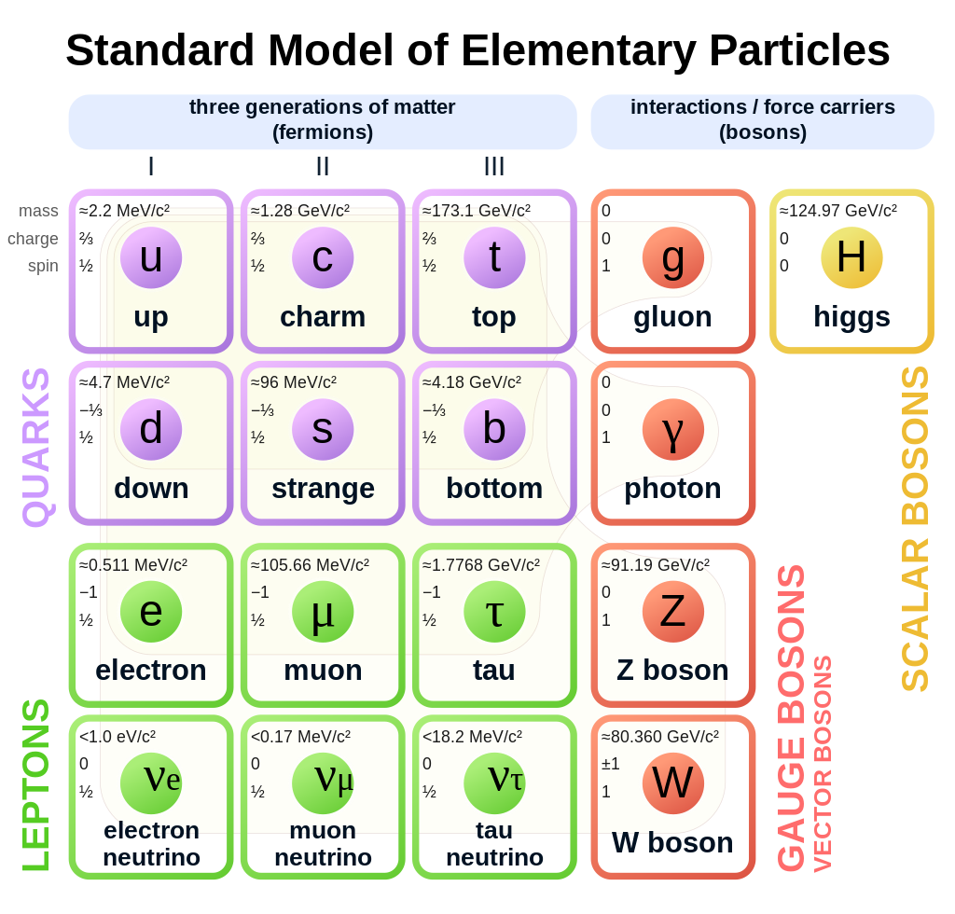

Keystones of the Standard Model

Slide 17
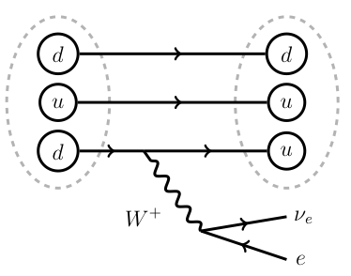
Feynman diagrams for the Weak, Electro-weak interaction
The diagrams are useful to calculate the interaction probability in one vertex
neutron decay into a proton
Weak interaction: n decay
W couples to:
Upper and lower members of a fermion generation.
-
-
e⁻
-
ν_{e}
Electro-weak interaction
Z couples to:
Matter and antimatter versions of a fermion.
e+
Z
°
e+
e-
e-
Time

Slide 18
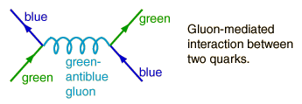
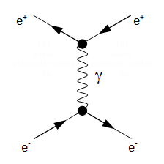
Feynman diagrams for
the Strong and EM interactions
Strong interaction
Time
Electromagnetic interaction
Time

Slide 19

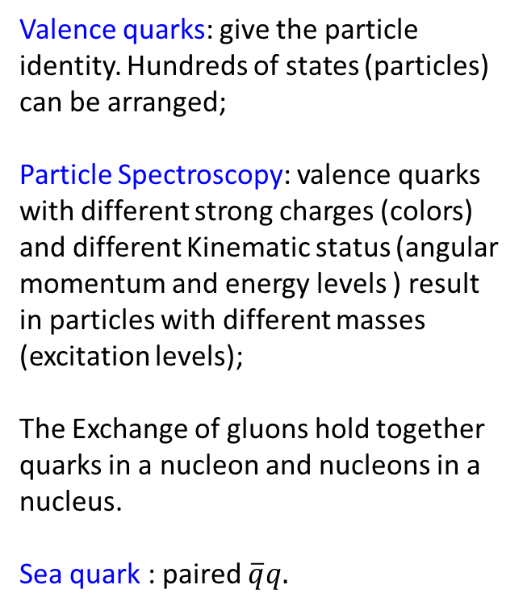
Valence quarks: give the particle identity. Hundreds of states (particles) can be arranged;
Particle Spectroscopy: valence quarks with different strong charges (colors) and different Kinematic status (angular momentum and energy levels ) result in particles with different masses (excitation levels);
The Exchange of gluons hold together quarks in a nucleon and nucleons in a nucleus.
Sea quark : paired $\overline{q}q.$

Slide 20
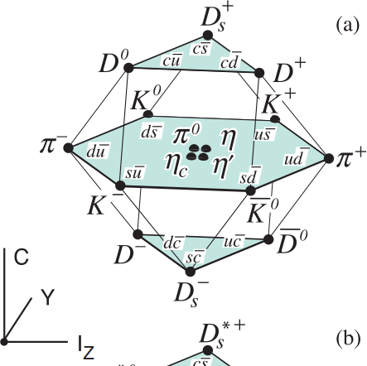
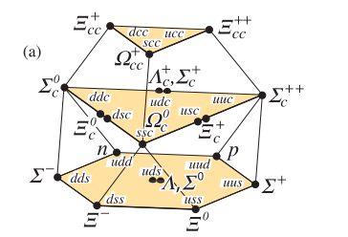
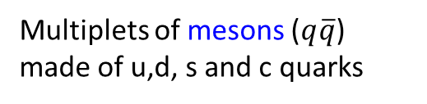
Mesons and Baryons spectroscopy: static quark content
=B+S
Multiplets of mesons ($q\overline{q}$) made of u,d, s and c quarks
Multiplets of barions made of u,d, s and c quarks

Slide 21
Summary
Particles and Interactions are quantum fields;
The particle-wave duality results in the Heisenberg incertitude principle. Energy quantization and more → Quantum Mechanics;
The QM incorporate the SR and predicts the existence of the anti-matter (Dirac equation);
The Quantum Field Theory (QFT) describes interactions between particle fields by means of mediator fields;
The Standard Model: is a mathematical framework providing a unified description of the three interactions; plus, the Higgs field. The SM is a QFT;
Particle spectroscopy: by the valence quarks (quarks and anti-quarks), hundreds of particles (states) can be built.

