Slide 1
Status of the n_TOF facility
CM 3-4 June 2024
Oliver Aberle – Ana-Paula Bernardes – M. Calviani (SY-STI-TCD)
03 June 2024

Slide 2
Content
Proton beam line FTN
  SEM grid
Target(s) and facility
  Homologation
  Autopsy and waste packaging of target #2
Work for YETS 24/25

Slide 3
Restart 2024
  TT2A
    New SEM grid detector head (larger aperture, more channels) running
  Target
    Cooling station safety improvement (extend under pressure confinement to the entire station + additional retention vessels for the moderator skids, as requested by the tripartite) requested by ASN & OFSP
    n_TOF Target #2 autopsy and waste packaging Project in the ISR8
    NEAR activities during 2024

Slide 4
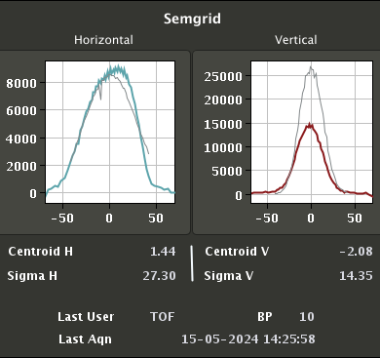
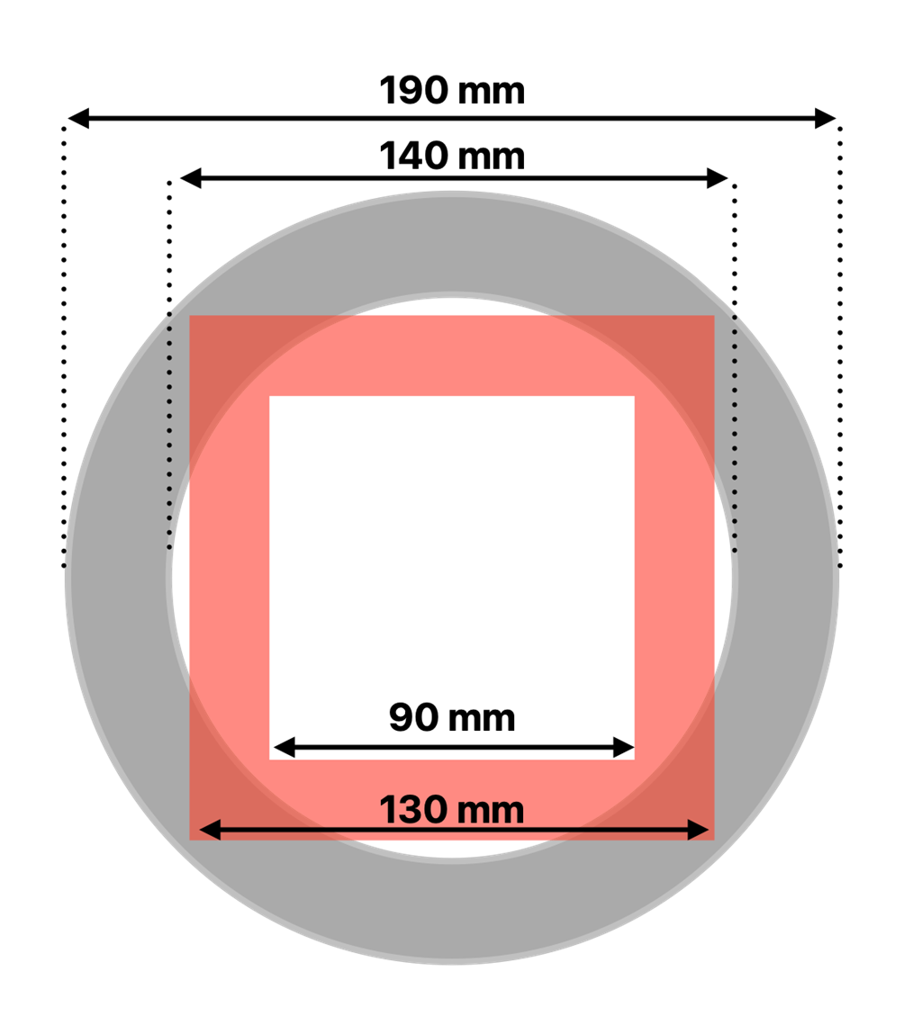
Upgrade of the Wire Grid System in FTN.BSGF484 to the Enlarged Aperture Version
EDMS 2958701
In 2024
Left: old design (SPSBSAPB0030)
Centre: new design SPSBSAPB0064
Right schematic overlap of the old (red) and new (grey) aperture, illustrating the increased clearance for the beam passage.

Slide 5
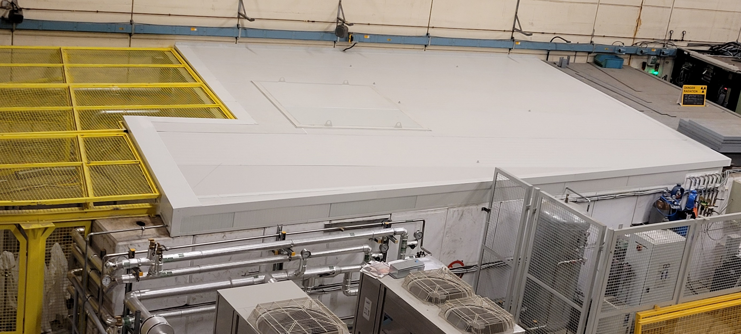
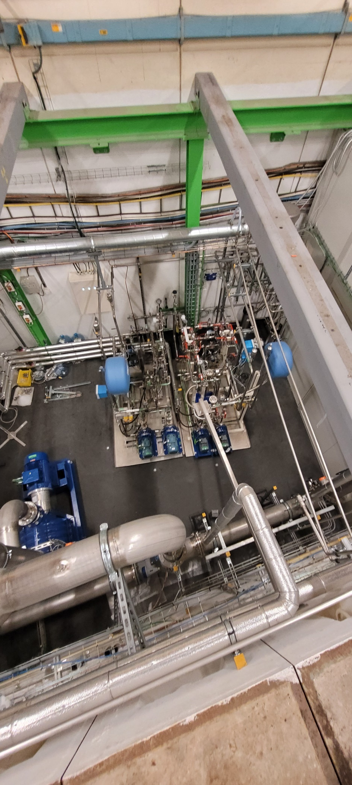
n_TOF target cooling station
Comments from the visit of the French and Swiss nuclear safety authorities, global confinement of entire cooling station implemented during the YETS

Slide 6
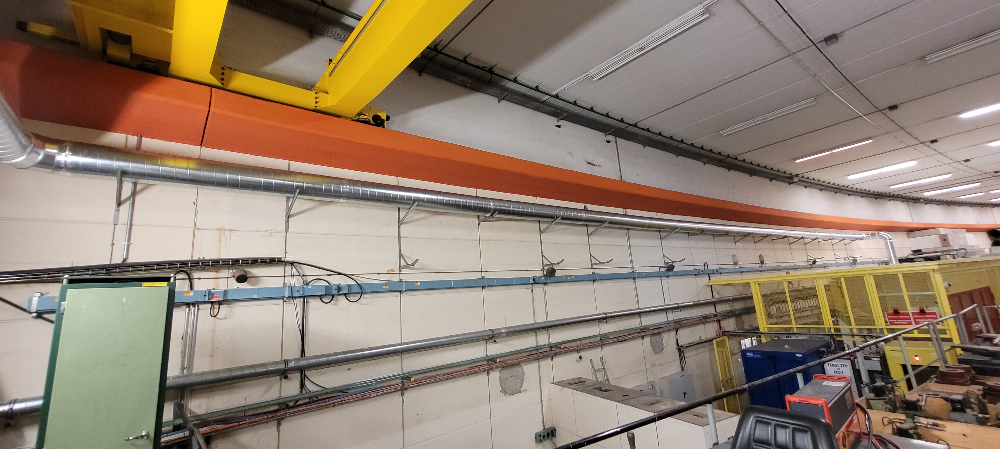
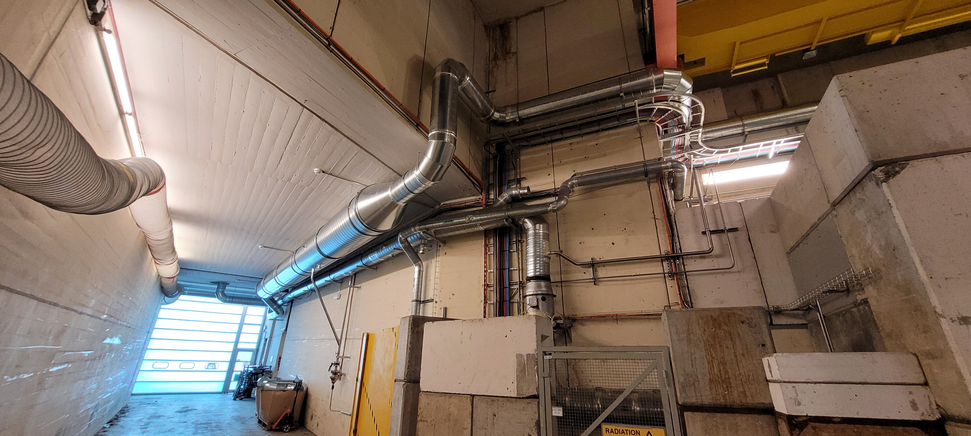
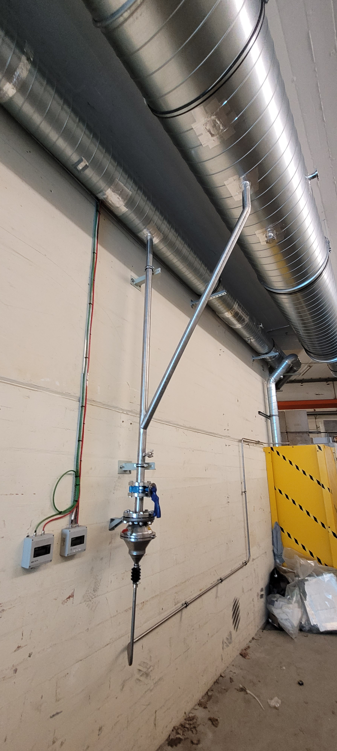
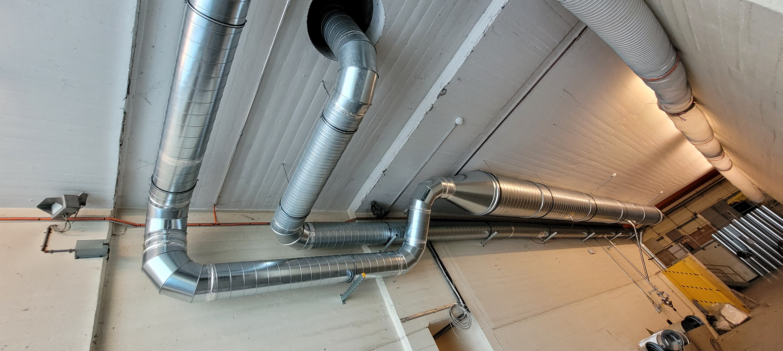
n_TOF target cooling station
Since the connection of the confined cooling station…

Slide 7
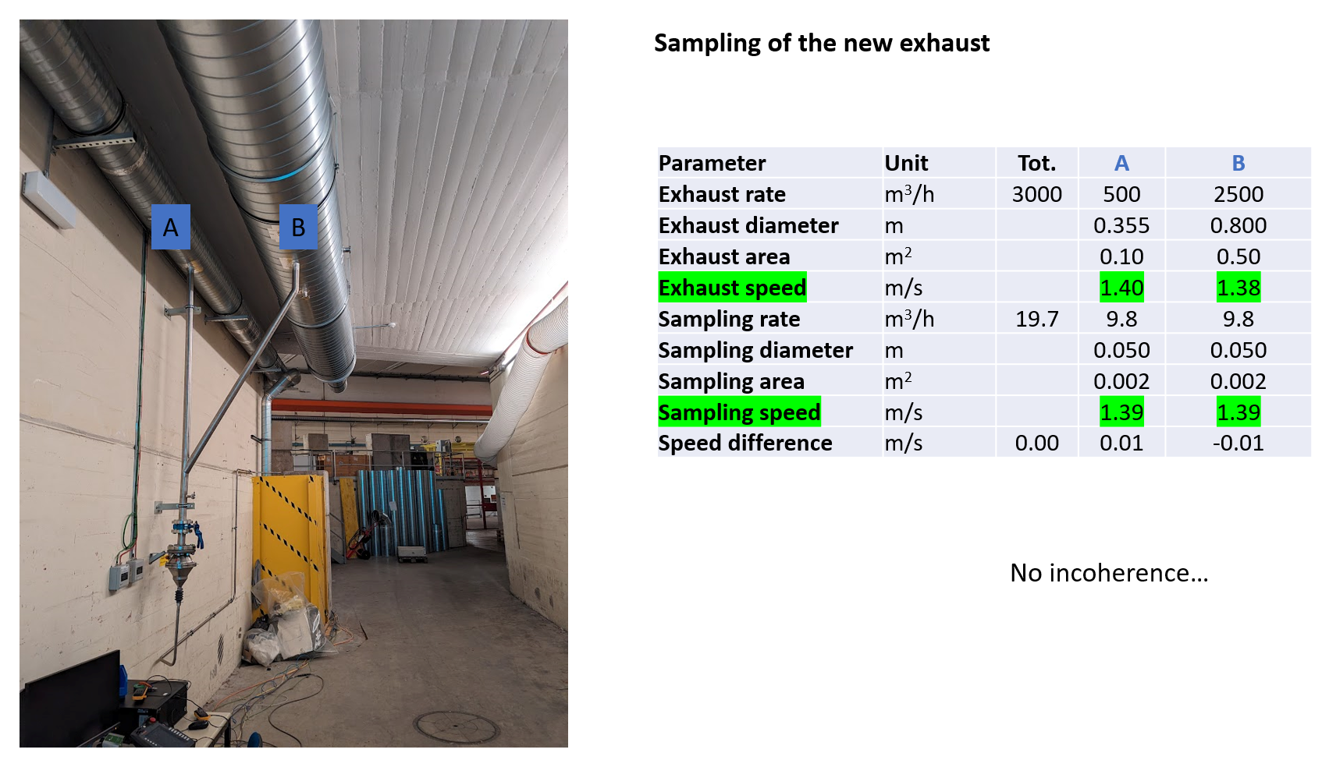
Atmospheric releases - Current status
Courtesy: Fabrice Malacrida (CERN)

Slide 8
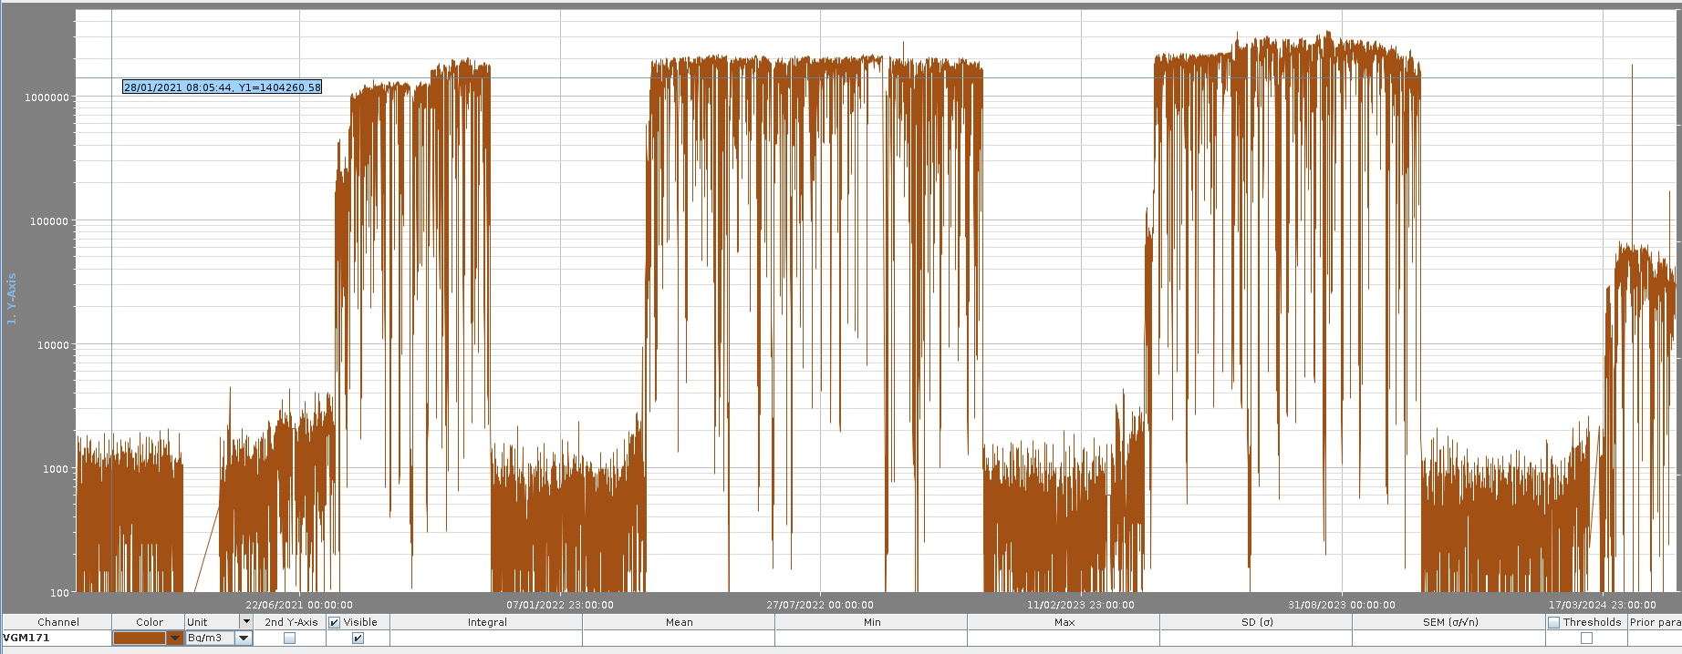
2024: Concentrations of short-lived gases from n_TOF about 20x lower than in previous years
(Should be ~½ of 2023 and then corrected)
2 MBq/m³
2021
2022
2023
2024
0.1 MBq/m³
Atmospheric releases - Current status
Courtesy: Fabrice Malacrida (CERN)

Slide 9
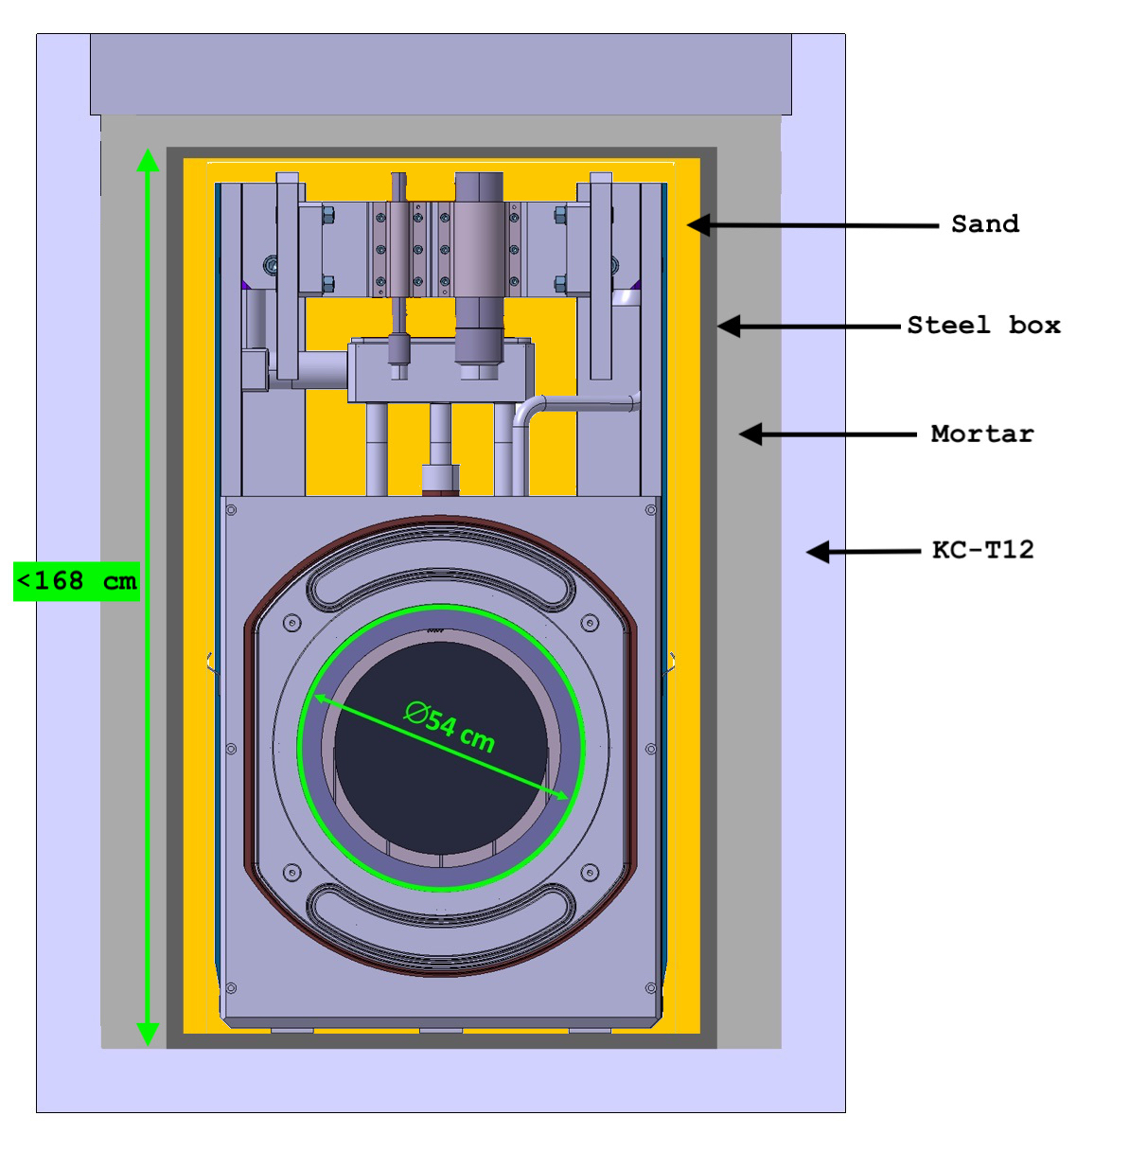
n_TOF spallation Target #2
Autopsy and Waste Packaging Review (T2AWPR) on 03/10/2023
https://indico.cern.ch/event/1293320/
In Switzerland, bulky radioactive waste items are generally cemented with mortar inside concrete containers. The so-called KC-T12 container is to be used for n_TOF Target #2 (e.g. same as n_TOF Target #1).
n_TOF #2 is made of a cylindrical monolithic lead block enclosed in a vessel (water cooling and moderator) made of aluminium ← chemical incompatibility with mortar
Target dimensions:
  Footprint 830 x 628 mm
  Height 1990 mm ← not compatible with KC-T12
A specific conditioning solution has been developed for n_TOF Target #2.
Review result (report in work):
No showstopper identified. Proposed timeline supported, green light to proceed after the final dry run in ISR8 (early 2024).
Courtesy P. G. Pisano, L. Bruno
On the behalf of HSE-RP-RWM

Slide 10
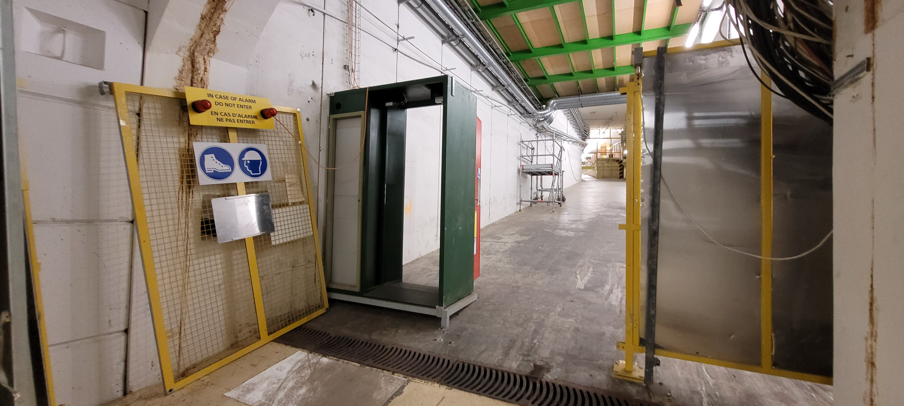
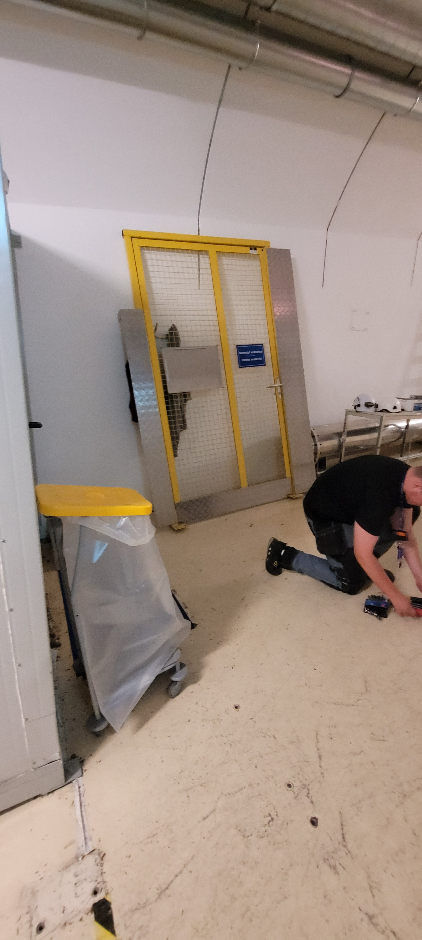
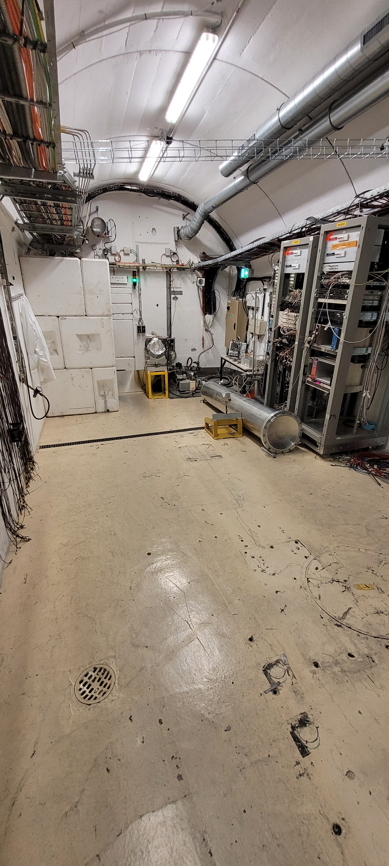
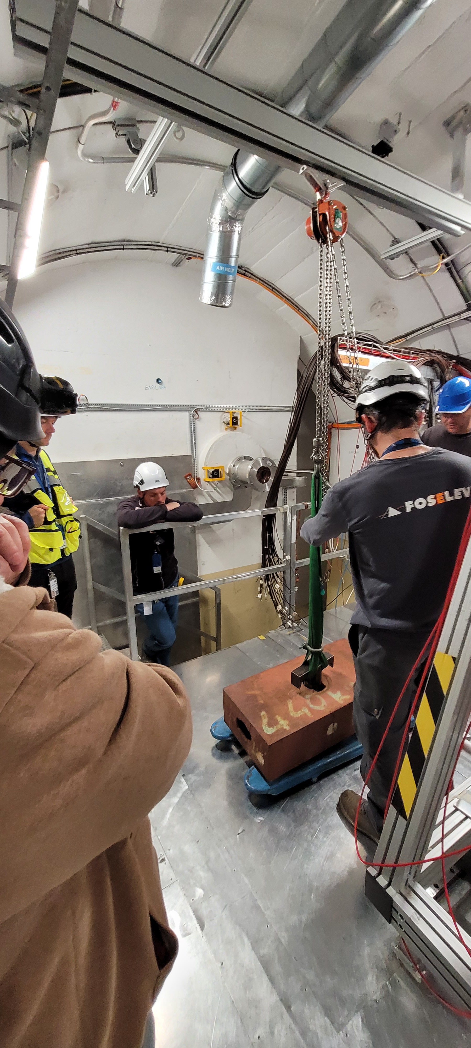
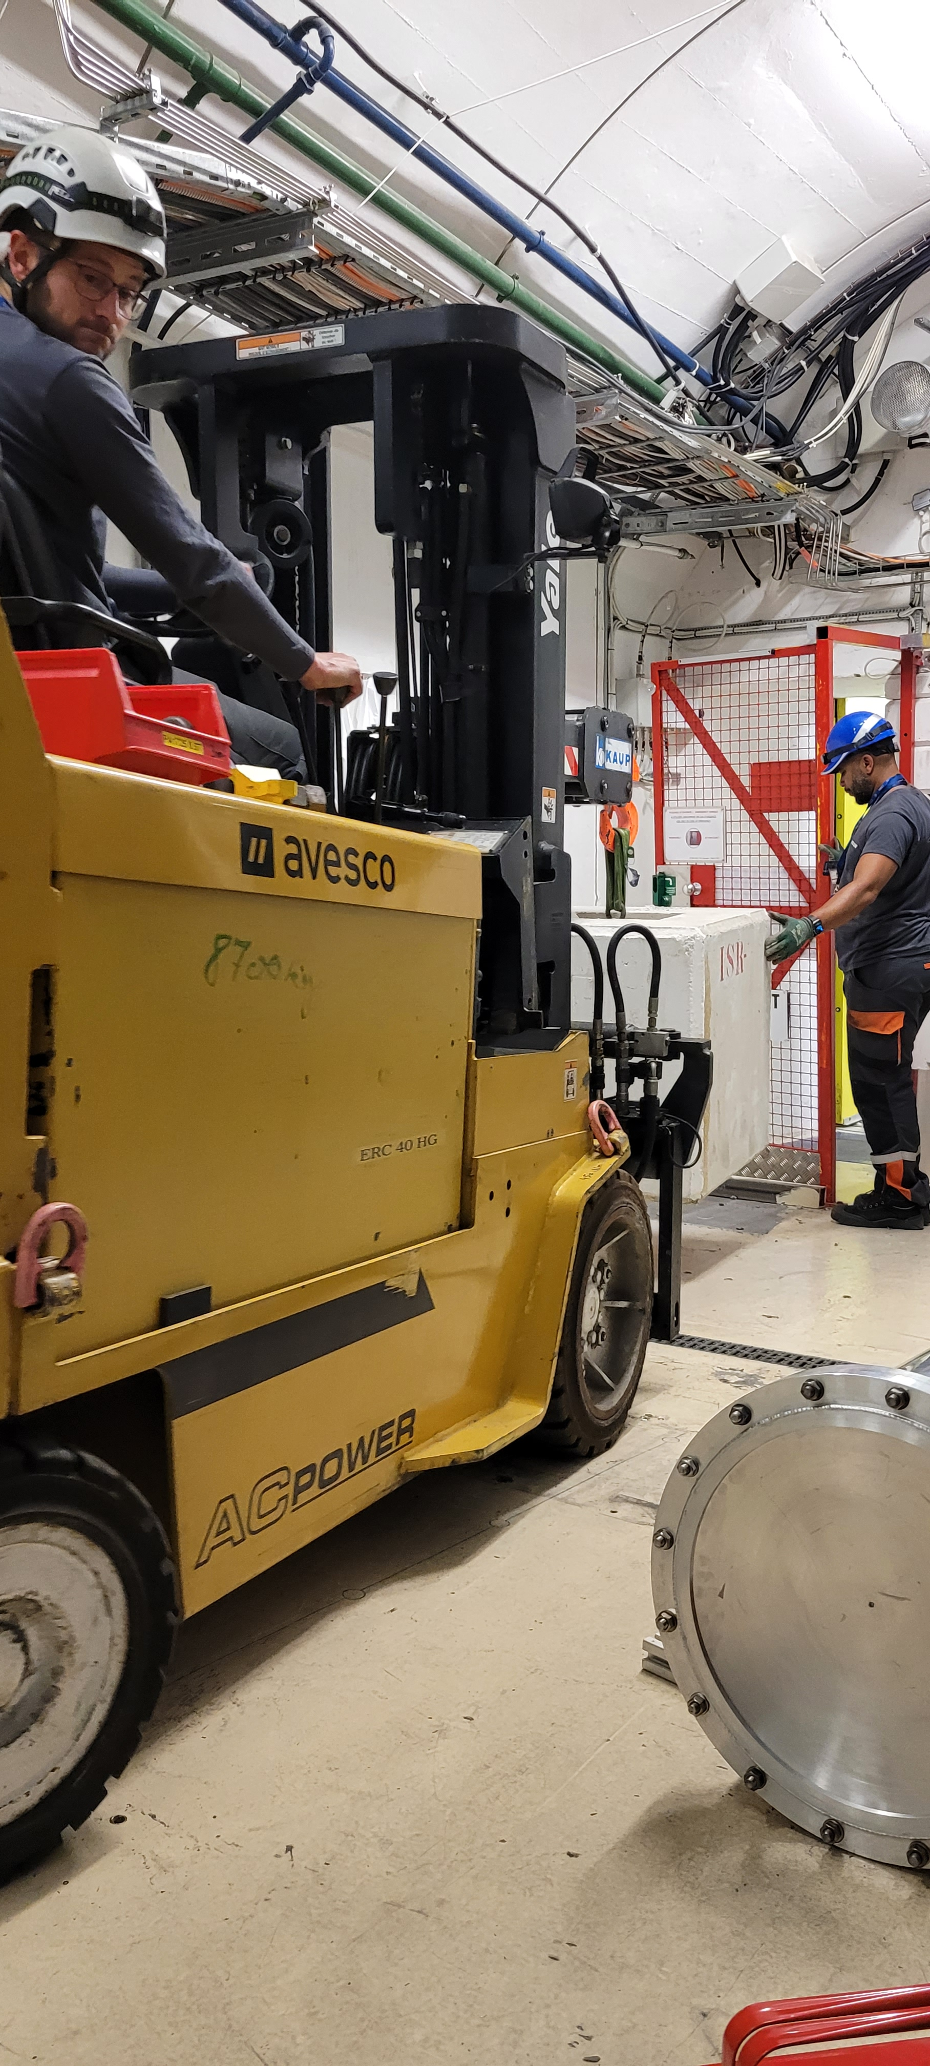
Preparation of escape lane
Remove doors
Remove beam pipe, dump and rails
Remove shielding blocks
Load test of lifting beam

Slide 11
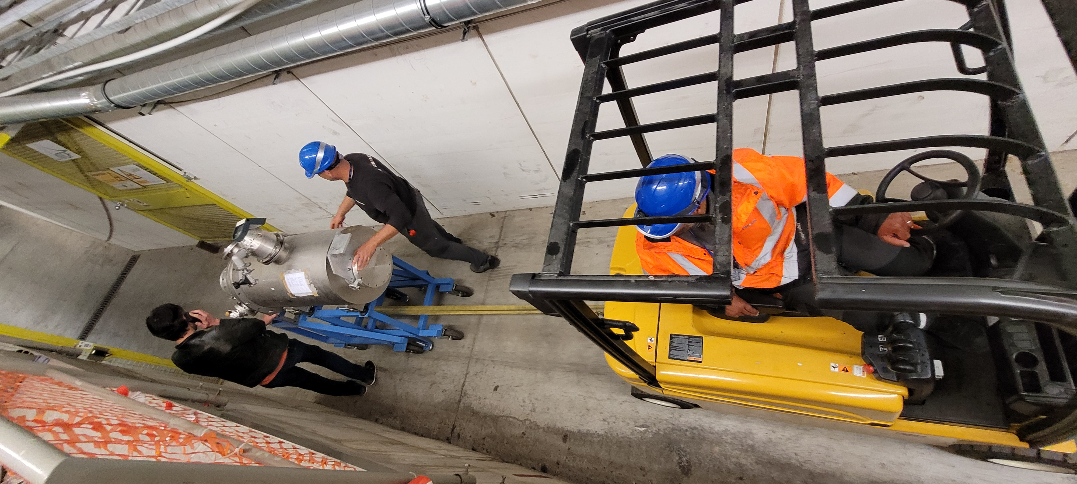
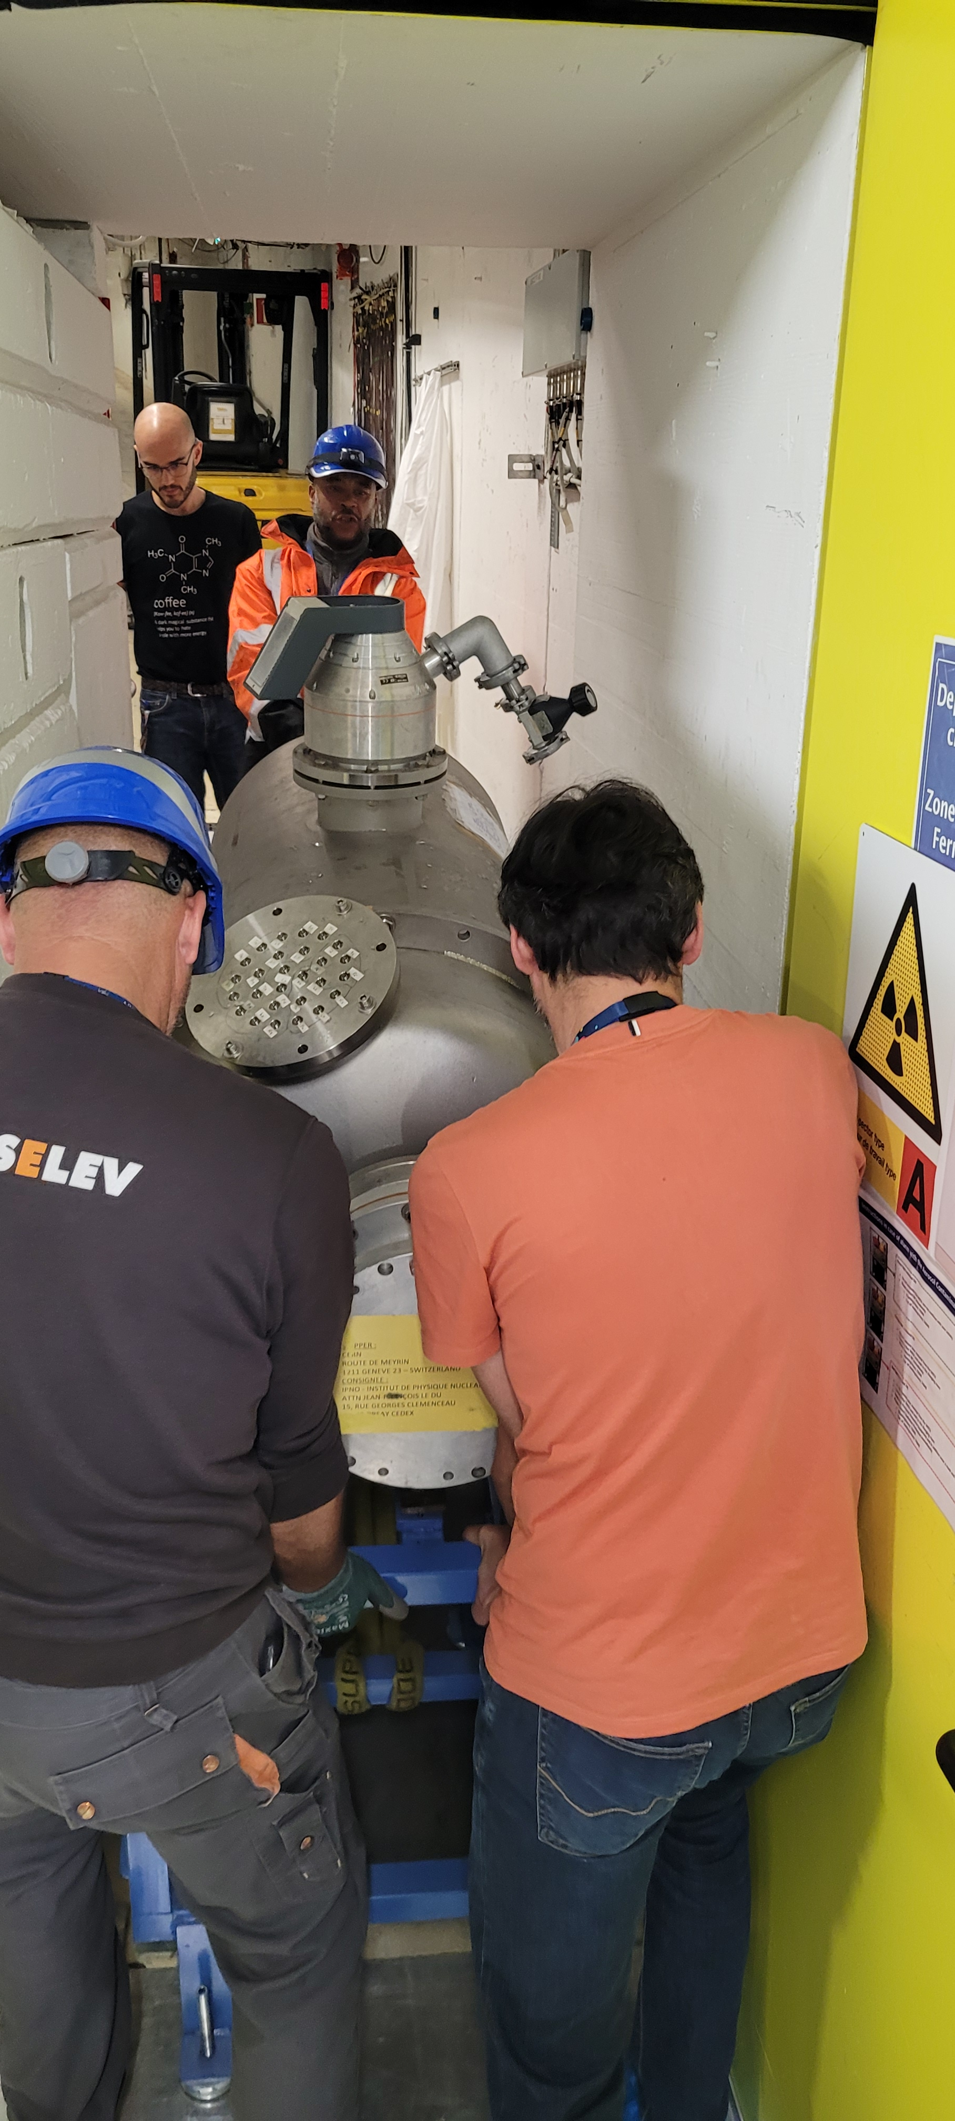
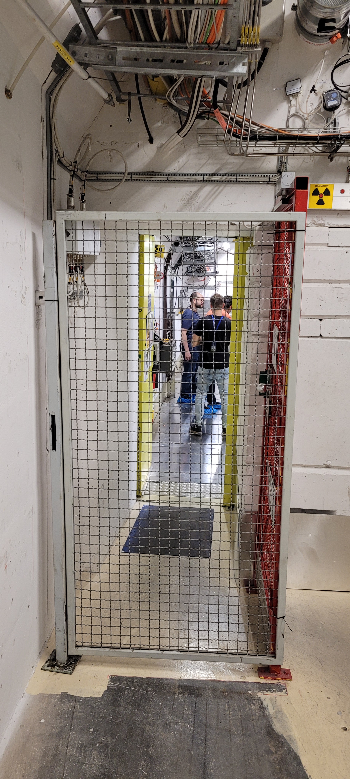
Modification of escape lane – PPAC installation
Is this wall/chicane indispensable
Gain in space and accessibility

Slide 12
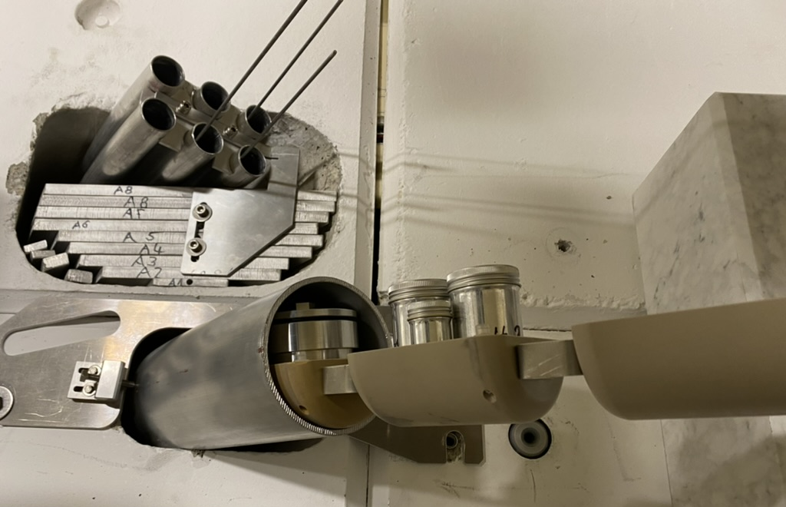
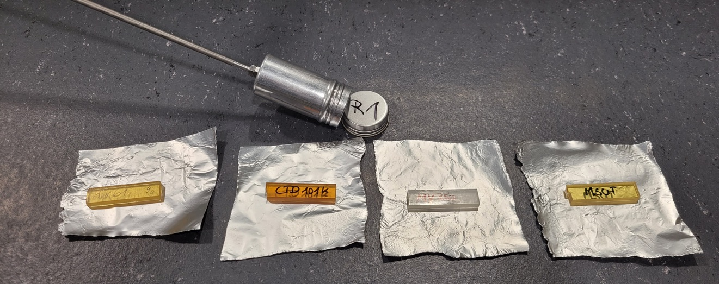
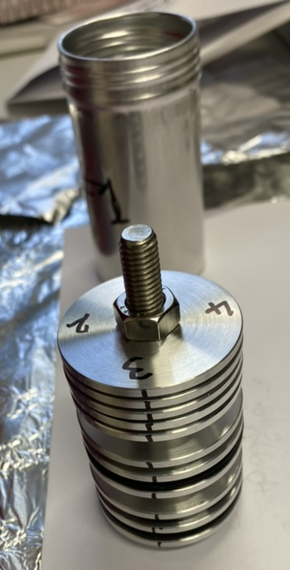
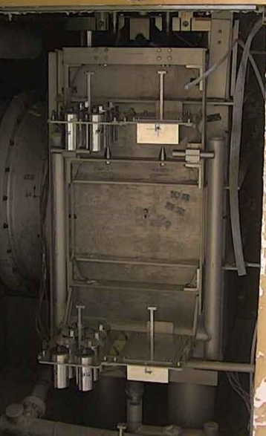
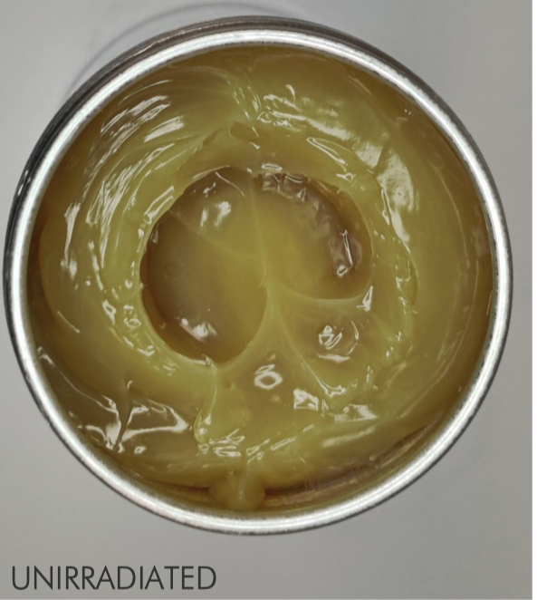
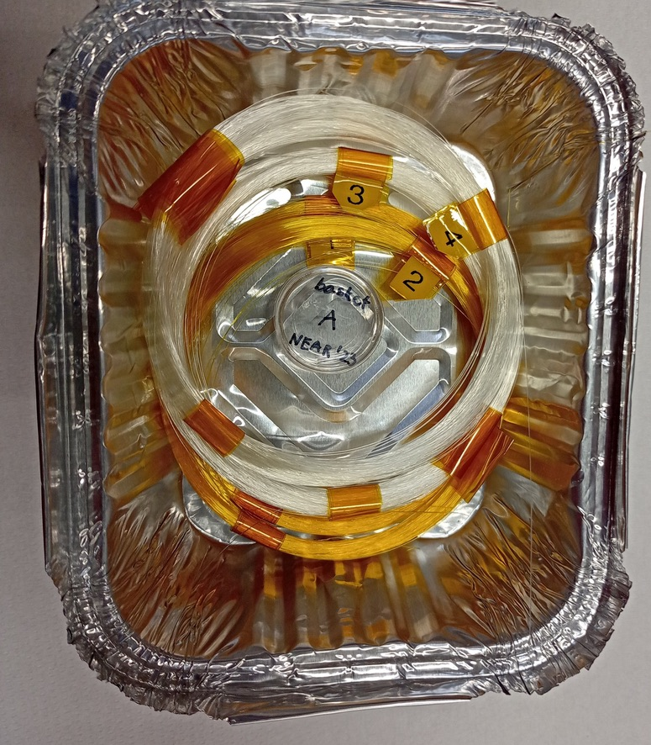
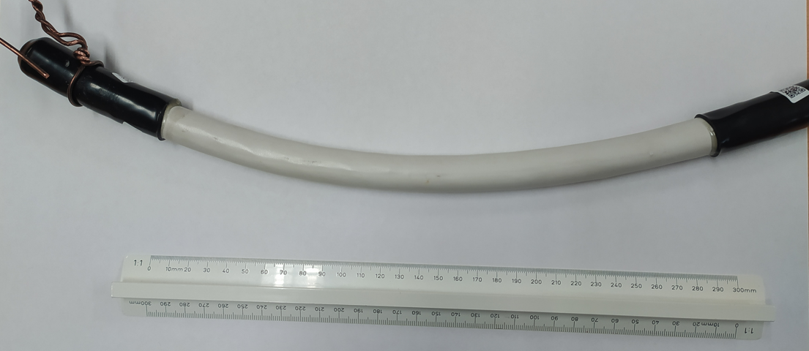
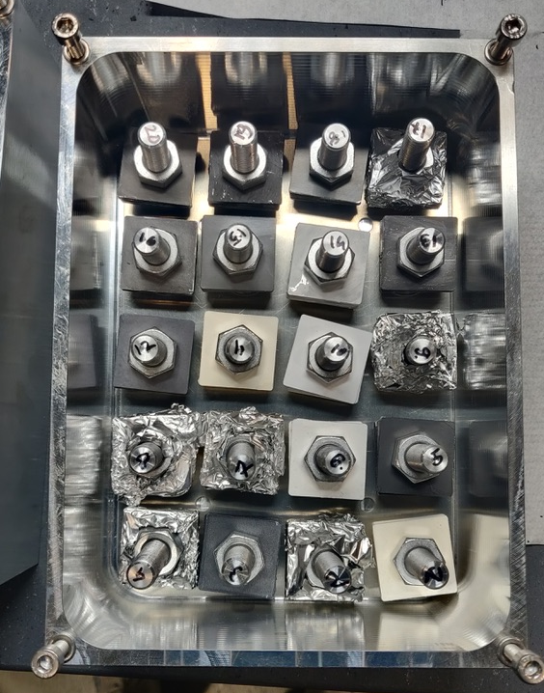
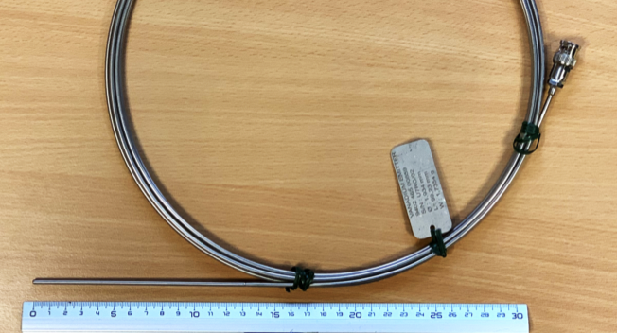
i-NEAR – n_TOF and R2M activities
new
Rabbits 1 and 2 positions
Magnet resine TE/MSC
Shelve positions
Optical Fibers collaboration UJM
Lubricant SY-STI
Elastomere SY-STI
Cables HSE-OHS
Large variety of samples installed at i-NEAR on Shelve or Rabbit positions
INTC-I-247
Coating SY-STI
INTC-I-247 Installation of a detector support in the n_TOF target shielding for high flux neutron and gamma detector irradiation (To be installed)

Slide 13
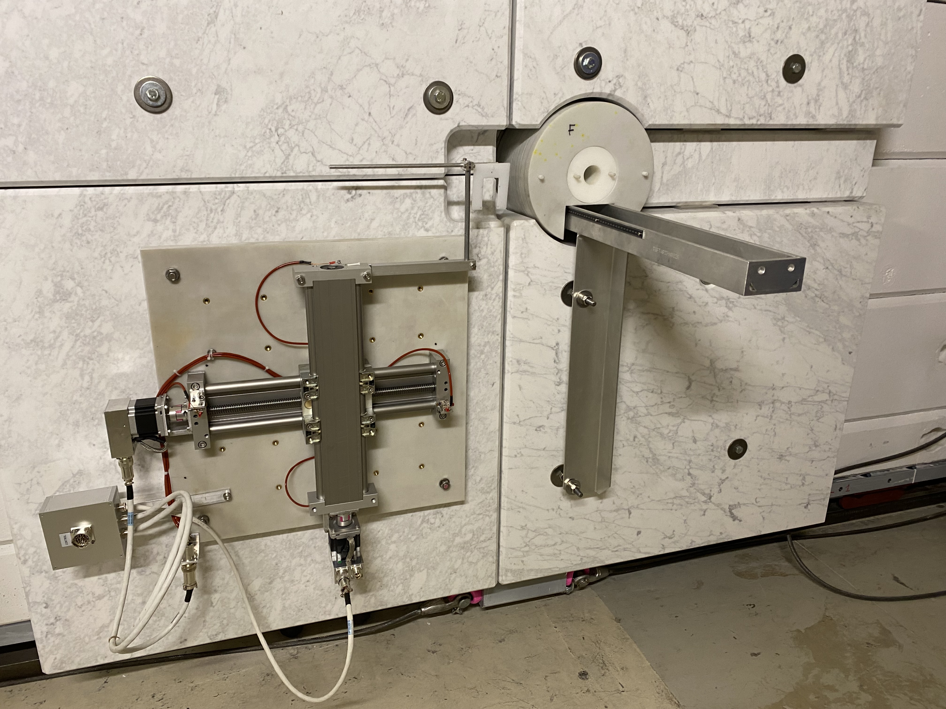
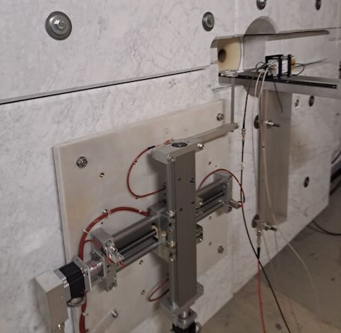
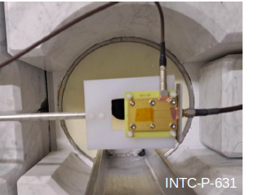
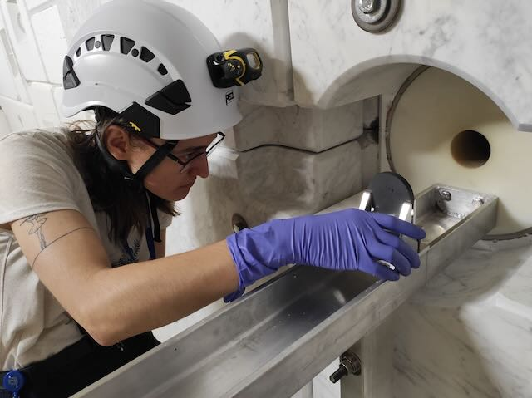
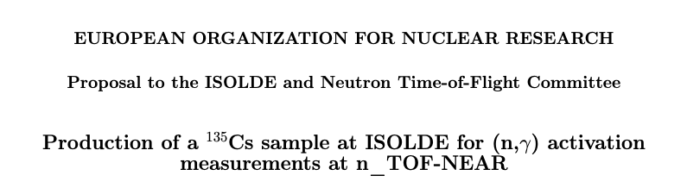
a-NEAR – n_TOF activities 2024
Diamond detector in position:
remote controlled
INTC-P-623 taken over by F.Garcia Infantes
INTC-P-631 Remotely controllable xy table
INTC-P-631
INTC-P-241 under preparation
Thermal neutron background INTC–P-241
Many thanks to Ana-Paula Bernardes!
INTC-P-241

Slide 14
Conclusions
Target performance excellent, FTN beam line modifications successful (SEM upgrade implemented Feb. 2024)
Thanks to the excellent work done by ABT, OP, BI, RP & STI, large beam spot on target (and its continuous monitoring via SEM grid with update) is available
This optimisation, coupled with efficient (gas) cooling systems and target thermocouples monitoring, allows for target average power increase (220*10¹⁰ p/s)
n_TOF facility homologated and safety files up to date, visit of the authorities to EAR1 is scheduled for 03/07/2024
Request to start 10 days earlier in 2025

Slide 15
Future

Slide 16
Consideration for the future
Infrastructure upgrades to enable future physics
n_TOF spallation target #4
Synergistic use of CERN facilities
n_TOF future in the FCC era
Technical Coordination post LS3 - local team and home institutes

Slide 17
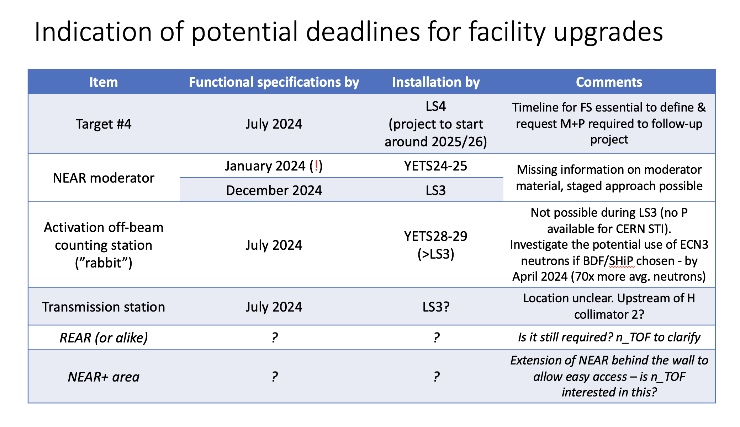
Message from 19th December 2023

Slide 18
Activation measurements
To preserve the uniqueness of n_TOF, focus could be on pulse intensity and less on avg. power
Joining forces with BDF/SHiP and proactively propose an activation station for astrophysical measurements on the side of the production target (~70x more intensity than a-NEAR)
Target #4 could then be focused and optimized for TOF
  Improvements on the target design => Target #4 could be an evolution of Target #3
  Outcome of the autopsy of Target#2 will drive the above
  Rework and optimization of FTN could help for a larger beam spot on target

Slide 19
n_TOF in the FCC era
FCC program is in the ramping up phase – plans for an accelerated program being discussed right now
You must state now the relevance of n_TOF in the long-term, lobbying together with ISOLDE (S. Freeman) the importance of a proton complex post 2040
Sketch of the future injector complex being drafted now!
Few GeV vs. 20 GeV/c ?

Slide 20
Technical Coordination post LS3 local team and home institutes
Oliver will retire in 2027 (sure)
Technical Coordination will be guaranteed, but likely not in the form of an engineer (probably as a technical engineer or mechanical technician)
Facility support guaranteed post LS3, but experiment support will likely be a “request base”, as must be properly anticipated
Account for less flexibility, delays might be less predictable

Slide 21
Technical Coordination post LS3 local team and home institutes
2025 should be a test case for a slightly different organization
Engineer & technical services should be scheduled at the beginning of the year in order for STI/TCD to organize accordingly
Experiments should anticipate requests for design & production (e.g. 2-3 months in advance)
… or maximize production at institutes lab (if possible)

Slide 22
A strong, regular and continuous contact with RCS (and ATS) management by the n_TOF collaboration management is absolutely required in this phase
We clearly miss an overall implementation strategy for the medium and long-term future – we can help you building one?

