Slide 1
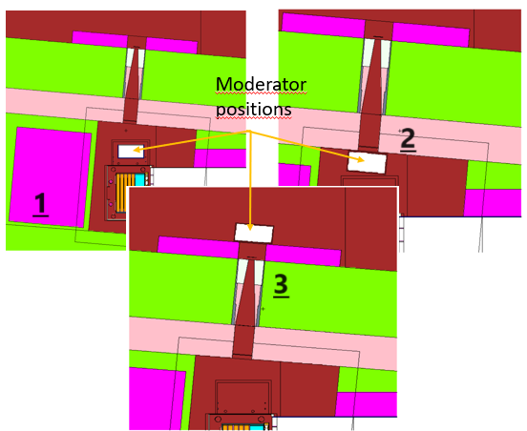

A moderator for the NEAR Station
Neutron spectra
Simulations
By Gediminas Stankunas

Slide 2
A moderator for the NEAR Station
Neutron spectra
Simulations
By Gediminas Stankunas

Slide 3
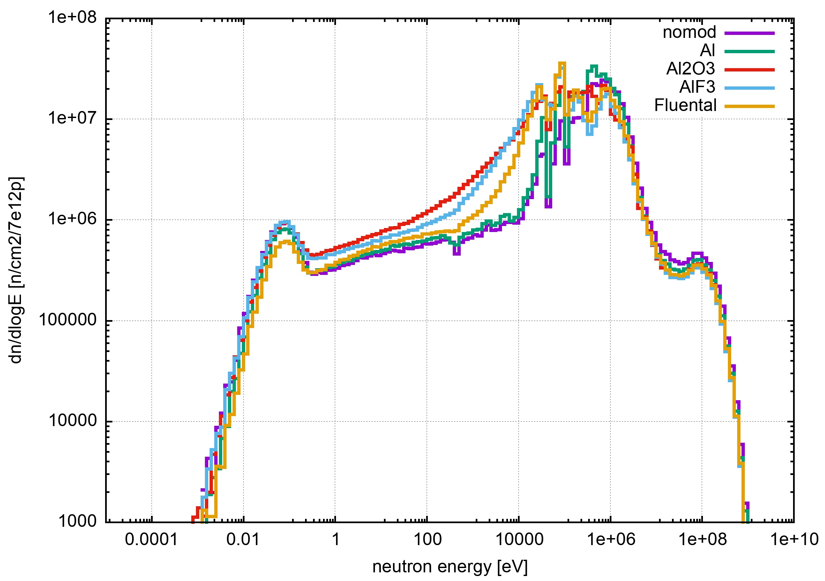
Neutron spectra

Slide 4
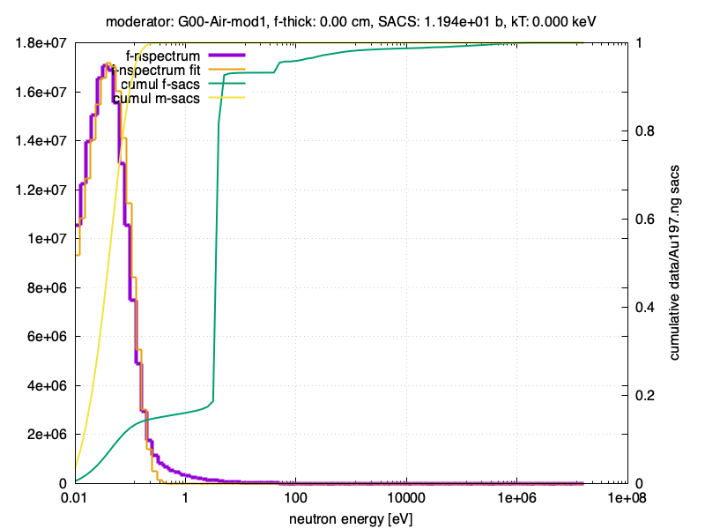
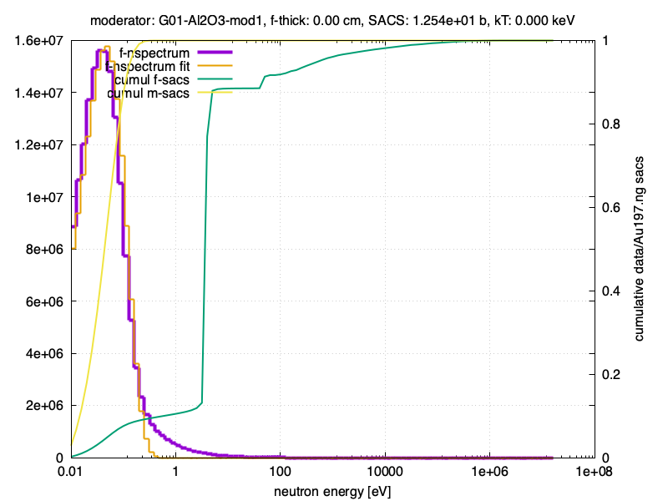
Neutron spectra

Slide 5
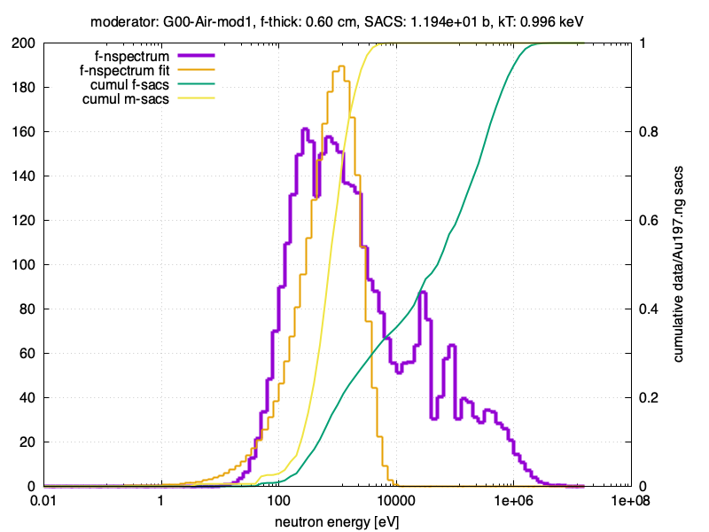
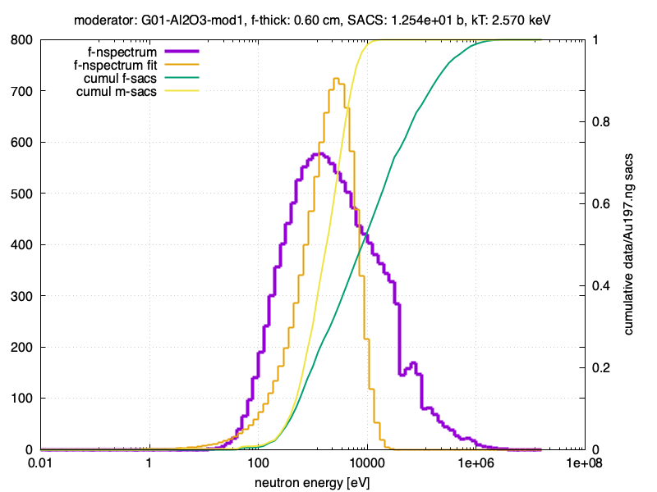
Neutron spectra

Slide 6
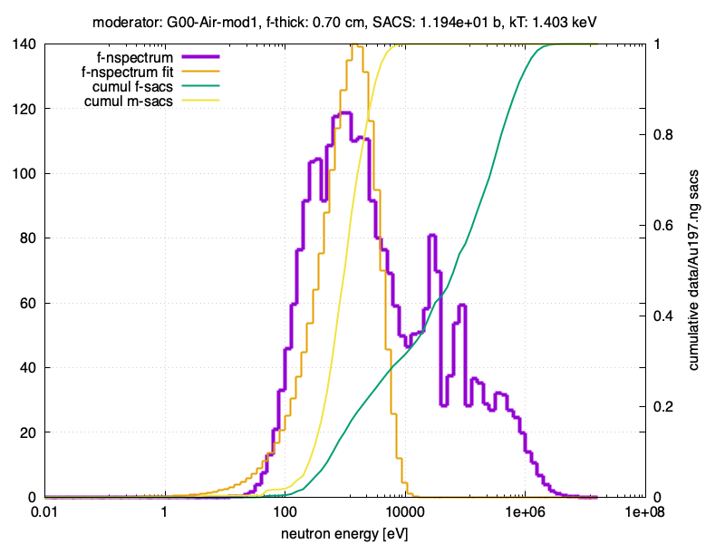
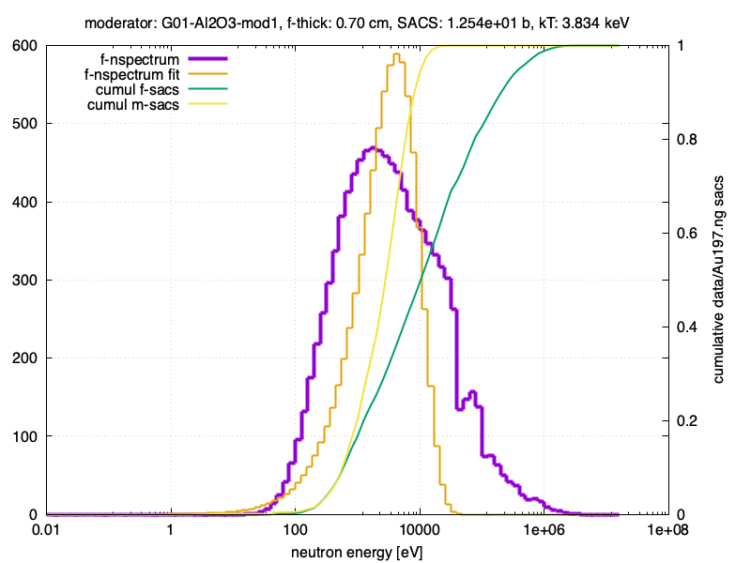
Neutron spectra

Slide 7
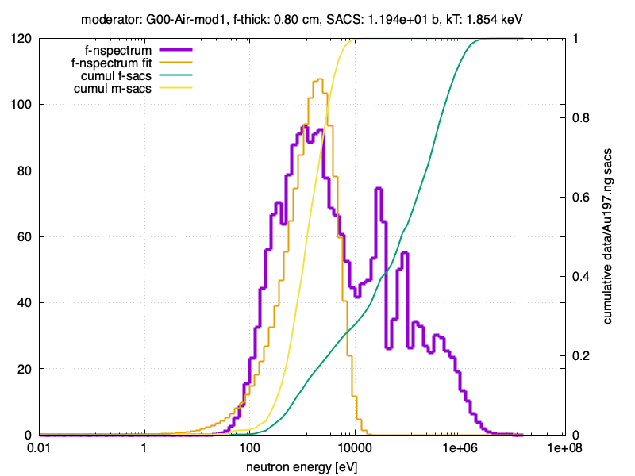
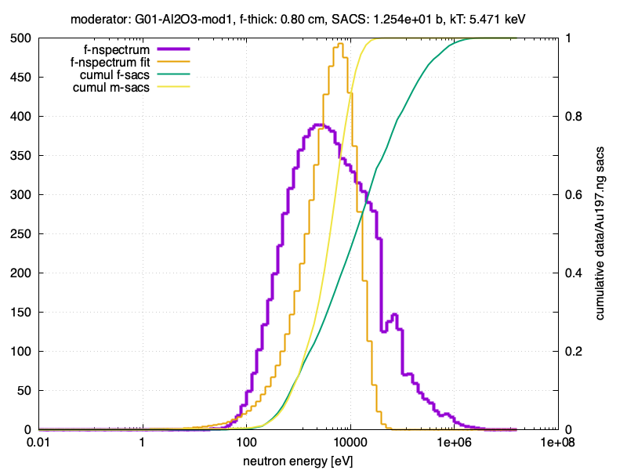
Neutron spectra

Slide 8
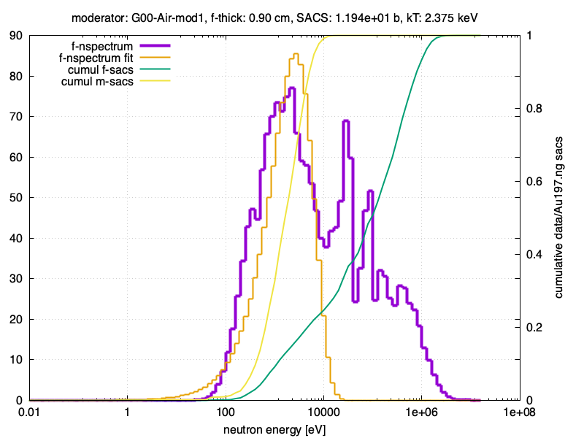
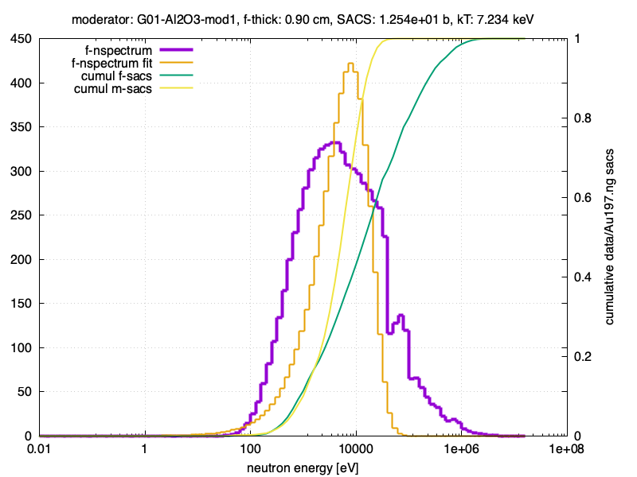
Neutron spectra

Slide 9
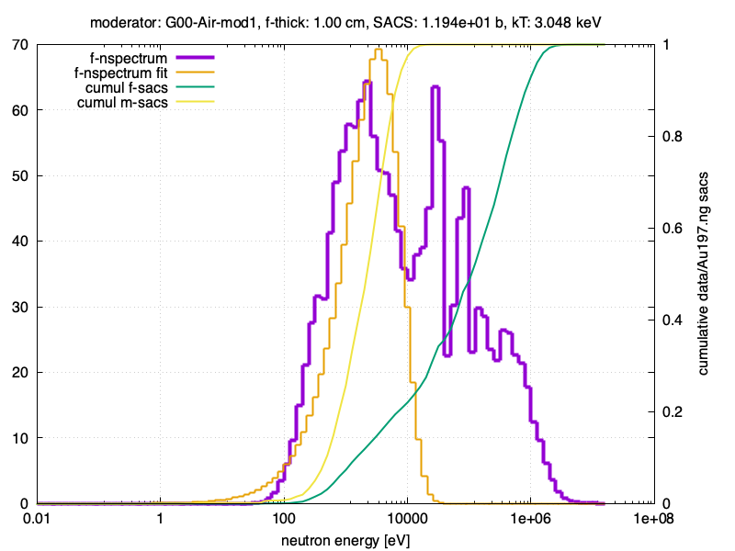
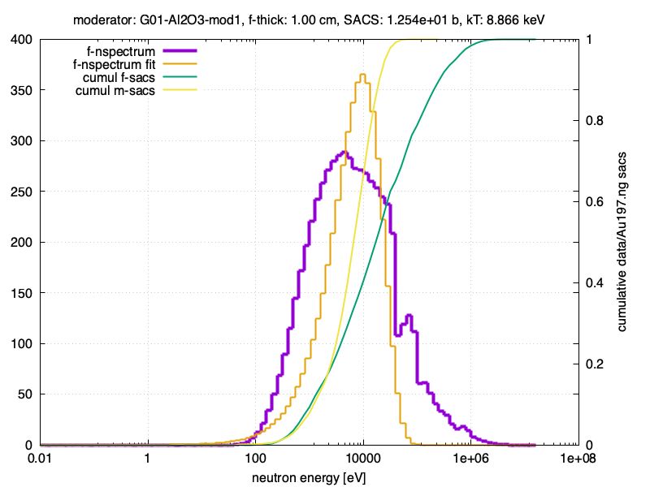
Neutron spectra

Slide 10
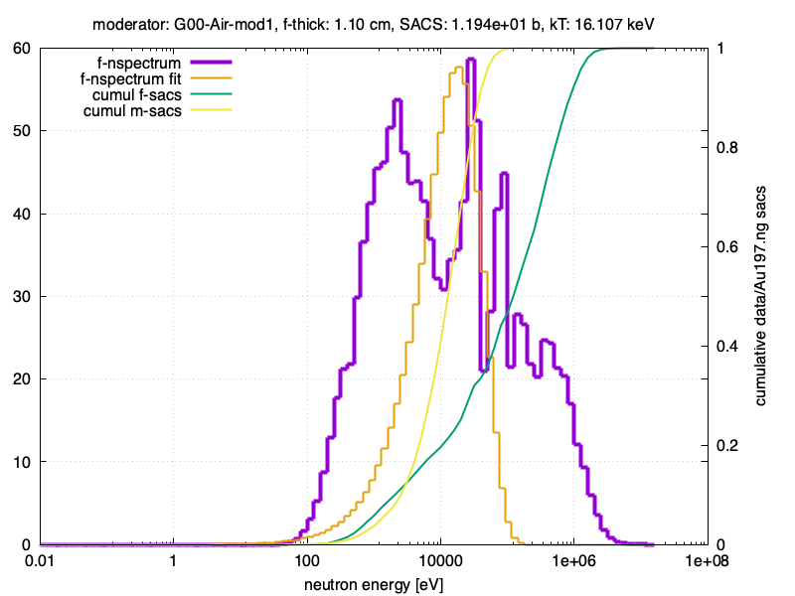
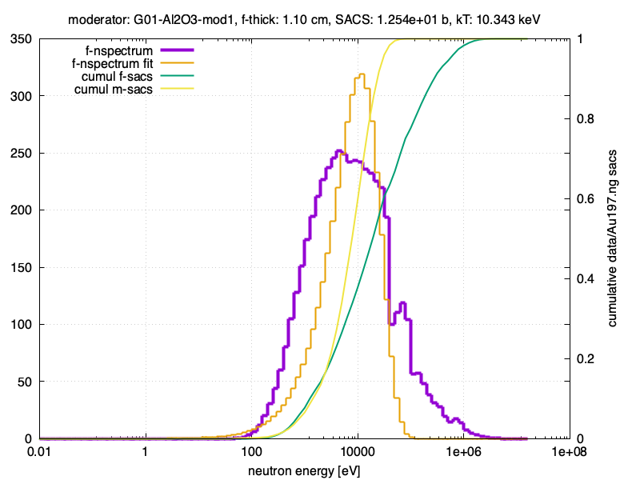
Neutron spectra

Slide 11
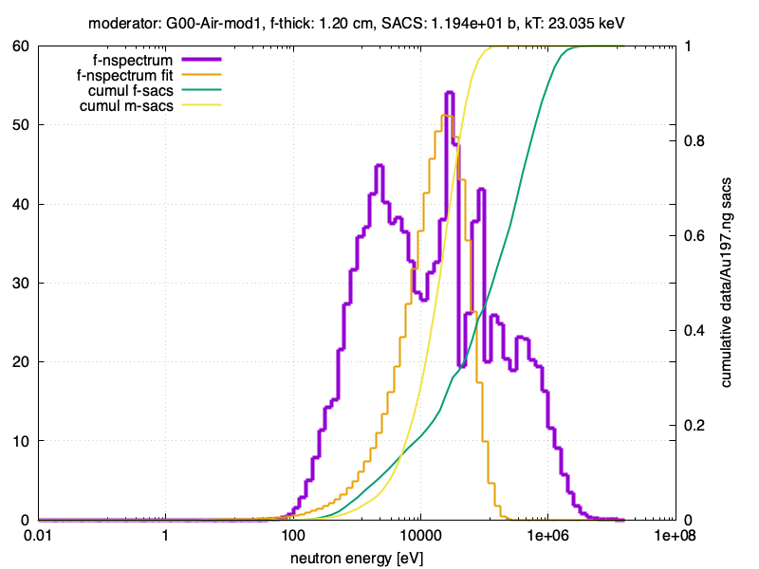
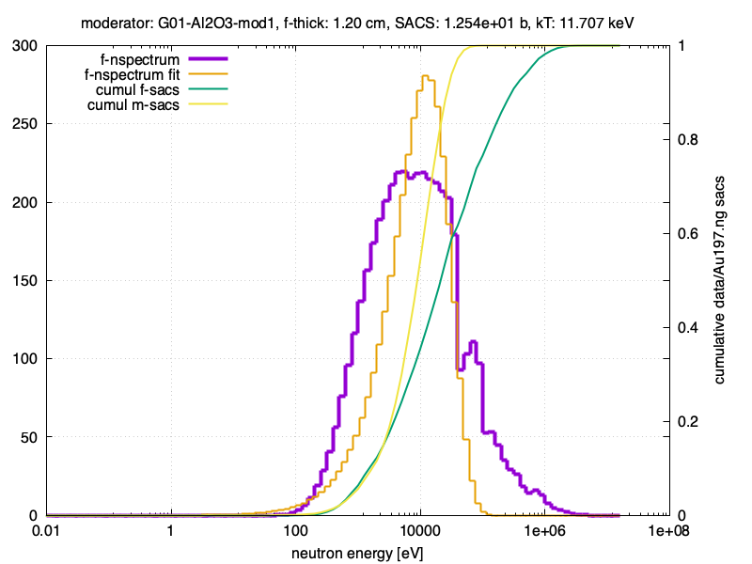
Neutron spectra

Slide 12
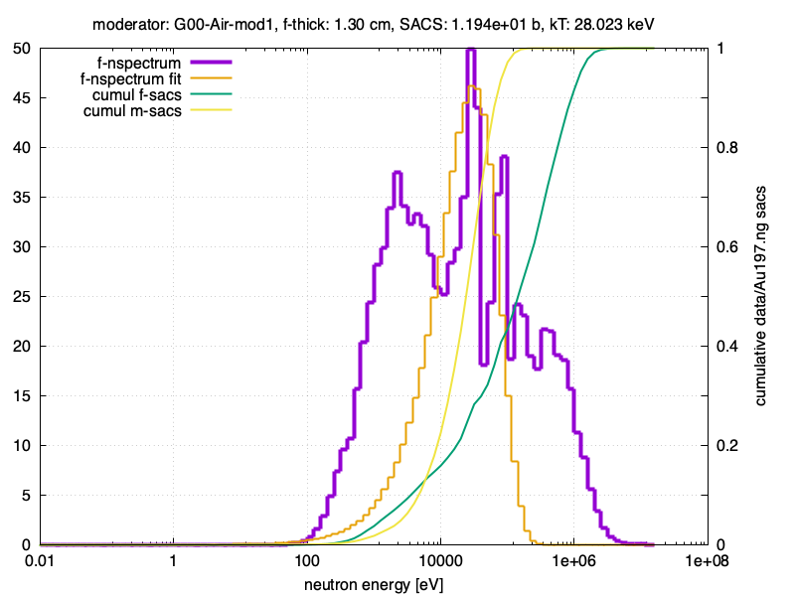
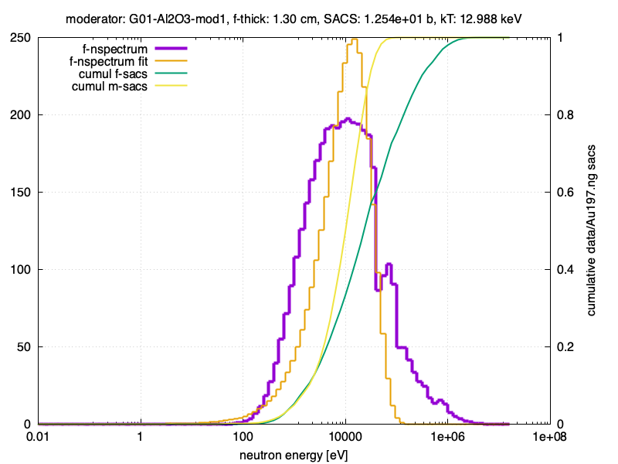
Neutron spectra

Slide 13
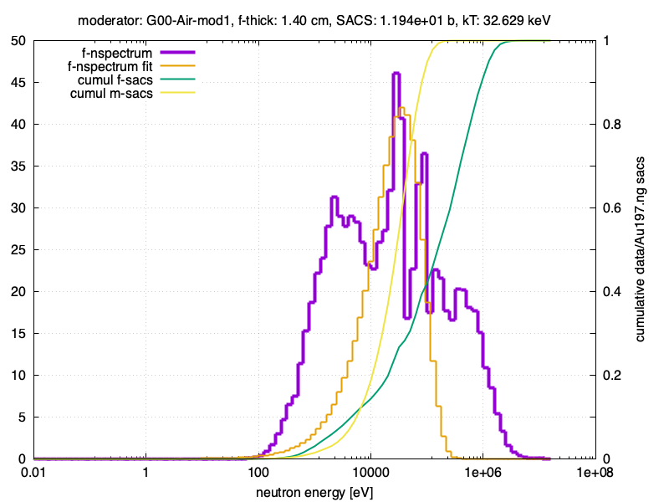
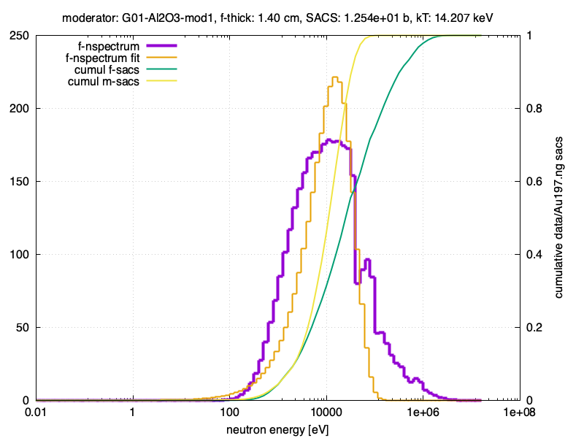
Neutron spectra

Slide 14
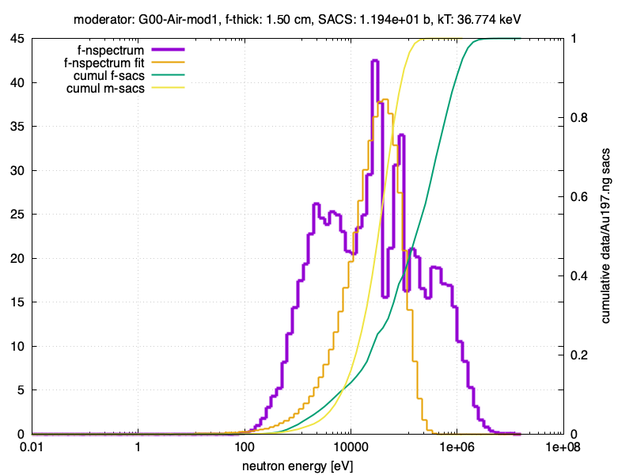
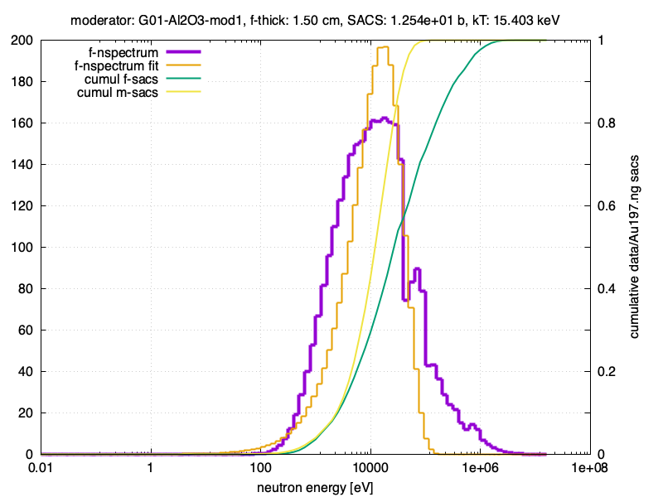
Neutron spectra

Slide 15
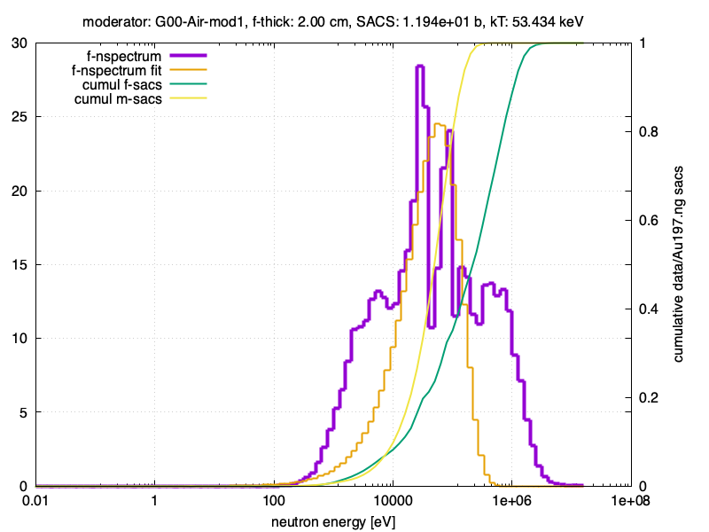
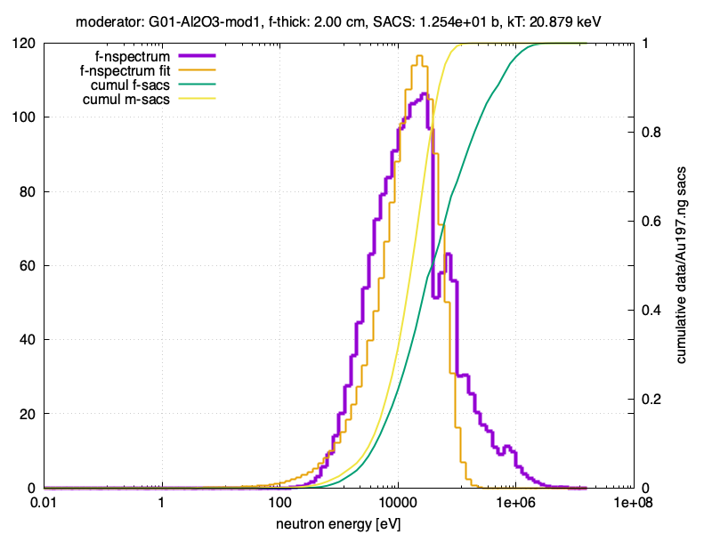
Neutron spectra

Slide 16
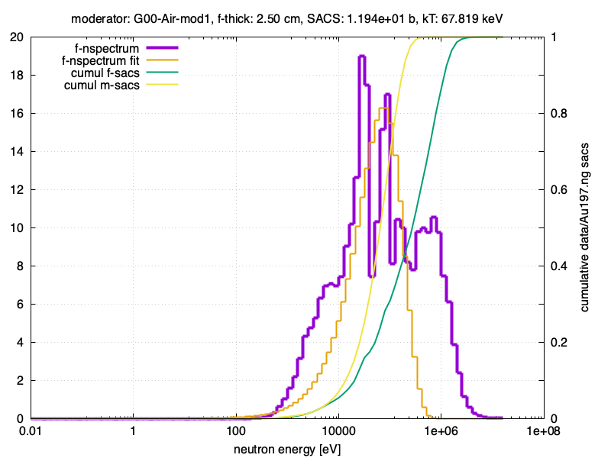
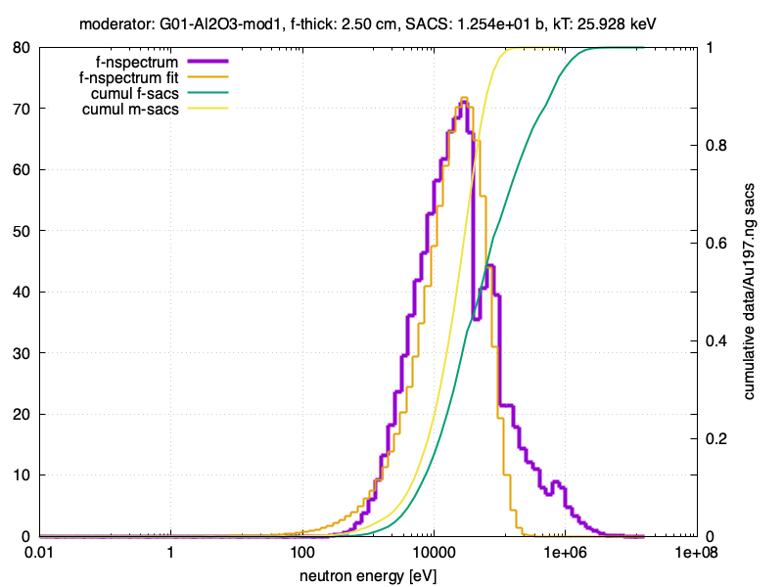
Neutron spectra

Slide 17
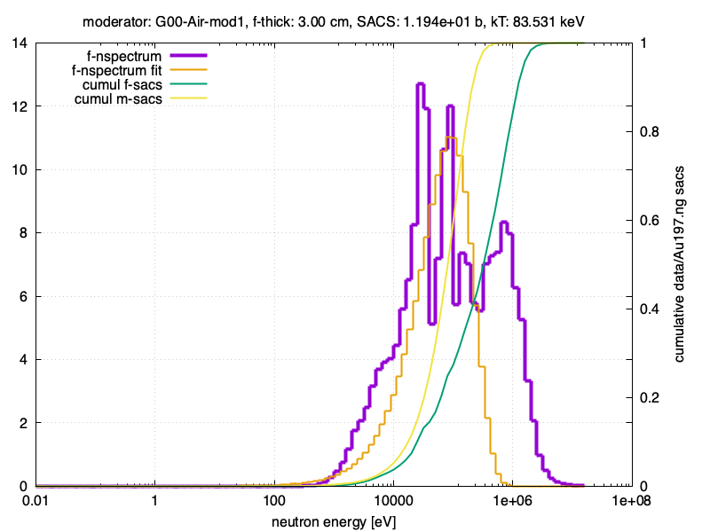
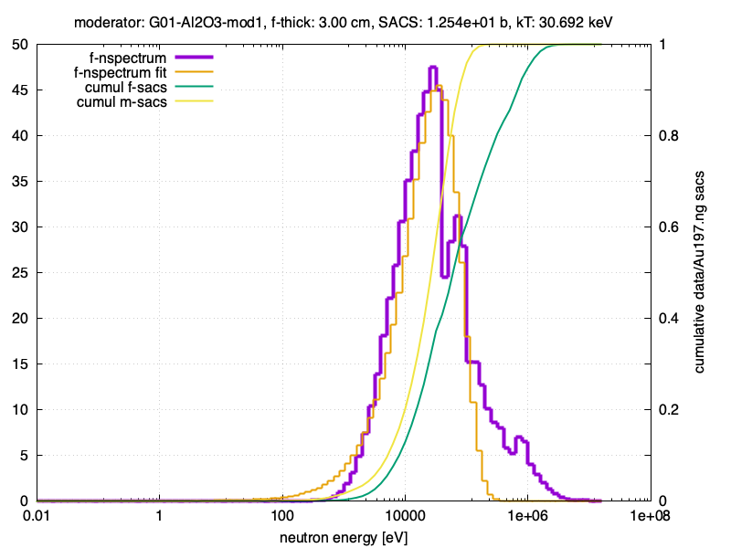
Neutron spectra

Slide 18
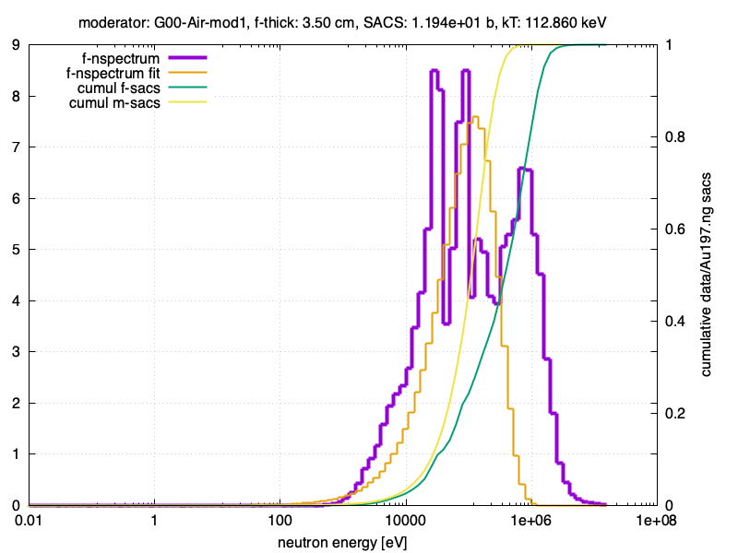
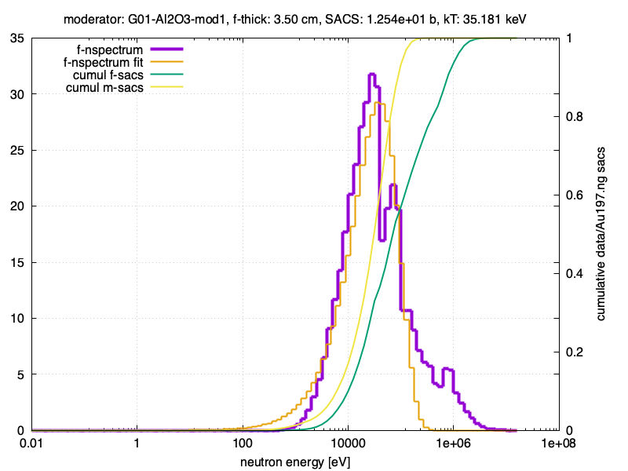
Neutron spectra

Slide 19
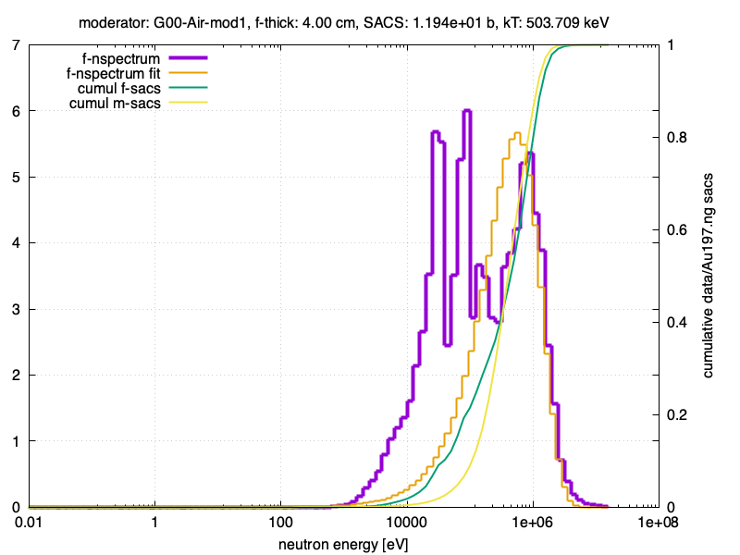
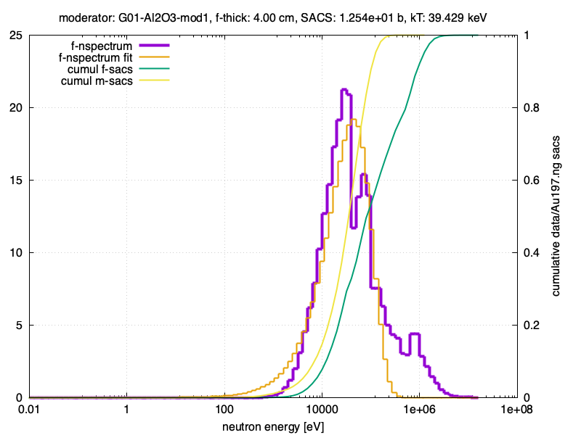
Neutron spectra

Slide 20
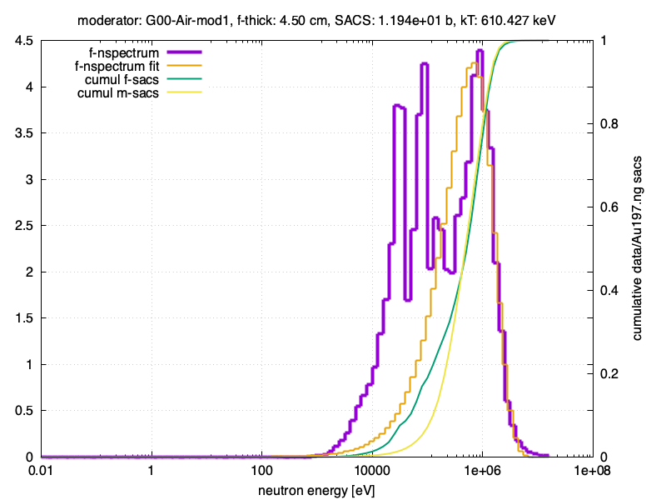
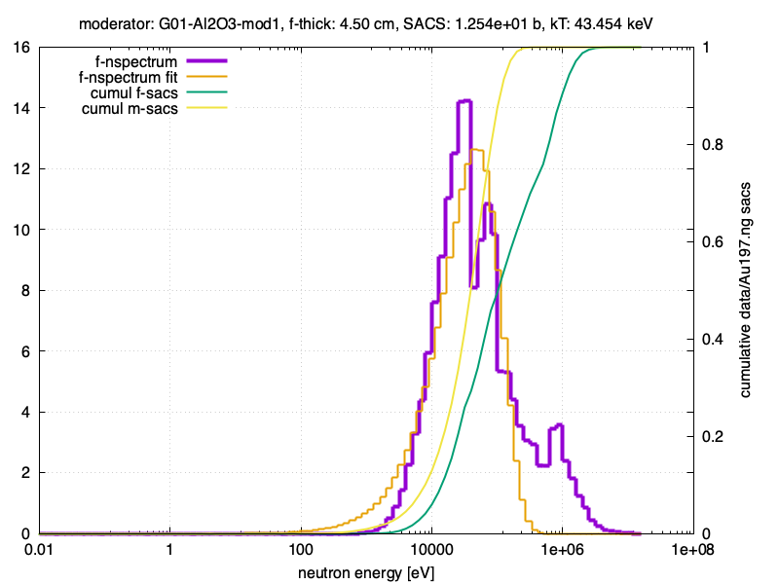
Neutron spectra

Slide 21
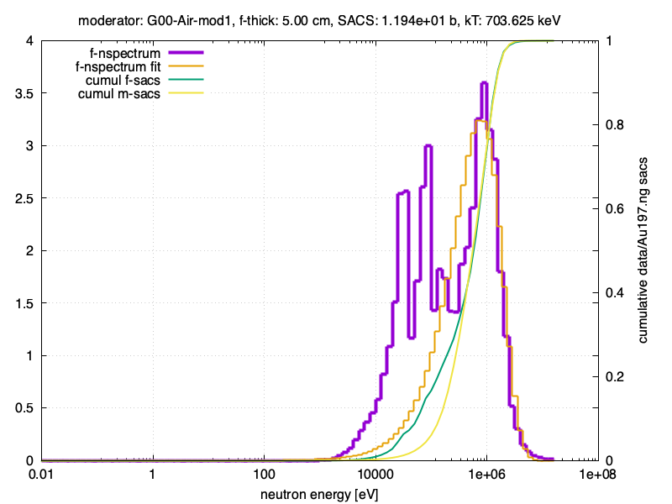
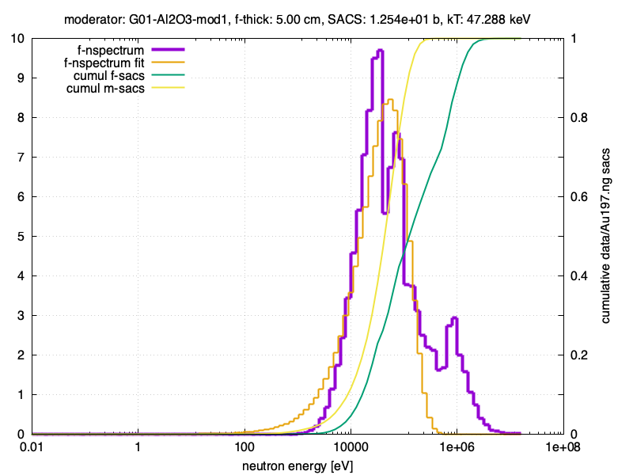
Neutron spectra

Slide 22
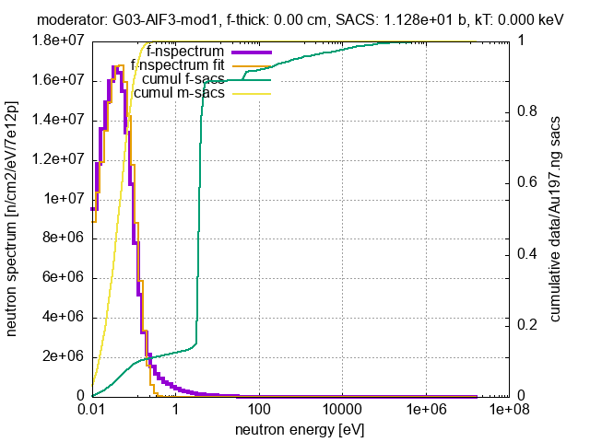
Neutron spectra: AlF3

Slide 23
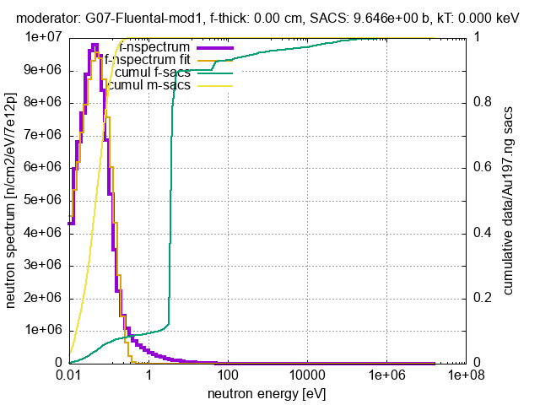
Neutron spectra: Fluental

Slide 24
Neutron spectra

Slide 25
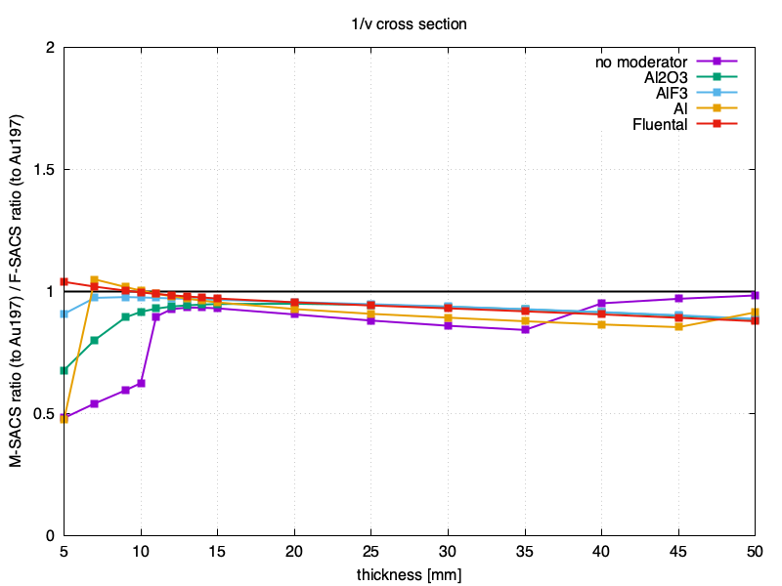

M-SACS & F-SACS
M-SACS is the spectral averaged cross section for a Maxwellian distribution (at a given kT)
F-SACS is the spectral average for the NEAR station neutron spectrum, filtered with B4C of given thickness [mm]
cross section $∝1/v$

Slide 26
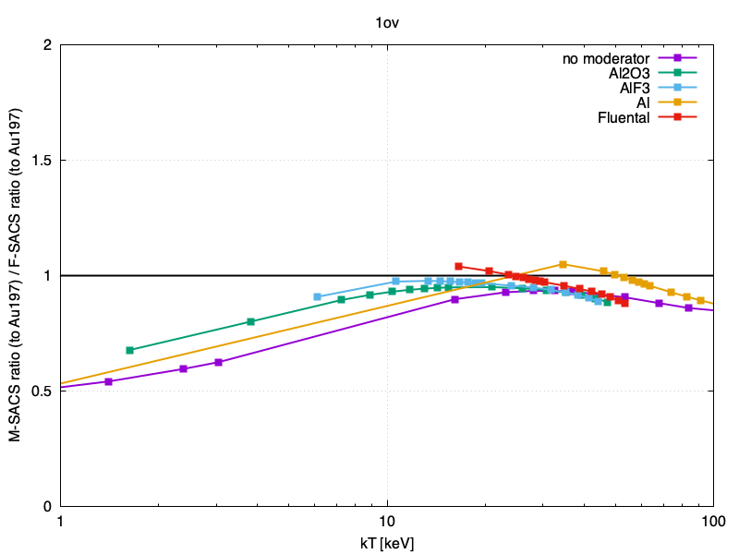
M-SACS & F-SACS
M-SACS is the spectral averaged cross section for a Maxwellian distribution (at a given kT)
F-SACS is the spectral average for the NEAR station neutron spectrum, filtered with B4C of given thickness [mm]
cross section $∝1/v$

Slide 27
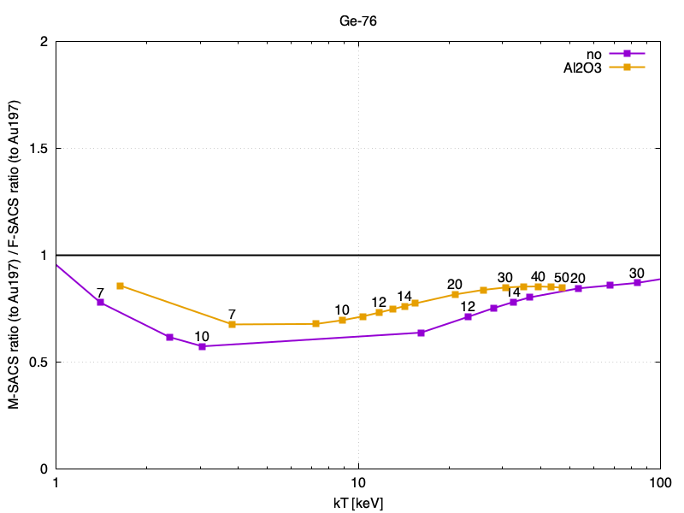
M-SACS & F-SACS
M-SACS is the spectral averaged cross section for a Maxwellian distribution (at a given kT)
F-SACS is the spectral average for the NEAR station neutron spectrum, filtered with B4C of given thickness [mm]

Slide 28
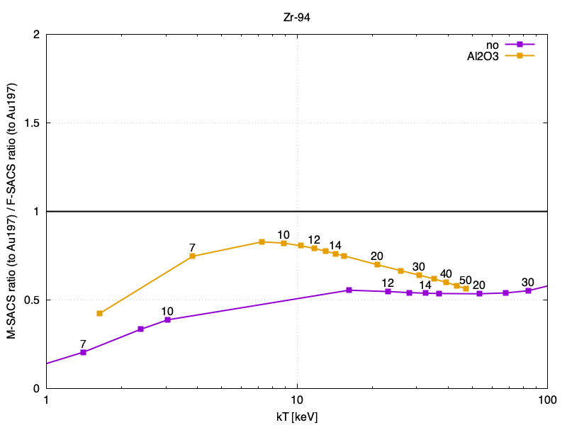
M-SACS & F-SACS
M-SACS is the spectral averaged cross section for a Maxwellian distribution (at a given kT)
F-SACS is the spectral average for the NEAR station neutron spectrum, filtered with B4C of given thickness [mm]

Slide 29
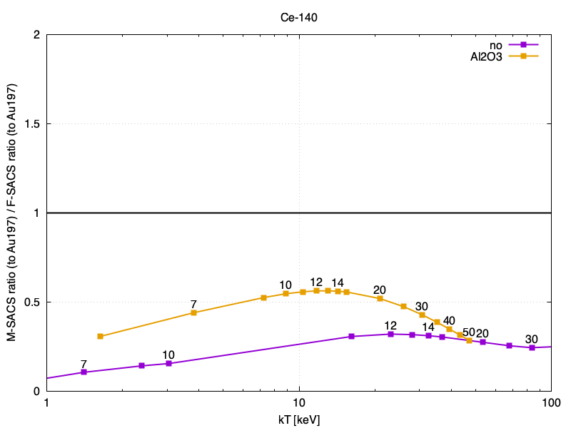
M-SACS & F-SACS
M-SACS is the spectral averaged cross section for a Maxwellian distribution (at a given kT)
F-SACS is the spectral average for the NEAR station neutron spectrum, filtered with B4C of given thickness [mm]

Slide 30
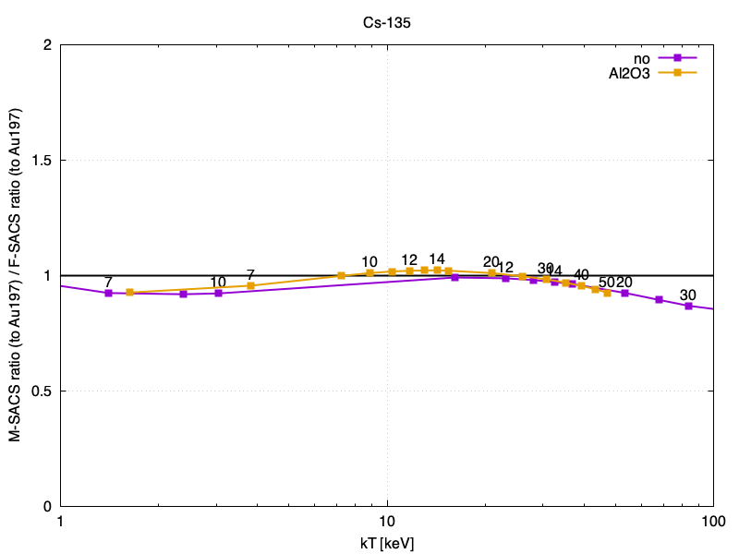
M-SACS & F-SACS
M-SACS is the spectral averaged cross section for a Maxwellian distribution (at a given kT)
F-SACS is the spectral average for the NEAR station neutron spectrum, filtered with B4C of given thickness [mm]

Slide 31
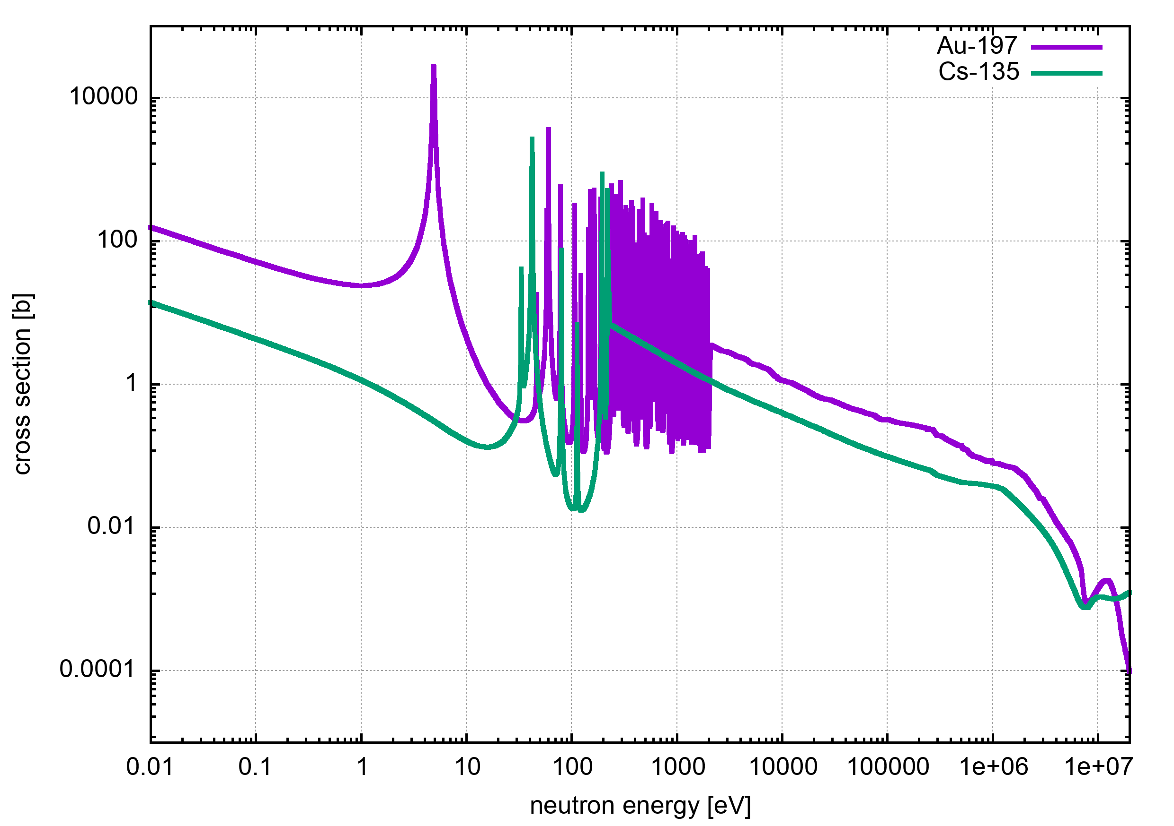
M-SACS & F-SACS

Slide 32
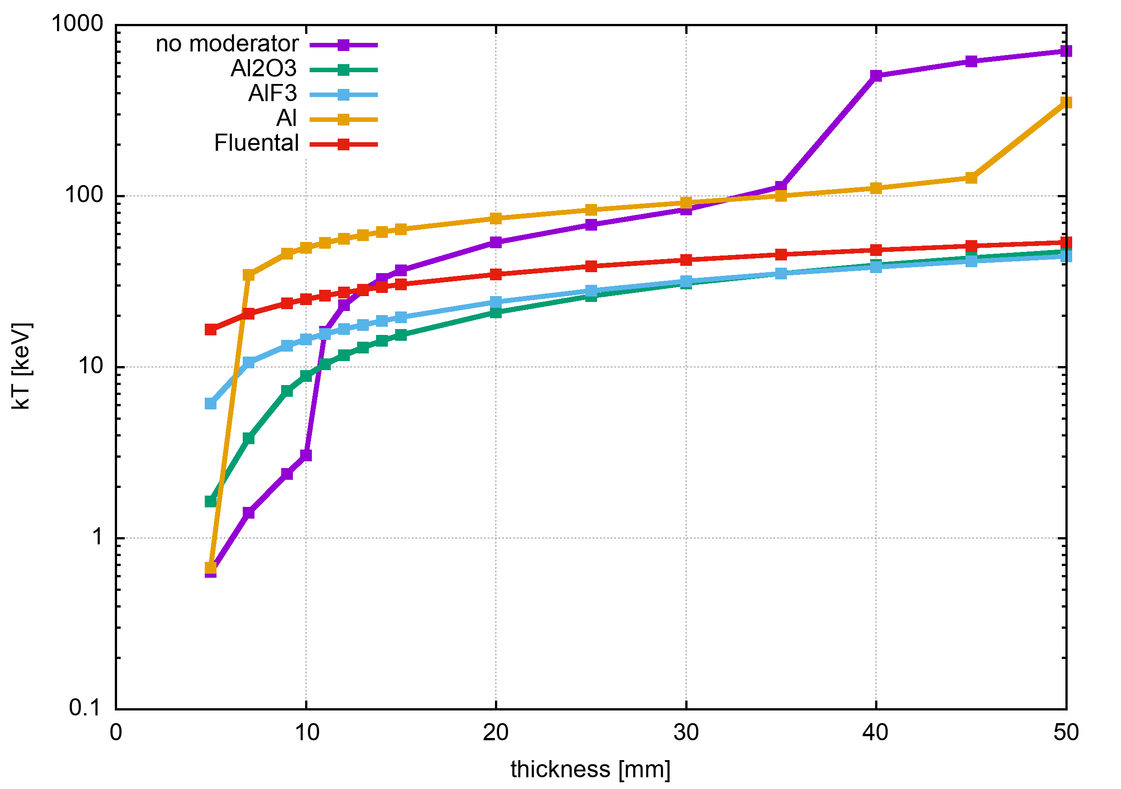
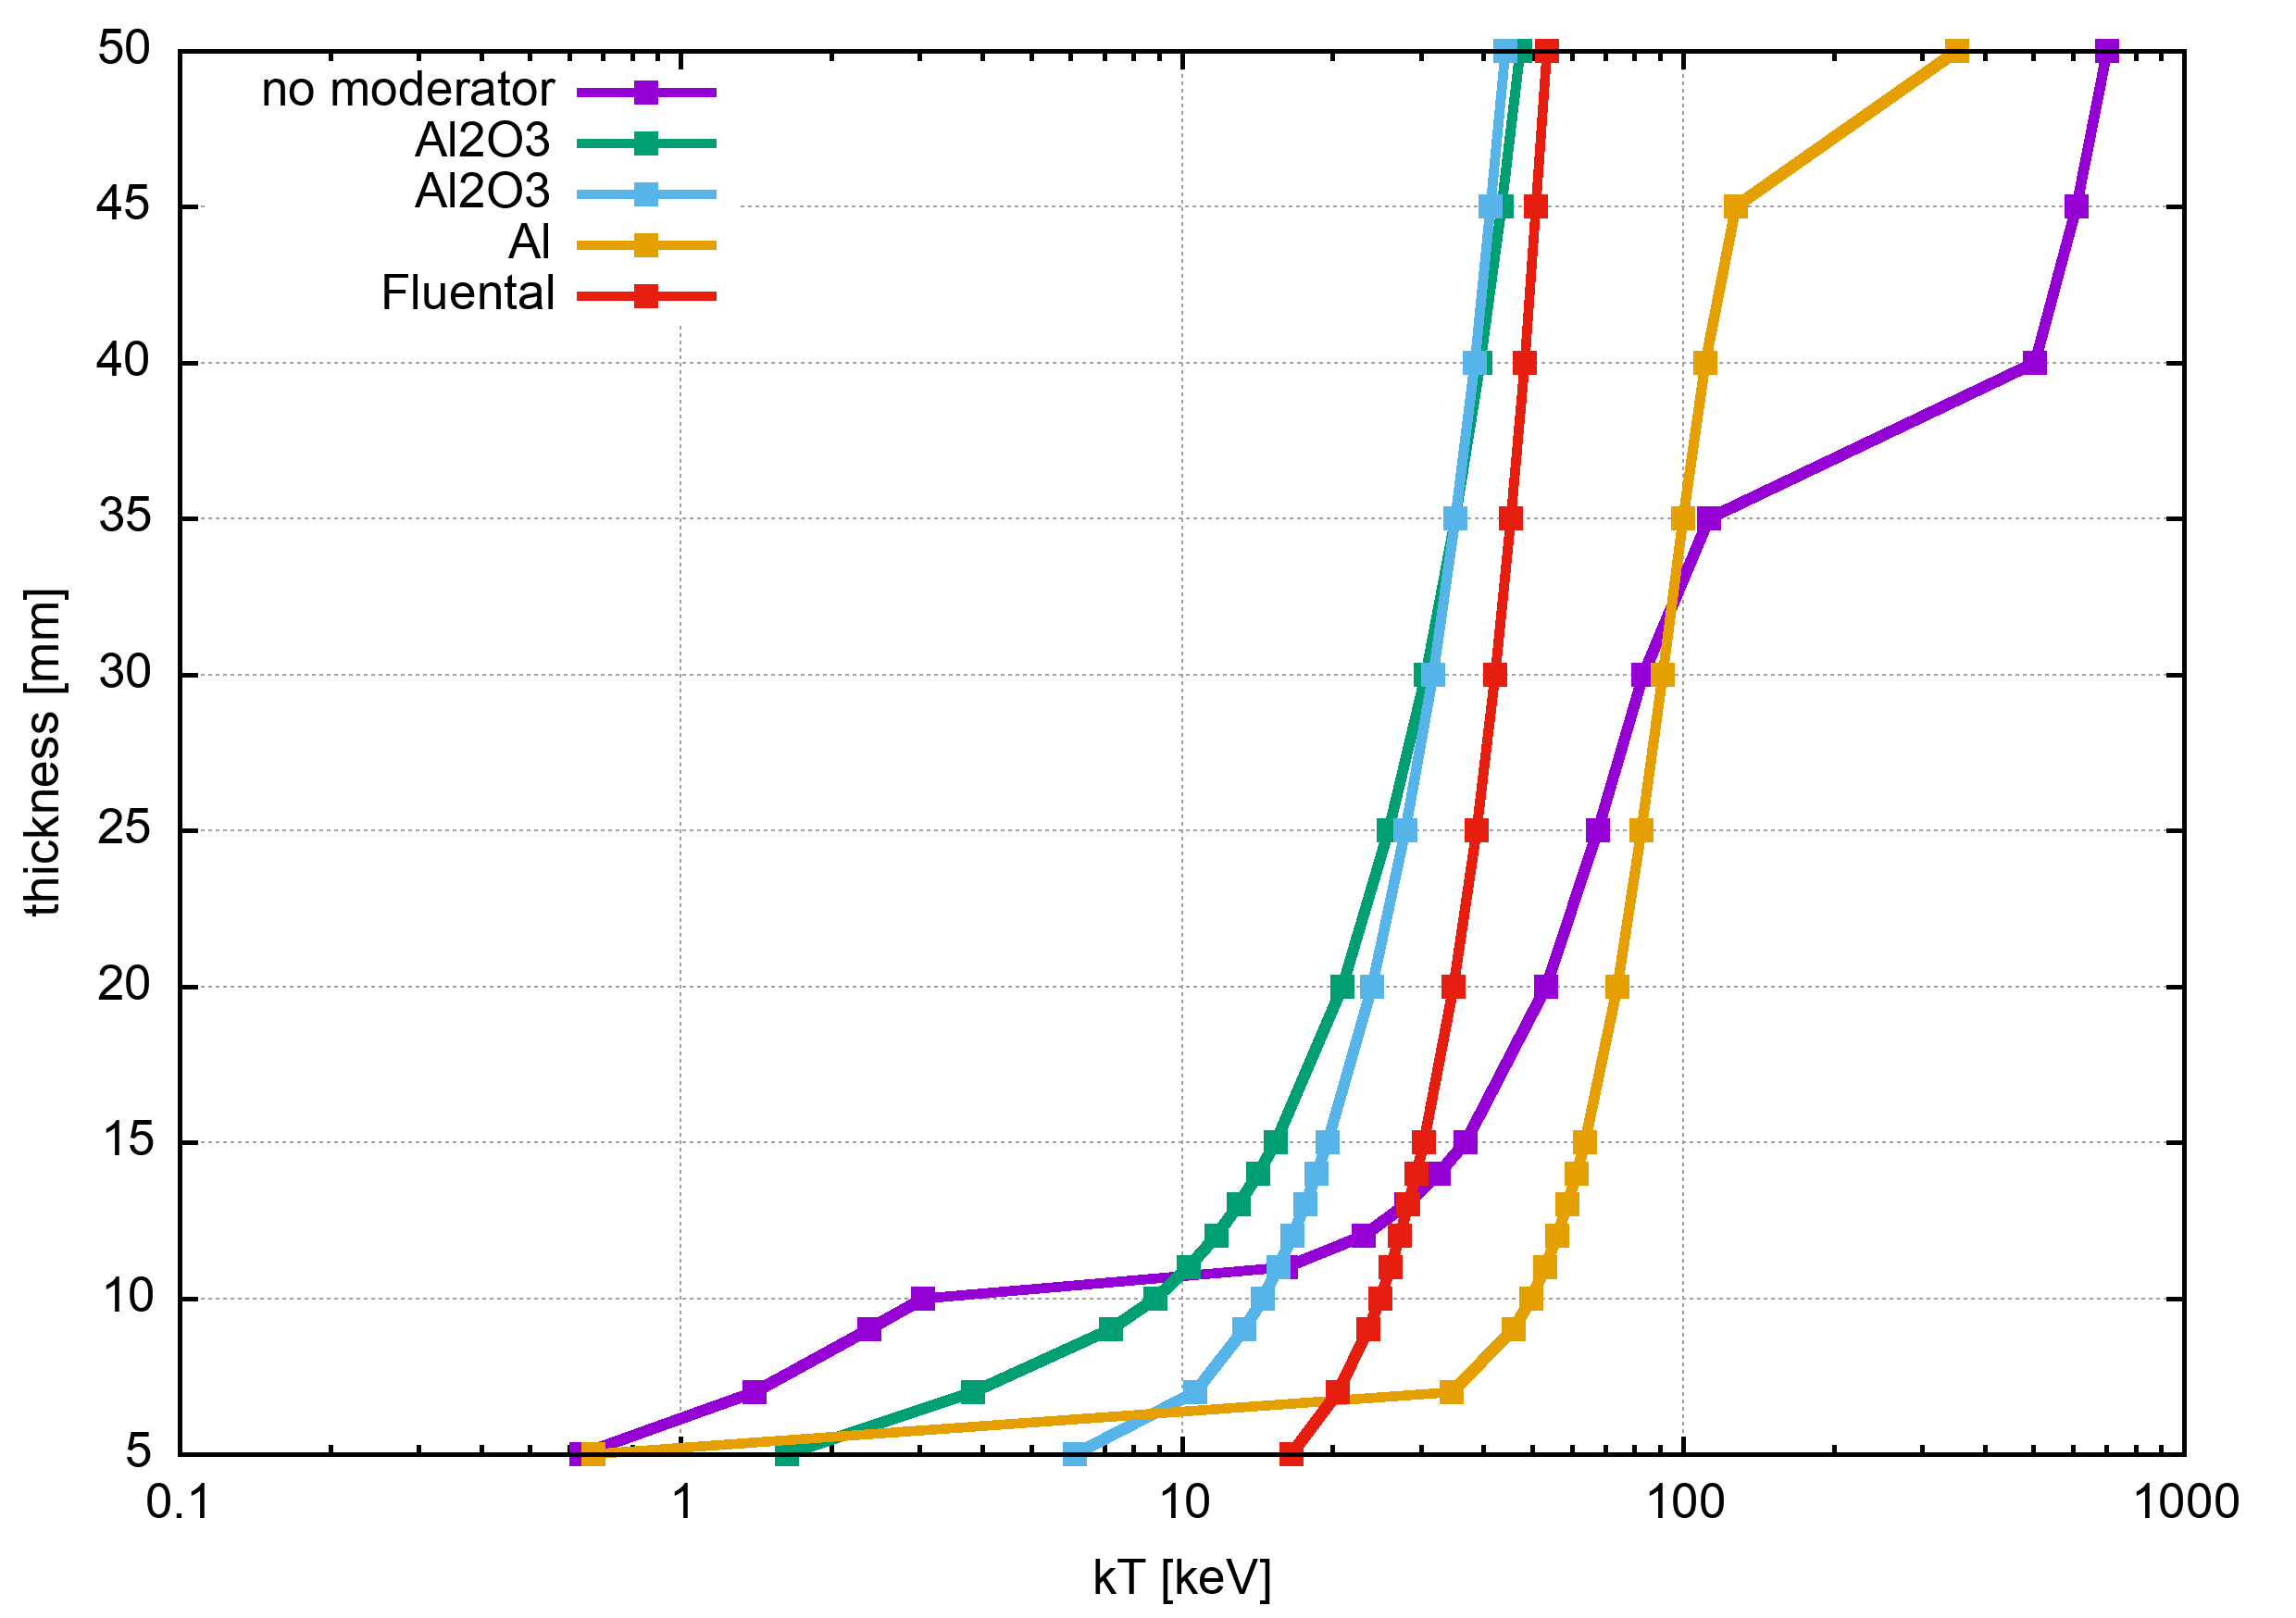
Filter thickness & temperature

Slide 33
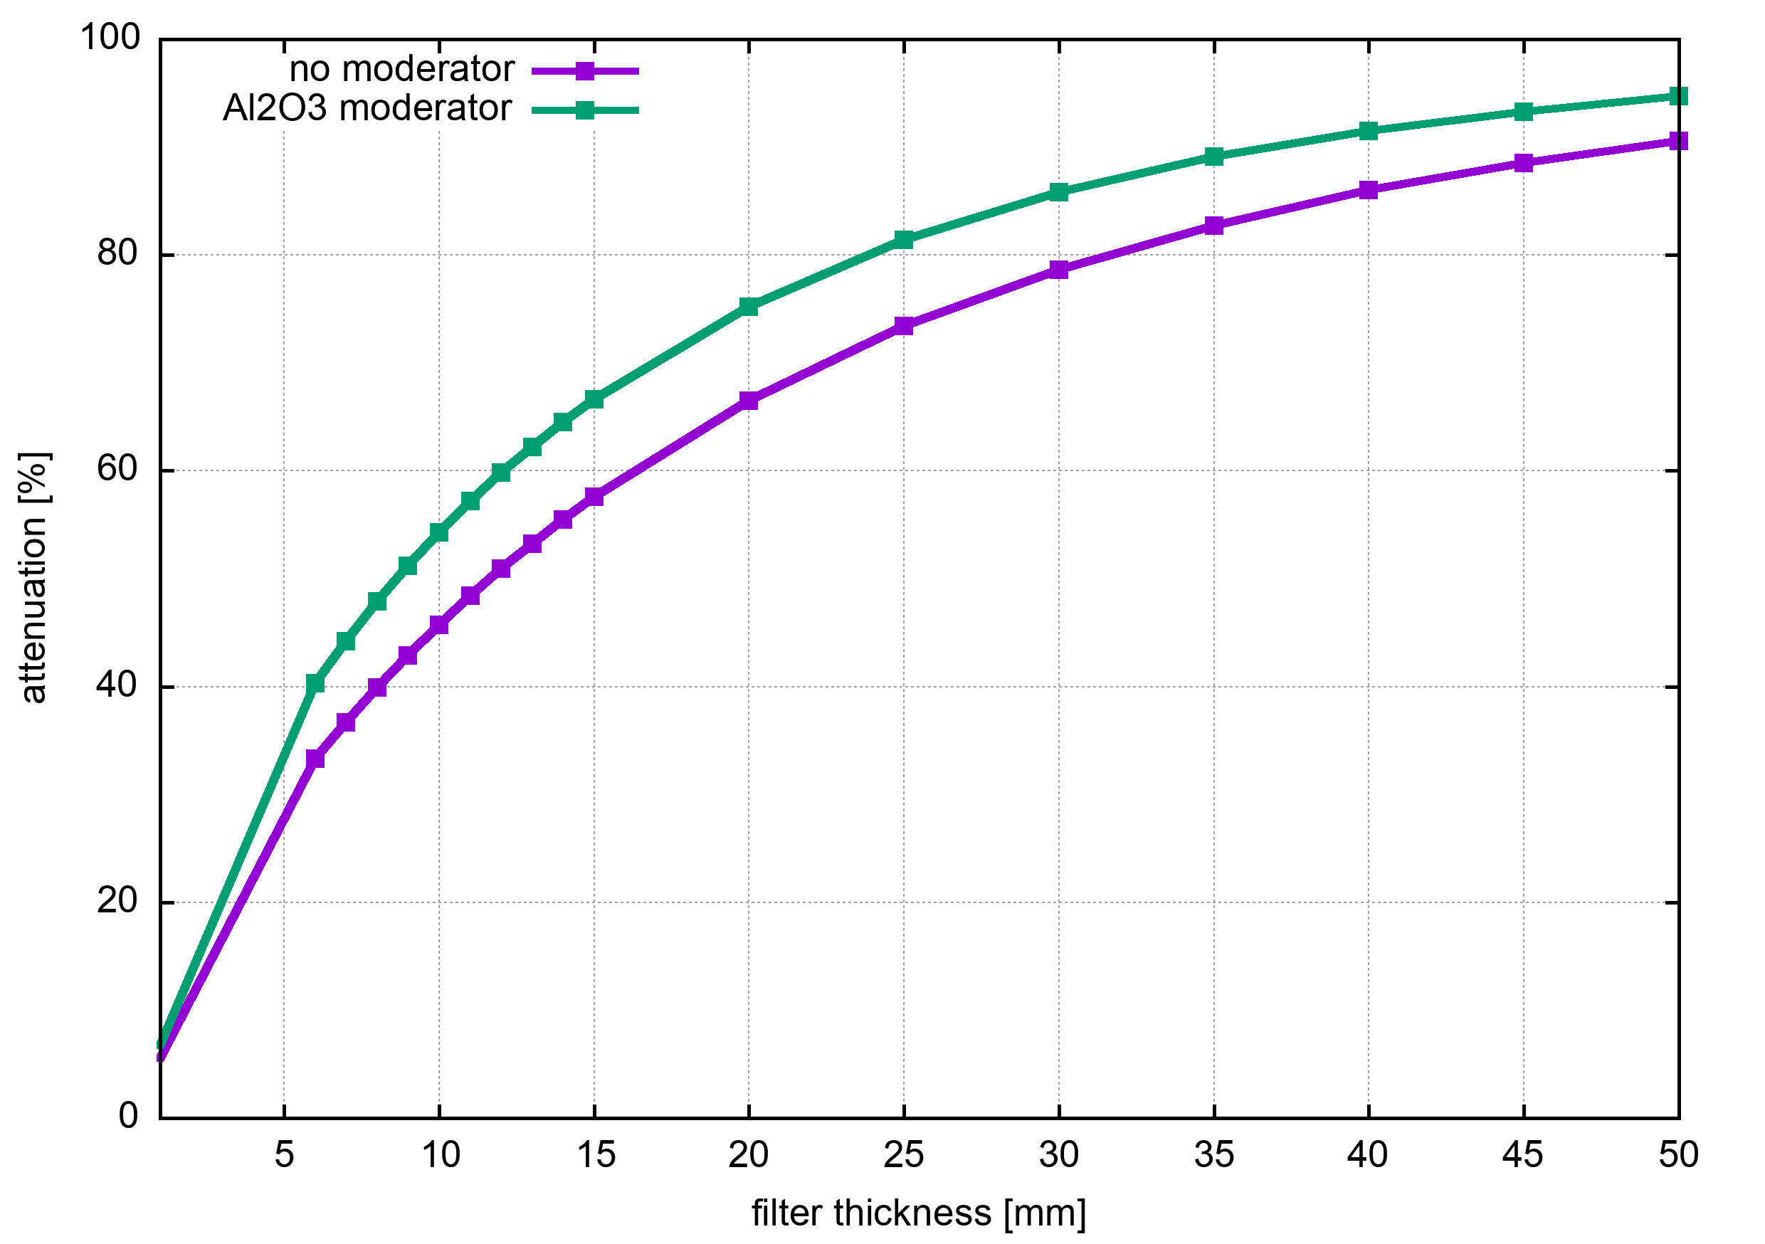
Attenuation by filters

Slide 34
@BDF: BIAS & BEAS positions

Slide 35

Geometry – CDS target
Activation Hole
Rabbit Hole
IRRP2
IRRP1
X
Z
EMDS 3093078

Slide 36

Geometry – CDS target
R2E@20m from target
R2E@10m from target
R2E Hole
X
Z
EMDS 3093078

Slide 37

@BDF: neutron spectra

Slide 38

@BDF: BEAS filtered neutron spectra

Slide 39

@BDF: BIAS filtered neutron spectra

Slide 40

@BDF: filtered neutron spectra

Slide 41

@BDF: filtered neutron spectra

Slide 42

@BDF: filtered neutron spectra

Slide 43

@BDF: filtered neutron spectra

Slide 44

@BDF: filtered neutron spectra

Slide 45

@BDF: filtered neutron spectra

Slide 46

@BDF: filtered neutron spectra

Slide 47

@BDF: filtered neutron spectra

Slide 48
The End

