Slide 1
Simulations for the NEAR Station beam moderator
Gediminas Stankunas
Lithuanian Energy Institute
Kaunas, Lithuania
Laboratory of Nuclear Installation Safety

Slide 2

CONTENT
Background
Simulation tools, geometry
Calculation results
Future plans

Slide 3
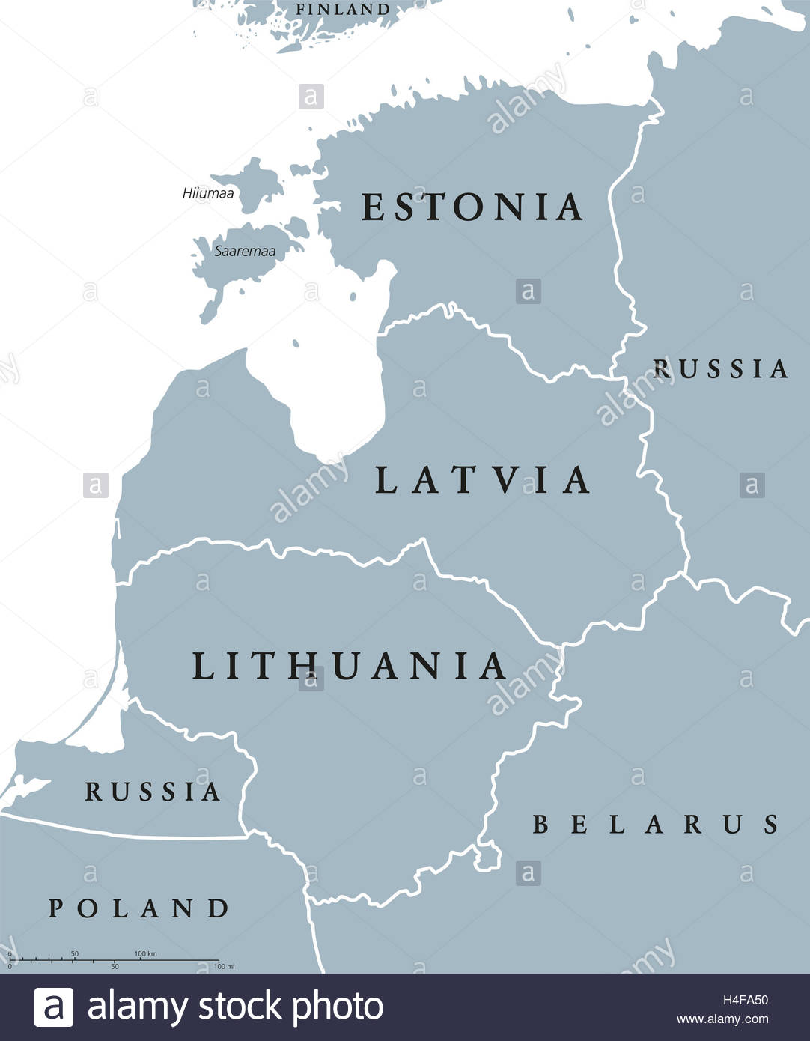

Background
Lithuania become the CERN associate member in 2018
The goal is to become full member in 2025-2026
All new activities are welcome in order to promote cooperation between Lithuania and CERN
The Consortium of three major universities of LT was
established in 2022.
On Monday (03.06), Lithuanian Energy Institute (LEI)
officially joined the Consortium
In this work, we introduce the capability of using the Monte Carlo N-particle (MCNP6) code to simulate the irradiation of materials in the NEAR Station.
Three moderator locations were chosen to be positioned and neutron spectra were estimated for several material compositions.

Slide 4

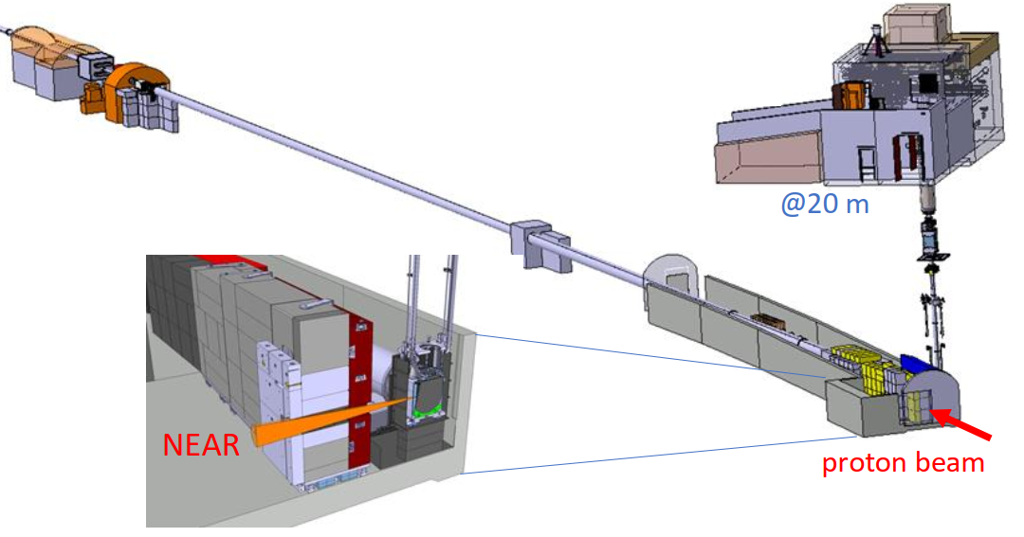
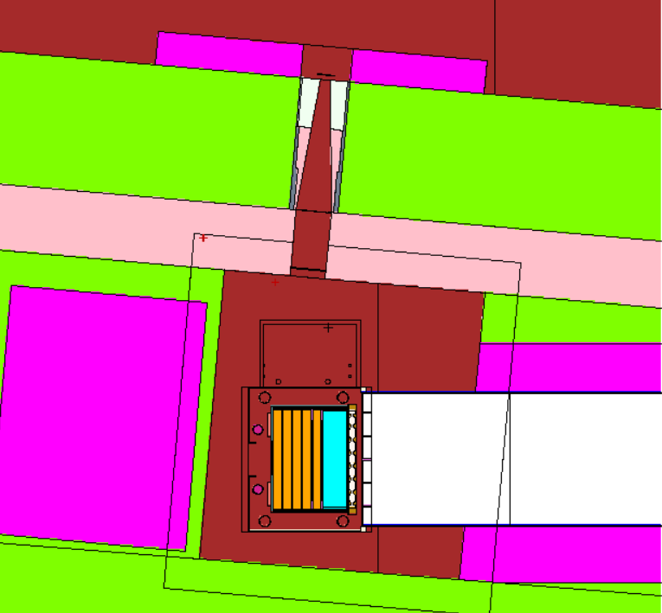
BACKGROUND
Neutronic simulation of neutron possible moderator cases:
possible material assessment for neutron spectra to be irradiated samples;
flux maps inside/outside the experimental site;
Monte Carlo simulation geometry of NEAR target

Slide 5
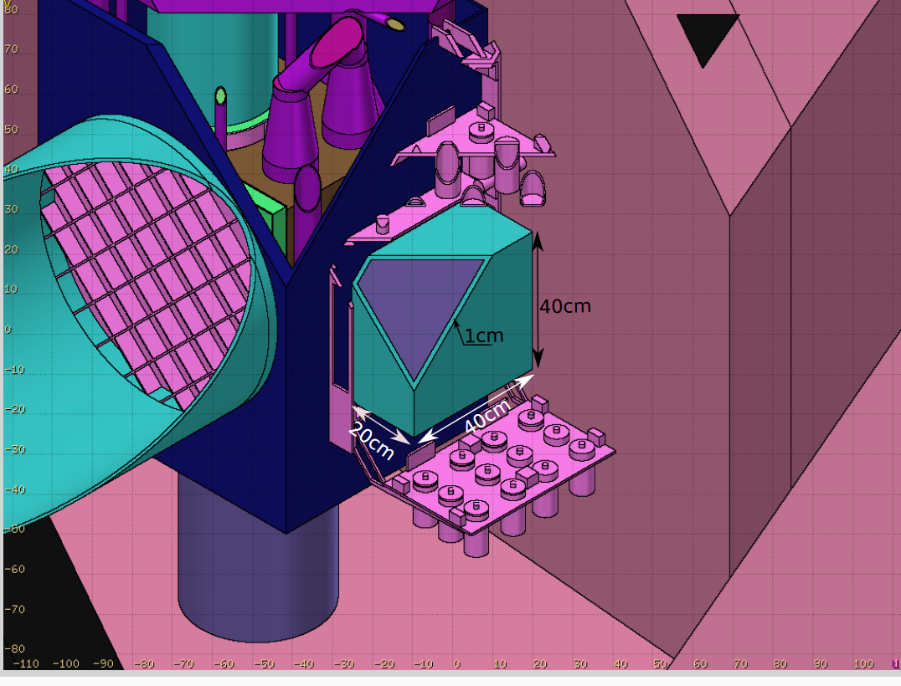
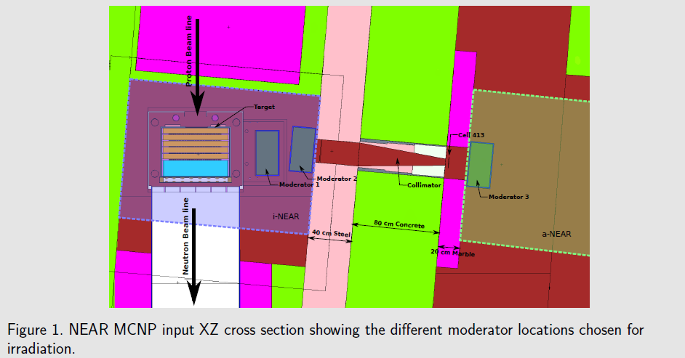
GEOMETRY
3 different position were chosen to considered for the location of the moderator during the simulation activities

Slide 6

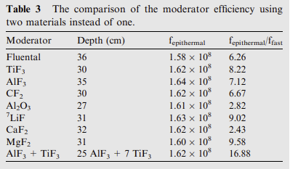
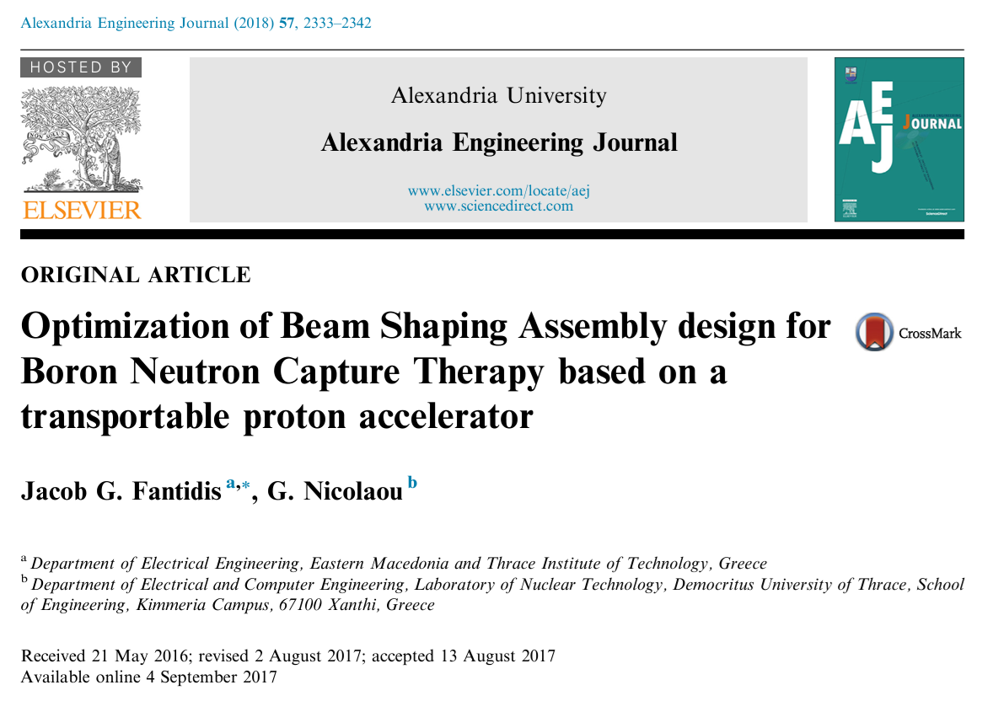
MATERIALS
8 different materials were chosen to considered for the composition of the moderator for the simulation activities
Material isotopical compositions were taken from:
FENDL 3.2 nuclear data library was used for simulations

Slide 7
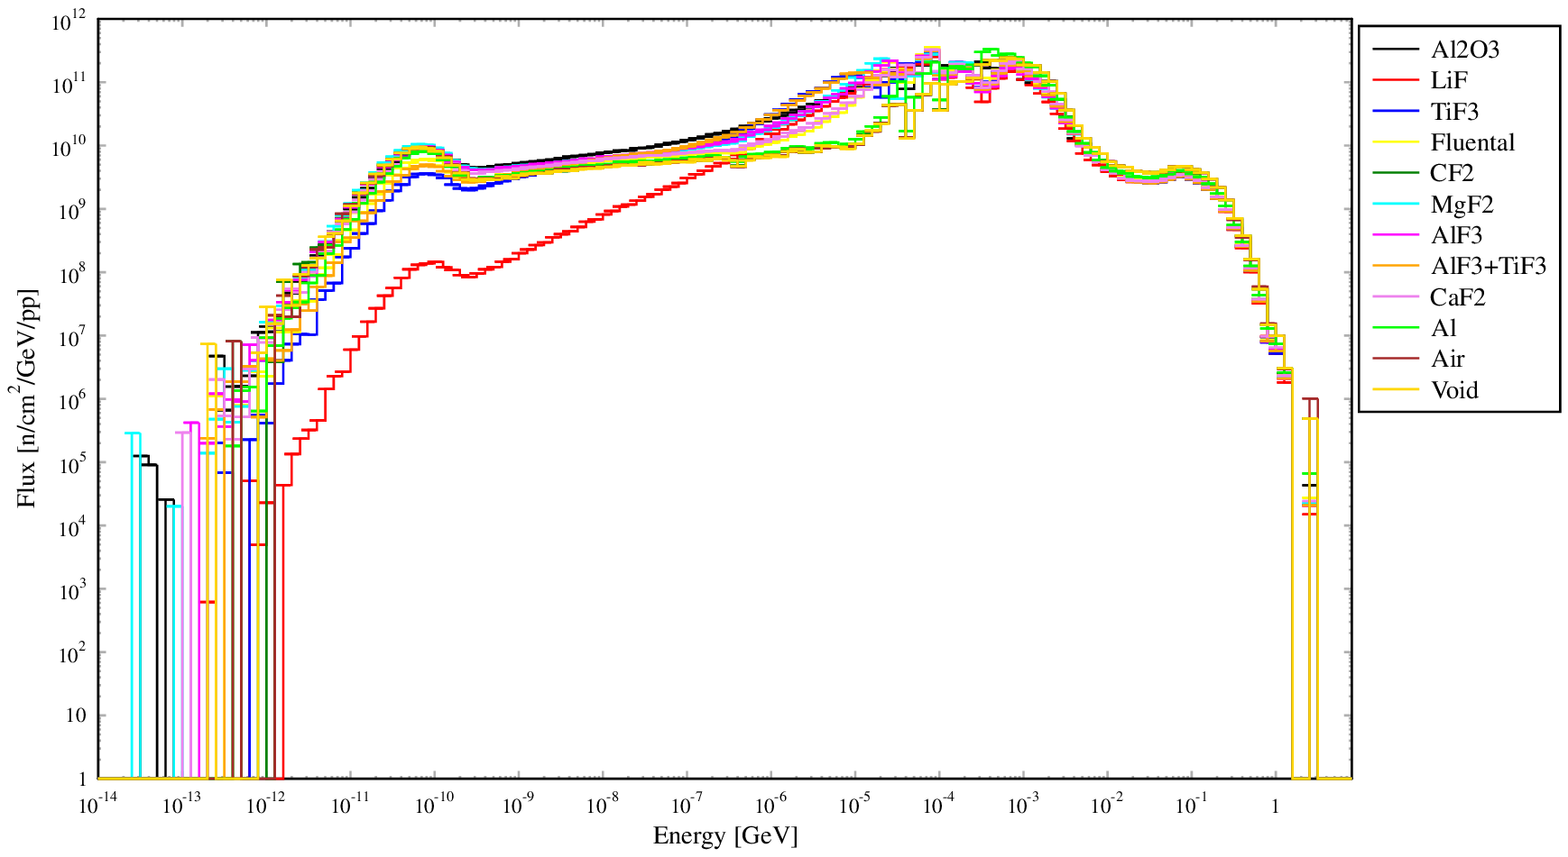
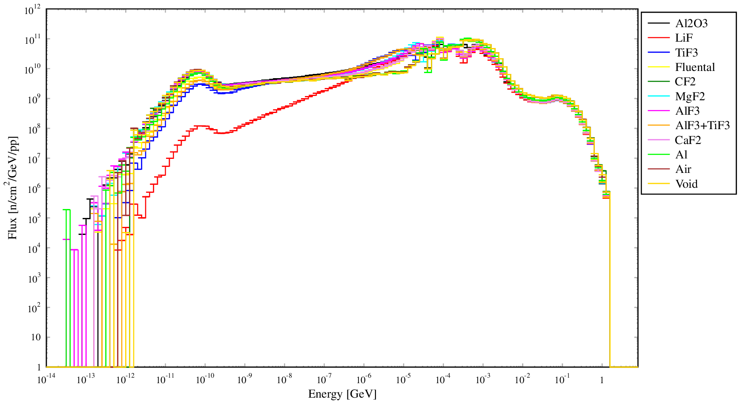
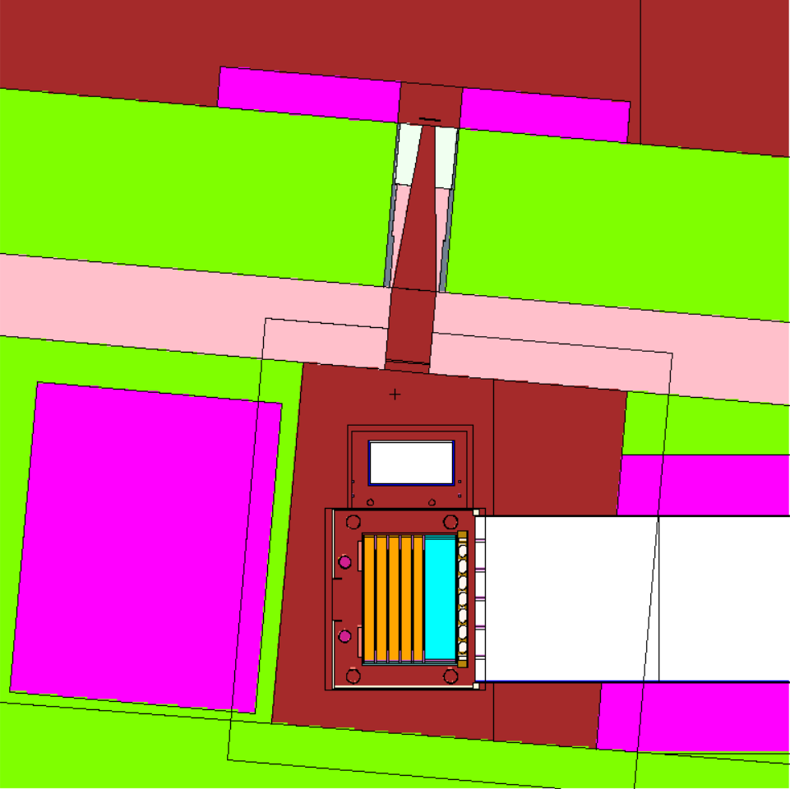
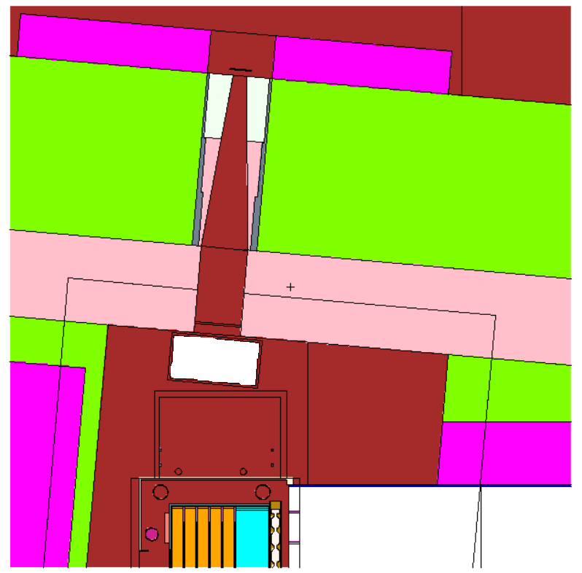
RESULTS
The neutron spectra calculations in two locations were done.
moderator Pos.#1
moderator Pos.#2

Slide 8
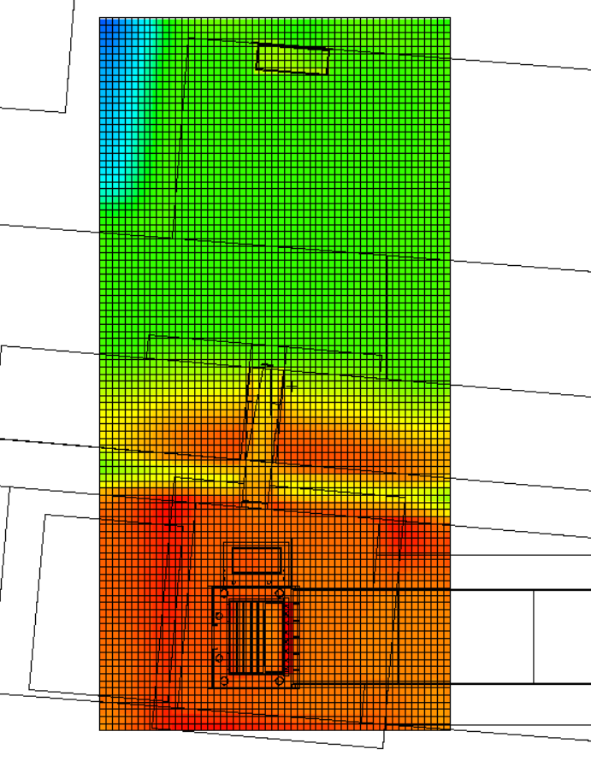
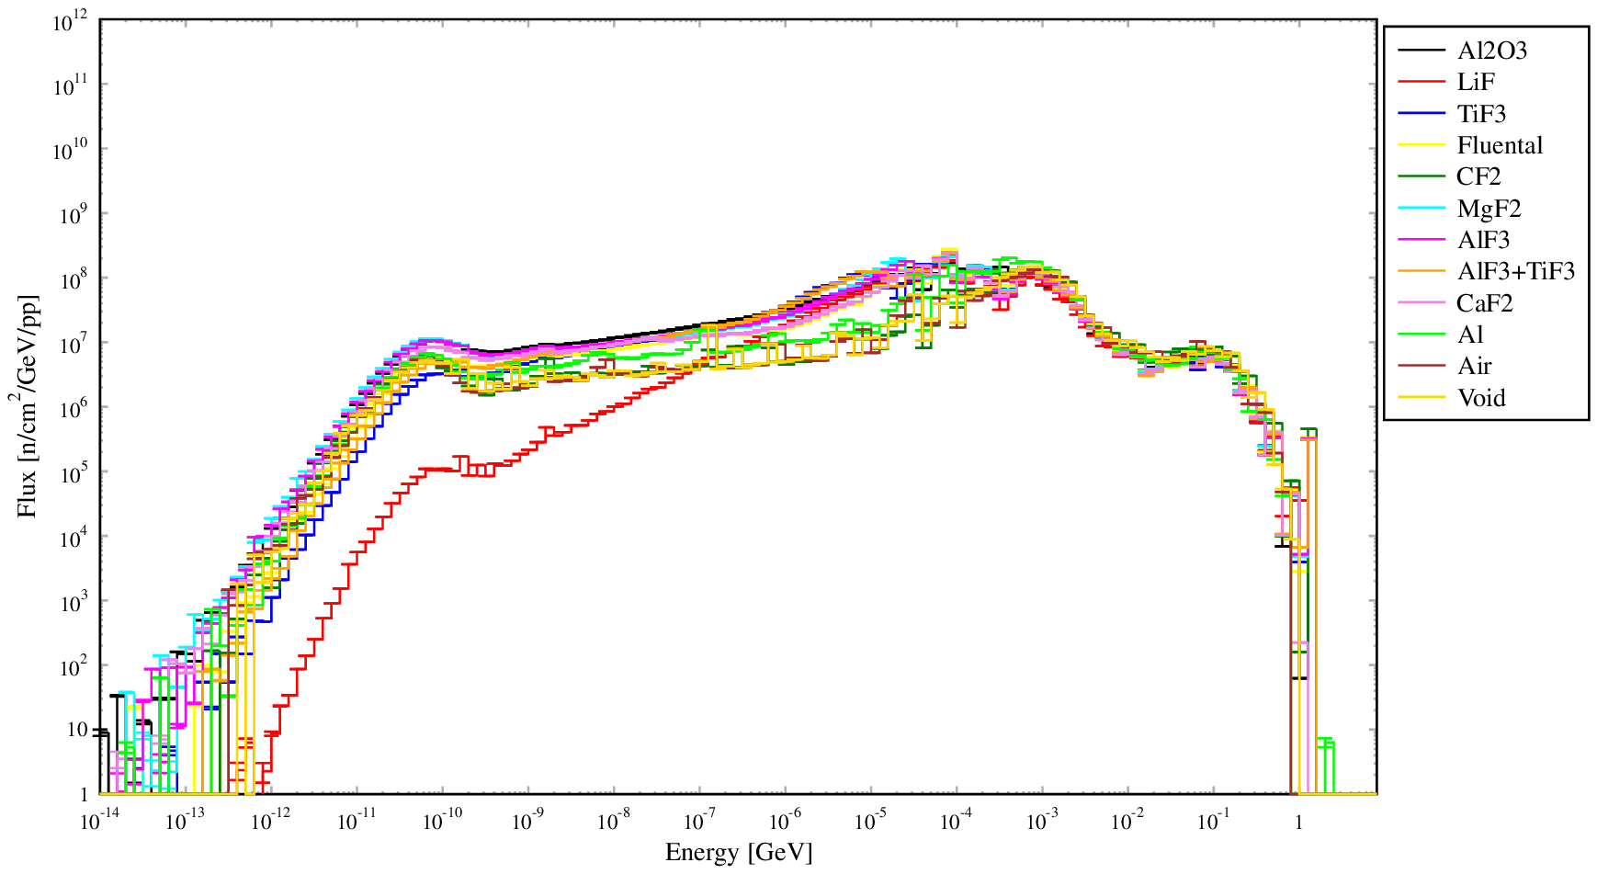
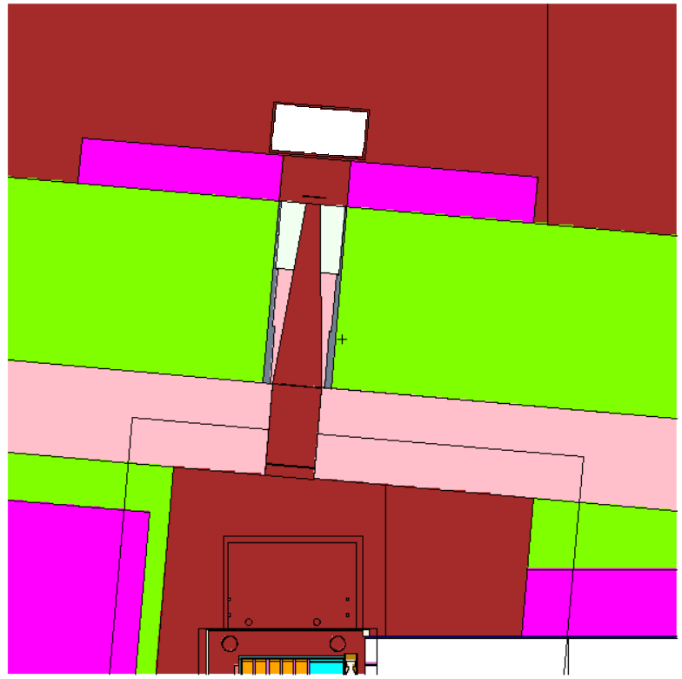
RESULTS
The most far location from the source required variance reduction techniques, thus weight windows file using ADVANTG (@ORNL) code was created and simulations performed.
moderator Pos.#3

Slide 9
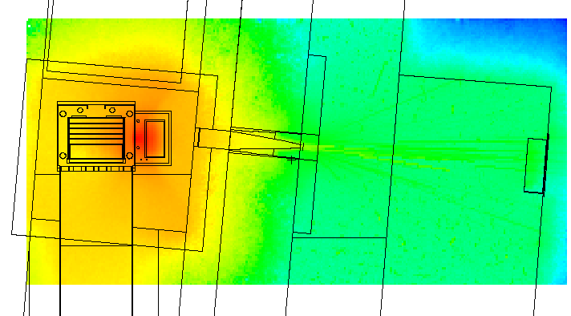
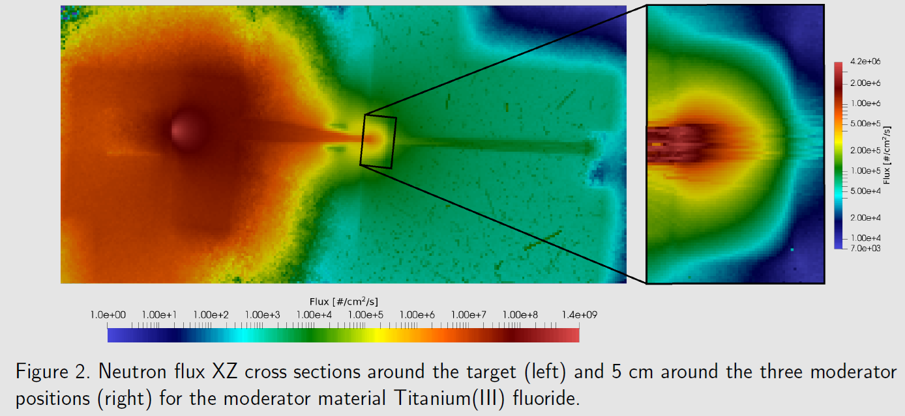
Neutron flux maps
Neutron flux distribution map was created for the moderator box for all material cases (position #1).
Neutron flux distribution map was created for the entire facility with moderator at position #3.

Slide 10
Summary
The MCNP input geometry was modified to include three irradiation positions
For variance reduction, weight windows for the target where generated and MCNP6 simulations for the defined neutron source where performed, from which neutron flux maps around the target and moderator positions, and neutron spectra where obtained.
These results indicate the defined MCNP6 neutron source and geometry are viable for future calculations.
Continuation plan for 2024:
Activation, decay heat, contact dose rate calculations using obtained spectrum
Identification of the nuclide inventories, pathway analysis using FISPACT (@CCFE) code and TENDL library
Publication (?)

Slide 11

gediminas.stankunas@lei.lt

