Slide 1

Updates on the MArEX initiative
INTC-I-256 >>

Slide 2
Updates on the MArEX initiative
Transmission measurement test performed in 2023

Slide 3
Updates on the MArEX initiative

Slide 4
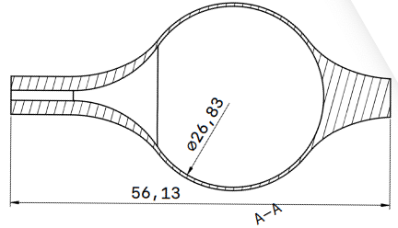
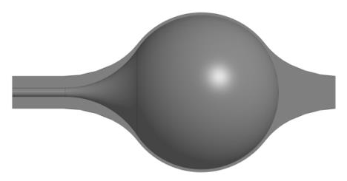
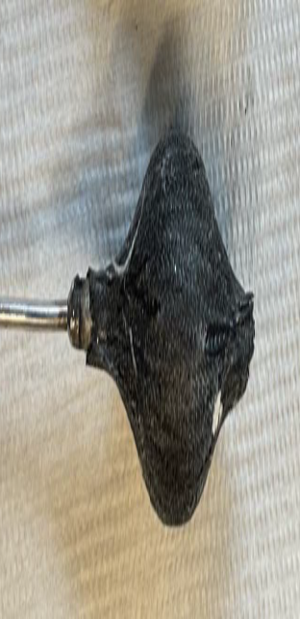
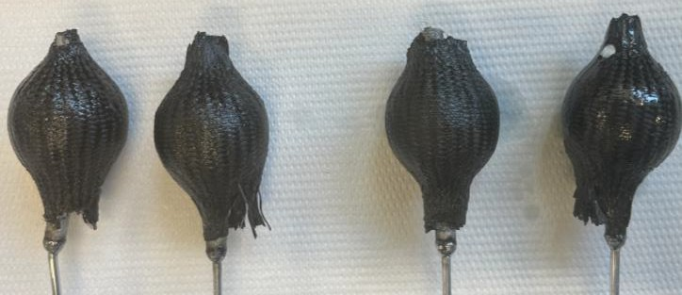
Gas target for capture measurement
1
2
3
4

Slide 5
Capture measurement in EAR-2
measurement planned to take place
w27 (from 3 July)

Slide 6
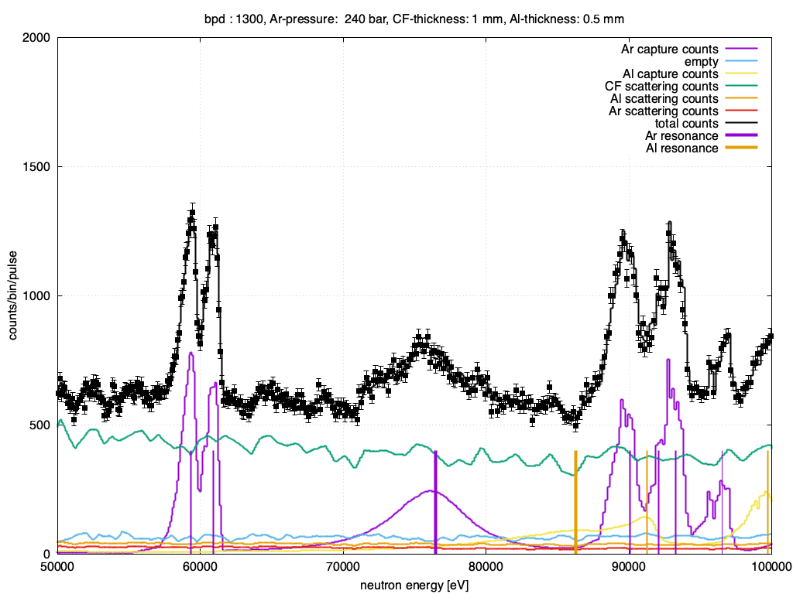
Capture measurement in EAR-2

Slide 7
LAr target (for 2025)

Slide 8
LAr target (for 2025)

Slide 9
LAr target (for 2025)

