Slide 1
3 MeV test stand:
RFQ2 commissioning and beyond

Slide 2
General Schedule
Installation procedure?
Interlock system?
Beam tests to start @~end of July.

Slide 3
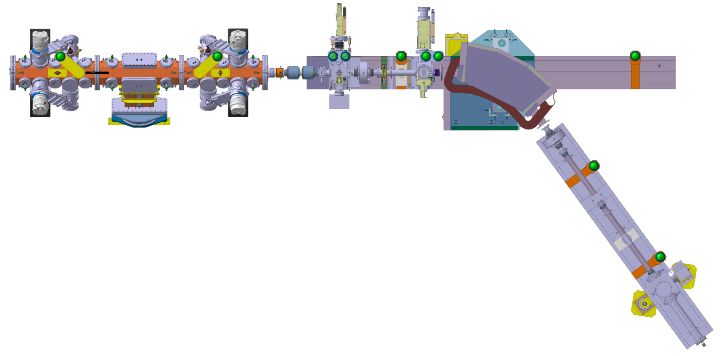
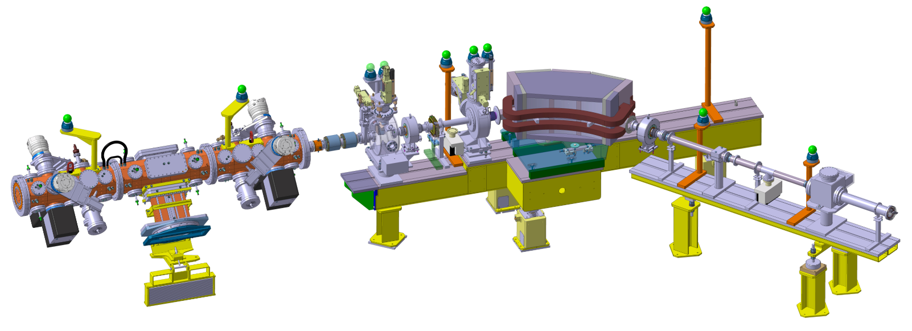
Integration views

Slide 4
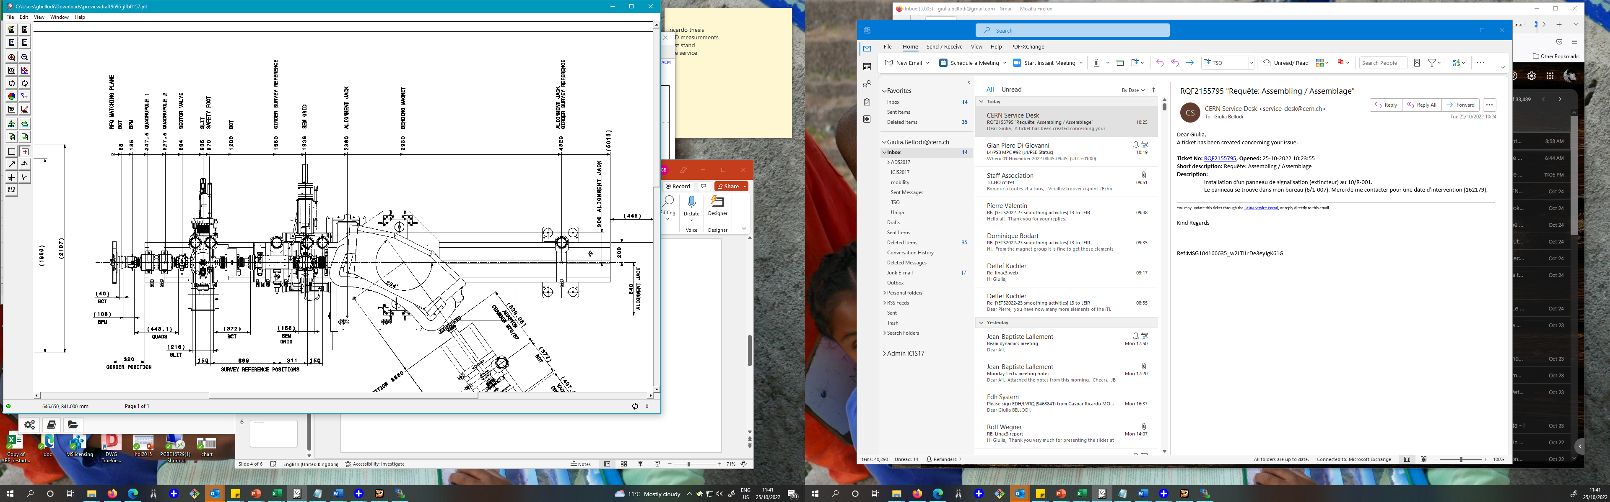
















steerer
RFQ

Slide 5
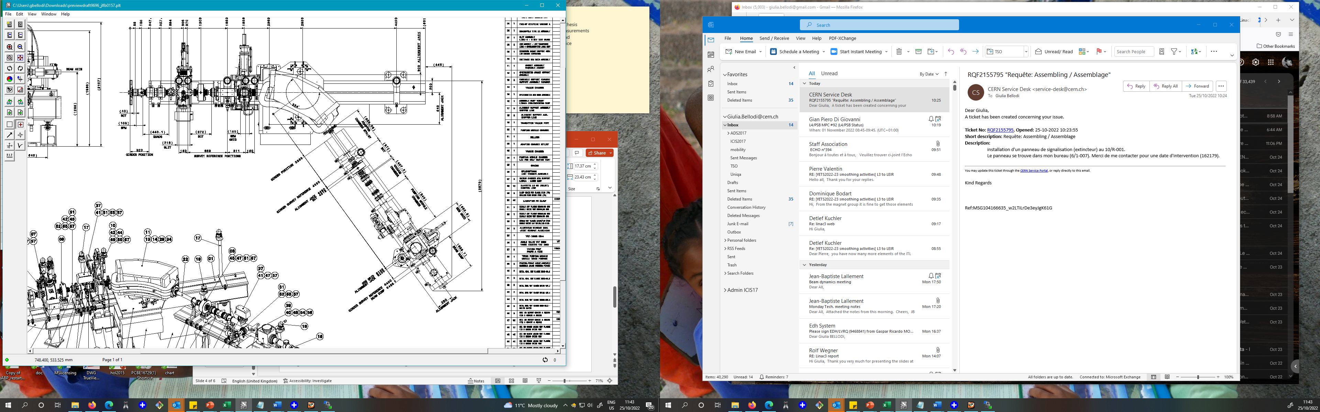
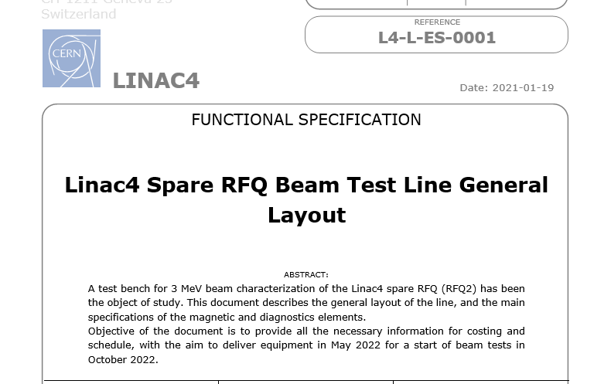




54 deg
Baseline: 300 us pulse length and a max current of 25-30mA.
+
dedicated periods of testing at higher than baseline beam current, up to a maximum of 50mA

Slide 6
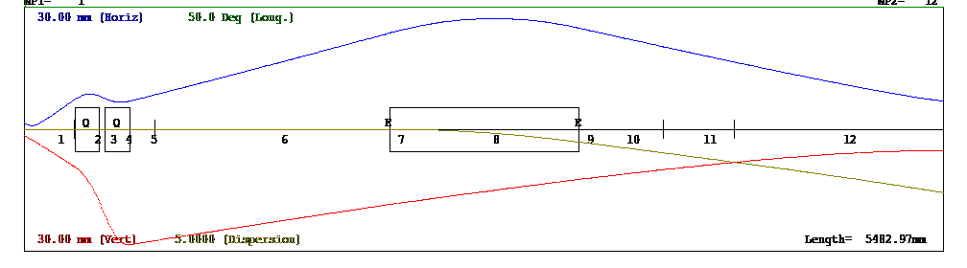
EM SEM
Spectro SEM
slit
have ~zero beam losses before the slit for representative transverse measurements
allow sufficient distance between EM slit and SEM
transport the beam at the end of the spectrometer line with good resolution for longitudinal measurements

Slide 7
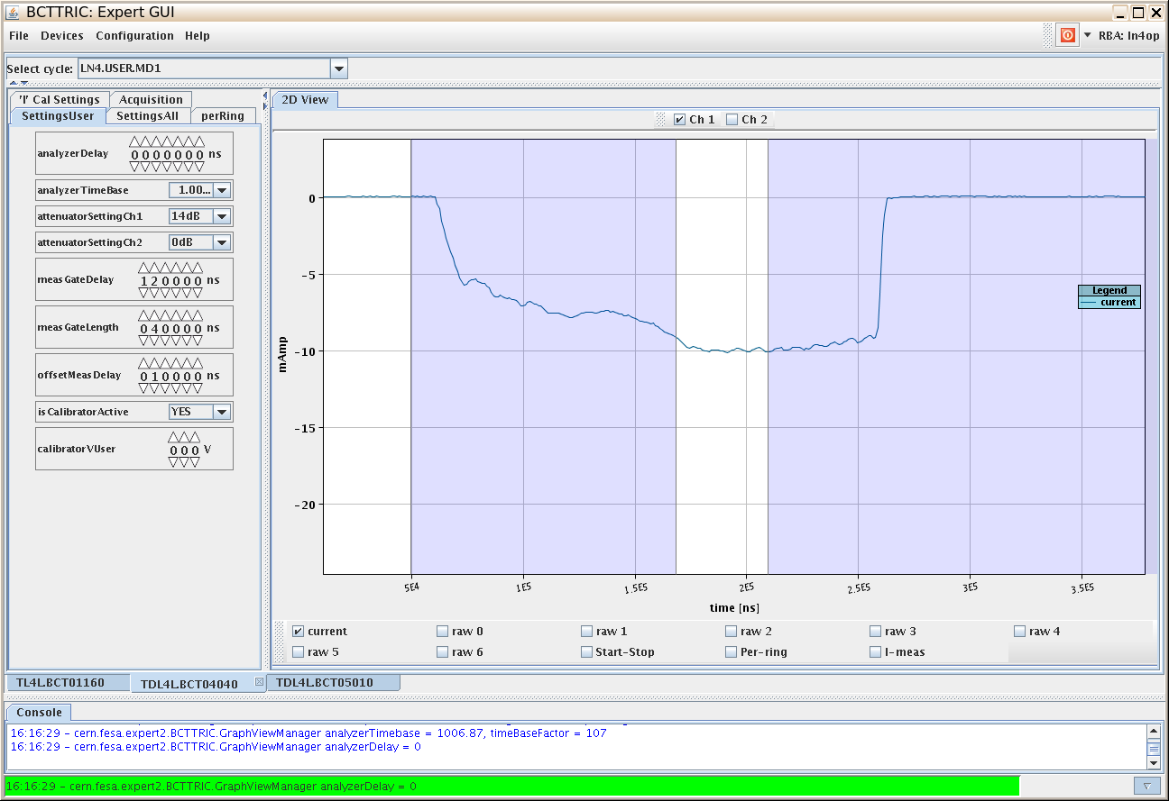
Back in 2013: RFQ1 commissioning
~ 3 weeks of measurement in parallel to RF conditioning, commissioning/debugging of diagnostics, interlocks, powering
First 3MeV beam
[Wednesday 13-Mar-2013 DAY]
19/02/2013 RF conditioning start,
07/03 RFQ connection,
13/03 first beam through RFQ with 75% transmission,
3 weeks RFQ commissioning (stage1) to first week of April
  RFQ+MEBT commissioning to end June
Final report:
CERN-ACC-2013-0259
Tuesday 02-Apr-2013 DAY “Today the RFQ operation is stopped.
The Diagnostic line is being prepared to be moved to its new location after the MEBT line”

Slide 8
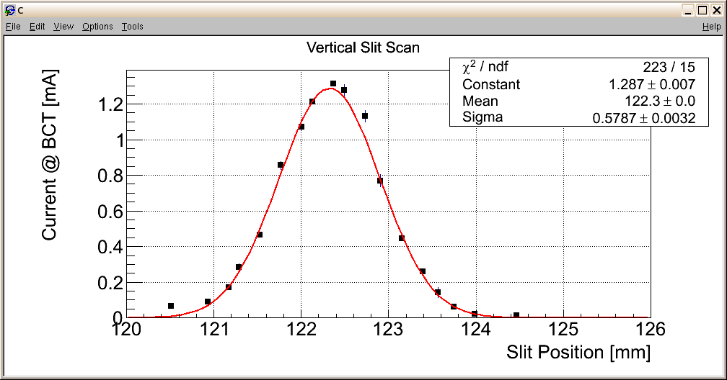
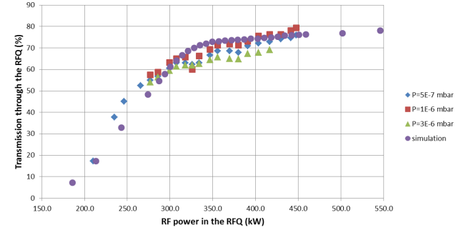
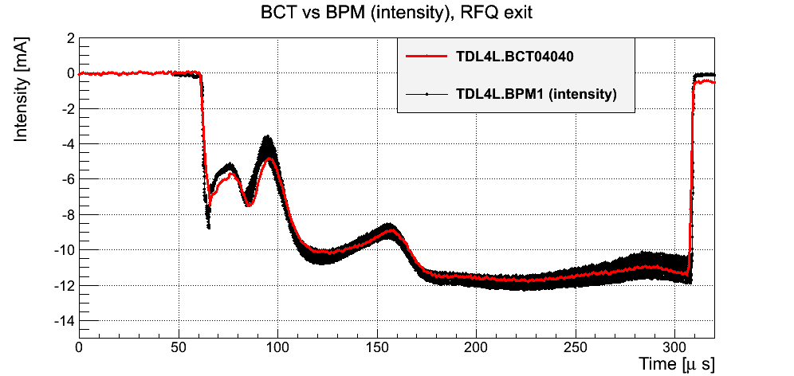
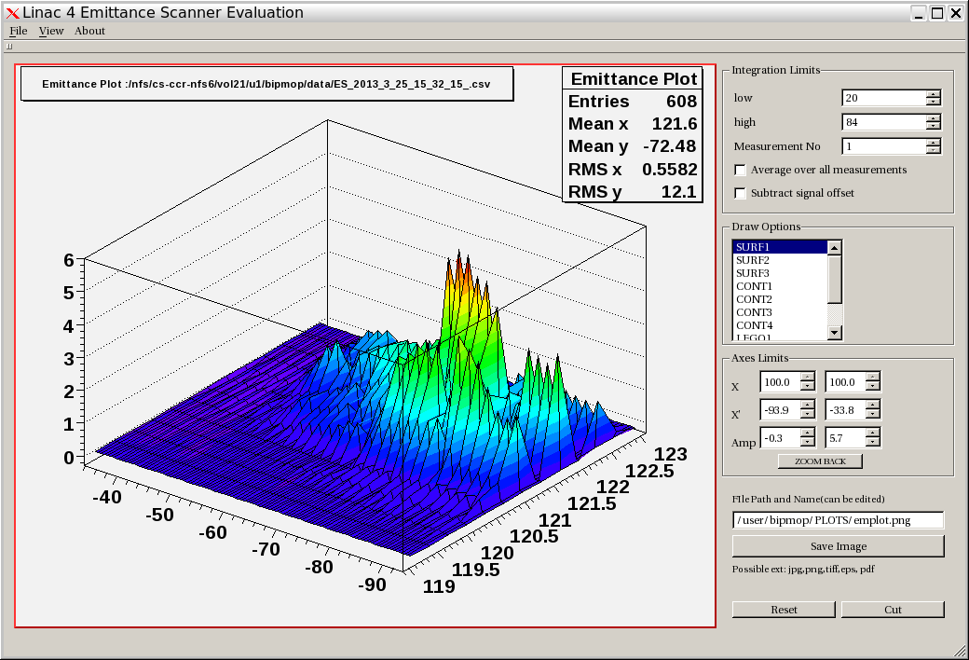
2013
RFQ transmission scans as a function of amplitude at different LEBT pressures
Guillotine profile measurements with quad scans
BPM measurements
10-12mA output beam current

Slide 9
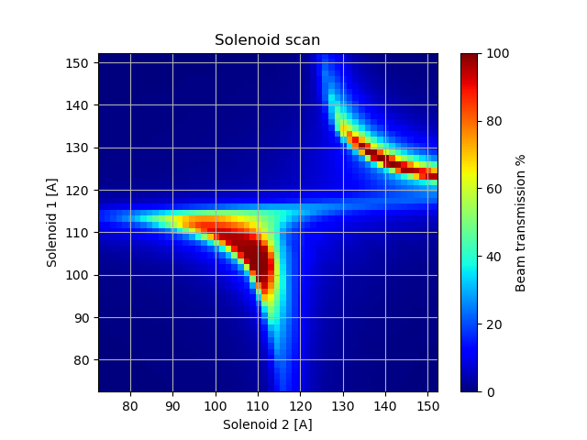
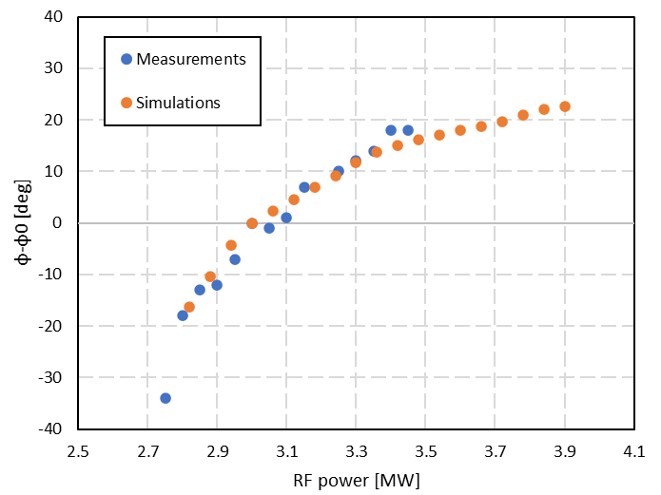
RFQ2 commissioning :
E Marchetti
Performance validation key measurements:
RFQ Transmission vs voltage/amplitude scan
Energy/energy spread in spectrometer line
Transverse emittance
Source /LEBT matching: map of RFQ transmission vs LEBT solenoid tuning
RFQ calibration via beam loading/phase measurements
https://indico.cern.ch/event/888416/contributions/3832645/attachments/2022712/3382810/bdm_20200420.pdf
The time of flight between the RFQ and the first buncher depends on the voltage applied to the RFQ due to the variation of the longitudinal phase advance in the RFQ.
V Bencini

Slide 10
2023 measurement plan
Baseline: 300 us pulse length & 25-30mA beam current.
RFQ transmission curve vs amplitude
RFQ transmission vs LEBT solenoids settings : map
Beam phase measurements vs RF amplitude
Transverse emittance measurements
Energy/ energy spread in spectro line
Repeat for :
different input beam currents from source/LEBT up to 50mA max
RFQ amplitudes
LEBT gas values (space charge compensation studies)
Count on ~3 weeks of validation measurements + one week ‘reliability run’
If extra time available: swap to source proton production mode and repeat the measurements above.

Slide 11
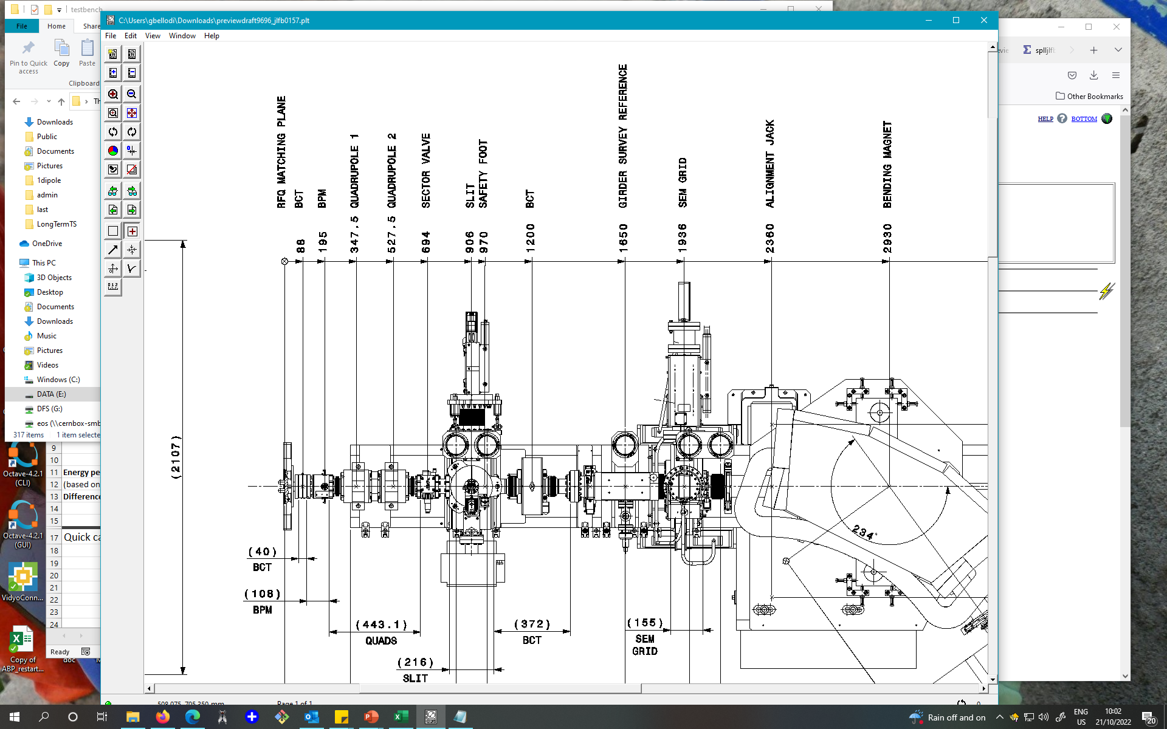
Location #1
SY/STI tests to follow
771mm
Irradiate isostatic graphite at 3 MeV in order to understand if there may be any long-term damage of L4 Chopper dump's core (graphite core since 2023).
Upstream dipole installation case selected due to its highest energy density on graphite and similarity with Chopper dump conditions. This option implies removing the SEM GRID and vacuum chamber with pump, in order to install the graphite test tank.
Graphite irradiation tests can be potentially done in September/October 2024.
One should foresee few weeks for dismantling and installation + few weeks for testing. However worth noticing that there is no demineralized water during the YETS. Thus the activity may have to be postponed to after the YETS24/25.

Slide 12
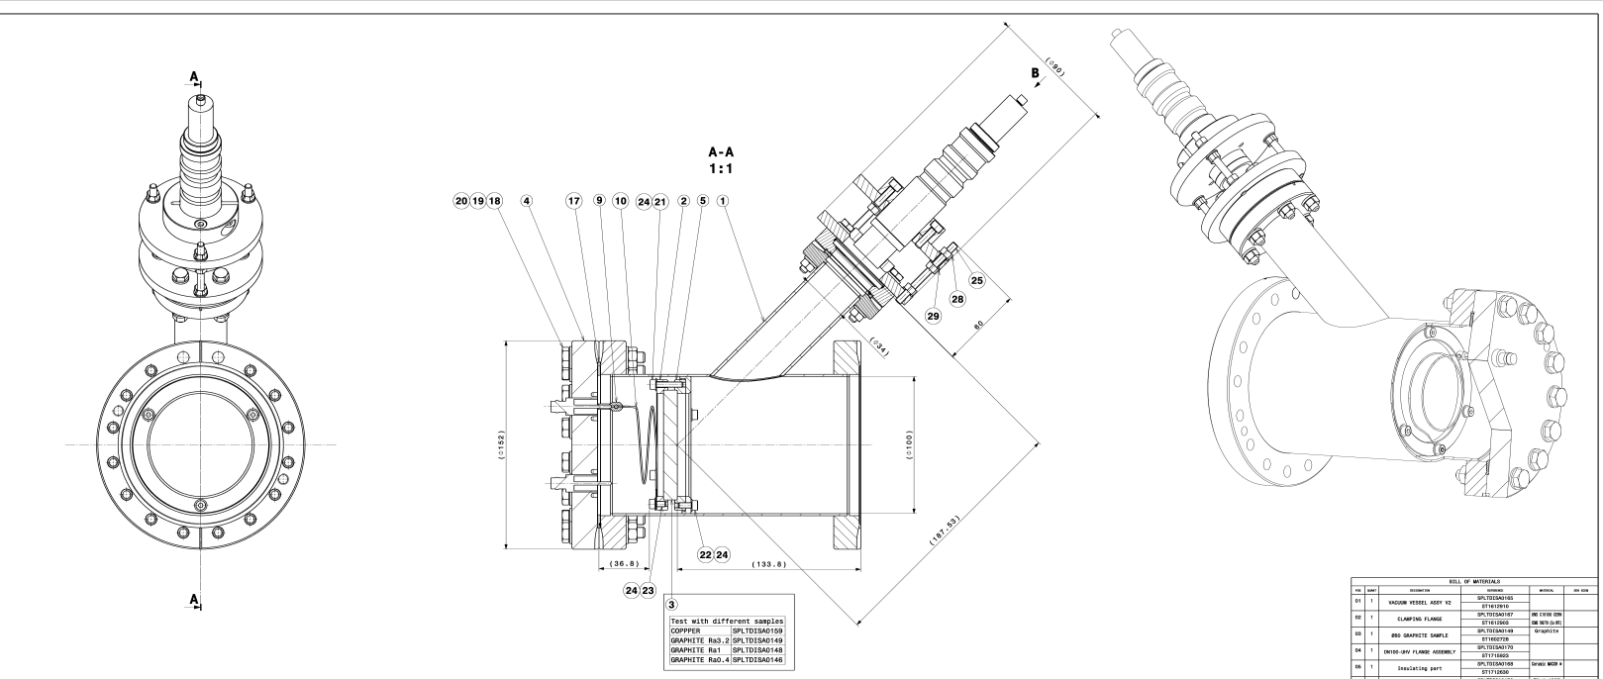
graphite test tank
viewport
sample

Slide 13



3 MeV test stand programme of studies funded beyond 2024:
Already discussed installation of additional pick-ups for beam position/TOF measurements at 3 MeV
Available setup and programme need definition.
When should we expect a decision on RFQs swap?
What would be the timeline and dynamics of a swap?
Which RFQ setup for near-future test-stand studies?
Will we need re-commissioning tests in the tunnel?

