Slide 1


Jet quenching in evolving matter
for SoftJet 2024
Andrey Sadofyev
LIP, Lisbon

Slide 2
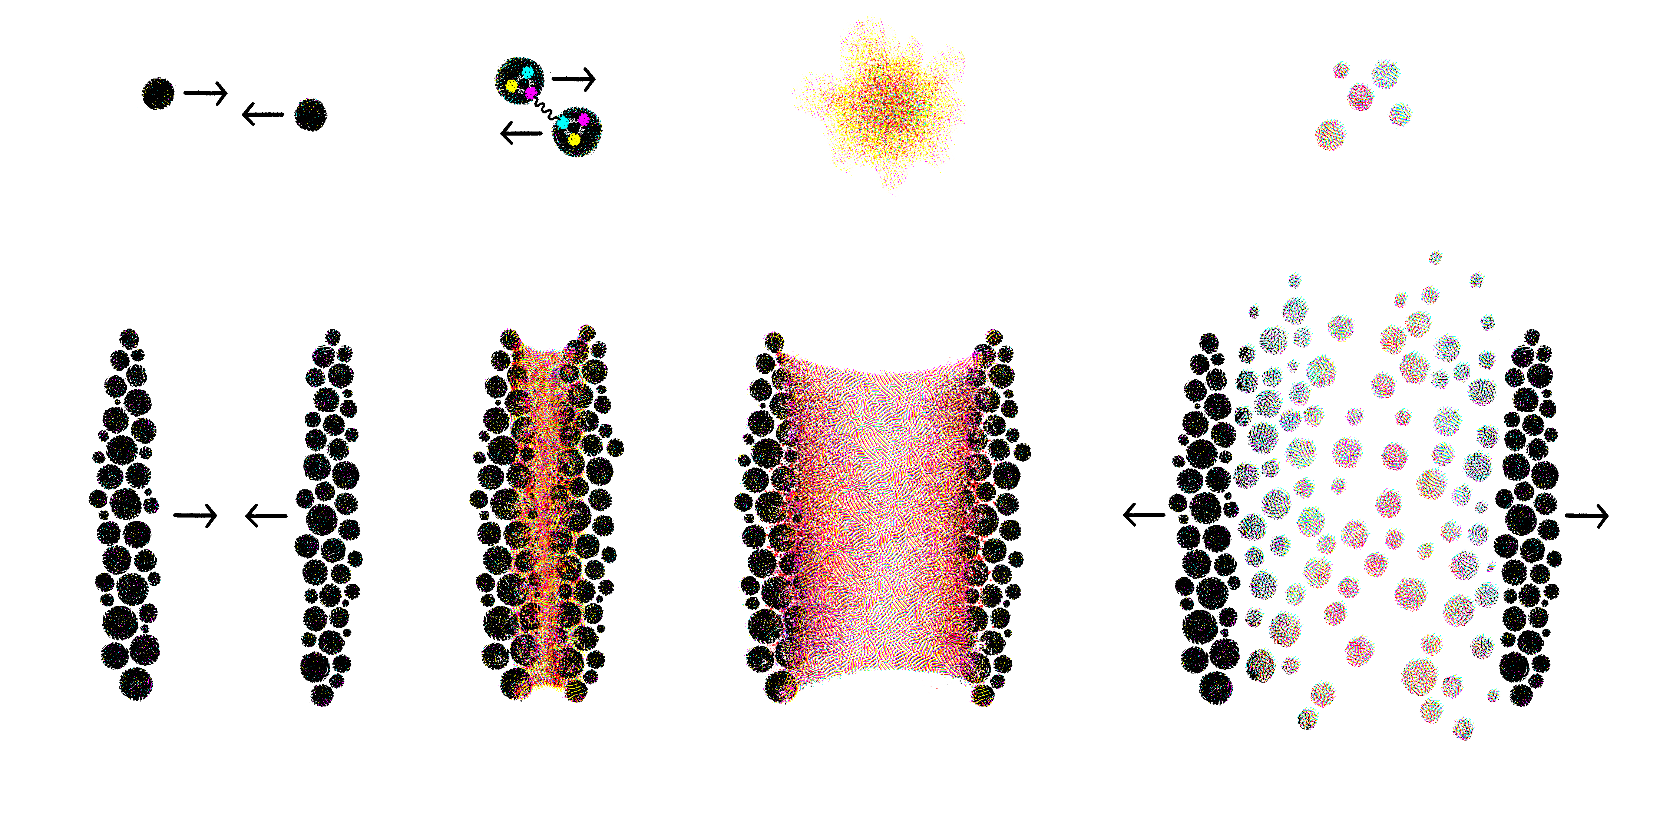
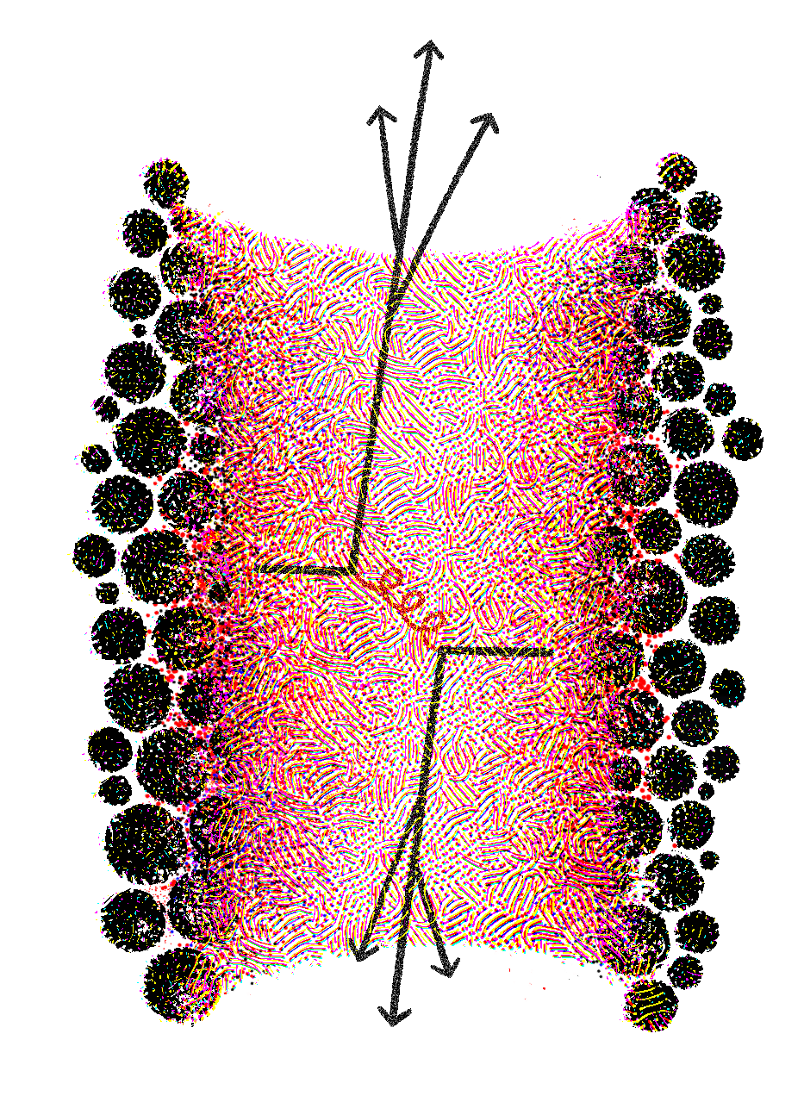
Heavy-ion collisions
elementary
constituents
small
system
complex
nuclear matter
large
system
2

Slide 3
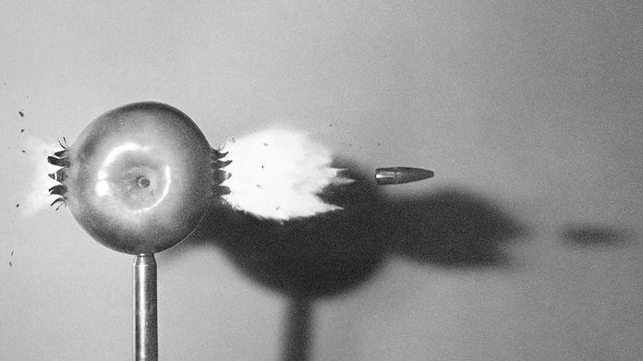
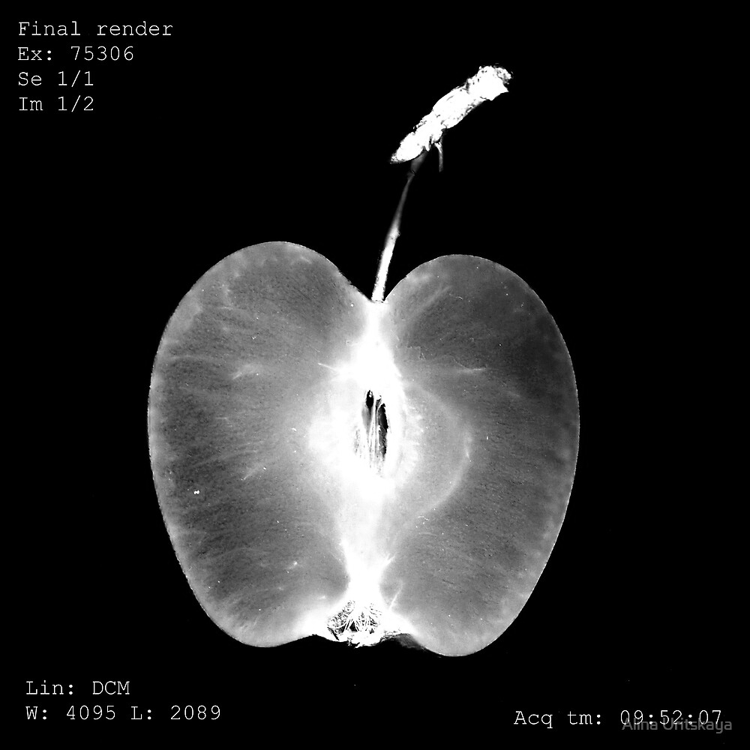
Jet tomography
3

Slide 4
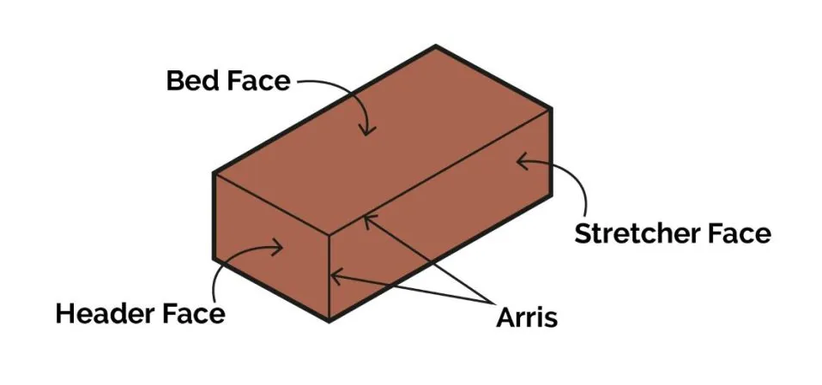
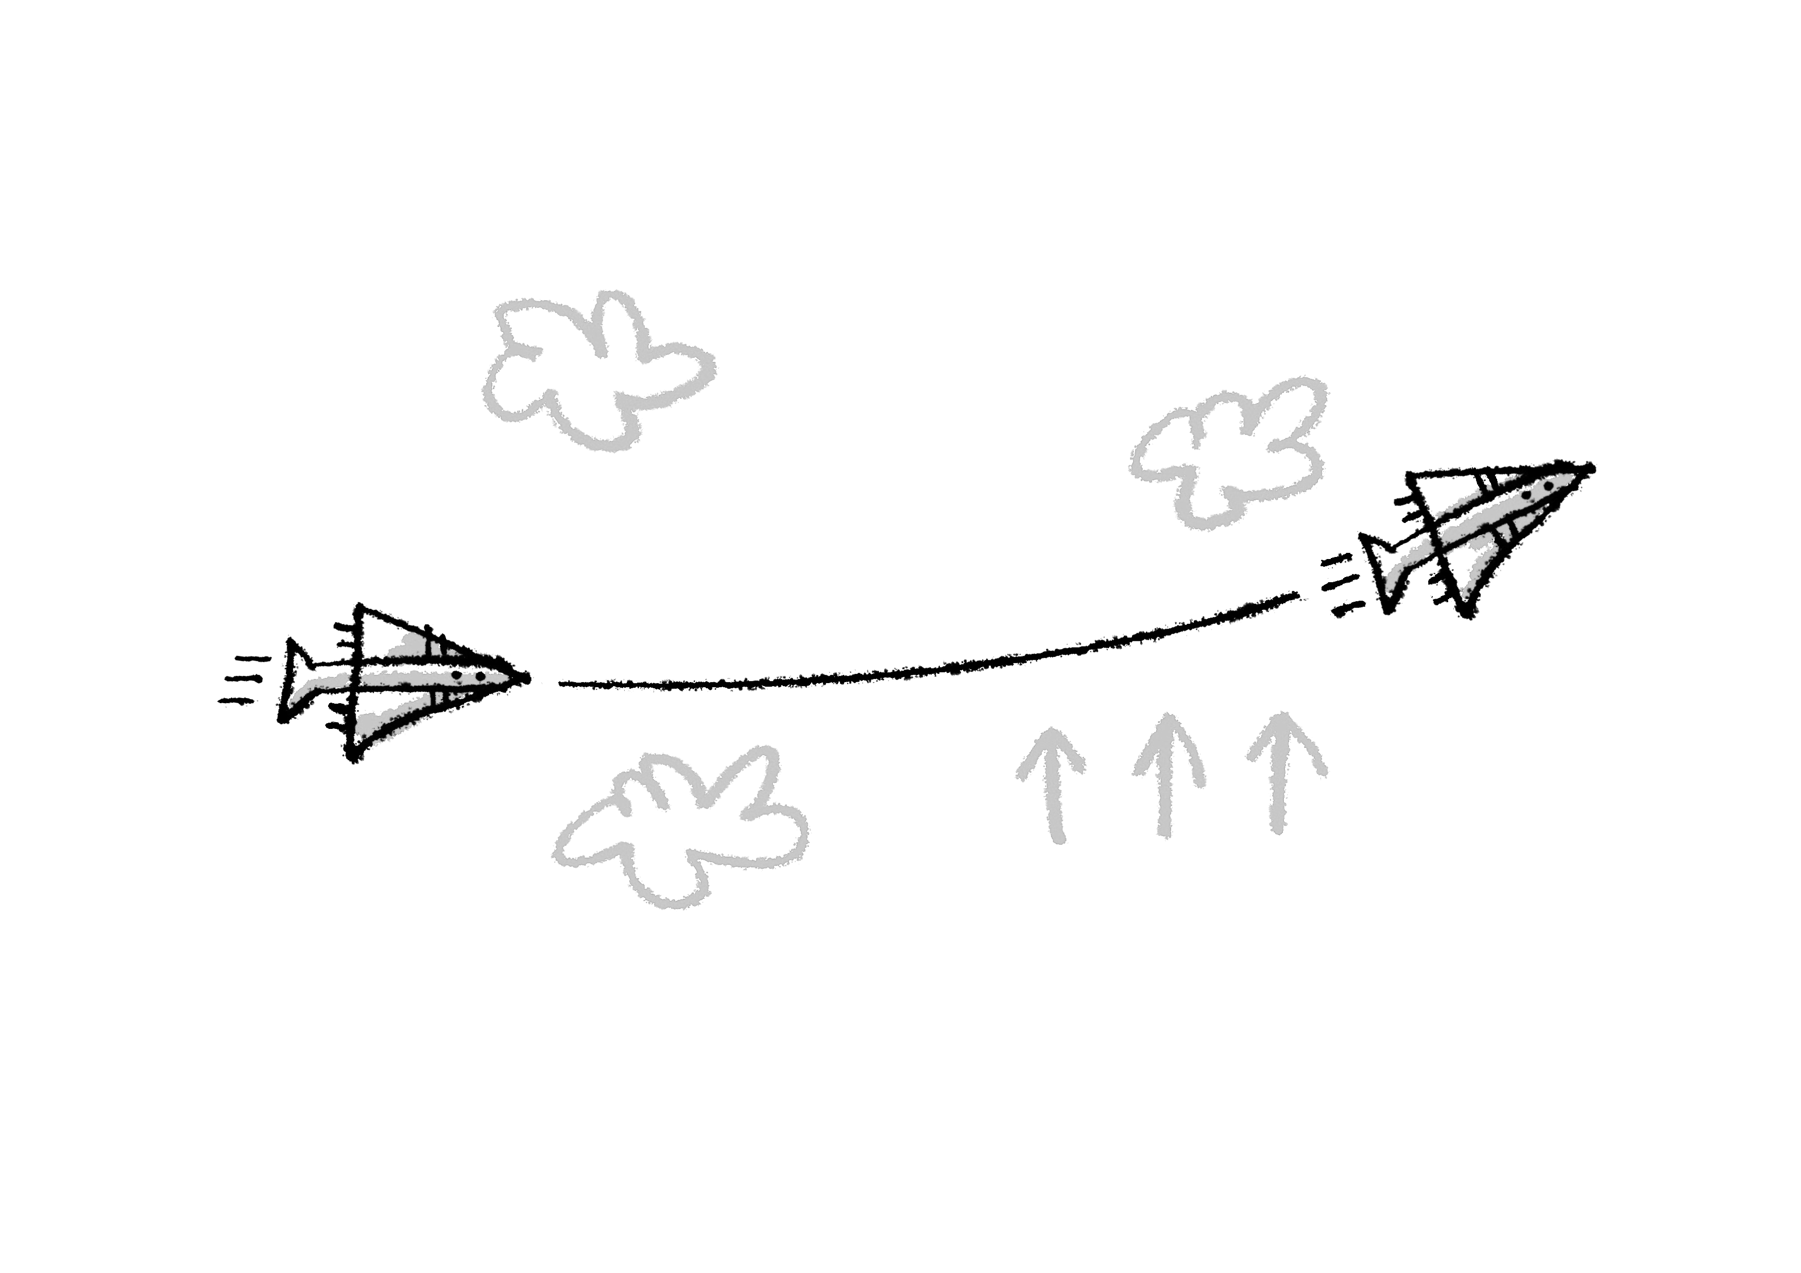
Static brick
4

Slide 5
Evolving matter
Does a jet feel the flow?
5

Slide 6
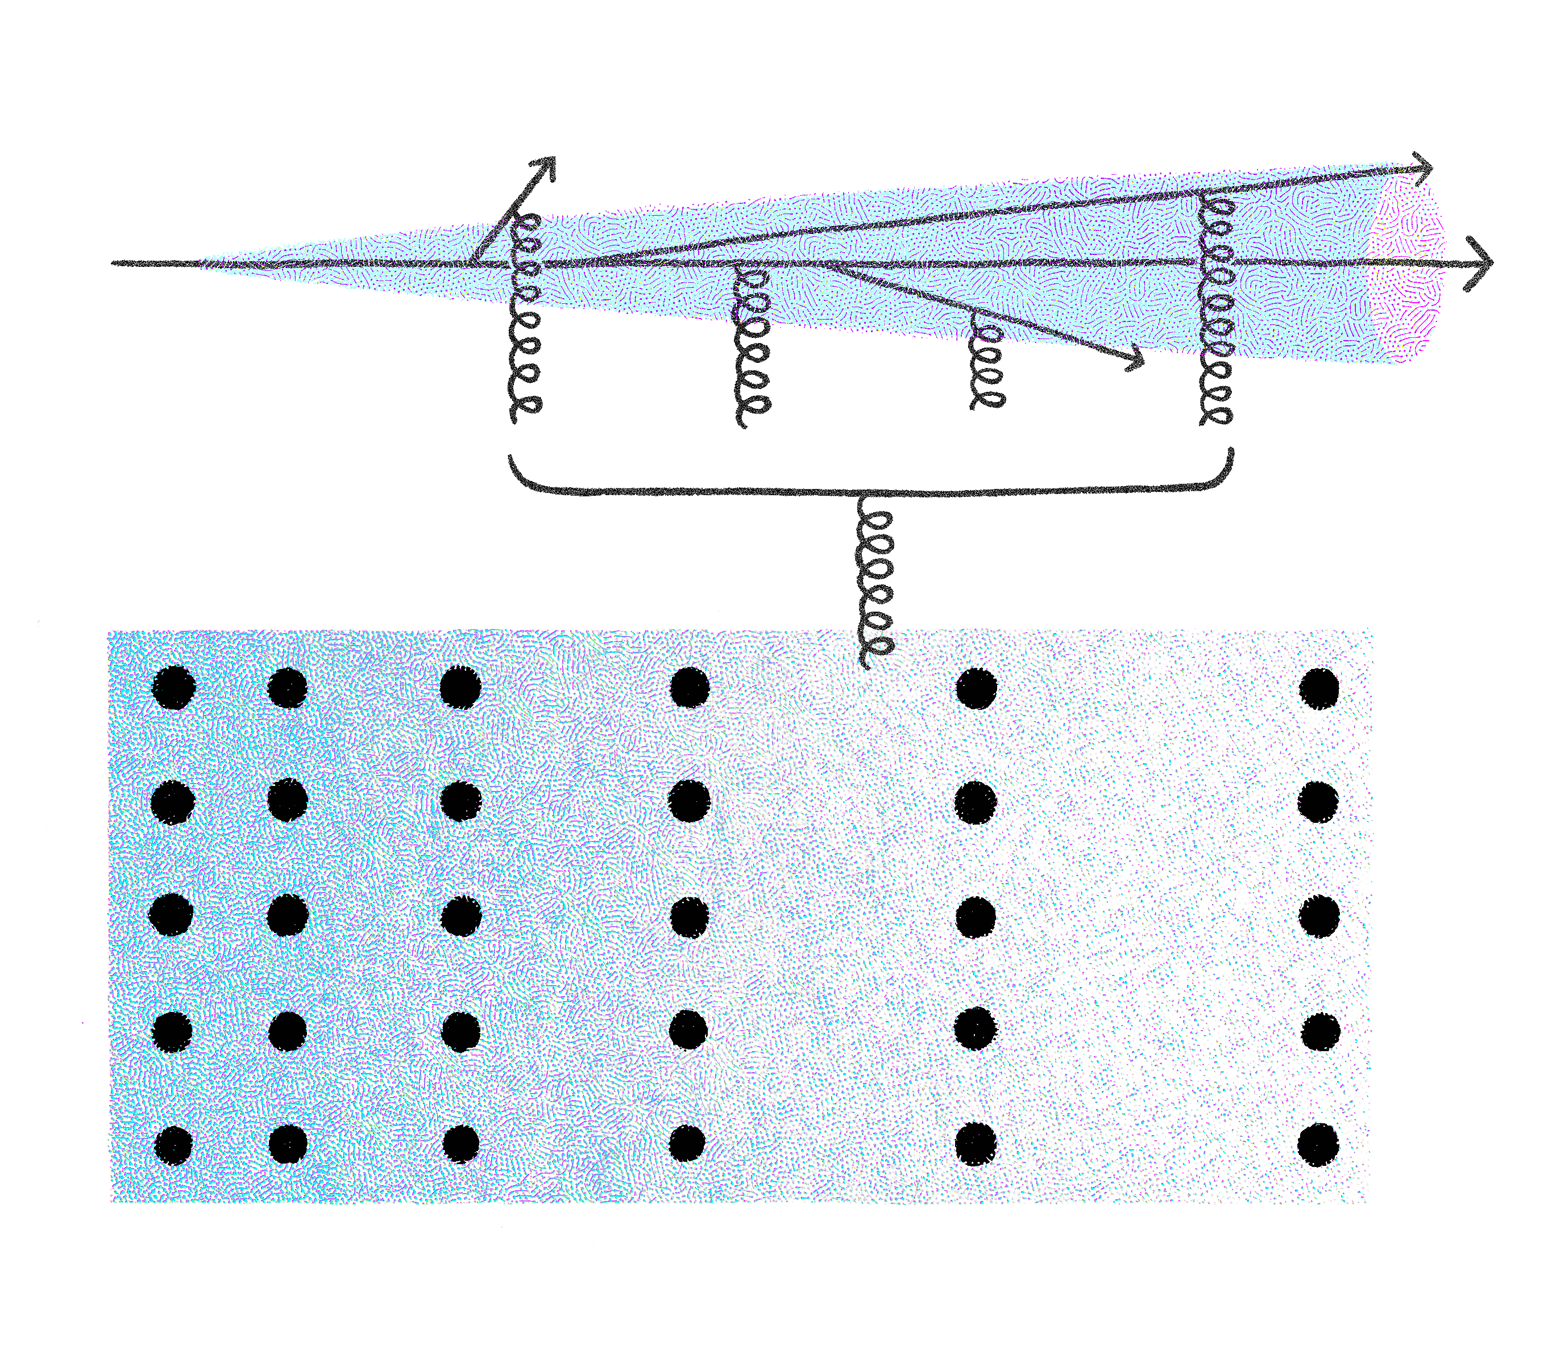
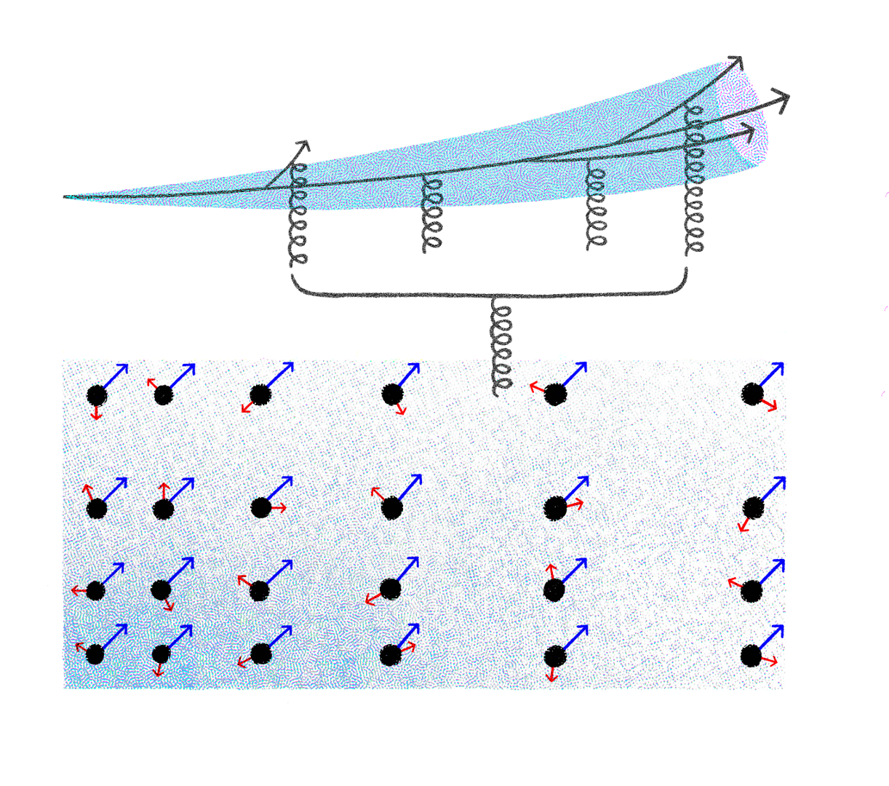
Jets in evolving matter
6

Slide 7
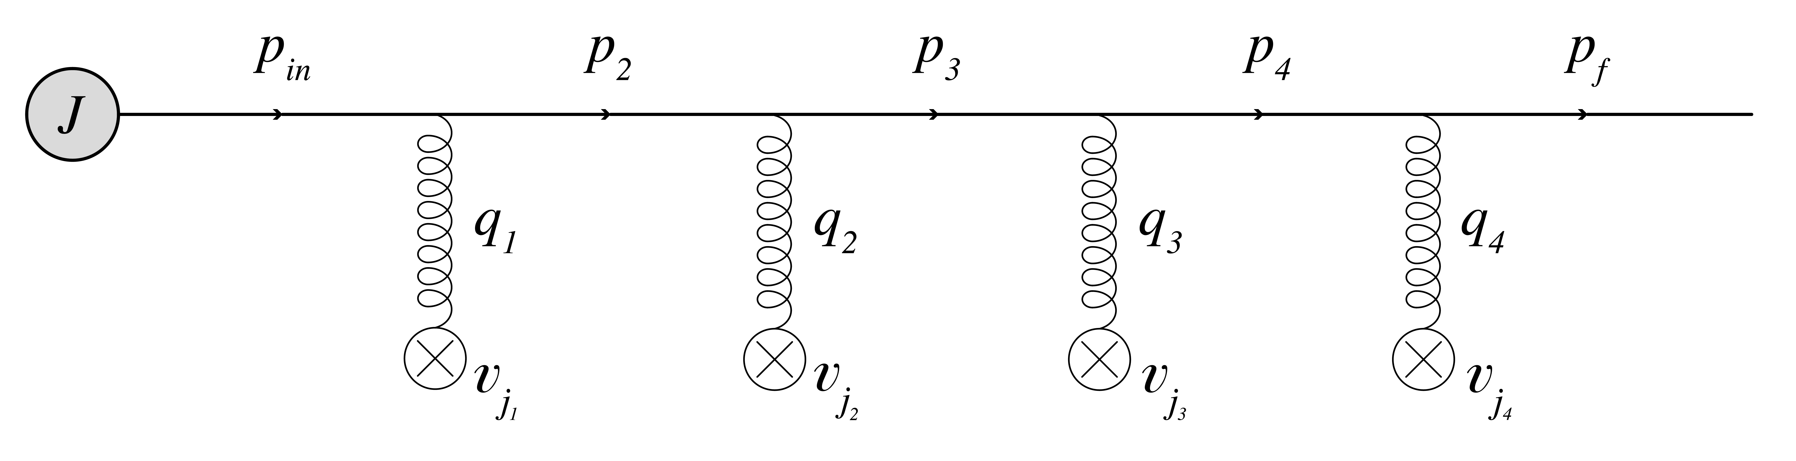
AS, M. Sievert, I. Vitev, PRD, 2021
Color potential
7

Slide 8
AS, M. Sievert, I. Vitev, PRD, 2021
J. Barata, AS, C. Salgado, PRD, 2022
C. Andres, F. Dominguez, AS, CS, PRD, 2022
L. Antiporda, J. Bahder, H. Rahman, M. Sievert, PRD, 2022
J. Barata, AS, X.-N. Wang, PRD, 2023
J. Barata, X. Mayo Lopez, AS, CS, PRD, 2023
M. Kuzmin, X. Mayo Lopez, J. Reiten , AS, PRD, 2024
J. Barata, G. Milhano, AS, EPJC, 2024
M. Kuzmin, X. Mayo Lopez, arxiv, 2024
Jets in evolving matter
What did we have?
Jets see the matter in HIC (and DIS) at multiple scales, and essentially X-ray it;
Theory is based on multiple simplifying assumptions: static matter, no fluctuations, etc;
What do we have?
The coupling of jets to the flow, structure (matter anisotropy), fluctuations, etc.
An updated parton transport equation needed for most modern simulations of jets in QCD matter;
What is still missing?
New jet observables sensitive to the medium evolution;
Coupled simulations of matter and jets for quantitative phenomenology;
8

Slide 9
AS, M. Sievert, I. Vitev, PRD, 2021
Color potential
the initial source
the initial distribution
the fluid velocity
inhomogeneity
9

Slide 10

Broadening (no flow, no anisotropy)
controls most of
the pheno simulations
opacity $χ$
10

Slide 11
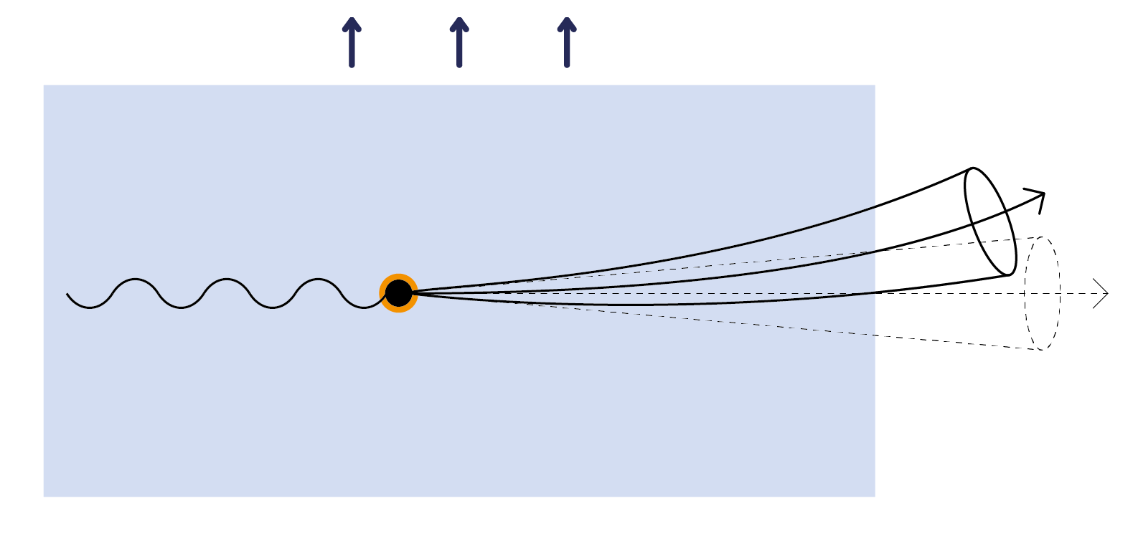
AS, M. Sievert, I. Vitev, PRD, 2021
C. Andres, F. Dominguez, AS, CS, PRD, 2022
Flow
11

Slide 12
AS, M. Sievert, I. Vitev, PRD, 2021
J. Barata, AS, C. Salgado, PRD, 2022
J. Barata, AS, X.-N. Wang, PRD, 2023
Anisotropy
12

Slide 13
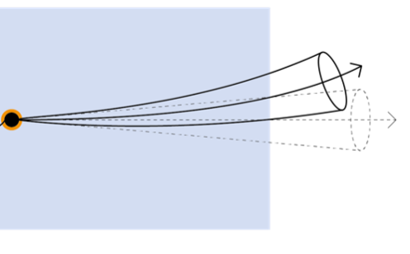
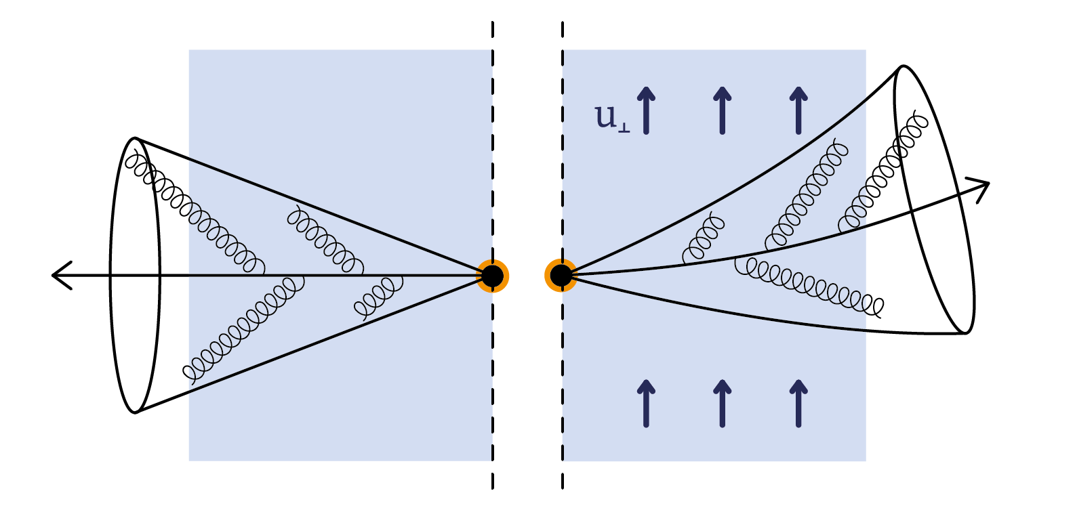

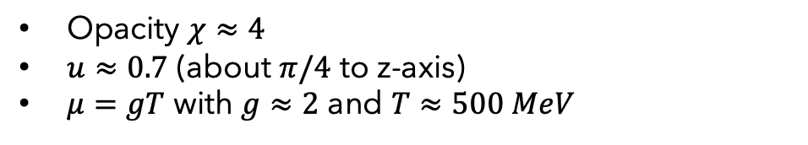

Jets in evolving matter
Opacity $χ≈4$
$u≈0.7$ (about $π/4$ to z-axis)
$μ=gT$ with $g≈2$ and $T≈500 MeV$
$E\sim 50 GeV$ and $\left\langle θ\right\rangle \sim 1^{o}$
$ω\sim 10 GeV$ and $\left\langle θ\right\rangle \sim {15}^{o}$
13

Slide 14
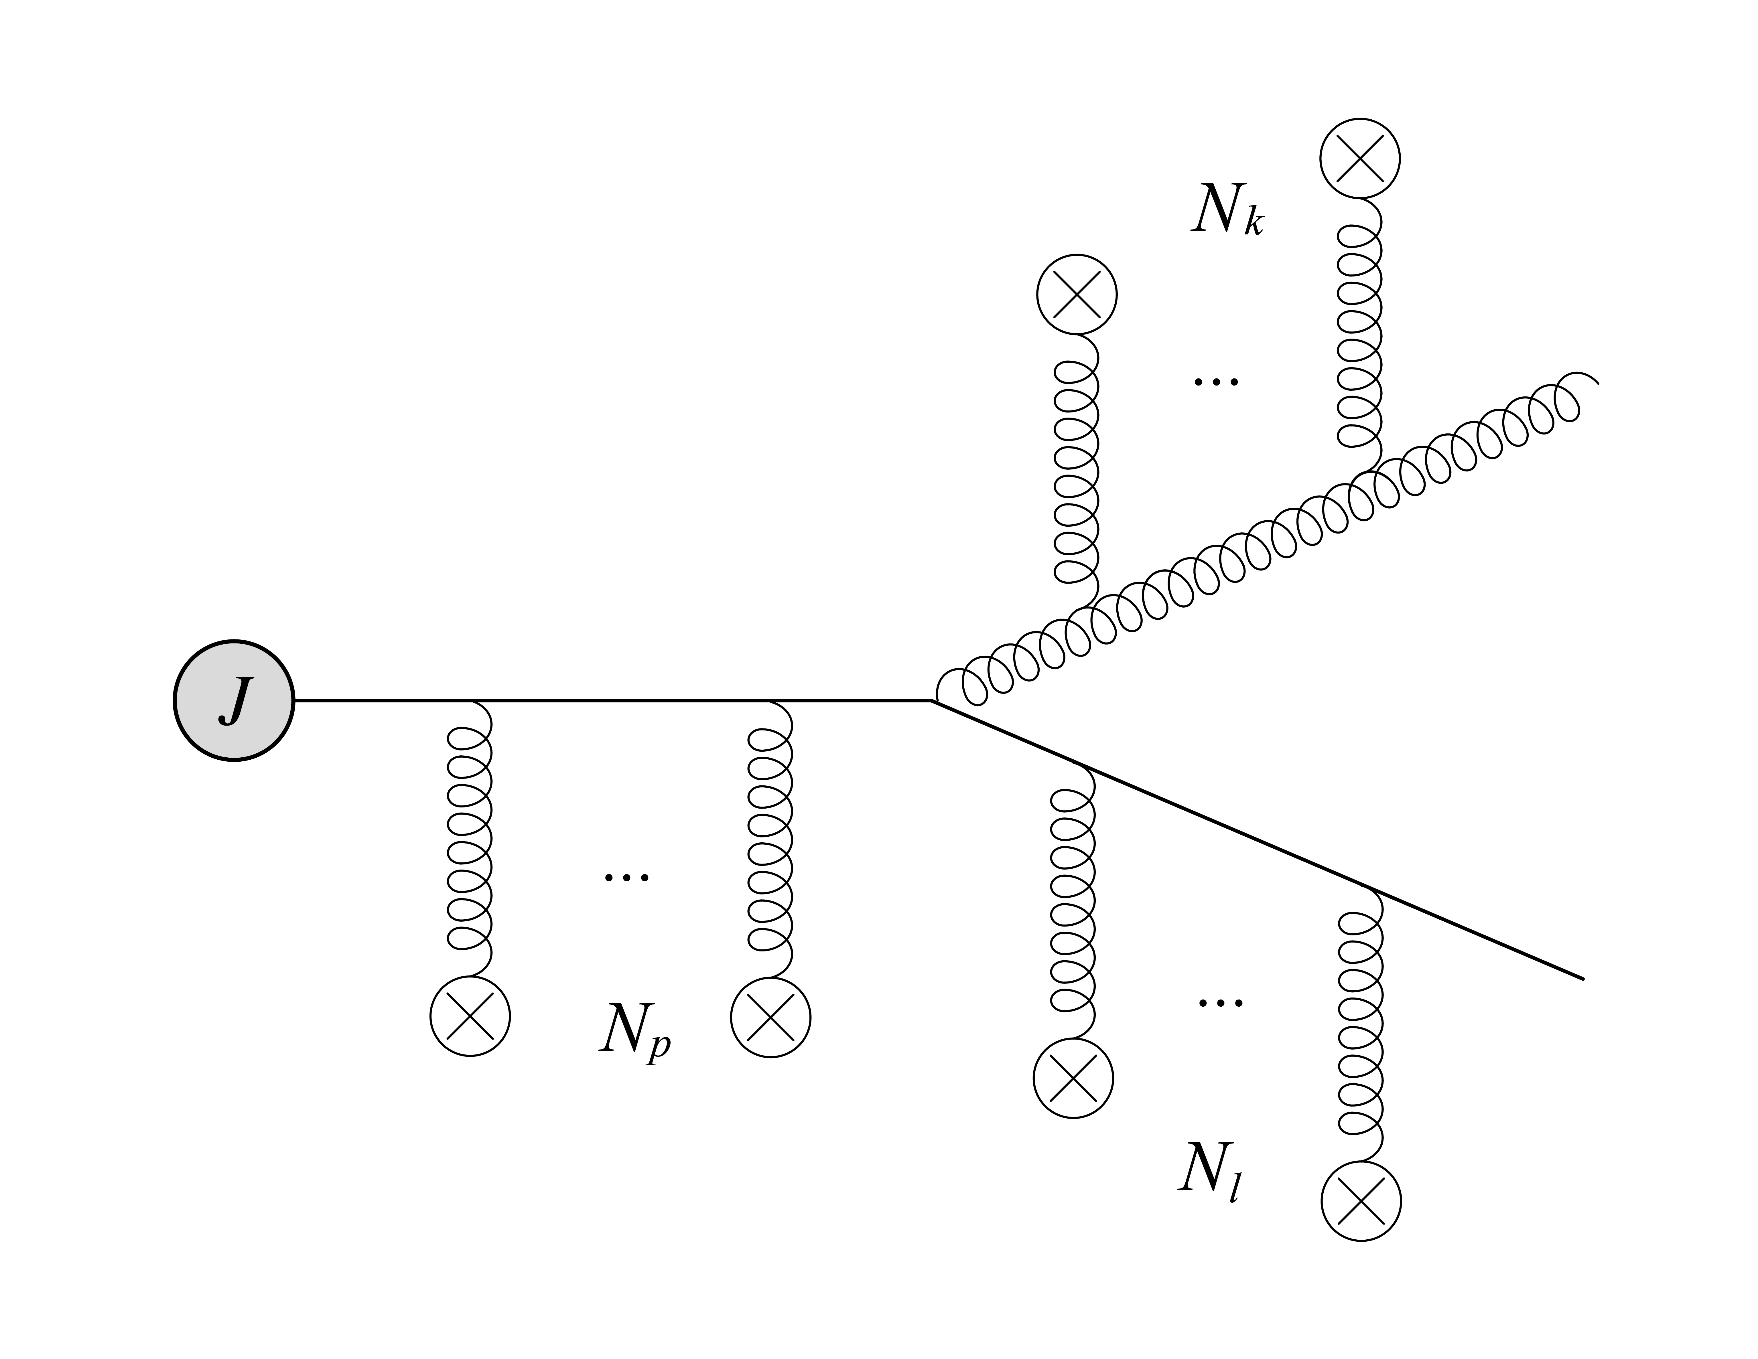
J. Barata, X. Mayo, AS, C. Salgado, PRD, 2023
Gluon emission
14

Slide 15
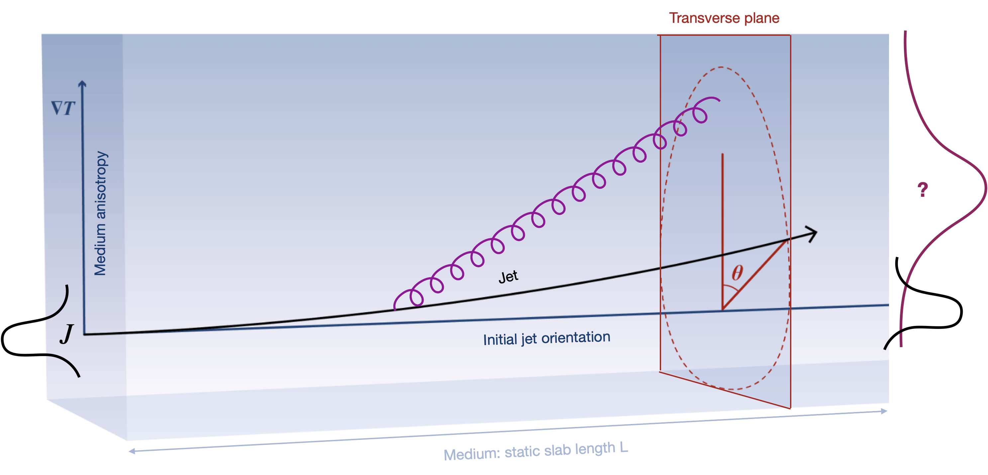
J. Barata, X. Mayo, AS, C. Salgado, PRD, 2023
Gluon emission
15

Slide 16
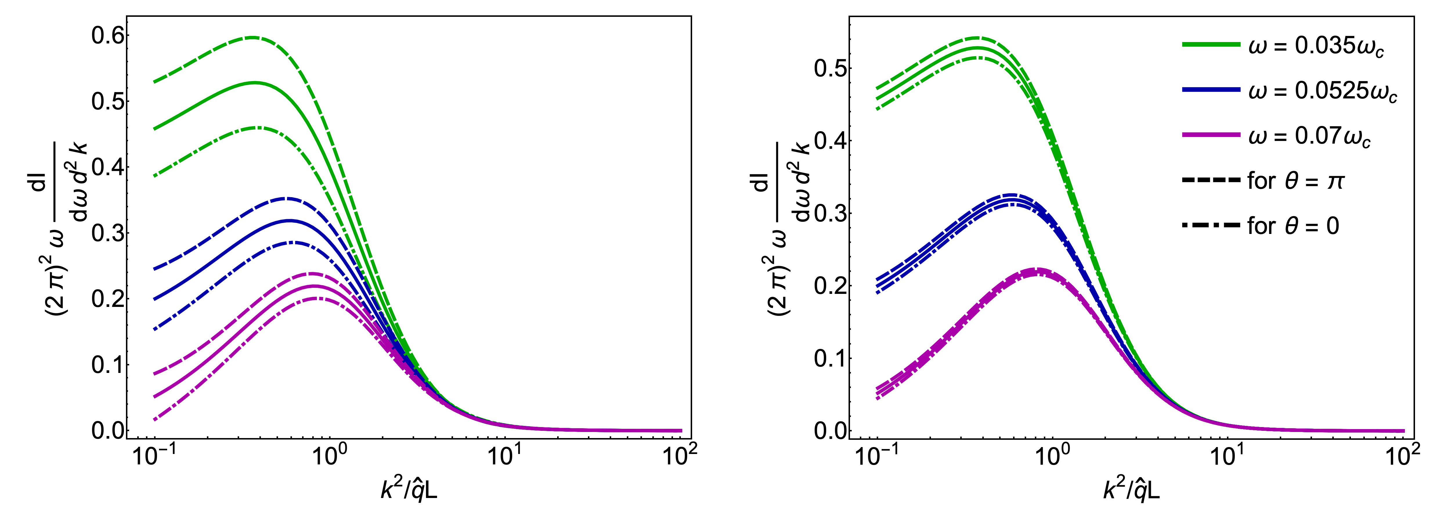
16

Slide 17
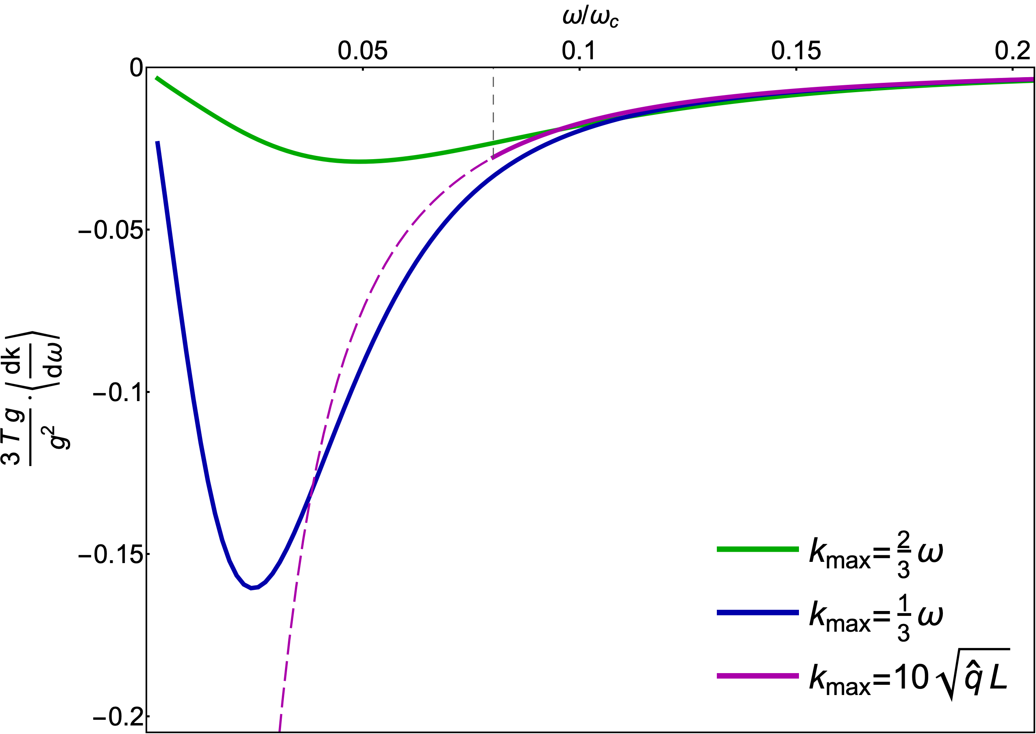
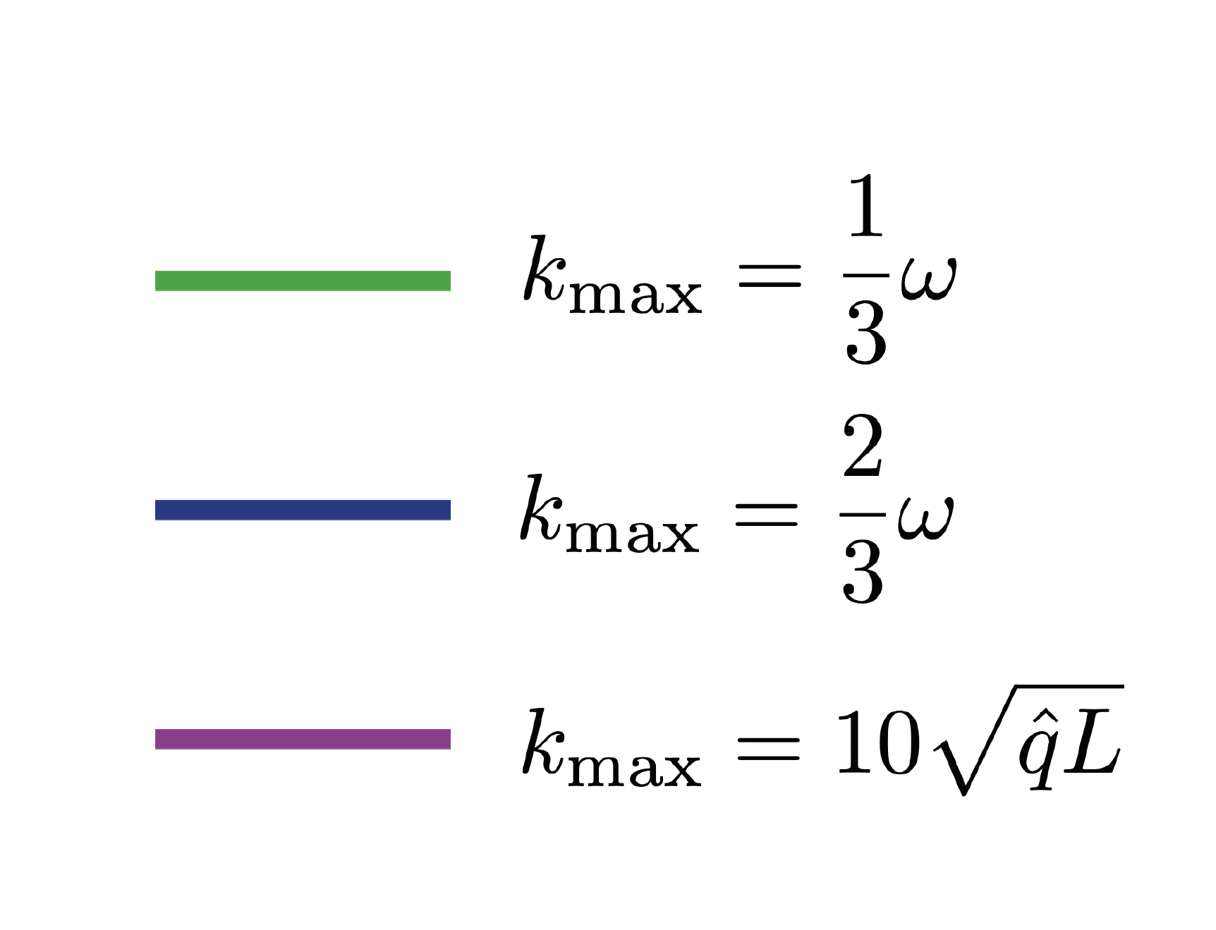
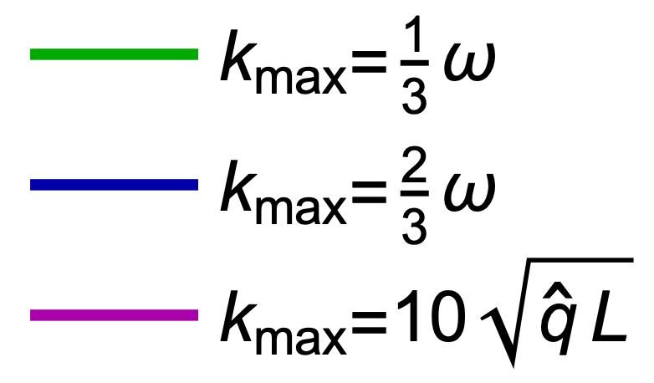
17

Slide 18
Jets in evolving matter
18

Slide 19
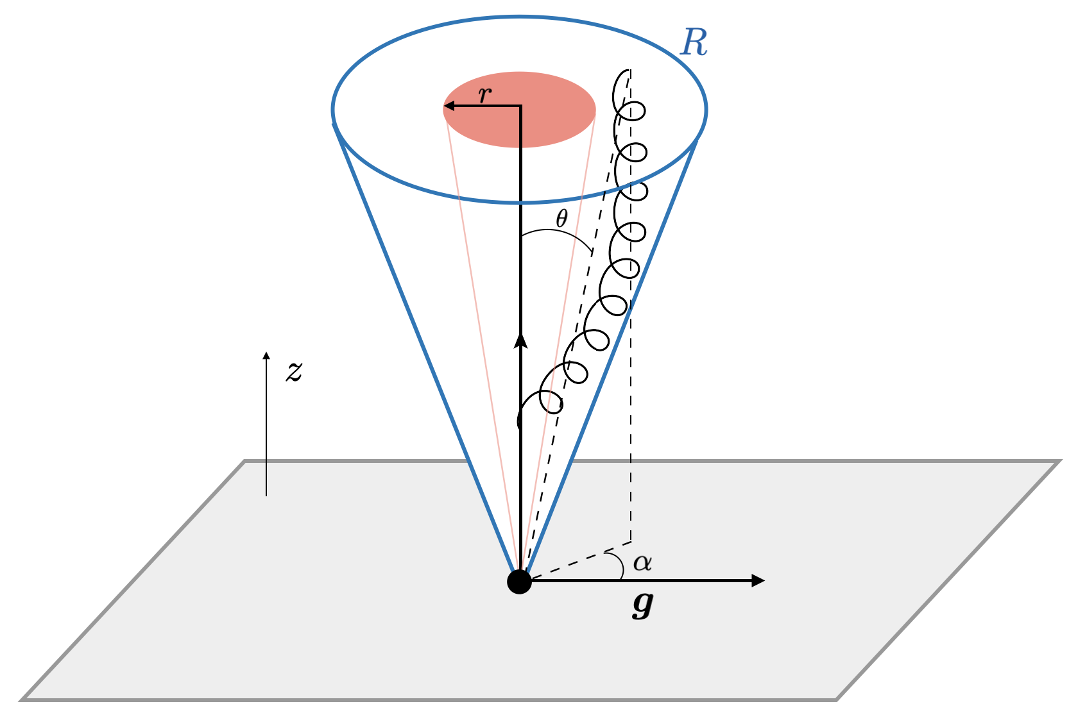
J. Barata, G. Milhano, AS, EPJC, 2024
Jets in evolving matter
19

Slide 20
J. Barata, G. Milhano, AS, EPJC, 2024
Estimates
The anisotropy leave traces in the shape observables
At the toy model level, we see how azimuthally differential EEC is affected by the gradients
The small-x BDMPS-Z formula is not strictly applicable, just an illustration
The gradient effects can be clearly seen
20

Slide 21
M. Kuzmin, X. Mayo, J. Reiten , AS, PRD, 2024
Mixed flow-gradient effects
21

Slide 22
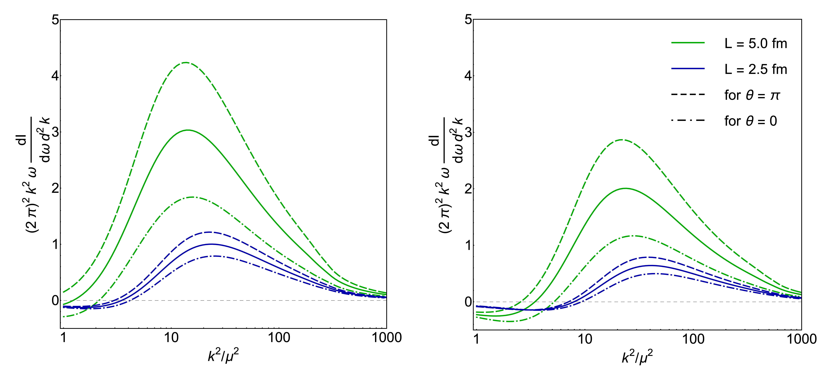
M. Kuzmin, X. Mayo, J. Reiten , AS, PRD, 2024
Jets in evolving matter
22

Slide 23
Summary
Energetic partons do feel the transverse flow and anisotropy, and get bended and distorted;
The transverse flow and anisotropy affect the pattern of the medium-induced radiation, modifying the substructure of jets;
Some of the effects appear in the eikonal limit, and are sizeable even when compared to the leading contributions;
These jet modifications can be probed in experiment, leading us towards actual jet tomography;
One should also expect similar evolution-induced effects for the other probes of nuclear matter, and for the other forms of nuclear matter;
23

