Slide 1


Backreaction of QGP fluids from recoil partons
Shoto Sakuma, Tetsufumi Hirano
Sophia University
SOPHIA
HADRON
PHYSICS
GROUP
Notes:
Thank you for the introduction and thank you all for giving me this opportunity to make a presentation here today.
Hello everyone, I’m Shoto from Sophia University in Tokyo.
Today I’m going to talk about the backreaction of QGP induced by recoil process

Slide 2
Introduction
SOPHIA
HADRON
PHYSICS
GROUP
Notes:
At first, I’d like to start from the introduction of my study.

Slide 3


Jet in heavy-ion collision
Jet
parton
hadron
$$q, g$$
Modification of jets holds
information about
“jet-medium interaction”
in QGP
Notes:
In heavy ion collision, the hard partons are generated after the initial collision, and these partons propagate through QGP medium interacting with QGP.
Then, after hadronization we observed the collection of particle as jet.
Therefore, Modification of jets holds information about “jet-medium interaction”.

Slide 4
Jet in heavy-ion collision
Jet
parton
hadron
$$q, g$$
Modification of jets holds
information about
“jet-medium interaction”
in QGP
medium parton
Jet-medium interaction
・Radiation induced by medium
・Elastic scattering
jet parton
Access the information about
quark-gluon plasma (QGP)
Notes:
In the jet-medium interaction, there are 2 types of interaction, like radiation induced by medium and elastic scattering between jet parton and medium parton.
by understanding these jet-medium interaction presicely, we can access the information of quark-gluon-plasma indirectly.
that’s why jet-medium interaction is important for qgp study.
In the elastic scattering,

Slide 5
Recoil and backreaction
JEWEL
Korinna C. Zapp, Phys. Lett. B735 (2014)
LBT
T. Luo et al., PLB782, 707-716 (2018)
QGP
Recoil
Medium parton kicked out by jet parton
・acquires high energy and momentum
・becomes non-equilibrated parton
medium parton
jet parton
Notes:
there is recoil process.
when medium parton which constitute QGP medium are kicked out by jet parton then, acquires high energy and momentum and beeomes non-equilibrated parton, this process is called recoil.

Slide 6
Recoil and backreaction
JEWEL
Korinna C. Zapp, Phys. Lett. B735 (2014)
LBT
T. Luo et al., PLB782, 707-716 (2018)
QGP
Recoil
Recoil partons
Medium parton kicked out by jet parton
・acquires high energy and momentum
・becomes non-equilibrated parton
medium parton
Energy and momentum of
jet partons are modified
jet parton
Notes:
and by the multiple scattering, energy and momentum of jet partons are modified.
not only radiation process , the recoil process is also crucial to understand properties of the QGP in heavy-ion collision.

Slide 7


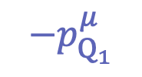
Recoil and backreaction
CoLBT-hydro
W. Chen, et al., PLB 777, 86 (2018)
QGP
medium parton
$$−p_{Q_{2}}^{μ}$$
$$−p_{Q_{1}}^{μ}$$
Hole
$$−p_{Q_{3}}^{μ}$$
Notes:
On the other hand, if we look at the QGP medium from the perspective of energy-momentum conservation,
due to the recoi, hole of QGP medium are generated l,
because energy-momentum of medium partons are picked up from QGP medium.
And these holes induce the

Slide 8
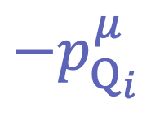
Recoil and backreaction
CoLBT-hydro
W. Chen, et al., PLB 777, 86 (2018)
Backreaction
QGP
Hole
medium parton
$$−p_{Q_{2}}^{μ}$$
$$−p_{Q_{i}}^{μ}$$
$$−p_{Q_{1}}^{μ}$$
Purpose
$$−p_{Q_{3}}^{μ}$$
Investigate the effect of
“dynamical” backreaction of QGP
To understand jet-medium interaction
Notes:
dynamical backreaction of QGP medium. like these blue arrows show.
for more precise understanding of jet medium interaction not only recoil process, but also backreaction should be considered dynamically.
So, the purpose of this study is to investigate the effect of dynamical backreaction of QGP,
to understand jet-medium interaction “more presicely”

Slide 9
Framework
SOPHIA
HADRON
PHYSICS
GROUP
Notes:
From here, I will talk about the framework of this study

Slide 10
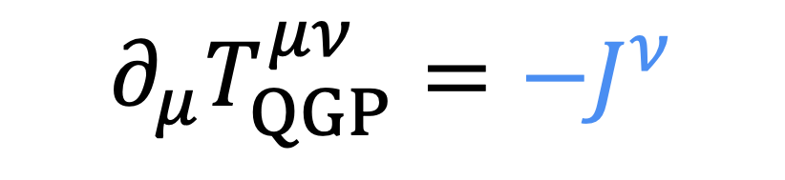


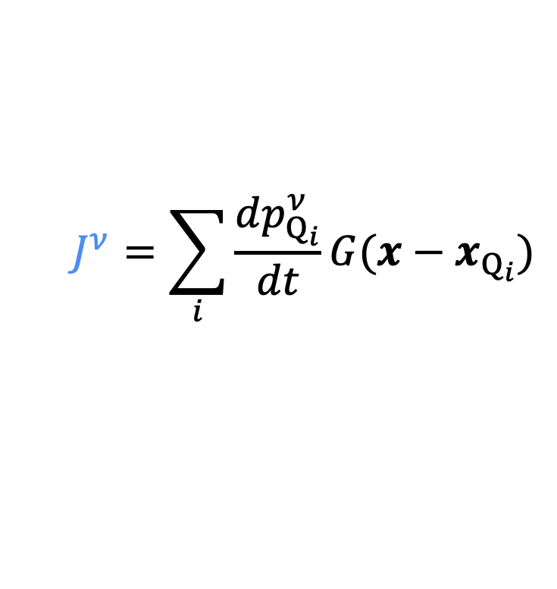
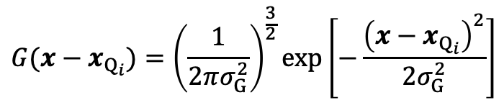
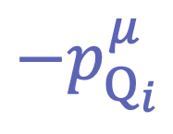
Negative source term for backreaction
Hydrodynamic eq. with “negative” source term
$$∂_{μ}T_{QGP}^{μν}={−J}^{ν}$$
Gaussian source
$$J^{ν}=\sum_{i}{\frac{dp_{Q_{i}}^{ν}}{dt}G(x−x_{Q_{i}})}$$
3D-Gaussian function
Hole
$$G(x−x_{Q_{i}})={\left(\frac{1}{2πσ_{G}^{2}}\right)}^{\frac{3}{2}}\exp\left[−\frac{{\left(x−x_{Q_{i}}\right)}^{2}}{2σ_{G}^{2}}\right]$$
$$−p_{Q_{i}}^{μ}$$
energy-momentum and position of
recoiled medium partons
$p_{Q_{i}}^{μ},x_{Q_{i}}$:
$σ_{G}$: width of gaussian
(3+1)-D ideal hydro
non-expanding system
conformal EoS
Notes:
To describe the dynamical backreaction of QGP, We introduced Hydrodynamic equation, with negative source term.
T munu is the energy momentum tensor of QGP medium, and J nu
on the right hand side is source term which represent the energy-momentum transfer between jet and medium
So, when recoil occur, the energy momentum of recoiled medium partons are picked up from qgp medium through the negative source term and this lead to backreactions in this model
source term is defined as this including 3D gaussian function.
the pmu Qi is the energy-momentum of recoiled medium parton, and bold x
and bold x Qi is positioin of recoiled medium parton
also, in this study, I used the 3+1 dimensional ideal hydro, conformal EoS, considered the non-expanding system

Slide 11

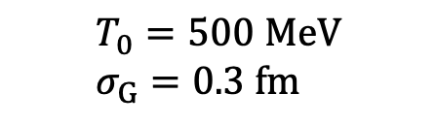




Test calculation
Static QGP brick
$$T_{0}=500 MeV \\ σ_{G}=0.3 fm$$
1 medium
parton
$$p_{Q}^{μ}=(2 GeV,2 GeV,0,0)$$
$$z$$
$$y$$
$$(0,0,0)$$
$$x$$
Notes:
here, I show you the result of the test calculation
Now, there is the static QGP brick and initial temparature is 500 MeV, width of gaussian is 0.3 fm
no medium parton of which energy and momentum in x direction is 2 GeV moving toward right direction

Slide 12


Test calculation
Static QGP brick
$$T_{0}=500 MeV \\ σ_{G}=0.3 fm$$
1 hole
$$−p_{Q}^{μ}=(−2 GeV,−2 GeV,0,0)$$
$$z$$
$$y$$
$$(0,0,0)$$
$$x$$
$$∂_{μ}T_{QGP}^{μν}={−J}^{ν}$$
“negative” source term
Notes:
let us consider the this situation, like this medium parton is picked up from QGP medium through negative source term and 1 hole is generated
in this case,

Slide 13
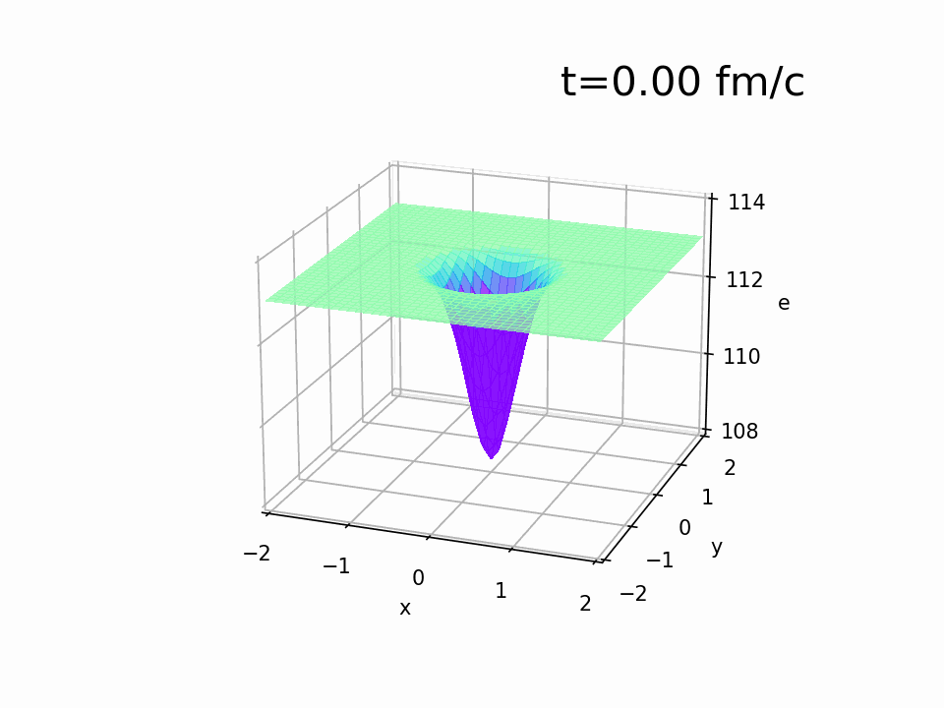
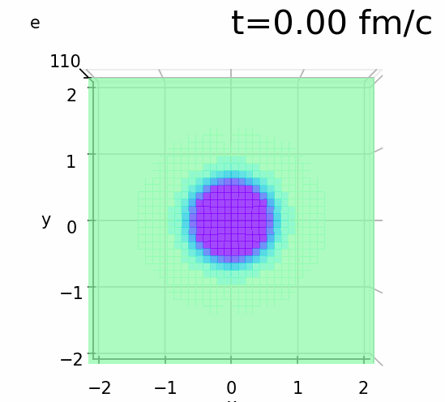
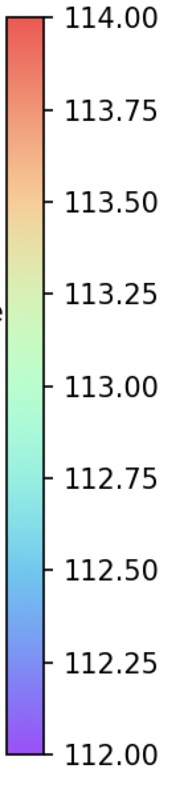






Test calculation
energy density of QGP
Static QGP brick
$$e (GeV/{fm}^{3})$$
$$T_{0}=500 MeV \\ σ_{G}=0.3 fm$$
Hole
$$y (fm)$$
1 hole
$$−p_{Q}^{μ}=(−2 GeV,−2 GeV,0,0)$$
$$x (fm)$$
$$z$$
$$(GeV/{fm}^{3})$$
$$y$$
$$y (fm)$$
$$(0,0,0)$$
Hole
$$x$$
$$∂_{μ}T_{QGP}^{μν}={−J}^{ν}$$
“negative” source term
Wake
$$x (fm)$$
Notes:
the time evolution of energy density of QGP is shown by these movie.
you can see that hole is moving toward right hand side and wake appear behind the hole
this is the dynamical hole' s movement described by hydrodynami with negative source

Slide 14



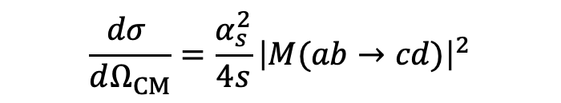

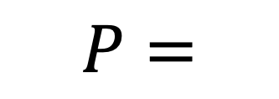

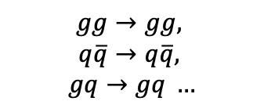
Elastic process
Static QGP brick
$$T\left(x\right),v\left(x\right), ΔV$$
Collision detection
Elastic scattering
fermi dist, bose dist ...
Stochastic method
LO-pQCD + parton’s Debye mass
to simulate Boltzmann equation
$$\frac{dσ }{dΩ_{CM}}=\frac{α_{s}^{2}}{4s}{\left|M(ab→cd)\right|}^{2}$$
$$n_{cell}, x_{i},p_{i}type_{i}$$
cell
$$v_{rel}Δt$$
$$P=$$
$$Δx$$
$$σ$$
Collision probability
$$gg→gg,$$
$$q\overline{q}→q\overline{q},$$
$$gq→gq …$$
Z. Xu and C. Greiner,Phys. Rev. C 71, 064901(2005)
Notes:
in this model to describe the recoil, elastic process is included
in the static QGP brick depend on medium information like the local temparature and local flow velocity of QGP medium, partons are sampled at every time step.
and according to the stochastic method which is used to simulate Bolzmann eauation collisions are detected following collision probablitiy
and also to describe the elastic scattering for Recoil Lo-pQCD and parton’s dDbye mass effect. included

Slide 15
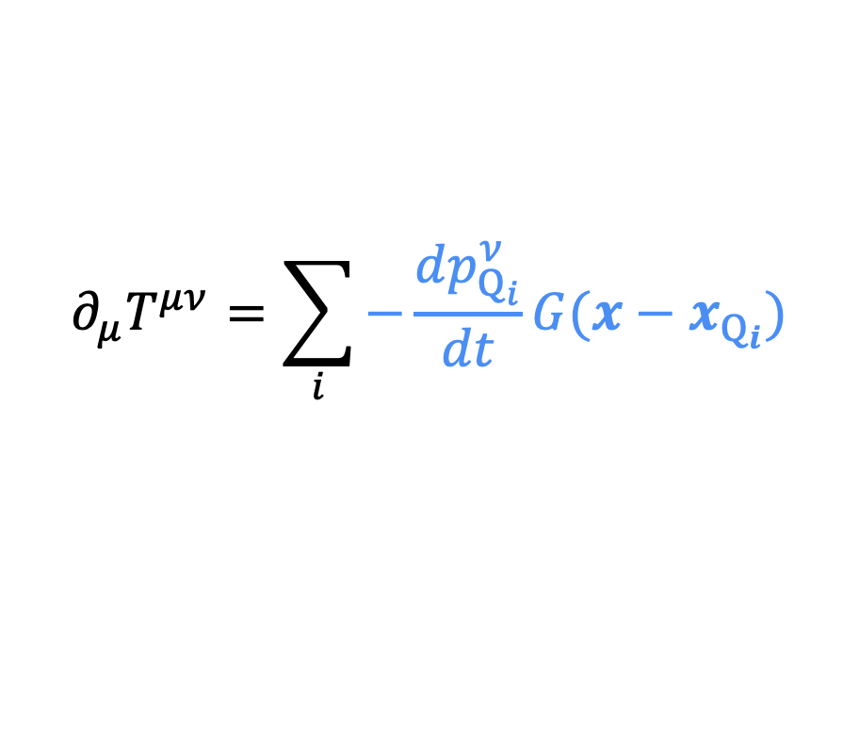
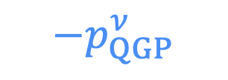




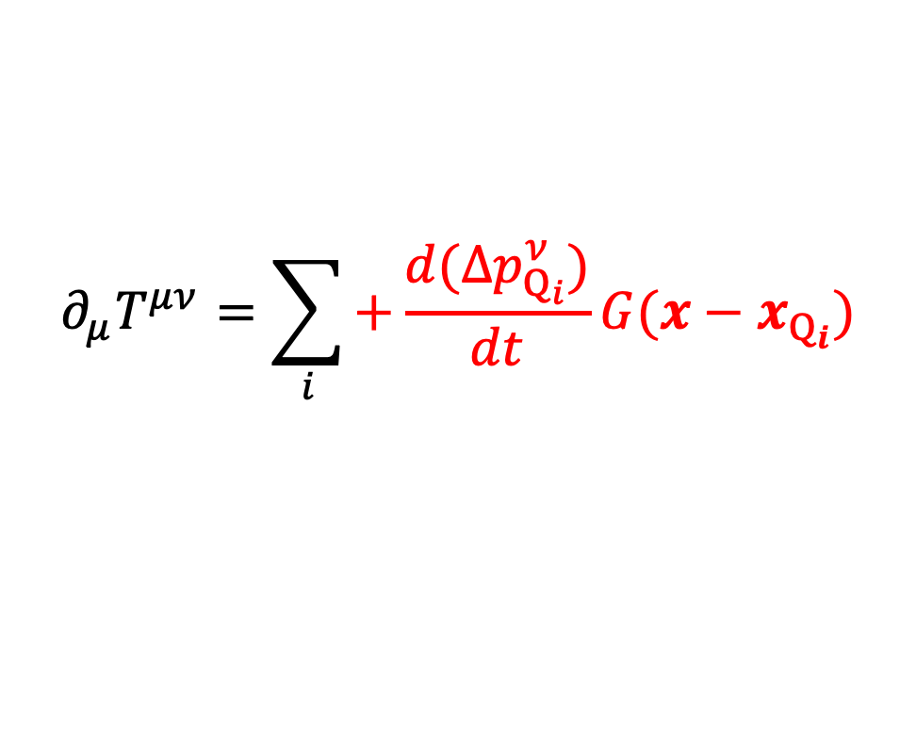

Medium response
$E_{thr}$: threshold of recoil
Backreaction from recoil
Deposition from jet energy loss
jet parton
$${Δp}_{jet}^{ν}$$
jet parton
$$E_{QGP}^{′}≧E_{thr}$$
@LRF
$$E_{QGP}^{′}<E_{thr}$$
@LRF
medium parton
$$−p_{QGP}^{ν}$$
recoil parton
medium parton
$${Δp}_{QGP}^{ν}$$
absorbed into medium
$$∂_{μ}T^{μν}=\sum_{i}{−\frac{dp_{Q_{i}}^{ν}}{dt}G(x−x_{Q_{i}})}$$
$$∂_{μ}T^{μν}=\sum_{i}{+\frac{d{(Δp}_{Q_{i}}^{ν})}{dt}G(x−x_{Q_{i}})}$$
Notes:
In this model, to describe the jet-medium interaction 2 type of medium responses are included.
depend on the threshold of recoil, which response medium occurs is determined.
in the case of that Energy of medium parton after scattering with jet parton is larger than the threshold, at Local rest frame
medium parton propagate as recoil parton and backreaction occur through the negative source term at the same tim
on the other hand, in the case of that Energy of medium parton after scattering with jet parton at Local rest frame is smaller than the threshold,
medium parton is absorbed into medium through positive source term, this process is energy-momentum deposition from jet enegy –momentum loss

Slide 16
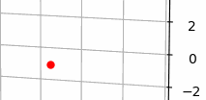
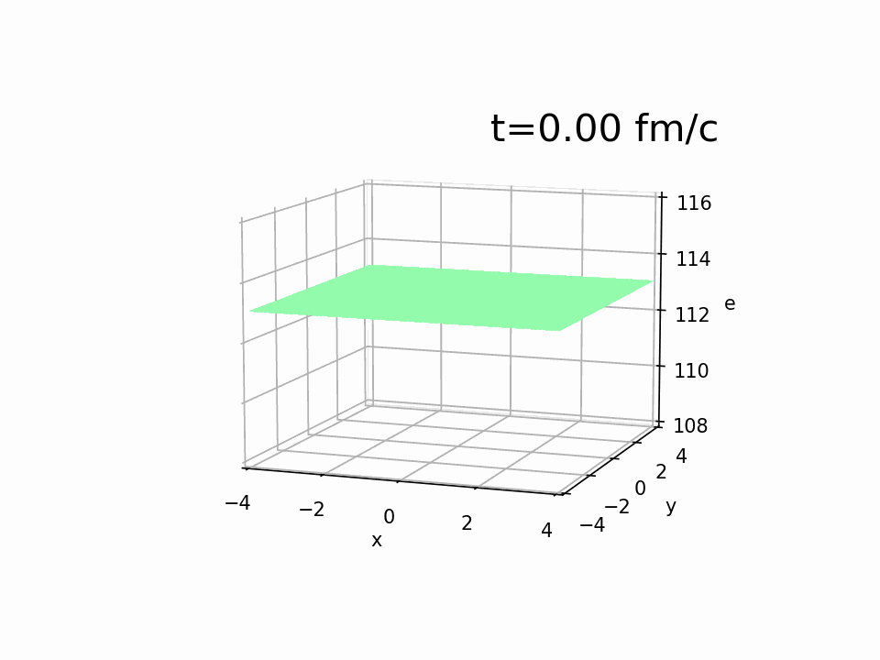





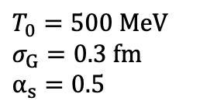
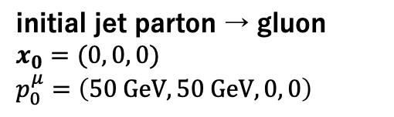




Set up of the simulation
$T_{0}=500 MeV$
$σ_{G}=0.3 fm$
$α_{s}=0.5$
Time evolution of $e_{QGP}$ with jet parton
initial jet parton → gluon
$x_{0}=(0, 0, 0)$
$p_{0}^{μ}=\left(50 GeV,50 GeV, 0, 0\right)$
jet parton
0
$$z (fm)$$
-2
medium
$$z$$
$$e (GeV/fm^{3})$$
$$y$$
$$x$$
$$@t=2.0 fm$$
Particlized by Cooper-Frye formula at “parton level”
$$y (fm)$$
F. Cooper and G. Frye, Phys. Rev. D 10, 186 (1974）
$$x (fm)$$
Notes:
this slide shows the set up the simulation that I’m going to show you the result,
in this set up, 1 gluon start to propagate as the initial jet parton of which energy and momentum in x direction are 50 GeV so moving toward right hand side in this picture,
after the jet – medium interaction, QGP medium is particlized by cooper frye formulat at parton level at time 2.0 fm
this is the movie of the sample event under this set up.
You can see that due to the recoil, number of jet parton increase and holes are generated then that induce the backreaction simoltiniously

Slide 17
Results
SOPHIA
HADRON
PHYSICS
GROUP
Notes:
I will show you results obtained in this simulation

Slide 18
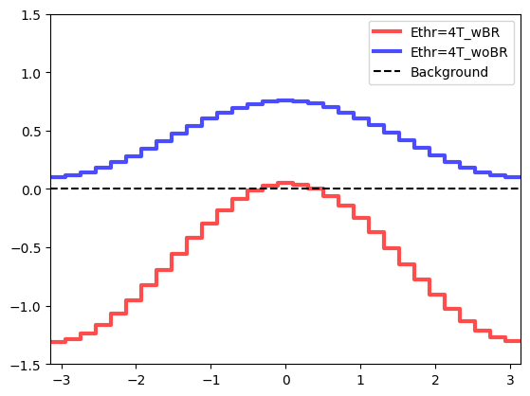







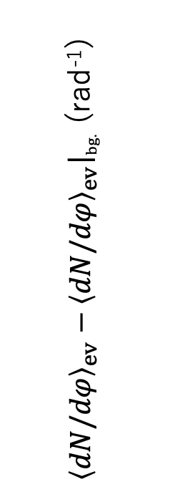
Effect of backreaction
$$y$$
Azimuthal momentum angle distribution
of medium parton
$$φ$$
$$x$$
$$φ=0$$
deposition only
$E_{thr}=4T$
w dep. & back.
initial jet parton
dep. only
$T$: local temperature
background
w. recoil
w. jet energy loss
${\left\langle dN/dφ\right\rangle }_{ev}−{\left\langle dN/dφ\right\rangle }_{ev}{\left.​\right|}_{bg.}$ (rad⁻¹)
backreaction & deposition
$φ$(rad)
Notes:
This slide shows the effect of backreaction.
This is the azimuthal angle distribution of medium parton after particlization and medium background’ destribution is subtracted.
blue line shows the case of only deposition, red line shows the case of backreaction & deposition.
but in both cases include the recoil and jet energy loss, so difference of these setting is with or without backreaction
in the case of the deposition only, azimuthal angle distribution inclueased over all and this has peak in jet parton’s direction.

Slide 19
Effect of backreaction
$$y$$
$$φ$$
$$x$$
$$φ=0$$
deposition only
$E_{thr}=4T$
w dep. & back.
initial jet parton
dep. only
$T$: local temperature
background
w. recoil
w. jet energy loss
${\left\langle dN/dφ\right\rangle }_{ev}−{\left\langle dN/dφ\right\rangle }_{ev}{\left.​\right|}_{bg.}$ (rad⁻¹)
backreaction & deposition
$φ$(rad)
Notes:
but, both backreaction & deposition case, due to the back reaction effect, we observed that dN/dφ reduce and the peak became steeper.

Slide 20
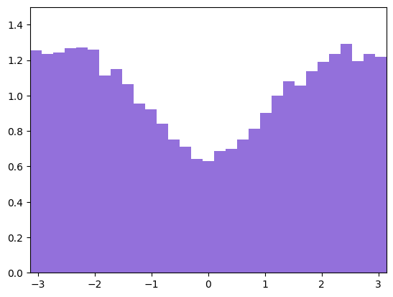


Effect of backreaction
jet parton
$$y$$
Azimuthal angle distribution
of medium parton
$$φ$$
recoiled medium parton
$$x$$
$$φ=0$$
$E_{thr}=4T$
w dep. & back.
initial jet parton
recoiled medium parton
dep. only
$T$: local temperature
background
w. recoil
w. jet energy loss
${\left\langle dN/dφ\right\rangle }_{ev}−{\left\langle dN/dφ\right\rangle }_{ev}{\left.​\right|}_{bg.}$ (rad⁻¹)
${\left\langle dN/dφ\right\rangle }_{ev}$ (rad⁻¹)
$φ$ (rad)
Scattering dynamics is crucial
to backreaction
$φ$(rad)
Notes:
we can understand this change by looking at the azimuthal distribution of recoiled medium parton
in this calculation, initial jet parton is moving toward φ= 0 direction.
when considering the collision propability, medium partons with opposite momentum direction from jet partons are more likely to scatter with jet parton and picke up from the medium due to the recoil
that’s why we observed such a recoiled medium parton distribution and that causes reduction of dN/dφ of medium parton
so scattering dynamics is crusial to backreaction.

Slide 21
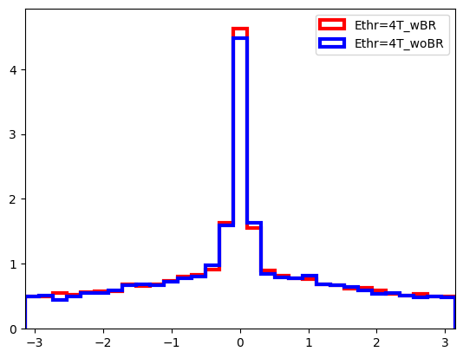
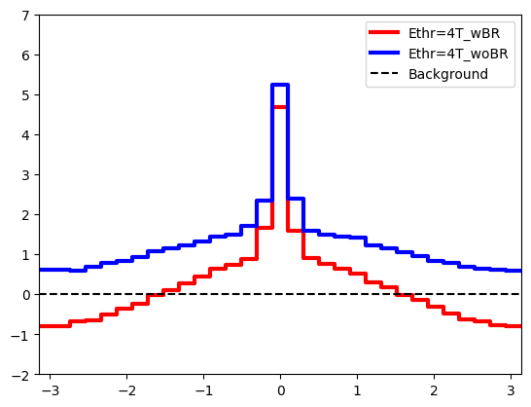
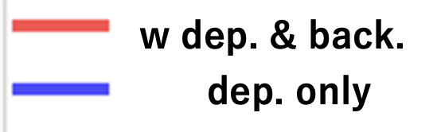
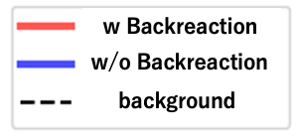




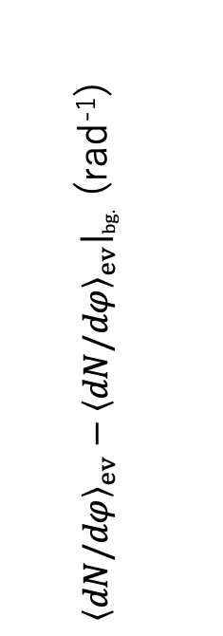

Effect of backreaction
jet parton
total（jet parton + medium paton）
$E_{thr}=4T$
$E_{thr}=4T$
w dep. & back.
dep. only
w. recoil
w. jet energy loss
w. recoil
w. jet energy loss
background
${\left\langle dN/dφ\right\rangle }_{ev}−{\left\langle dN/dφ\right\rangle }_{ev}{\left.​\right|}_{bg.}$ (rad⁻¹)
${\left\langle dN/dφ\right\rangle }_{ev}$ (rad⁻¹)
$φ$(rad)
$φ$(rad)
No significant effect by backreaction
Backreaction modifies total $dN/dφ$
Notes:
and this is the azimuthal angle distribution of the jet partons’ final state.
We found that backreaction does’nt effect jet structure significantly,
so, total azimuthal distribution summing the medium parton and jet parton
we can see the reduction due to the backreaction mostly comes from medium modification
前
のスライドを受けることを伝える。

Slide 22
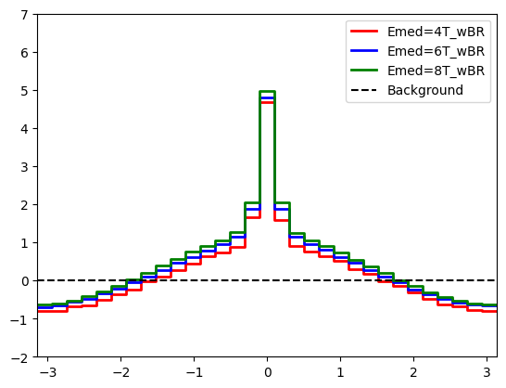
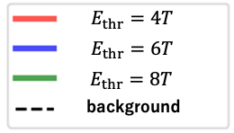
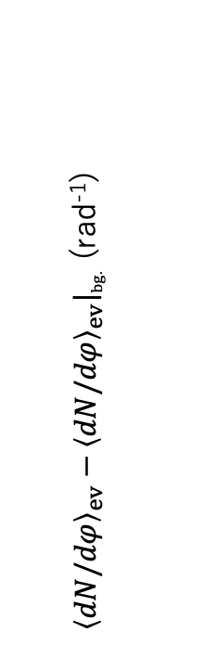



Interplay between backreaction vs deposition
$$E_{thr}=4T, 6T, 8T$$
$T$: local temperature
total（jet parton + medium parton）
${\left\langle dN/dφ\right\rangle }_{ev}−{\left\langle dN/dφ\right\rangle }_{ev}{\left.​\right|}_{bg.}$ (rad⁻¹)
$φ$(rad)
Notes:
in this slide these 3 line are obtained the under the different threshold of recoil, like threshold is 4 times Tempareture, 6 times Tempareture, and 8 times Tempareture
from this graph, we can’t see significant difference among these 3 cases

Slide 23
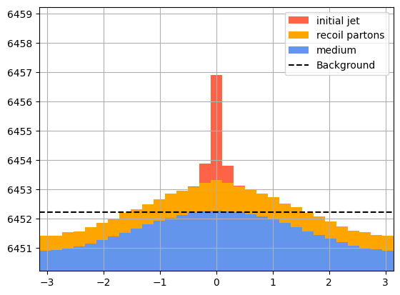
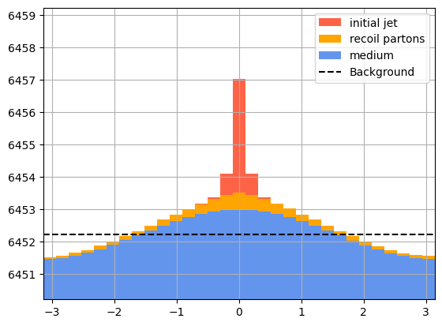






Interplay between backreaction vs deposition
$$E_{thr}=4T, 6T, 8T$$
$T$: local temperature
$$E_{thr}=4T$$
$$E_{thr}=8T$$
recoil & backreaction
recoil & backreaction
total（jet parton + medium parton）
${\left\langle dN/dφ\right\rangle }_{ev}$ (rad⁻¹)
$${\left\langle dN/dφ\right\rangle }_{ev} \text{(}\text{rad}\text{−1}\text{)}$$
${\left\langle dN/dφ\right\rangle }_{ev}−{\left\langle dN/dφ\right\rangle }_{ev}{\left.​\right|}_{bg.}$ (rad⁻¹)
$φ$ (rad)
$φ$ (rad)
Different particle ratio of jet parton to medium parton
$φ$(rad)
Notes:
but if we look at the component of initial jet parton showned as red color, recoil parton shown as orange color, and medium parton shown as blue color becomes different.
Different rate of backreaction and deposition leads to different particle ratio of jet parton and medium parton

Slide 24

Interplay between backreaction vs deposition
$$E_{thr}=4T, 6T, 8T$$
$T$: local temperature
$$E_{thr}=4T$$
$$E_{thr}=8T$$
recoil & backreaction
recoil & backreaction
total（jet parton + medium parton）
${\left\langle dN/dφ\right\rangle }_{ev}$ (rad⁻¹)
$${\left\langle dN/dφ\right\rangle }_{ev} \text{(}\text{rad}\text{−1}\text{)}$$
${\left\langle dN/dφ\right\rangle }_{ev}−{\left\langle dN/dφ\right\rangle }_{ev}{\left.​\right|}_{bg.}$ (rad⁻¹)
$φ$ (rad)
$φ$ (rad)
Different particle ratio of jet parton to medium parton
scattering
fragmentation
vs
$$f_{eq}(p, T)$$
Jet:
medium:
Different particle ratio of parton & hadron
Outlook:
$φ$(rad)
Investigate the particle ratio of hadron to constrain the backreaction picture
Notes:
So if looking at the particle ratio of hadron in this model and compare to experimental result, we can constrain which pictures is more reasonable from particle ratio of hadron.
because particle ratio of parton or hadron are determined from different mechanism between jet and medium
So, as a outlook of this study we will investigate that the particle ration of parton & hadron after including hadronization to understand the precise picture of backreaction & deposition

Slide 25
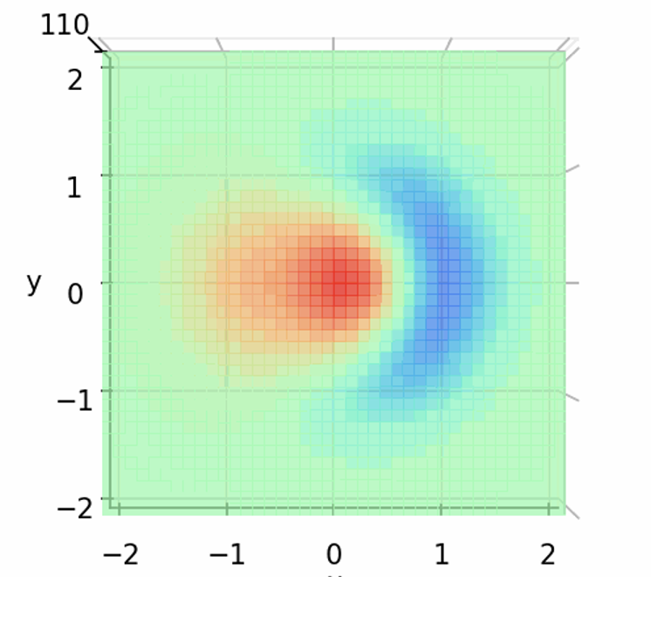
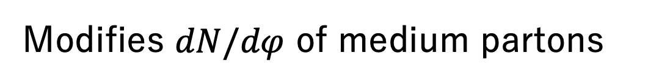


Summary and outlook
We introduced hydrodynamic equation with “negative” source term
to describe the backreaction of QGP dynamically
Movement of hole and wake behind the hole
Hole
Scattering dynamics is crucial to backreaction
Modifies $dN/dφ$ of medium partons
$$y (fm)$$
Outlook
$$x (fm)$$
Use PYTHIA for initial jet partons & analyze the jet structure function
Include backreaction to Dynamical Core-Corona Initialization (DCCI)
to compare with experiment
Y. Kanakubo et al., Phys. Rev. C 105 , 024905 (2022)
Notes:
let me summarize my talk
in this study,
we obserbed
we found that

Slide 26
Back up
Notes:
Uを大文字にする。Universityのところ。

Slide 27
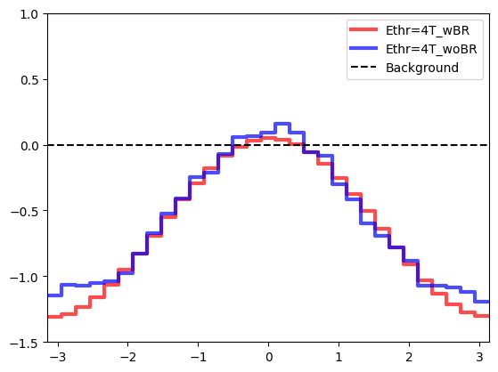
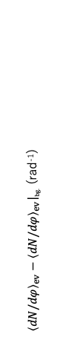


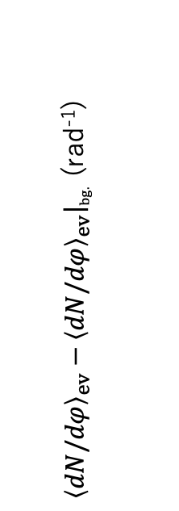




Dynamical hole effect
Subtracted
= only deposition ー recoiled medium parton
Azimuthal angle distribution
${\left\langle dN/dφ\right\rangle }_{ev}$ (rad⁻¹)
medium
w Backreaction
${\left\langle dN/dφ\right\rangle }_{ev}−{\left\langle dN/dφ\right\rangle }_{ev}{\left.​\right|}_{bg.}$ (rad⁻¹)
Subtracted
ー
background
${\left\langle dN/dφ\right\rangle }_{ev}−{\left\langle dN/dφ\right\rangle }_{ev}{\left.​\right|}_{bg.}$ (rad⁻¹)
Azimuthal angle $φ$ (rad)
Azimuthal angle $φ$ (rad)
interference of holes?
$$N_{1 hole}=−1$$
$$N_{1 hole}≠−1$$
$$≠$$
Azimuthal angle $φ$ (rad)
→more analysis is necessary

Slide 28
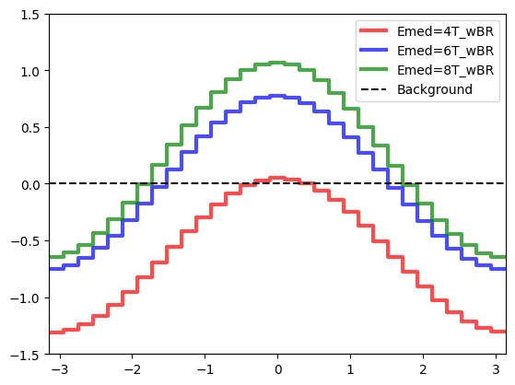
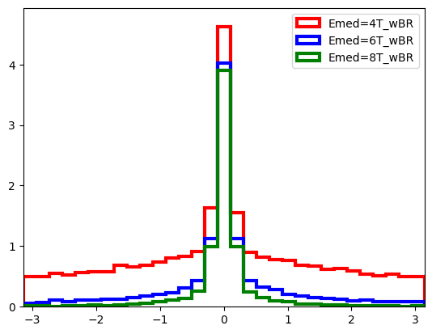
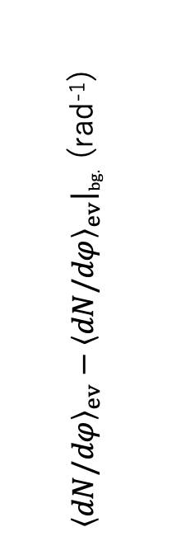



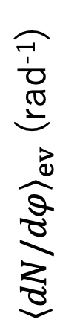


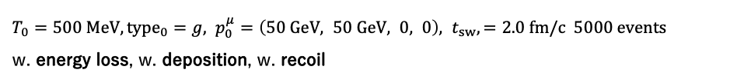

Threshold of recoil $E_{thr}=4T,6T,8T$
Setting:
$T_{0}=500 MeV, {type}_{0}=g, p_{0}^{μ}=\left(50 GeV, 50 GeV, 0, 0\right), t_{sw},=2.0 fm/c 5000 events$
w. energy loss, w. deposition, w. recoil
medium partons
jet partons
w. Backreaction
$$E_{thr}=4T$$
w. Backreaction
$$E_{thr}=6T$$
$$E_{thr}=8T$$
background
${\left\langle dN/dφ\right\rangle }_{ev}−{\left\langle dN/dφ\right\rangle }_{ev}{\left.​\right|}_{bg.}$ (rad⁻¹)
${\left\langle dN/dφ\right\rangle }_{ev}$ (rad⁻¹)
Azimuthal angle $φ$ (rad)
Azimuthal angle $φ$ (rad)
$E_{thr}$ → the effect of deposition , backreaction

