Slide 1
BDF Trolley
Roller skates
Jean-Louis Grenard, Christophe Mucher - CERN
18-8-2023

Slide 2
Context
New target station for a new experiment
Time frame:
  Project approval 2024
  Detail engineering 2022 -> 2026
  Mock-up installation ~2027
  Final installation ~2029

Slide 3
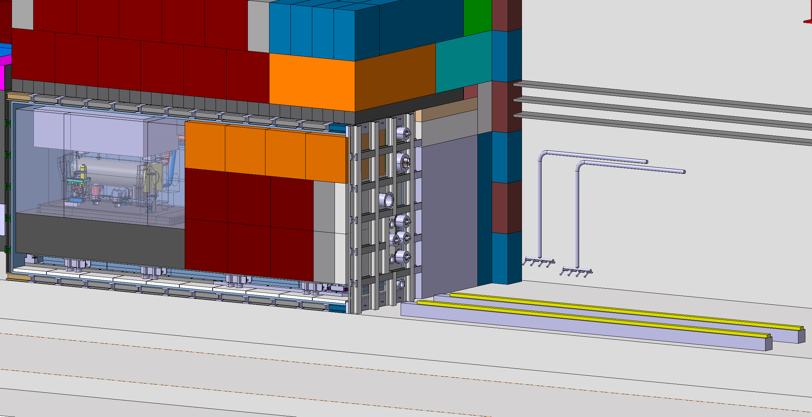
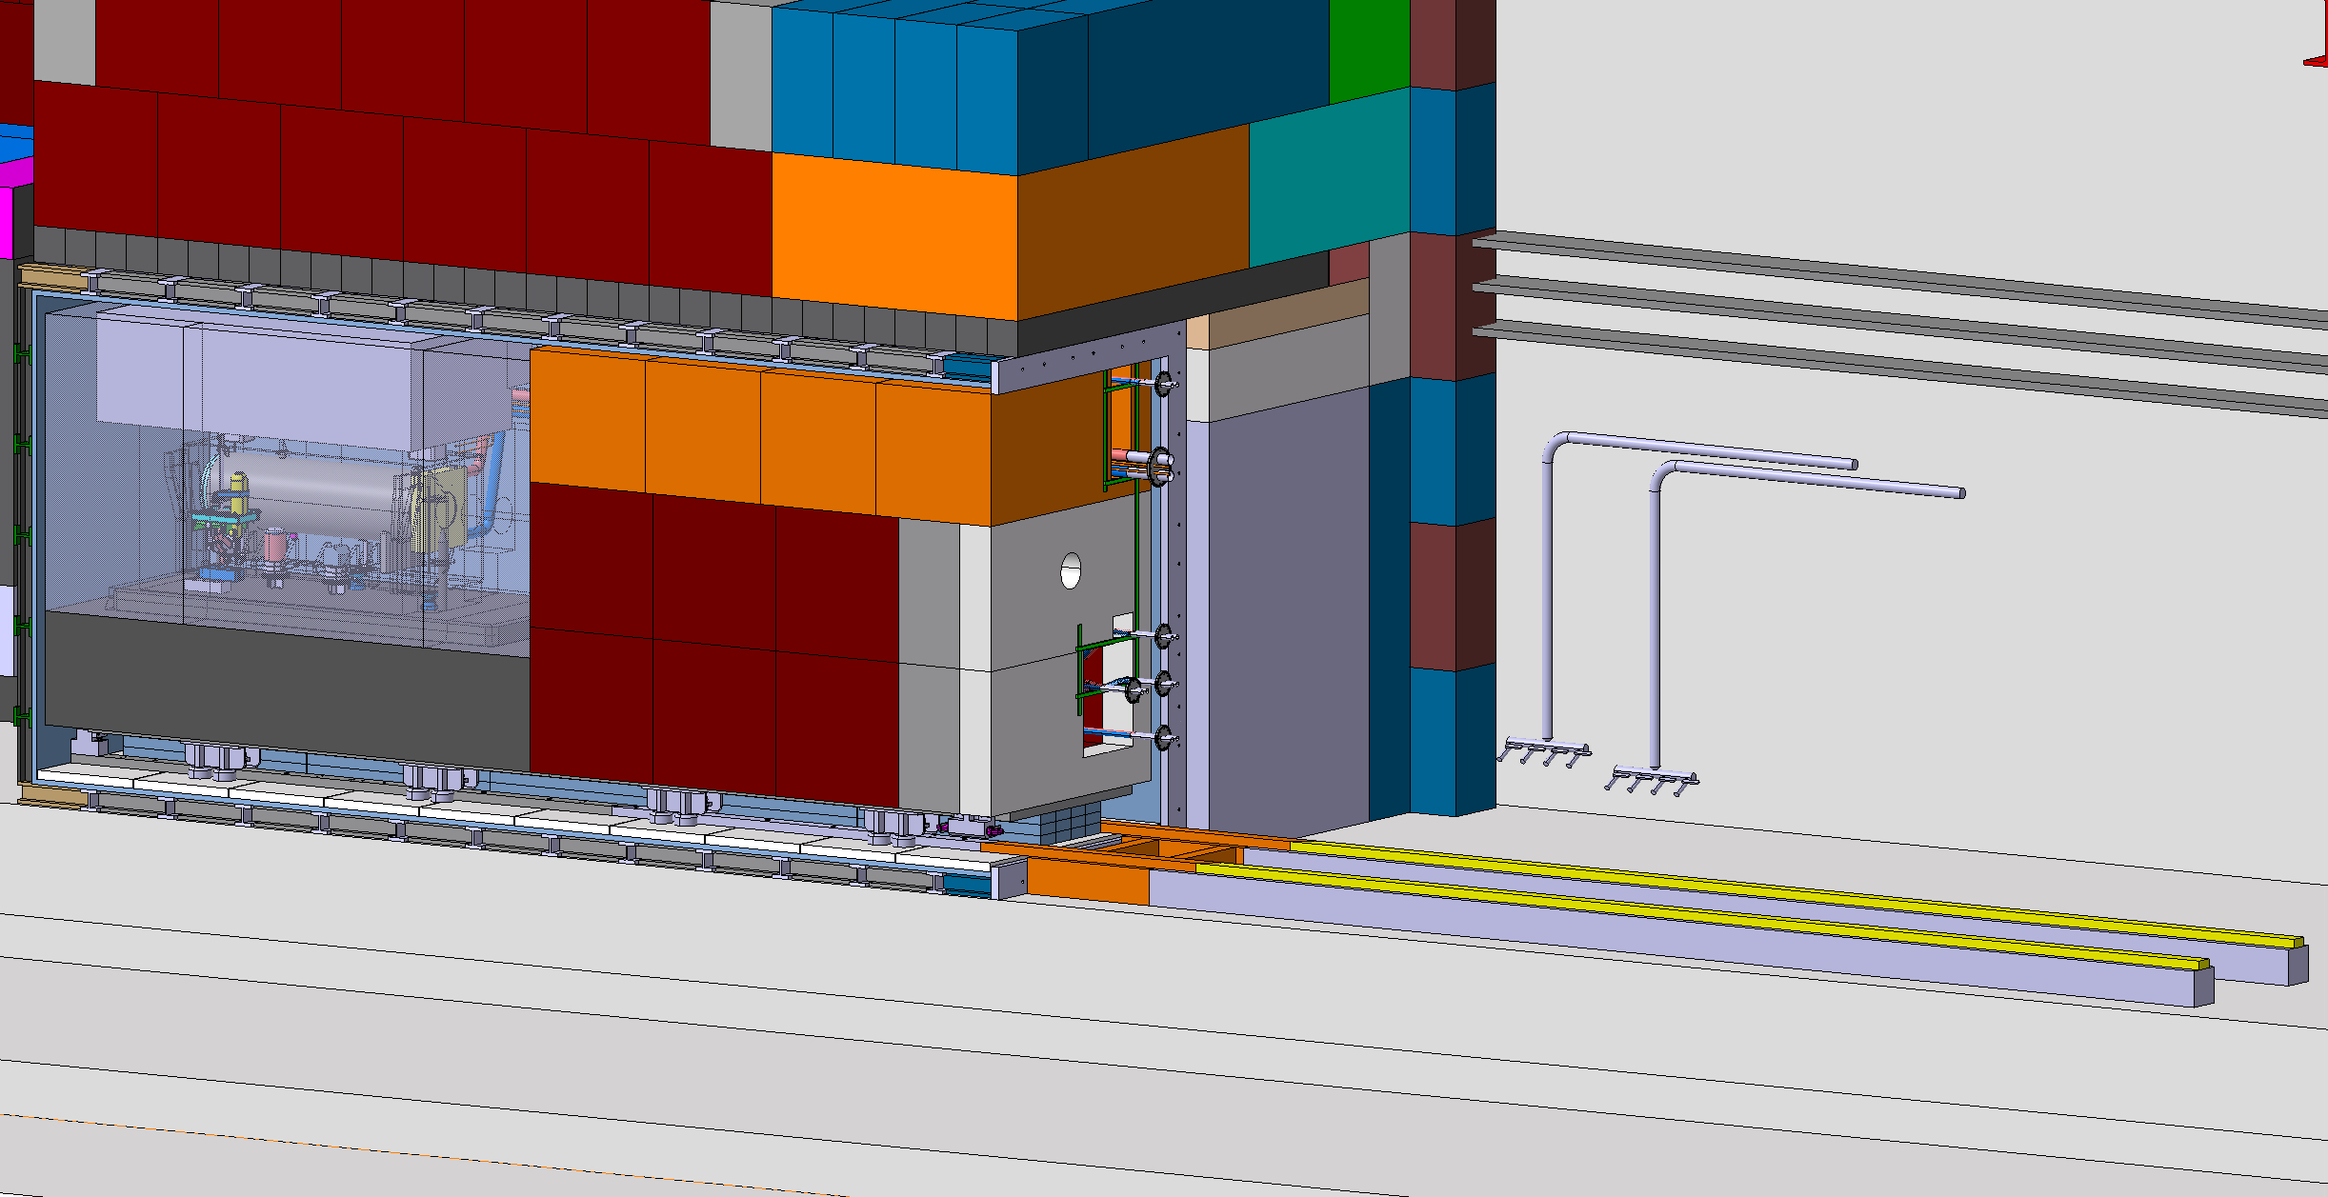
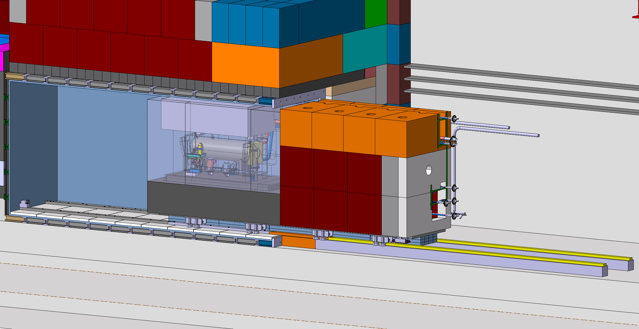
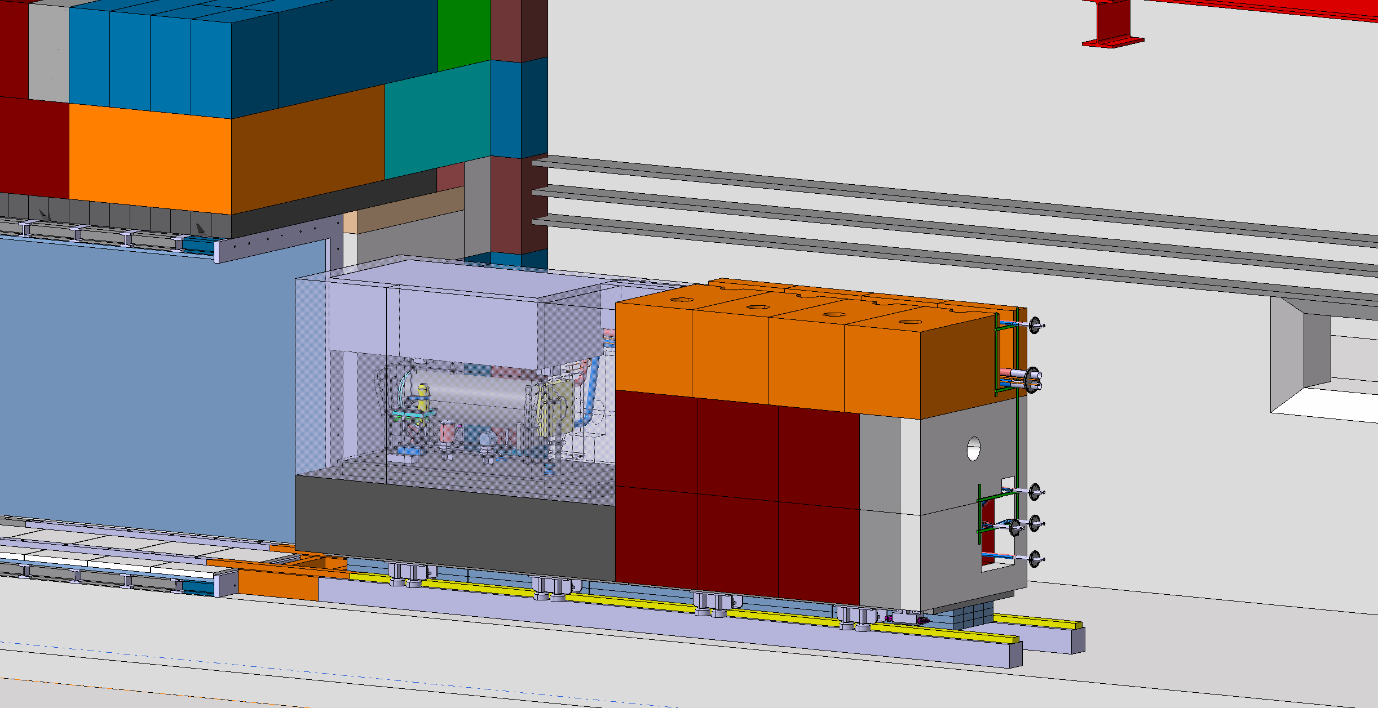
Trolley
~3m
~6m
~1m

Slide 4
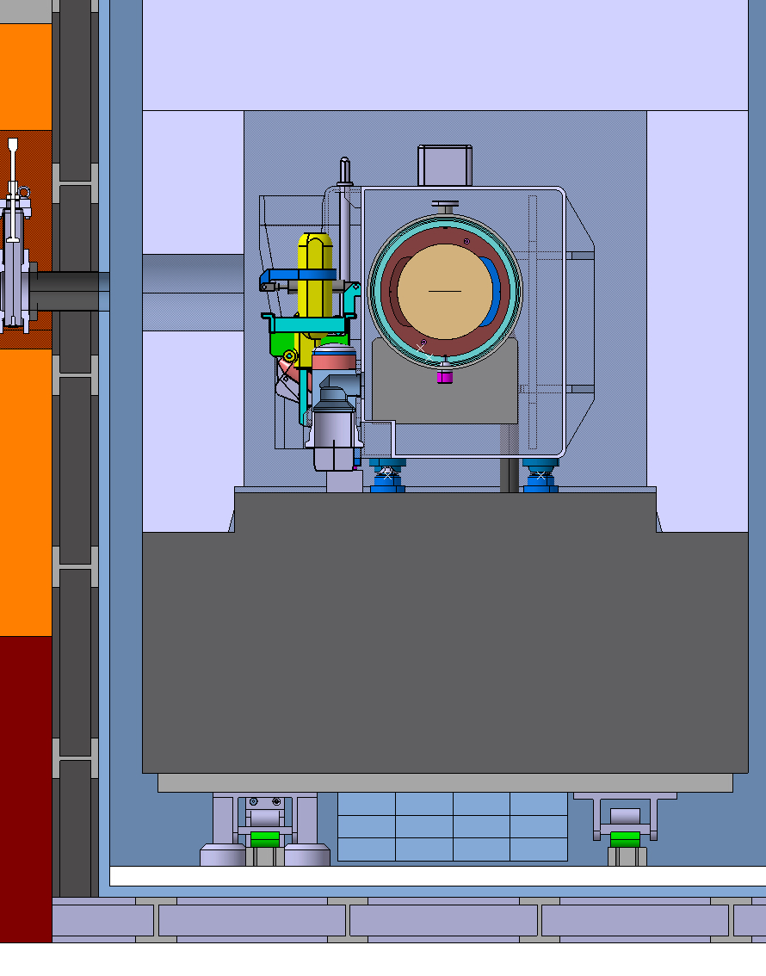
Trolley – constrains
During operation in primary vacuum
During maintenance in an industrial environment (possibly some dust)
Potential presence of water (in case of a water leak)
High level of radiation MGy
  No plastics
Total weight to be moved ~200t

Slide 5
List of questions
Do you have full stainless-steel constructions?
Any typical application of full stainless-steel design?
If we would like to buy a prototype do you have an existing design?
  Qualification within our environment
What mechanical tolerances could you achieve with your design?
Are they bearings on the guide wheels?
What are the requirement (hardness, tolerances) for the rails?

