Slide 1
6th International Workshop on New Photon-Detectors
Applications Session
Ultra-Low Resource Time-to-Digital Converter for PET TOF Systems Achieving Sub-10 ps Resolution Using LUT-Based Counter on FPGA
Daehee Lee¹, Ian Hwang², Sun Il Kwon¹
Department of Biomedical Engineering, UC Davis, California, USA
Baskin School of Engineering, UC Santa Cruz, California, USA
November 21, 2024

Slide 2
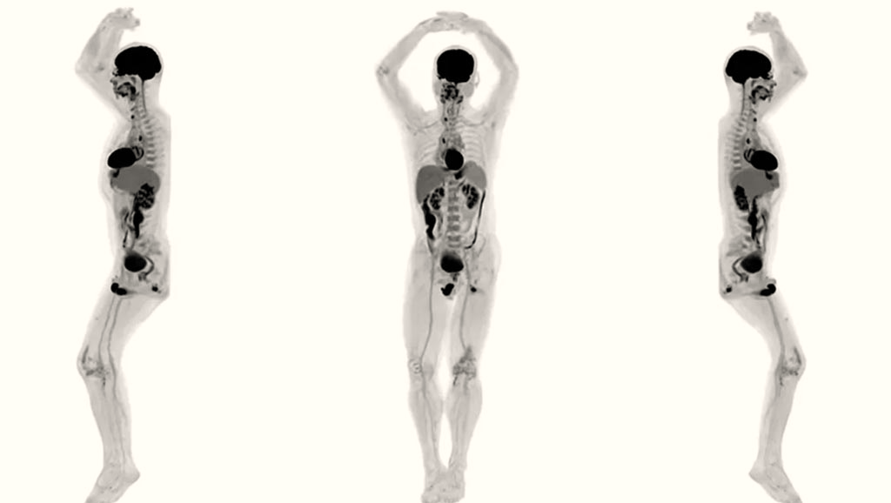
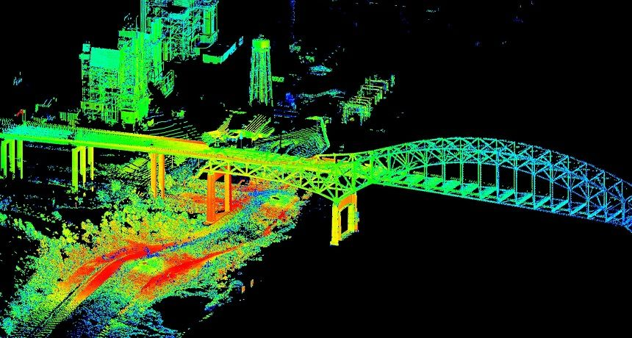
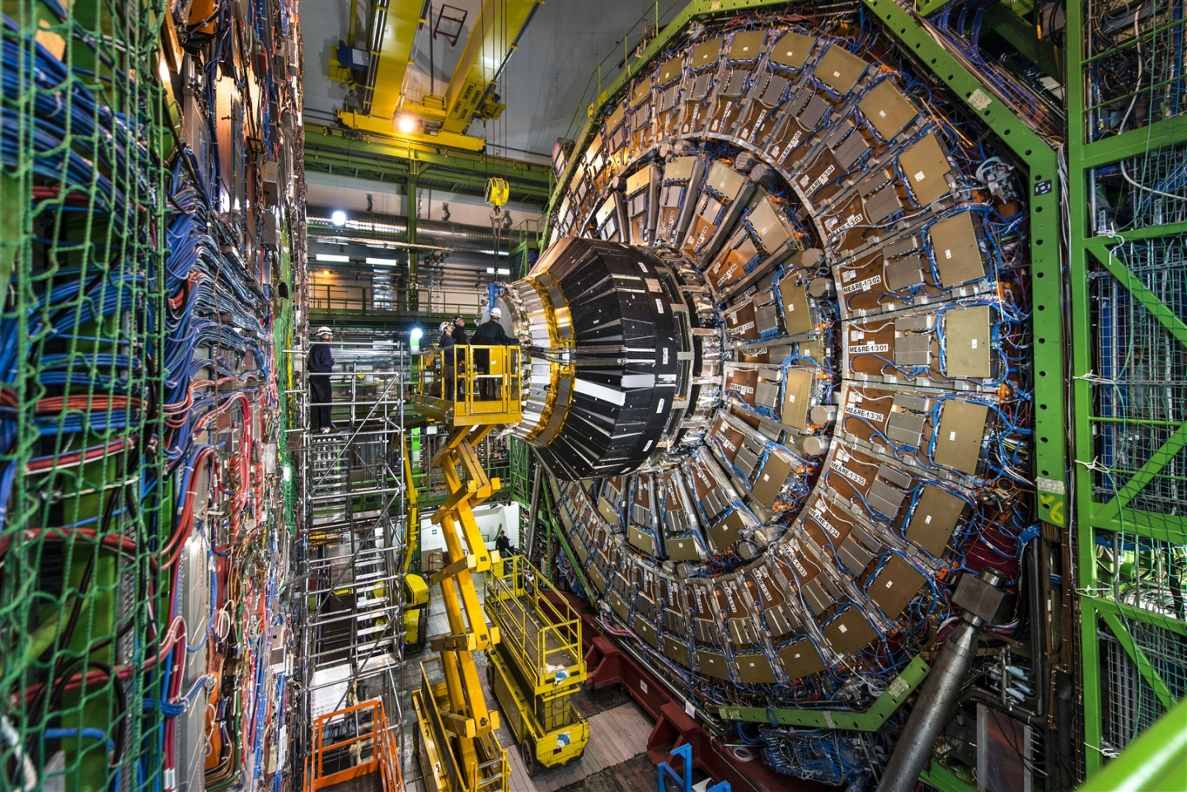
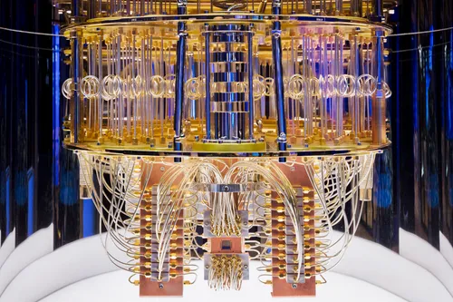
1. Time-to-Digital Converter
Time-to-Digital Converters (TDCs)
are electronic circuits that digitize continuous time values into discrete digital values.
Medical Field
Industry
Total-body TOF PET, uExplorer
LiDAR
Physics
Computing
LHC cern
IBM Quantum System One
1

Slide 3
1. Time-to-Digital Converter
Time-to-Digital Converters (TDCs)
are electronic circuits that digitize continuous time values into discrete digital values.
TDC applications
Medical Field
Industry
Total-body TOF PET, uExplorer
LiDAR
Physics
Computing
LHC cern
IBM Quantum System One
1

Slide 4
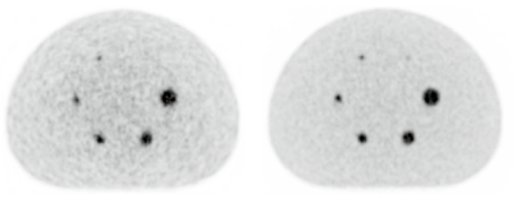

1. Time-to-Digital Converter
Time-of-flight Positron Emission Tomography
NON-TOF PET
TOF PET
*LOR: Line of Response
*D: Diameter
Noise
Coincidence Time Resolution (CTR)
T_{Right}
Source
D
LOR
T_{Left}
T_{Left}
T_{Right}
FWHM
Scintillator
Sensor
$$∆x=\frac{c×CTR}{2}$$
Siemens Biograph mCT (PET/CT), 2019
2

Slide 5
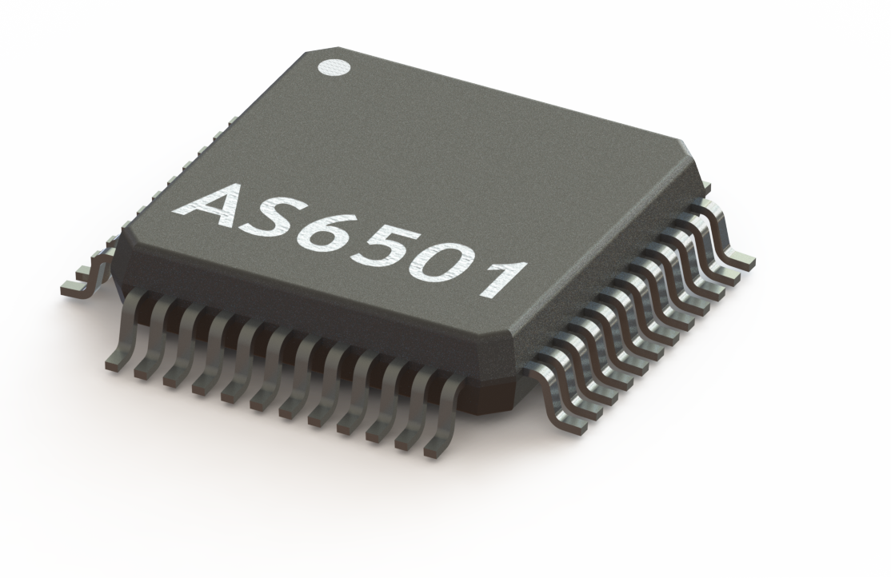

1. Time-to-Digital Converter
Application-specific Integrated Circuit (ASIC) vs. Field-programmable Gate Array (FPGA)
FPGA-based TDC
Feature | ASIC | FPGA
Purpose | Fixed function | Reconfigurable
Performance | High | Moderate
Power | Low | High
Flexibility | Low | High
Development cost | High | Low
Unit cost | Low | High
Time to market | Long | Short
Logic density | High | Moderate
Tapped Delay Line
+
Coarse Counter
Phased Clocks
Differential
Pulse shrinking
Rui Machado et al., (2019)
3

Slide 6
1. Time-to-Digital Converter
Tapped Delay Line (TDL) with CARRY4
TDL
CLB N
A CLB is crucial for fast signal propagation and TDL implementation.
CO3
DFFs
MUX
1 0
D Q
C3
1
O3
Thermometer codes
CARRY4
CO2
C0 - C1 - C2 - C3 - C4 …
MUX
1 0
D Q
C2
1
O2
1 - 0 - 0 - 0 - 0 …
Clock
CO1
MUX
1 0
1
O1
D Q
C1
CO0
MUX
1 0
1
O0
D Q
C0
CLB N-1
CLB 0
TIME_{IN}
4

Slide 7
1. Time-to-Digital Converter
Tapped Delay Line (TDL) with CARRY4
TDL
CLB N
A CLB is crucial for fast signal propagation and TDL implementation.
CO3
DFFs
MUX
1 0
D Q
C3
1
O3
Thermometer codes
CARRY4
CO2
C0 - C1 - C2 - C3 - C4 …
MUX
1 0
D Q
C2
1
O2
1 - 0 - 0 - 0 - 0 …
1 - 1 - 0 - 0 - 0 …
Clock
CO1
MUX
1 0
1
O1
D Q
C1
CO0
MUX
1 0
1
O0
D Q
C0
CLB N-1
CLB 0
TIME_{IN}
4

Slide 8
1. Time-to-Digital Converter
Tapped Delay Line (TDL) with CARRY4
TDL
CLB N
A CLB is crucial for fast signal propagation and TDL implementation.
CO3
DFFs
MUX
1 0
D Q
C3
1
O3
Thermometer codes
CARRY4
CO2
C0 - C1 - C2 - C3 - C4 …
MUX
1 0
D Q
C2
1
O2
1 - 0 - 0 - 0 - 0 …
1 - 1 - 0 - 0 - 0 …
1 - 1 - 1 - 0 - 0 …
Clock
CO1
MUX
1 0
1
O1
D Q
C1
CO0
MUX
1 0
1
O0
D Q
C0
CLB N-1
CLB 0
TIME_{IN}
4

Slide 9
1. Time-to-Digital Converter
Tapped Delay Line (TDL) with CARRY4
TDL
CLB N
A CLB is crucial for fast signal propagation and TDL implementation.
CO3
DFFs
MUX
1 0
D Q
C3
1
O3
Thermometer codes
CARRY4
CO2
C0 - C1 - C2 - C3 - C4 …
MUX
1 0
D Q
C2
1
O2
1 - 0 - 0 - 0 - 0 …
1 - 1 - 0 - 0 - 0 …
1 - 1 - 1 - 0 - 0 …
1 - 1 - 1 - 1 - 0 …
1 - 1 - 1 - 1 - 1 …
Clock
CO1
MUX
1 0
1
O1
D Q
C1
CO0
MUX
1 0
1
O0
D Q
C0
CLB N-1
Average timing resolution with CARRY4 is
~10 ps (Virtex-7 series, Xilinx).
CLB 0
TIME_{IN}
4

Slide 10
1. Time-to-Digital Converter
Tapped Delay Line (TDL) with CARRY4
TDL
CLB N
A CLB is crucial for fast signal propagation and TDL implementation.
CO3
DFFs
MUX
1 0
D Q
C3
1
O3
Thermometer codes
CARRY4
CO2
C0 - C1 - C2 - C3 - C4 …
MUX
1 0
D Q
C2
1
O2
1 - 0 - 0 - 0 - 0 …
1 - 1 - 0 - 0 - 0 …
1 - 1 - 1 - 0 - 0 …
1 - 1 - 1 - 1 - 0 …
1 - 1 - 1 - 1 - 1 …
Clock
CO1
MUX
1 0
1
O1
D Q
C1
CO0
MUX
1 0
1
O0
D Q
C0
CLB N-1
Average timing resolution with CARRY4 is
~10 ps (Virtex-7 series, Xilinx).
CLB 0
TIME_{IN}
Average timing resolution with CARRY8 is
~5 ps (Ultrascale series, Xilinx).
4

Slide 11
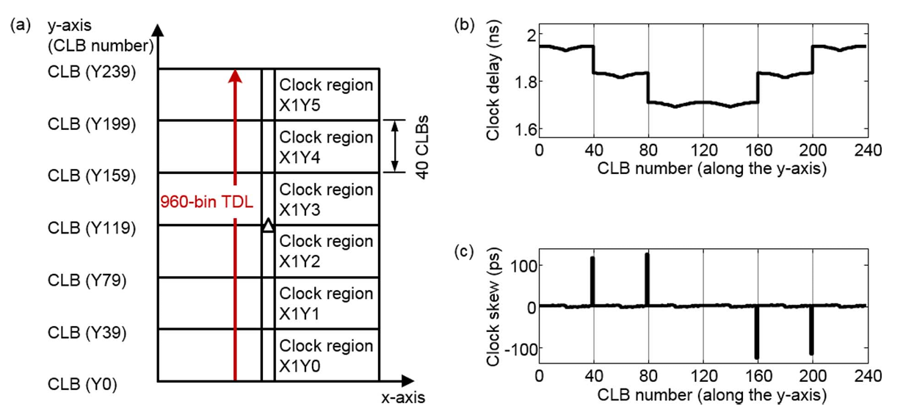
1. Time-to-Digital Converter
Tapped Delay Line (TDL) with CARRY4
Jun Yeon Won et al, 2016
FPGA-based TDC
Tapped Delay Line
+
Coarse Counter
Phased Clocks
Differential
Pulse shrinking
Ultra bins are unavoidable due to clock region changes.
FPGA resources are limited.
➔ The smaller the resource usage, the more TDC implementations can be accommodated.
6

Slide 12
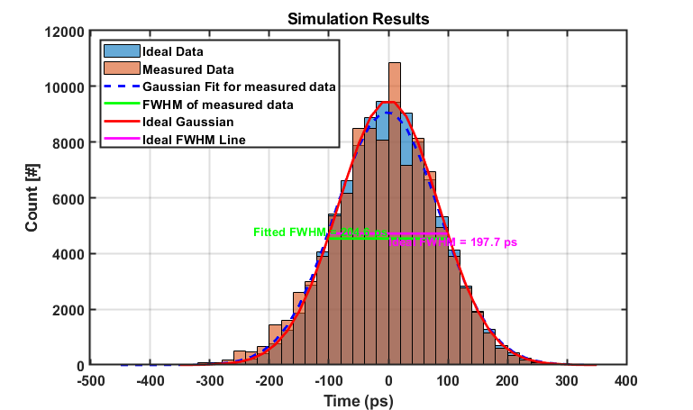
1. Time-to-Digital Converter
Tapped Delay Line (TDL) with CARRY4
Simulation results
Simulation
Average bin size 5 ps
Std 5 ps
CARRY8-based TDC
CARRY4-based TDC
Ideal FWHM: 198 ps
Measured FWHM: 205 ps
5

Slide 13

2. Proposed LUT-based TDC
Proposed LUT-based TDC
FPGA-based TDC
Clock-based Counter
LUT-based Counter
Clock Cycle
#1
#2
…
Tapped Delay Line
Coarse Counter
LUT-based Counter
Phased Clocks
#1
#2
#3
#4
#5
#6
#7
…
Differential
~250 ps
Not Synchronized to the Clock
Pulse shrinking
Low resource is required for LUT-based counter
But the average bin size is ~250 ps
7

Slide 14
2. Proposed LUT-based TDC
Proposed LUT-based TDC
FPGA-based TDC
Clock-based Counter
LUT-based Counter
Clock Cycle
#1
#2
…
Tapped Delay Line
Coarse Counter
LUT-based Counter
Phased Clocks
#1
#2
#3
#4
#5
#6
#7
…
Differential
~250 ps
Not Synchronized to the Clock
Pulse shrinking
Low resource is required for LUT-based counter
But the average bin size is ~250 ps ➔ 10 ps
7

Slide 15
2. Proposed LUT-based TDC
Schematic of the proposed LUT-based TDC
Time_{IN}
Logic
out
Clock
IN logic
Time
CLK
Time_{IN}
Time
Logic out
Time
The input logic generates a pulse when the TimeIN is enqueued
and terminates the pulse at the next clock edge.
8

Slide 16
2. Proposed LUT-based TDC
Schematic of the proposed LUT-based TDC
Time_{IN}
Logic
out
Delay
Clock
IN logic
…
Time
CLK
Time
AND
Time_{IN}
Enable
1
Enable
2
Enable
3
Enable
N
Time
Time
Logic out
Time
Enable 1
Enable signals are gradually shorten
from Enable 1 to Enable N.
Enable 2
Enable 3
…
Enable N-1
Enable N
8

Slide 17
2. Proposed LUT-based TDC
Schematic of the proposed LUT-based TDC
Time_{IN}
Logic
out
Delay
Clock
IN logic
…
Time
CLK
AND
Time_{IN}
Enable
1
Enable
2
Enable
3
Enable
N
Time
LUT-based Counter
Logic out
2-bit: 0-1-2-3
CNT 1
CNT 2
CNT 3
CNT N
LUT-based Counter Value
CNT 1
1
2
3
Enable 1
➔ #3
CNT 2
1
2
3
Enable 2
➔ #3
CNT 3
1
2
Enable 3
➔ #2
…
…
CNT N-1
1
Enable N-1
➔ #1
Bin size
Sum(All LUT-based Counters)
Enable N
8

Slide 18
2. Proposed LUT-based TDC
Schematic of the proposed LUT-based TDC
Time_{IN}
Logic
out
Delay
Clock
IN logic
…
Time
CLK
AND
Time_{IN}
Enable
1
Enable
2
Enable
3
Enable
N
Time
LUT-based Counter
Logic out
2-bit: 0-1-2-3
CNT 1
CNT 2
CNT 3
CNT N
LUT-based Counter Value
CNT 1
1
2
Enable 1
➔ #2
CNT 2
1
2
Enable 2
➔ #2
CNT 3
1
Enable 3
➔ #1
…
CNT N-1
Enable N-1
Bin size
Sum(All LUT-based Counters)
Enable N
8

Slide 19
2. Proposed LUT-based TDC
Schematic of the proposed LUT-based TDC
Ch N
…
Ch 1
MEMORY
Time_{IN}
IN logic
Logic
out
…
Delay
CLK
IN logic
CLK
…
AND
AND
CNT 1
CNT 2
CNT 3
CNT N
CNT 1
CNT 2
CNT 3
CNT N
∑
∑
9

Slide 20
3. Experiment Results
Single channel test
Total active bins: 212
2000 ps
90%
Average Bin Size: 9.4 ps
80%
STD of Bins: 10 ps
10ps
16ps
10

Slide 21
3. Experiment Results
Multi-channel Test
Linearity Test Results
FGPA board
𝛥t
CLK
11 ps
Time_{IN Ch2}
TDC ch2
𝛥t
TDC ch1
Random input
Time_{IN Ch1}
9 ps
-2 ps
-14 ps
12

Slide 22


3. Experiment Results
Temperature Test
Average bin sizes depending on temperature changes
FGPA board
Random input
CLK
TDC ch1
Time_{IN Ch1}
Average bin size is stable.
➔ No temperature correction circuit, which requires a huge resource, is needed.
13

Slide 23

3. Experiment Results
Location Test
Average bin sizes depending on location changes
FGPA board
CLK
Random input
TDC ch1
TDC ch1
TDC ch1
Time_{IN Ch1}
Average bin size is stable.
➔ No location correction circuit, which requires a huge resource, is needed.
14

Slide 24
3. Experiment Results
Experimental Setup
FGPA board
LYSO
3 x 3 x 20 mm³
CLK
LYSO
3 x 3 x 20 mm³
TDC ch2
²²Na
Time_{IN Ch2}
TDC ch1
NUV-MT (FBK)
NUV-MT (FBK)
Time_{IN Ch1}
PZ-circuit
PZ-circuit
Calculated FWHM
Osc. (sampling 40ps, interpolation) 245 ps
LUT-based TDC (10ps/10ps) 240 ps
CARRY8-based TDC (5ps/5ps) 241 ps
Ave. / STD
15

Slide 25
4. Conclusion
Resource use comparison
Utilization |  | CARRY8-based TDC | LUT-based TDC | Differences
 | CARRY8 | 102 | 2 | -100 (▼98%)
 | CLB LUTs | 837 | 404 | -432(▼52%)
 | CLB Registers | 1110 | 807 | -303(▼27%)
Power consumption comparison
Power consumption | CARRY8-based TDC | LUT-based TDC | Differences
Ch | 0.109 W | 0.006W | -0.103W(▼94%)
Reduced resource usage and lower power consumption enable the implementation of more TDC channels within a limited area.
16

Slide 26
4. Conclusion
LUT-based Time-to-Digital Converter
is successfully implemented with dramatically reduced resources
Average bin size 9.4 ps ⬅ Sub-10 ps Bin Size
is internally free from location and temperature variation
The clock-asynchronized LUT-based TDC operates in a random sequence, minimizing the impact of temperature and location variations on performance.
As a result, there is no need to implement correction circuits, which would otherwise require a significantly large amount of resources.
Next step
The LUT-based TDC still exhibits large bins (>40ps).
➔ It will be investigated to make bin size more even
17

Slide 27
Q & A
Thank you for your attention.
17

Slide 28
3. Experiment Results
Single channel test
Differential Nonlinearity (DNL) and Integral Nonlinearity (INL)
11

Slide 29
3. Experiment Results
17

