Slide 1
Welcome to PD24
Fabrice Retiere (TRIUMF)
Giacomo and Maria Adriana did most of the work
F. Retiere (TRIUMF, Chair)
G. Gallina (TRIUMF, Princeton Univ., Co-Chair)
D. Grant (SFU)
H. Lewis (TRIUMF)
K. Raymond (TRIUMF)
M. A. Sabia (TRIUMF, Sapienza)
F. Shi (TRIUMF)
R. Underwood (TRIUMF)
P. Agnes (GSSI)
P. Organtini (Princeton Univ.)
A. Jamil (Princeton Univ.)

Slide 2
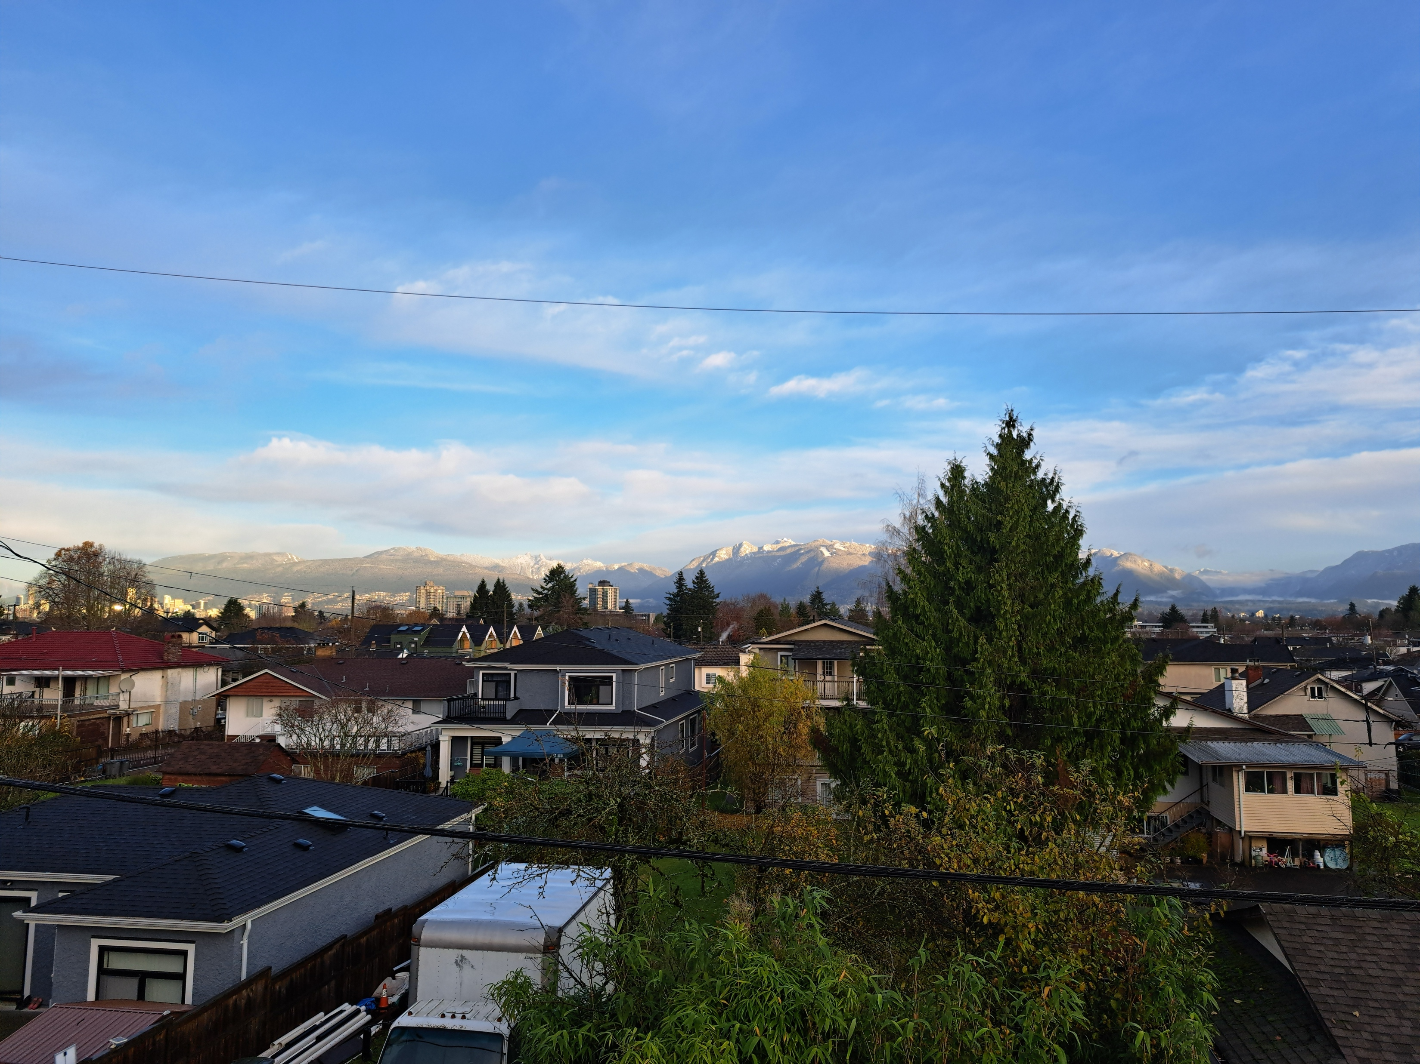
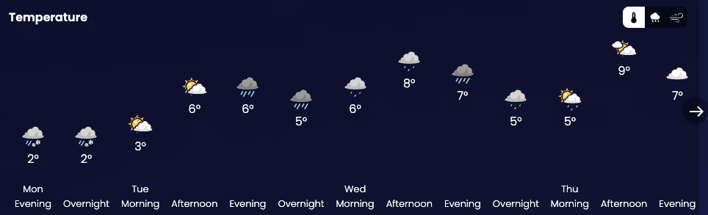
November is the worth month in Vancouver
I am happy because the temperature will stay below 8C
  Snowing on the mountains! Whistler opening on Thursday
But be mindful of the rain and opportunistic when it doesn’t
Enjoy listening to many excellent talks

Slide 3
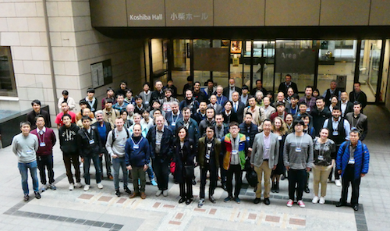
Thank you all for being back after 6 years!
University of Tokyo in November 2018
We were orphan despite
  The bari SiPM workshop in October 2019
  NDIP in July 2022 in France
  NDIP is coming back in 2025, always in France

Slide 4
Continuing the PD workshop
Competing and related events
  International SPAD sensor workshop in June in Trento, Italy
  Single Photon Workshop happening this week in Edinburgh, Scotland
  CPAD happening this week at Oak Ridge, Tennessee, USA
The community is growing outside “subatomic physics”
Consolidation of the R&D effort in Subatomic physics
  CERN DRD4 for photon detector and Particle Identification
  CPAD effort in photon detector
How to stay relevant?
  Could we consider aligning the PD workshop date with a DRD4 collaboration meeting?

Slide 5
Continuing the PD workshop
Revisiting the International Advisory Committee
  Current member, lets meet for lunch on Wednesday
Planning the next workshop in 2026
  Seeking expression of interest
  Giacomo and myself will collect requests for now
  We already have expression of interest! So, it will happen
  Our aim to finalize a choice very soon…

Slide 6
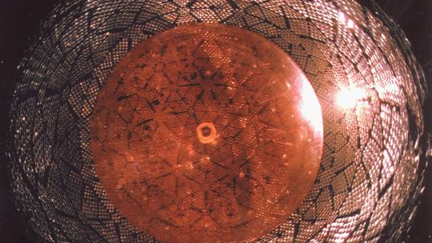
Now – a few provocative notes
Are PMT becoming obsolete?
Will JUNO be the next SNO?
Is there any way to detect light over large area without a huge price tag?
  Critical for neutrino physics and astronomy

Slide 7
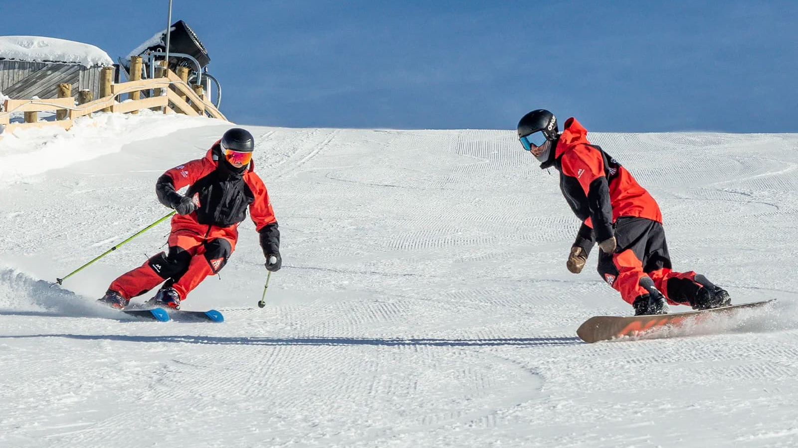
Who will win the competition for fastest timing?
SiPM
(digital)
MCP

Slide 8
Will digital SiPMs become wide-spread by 2030?
“No, they are not versatile”
  “I could not do anything with Philip’s digital photon counter”
“No, they are too pricey”
  Especially 3D integrated
“No, digital SPADs are crap”
  Most foundries over SPAD with large dark noise
Yes, they offer best performances
Yes, they offer lowest power dissipation
My answer, yes coupled with design capabilities for tailoring them
Yours?

Slide 9
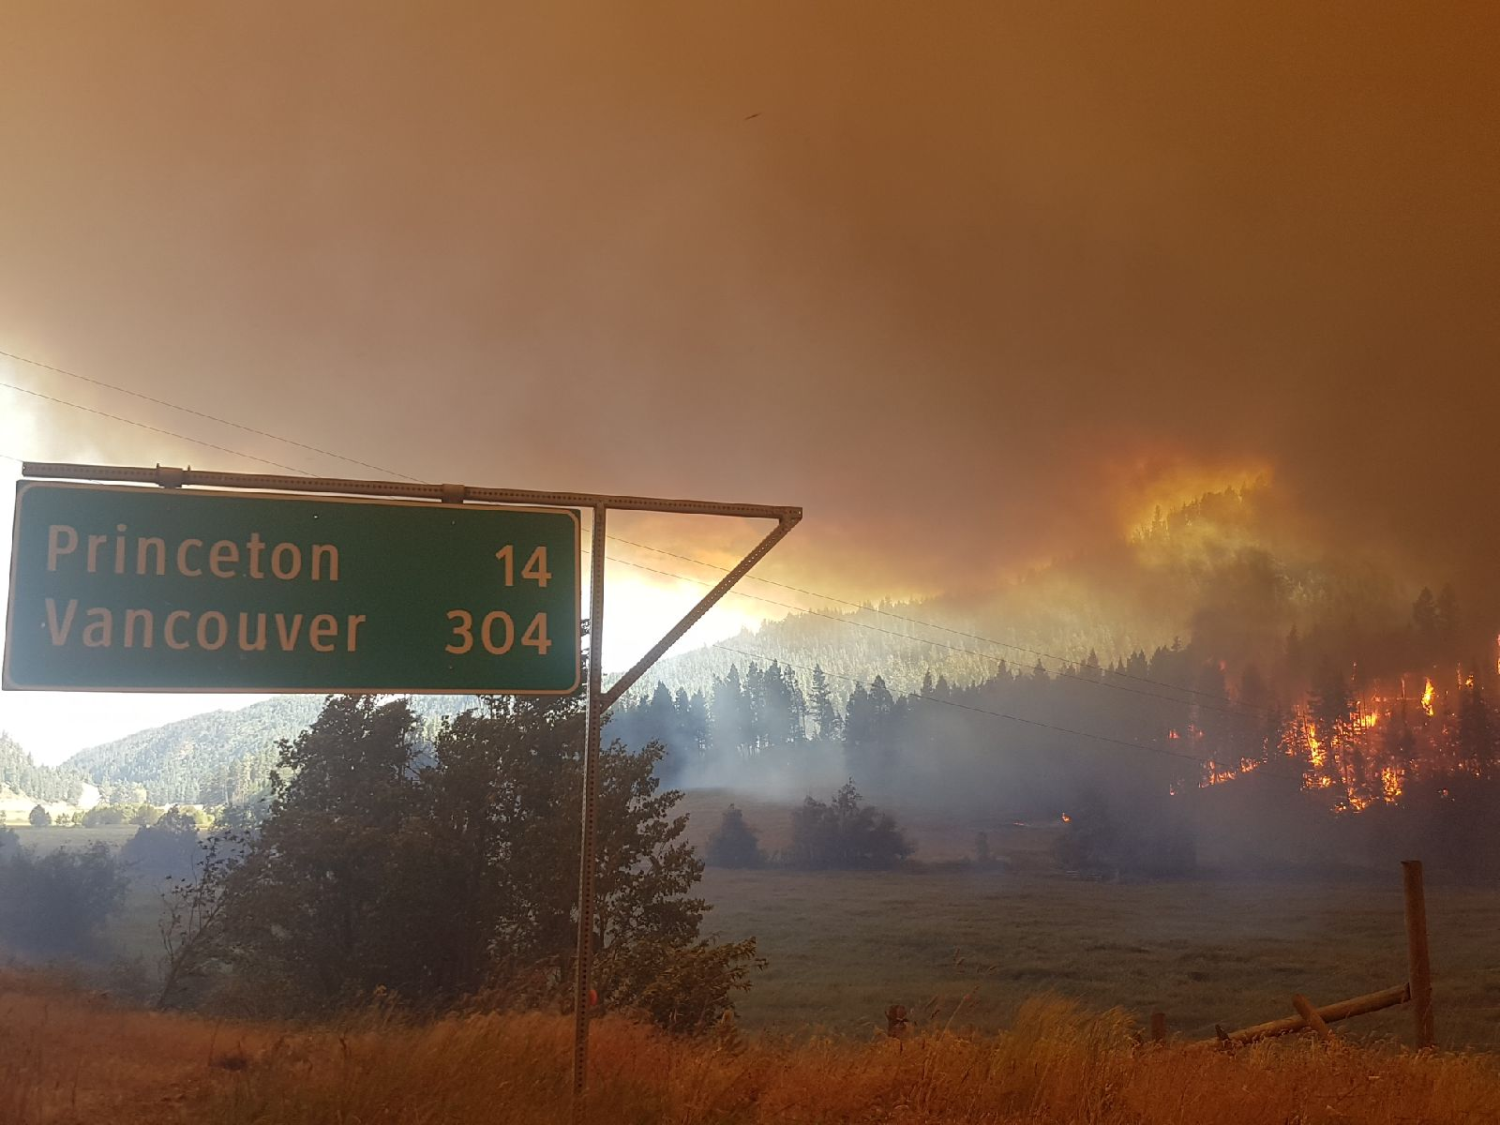
Should we venture in applications outside subatomic physics?
No
  The competition is fierce
  It is a distraction
  We are not after making money
Yes, because we have to

Slide 10
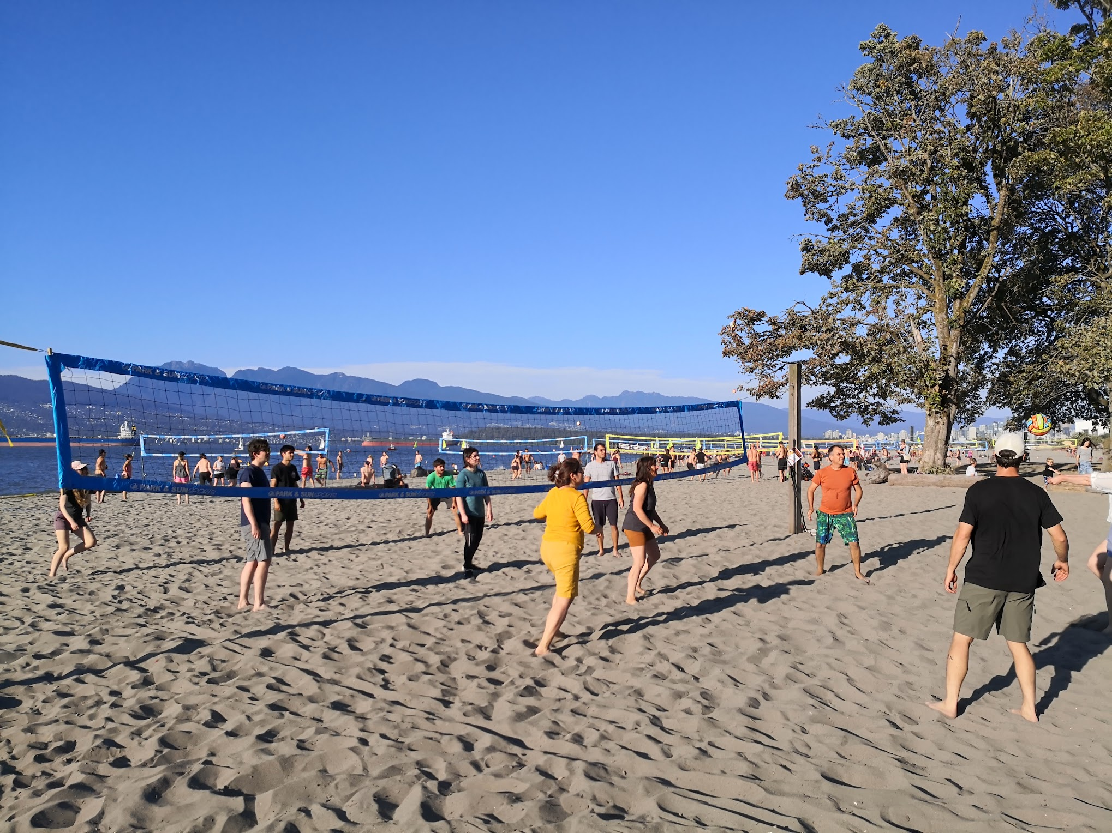
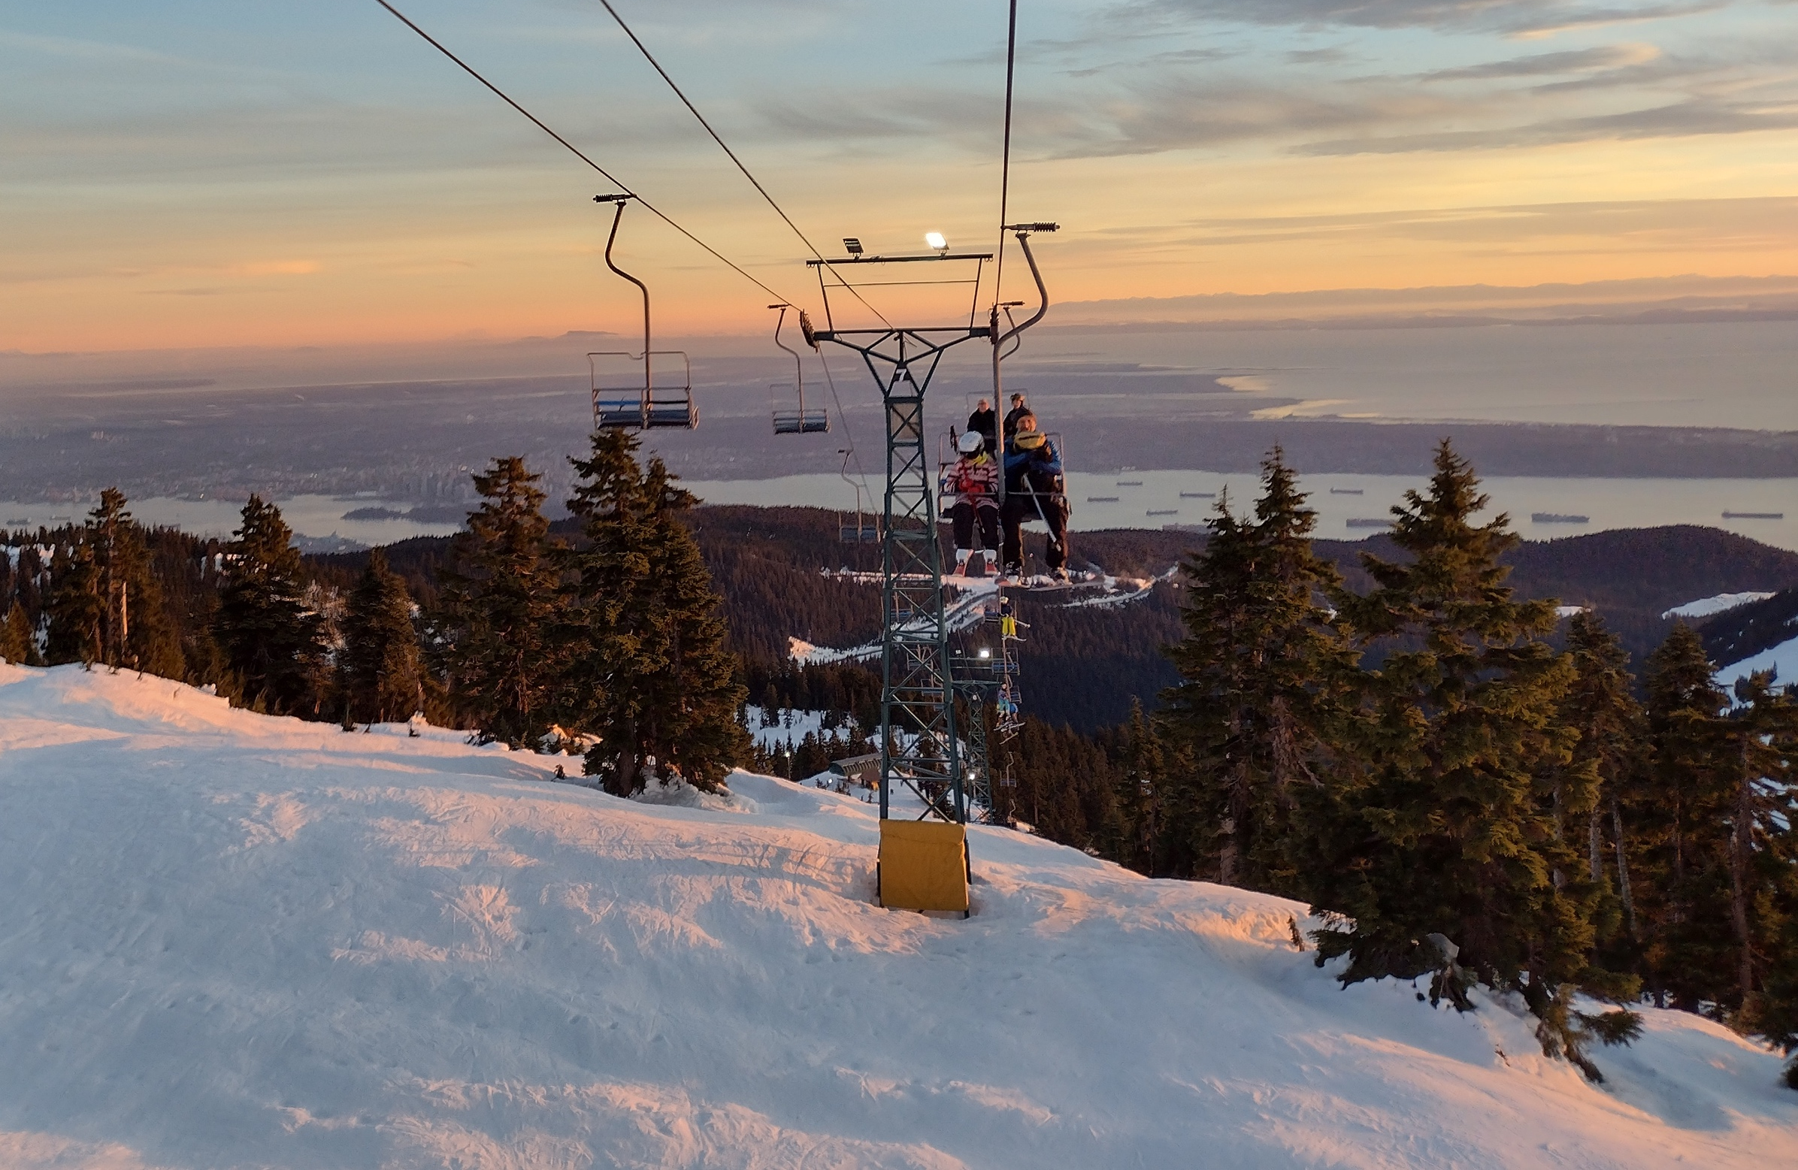
Lets start!
We need a few more junior chairs –
if you are a postdoc or student contact us
It does not always rain in Vancouver
Come back as a collaborator or member of our group

Slide 11
Back-side illuminated for everything
p+
p
p-epi
p-epi
Even dark matter search
n+
n
Poly
SiO2
100-500 um
Electron trajectories
Geiger mode avalanche
Hole trajectories
Linear avalanche
VUV – Blue photon
Charged particle
Neutron or dark matter
5-50um
Un-depleted
depleted
80um
5-20um
CMOS
CMOS
CMOS
CMOS
Front side avalanche diode
Back side avalanche diode
Extended
Ultra-thick

Slide 12
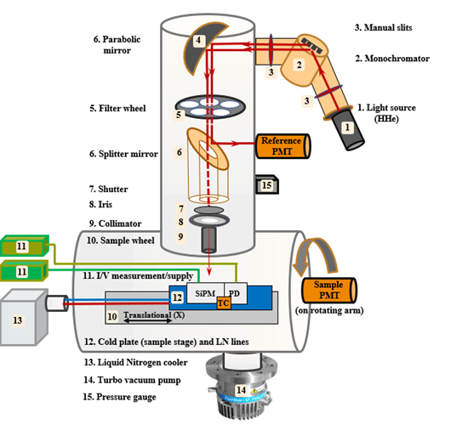
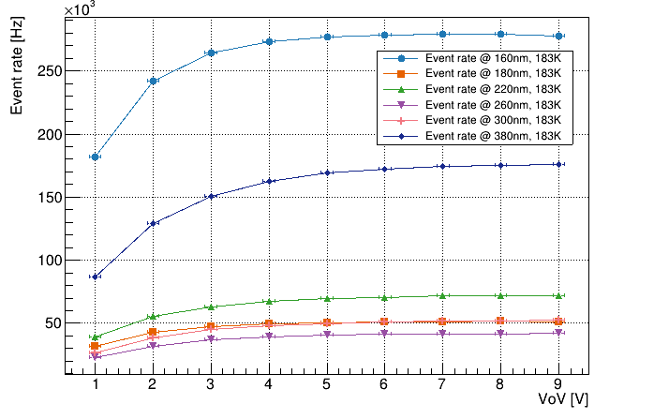
Asset: Vacuum Ultra-Violet Efficiency reflectivity and Absorption setup (VERA)
For example: inferring the number of electrons produced per VUV photon

Slide 13
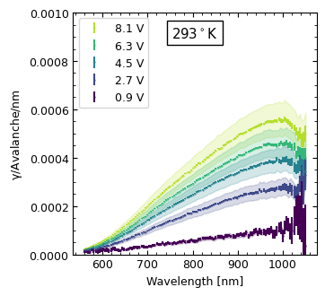
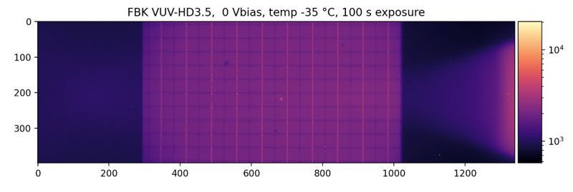
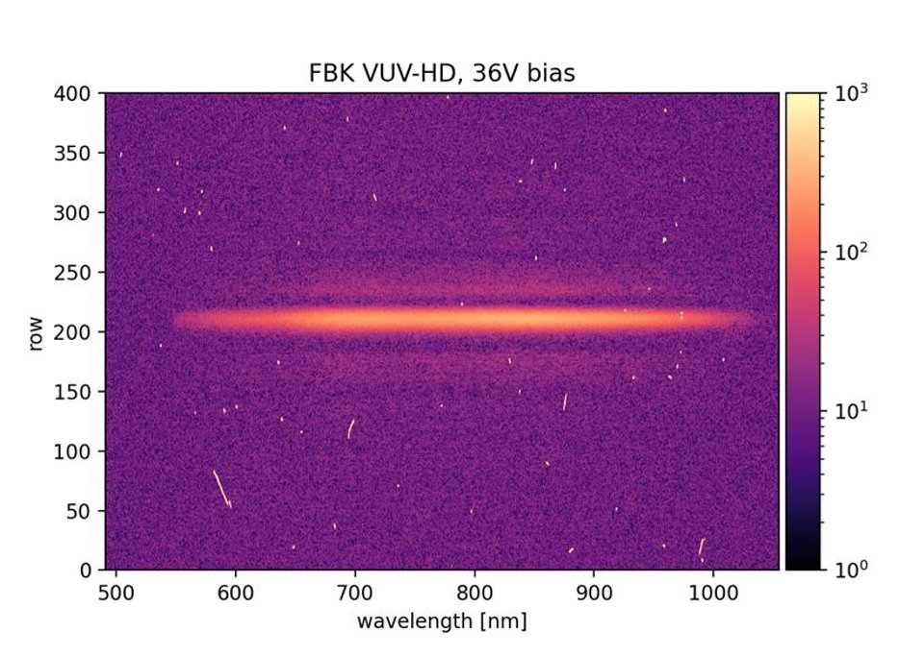
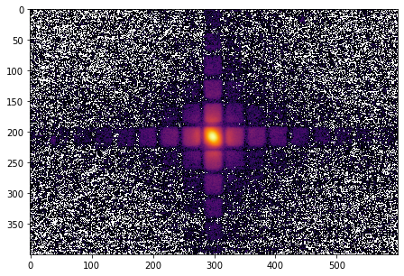
Asset: MIEL
Cooled X-Y Stage
SPAD
Vacuum Window
SiPM Surface
Vacuum Chamber
Objective
FBK Reflected Light and Laser Spot
Dichroic Mirror
Tunable laser
300 - 1500nm
Emission Filter
Emitted Light
IX-83 Microscope
Diffraction
Grating
B)
A)
Spectroscopy
Imaging
Spectrometer and Cryogenically Cooled Camera
2D Emission Map

