Slide 1
Closing PD24
Fabrice Retiere (TRIUMF)
We respectfully acknowledges the Sḵwx̱wú7mesh Úxwumixw (Squamish), səl̓ilw̓ətaʔɬ (Tsleil-Waututh) and xʷməθkʷəy̓əm (Musqueam) peoples on whose traditional, unceded territories the Vancouver campus resides.

Slide 2
Special thanks
The International Advisory Committee for helping make the workshop happen
Darren Grant (SFU) and the Simon Fraser University team for all the behind the scene work
The abstract review team led by Paolo Agnes (Gran Sasso Science Institute)
All the pictures by Paolo Organtini (Princeton Univ.)
Maria Adriana Sabia (TRIUMF, Sapienza) for managing the agenda, the tour,...
M. Walzcak (Gran Sasso Science Institute) with help from Seraphim Koulosousas (Royal Holloway University London) for the audio/video
Everyone from the TRIUMF team to help on short notice
And Giacomo Gallina (TRIUMF, Princeton Univ., Co-Chair) for everything else

Slide 3
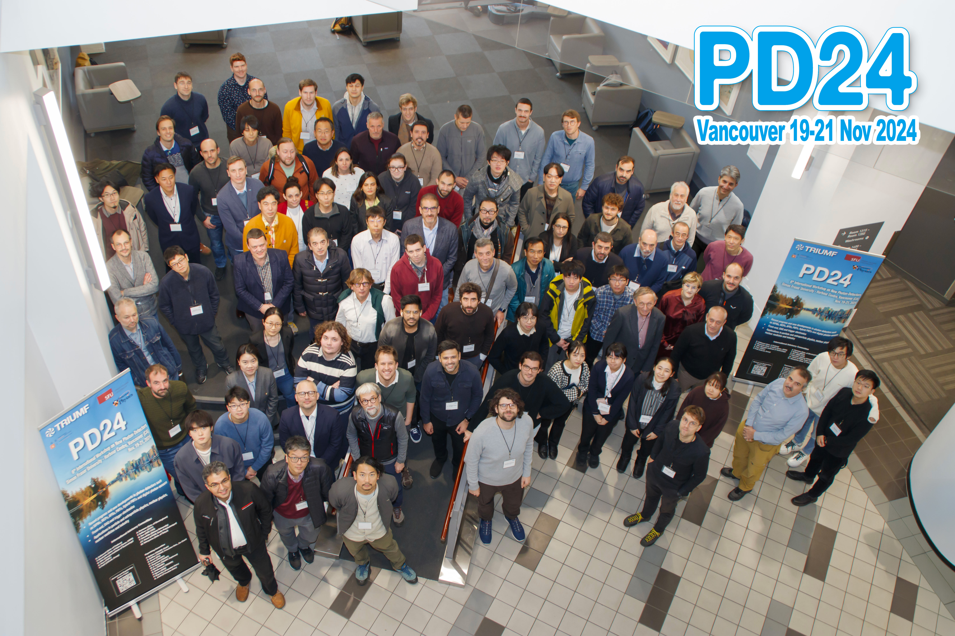
Many thanks to all attendees

Slide 4
Posters
I was very impressed by the quality of the posters
This is the sign of a healthy community!

Slide 5
The need for single photon detectors is stronger than ever
Many contributions. Sorry for not citing names
”Standard model” particle physics – now and in the future
  From CMS, from HPD to “rad-hard” SiPMs
  Electron-Ion Collider + ALICE, Quantum Chromo-Dynamics with many SiPMs
  LHCB low light fast timing. Playing out the SiPM – MCP competition
  Future colliders, conceptual stage development, rad hard and high performance
  Low energy applications continue to bring new challenge, e.g. Liquid Xenon calorimeter for MEG
Neutrino and dark matter
  It is exciting to see JUNO about to turn on. HyperK is around the corner and sometime soon DUNE
  New concepts for very large area detectors, Dichroicon, ASIC,… Digital Hybrid Photo-detector?
  Noble liquid detectors drive need for Vacuum UV light detection, with low power dissipation even in HV floating condition (nEXO, DarkSide, DUNE)
Astronomy, neutrinos, cosmic ray, gamma ray
  In-space astronomy and new camera type
  No air-shower and neutrino astronomy contribution at this workshop but I am expecting, we will hear back
Many non-subatomic physics application
  Medical imaging, neutron detection,…

Slide 6
SiPM radiation damage
The current status – Y. Musienko
  Performances degrade a lot
    Dark noise is the main issue
  Detector with large signals can survive. M. Wayne
  Annealing helps
  Hamamatsu’s SiPM appear to sustain radiation damage a bit better than FBK’s
The path forward. A. Gola et al.
  Lowering the gain – lowering the maximum electric field
    Reduce dark noise
  Lowering the temperature. E. Rivera et al.
    Dark noise start lower
  Focusing the light with lenses

Slide 7
PMT & MCP – what is new?
PMT – when low dark noise is required and timing is moderately demanding
  Comprehensive overview talk by S. Qian
  JUNO + HyperK are in the commissioning/construction phase – quite a few talks and posters
  Next? Neutrino astronomy (P-ONE, IceCUBE, Km3Net?)
MCP – when low dark noise and fast timing is required
  MCP + Anode + electronics integration is major effort – T. Conneely, L. Ma
  Timing achieve in the 10-20ps Single Photon Timing Resolution

Slide 8
Electronics – new ASICs
Analog Photon Processor for PMT – J.Klein
Wide range of development at Fermilab and many other labs – P. Rubinov
LightPix for large number of channels – S. Greenberg
CAEN + WEEROC and others providing complete solutions – M. Locatelli

Slide 9
Optics and photonics
Dichroicon – Josh Klein (Penn)
Macro lenses – Guido Haefeli (EPLF)
Meta lenses – (M. Garcia Peris, U. Manchester - poster)
“Photonic” communication by modulating light - James Sinclair (SLAC) and Paul Rubinov (Fermilab)
My view: with advent of simulation software and photonic fabs, it is a field that will expand

Slide 10
New material for photo-detection
Selenium – compelling for UV and can be adjusted for visible
GaN – focus on UV and VUV
GaN photo-cathode for HPD
Diamond as a scintillator

Slide 11
SiPM – Many new development with still not well understood feature
Progress showed by Hamamatsu, FBK and RayQuant
Question marks
  Burst
  Efficiency in liquid Xenon – T.Iwamoto
  Temperature dependence of efficiency – S. Borden (poster)
Advancing models
  Photon detection efficiency modeling. Austin de Ste Croix
  Timing response. Seraphim Kolousousas

Slide 12
Digital SiPMs
Peter Fischer showed that monolithic digital SiPM can deliver high performances. But where to make them?
  Lfoundry / Sparc is most common – N. D’ascenzo, R. Dolenek, RayQuant
  Global foundry in the US – P. Rubinov
  Fraunhofer IMS has lowest dark noise but being phased out – P. Fischer
  Other unknown options: TSMC (Taiwan), AMS (Austria), X-fab (Germany), STMicroelectronics + some in China
  We should compare the various options
Is 3D/2.5D a best way forward?
  Great progress at Sherbrooke (G. Lessard) and FBK (A. Gola)
  Separate SPAD chip for CMOS chip but require chip to chip integration
  Single Photon timing resolution for single SPADs about 20ps

Slide 13
Towards PD26
Prediction 1. digital SiPMs will be used in SAP applications at the next PD in 2026
  Digital SiPMs will make most analog SiPM obsolete by 2030
  At least for the group that can pool resources to custom design chip for each application
Prediction 2. digital SiPM will overtake MCP for SPTR
  Unless MCP integrated on silicon succeed
Prediction 3. digital Hybrid Photo-Detector will get to the proof of concept stage
Prediction 4. There will be a full session about photonic and non-linear optics (3D AR structures,…)

Slide 14
Towards PD26 – For digital SPAD lovers…
Medium under test
Human body (A Dalla Mora)
Air – smoke/fluorescence
Water
…
There is a wealth of opportunities
Customize digital SPAD for requirement
Embed light source
Use entangled photons?
Find new applications…
Light source
Digital SPAD

Slide 15
Look towards PD26 and PD27
The International Advisory Committee met at lunch time. Addition of new members:
  Shiva Abbaszadeh (UC Santa Cruz, RDC2, new materials)
  Nicola D’ascenzo (Huazhong University of Science, China, digital SiPM, medical imaging)
  Massimiliano Fiorini (INFN Ferrara, DRD4, BSI SiPM, MCP)
  Roxanne Guenette (U. Manchester, DRD2, noble liquid)
  Guido Haefeli (EPFL Lausanne, SiPM for tracker, LHCB)
  Josh Klein (U. Pennsylvania, PMT, neutrino)
We agreed to organize PD26 and PD27 assuming that NDIP happens in France in 2025 (to be confirmed)
We received several proposals for next PD. We are proposing to have PD26 in Italy (venue to be selected) and PD27 tentatively in China organized by IHEP. We look forward to JUNO results after 2 years of operation!

Slide 16
Farewell
And enjoy the TRIUMF tour tomorrow morning
You will see: TRIUMF general, VERA, MIEL, PMT Testing Facility, Neutron spectrometer proto

