Slide 1

MuCol
4th Governing board
Financial aspects (14.05.2024)
Laura Gina DALLA PALMA
CERN

Slide 2
Expenses: general rules
To be considered eligible for the EU, expenses must be:
Actual : they must be real and not estimated, budgeted or imputed and they must be declared under on of the budget categories (Annex 2);
Incurred by each beneficiary. Supporting documents proving the payment of the costs by the beneficiaries must be kept for all costs and for up to five years after the payment of the balance;
Incurred during the duration of the project (01.03.2023 – 28.02.2027) with the exception of costs relating to final reports and CFS;
Determined according to the usual accounting and management principles and practices of each organisation, identifiable and verifiable and comply with national law on taxes, labour and social security;
Used for the sole purpose of achieving the objectives of the project and its expected results, in a manner consistent with the principles of economy, efficiency and effectiveness;
Recorded in each beneficiary accounts.

Slide 3
Non-eligible expenses
costs that do not comply with the conditions set out above Article 6.1 to 6.4 of the GA, ex.
  provisions for future losses or debts; interest owed; doubtful debts;
  currency exchange losses; bank costs charged by the beneficiary’s bank for transfers;
  excessive or reckless expenditure;
  deductible VAT;
  costs incurred outside the project duration or during suspension of the implementation of the action;
  Expenses not linked to the action (mobile phone and related invoices, language courses, printers, paper…….).
costs declared under another EU or Euratom grant (no double funding)

Slide 4
Keeping records
General Information about the beneficiary :
  Beneficiary legal registration
  Organisation chart
  List of all other EU funding received (last 5 years)
  List of projects running
  Certified accounts ….
Unit costs ? Adequate records and supporting documentation to prove the number of units declared
Actual costs ? Contracts, subcontracts, invoices, accounting records….
Supporting documents for personnel costs
  Employment contract
  Beneficiary internal guidelines for time recording + timesheets
  Collective labour and job descriptions
  Payroll / salary slips for all personnel involved in the action
  Proof of payment ….
Supporting documents for travel costs
  List and dates of events/trips/conference + link to the action
  Agenda, participant list
  Authorised travel request forms
  Underlying documentation (original invoices(bus, taxi, hotel…) , minutes of the meeting, facilities reservations, boarding cards if printed, link to presentation

Slide 5
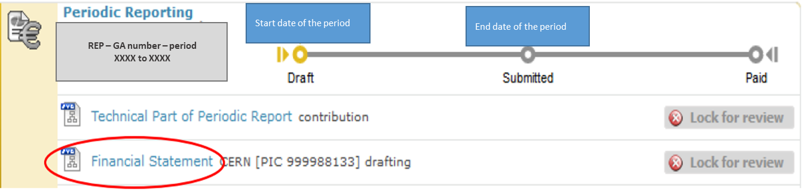
Reporting to the EU
When ?
  At the end of each reporting period as stated in the GA (RP1 01.03.2023 – 28.02.2025 + 60 days and RP2 01.03.2025 – 28.02.2027 + 60 days)
What ?
  Financial Statement
  Technical Period report
  Certificate on Financial Statement (end of the project)
Who ?
  Persons working on the project and Scientist in charge
  External Grants Section (for CERN)
  External Auditor if thresholds reached

Slide 6
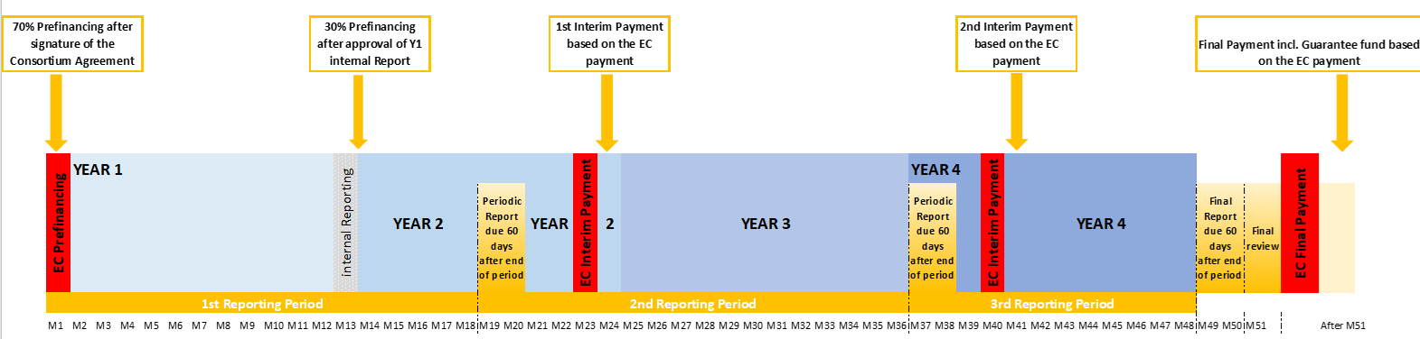
Payments procedures
EC payments as per the Grant Agreement
Coordinator payments as per the Consortium Agreement
Example:

Slide 7
IRUS vs Financial Report
IRUS
Financial report
Estimated expenses
No need of official supporting documents
Purpose : distribution of the remaining 30% of prefinancing (as agreed in C.A)
Consumption of the project costs incurred during the period
Records of supporting documents
Purpose: performance of the project against the original planning AND perception of the interim payment from EC

Slide 8
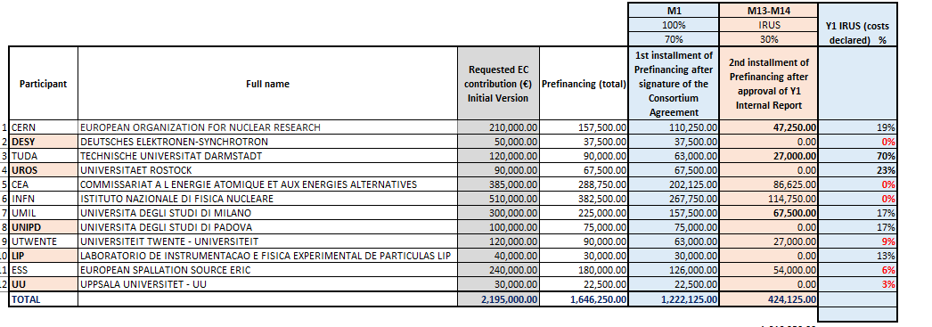
IRUS

