Slide 1
Performance of the cooling system is worse than hoped for.→ Need to increase beam power. → Need mature concept for the ESPP in 03/2025
How to start ?
Rui Franqueira Ximenes et al. (SY-STI-TCD)

Slide 2

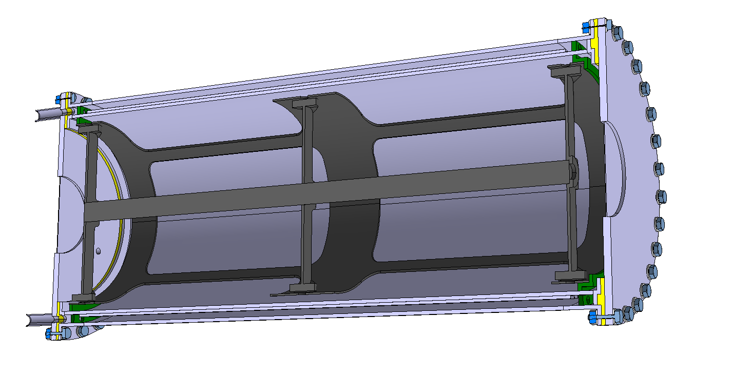
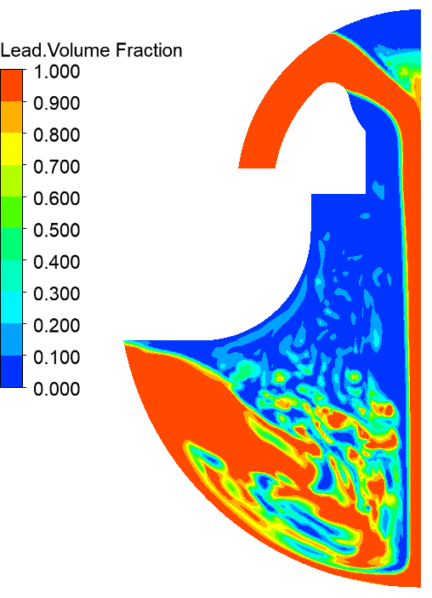
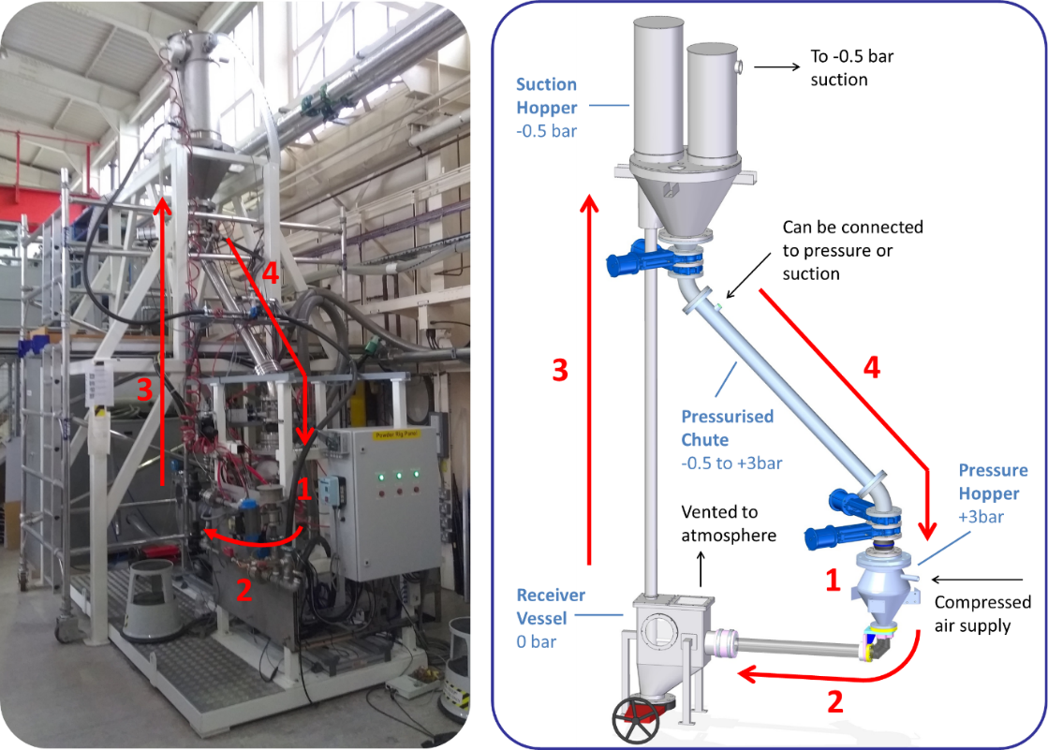
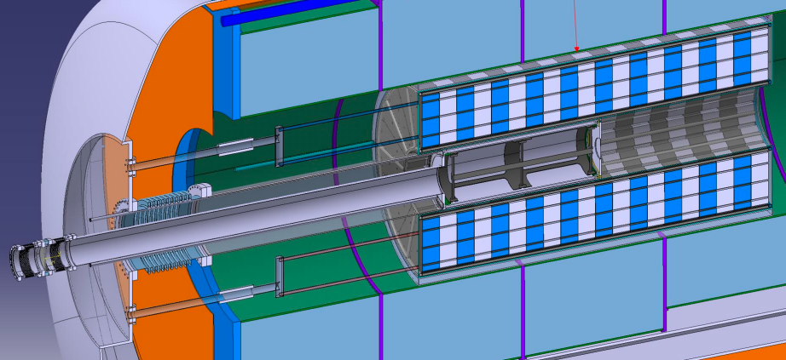
Targetry options
CERN leading C-Target system studies & liquid-Pb option with ENEA. RAL & Warwick University leading fluidized W option. → C-Target is baseline with 2 MW
C-Target & target system
CERN
Liquid Pb Target
ENEA & CERN
Fluidized W-Target
RAL & Warwick Uni.
R. F. Ximenes, M. Calviani, D. Calzolari, A. Lechner, F. Saura, J. Manczak, C. Mucher et al
C. Carrelli, M. Tarantino, I.Di Piazza, P.C. Puviani et al.
C. Densham, J.J. Back, W. Bishop, D. Wilcox, et al.

Slide 3
C-Target >2MW
First fine tune up to what power the current concept can go (reduce safety margins)
Possible “easy improvements”
Thermal shock
Higher pulse frequency to reduce pulse thermal shock
Larger beam spot size
High temperature
Change baseline of the cooling from indirect cooling to direct cooling (e.g. like T2K)
Target system constrain
Shielding requirements to increase. Larger solenoids. More expensive.

Slide 4
Targetry options
Pb-Liquid Target
Opportunities
Known liquid-Pb / LBE thermo-hydraulics
Cooling outside vacuum chamber.
Radioisotopes mostly retained.
No degradation of target material.
Synergies between different projects at CERN such as FCCee.
Challenges
Liquid-Pb containment vessel and windows (material, temperatures, DPA).
MHD interaction.
Cavitation-induced erosion.
Temperature and dynamic effects.
Dynamic multi-phase flow simulation complexity
Conceptual designs
Pipe flow.
Vertical curtain.
Jet stream.
C. Carrelli, M. Tarantino, I.Di Piazza, P.C. Puviani et al.

Slide 5
Targetry options
W-Fluidized Target
Advantages
No cavitation, corrosion, radiochemistry damage.
High thermal-shock resistance.
Heat removal.
Challenges
Erosion management & powder handling.
Reduced experience in operational facilities
Offline tests at RAL & HiRadMat beam test
Test rig built and operated at Rutherford Appleton Laboratory from 2009-2018
C. Densham, J.J. Back, W. Bishop, D. Wilcox, et al.
Response of various size spherical tungsten particles to 2x10¹¹ p+ at HiRadMat (CERN)

Slide 6
Many thanks!
Special thanks to Francisco and his key contributions these last 3 years ☺

Slide 7
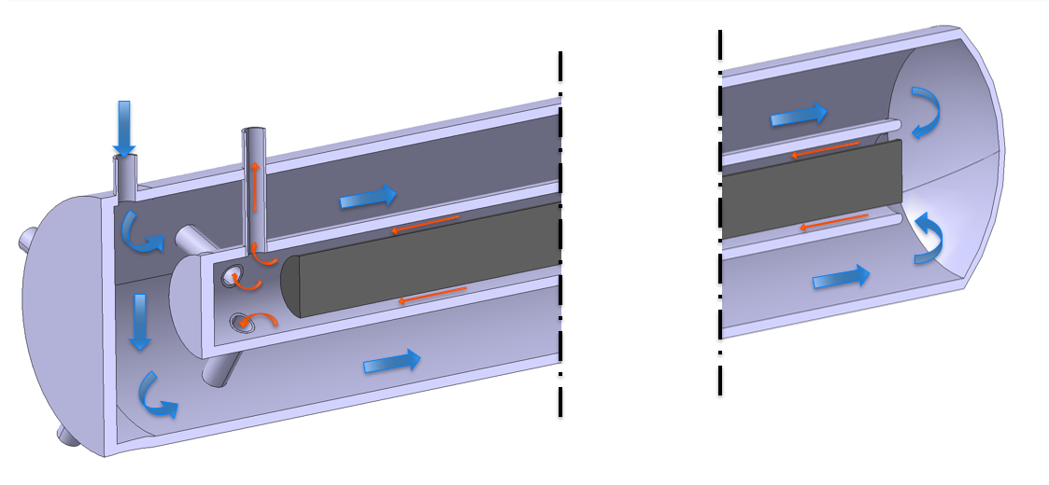
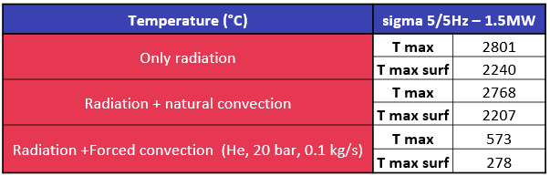
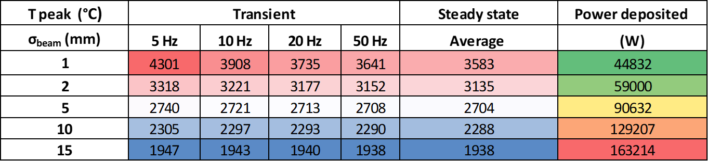
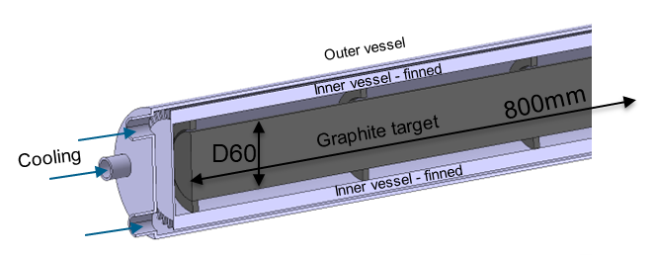
Carbon Target: engineering feasibility
Direct cooling considerations
Maximum temperature and power deposition for 1.5 MW as function of the beam sigma.
Old concepts
  Target Cooling
  Due to high T and sublimation of graphite, an enclosed ‘pressurized’ atmosphere is required.
  However, active cooling can be made indirectly. Heat dissipation mostly via radiation and natural convection. → target confinement / separation of cooling system is advantageous (maintenance, RP, disposal, cooling services requirements).

Slide 8
Carbon target & target systems considerations
Target Physics requirements
Solenoid / Double Horn
Shielding
P+
µ
Cooling &
Capture
Target Engineering requirements
Proton driver
Carbon Target
Production
Pulse intensity
Pulse length
Pulse frequency
Beam size
Beam energy
Pion/Muon yield
Emittance
++…
++ Other requirements
Dynamic load
High temperature & average power
Fatigue
Radiation damage
Integration
Operation / Maintenance / Disposal
Design
Cooling
Sing/multiple rods
Length / λ
Diameter
Tilt
Target vessel size
Beam windows
Type of cooling
Passive/active
Parameters
Dedicated/shared
Material
Radio Protection
Material / alloy
Availability
Properties
Radiation damage
Services

