Slide 1
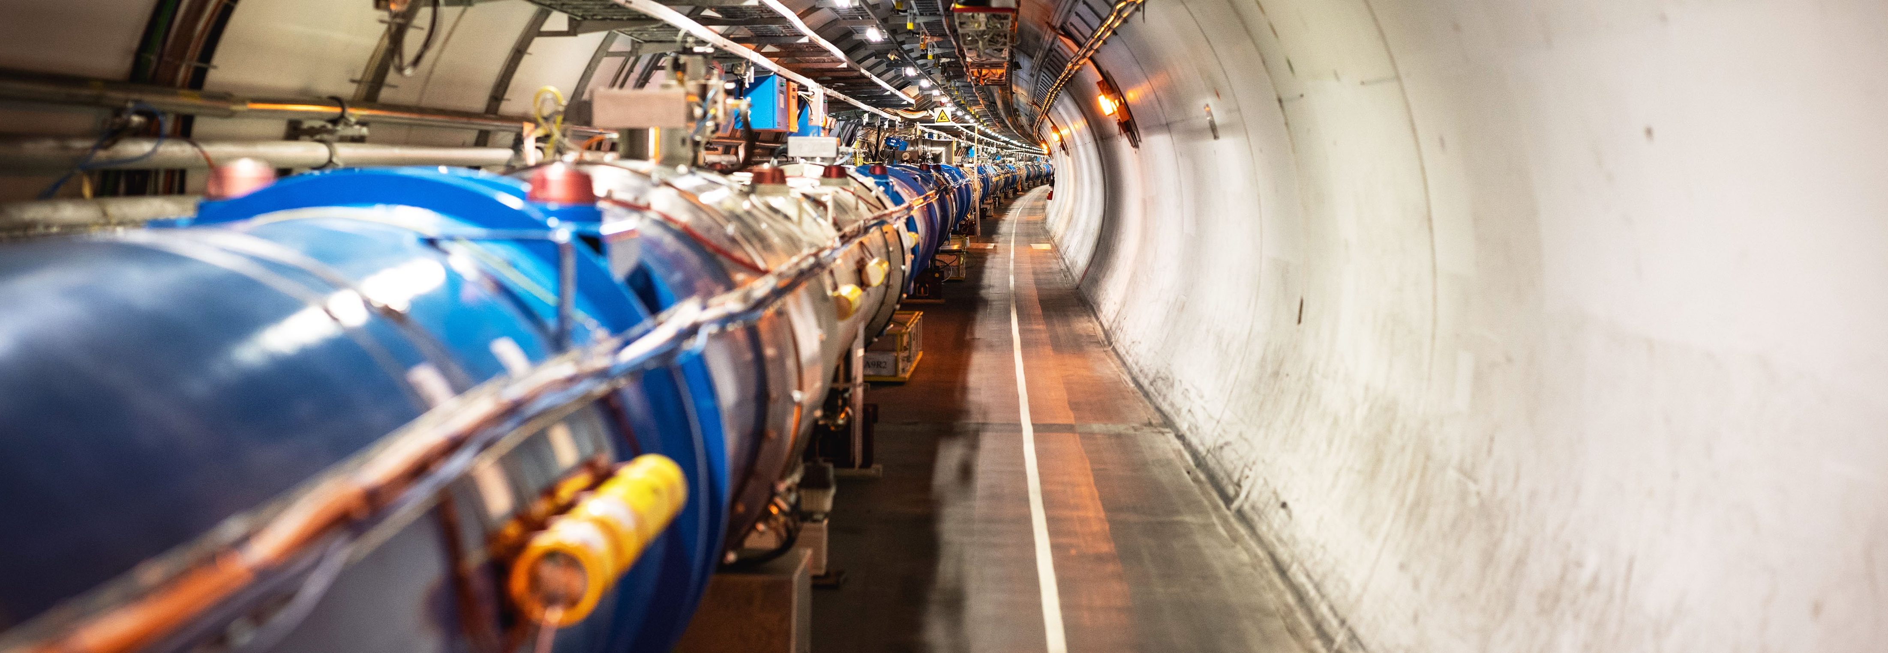
Welcome and Introduction
Joint CERN-Korea Committee (CKC)
Emmanuel Tsesmelis
Head of Associate Member State and Non-Member State Relations
CERN
22 April 2024

Slide 2
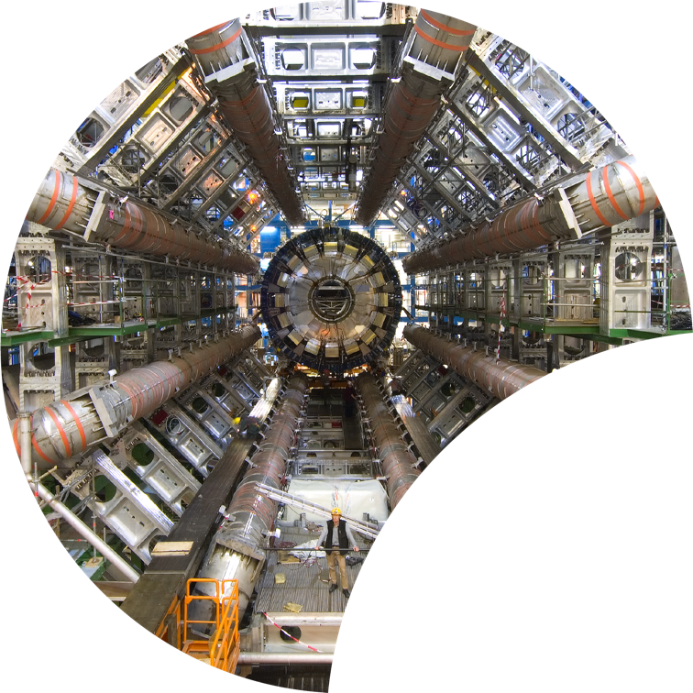
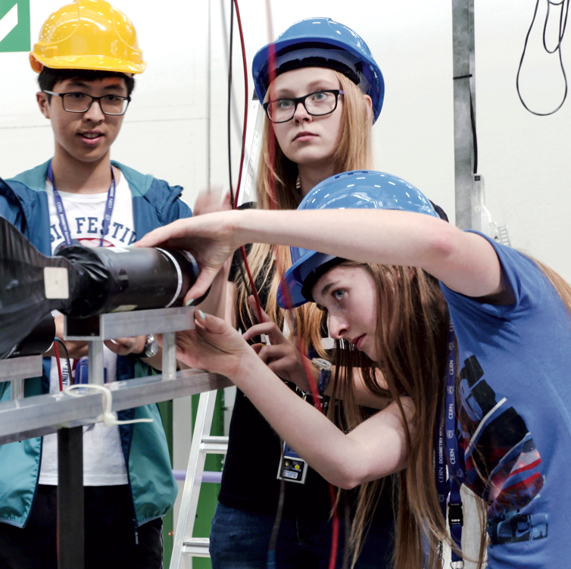

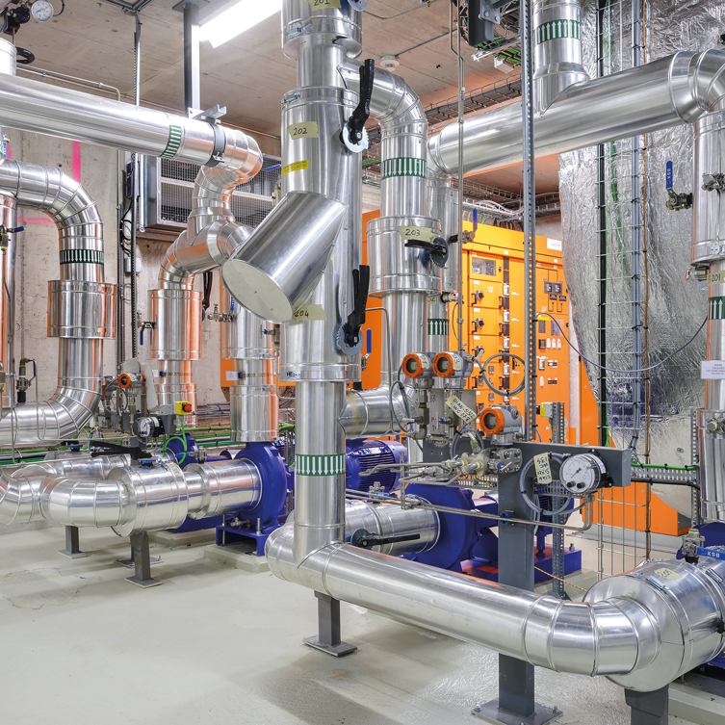

Four pillars underpin CERN’s mission
RESEARCH
EDUCATION
& TRAINING
COLLABORATION
TECHNOLOGY
& INNOVATION

Slide 3
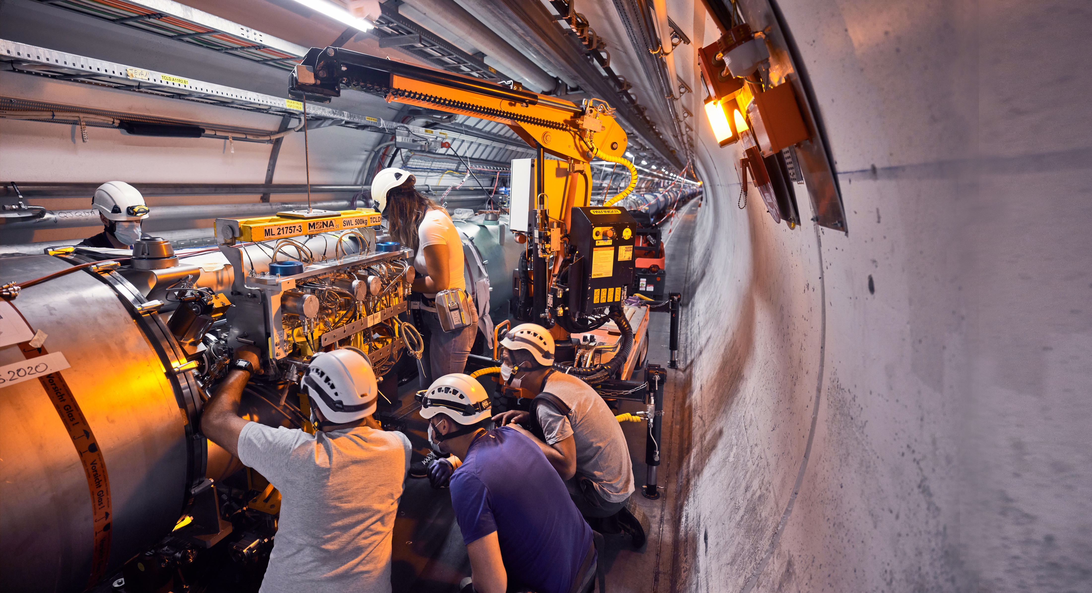
Upgrade to the
High-Luminosity LHC is under way
The HL-LHC will use new technologies to provide
10 times more collisions
than the LHC.
It will give access to rare phenomena, greater precision and discovery potential.
It will start operating in 2029, and run until 2041.

Slide 4
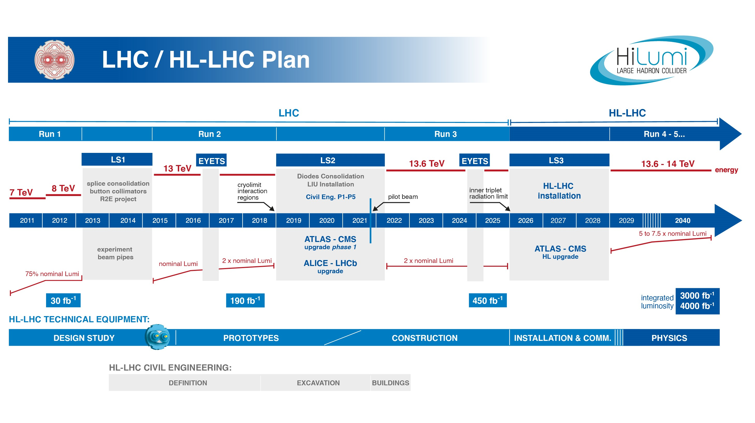
EU funded HiLumi
Design Study
Approval of
HL-LHC Project
We are here
HL-LHC Operation
Run3 operation
2 years until start of Long Shutdown 3
The project is ready for installation start in 2026! ➔ endorsed by 2023 C&SR

Slide 5
Goal of HL-LHC Upgrade Project
The main objective of the HL-LHC is to determine and build a hardware configuration and a set of beam parameters that will allow the LHC to reach the following targets:
Prepare machine for operation beyond 2025 and up to 2040
Devise beam parameters and operational scenarios for:
  Enabling a total integrated luminosity of 3000 fb⁻¹
    Implies an integrated luminosity of 250 fb⁻¹ per year
  Operation at μ ≤ 140 (➔ peak luminosity 5 x 10³⁴ cm⁻² s⁻¹)
-> A challenge as well for the experiments!
Operation with levelled luminosity!

Slide 6
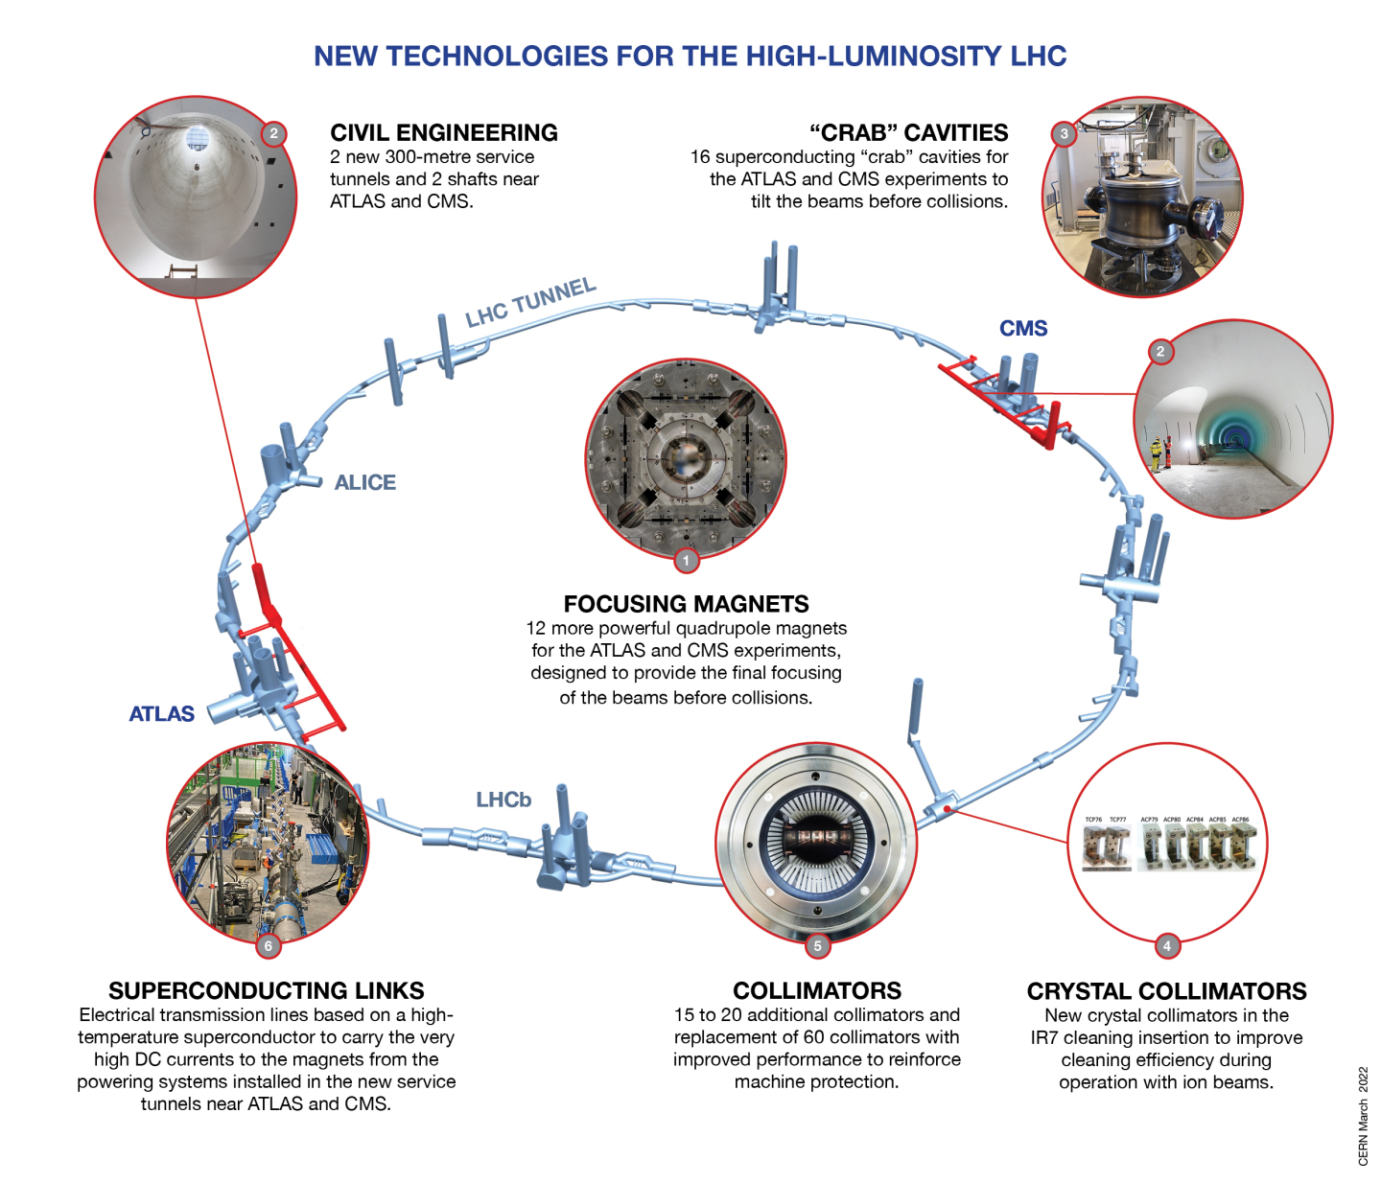
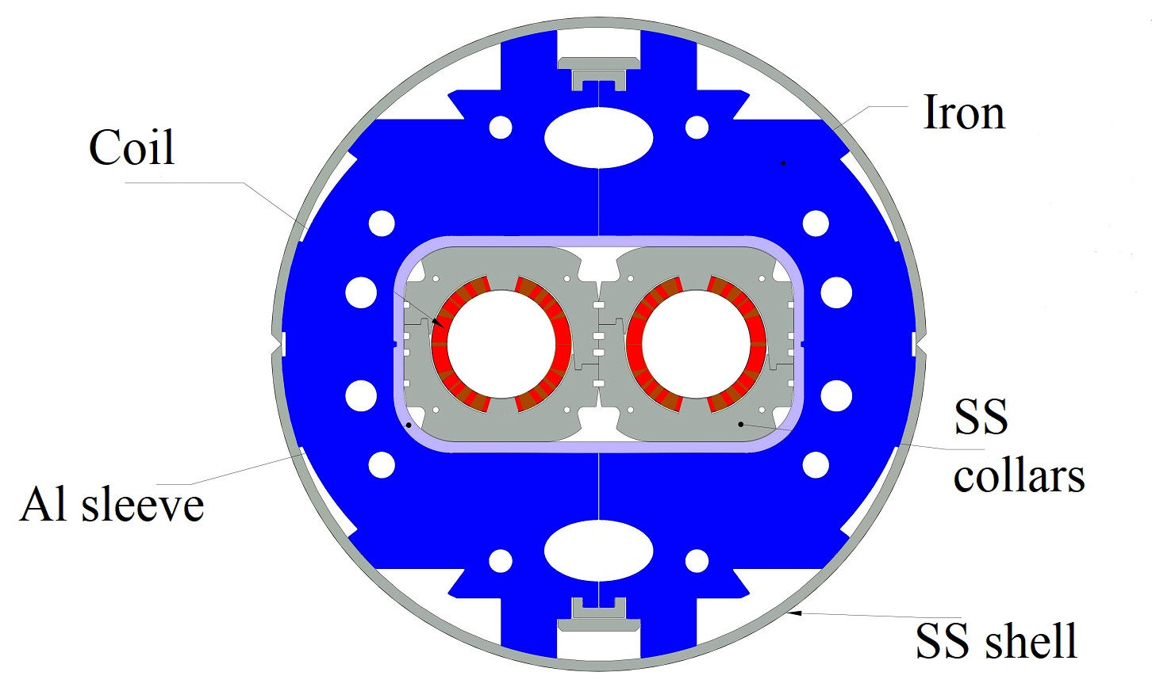
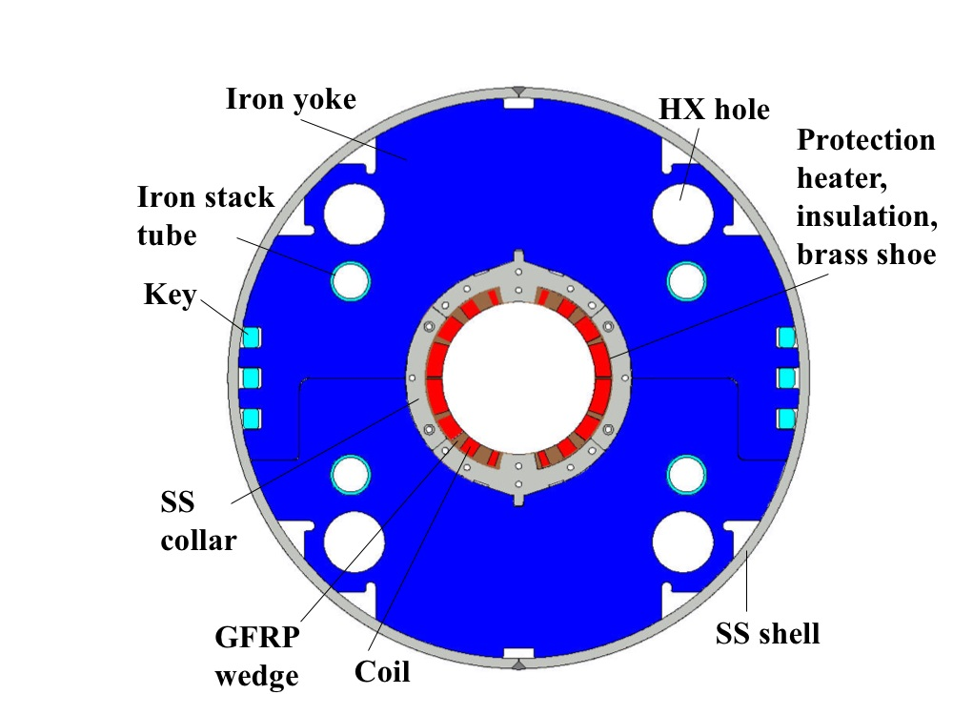
Technology
Landmarks
Series production in Industry well underway
Prototype and first series delivered to CERN
Separation / Recombination
dipole magnets: D1 & D2
Finished in 2023
Finished in 2023
Fully validated in 2023 and first magnets ready for installation
Complete Prototype System installed in SM18 and under testing
½ system already installed for Run3
Successfully deployed in 2023 Pb-Pb run
Prototype cryostated @ CERN

Slide 7
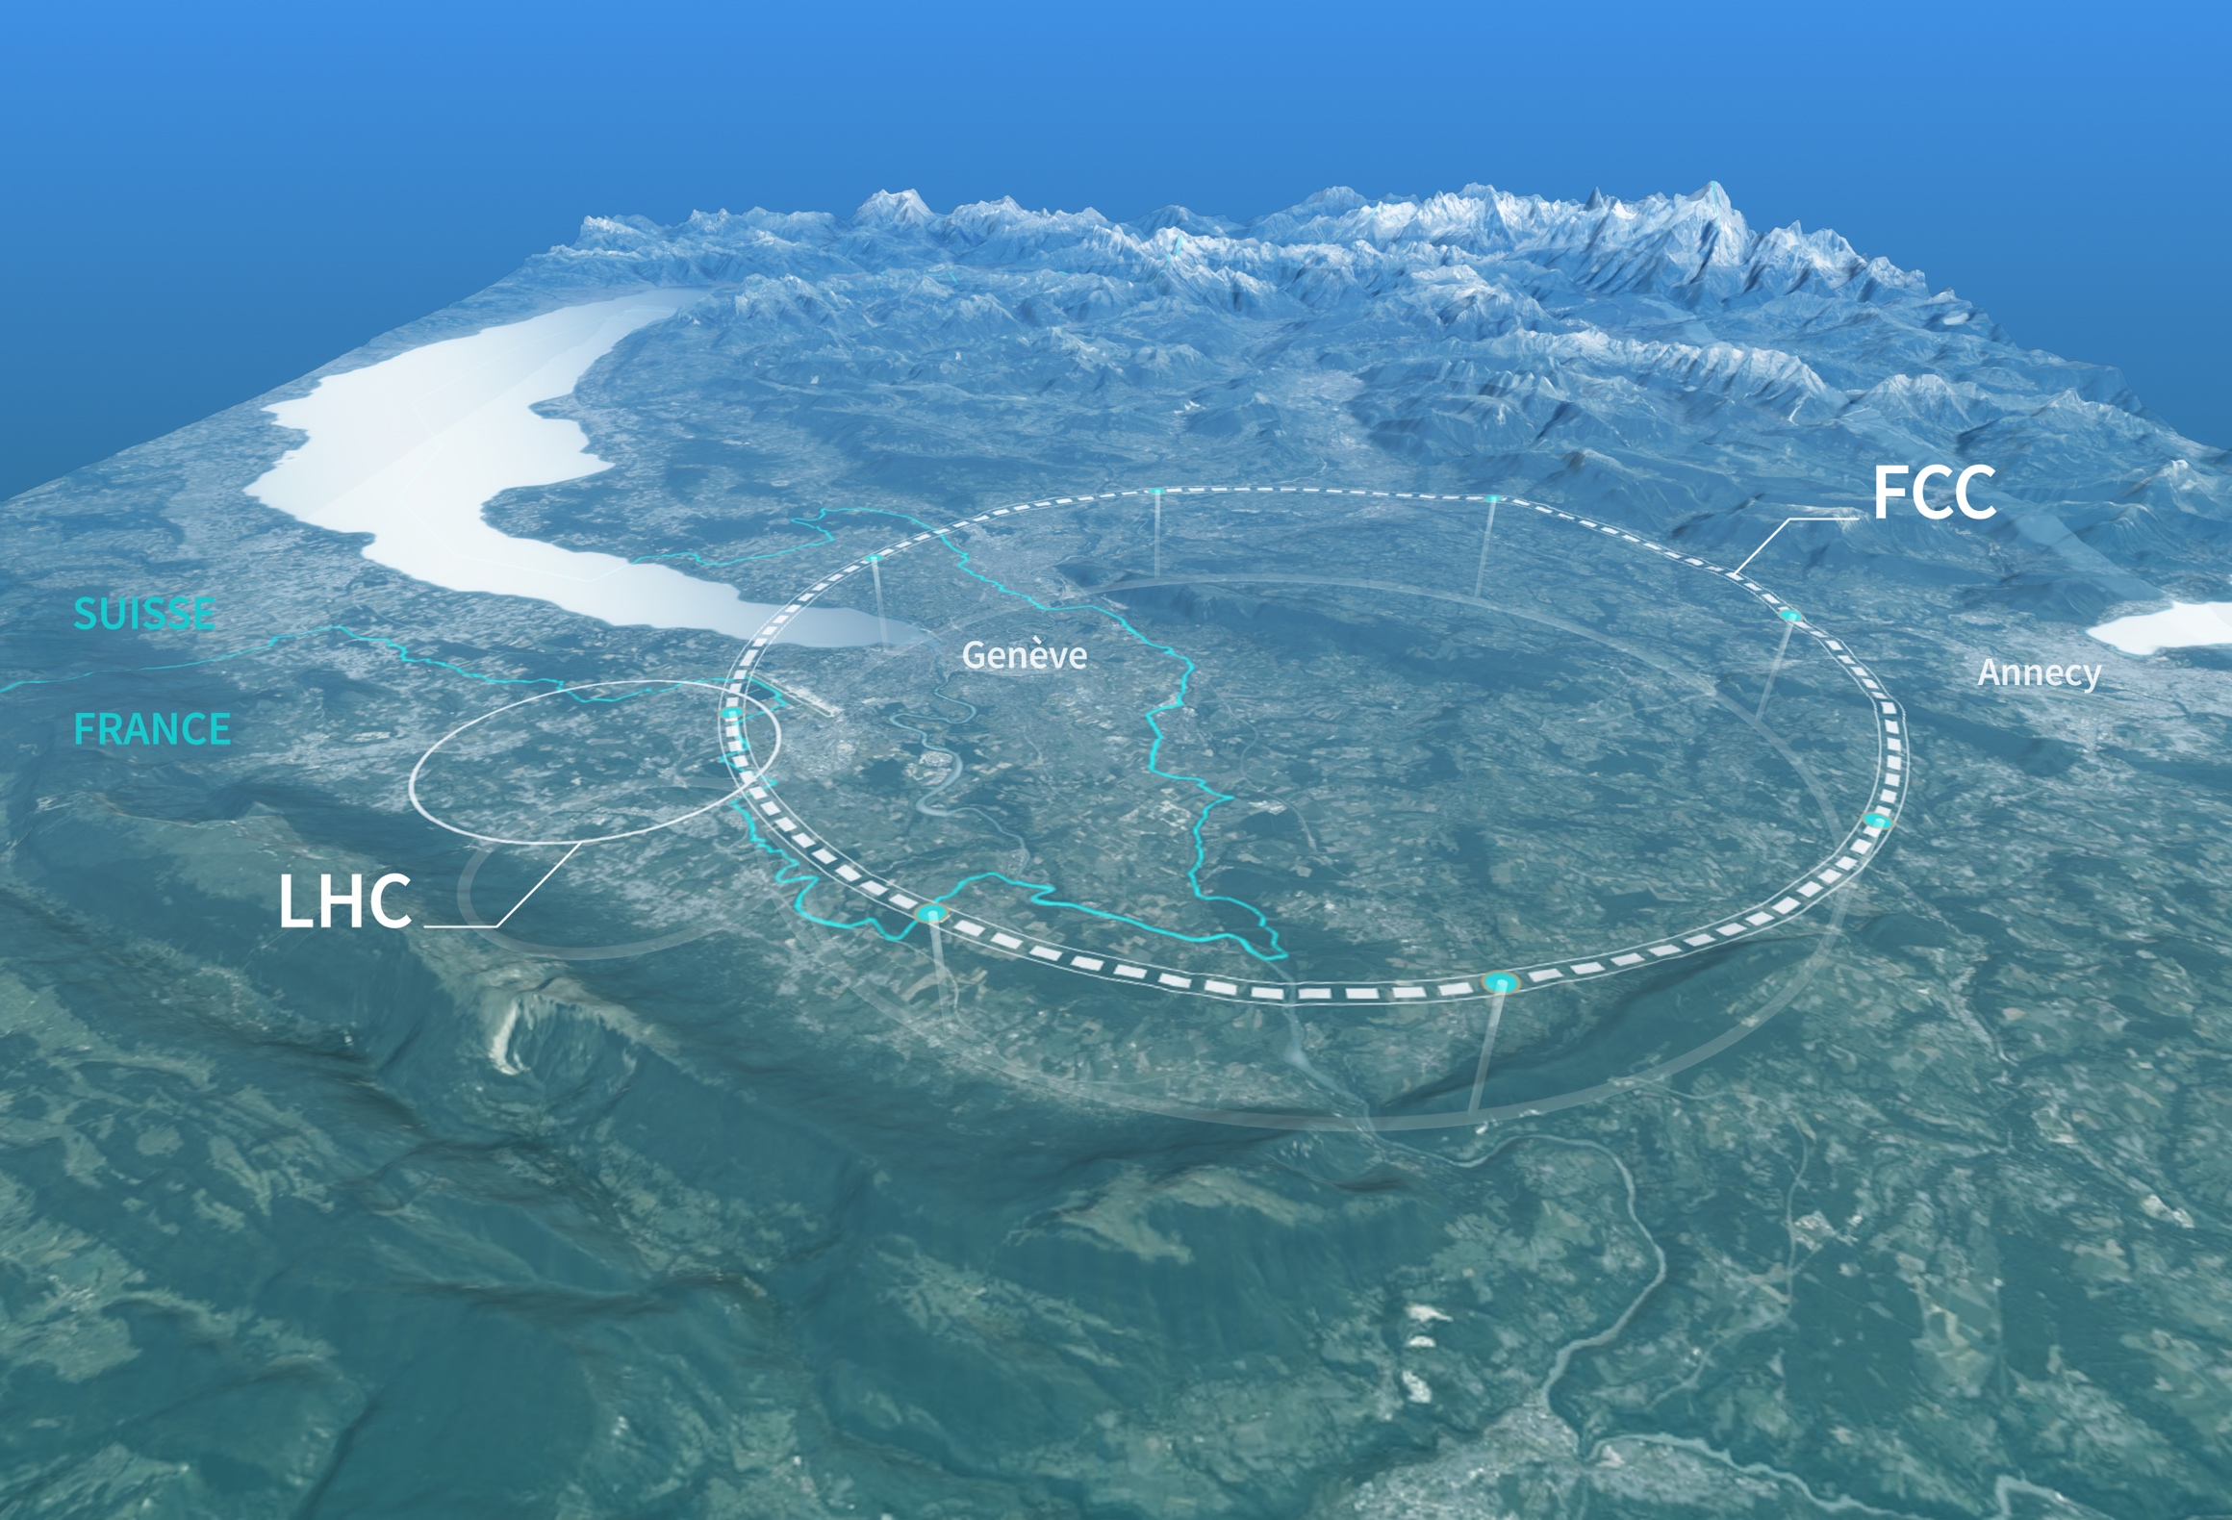
Preparing CERN’s future
Driven by the 2020 Update of the European Strategy for Particle Physics
Technical and financial feasibility study of a Future Circular Collider (report for end 2025)
Accelerator R&D to develop technologies for FCC and for alternative options
Detector and computing R&D
Maintain and expand a compelling scientific diversity programme
Continue to support other projects around
the world

Slide 8

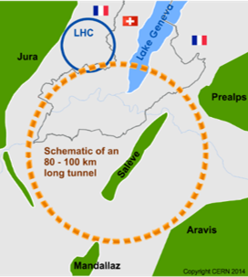
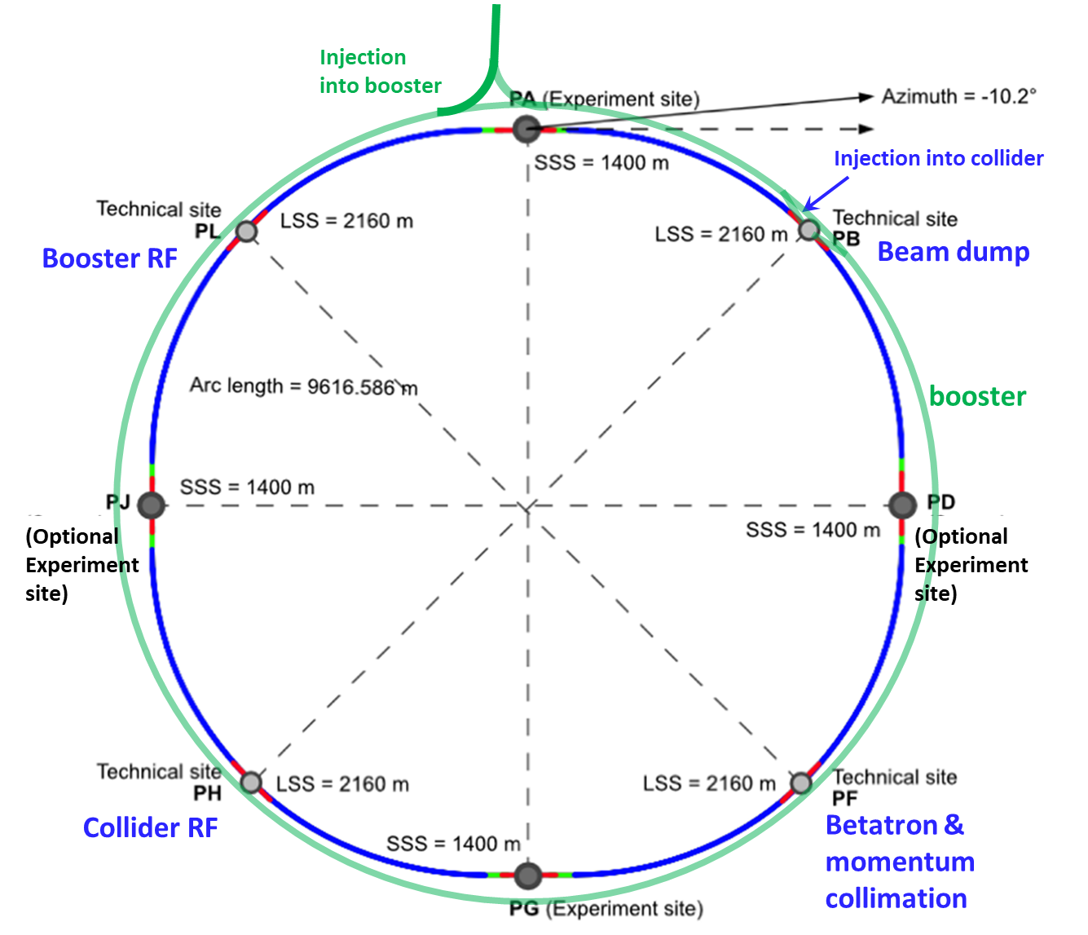
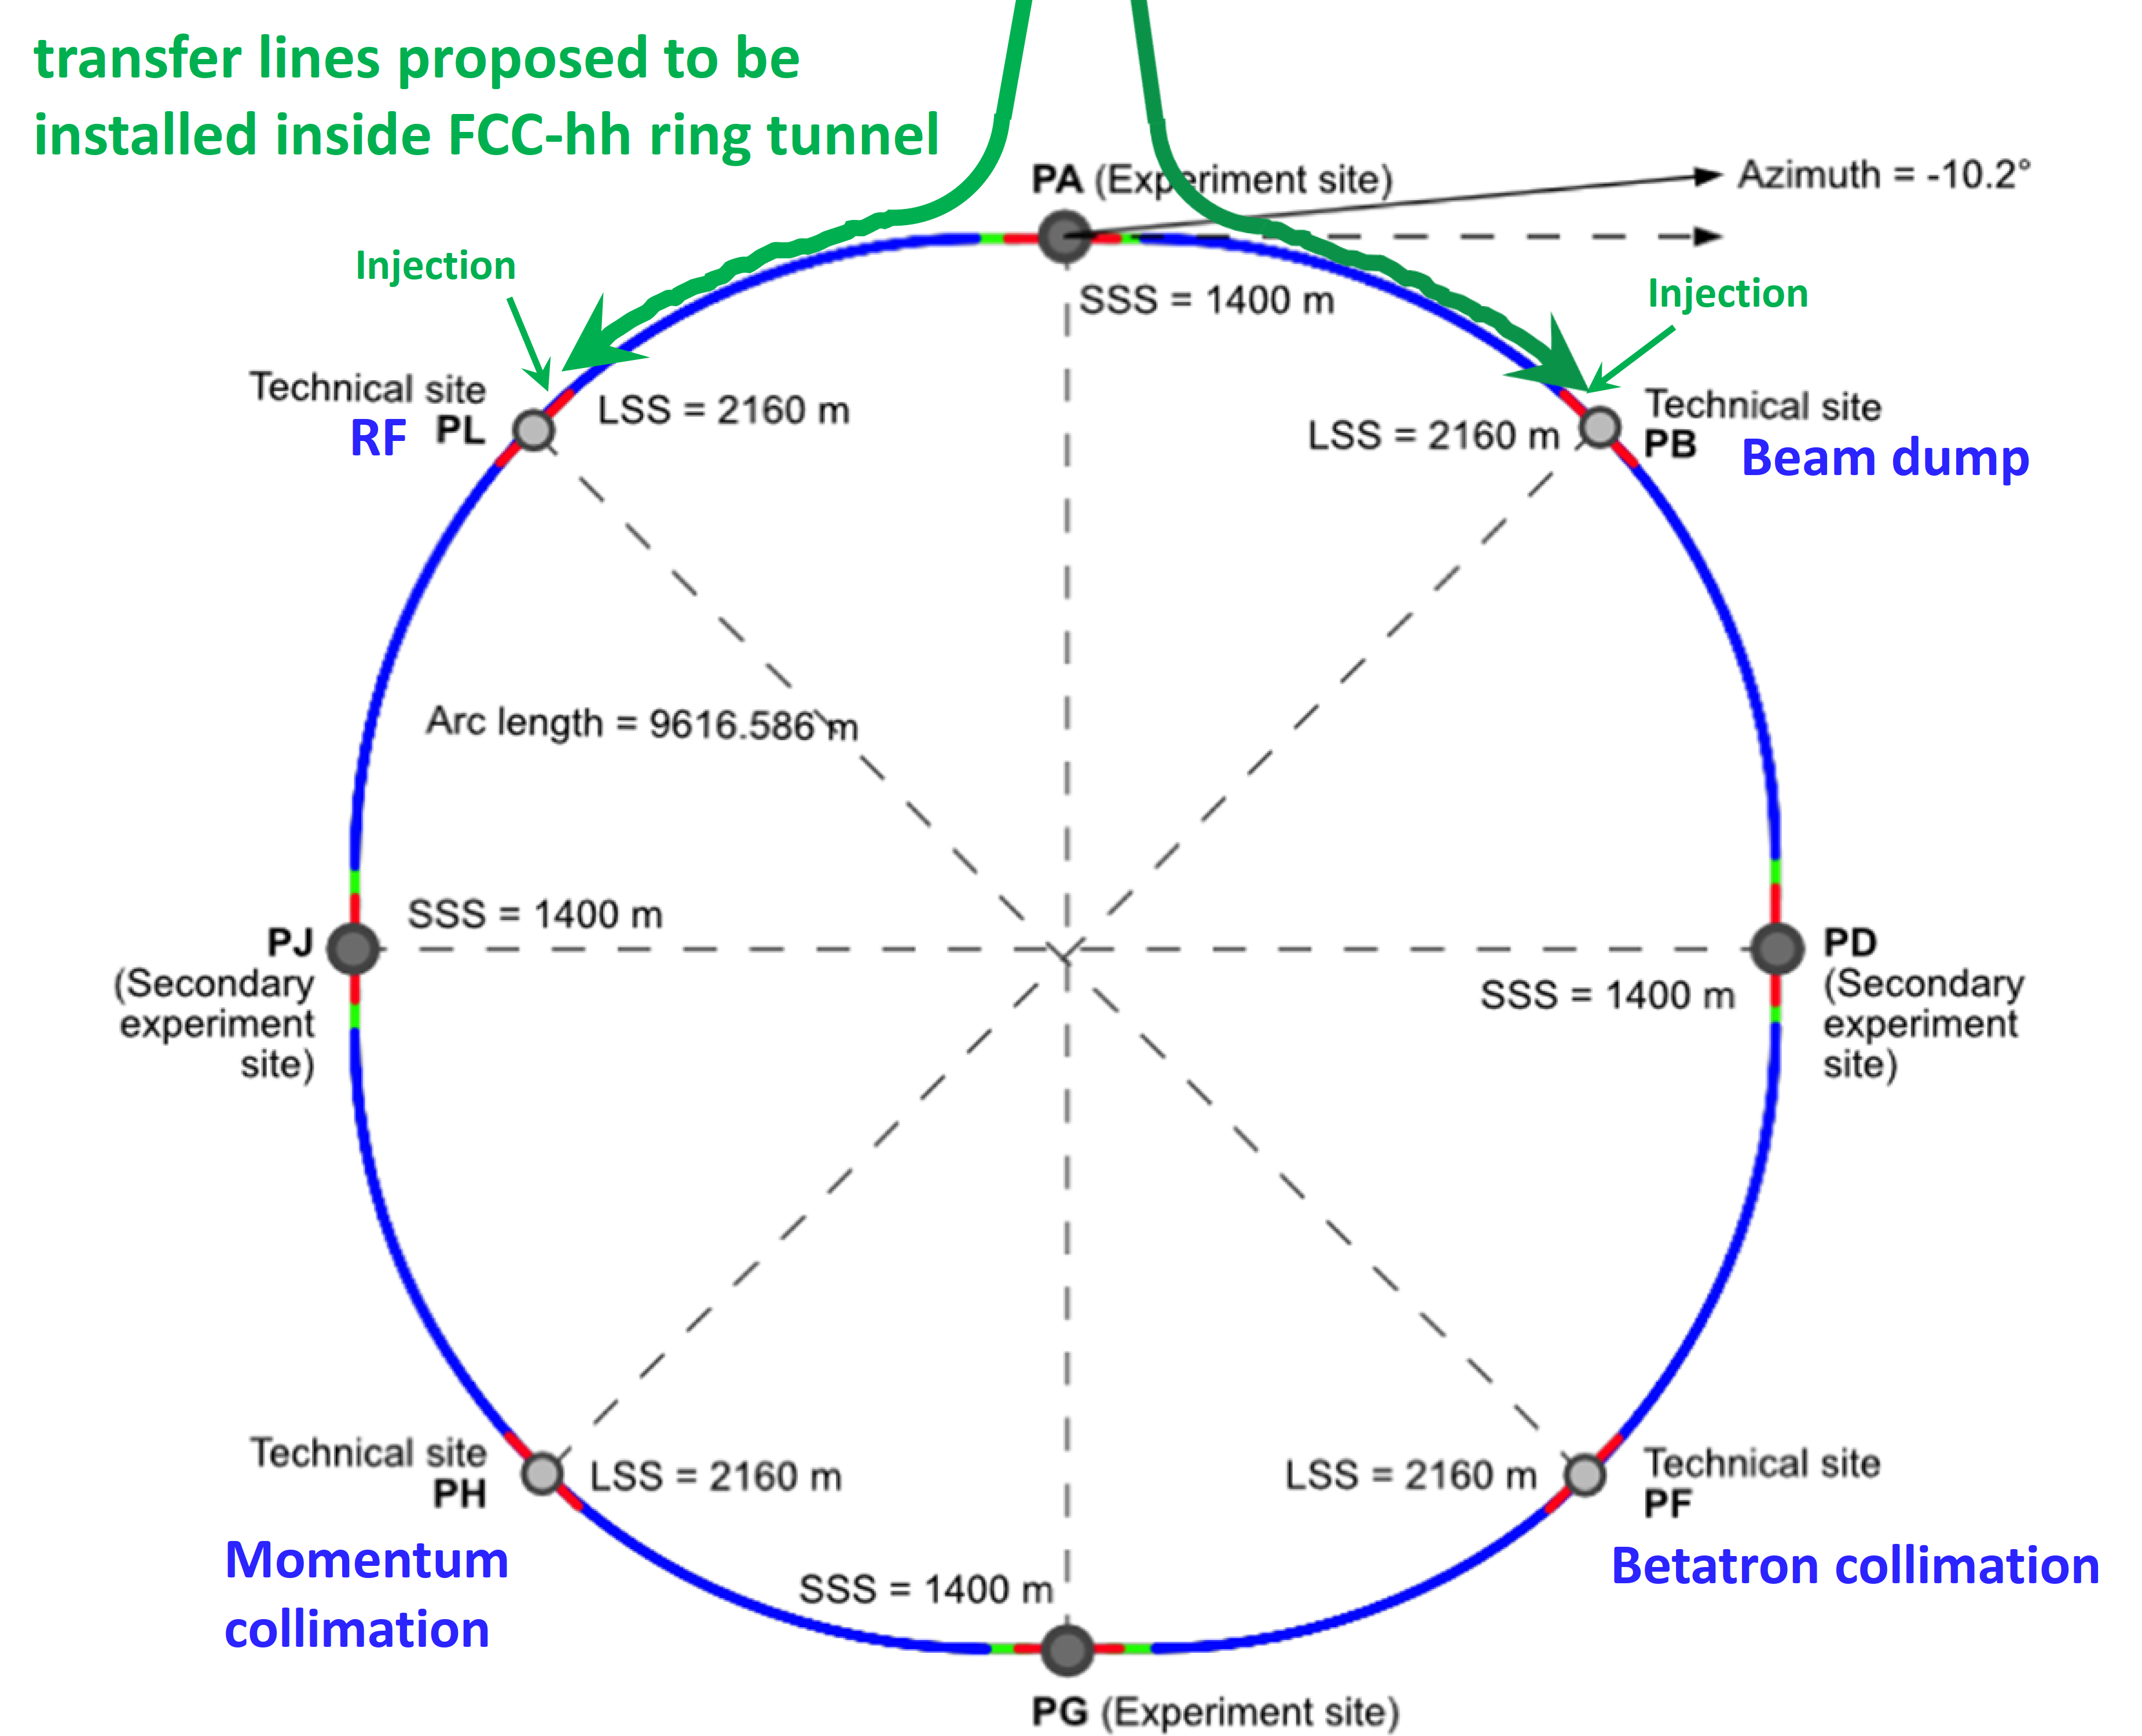
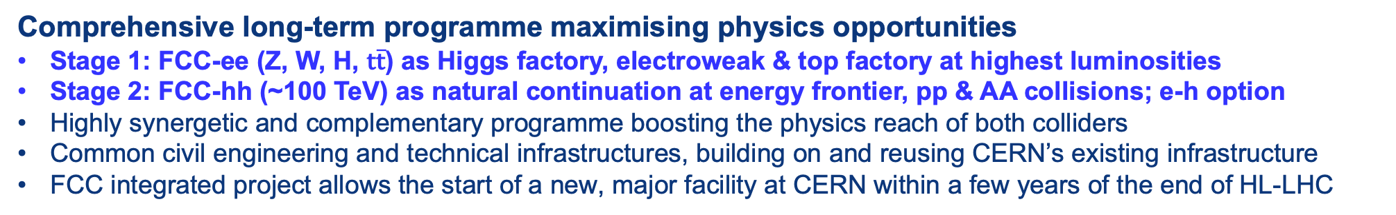
FCC Integrated Programme
Comprehensive long-term programme maximising physics opportunities
Stage 1: FCC-ee (Z, W, H, $\text{t}\overline{\text{t}}$) as Higgs factory, electroweak & top factory at highest luminosities
Stage 2: FCC-hh (~100 TeV) as natural continuation at energy frontier, pp & AA collisions; e-h option
Highly synergetic and complementary programme boosting the physics reach of both colliders
Common civil engineering and technical infrastructures, building on and reusing CERN’s existing infrastructure
FCC integrated project allows the start of a new, major facility at CERN within a few years of the end of HL-LHC
FCC-ee
FCC-hh

Slide 9
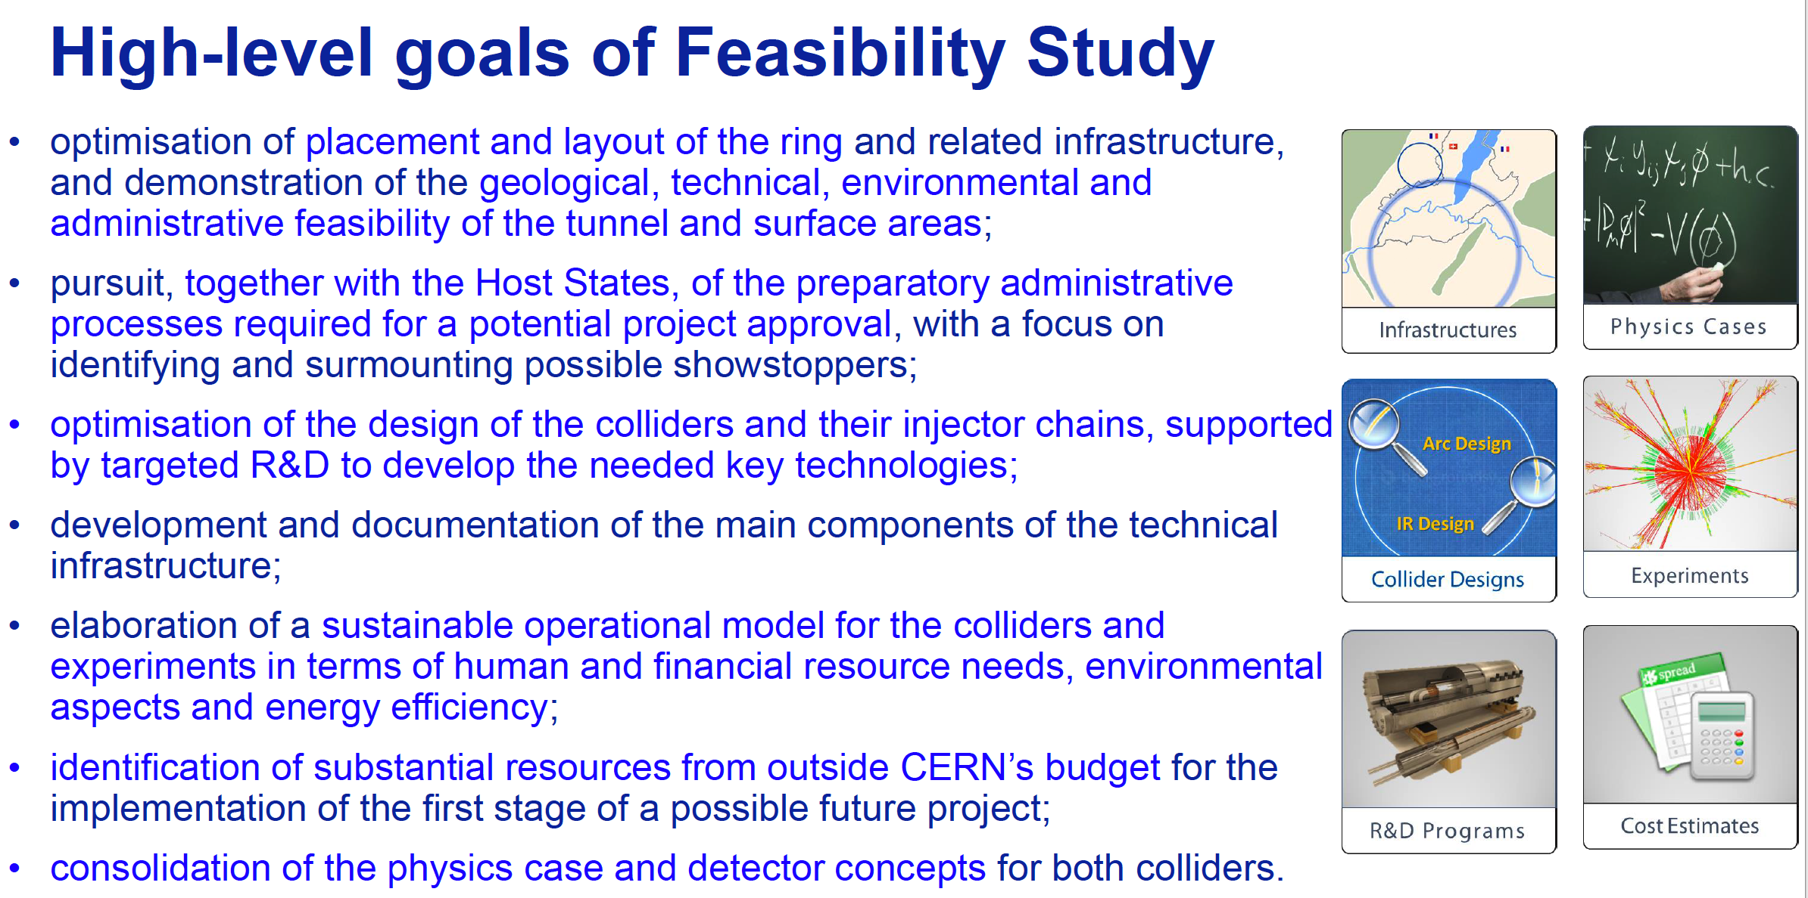
High-level Goals of Feasibility Study
Increasing international collaboration as a prerequisite for success:
links with science, research & development and high-tech industry will be essential to further advance and prepare the implementation of FCC

Slide 10
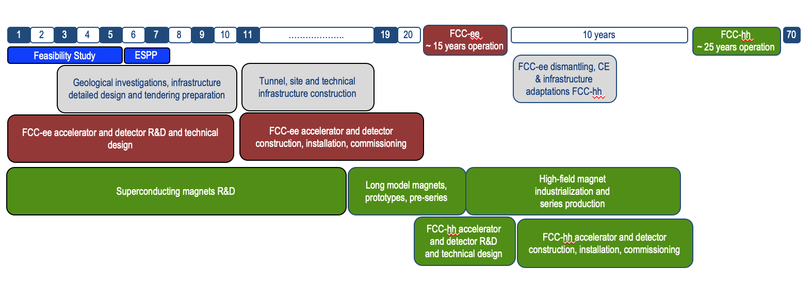
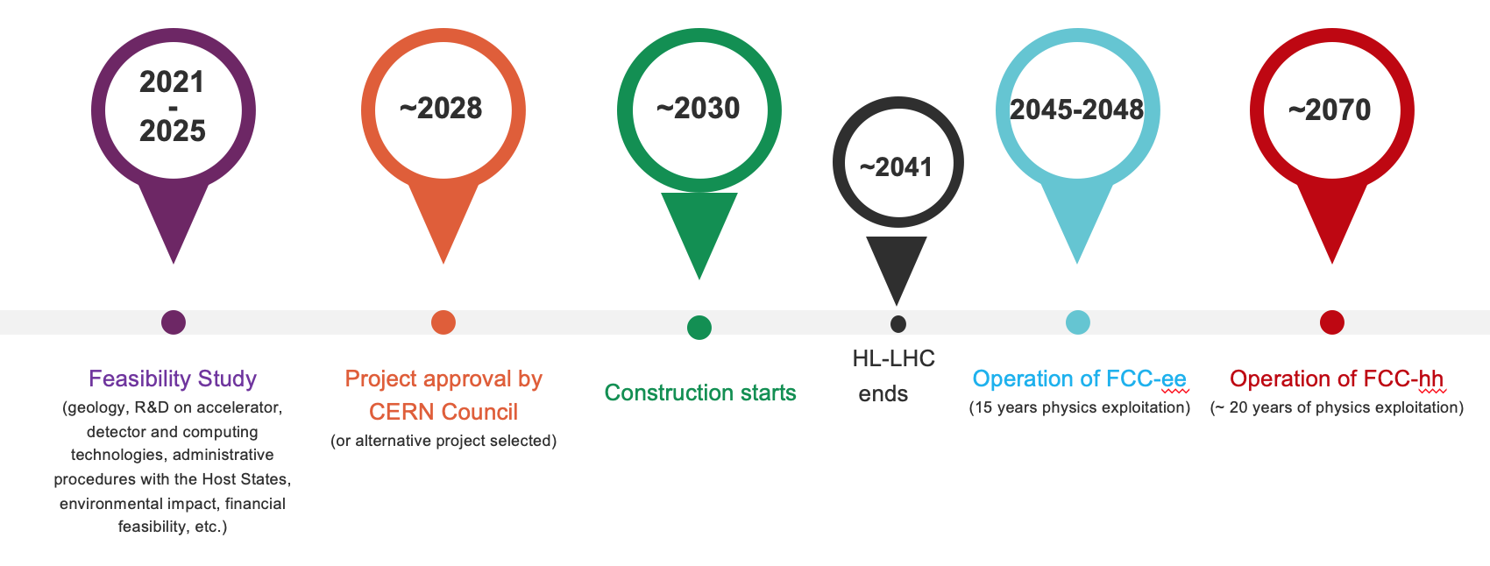
FCC Integrated Programme - Timeline
Note: FCC Conceptual Design Study
started in 2014 leading to CDR
in 2018
“Realistic” schedule taking into account:
past experience in building colliders at CERN
approval timeline: ESPP, Council decision
that HL-LHC will run until 2041
Can be accelerated if more resources available
2033
2048
2074

Slide 11
FCC Feasibility Study – Mid-term Status Summary
The first part of the FCC Feasibility Study has been completed with the Mid-term Review
20 – 22 November 2023: SPC and FC review meetings on mid-term review
2 February 2024: CERN Council meeting on mid-term review
Focus 2021 - 2023:
Identifying best placement & layout and adapting entire project to new placement.
This provided the input for the mid-term review documentation and cost estimate update.
Fruitful collaboration between scientific & technical actors, in close cooperation with the CERN Host State services, at departmental/cantonal and local level. Direct exchange in place with communes concerned by surface sites. Environmental studies ongoing.
Focus 2024 - 2025:
Subsurface investigations, further optimisation of implementation, surface sites, synergies, etc.
Full design iteration in view of technical and cost optimisation of entire project.
Cost containment and reduction of cost uncertainties, development of risk register.
Further development of an affordable funding model and related governance implications (with Council).
Environmental impact (civil engineering, excavated materials, sustainability); geological investigations
Completion of the FCC Feasibility Study in 2025.

Slide 12

Status of FCC Global Collaboration
The CERN Council reviewed the work undertaken in a fruitful meeting on 2 February 2024.
It congratulated and thanked all the teams involved in the study for the excellent and significant work done so far and for the impressive progress, and looks forward to receiving the final report in 2025.
150
Institutes
32
Companies
34
Countries
EC
H2020
FCC Feasibility Study: Aim is to increase further the collaboration, on all aspects,
in particular, on Accelerator and Particle/Experiments/Detectors (PED).

Slide 13
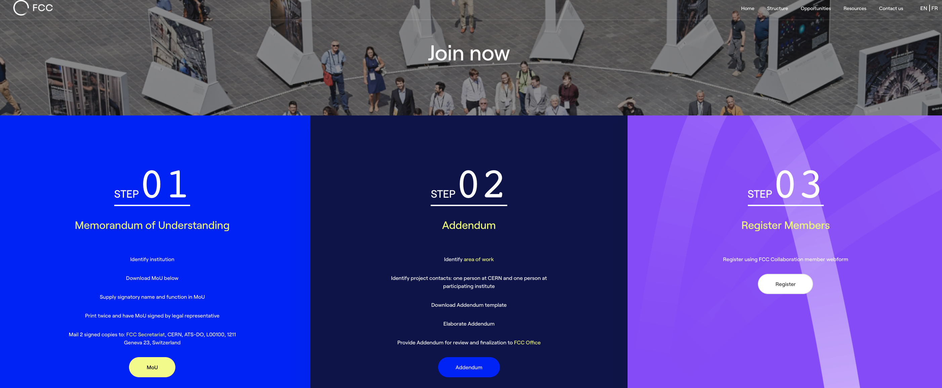
FCC Feasibility Study Collaboration Membership
Participation in FCC through MoU and Addenda.
The FCC MoU for the first phase of the study is being updated to cover the Feasibility Study.
The current participating institutes who wish to take part in the Feasibility Study can continue to participate on the basis of the previously signed MoU until the updated MoU is signed.
https://fccis.web.cern.ch/join-now

Slide 14
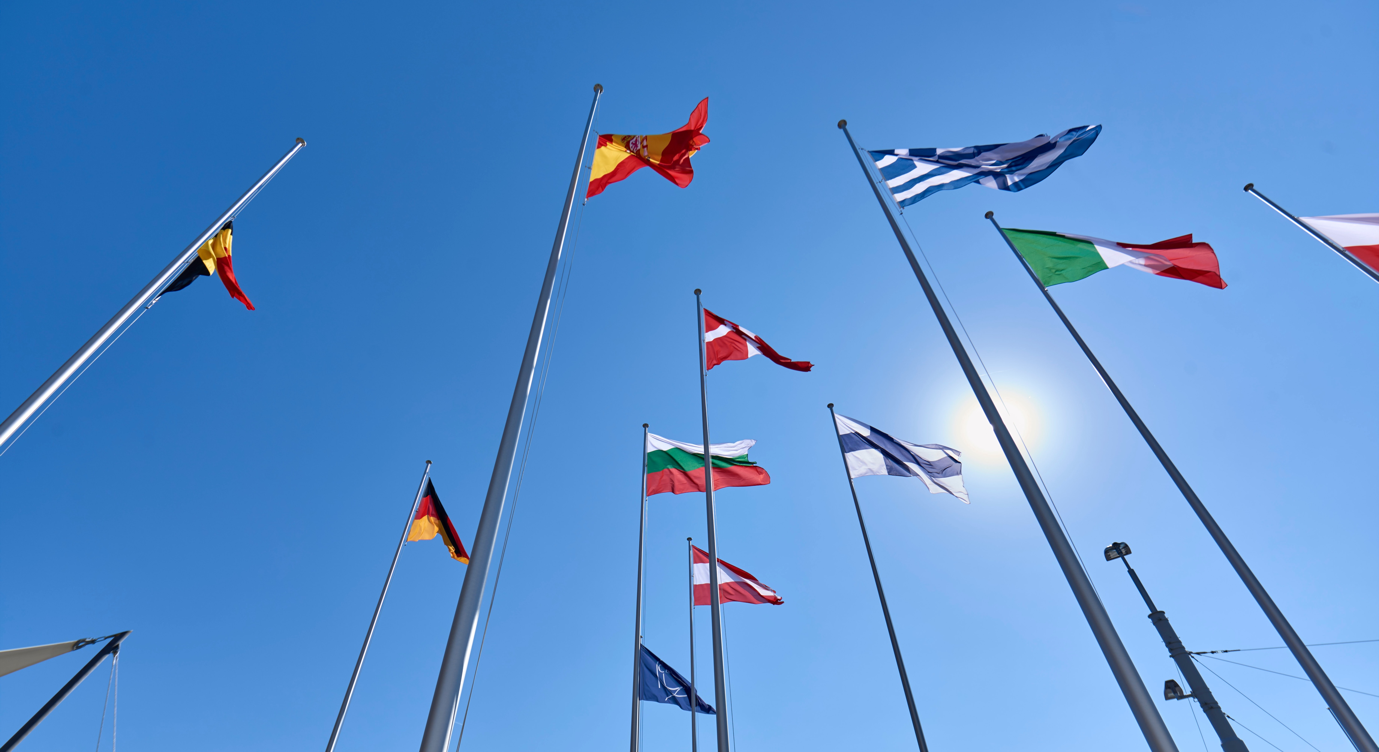
COLLABORATION

Slide 15

Science for peace
CERN was founded in 1954 with 12 European Member States
CERN’s annual budget
is 1200 MCHF (equivalent
to a medium-sized European university)
23 Member States
Austria – Belgium – Bulgaria – Czech Republic
Denmark – Finland – France – Germany – Greece Hungary – Israel – Italy – Netherlands – Norway
Poland – Portugal – Romania – Serbia – Slovakia Spain – Sweden – Switzerland – United Kingdom
As of 31 December 2023
Employees:
2666 staff, 1002 graduates
Associates:
12 370 users, 1513 others
3 Associate Member States
in the pre-stage to membership
Cyprus – Estonia – Slovenia
8 Associate Member States
Brazil – Croatia – India – Latvia – Lithuania – Pakistan
Türkiye – Ukraine
6 Observers
Japan – Russia (suspended) – USA
European Union – JINR (suspended) – UNESCO
Around 50 Cooperation Agreements
with non-Member States and Territories
Albania – Algeria – Argentina – Armenia – Australia – Azerbaijan – Bangladesh – Belarus – Bolivia
Bosnia and Herzegovina – Canada – Chile – Colombia – Costa Rica – Ecuador – Egypt – Georgia – Honduras
Iceland – Iran – Jordan – Kazakhstan – Lebanon – Malta – Mexico – Mongolia – Montenegro – Morocco – Nepal
New Zealand – North Macedonia – Palestine – Paraguay – People's Republic of China – Peru – Philippines – Qatar
Republic of Korea – Saudi Arabia – Sri Lanka – South Africa – Thailand – Tunisia – United Arab Emirates – Vietnam

Slide 16
A laboratory for people around the world
Distribution of all CERN Users by the country of their home institutes as of 31 December 2023
Geographical & cultural diversity
Users of 110 nationalities
22.5 % women
Member States 7438
Austria 86 – Belgium 129 – Bulgaria 46 – Czech Republic 252
Denmark 47 – Finland 88 – France 842 – Germany 1296
Greece 112 – Hungary 80 – Israel 74 – Italy 1609 – Netherlands 167 Norway 77 – Poland 322 – Portugal 105 – Romania 113
Serbia 38 – Slovakia 67 – Spain 413 – Sweden 106
Switzerland 419 – United Kingdom 950
Associate Member States
in the pre-stage to membership 69
Cyprus 14 – Estonia 29 – Slovenia 26
Associate Member States 541
Brazil 135 – Croatia 37 – India 145 – Latvia 21 – Lithuania 17 – Pakistan 30 Türkiye 129 – Ukraine 27
Observers 3005
Japan 219 – Russia (suspended) 779 – United States of America 2007
Non-Member States and Territories 1317
Algeria 2 – Argentina 16 – Armenia 16 – Australia 26 – Azerbaijan 3 – Bahrain 3 – Belarus 14 – Canada 206
Chile 45 – China 414 – Colombia 24 – Costa Rica 3 – Cuba 3 – Ecuador 4 – Egypt 24 – Georgia 34 – Hong Kong 15 Iceland 3 – Indonesia 7 – Iran 14 – Ireland 4 – Jordan 3 – Kazakhstan 3 – Kuwait 2 – Lebanon 7 – Madagascar 1
Malaysia 4 – Malta 1 – Mexico 56 – Montenegro 3 – Morocco 18 – New Zealand 2 – Nigeria 2 – Oman 1
Palestine 1 – Peru 3 – Philippines 1 – Republic of Korea 168 – Saudi Arabia 6 – South Africa 61 – Sri Lanka 10
Taiwan 52 – Thailand 17 – Tunisia 4 – United Arab Emirates 10 – Vietnam 1

Slide 17
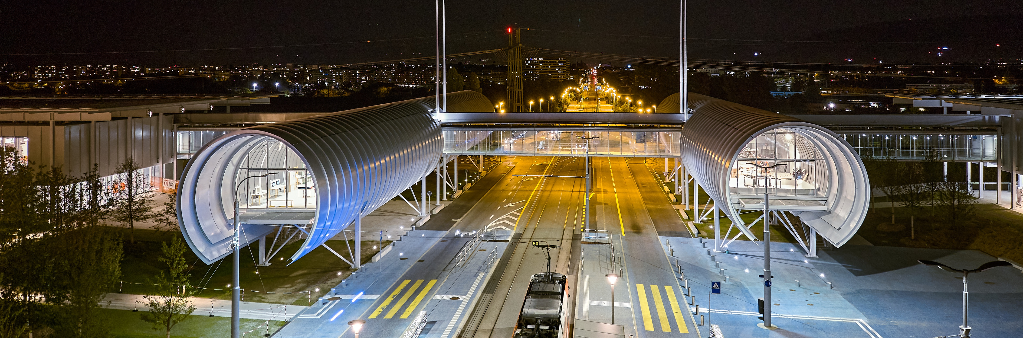
CERN Science Gateway
CERN’s new education and outreach centre for all
publics aged 5-plus.
Inaugurated
7 October 2023.
Number of visitors: >150 000
Immersive exhibitions, education labs, events
and shows.
Centrepiece of CERN 70th Anniversary on 1 October 2024

Slide 18
Thank you

