Slide 1
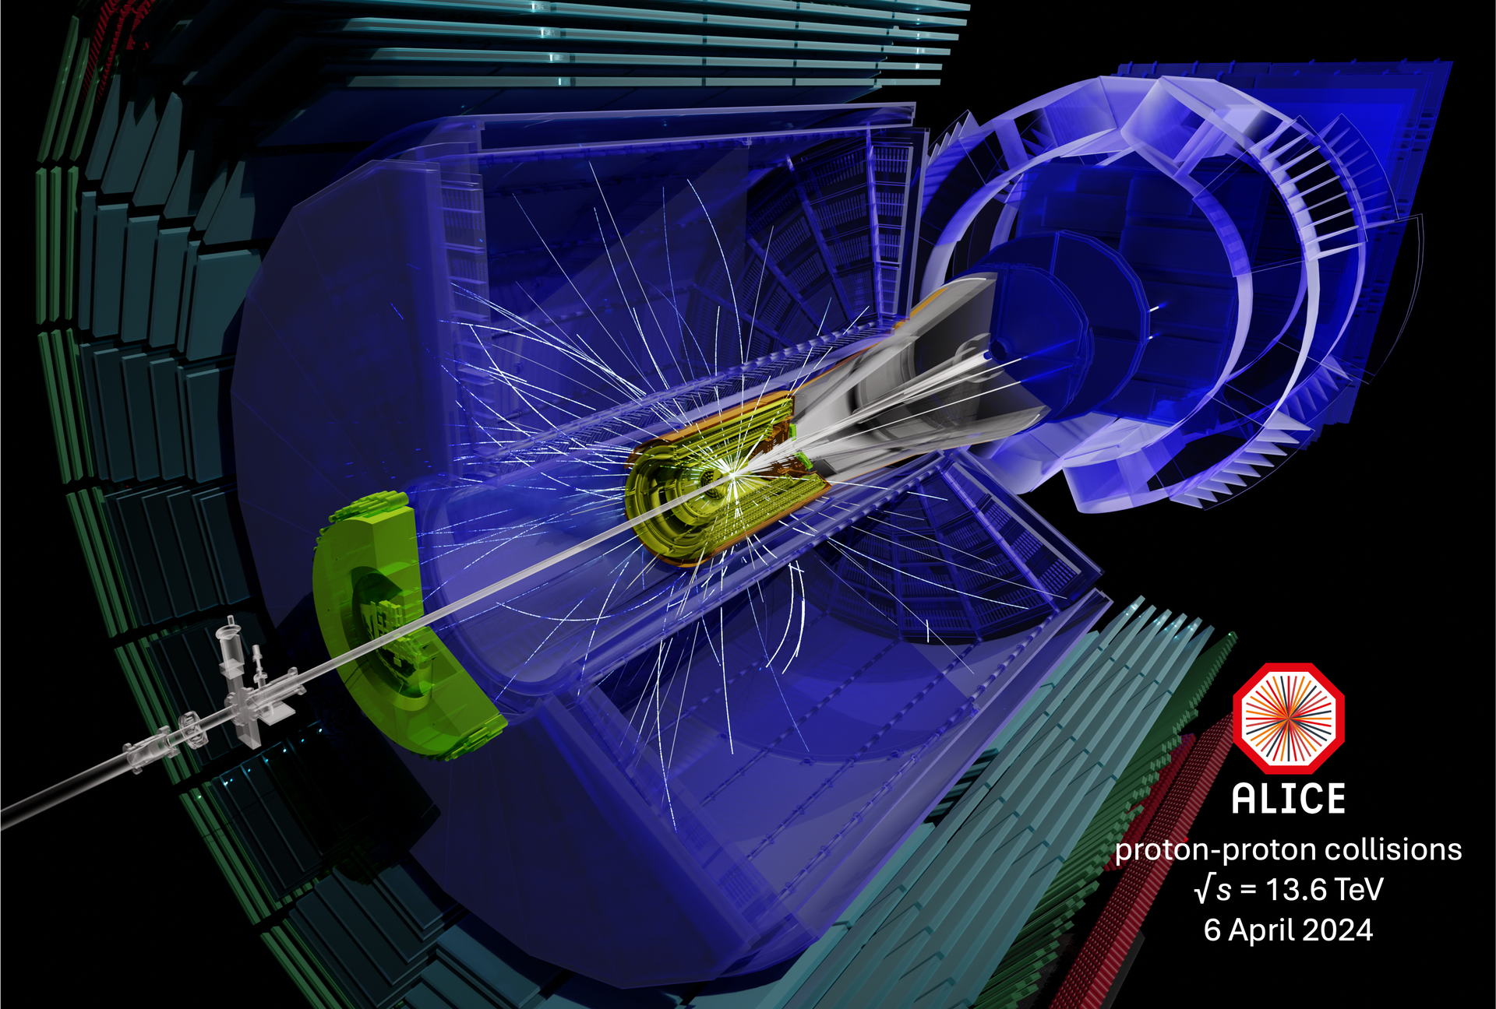
ALICE status update
Marco van Leeuwen,
Nikhef and CERN
CERN-Korea Committee meeting
22 April 2024

Slide 2
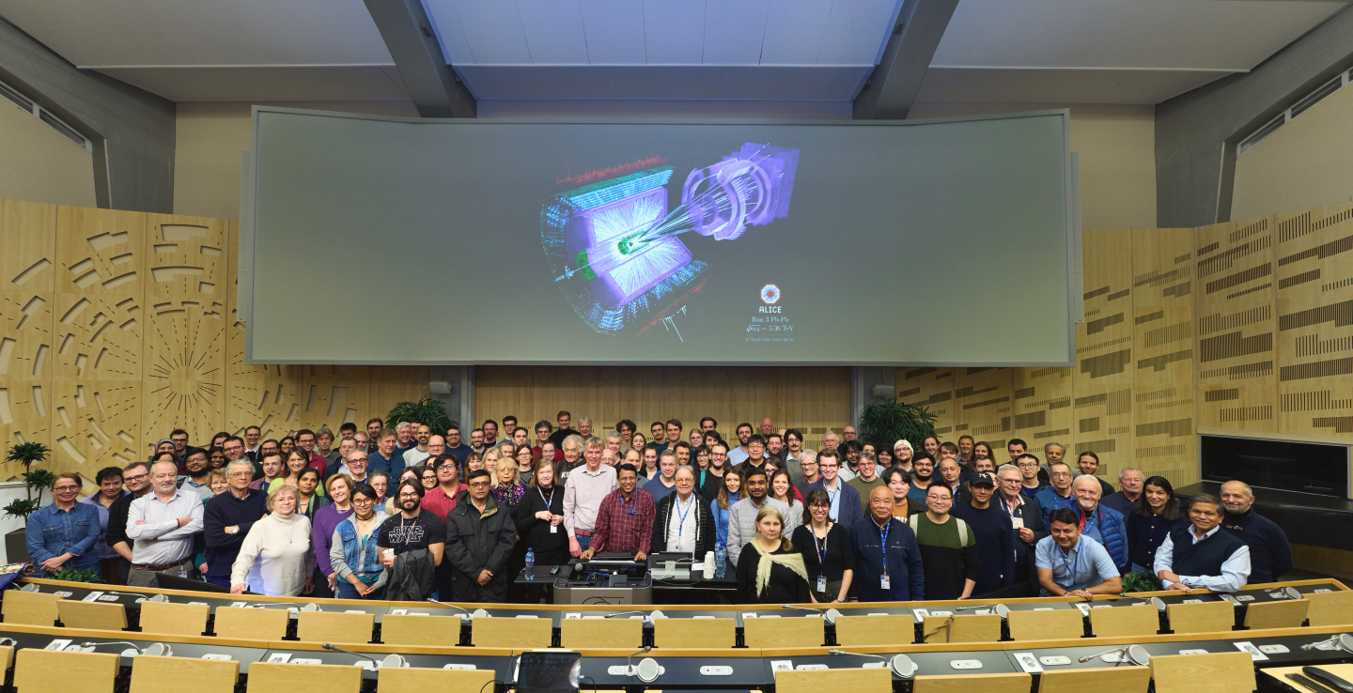
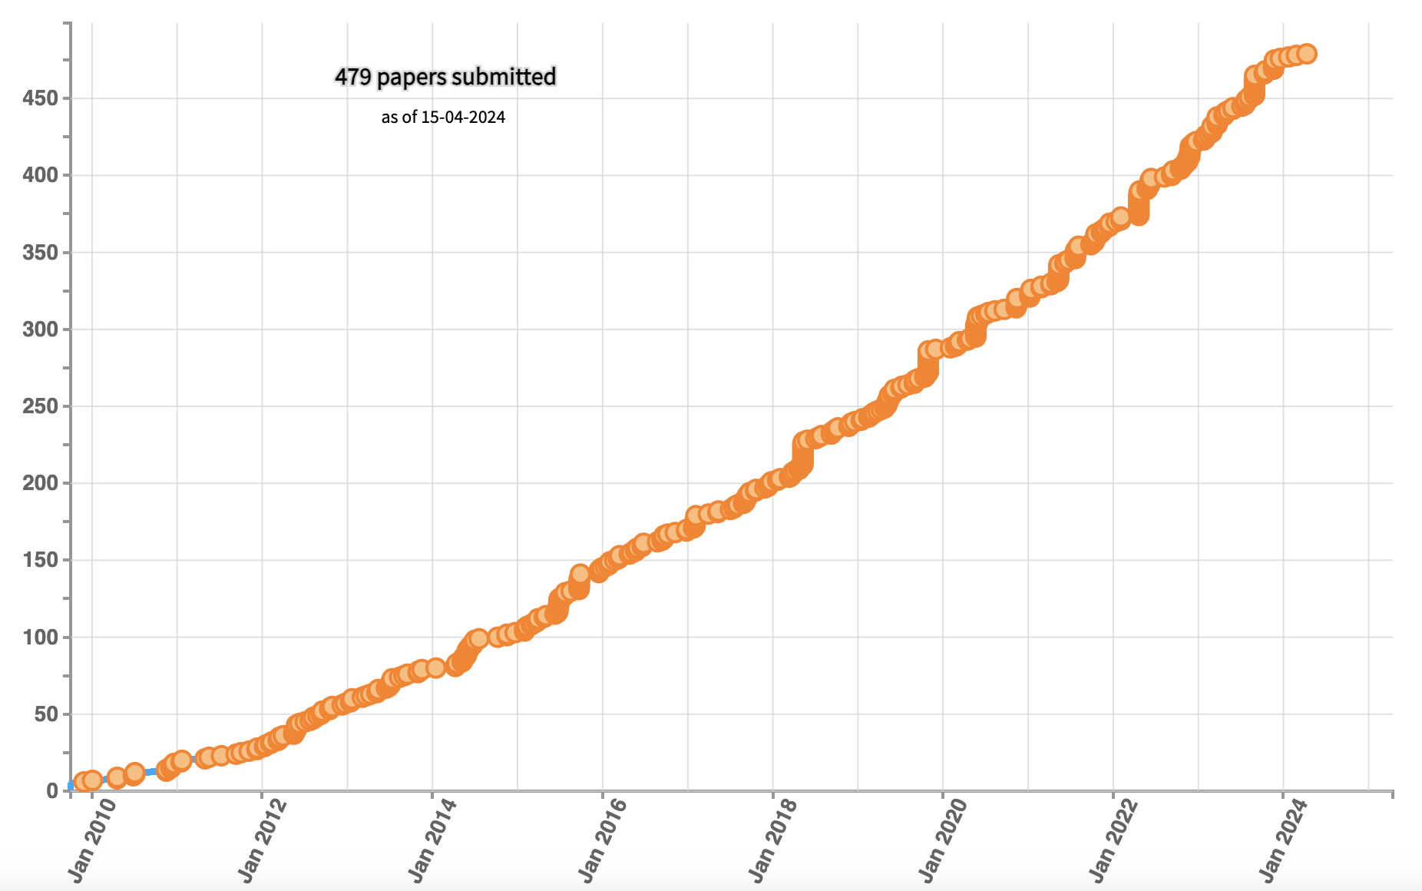
ALICE collaboration updates
ALICE collaboration:
1069 authors
173 institutes in 40 countries
New associate member institutes
MCAST, Malta
CHPC, South Africa
Dhaka, Bangladesh
ALICE Week, March 2024
477 papers submitted
9 Korean Institutes,
45 active members
33 authors

Slide 3
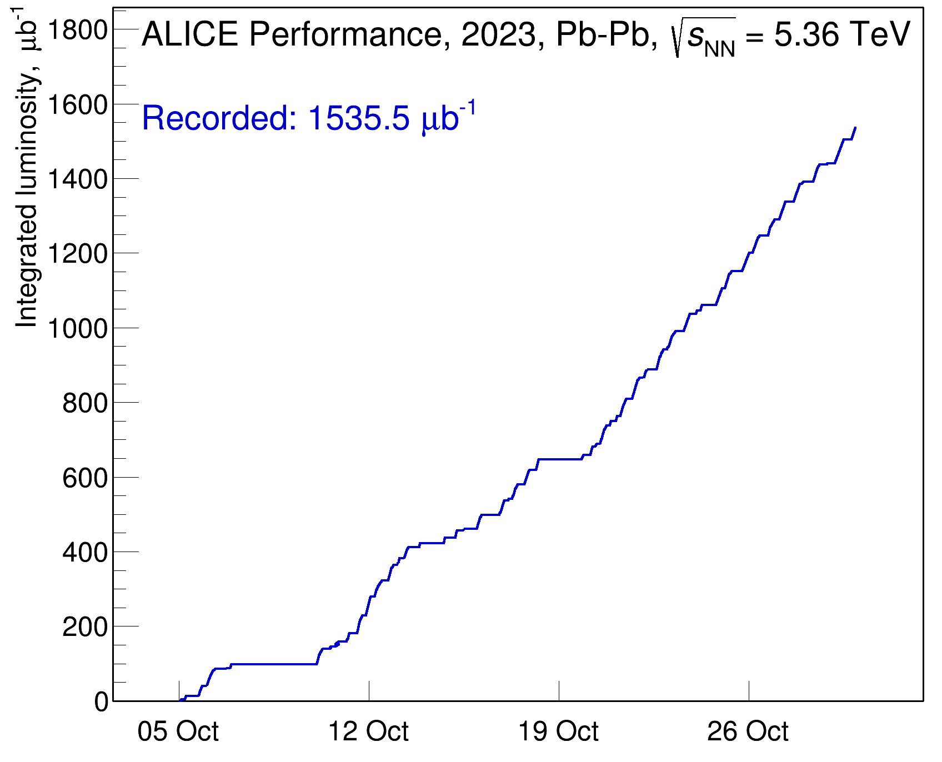
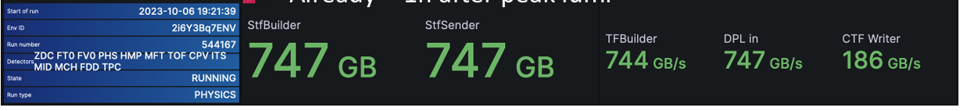
Run 3 heavy-ion data taking
Recorded Pb-Pb luminosity
Successful heavy-ion run
  Total recorded luminosity: 1.5 nb⁻¹ — 11.5 G events
  40x more minimum bias events than in run 2
  Total run time: about 6 weeks
Reconstruction in progress:
  Test pass on 20% of data sample to verify reconstruction performance and refine calibrations
  Second pass in progress
Aim to collect similar size data sample in three-week run in 2024
  4.5 pb⁻¹ pp collisions at same energy for reference
full system validated up to target interaction rate (50 kHz)
data rates: 600-800 GB/s input to FLPs, 160-190 GB/s to EOS

Slide 4
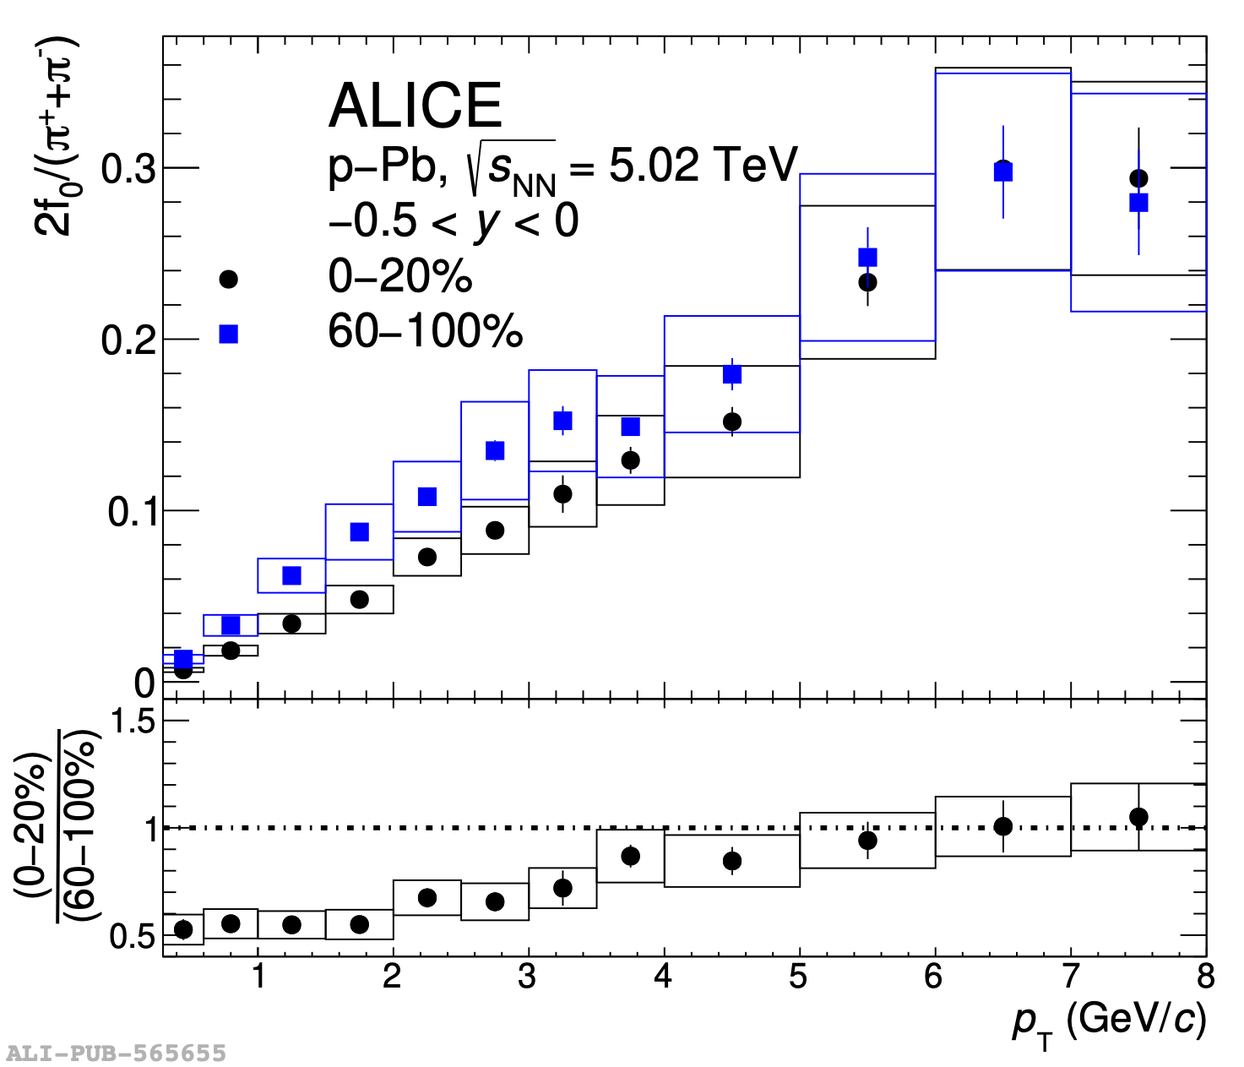
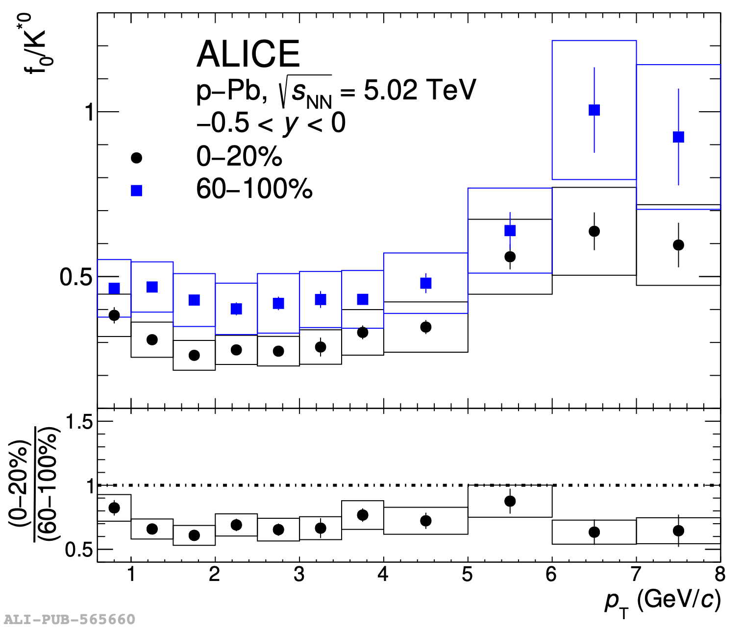
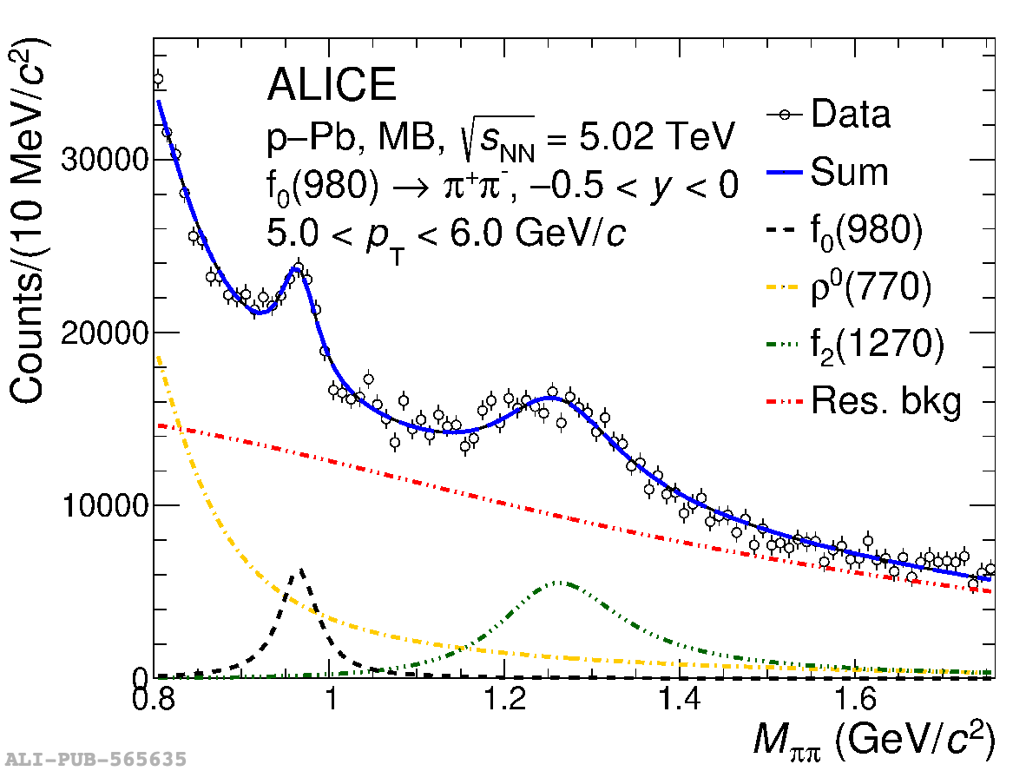
f0(980) production in p-Pb collisions
arXiv:2311.11786, accepted by PLB
f0/𝜋 ratio
f0/K^{*0} ratio
Unexpected suppression of f0(980) production in central p-Pb collisions — rescattering of decay products ?
Paper committee member: Junlee Kim (Jeonbuk Nat Univ, now CERN)
ALICE update | CKC meeting 22 April 2024 | Marco van Leeuwen

Slide 5
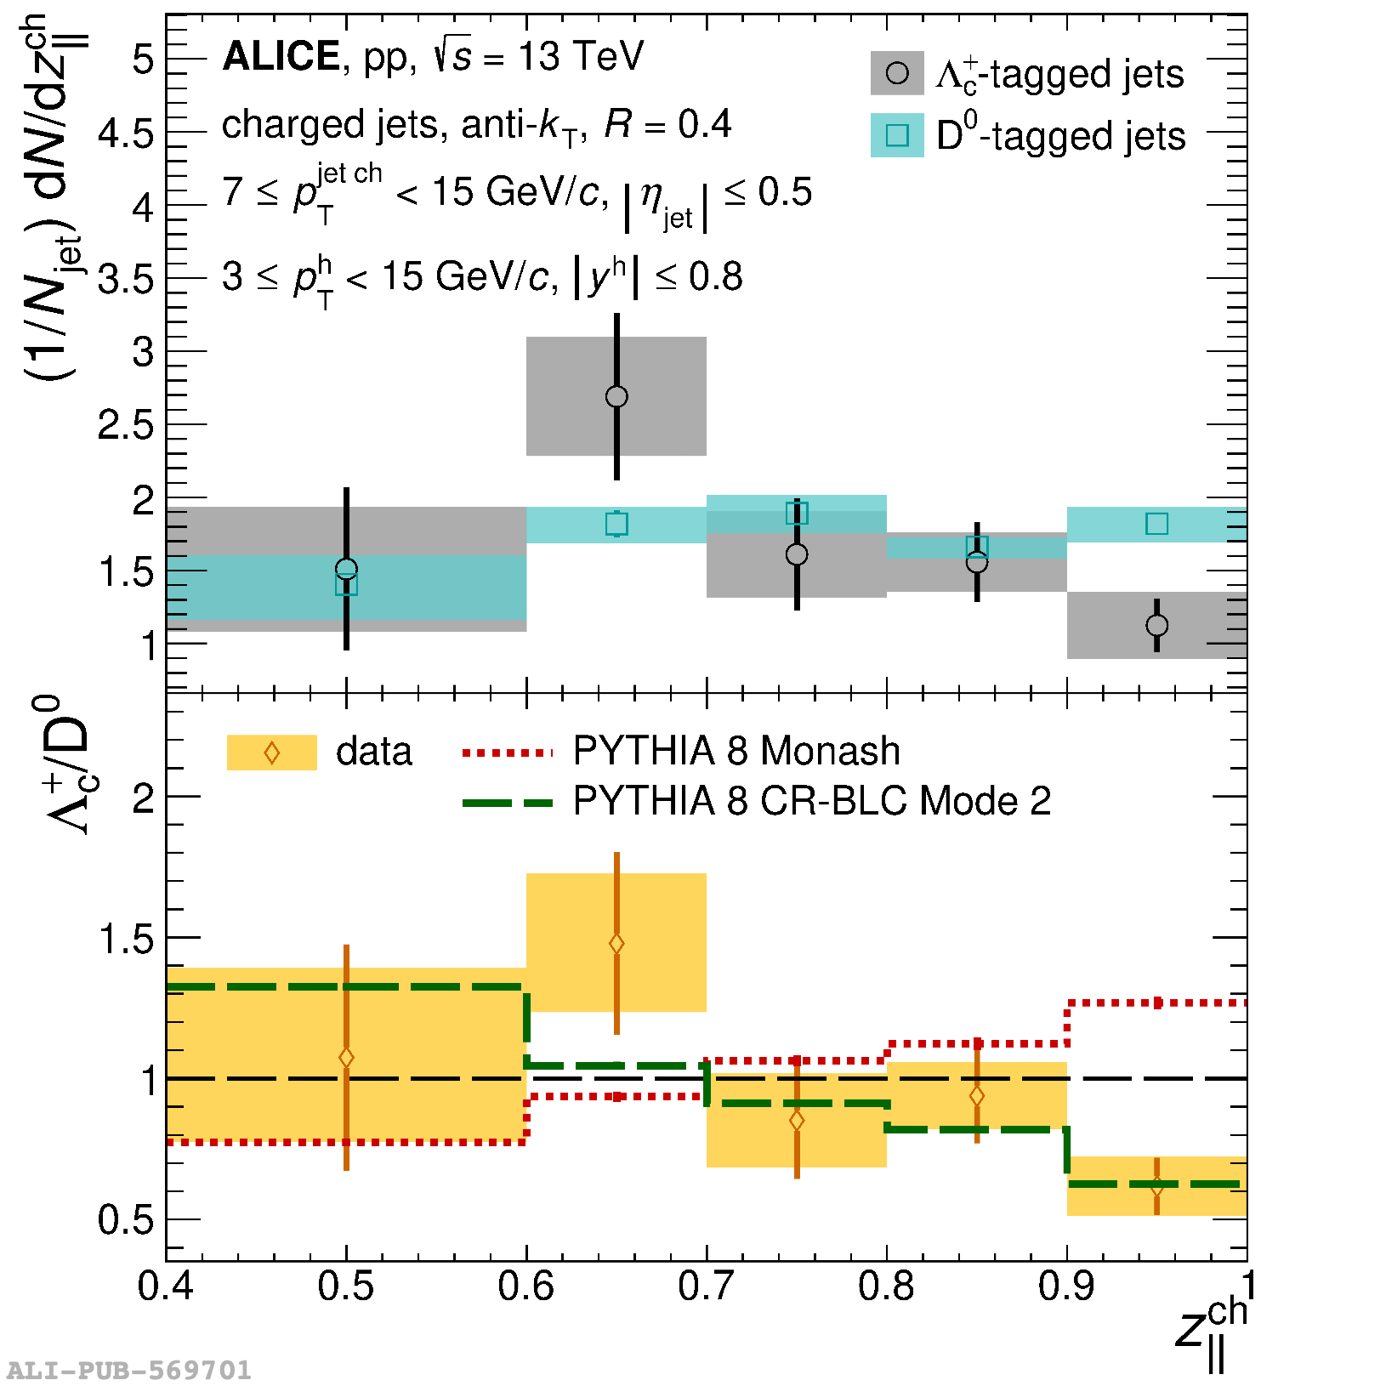
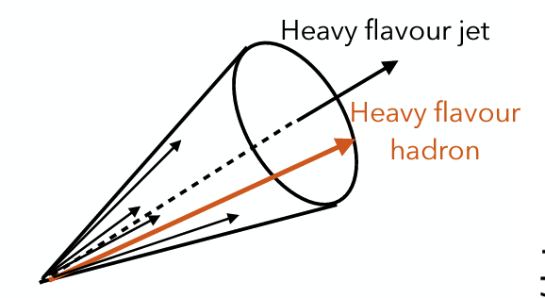
Charm baryon production in jets
Phys. Rev. D 109 (2024) 072005
Momentum fraction $Λ_{c}^{+}$ and D mesons in jets
Production of charm baryons in pp collisions larger than expected from e⁺e⁻ collisions (breaking of factorisation)
New measurement of charm baryon production in jets:
  Baryon distribution softer than mesons
  Matches well with a model that includes color recombination and baryon junctions
Paper Committee member: Vit Kucera (Inha University)

Slide 6
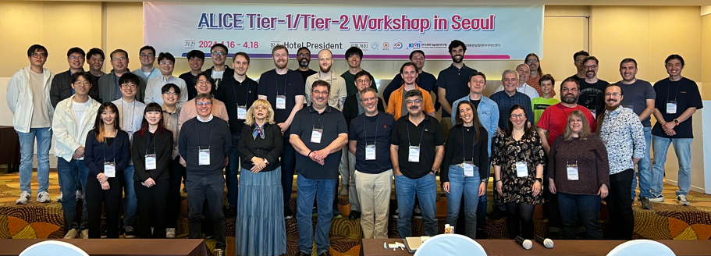



11th annual ALICE Tier1/Tier2 workshop
16-18 April 2024 in Seoul
Organized by KISTI-GSDC,
co-sponsored by KSHEP
45 participants from Asia, Europe,
North and South America
Computing centre managers, network experts,
Grid software developers and security
Discussions on
  Status and future development of the Grid middleware
  Network infrastructure
  Site operation and resources planning
  Integration of HPC systems, e.g. NURION at KISTI
  Grid and site computing security
Thank you for hosting
this important event!

Slide 7
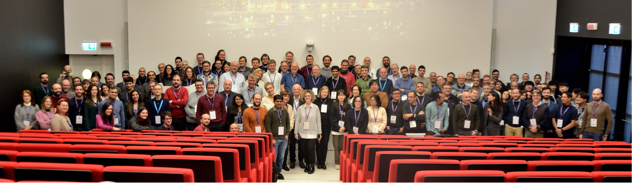
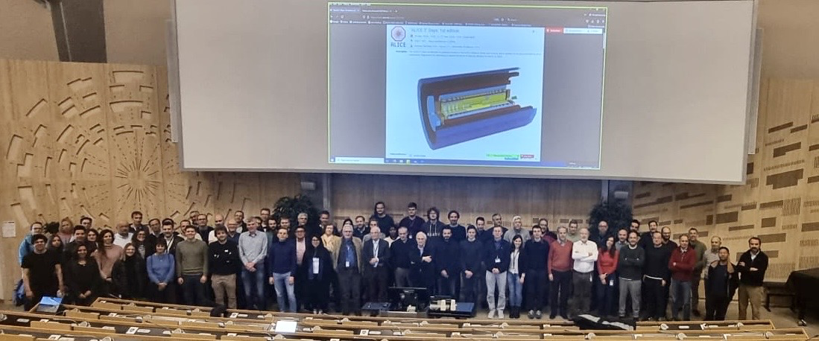
Upgrades: ITS3, FoCal and ALICE 3
“ALICE 3” Days, CERN, 25-27 March
ALICE Upgrade week, 4-7 December 2023, Torino
ALICE 3 Days, 25-27 March, CERN

Slide 8
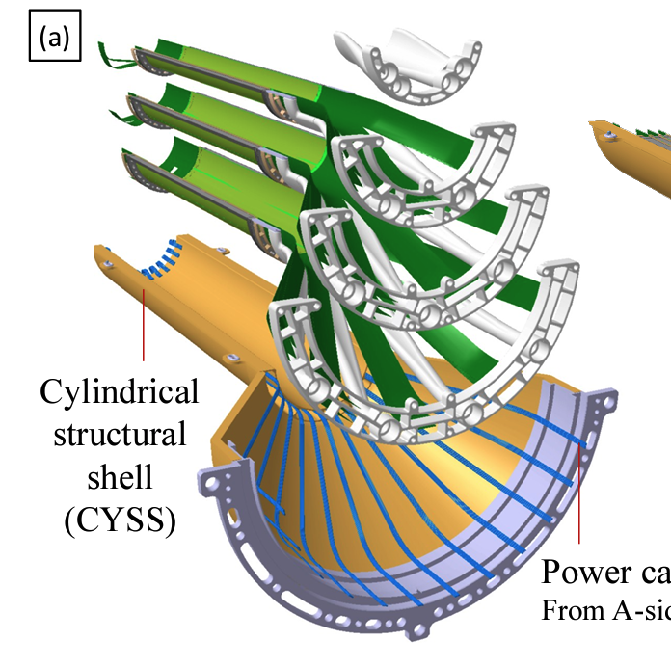
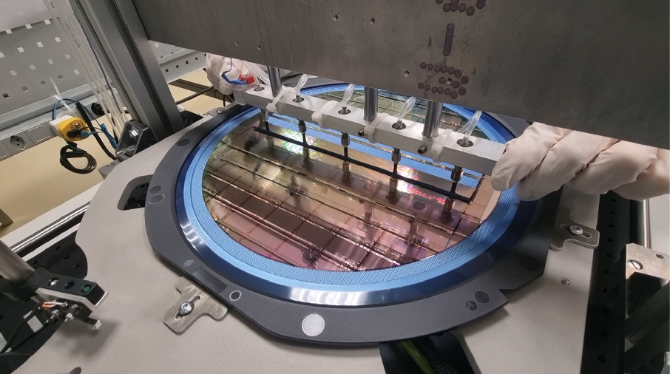
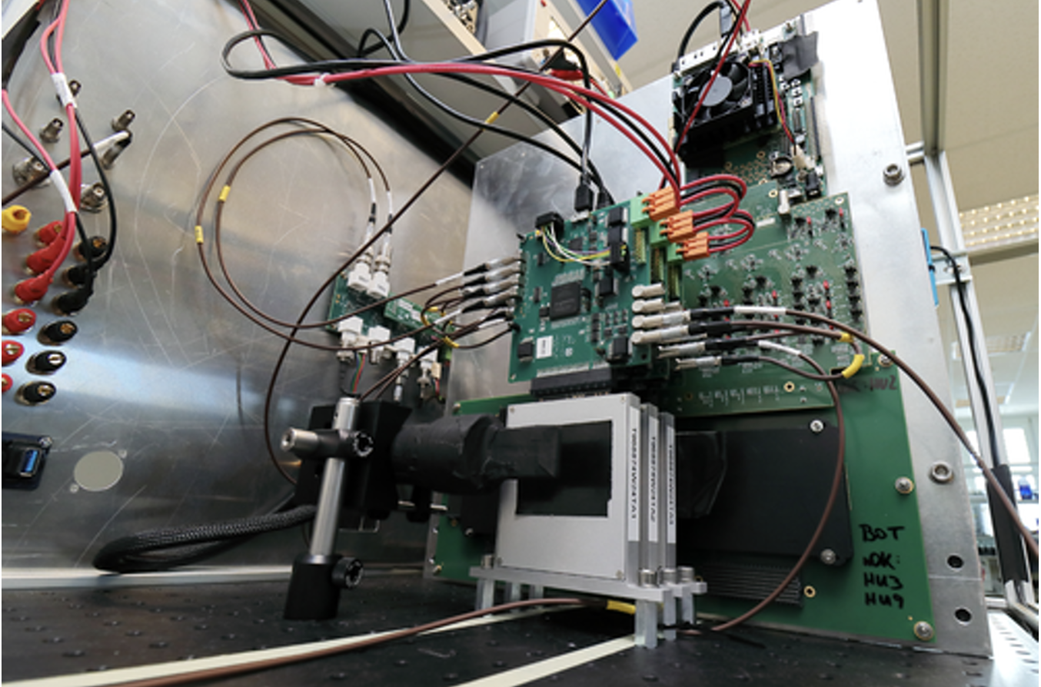
LS3 upgrades: ITS 3 — ultra-light fully cylindrical tracking layers
Wire bonding of curved sensors
Handling of stitched structures
Beam tests
ITS3: replace inner three layers of ITS with ultralight tracker
Large-area curved sensors (stitched CMOS)
Air cooling — low power
Improve performance for heavy flavour, dielectrons (thermal radiation) — physics performance note
New Engineering Run 1 stitched sensors being tested
TDR approved (CERN-LHCC-2024-003)
ALICE update | CKC meeting 22 April 2024 | Marco van Leeuwen

Slide 9
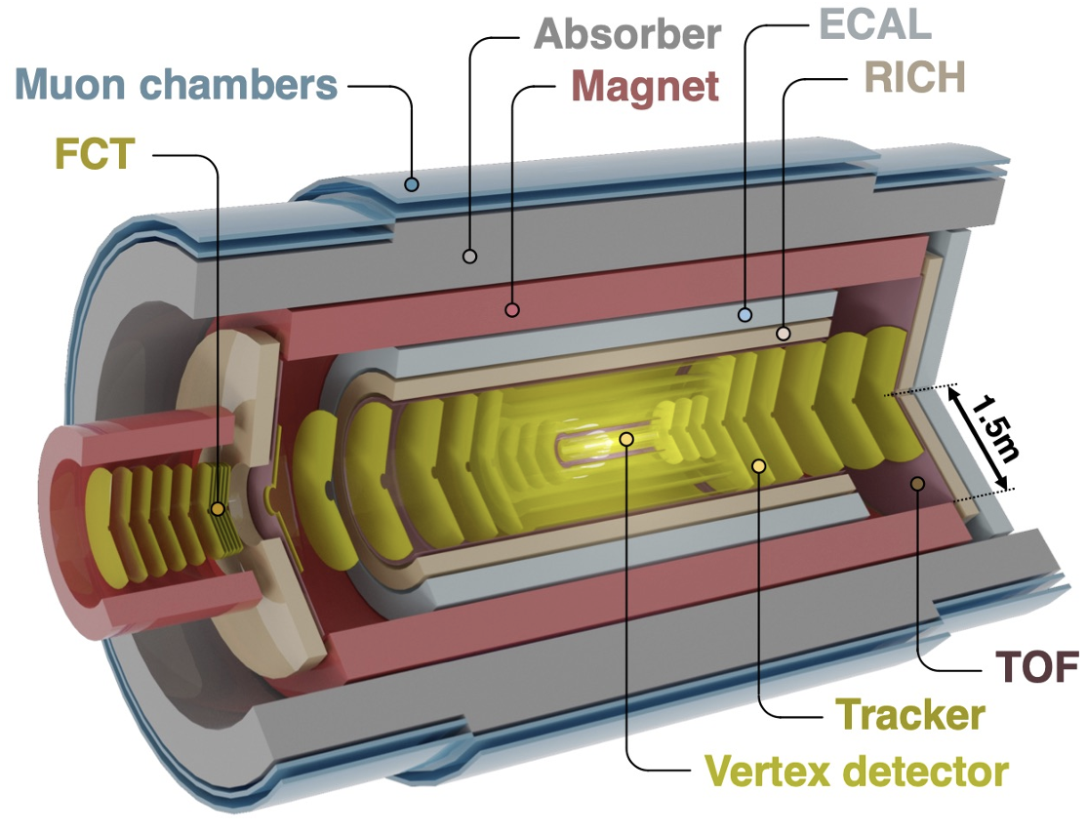
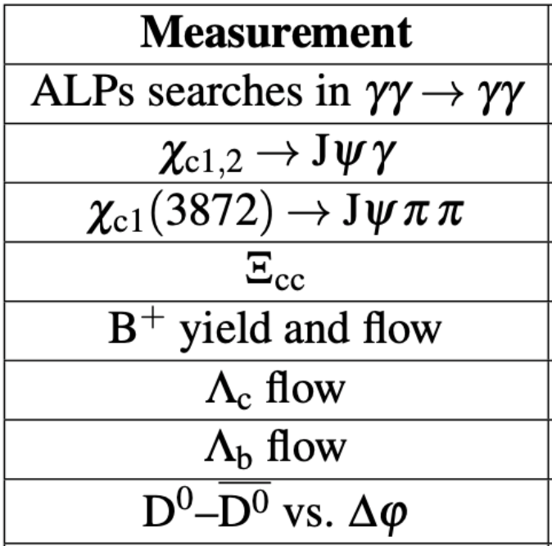
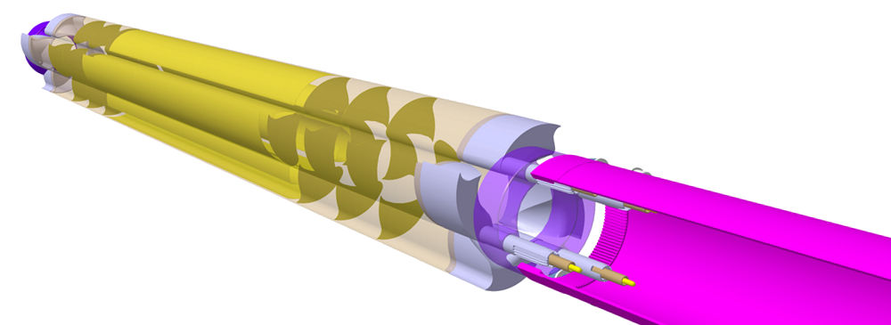
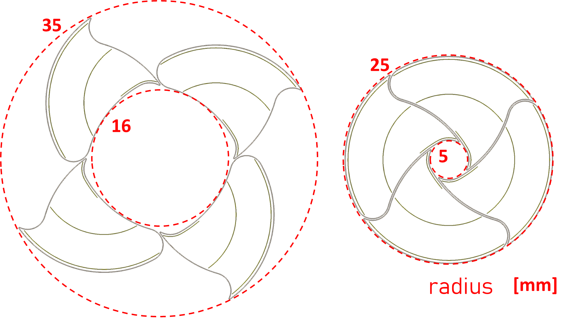
ALICE 3 upgrade
ACTS
ALICE 3 design:
Compact and lightweight all-silicon tracker
  Excellent pointing resolution with a retractable vertex detector
Extensive particle identification: TOF, RICH
Large acceptance
Sensor R&D started: test beams for MID, ECal, RICH TOF
Cost and schedule: Scoping Document
Two main scoping options defined:
  Setup without ECal
  Reduced magnetic field: ~ 1 T
Letter of Intent: LHCC-2022-009
Scoping Document
reviewed by editorial committee
Retractable vertex tracker
Notes:
neuartiges Detektorkonzept
große Akzeptanz → Si-Tracker
sehr gute Pointing Auflösung
PID über große Akzeptanz

Slide 10
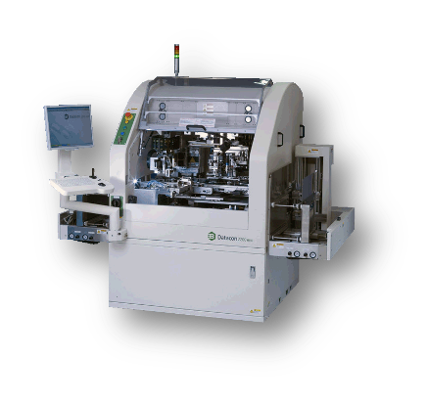
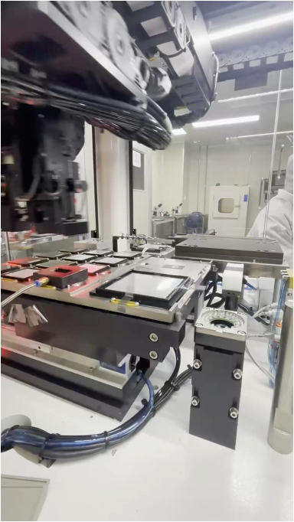
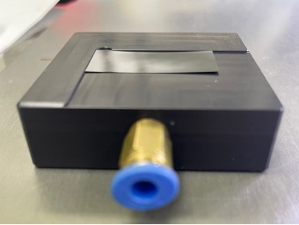
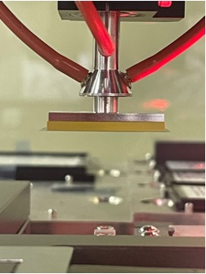
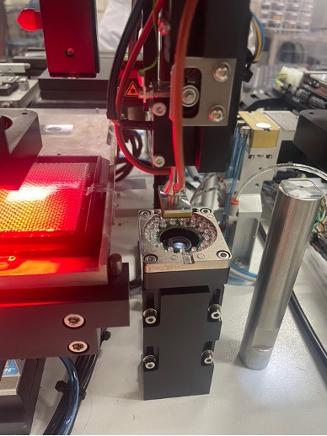
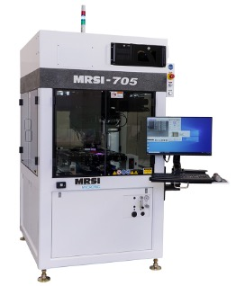
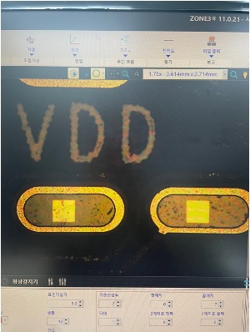
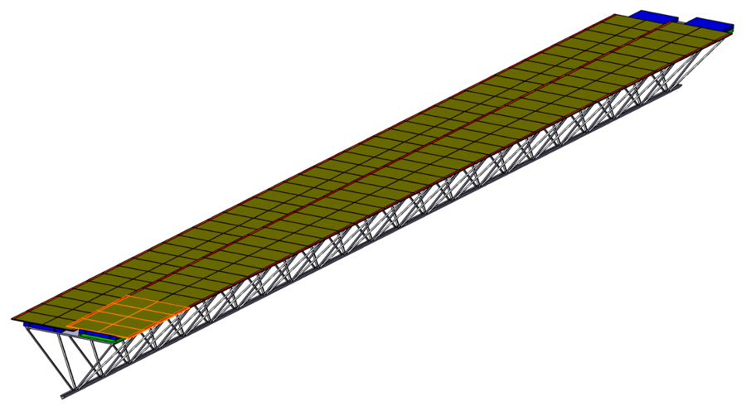
Outer tracker R&D: module production
Commercial general purpose die
attach machine
Chip holder
Chip gripper
Marker scan
Position reproducible
with 5 μm level accuracy
Tests with Korean company: MEMSPACK
Large area: automated industrial production of multi-chip modules
First tests with dummy modules in collaboration with industry
Ladder design
Module

Slide 11
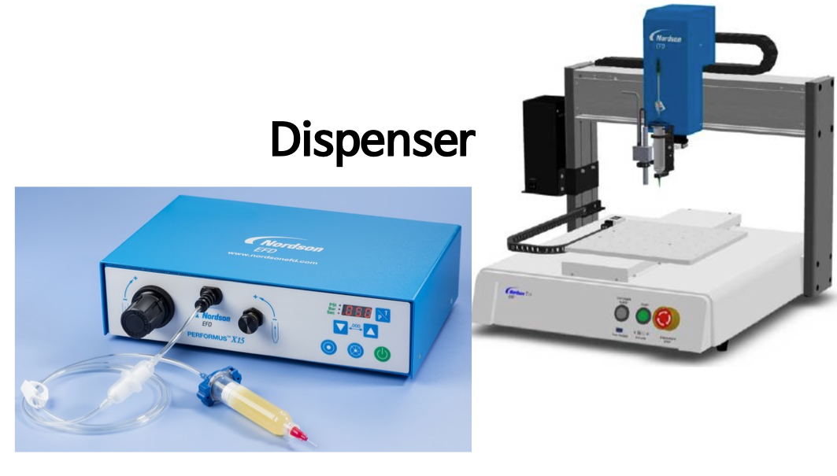
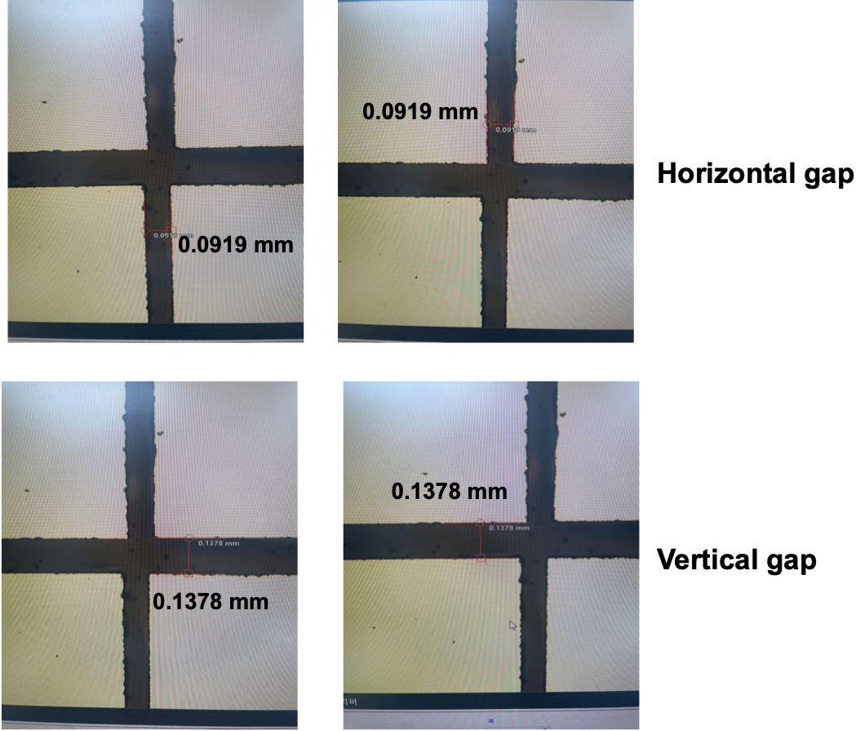
R&D for ALICE 3: module production
Key R&D item for ALICE 3: automated module assembly
Multi-chip modules to assembly large area
Automatic glue dispensing
Test sensor positioning
R&D with MEMSPACK to develop assembly process
First tests of position accuracy very promising
Next step: test with glueing
  Determines production throughput
Important input for module design, schedule and cost estimates

Slide 12
Conclusion
Run 2 data continues to produce new results
Processing of Pb-Pb data is advancing — aim for first results in summer
ALICE Tier-1/2 workshop hosted by KISTI
R&D for ITS3 and ALICE 3 progressing well
Thank you for your support and attention

Slide 13
Extra slides

Slide 14
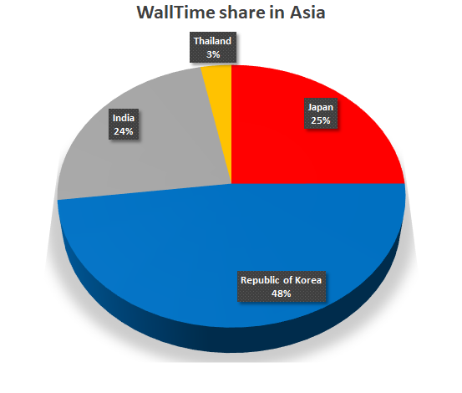
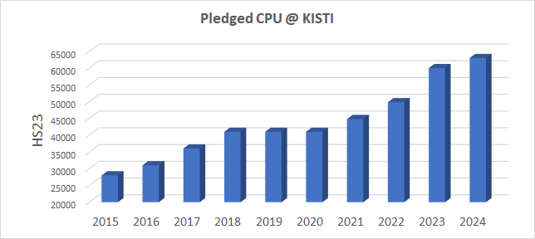
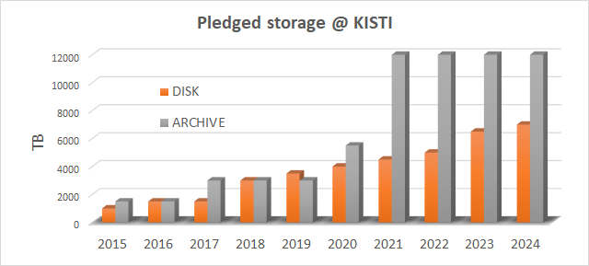
KISTI contribution to ALICE computing
Joined ALICE Grid in 2007
Substantial contribution to ALICE computing
Only Tier 1 in Asia: very reliable operation
Important regional function
KISTI provides 15% of the ALICE T1 resources and 50% of the computing capacity in Asia
Robust growth over the past 11 years, today more than 3500 CPU cores and about 20 PB of storage

