Slide 1
DA studies with Xsuite & bisection applied to DA analysis
With help from scripts made by M. Hofer and P. Kicsiny

Slide 2
Oide’s DA
Tracking planes with varying action J, phase φ and energy offset δ
J varies in ±40σ, δ varies in ±3% (or less depending on beam energy)
Φ is [0, π/4, π/2, 3π/4, π, -3π/4, -π/2, -π/4]
Average the particle survival over the various phases
X = Y = J cos(Φ) , PX = PY = J sin(Φ) and J_{x}/J_{y} = ε_{x}/ε_{y}
The ‘brute force’ DA tracks a lot of macroparticles
e.g. 10k to 40k macroparticles depending on grid size and refinement.
The particles surviving in the ‘central region’ of the DA take a lot of time for a not so relevant information, and the better the DA the more time it will take.
Proposal: perform a bisection to find the DA limit to decrease the macroparticles tracked and the DA simulation duration.

Slide 3
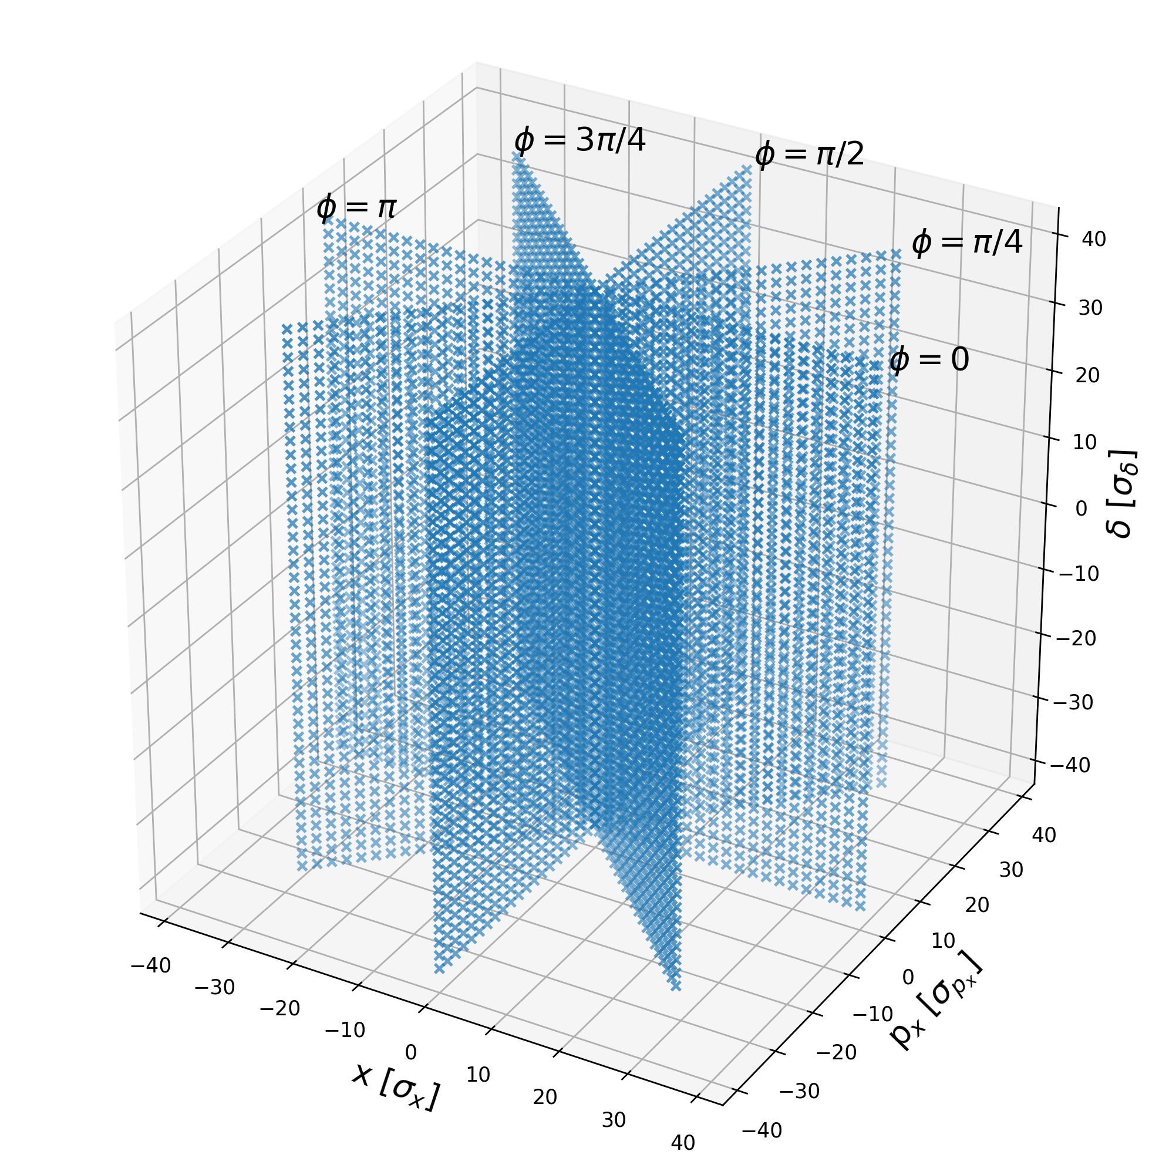
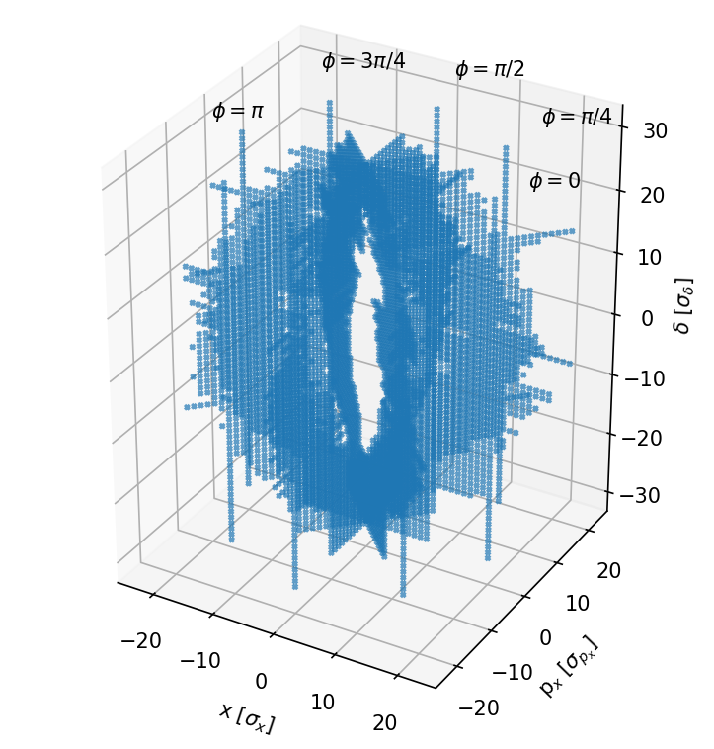
Oide’s DA - Macroparticle grid
‘Brute force’ grid
Grid resulting from bisection

Slide 4
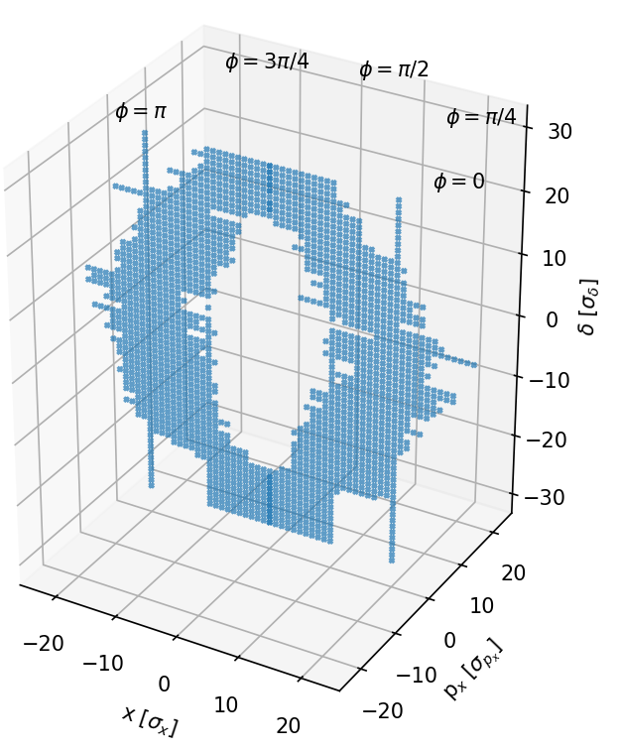
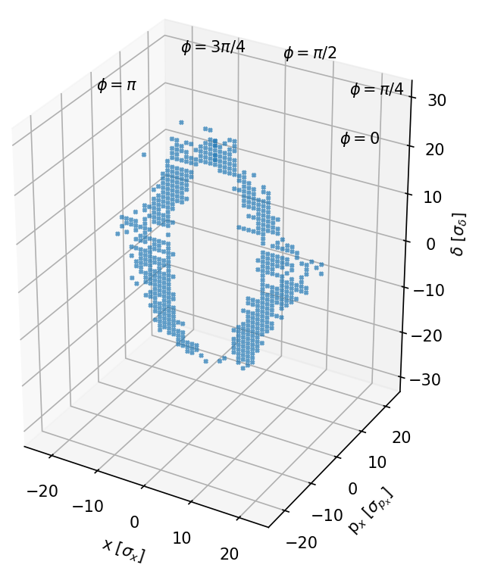
Oide’s DA - Macroparticle grid
All phases
Only φ=0
Only φ=0, and all survived

Slide 5
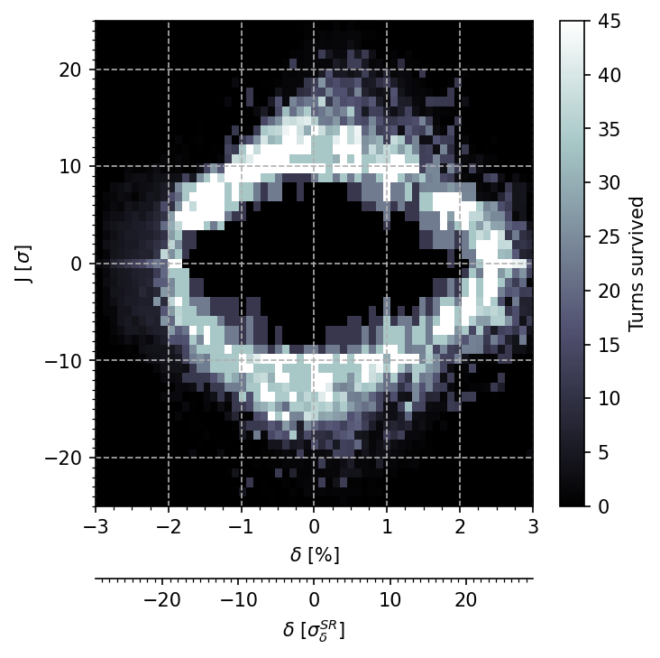
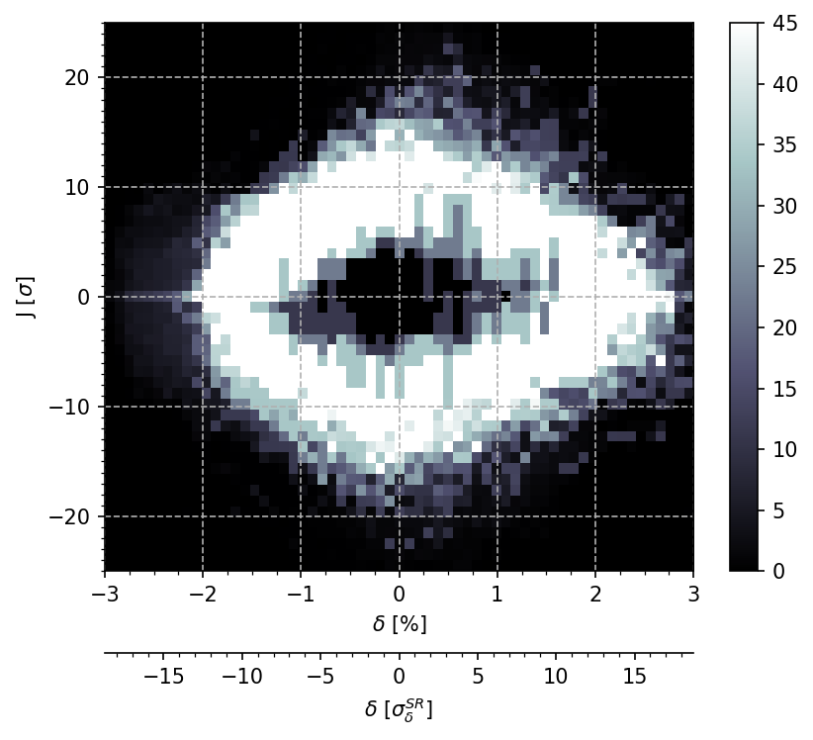
Resulting DA
As you increase the ‘depth’ of tracked macroparticle in action J, the central area becomes increasingly whiter, proving the particles survived.
Some parts of the central region appear less white because of the average between phase planes because some planes have no data at this (δ,J) position.

Slide 6
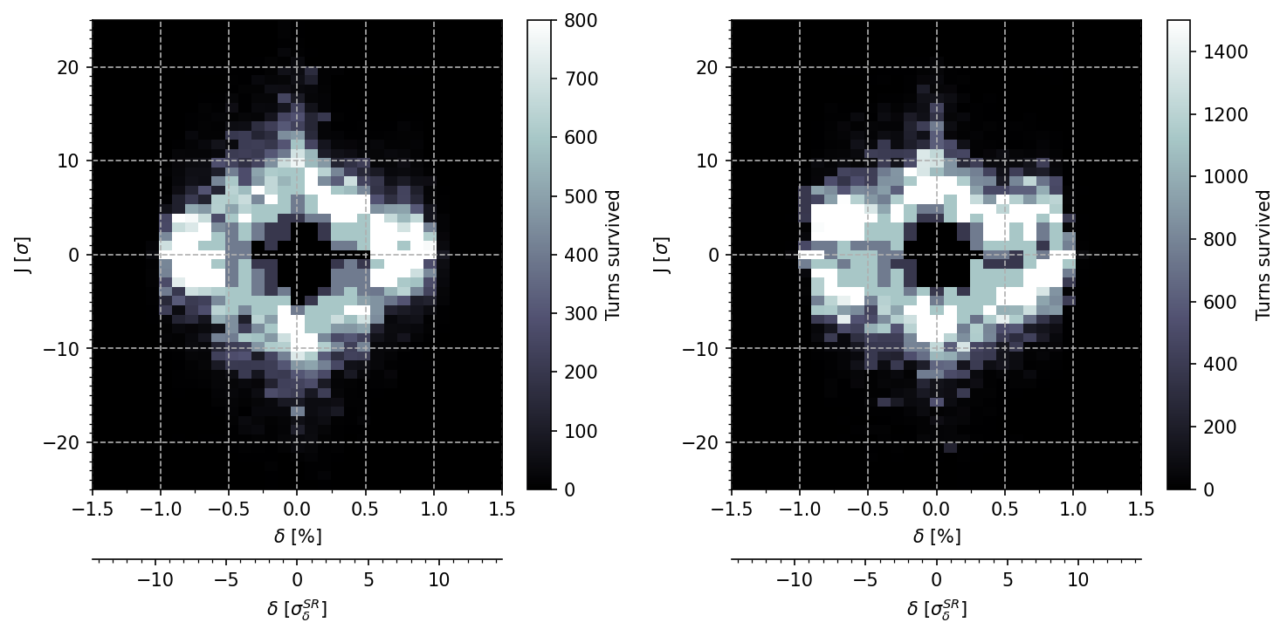
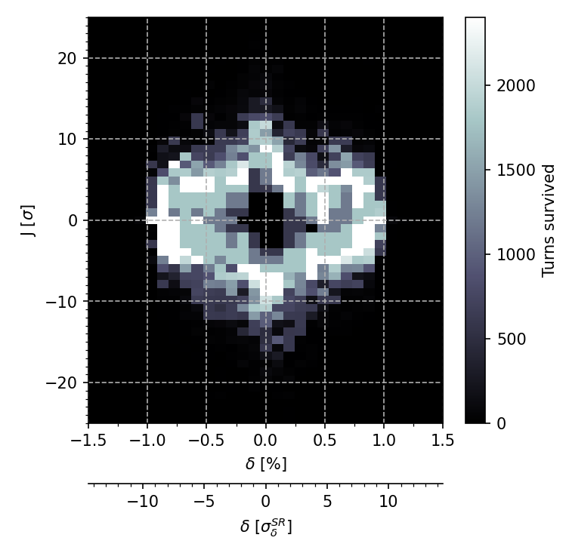
Results with increasing number of turns
800 turns ~ 2h09
Including slicing and Xsuite line conversion from MADX sequence
1500 turns ~ 3h28
including slicing and Xsuite line conversion from MADX sequence
2400 turns ~ 3h
including slicing and Xsuite line conversion from MADX sequence

Slide 7
Potential interest of bisection for DA
Assuming a fixed time to track in the FCC-ee lattice, let’s say 6ms/macroparticle/turn, if one needs less macroparticles to find the DA than a ‘brute force’ method:
One can increase the number of turns to perform the DA (is it necessary ?)
One can refine the grid to perform a more precise DA (is it necessary ?)
One can compute the DA faster in view of DA optimization as presented by S. White.
This method can be implemented as a test on the GitLab repository.

Slide 8
Some results

Slide 9
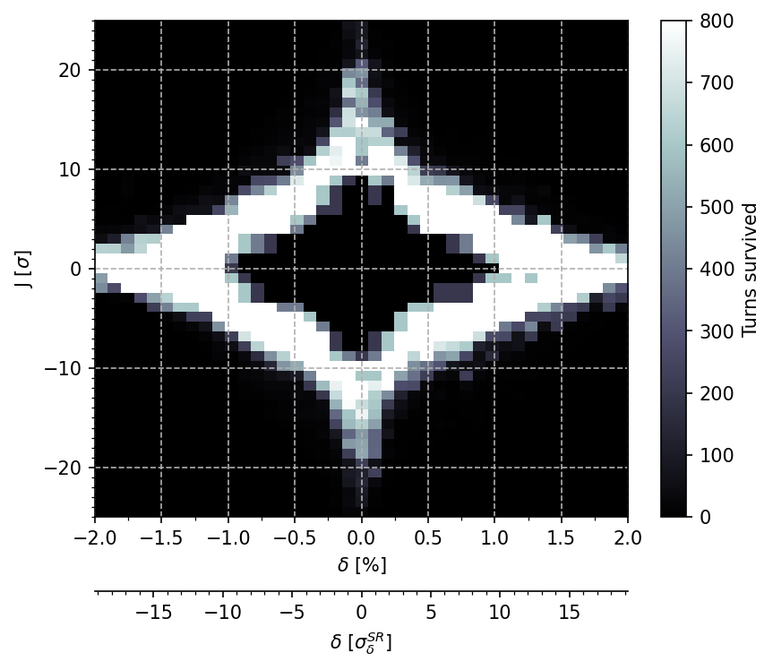
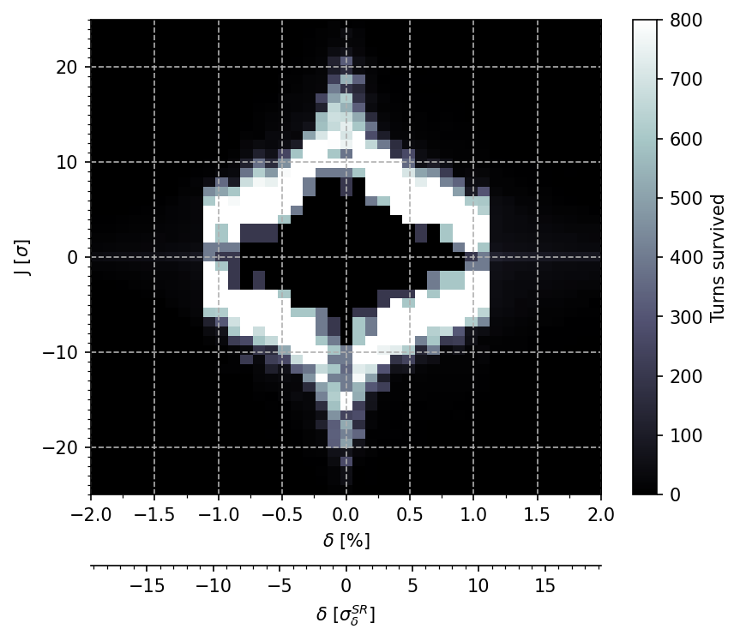
DA at Z with varying RF voltage (V24.3_LCC)
200 MV total RF voltage
80 MV total RF voltage
Agrees with the RF acceptance formula.

Slide 10
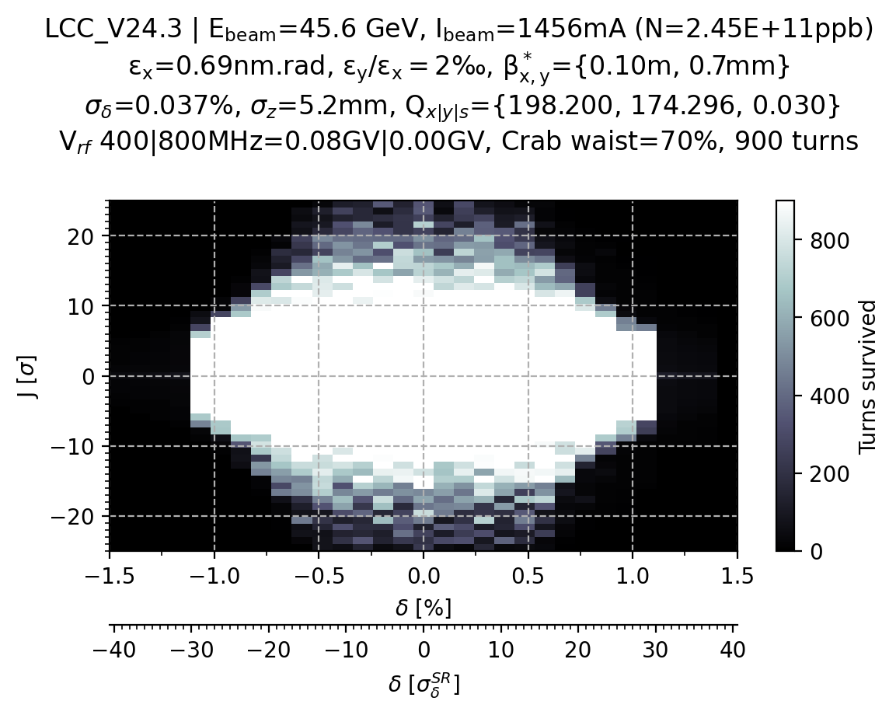
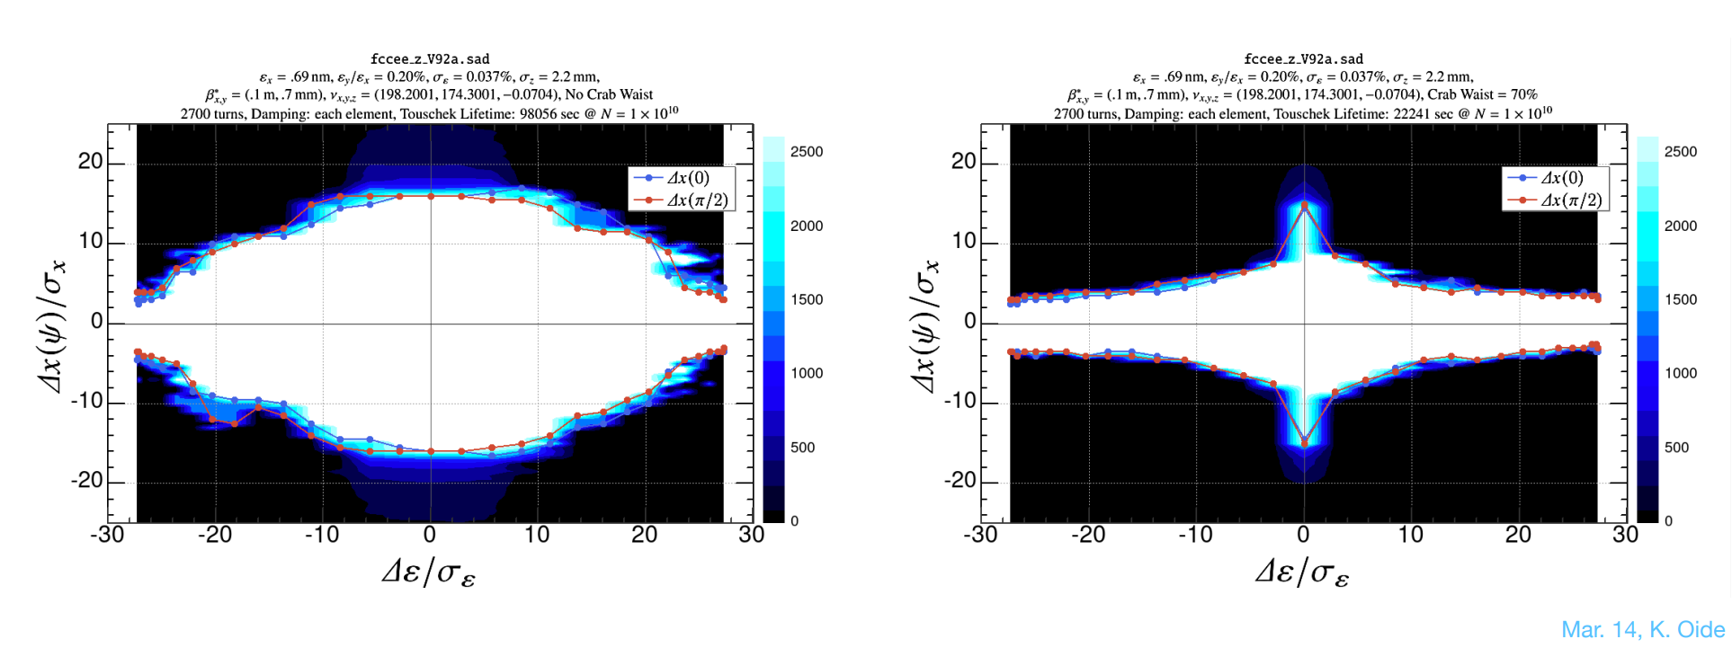
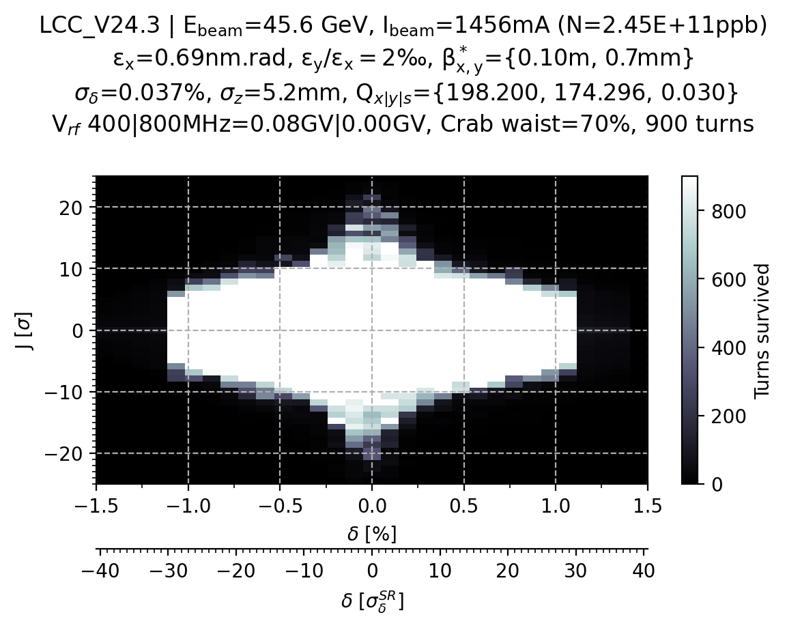
V24.1 (LCC) @Z
CW=0%
No crab waist
Similar DA with crab waist off between Xsuite and SAD.
Still better DA off-energy
With crab waist on, seems to be different,
which value for cs_comp is set in SAD ?
the number of turns differ 900 turns for Xsuite, 2700 turns for SAD.
The RF voltage is 80 MV.
SAD results from K. Oide
CW=70%

Slide 11
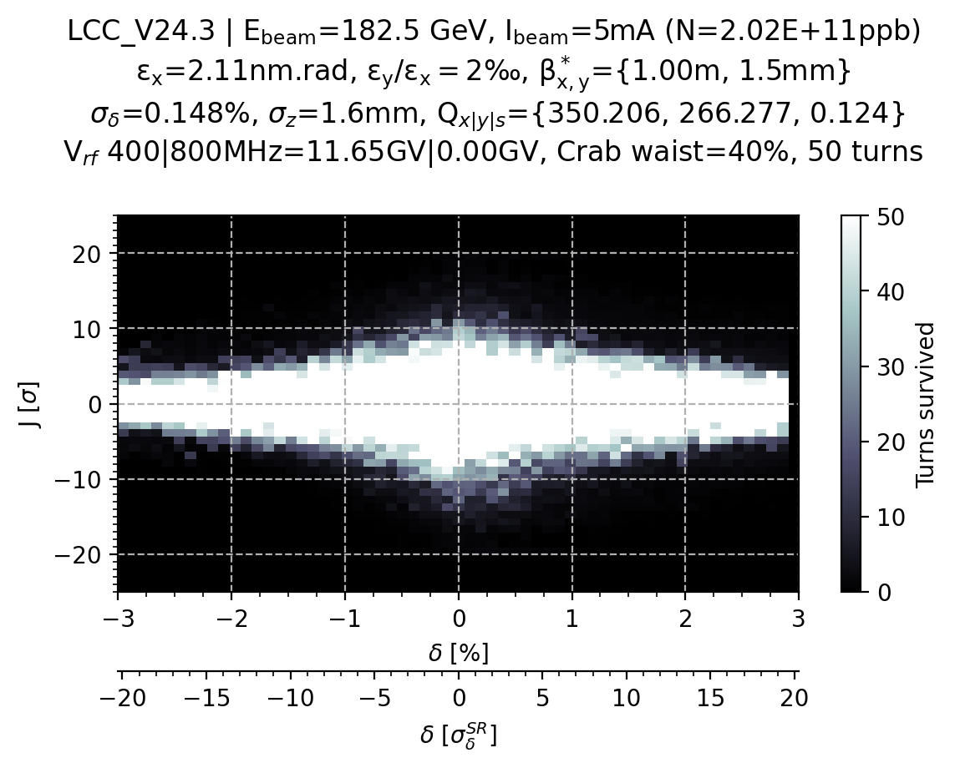
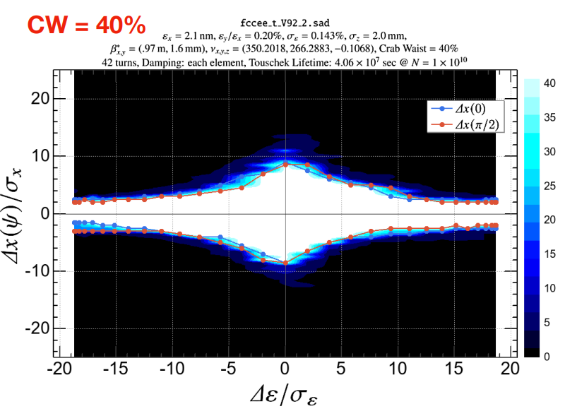
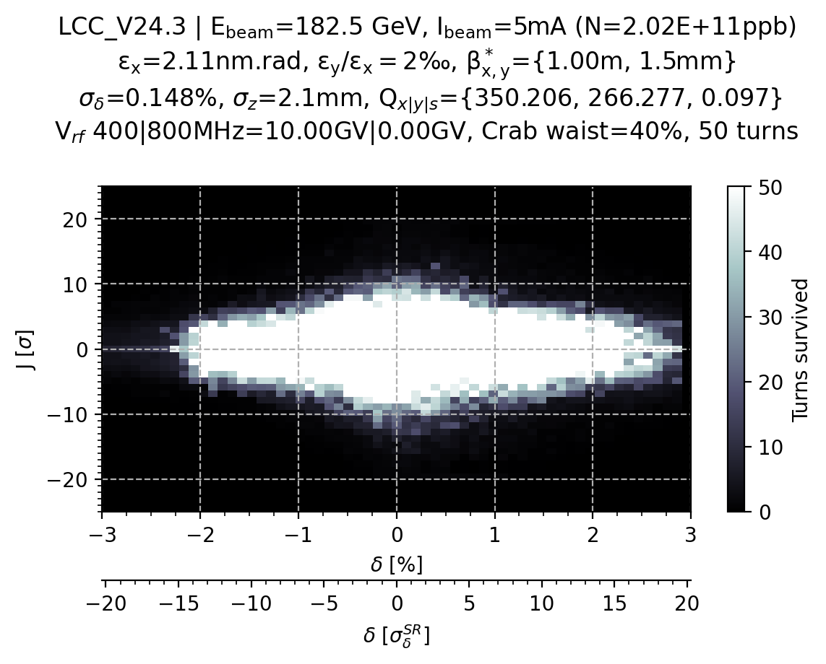
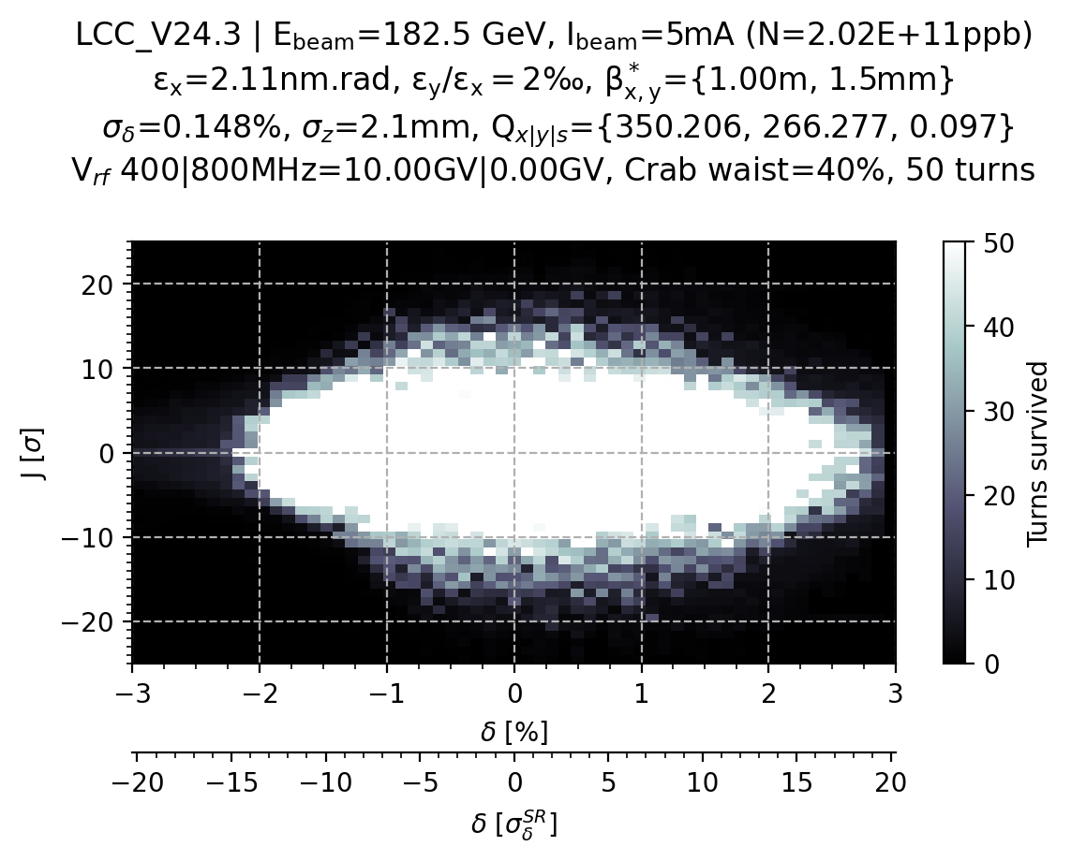
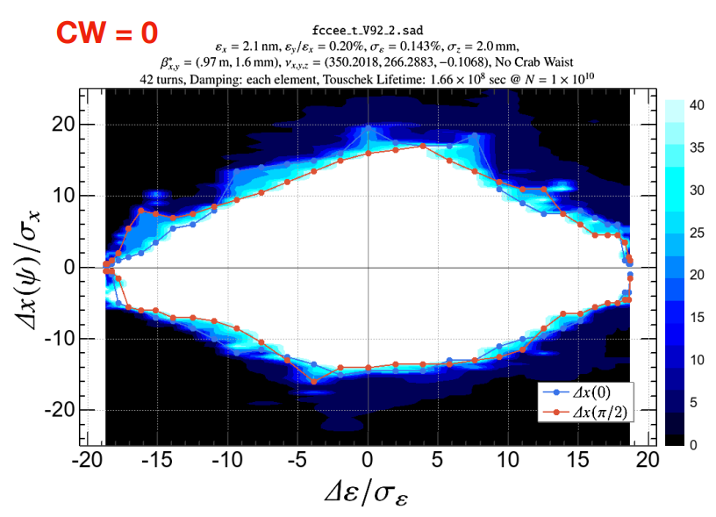
V24.1 (LCC) @tt
Vrf = 11.65GV and 800MHz
Vrf = 10GV and 800MHz
Vrf = 10GV and 800MHz
No crab waist
Crab waist at 0 or 40%
cs_frac = cs_comp = 0.4
800MHz RF frequency with
harmonic = 242400 and not 135000 and same RF voltage as GHC lattice

Slide 12
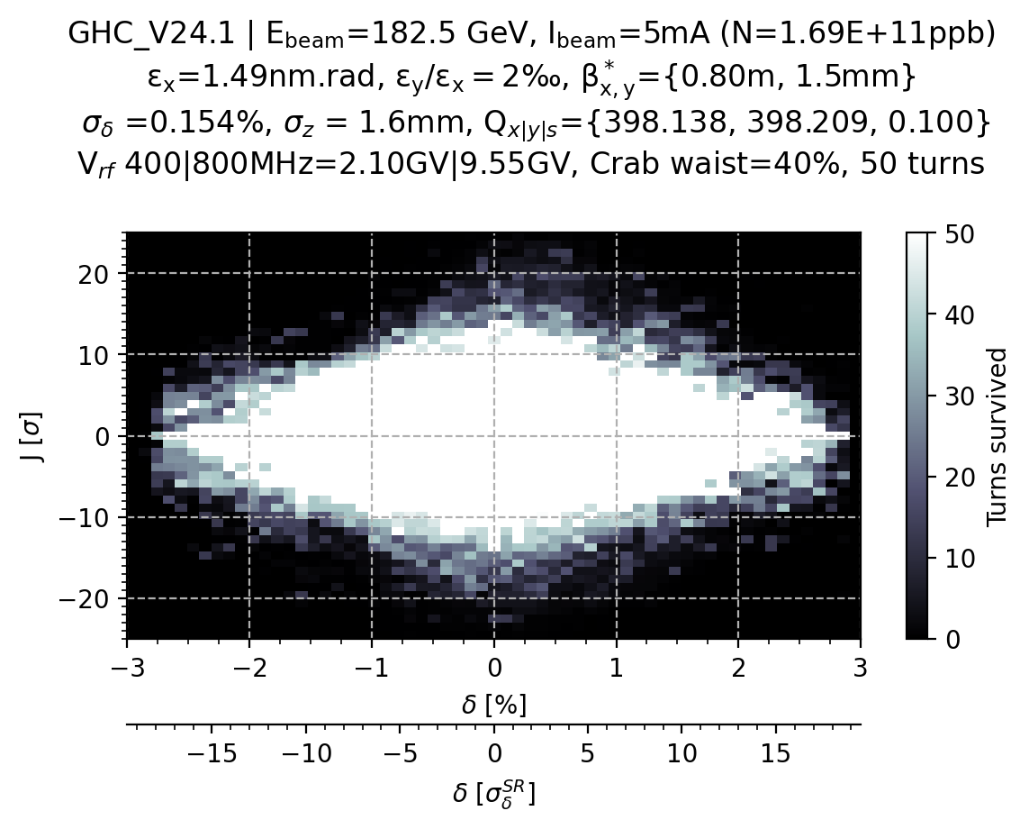
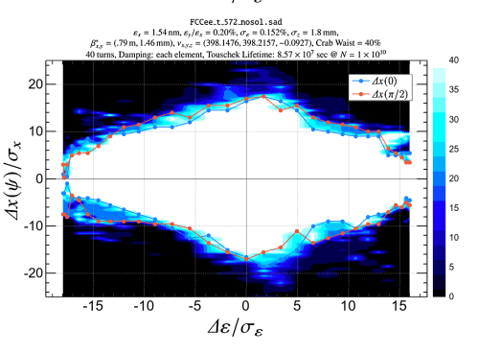
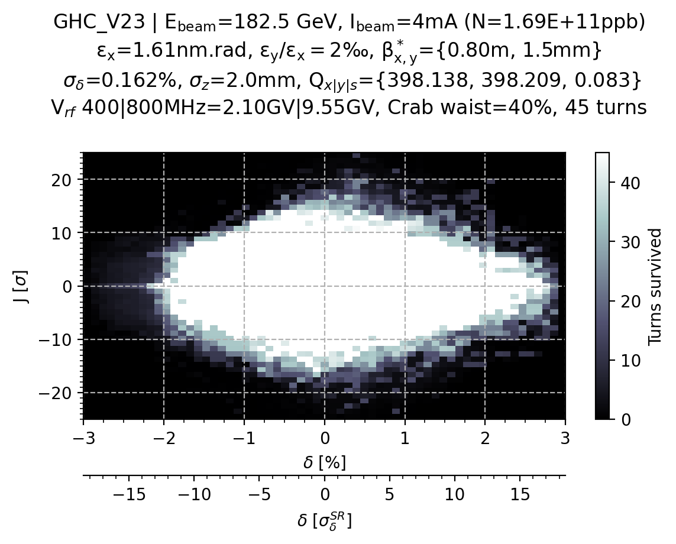
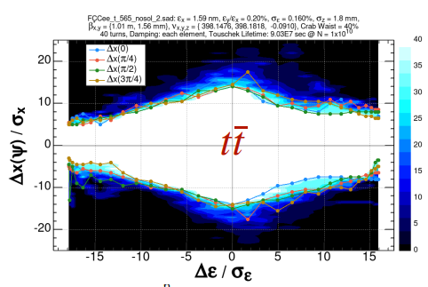
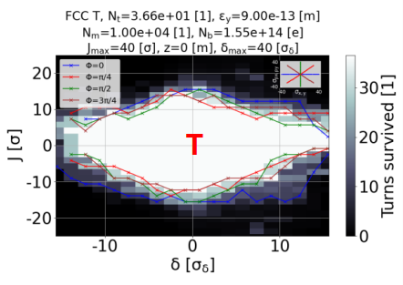
V23 vs V24.1 (GHC lattice) @tt
tt v24
tt v24
tt v23
Peter’s result

Slide 13
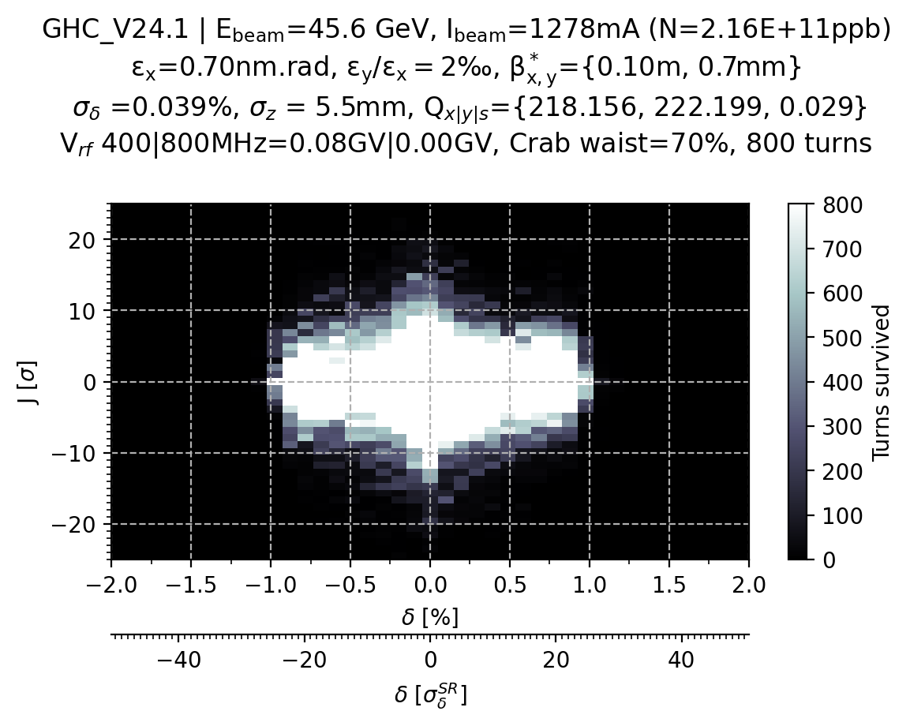
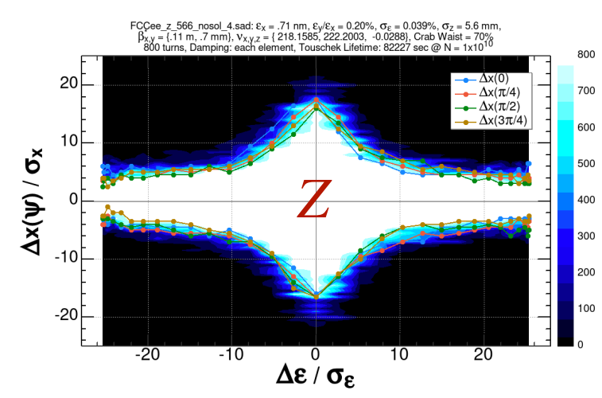
V24.1 (GHC lattice) @Z

Slide 14
DA at Z
V24.3_LCC
V24.3_LCC
V24.1_GHC
200 MV total RF voltage
80 MV total RF voltage

Slide 15
Summary & outlook
Used Xsuite to perform DA study similar to what P. Kisciny had presented in previous optics meeting(s) with the addition of bisection to find the DA limit or chaotic region with less macroparticles (i.e. faster).
It can be implemented as a test on Gitlab, and it can be used to perform DA-based optimization with Xsuite.
Preliminary DA comparison between Xsuite and SAD yields comparable results without crab waist (K. Oide results of 180th optics meeting). Adding crab waist the results differ more. May be explained by the use of different settings of some variables (e.g. cs_comp), different magnet slicing, different number of tracked turn, etc..
Comparison with pyAT to come next, currently in discussion with S. White

Slide 16
Parameters
SR with quantum fluctuation
Slicing as in the GitLab repository for the GHC lattice (ref)
Similar slicing for the LCC lattice (see next slide)

Slide 17
LCC lattice slicing
// Slicing with special attention ot IR quads and sextupoles
SELECT, FLAG=makethin, CLASS=RFCAVITY, SLICE = 1;
SELECT, FLAG=makethin, CLASS=sbend, SLICE = 4;
SELECT, FLAG=makethin, CLASS=rbend, SLICE = 4;
SELECT, FLAG=makethin, CLASS=quadrupole, SLICE = 4;
SELECT, FLAG=makethin, CLASS=sextupole, SLICE = 4;
SELECT, FLAG=makethin, PATTERN=d[lfs], SLICE = 10;
SELECT, FLAG=makethin, PATTERN=q[fd][123456], SLICE = 10;
SELECT, FLAG=makethin, PATTERN=q[fd][m], SLICE = 10;
SELECT, FLAG=makethin, PATTERN=qd0, SLICE = 125;
SELECT, FLAG=makethin, PATTERN=s[fd][xy], SLICE = 20;
SELECT, FLAG=makethin, PATTERN=s[fd][m], SLICE = 20;
SELECT, FLAG=makethin, PATTERN=scrab[lr], SLICE = 20;

