Slide 1
Update on booster vacuum system, operation mode and polarisation time estimate in the DR
Frank Zimmermann
183rd FCC-ee Optics Design Meeting & 54th FCCIS WP2.2 Meeting

Slide 2
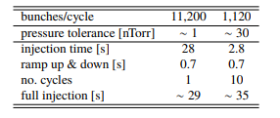
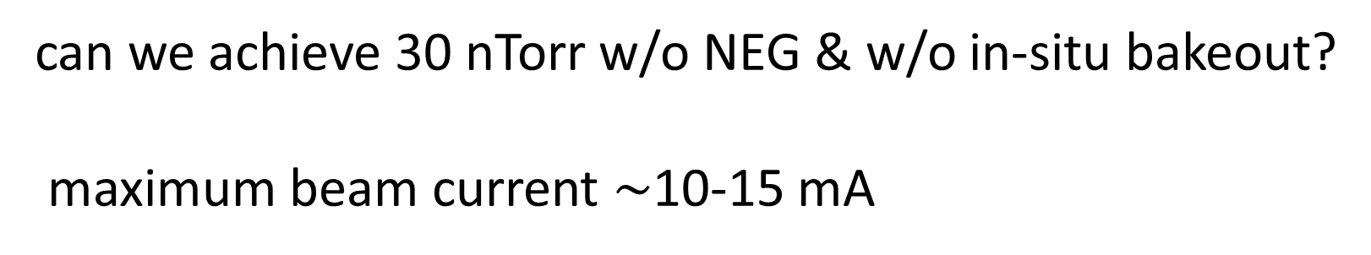
booster proposal based on FCC-ee “booster day”
https://indico.cern.ch/event/1378927/
vacuum system
no NEG
no bake-out
Cu chamber with thickness 1-1.5 mm OK (L. Von Freeden),
inner radius 30 mm (L. Von Freeden
can we achieve 30 nTorr w/o NEG & w/o in-situ bakeout?
maximum beam current $\sim$10-15 mA

Slide 3
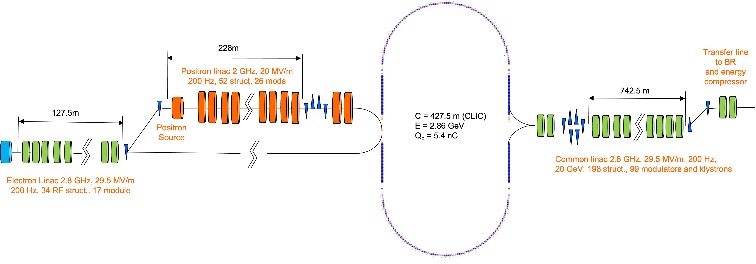
proposed alternative injector layout
R. Zennaro, P. Craievich et al.
from MTR

Slide 4


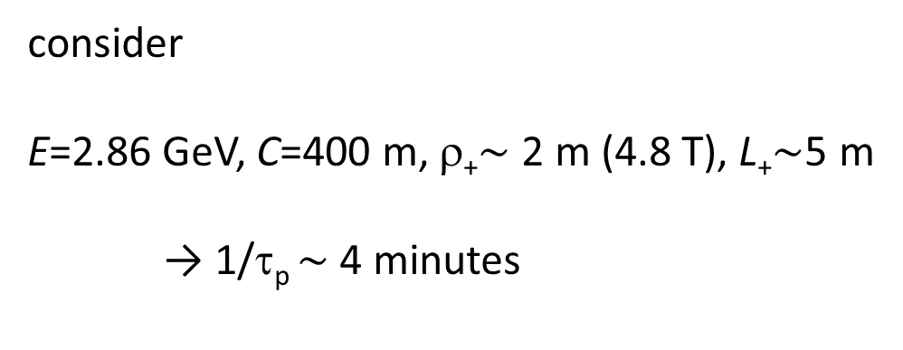
pre-polarisation in damping ring?
this may save 1-2 hours each time when filling from scratch after an abort
polarisation time
$$\frac{1}{τ_{p}}≈F\frac{γ^{5}L_{+}}{ρ_{+}^{3}}$$
$$F=\left(\frac{5\sqrt{3}}{8}\right)\frac{r_{e}ℏ}{m_{e}C}$$
with
E. Gianfelice, PRAB 19, 101005 (2016)
consider
E=2.86 GeV, C=400 m, ρ₊$\sim$ 2 m (4.8 T), L₊$\sim$5 m
→ 1/τ_{p} $\sim$ 4 minutes

