Slide 1
EESD – test at 20 K
12-04-2024
Gerard Willering TE-MSC-TM
Franco Mangiarotti, Jerome Feuvrier, Jean-Luc Guyon, Patrick Viret, Mariano Pentella, et al.
With many thanks to cryo operation team: Remi Mauny, Nicolas Balin, et al.
And credits to the EESD team Lucie Baudin, Nicolas Bourcey, Arnaud Devred, Patricia Borges de Sousa et al.
Preliminary results with purpose of intitial discussion.

Slide 2
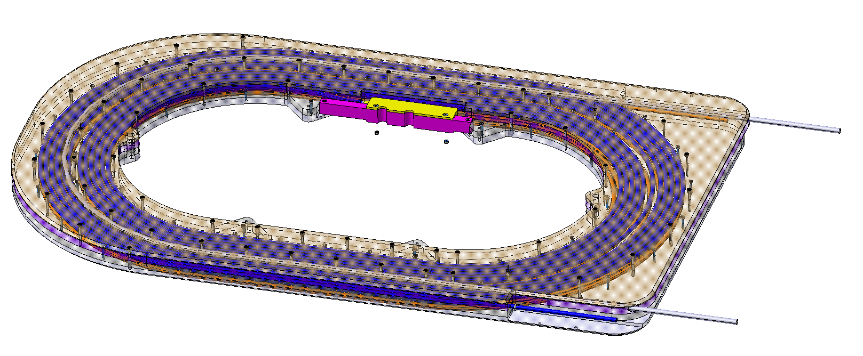
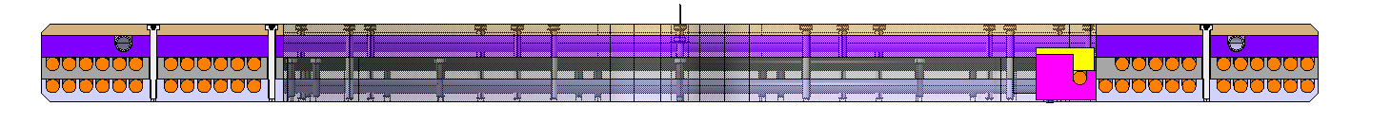
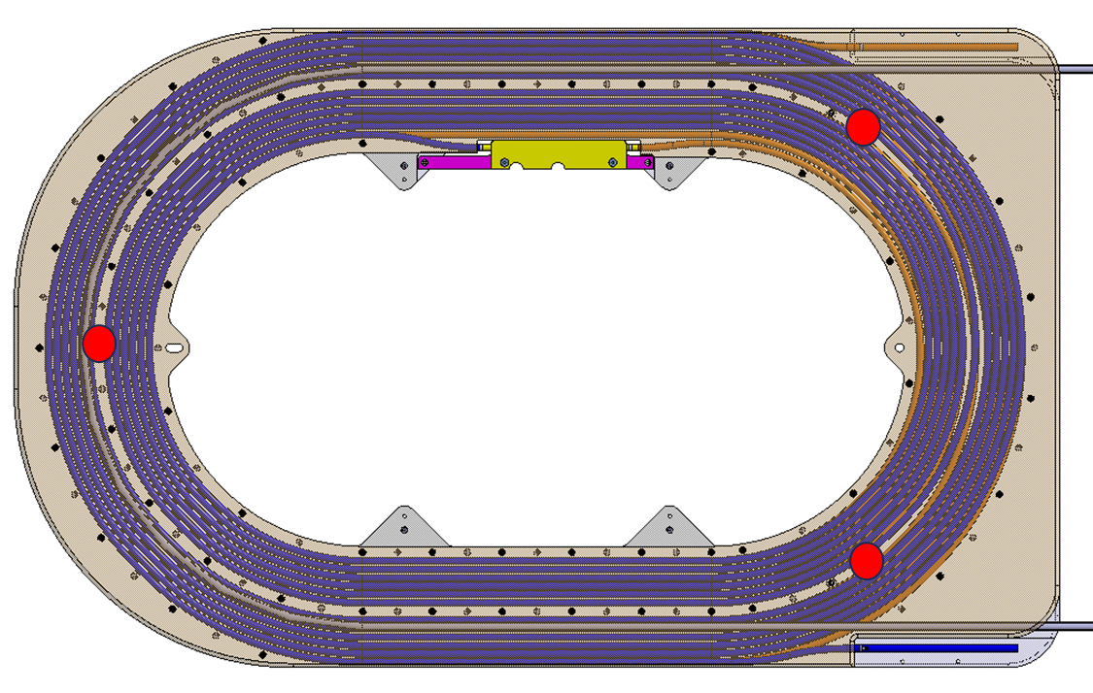
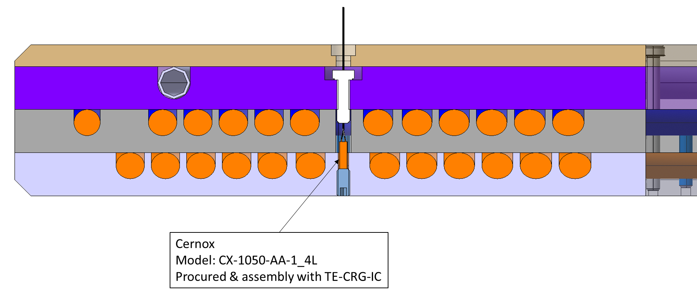
EESD reference pictures:
Two layer coil
Aluminum cooling layer
Upper layer
Lower layer
Three CERNOX temperature probes

Slide 3
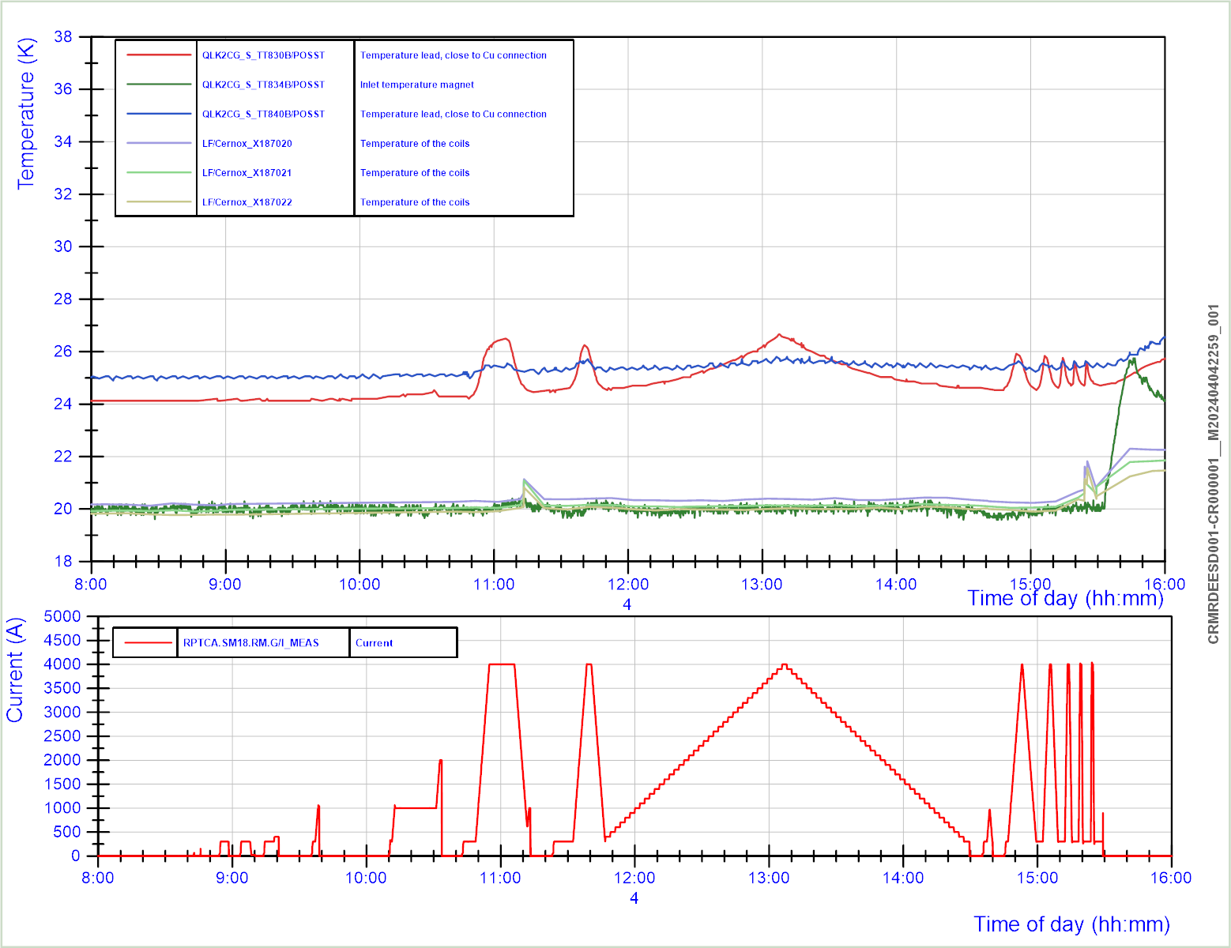
Powering at ~20 K
4 april 2024
Leads temperature at 24-25 K, increasing during powering.
He-valve closed, no active leads cooling, but OK for 4 kA.
Magnet temperature at 20 K
Powering cycles performed.

Slide 4
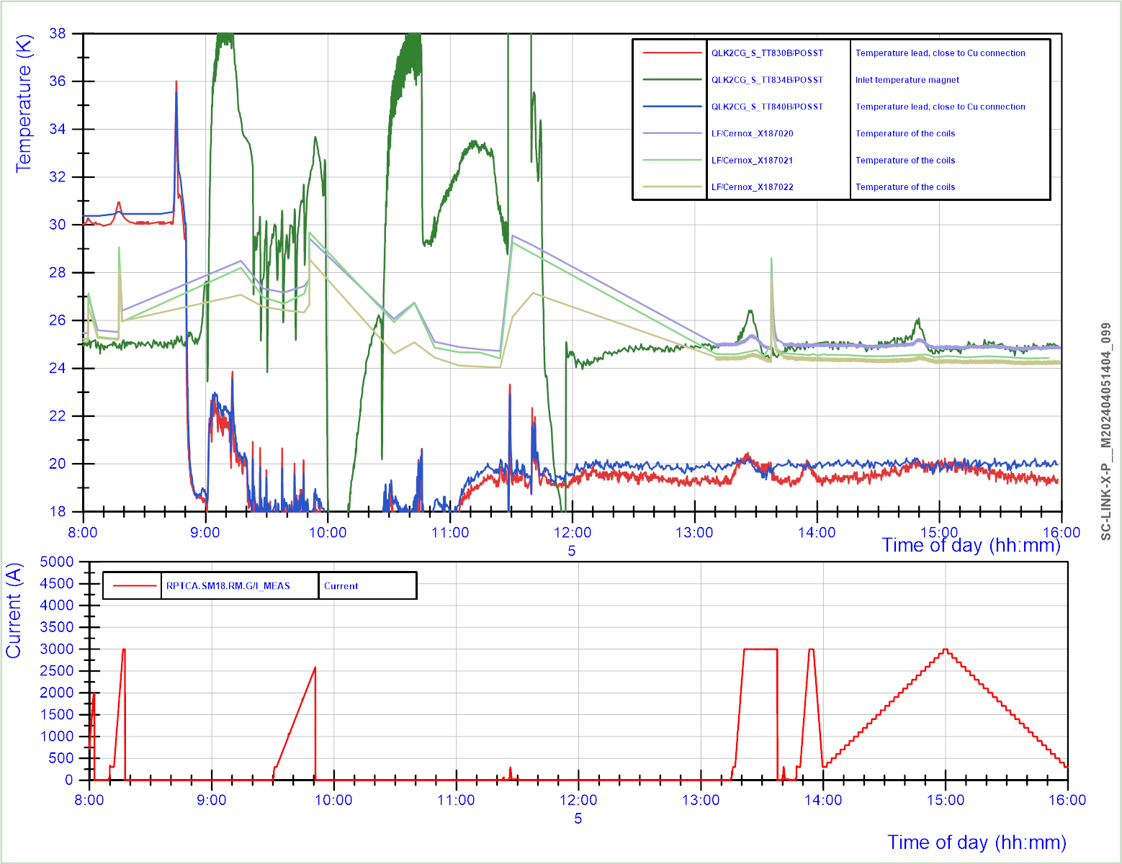
Powering at ~25 K
5 april 2024
Leads temperature at 30-31 K, increasing during powering.
He-valve closed, no active leads cooling, quench after 1 minute at 3 kA.
Quench at 2.6 kA, while helium input temperature was not stable and going up to 32 K.
Measurement of temperature in coil was not yet optimized.

Slide 5
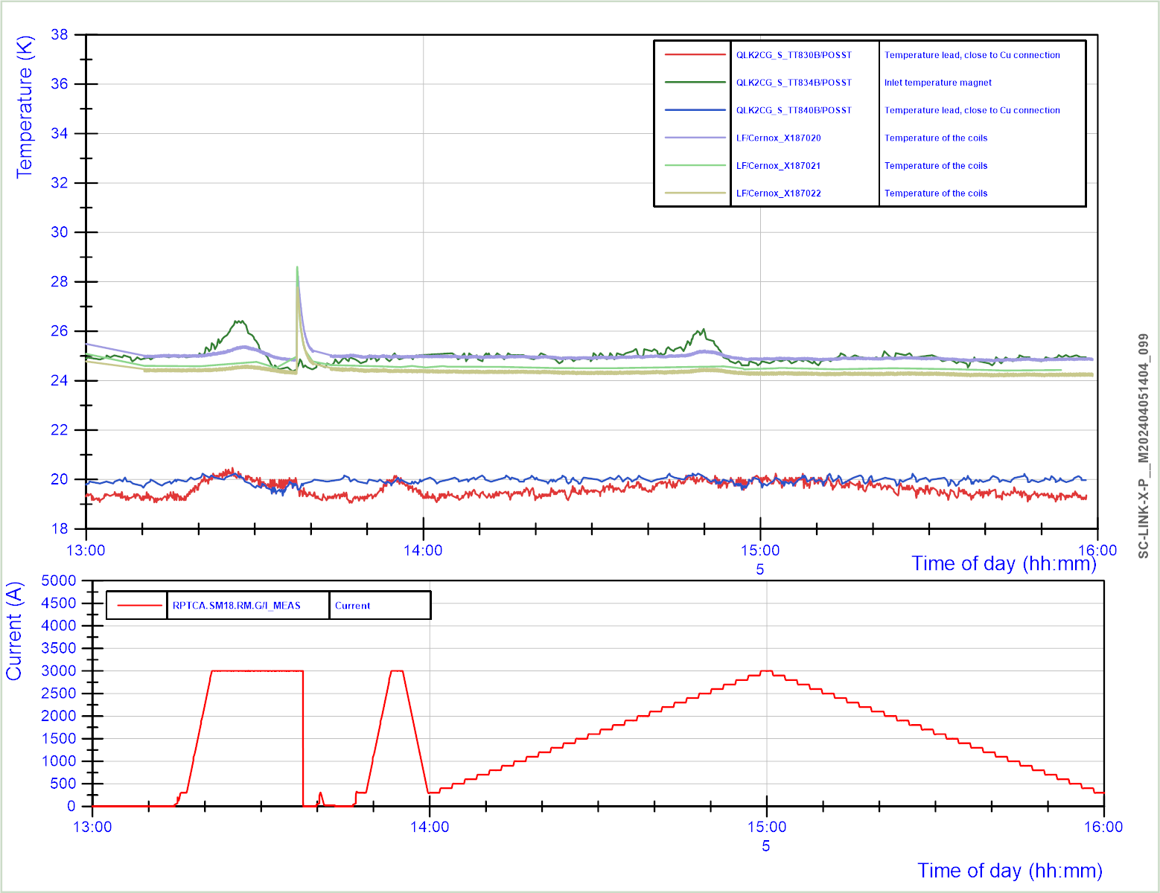
Powering at ~25 K
5 april 2024
Good efforts by cryo operation for stable 25 K in the coil and control of leads temperature at ~20 K.
Temperature measurement in coil also improved.
Temperature rise after fast current decay
Powering at ~25 K

Slide 6
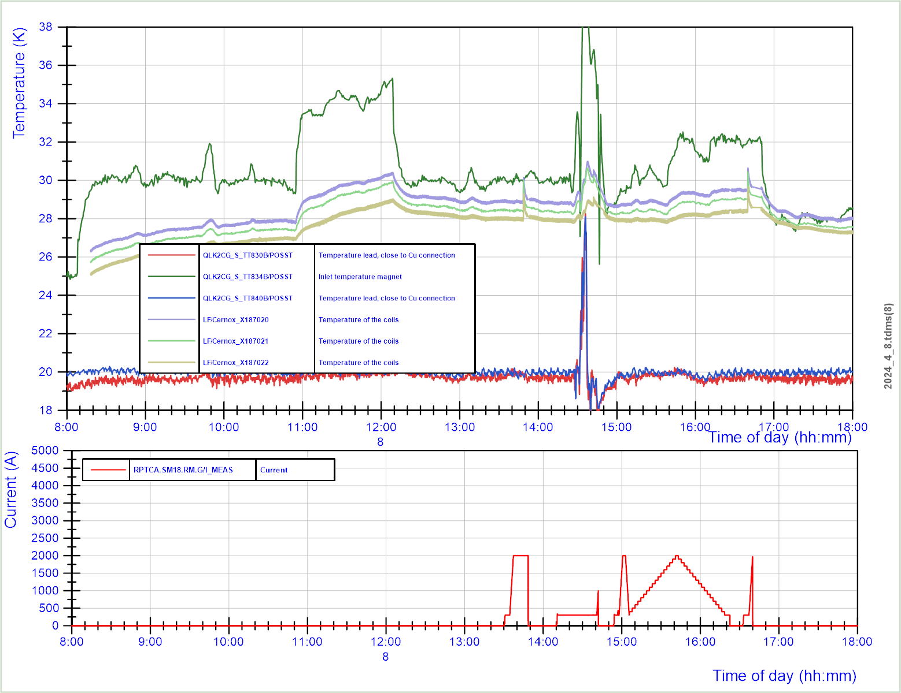
Powering at ~30 K
8 april 2024
Stepfunction in inlet temperature.
Slowly followed by increase in coil temperature.
Powering at ~30 K
quench

Slide 7
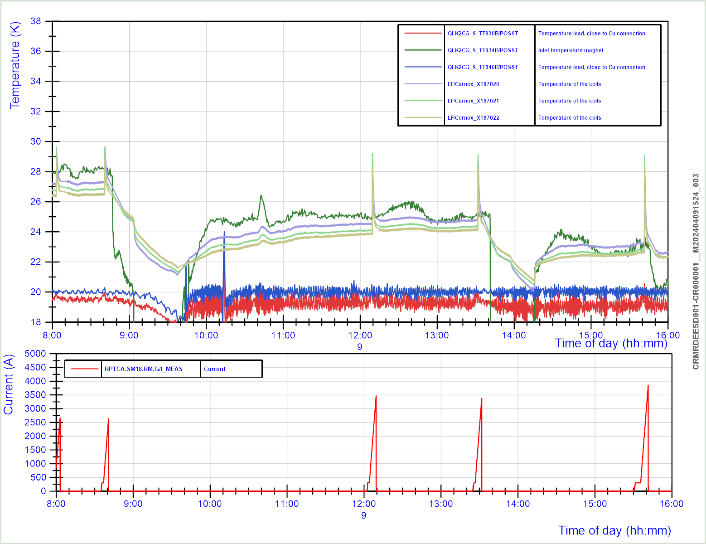
5 quenches at variable temperatures 9 april 2024
Former temperature rise following quench

Slide 8
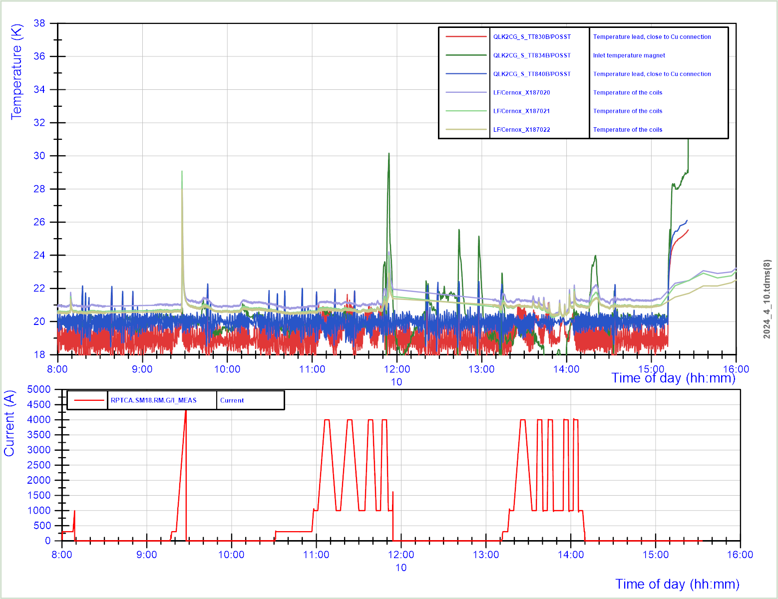
1 quench and AC loss cycles up to 150 A/s
10 april 2024
Magnet reached 9 times 4 kA ~20.

Slide 9
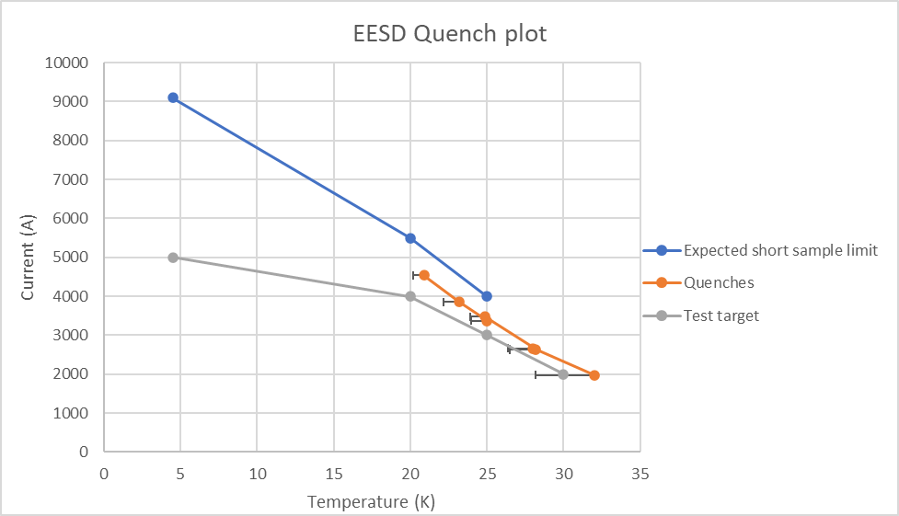
Quench plot EESD
Main question: what is the real temperature of the coil.
3 probes in the former, 1 helium inlet temperature. For this plot I took the highest temperature, assuming that the coil quenches at the spot where we have highest temperature. This may need further detailed analysis.

Slide 10
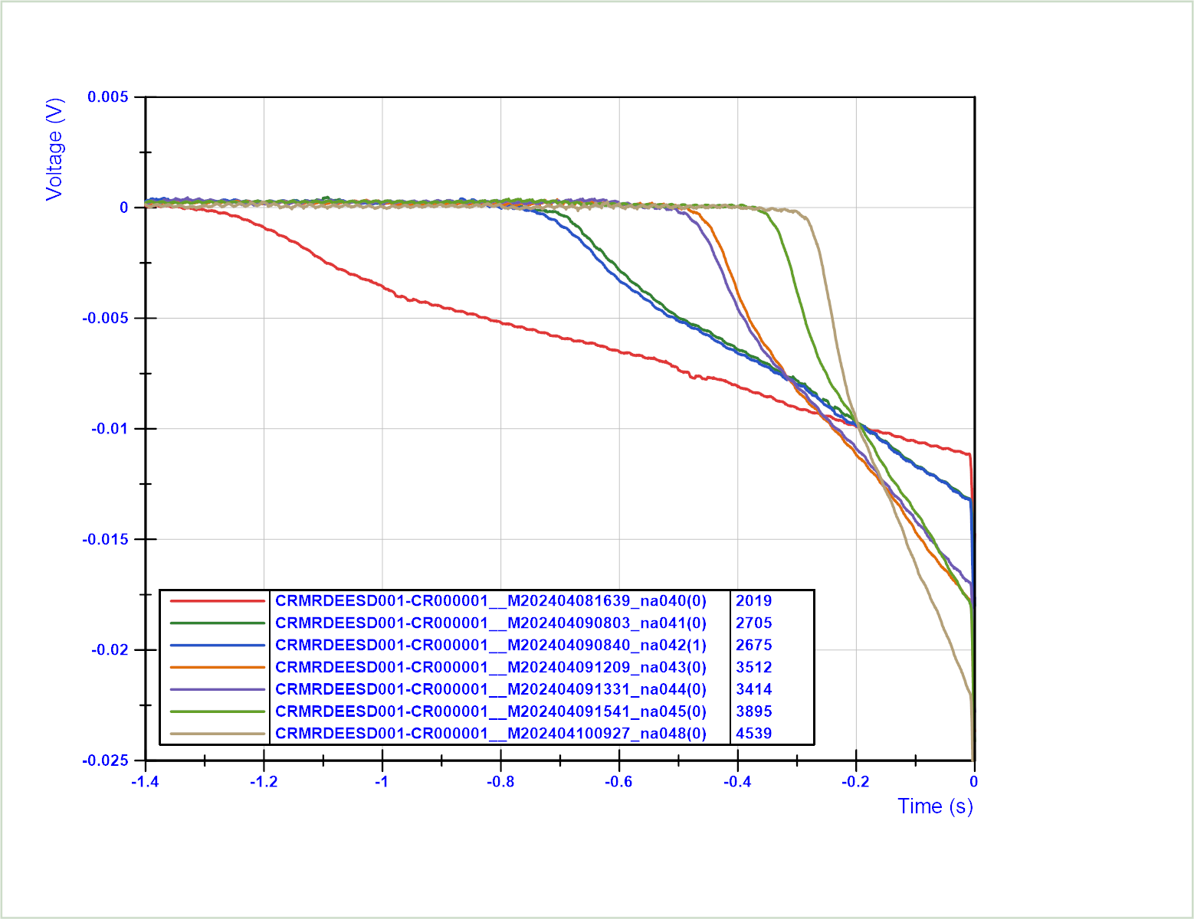
Voltage during quench
Very slow voltage build up
8 mV/second at 2000 A at 30 K
80 mV/second at 4500 A at 20 K
Similar profile.
Negative voltage indicates quench in lower coil layer.
All quenches in the same coil, could indicate that that coil is a bit warmer.
If both coils quench simultaneously, we will not be able to protect and we will burn the coil easily. A co-wound wire in the grooves seems to be a simple solution for this issue.

Slide 11
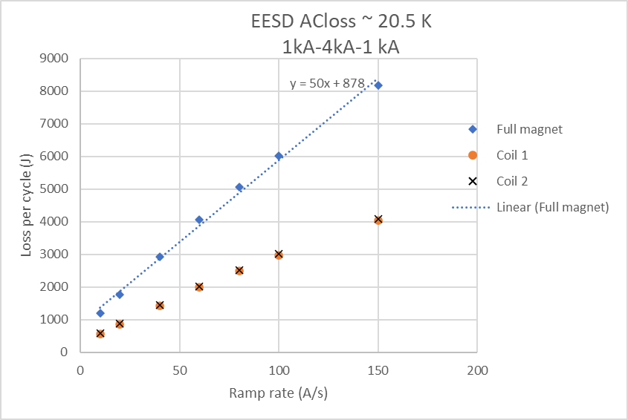
AC loss EESD
Measured at ~20.5 K
Current cycles from 1 to 4 to 1 kA.
Both coils have the same loss.
Most loss is ramp rate dependent loss
(~50 J per A/s, mostly induced currents) and only a small fraction is ramp rate independent (~800 J, mostly magnetization).
Easy to imagine currents induced in the aluminum cooling layer, highly coupled with the magnet with a low resistance.

Slide 12
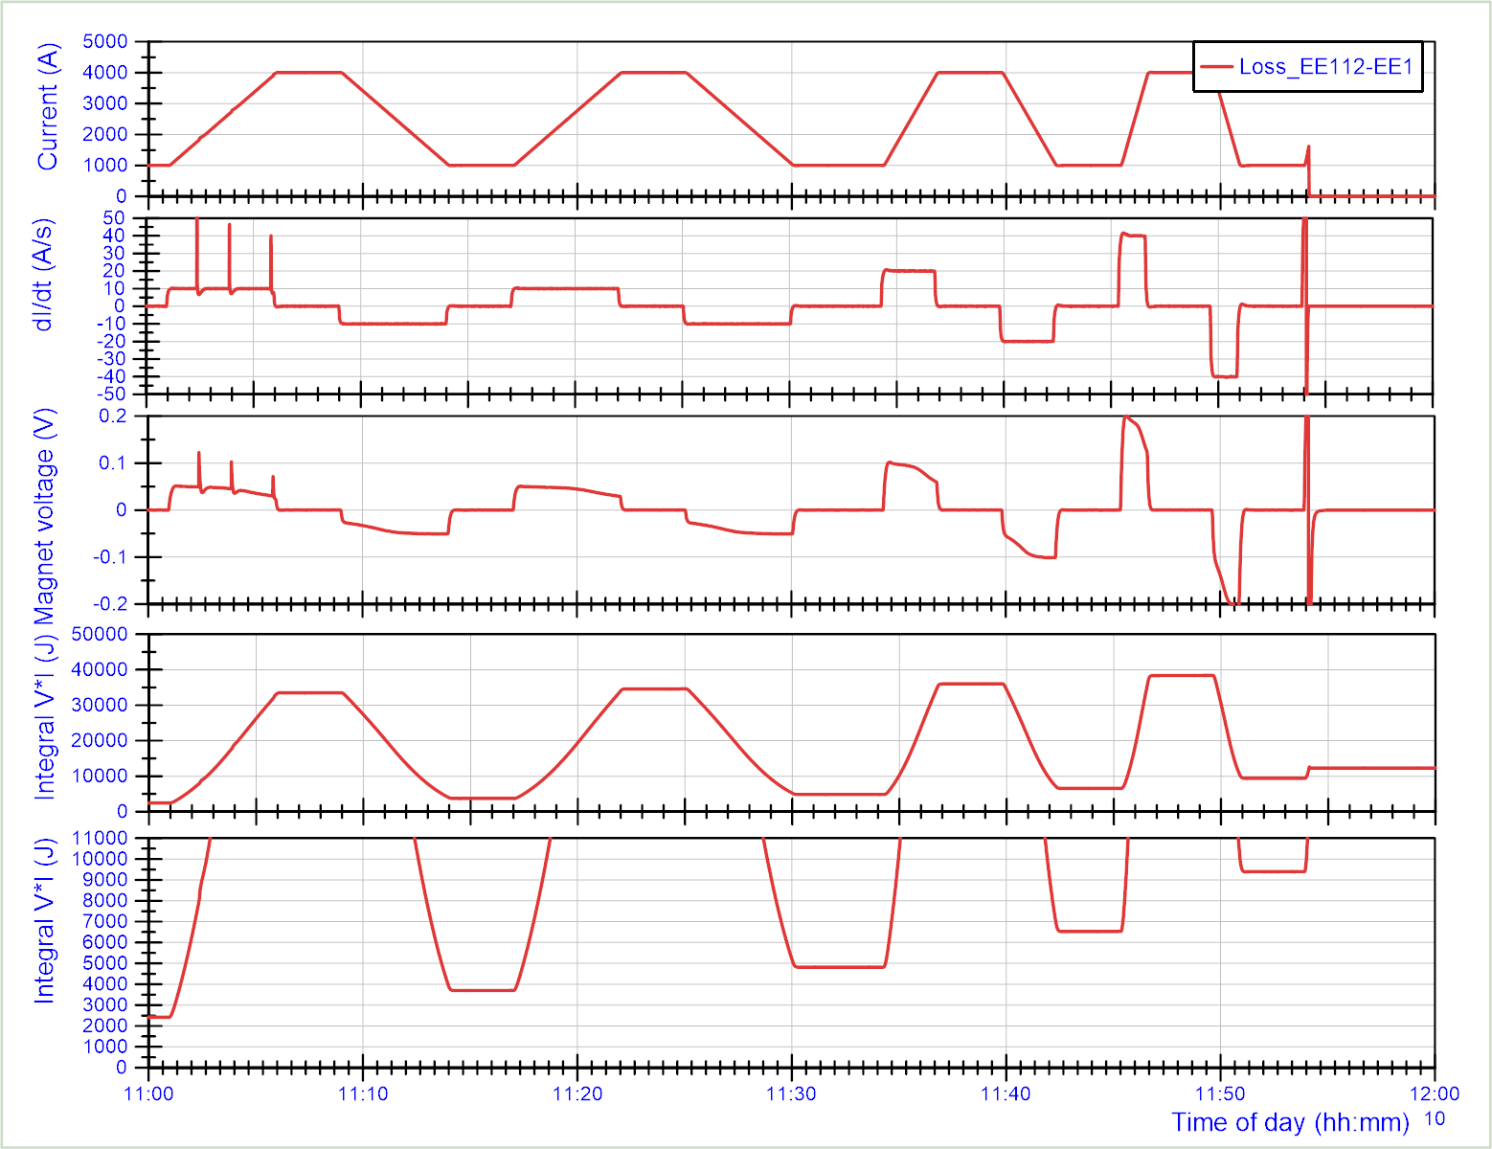
How to measure AC-loss
Current ramps at different ramp rates
Integrate V*I. We can see the L*dI/dt energization and deenergization of the magnet (about 30 kJ between 1 and 4 kA)
However, if we integrate one cycle, we do not arrive at the same level as before. This is the losses we have on the way (hopefully no resistive losses, only magnetization and coupling current)

Slide 13
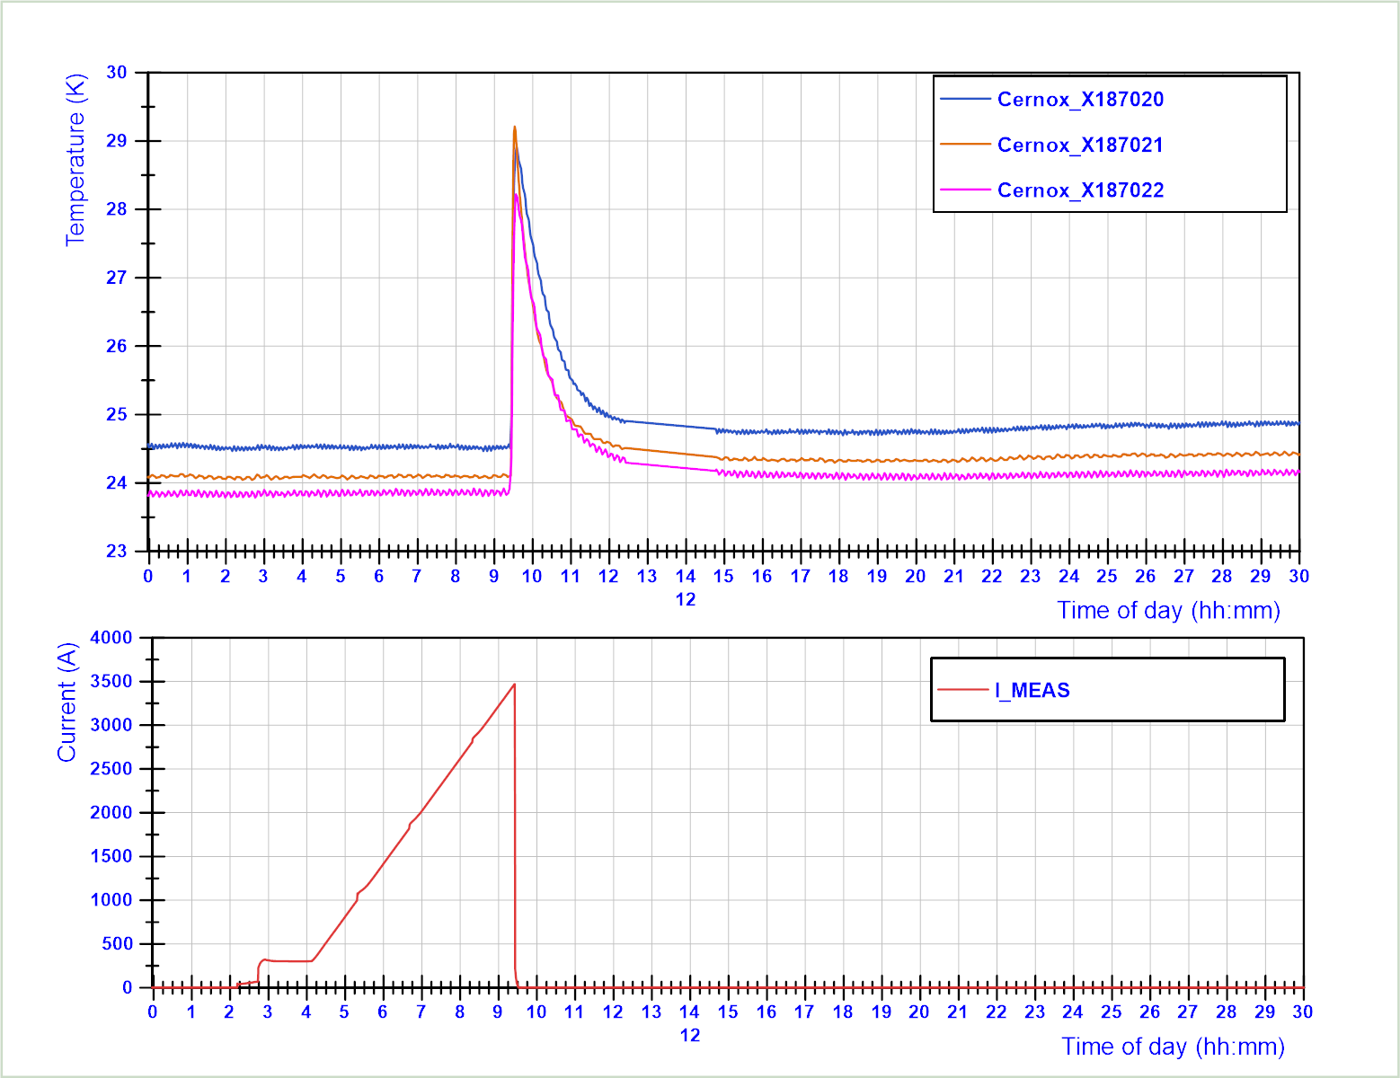
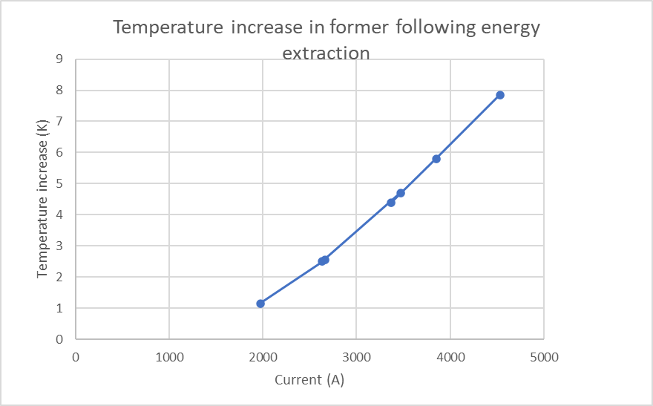
Temperature rise in the former following power supply switch of and energy extraction
The temperature has a systematic rise after each energy extraction (independent of quench in the magnet).

Slide 14
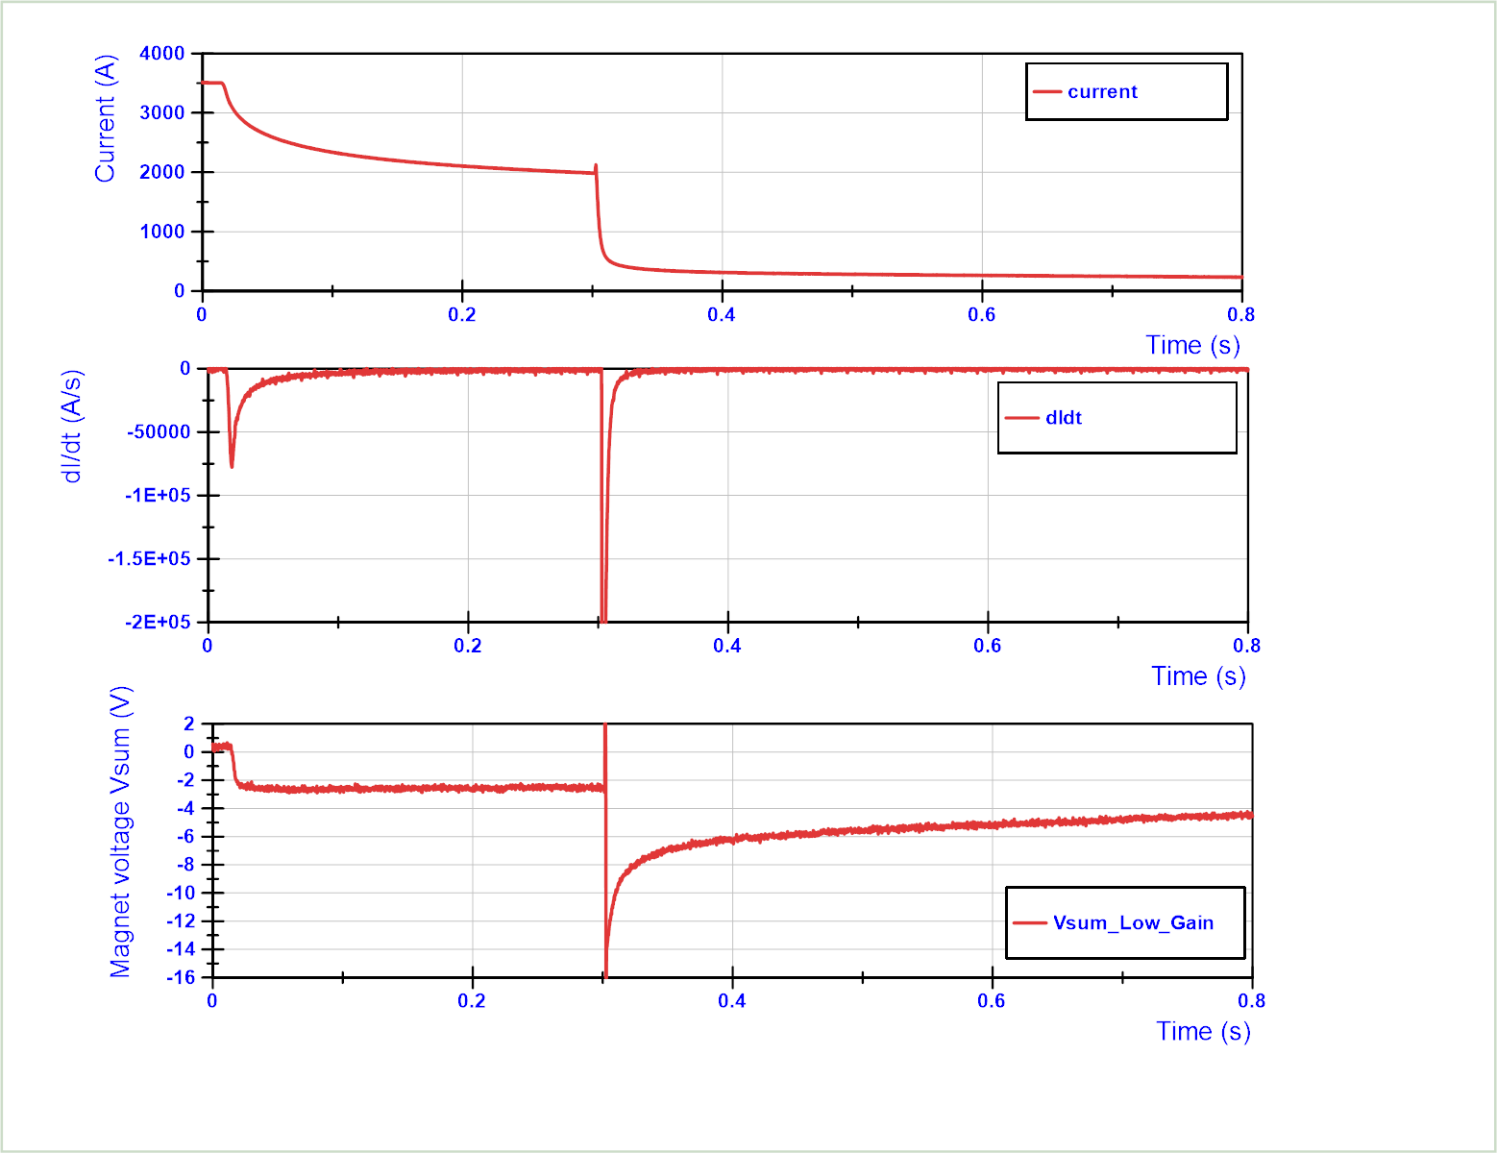
Current decay following energy extraction
Energy extraction 20 mOhm (40 V at 2 kA) is switched in with a delay of 300 ms.
Fast current decay measured by the power converter.
Power supply switch off.
External voltage on the magnet drop from 0 to -2.5 V.
This causes already a very fast decay, only seen in magnet with a highly coupled layer.
Final current decay takes very long, since the current induced in the former will be fed back to the magnet.

Slide 15
Conclusion
In SM18 we are very happy to test a magnet in HFM of this size in helium gas at 20 K - 30 K. This is a very important milestone and paves the way to future tests of full HTS magnets in gas for example. Many thanks to all involved!!
Very smooth cryo operation.
On the magnet:
Made it to target current
Quench limits defined (careful with the exact temperature of the coil in the plot)
AC loss defined
Magnetic measurements done
Suggestions from my side:
Consider a co-wound wire for symmetric quench detection.

Slide 16
Additional slides

Slide 17
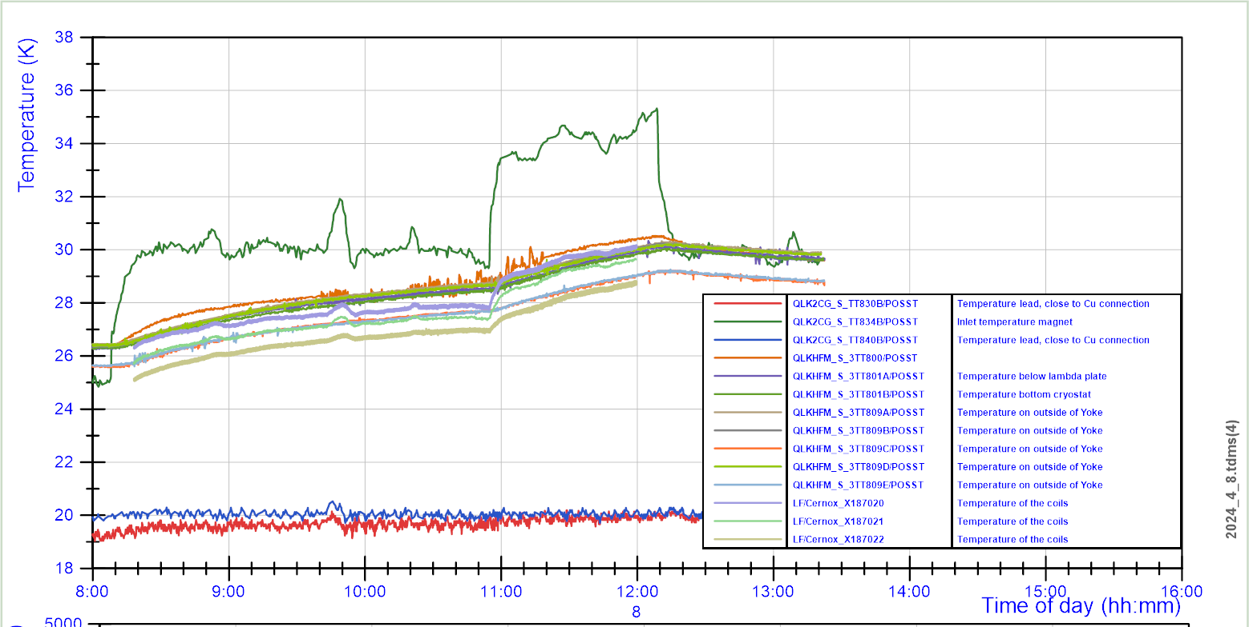
Temperature in the yoke compared to the coil.
Step in He inlet temperature
Probes on outside of the yoke have about the same slope as those in the coil.

