Slide 1
CCC Mini Workshop, CERN, 18th June 2024
Thomas Sieber
CCC Perspective at GSI/FAIR
Notes:
1

Slide 2
Outline
CCC time schedule for FAIR
Current status
Pending tasks / developments
Notes:
2

Slide 3
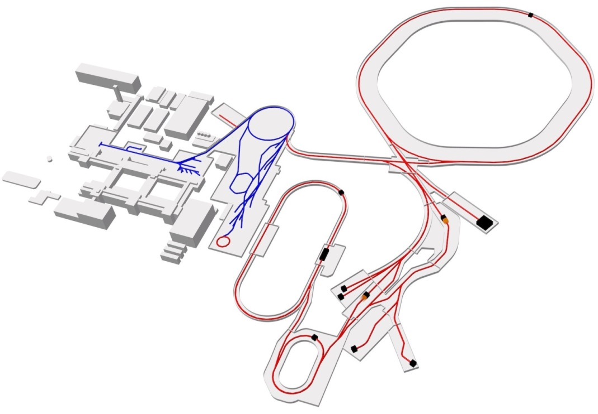
CCC Installation Points at FAIR
Proton Linac
UNILAC
SIS18
SIS100
FAIR
GSI
CBM
Cryring
PANDA
Super FRS
HESR
CR
NuSTAR
CCC Position
FAIR council decision: 4 x HEBT, (1 x storage ring), 1 x prototype in CRYRING → compact CCC
June 18th 2024
CCC Mini Workshop
Thomas Sieber 1
Notes:
3

Slide 4
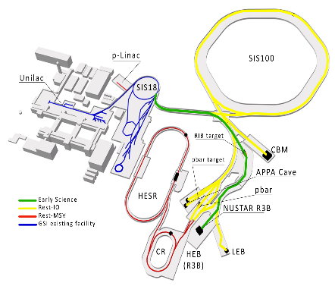
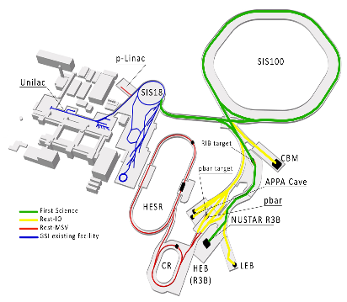
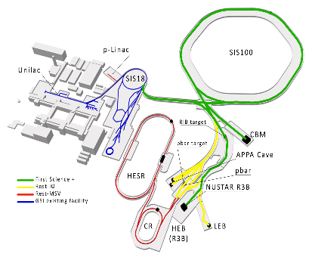
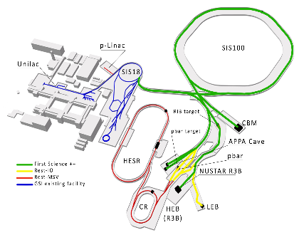
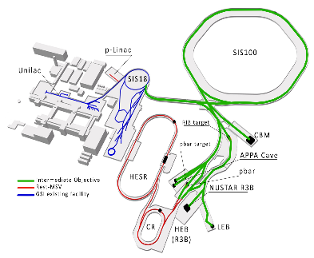
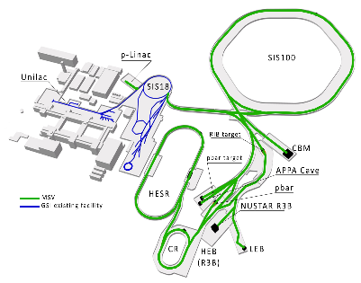
Updated FAIR Planning
?
CCC Position
Early Science
First Science
First Science +
2026
2028
2028
tbd
First Science ++
Intermediate Objective
Modulare Startversion
June 18th 2024
CCC Mini Workshop
Thomas Sieber 2
Notes:
4

Slide 5
Time schedule, next steps, costs
25 l/d liquefier 2023/2024 (current purchase: 150 k€) will arrive next month
Next steps (ES scenario):
  1x cryostat with SPS based slow controls (ILK, 250 k€, Q3/2024)
  1x liquefier (150 k€, Q3/2024) → TransMit company
  1x CCC detector + electronics (50 k€, Q3/2024)
  → 2 full CCC detector systems for ES 2024+2025
Following steps (FS scenario):
  order 2 systems together 2026/2027 (~900 k€)
Separate planning for CRYRING
System costs (2019)
Nb CCC 150 k€
Cryostat 200 k€
Liquefier 80 k€
SQUID + electronics 10 k€
DAQ 10 k€
Support 5 k€
Total ~ 450 k€
June 18th 2024
CCC Mini Workshop
Thomas Sieber 3
Notes:
5

Slide 6
Current Activities
Thermal shield modified for better He flow, test is ongoing
25 l/d liquefier ordered, arrives in July → tests
Ring FESA class started (based on AD class), currently on hold, due to HEBT
nonmagnetic He + UHV tube by NTG company, cryo test next week
CCC-XD and DCCC beam test at SIS18 → evaluation → Lorenzo
HEBT FESA class to be completed (SQUID controls)
Filtering of periodic noise
Implementation of CCC in spill optimzation feedback system (online spill correction)
Slow controls, hardware specification, interface with UNICOS
Optimization of DCCC (→ Volker)
[Optimization of SQUID electronics, FLL stability, radiation hardness – at the moment 0.0 ressources]
June 18th 2024
CCC Mini Workshop
Thomas Sieber 4
Notes:
6

Slide 7
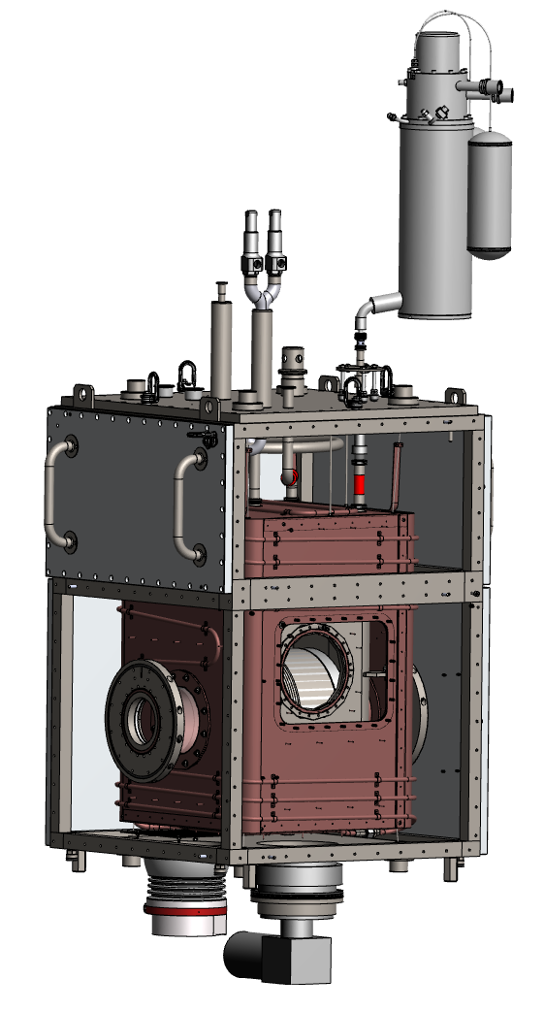
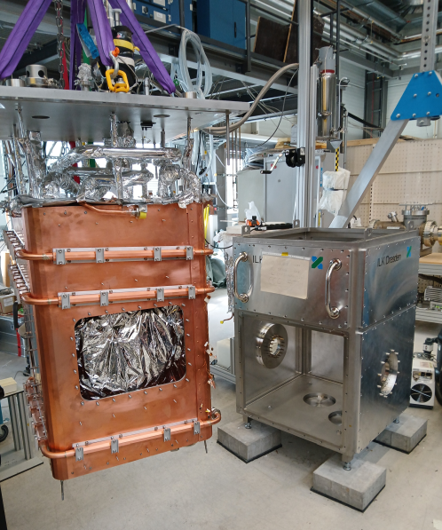
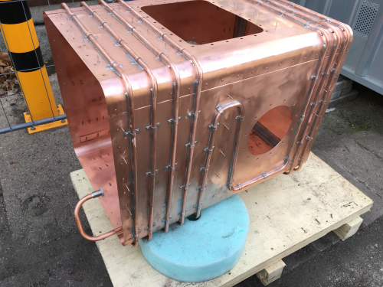
Modified Thermal Shield
Cryostat Design
Liquefier
Head
Vacuum Tank
Aluminum
Windows
Thermal
Shielding
with
Enthalpie Line
1200
UHV Beam
Tube
Steel
Frame
7 m of 14 mm diameter enthalpy tube
before: 15 m with 10 mm
much better manufacturing
critical point: soldering
Helium
Container
CCC Shield +
Detector
June 18th 2024
CCC Mini Workshop
Thomas Sieber 6
Notes:
7

Slide 8
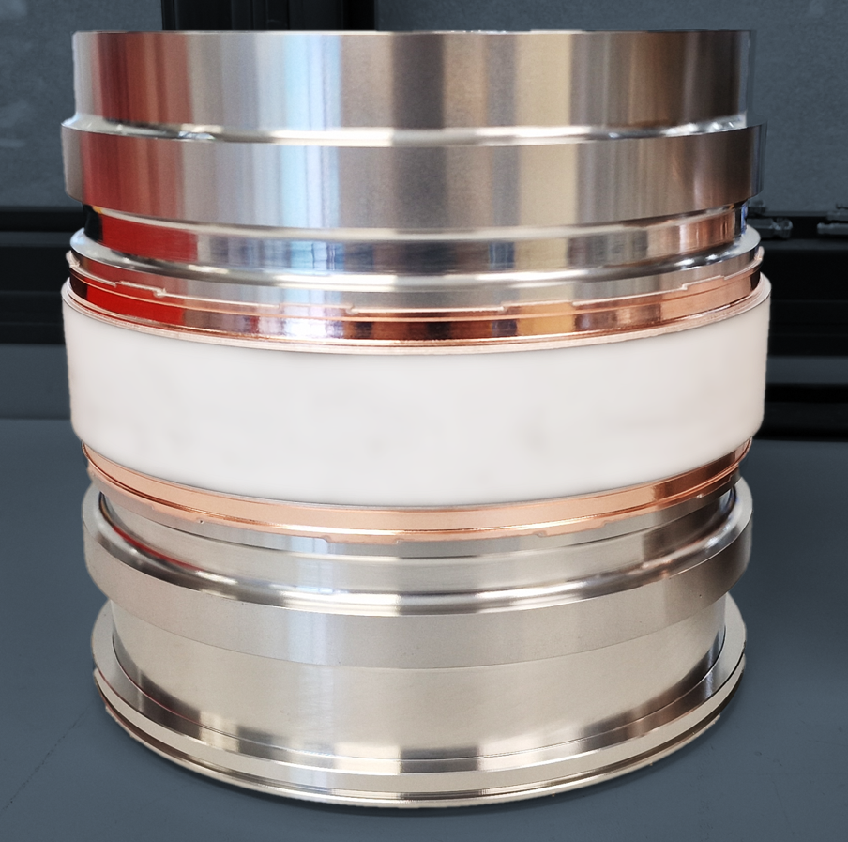
Nonmagnetic Gap
Motivation: strong influence of inner parts on measurement
common development GSI / NTG
connection ceramics – copper – stainless steel
temperature range 4 K – 600 K
LN test with leakage testing on 24.06.
if successfull → ordering of UHV tube
June 18th 2024
CCC Mini Workshop
Thomas Sieber 5
Notes:
8

Slide 9
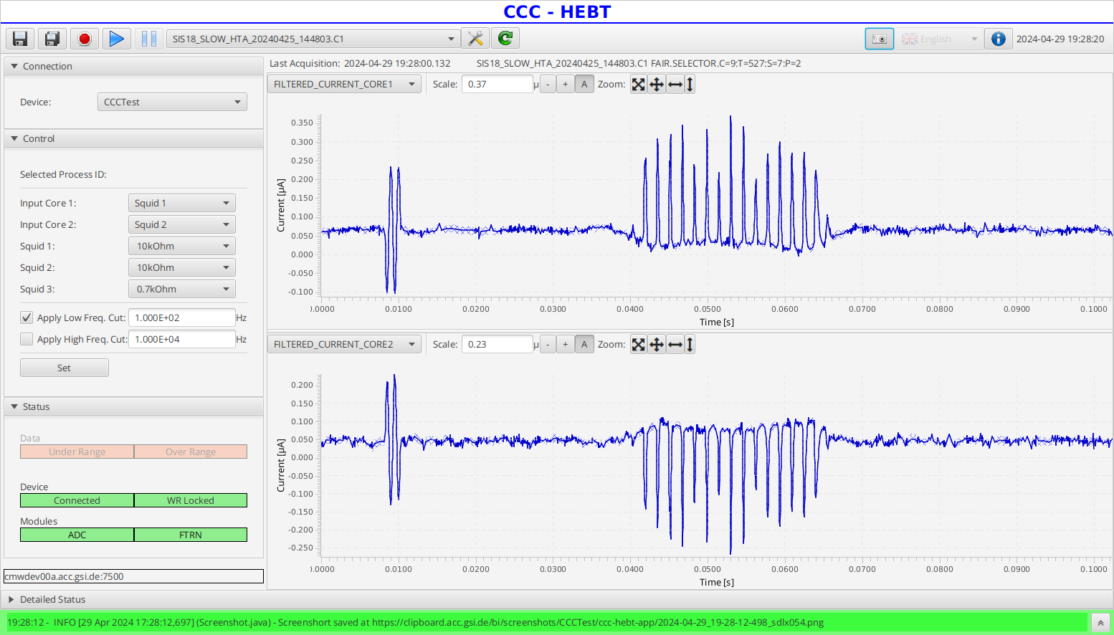
Spill Measurement in FESA
June 18th 2024
CCC Mini Workshop
Thomas Sieber 6

Slide 10
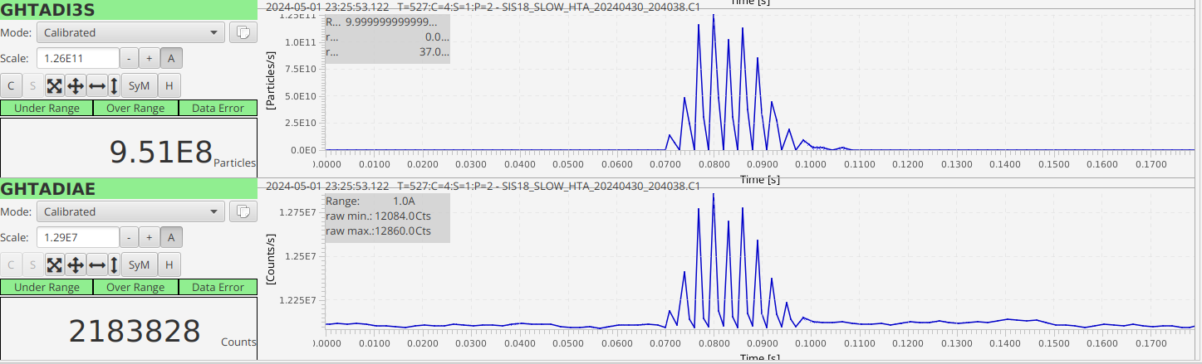
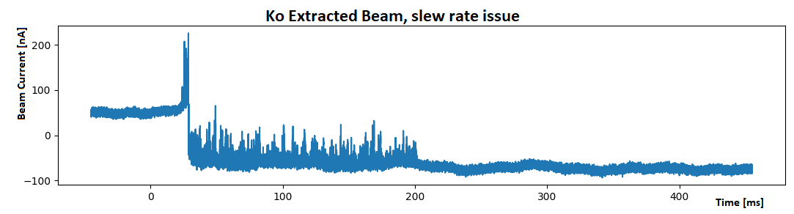
Feedback Detector for KO extr. Beam
U(CCC)
SEM
Level Shifter
T-splitter
CCC
DAQ
CCC
U/f
converter
U(CCC)
PS 710
Disc. (15ns)
Patch panel No. 4 (1)
LeCroy 428F
Analogue
PS 710
Disc. (20ns)
Octal
Fan Out
PS 710
Disc. (15ns)
A. Reiter
H. Bräuning
Setup for SDR Feedback Loop
Scope
SDAOSZI015
RF-Exciter
System
(Rack 111 )
Lassie
DAQ
- Flux Jump occurred at
both SQUIDS
- Due to spill properties at
Ar beam or general problem?
- Once CCC works filtering in
FESA will provide good signal
June 18th 2024
CCC Mini Workshop
Thomas Sieber 7

Slide 11
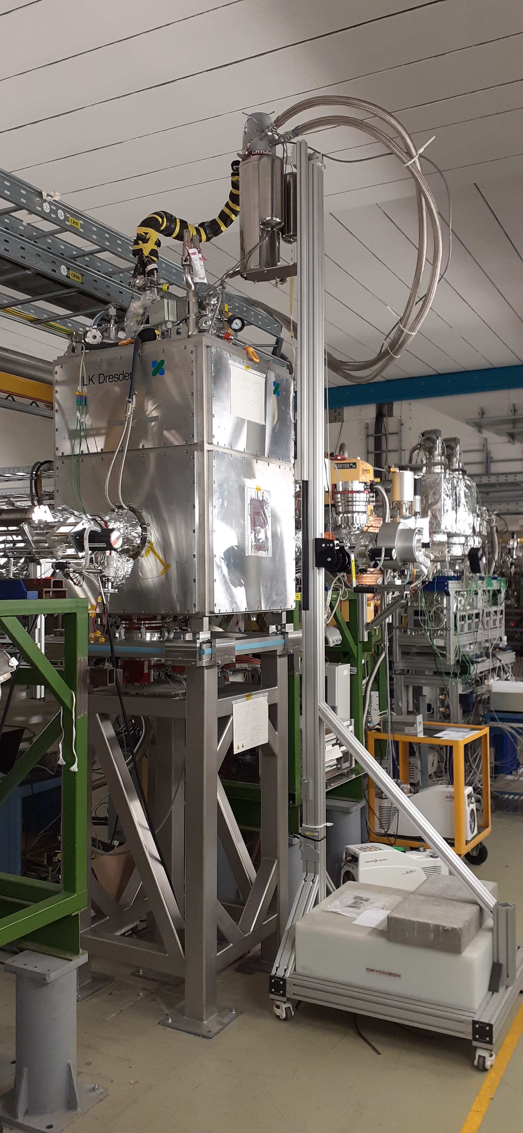
Situation at CRYRING
CCC-XD (Niobium) successfully operated in storage ring, nA measurement could be demonstrated, support for Cryring experiments provided.
strong influence of rf-background on V/Φ Curve when moving from lab to machine. Bias Current reduced, operation less stable than in laboratory
unavoidable jump at injection, slew rate problems partly solved by damping the system
magnetic ramp up to 30 nA → better magnetic shielding required
filtering of periodic disturbances (liquefier, 30 nA) required, to be implemented in FESA class
Todos:
improve slew rate limitations (→ damping + modified eigenmodes by matching trafo)
improve magnetic shielding (→ shield from axial CCC)
longer standing time (→ new thermal shield, bigger liquefier)
less expensive (→ lead shielding)
better noise behavior, current resolution etc. (→ matching transformer design, Dual Core CCC)
space restrictions: compact 0.5 m CCC required – seems realistic with axial shielding
→ project dependent on future modifications / experimental programme of CRYRING
June 18th 2024
CCC Mini Workshop
Thomas Sieber 8
Notes:
11

Slide 12
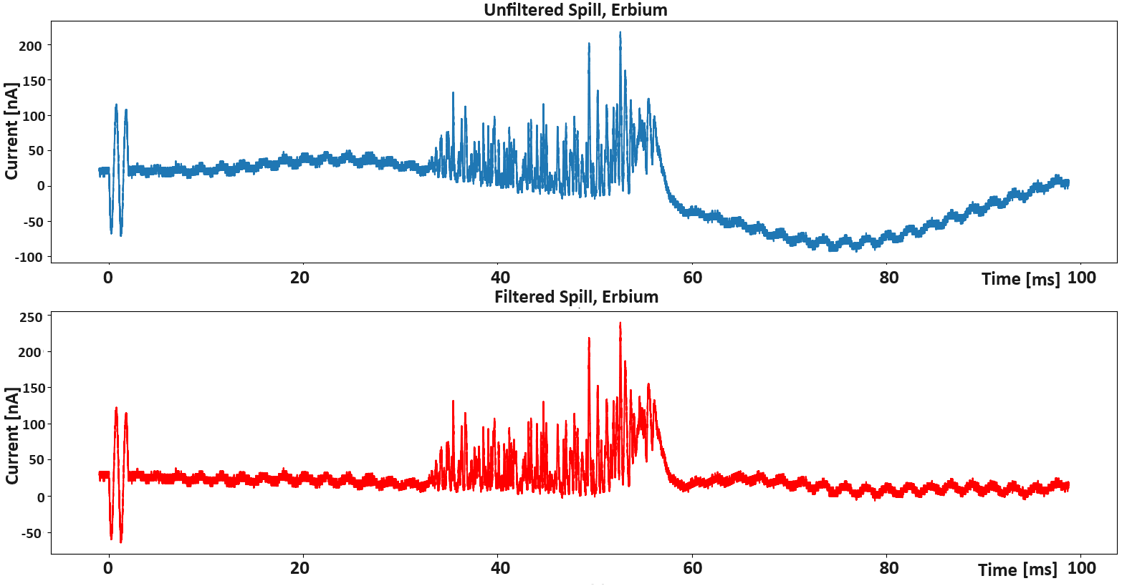
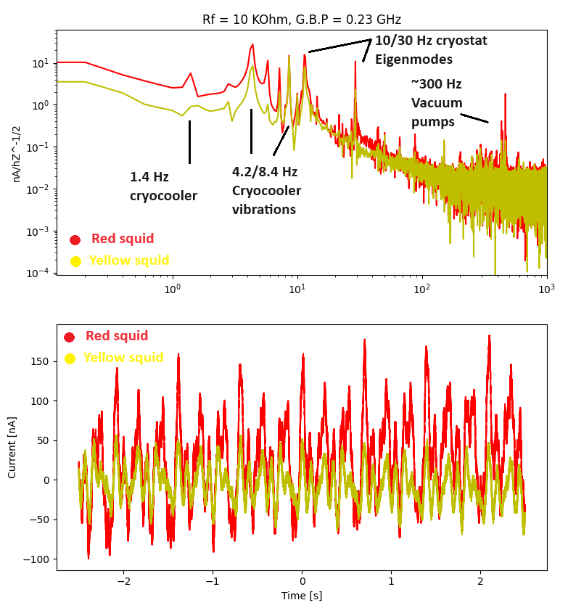
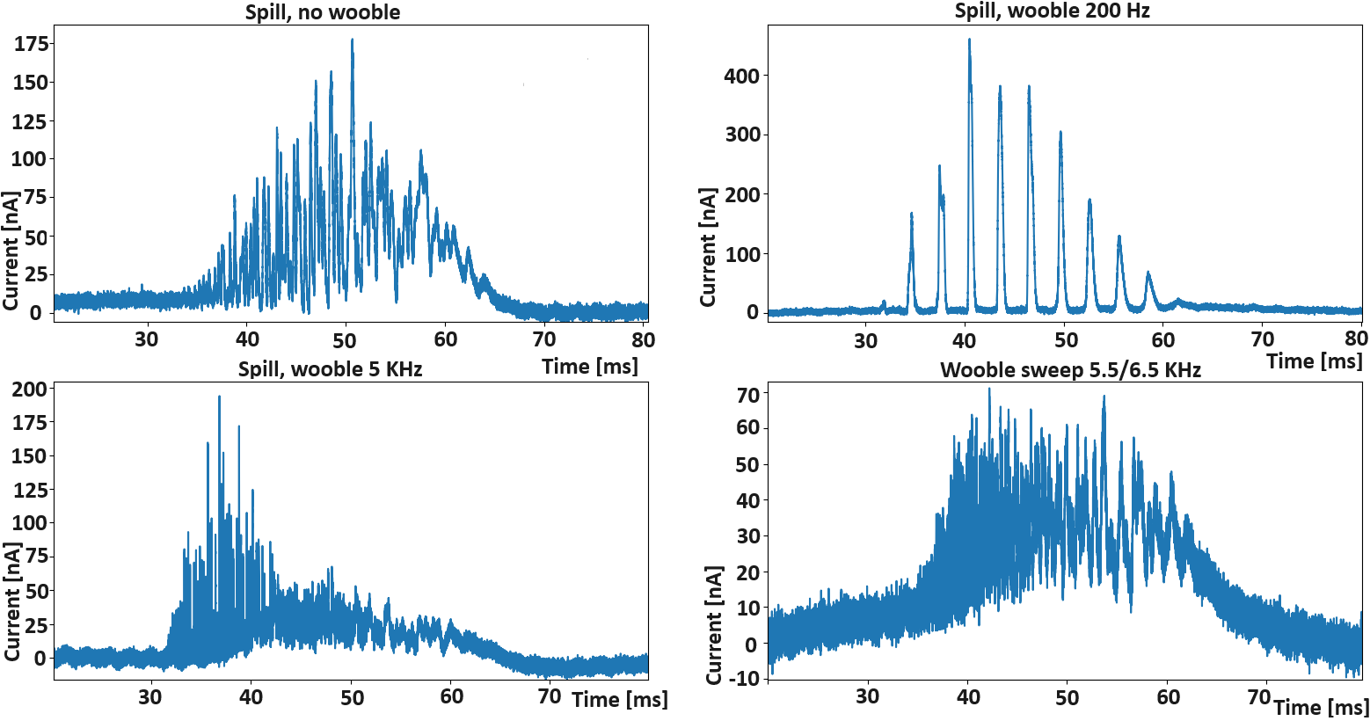
Engineering Run 04/2024 DCCC@SIS18
Beam: Er⁵⁷⁺, ~5*10⁸pps, 400 MeV/u, t_{extr} 20 ms – 1 s
FFT from Er beam
Test of tune „wobbling“ with Ar beam
Beam: Ar¹⁸⁺, ~3*10⁹pps, 400 MeV/u, t_{extr} 50 ms – 2 s
9
June 4th 2024
GSI Machine Coordination Meeting
Thomas Sieber

Slide 13
Summary and Outlook
CCC focus at FAIR changed from storage rings to transport sections → FAIR Early Science … FS, FS+ scenarios
CCC-XD successfully operated in storage rings and transport lines, nA and spill measurement could be demonstrated, system fulfils FAIR requirements (almost)
Beamtime in Dec. 2023 showed XD setup capability for online spill analysis
Axial CCC type provides excellent magnetic shielding, but is extremely noise sensitive
Dual core CCC combines advantages of both systems and will be the choice for FAIR
DCCC successfully tested with beam, operation as detector for feedback system did not work out (so far)
Current activities:
- New thermal shield test (June 2024)
- Liquefier test (July 2024) → collaboration with TransMIT Gießen?
FESA class development ongoing, including filtering, online data processing and SQUID controls (and input for spill optimization)
finalization of DCCC design
collaboration with FH Jena for advanced signal processing
purchasing of cryostat for 2nd CCC end of 2024
….. slow controls (Simatic) for cryostat + optimization of commercial electronics → whenever ressources available
10
June 18th 2024
CCC Mini Workshop
Thomas Sieber
Notes:
13

Slide 14
Further Collaboration Topics GSI / CERN / Jena
FESA class for storage rings
FESA class for HEBT (→ merge)
DCCC optimization and tests at GSI / CERN → FAIR + SPS
Slow controls for cryogenic/vacuum system with UNICOS
Liquefier development (beyond Cryomech)
Dry cryostat (FAIR dimensions + time schedule?)
Improved filtering of periodic disturbances
CCC as detector for spill optimization feedback system
Nonmagnetic ceramic gaps
Optimization of SQUID electronics (FLL stability, radiation)
10
June 18th 2024
CCC Mini Workshop
Thomas Sieber
Notes:
14

Slide 15





CCC Collaboration 2015-2024
HI Jena: Laboratory tests, shielding and SQUID circuit design, SPICE models → signal processing
FSU Jena: Laboratories (cold lab, EMV shielded), administration (BMBF appl.)
IPHT Jena: SQUID development and production, SQUID electronics, magn. shield
TEMF: Simulations, shielding factors, electrical and mechanical eigenmodes and stability
CERN: Cryostat development, FESA, beamline tests (ring) (1 PhD thesis)
GSI: Cryostat, beam test (HEBT/ring), detector development (2 PhD thesis), FESA, electronics optimization
… AND
Magnicon: SQUID electronics, expertise, radiation test; FH Jena: Signal processing
11
June 18th 2024
CCC Mini Workshop
Thomas Sieber
Notes:
15

Slide 16
Thank you for your attention !
Notes:
16

Slide 17
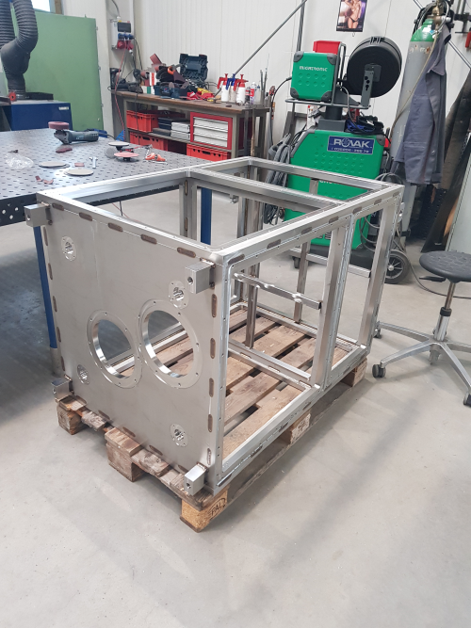
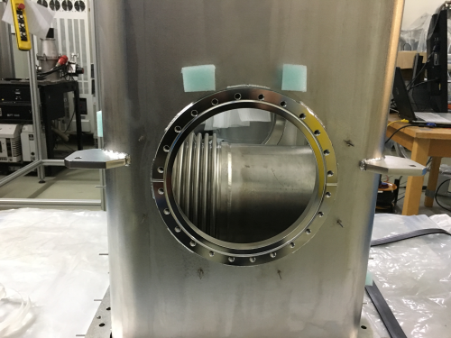
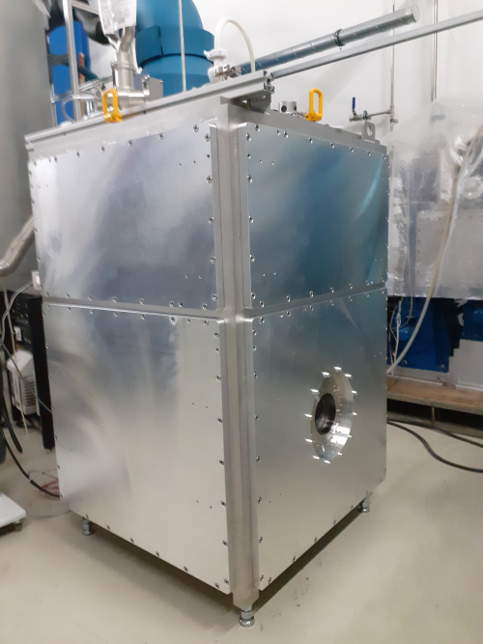
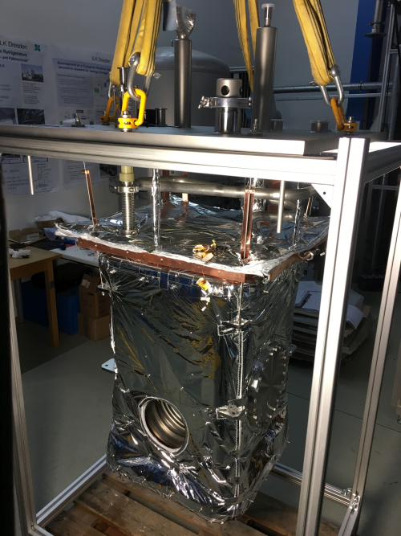
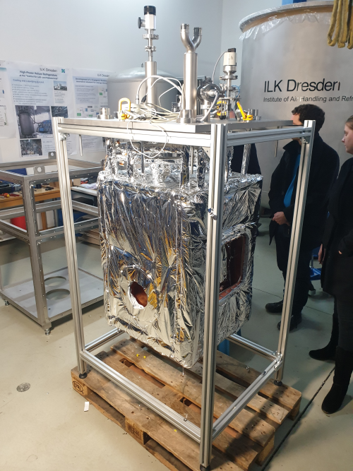
Production of the CRYRING Cryostat
Frame
Thermal
Shield
He-Chamber
Al Windows
mounted
He-Chamber
with MLI
Shield and
tubing with MLI
September 27th 2022
8th Annual MT Meeting, DESY, Hamburg
Thomas Sieber
Notes:
17

Slide 18
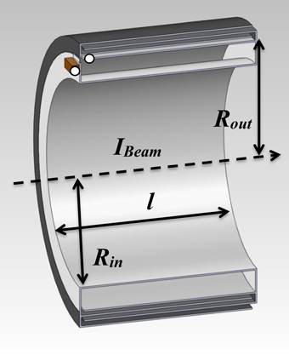
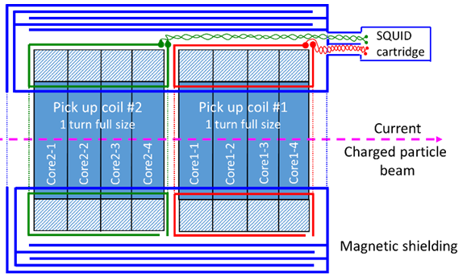
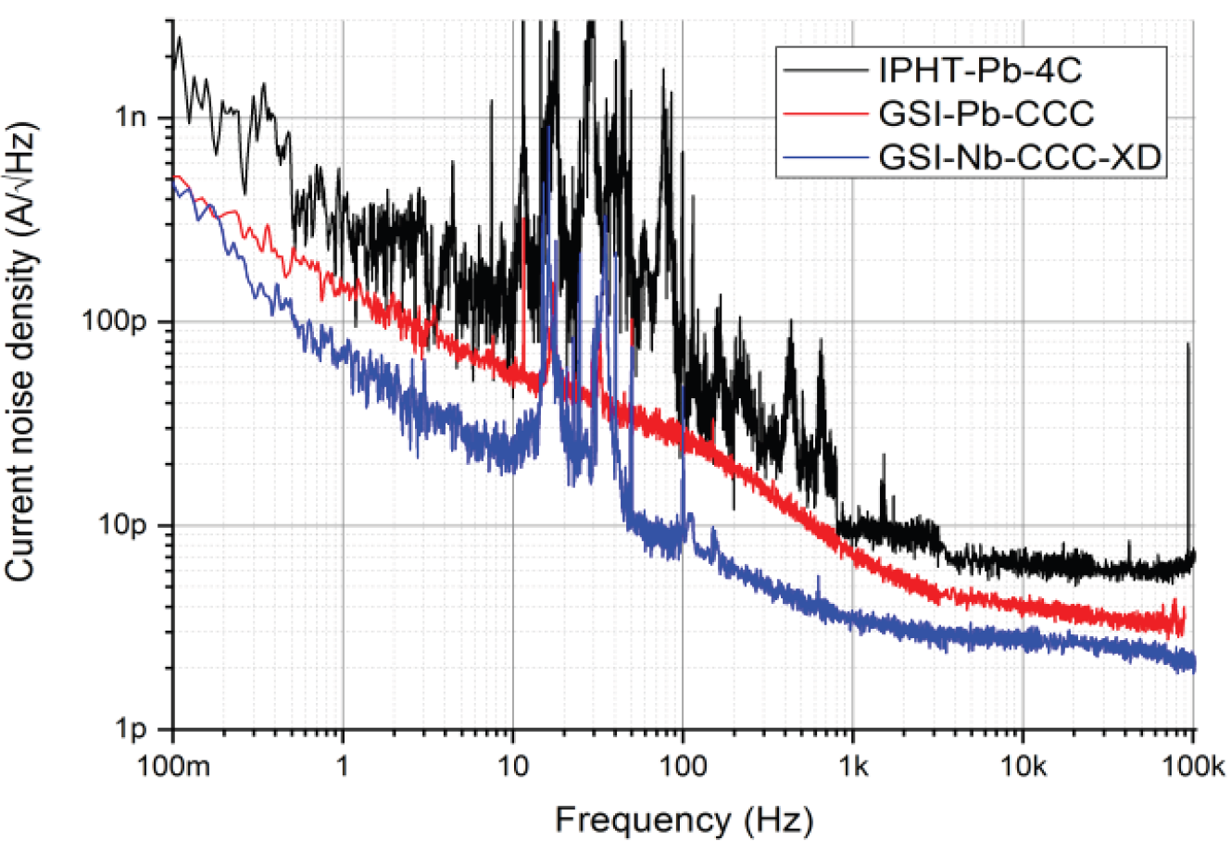
Alternative CCC Types
Axial/Coreless-CCC
Pros
magn. shielding (-150 dB instead of -75 dB)
lead / costs
easy manufacturing
[two stage SQUID]
Cons
weak coupling (beam)
excessive noise
Dual Core CCC
Dual-CCC
Pros
magn. shielding (150 dB instead of 75 dB)
lead / costs
easy manufacturing
[two stage SQUID]
strong coupling
low noise background
redundancy
350 mm
Noise figures for classical and axial CCC
June 18th 2024
CCC Mini Workshop
Thomas Sieber 6

