Slide 1
Collinear Laser Spectroscopy of ^{223-226,228}Ra⁺
Proposal for ISOLDE winter physics
(INTC-P-699)

Slide 2
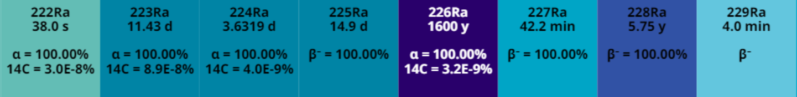
Key facts of the proposal
Collinear Laser Spectroscopy of ^{223-226,228}Ra⁺ at COLLAPS
(→ same isotopes as in RaF beamtimes at CRIS)
Goal: Increased precision in isotope shift (factor 10) and hyperfine constants
(factor 2 – 10) in two transitions compared to previous measurements
Request: 13 Shifts with previously irradiated UCx target
(1x preparation, 2x5 measurements, 2x systematic investigations)
→ RILIS not strictly necessary since Ra is easily surface ionized
→ ISOLDE winter physics

Slide 3
Why Radium II (again)?
→ was measured in the 1980s at COLLAPS by Klaus Wendt et al.
Recently large interest in ²²³Ra and ²²⁵Ra due to their P,T-violating properties
→ P-odd nuclear anapole moment & P,T-odd nuclear Schiff moment
  Schiff operator directly dependent on mean-square charge radius <r_{C}²>
  → Isotope shift measurements in Ra⁺
  Anapole moment dependent on spatial distribution of nuclear current density j(r)
  → Can be constrained by measurements of the Bohr-Weisskopf-effect in HFS

Slide 4
Charge radius of ^{223,225}Ra
Current precision of δ<r_{C}²> is on the 5% level. No absolute value in the Ra chain has been measured (yet). ΔR/R ≤ 1.5% necessary to not limit intrinsic-frame Schiff moment
Direct measurement of <r_{C}²> of ^{223,225}Ra unrealistic (lifetime), but new radius
of ²²⁶Ra is targeted by muX (PSI, see proposal INTC-P-704) and might be feasible at SCRIT (electron scattering)
New isotope-shift measurements from this proposal together with new state-of-the-art atomic structure calculations (by L. Skripnikov, in preparation) will improve the δ<r_{C}²>^{225,226} and δ<r_{C}²>^{223,226} to ≤ 1% precision
→ Combining both results will deliver a new precise value for <r_{C}²> of ^{223,225}Ra

Slide 5


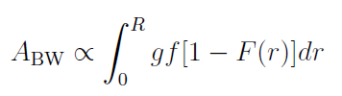
Bohr-Weisskopf-effect in ^{223,225}Ra
Atomic magnetic field
Hyperfine constant with
→ extraction of A_{BW} will constrain F(r) and by that also the spatial distribution of nuclear current density j(r)
But: (In principle) only possible when non-optical measurement of g is available
→ only for ^{213,225}Ra
measure
calculate
extract
→ F(r) is the spatial distribution of nuclear
Magnetization

Slide 6
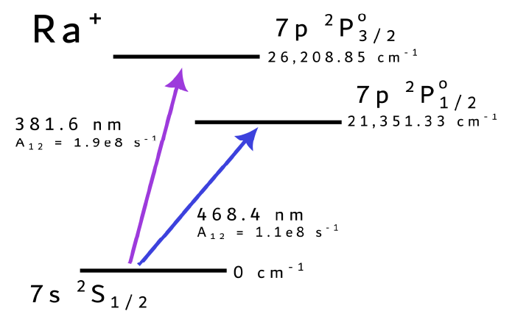
Bohr-Weisskopf-effect in ^{223,225}Ra
However, BW contribution differs in states
7s ²S_{1/2}: 4.3%
7p ²P_{1/2}: 1.4%
7p ²P_{3/2}: 0.4%
Plan:
1. Measure HFS in D2 transition precisely with CLS
2. Extract g-factor from ²P_{3/2} state with 0.4% systematic uncertainty
3. Extract A_{BW} from ²S_{1/2} state which has 10 times higher sensitivity to BW

Slide 7
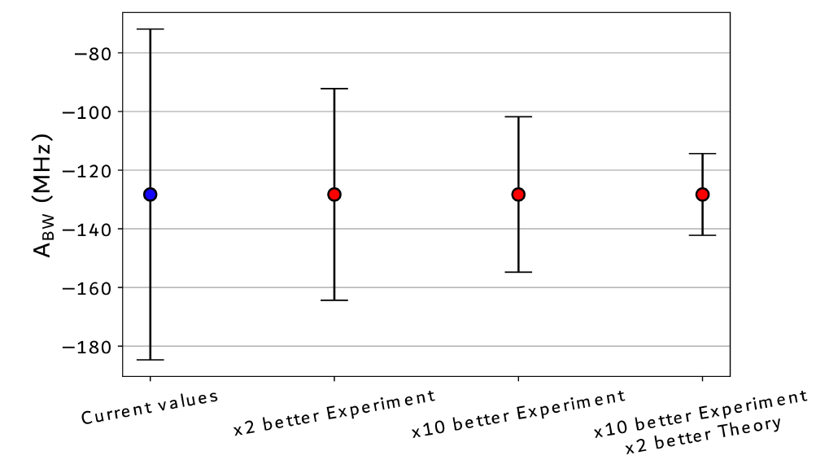
Bohr-Weisskopf-effect in ^{223,225}Ra
For ²²³Ra:

Slide 8
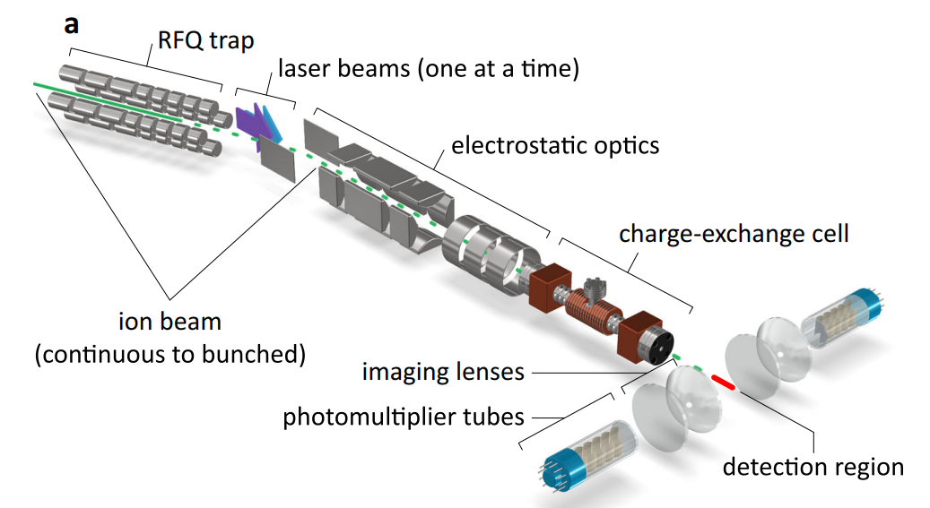
The COLLAPS setup
(Not needed)
Main improvements compared to 1980s measurements:
High-voltage measurements (ISCOOL & scanning voltage), at least x10 better
Laser frequency measurement & stabilization

Slide 9
Response to TAC comments
Is this proposal also possible as online beamtime?
→ In principle, yes. However, we would prefer an offline beamtime since this would ease the scheduling
from our side. Furthermore, we expect less contamination (Fr) in an offline beamtime.
Is this proposal still feasible within the requested shifts (13) with a reduced ion beam (≤ 7e5 ions)?
→ Yes, since we don’t expect to be limited in statistical, but in systematic uncertainties.
Therefore, the following considerations were made for the initial (conservative) shift request:
  Since the pA of ion beam was estimated from the CRIS RaF run anyways, we made our shift estimation
  with an assumed yield of 1e6 – 5e6 ions/s
  For similar intensities, we usually need 0.5 shifts per isotope and transition. For this beamtime, we
  doubled this time to not only acquire more statistics, but to investigate and accommodate for systematic
  uncertainties, which means many reference measurements (→ magnet cycling). However, this
  is something we can accommodate for and slightly reduce the number of reference measurements if
  necessary.
  → Summarized: Of course, more beam would be better, but 7e5 ions/s should still be feasible, if the beam
  is rather clean!

