Slide 1
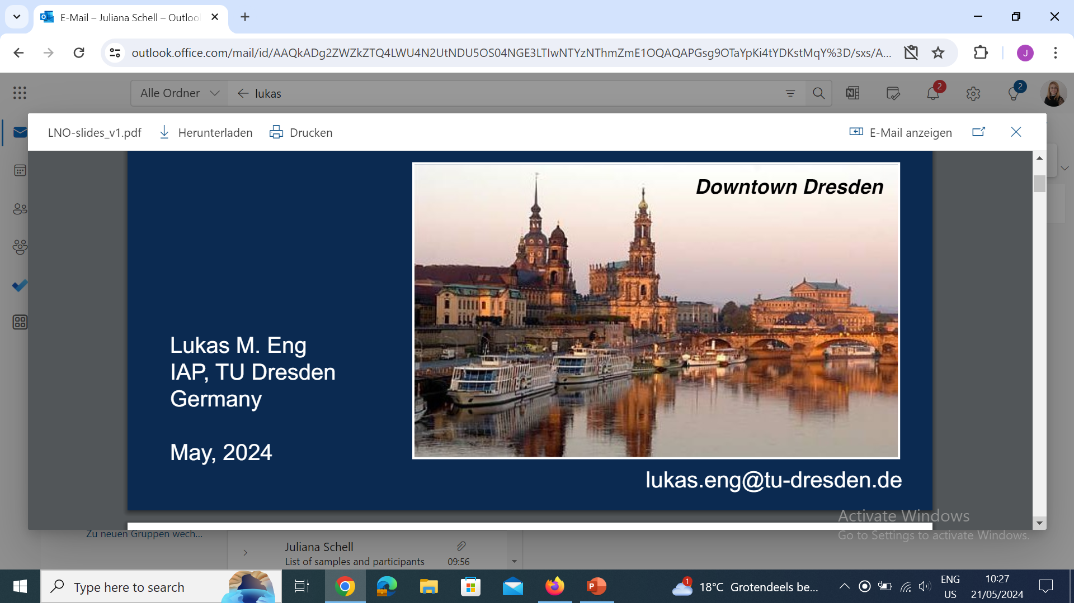
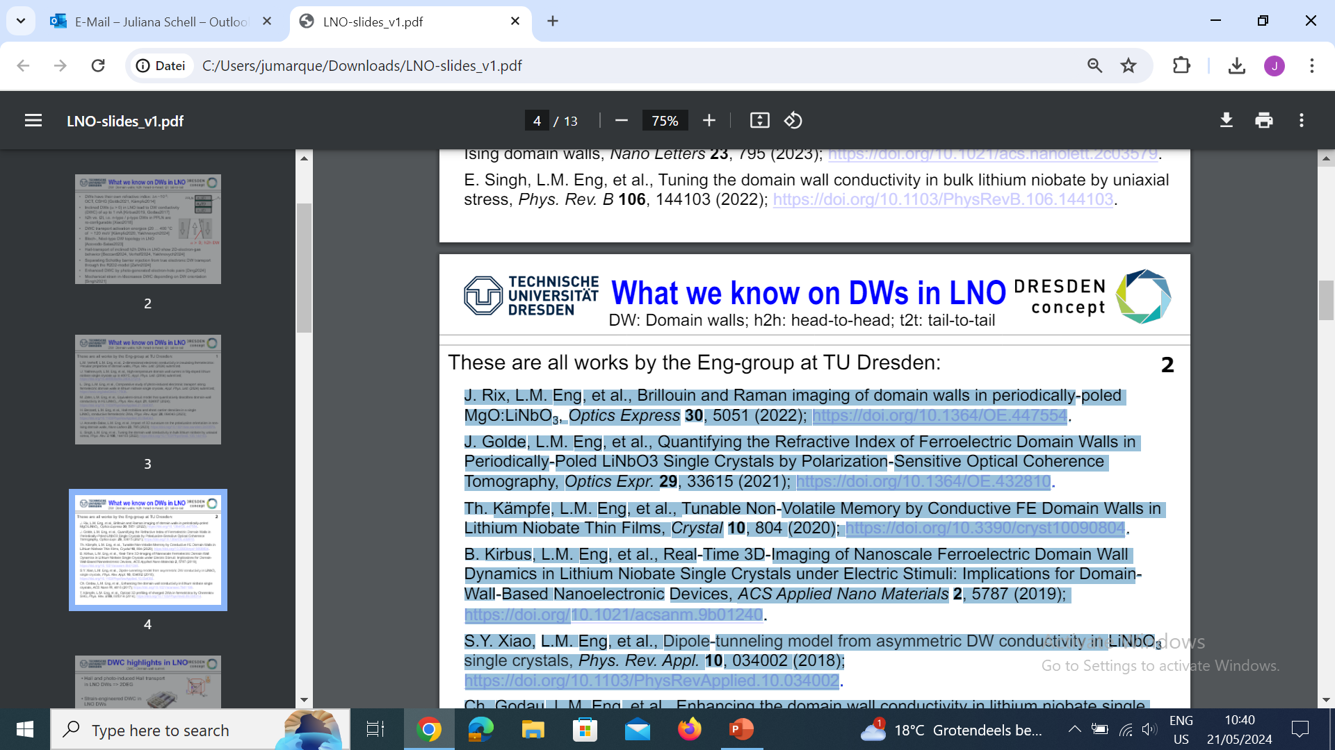

Local study of Lithium Niobate domain walls
Presenter name and spokesperson
Dr. Juliana Heiniger-Schell
Second spokesperson
Prof. Lukas Eng

Slide 2
Collaboration CERN-INTC-2024-034 / INTC-P-703
  J. H.-Schell^{1,2}, H. M. Gürlich³, T. T. Dang², I. C. J. Yap², B. Dörschel², S. D. Seddon³, B. Koppitz³, A. M. L. Lopes⁴, A. W. Carbonari⁵, N. Lima^{1,5}, P. Rocha-Rodrigues⁴, L. M. Eng^{3,6}
  ¹ European Organization for Nuclear Research (CERN), CH-1211 Geneva, Switzerland
  ² Institute for Materials Science and Center for Nanointegration Duisburg-Essen (CENIDE), University of Duisburg-Essen, 45141 Essen, Germany
  ³ Institute of Applied Physics, Technische Universität Dresden, 01062 Dresden, Germany
  ⁴ Institute of Physics for Advanced Materials, Nanotechnology and Photonics (IFIMUP), 4169 - 007 Porto, Portugal
  ⁵ Instituto de Pesquisas Energéticas e Nucleares IPEN-CNEN/SP, São Paulo 05508-000, Brazil
  ⁶ ct.qmat: Dresden-Würzburg Cluster of Excellence—EXC 2147, Technische Universität Dresden, 01062 Dresden, Germany

Slide 3
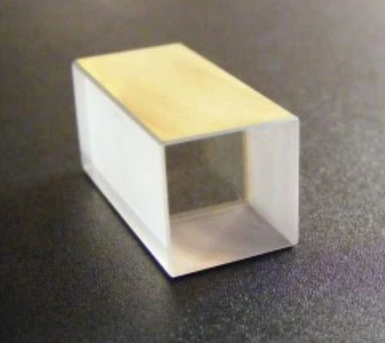
Lithium Niobate
Robust wide-band-gap ferroelectric (E _{g} ≈ 4 eV)
High Curie temperature (T _{C} ≈ 1200 °C)
Large values of the spontaneous polarization near room temperature (P _{S} ≈ 70 µC/cm²)
The 5-%Mg doping level leads to a two-order higher optical stability
References:
C. S. Werner et al., Sci Rep 7, 9862 (2017). https://doi.org/10.1038/s41598-017-09703-2
Y. Furukawa et al., Jpn. J. Appl. Phys. 35 (1996) 2740. https://dx.doi.org/10.1143/JJAP.35.2740

Slide 4
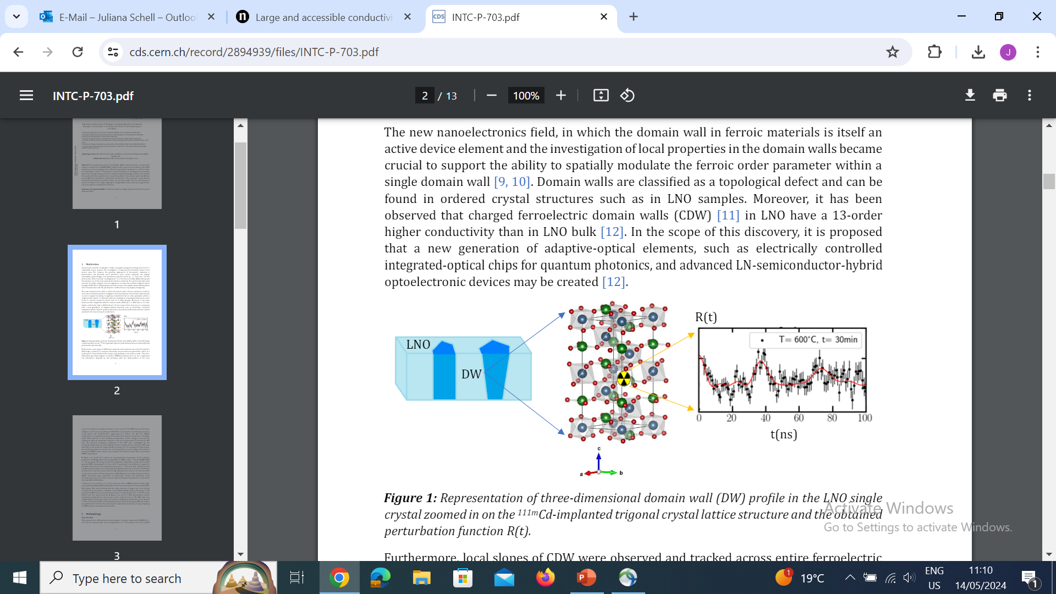
Domain Walls (DW)
General
Lithium Niobate
Ferroelectric domain walls isolate regions with different polarizations.
Due to the local breaking of spatial symmetry, DW can exhibit properties completely different from those of the material
Charged ferroelectric domain walls (CDW) in LNO have a 13-order higher conductivity than in bulk.
New applications: adaptive-optical elements, electrically controlled integrated-optical chips for quantum photonics, and advanced LN-semiconductor-hybrid optoelectronic devices
References:
C. S. Werner et al., Sci Rep 7, 9862 (2017). https://doi.org/10.1038/s41598-017-09703-2
R. K. Vasudevan, et al. Adv. Funct. Mater. 23 (2013) 2592. https://doi.org/10.1002/adfm.201300085
C. S. Werner et al., Scientific Reports 7 (2017) 9862. https://doi.org/10.1038/s41598-017-09703-2

Slide 5
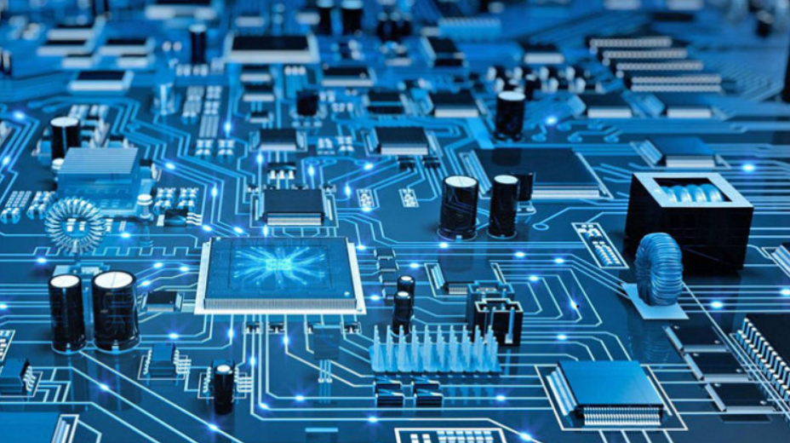
Applications current state of art and future
LNO in nanoelectronics
The role of DW in performance
Sensors in compact eletromechanical systems
Selectors in phase-change memory and resistive random access memory
Half-wave/full wave rectifiers in modern nanocircuits.
Conduction through head-to-head, neutral or tail-to-tail DWs
High conductivity between polarization orientations
Ultra-thin topological interface (~few units cells)
“DW electronics’
References:
J. Sun et al., ACS Appl. Mater. Interfaces 2023, 15, 6, 8691–8698 (https://pubs.acs.org/doi/full/10.1021/acsami.2c20579)
D. Hu et al., IEEE 2024 (https://ieeexplore.ieee.org/abstract/document/10373934)
H. Beccard et al., Phys. Rev. Appl. 2023 (https://journals.aps.org/prapplied/abstract/10.1103/PhysRevApplied.20.064043)
.

Slide 6
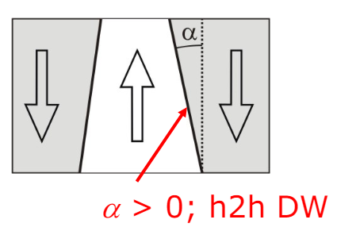
Applications current state of art and future
The role of DW in performance
Inclined DWs (a > 0) in LNO lead to DW conductivity (DWC) of up to 1 mA [Kirbus2019, Godau2017]
h2h vs. t2t, i.e. n-type / p-type DWs in PPLN are re-configurable [Xiao2018]
DWC transport activation energies (20 … 400 °C of ~ 120 meV [Kämpfe2020, Yakhnevych2024]
Bloch-, Néel-type DW topology in LNO [Acevedo-Salas2023]
Hall-transport of inclined h2h DWs in LNO show 2D-electron-gas behavior [Beccard2024, Verhoff2024, Yakhnevych2024]
Separating Schottky barrier injection from true electronic DW transport through the R2D2-model [Zahn2024]
Enhanced DWC by photo-generated electron-hole pairs [Ding2024]
Mechanical strain in-/decreases DWC depending on DW orientation [Singh2021]

Slide 7
Works of the group Prof. Lukas Eng (TU-Dresden)
L. M. Verhoff, L.M. Eng, et al., 2-dimensional electronic conductivity in insulating ferroelectrics: Peculiar properties of domain walls, Phys. Rev. Lett. (2024) submitted.
U. Yakhnevych, L.M. Eng, et al., High-temperature domain wall current in Mg-doped lithium niobate single crystals up to 400°C, Appl. Phys. Lett. (2004) submitted; https://doi.org/10.48550/arXiv.2404.01214.
L. Ding, L.M. Eng, et al., Comparative study of photo-induced electronic transport along ferroelectric domain walls in lithium niobate single crystals, Appl. Phys. Lett. (2024) submitted; https://arxiv.org/abs/2402.17508.
M. Zahn, L.M. Eng, et al., Equivalent-circuit model that quantitatively describes domain-wall conductivity in FE LiNbO₃, Phys. Rev. Appl. 21, 024007 (2024); https://doi.org/10.1103/PhysRevApplied.21.024007.
H. Beccard, L.M. Eng, et al., Hall mobilities and sheet carrier densities in a single LiNbO₃ conductive ferroelectric DWs, Phys. Rev. Appl. 20, 064043 (2023); https://doi.org/10.1103/PhysRevApplied.20.064043.
U. Acevedo-Salas, L.M. Eng, et al., Impact of 3D curvature on the polarization orientation in nonIsing domain walls, Nano Letters 23, 795 (2023); https://doi.org/10.1021/acs.nanolett.2c03579.
E. Singh, L.M. Eng, et al., Tuning the domain wall conductivity in bulk lithium niobate by uniaxial stress, Phys. Rev. B 106, 144103 (2022); https://doi.org/10.1103/PhysRevB.106.144103

Slide 8
Works of the group Prof. Lukas Eng (TU-Dresden)
J. Rix, L.M. Eng, et al., Brillouin and Raman imaging of domain walls in periodically-poled MgO:LiNbO₃, Optics Express 30, 5051 (2022); https://doi.org/10.1364/OE.447554.
J. Golde, L.M. Eng, et al., Quantifying the Refractive Index of Ferroelectric Domain Walls in Periodically-Poled LiNbO₃ Single Crystals by Polarization-Sensitive Optical Coherence Tomography, Optics Expr. 29, 33615 (2021); https://doi.org/10.1364/OE.432810.
Th. Kämpfe, L.M. Eng, et al., Tunable Non-Volatile Memory by Conductive FE Domain Walls in Lithium Niobate Thin Films, Crystal 10, 804 (2020); https://doi.org/10.3390/cryst10090804.
B. Kirbus, L.M. Eng, et al., Real-Time 3D-Imaging of Nanoscale Ferroelectric Domain Wall Dynamics in Lithium Niobate Single Crystals under Electric Stimuli: Implications for Domain Wall-Based Nanoelectronic Devices, ACS Applied Nano Materials 2, 5787 (2019); https://doi.org/10.1021/acsanm.9b01240.
S.Y. Xiao, L.M. Eng, et al., Dipole-tunneling model from asymmetric DW conductivity in LiNbO₃ single crystals, Phys. Rev. Appl. 10, 034002 (2018); https://doi.org/10.1103/PhysRevApplied.10.034002.
Ch. Godau, L.M. Eng, et al., Enhancing the domain wall conductivity in lithium niobate single crystals, ACS Nano 11, 4816 (2017); https://doi.org/10.1021/acsnano.7b01199.
T. Kämpfe, L.M. Eng, et al., Optical 3D profiling of charged DWs in ferroelectrics by Cherenkov SHG, Phys. Rev. B 89, 035314 (2014); https://doi.org/10.1103/PhysRevB.89.035314.

Slide 9
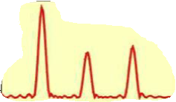
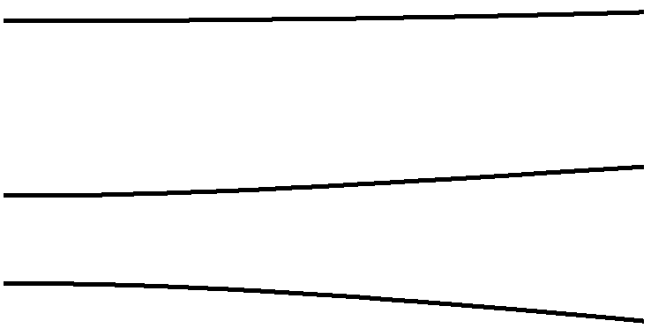
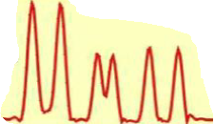
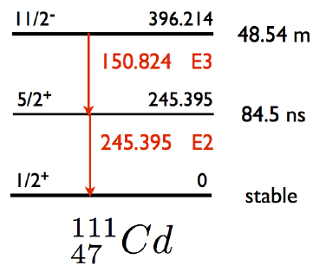

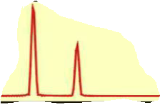





Perturbed Angular Correlation (PAC)
A method to probe hyperfine interactions in matter
Transition frequencies
Nuclear level splitting
ω₁
ω₂
ω₃
Electric Field Gradient (EFG)
ω₂
ω₃
$$\left(\begin{matrix}V_{xx} & 0 & 0 \\ 0 & V_{yy} & 0 \\ 0 & 0 & V_{zz}\end{matrix}\right)$$
ω₁
ω$∝$
5/2⁺
245.395keV
84.5ns
+ combined interactions
ω_{n}
Magnetic Hyperfine field
$$\left(0,0,B_{z}\right)$$
ω_{L}
2ω_{L}
ω$∝$
ω_{L}
2ω_{L}
Nuclear probing state in matter
Consequence
Observable

Slide 10
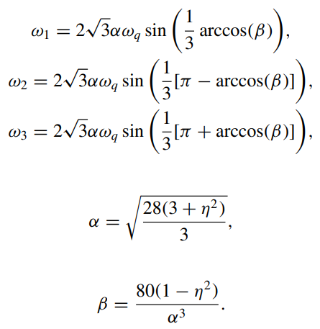
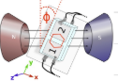

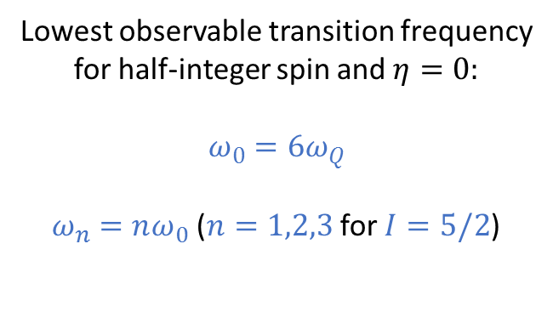
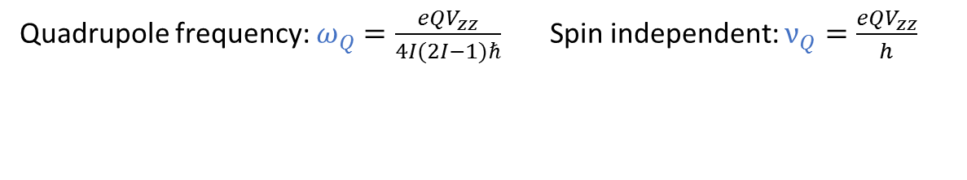
The frequencies
Quadrupole frequency: $ω_{Q}=\frac{eQV_{zz}}{4I(2I−1)ℏ}$ Spin independent: $ν_{Q}=\frac{eQV_{zz}}{h}$
Lowest observable transition frequency
for half-integer spin and $η=0:$
$$ω_{0}=6ω_{Q}$$
$ω_{n}=nω_{0}$ ($n=1,2,3$ for $I=5/2$)
For $η≠0 and I=5/2$

Slide 11
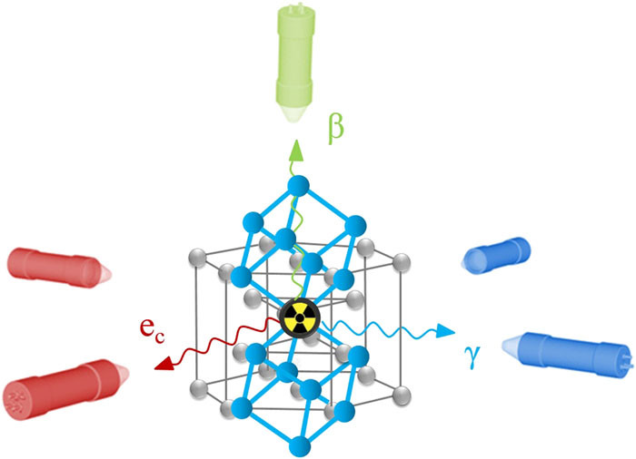
The EFG in LNO
LNO properties
Nuclear probe properties
Nuclear probe incorporation method and measurements conditions
Apply fields
Vzz and η values
Conduction electrons (DWs)
Electrons bound to the probe
AIP Advances 7, 105017 (2017)
https://doi.org/10.1063/1.4994249
Defects and lattice deformation
Lattice location of the probe

Slide 12
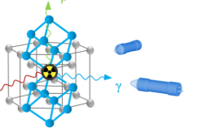
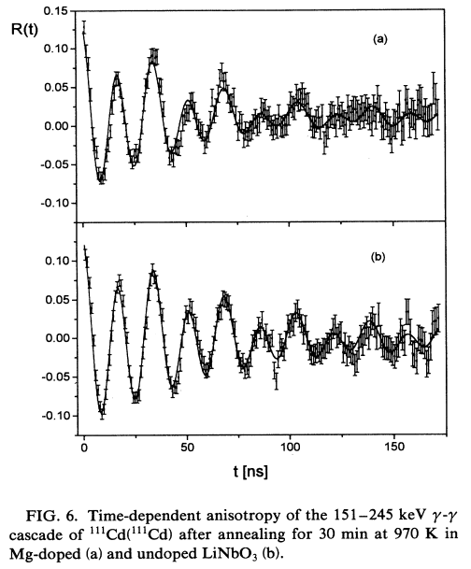
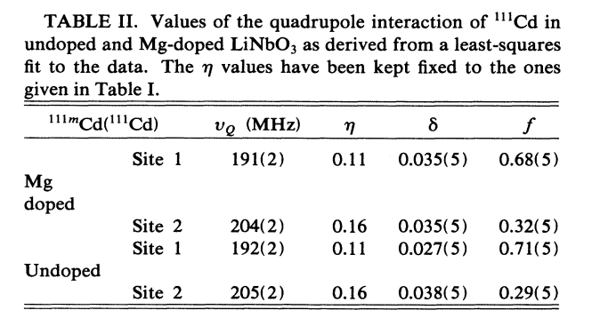
Previous TDPAC measurements
^{111m}Cd implanted in LNO at 60 keV (ISOLDE)
Figure source: B. Hauer et al. Phys. Rev. B 51, 6208 (1995).

Slide 13
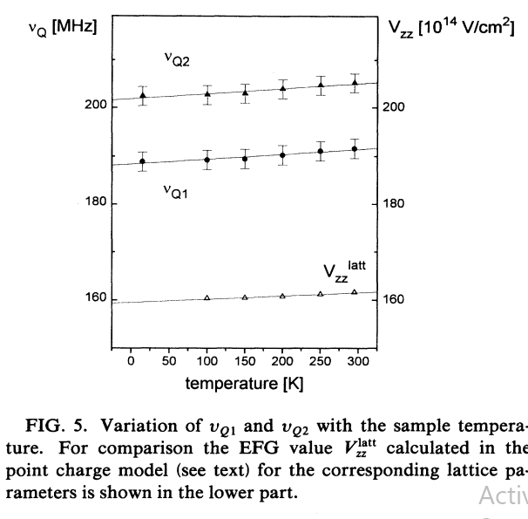
Previous TDPAC measurements
¹¹¹In implanted in LNO at 150 keV
Figure source: B. Hauer et al. Phys. Rev. B 51, 6208 (1995).
v_{Q1} = 192(1) MHz and asymmetry parameter η = 0.11(2) (predominant 68%) and v_{Q1} = 205(1) MHz and η = 0.16(4).
Second fraction for In@Li associated to a Nb-vacancy.

Slide 14
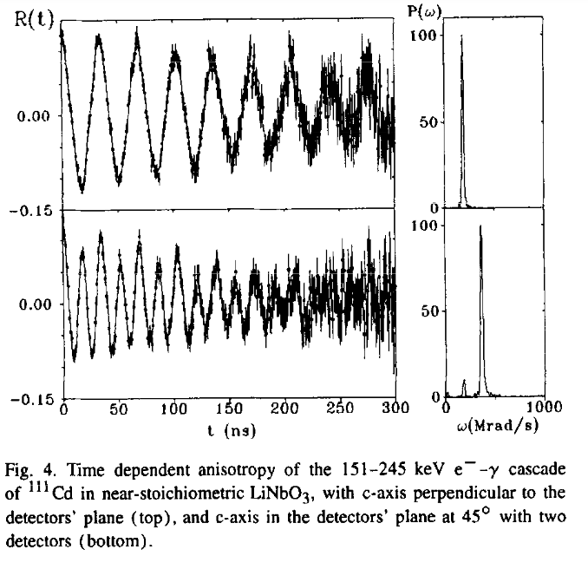
Previous TDPAC measurements
Obtained NQI for ^{111m}Cd 60 keV at ISOLDE
Figure source: A. Kling, et al., Nucl. Instr. Meth. B 1996, 113, 293–295. https://doi.org/10.1016/0168-583X(95)01329-6
v_{Q} = 191(2) MHz and asymmetry parameter η = 0. The asymmetry parameter indicate a higher crystal lattice.
Other references: LN (4.6 wt% K2O)
A. Kling, J.G. Marques, Crystals 2021, 11, 501.
https://doi.org/10.3390/cryst1105050

Slide 15
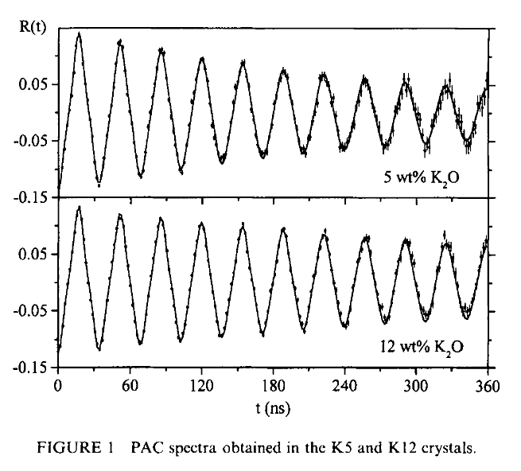
Previous TDPAC measurements
Obtained NQI for ¹¹¹In 150 keV at HISKP
Figure source: J.G. Marques, et al., Rad. Eff. Def. Solids 1999, 150, 233–236. https://doi.org/10.1080/10420159908226235
v_{Q1} = 191(2) MHz and v_{Q2} = 205.2 MHz and asymmetry parameter η > 0. Two distinct Li-sites. Lattice disorder decreases with increase of K₂O (lower delta value).
Data could not be described by models that consider vacancies and Nb antisites.
Other references: LN (4.6 wt% K2O)
A. Kling, J.G. Marques, Crystals 2021, 11, 501.
https://doi.org/10.3390/cryst1105050

Slide 16
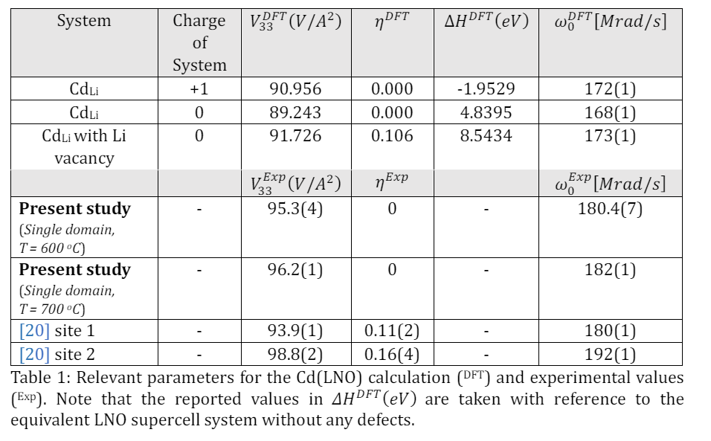
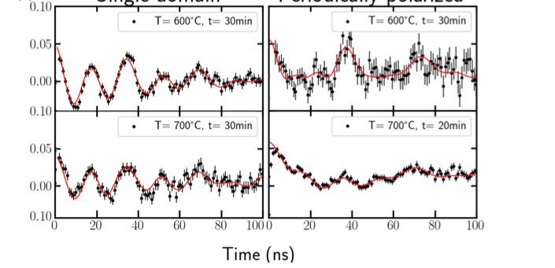
Our TDPAC measurements
Spectra
Comparison with DFT and previous work
R(t) Single Domain Periodically poled

Slide 17
Beam request ^{111m}Cd 9 shifts (72 hours) + 1 shift reserved
Probe | Annealing | Number of samples (5 angular dependence measurements + reproduction) | Beam time
Single domain 30 keV (repeat for 60 keV) | air | 10 +10 | 10 hours
 | Oxygen flow | 10 +10 | 10 hours
 | Ar flow | 10 +10 | 10 hours
Periodically poled 30 keV (repeat for 60 keV) | air | 10 +10 | 10 hours
 | Oxygen flow | 10 +10 | 10 hours
 | Ar flow | 10 +10 | 10 hours
Single domain 30 keV applied E field (repeat for 60 keV) | air | 2 +2 | 2 hours
 | Oxygen flow | 2 +2 | 2 hours
 | Ar flow | 2 +2 | 2 hours
Periodically poled 30 keV applied E field (repeat for 60 keV) | air | 2 +2 | 2 hours
 | Oxygen flow | 2 +2 | 2 hours
 | Ar flow | 2 +2 | 2 hours

Slide 18
Beam request ¹¹¹In 2 shifts
Probe | Annealing | Number of samples (~10 angular dependence measurements + reproduction) | Beam time
Single domain 30 keV (repeat for 60 keV) | air | 1 +1 | 2 hours
 | Oxygen flow | 1 +1 | 2 hours
 | Ar flow | 1 +1 | 2 hours
Periodically poled 30 keV (repeat for 60 keV) | air | 1 +1 | 2 hours
 | Oxygen flow | 1 +1 | 2 hours
 | Ar flow | 1 +1 | 2 hours
Single domain 30 keV applied E field (repeat for 60 keV) | air | 1 +1 | 2 hours
 | Oxygen flow
 | Ar flow
Periodically poled 30 keV applied E field (repeat for 60 keV) | air | 1 +1 | 2 hours
 | Oxygen flow
 | Ar flow

Slide 19


Thank you! Acknowledgments
BMBF
Bundesministerium für Bildung und Forschung
Erforschung kondensierter Materie mit Großgeräten Ausbau und Unterhalt der Einrichtungen an ISOLDE/CERN
Germany, contract: 05K16PGA and 05K22PGA for ISOSOL and for PACBIT Prof. Dr. D. Lupascu, Dr. J. H.-Schell
European Union’s Horizon Europe Framework research and innovation programme
Agreement no. 101057511 (EURO-LABS)

Slide 20



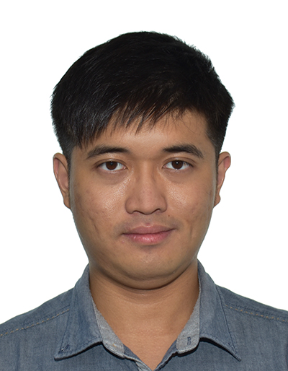



Prof. Lukas Eng
Spokesperson
Dr. Juliana Schell
Spokesperson
Mr. Thanh Dang
PhD candidate
Mr. Ian Yap
PhD Candidate
More researchers from TU-Dresden:
S. D. Seddon, B. Koppitz
Consultants:
M. L. Lopes, A. W. Carbonari,
P. Rocha-Rodrigues
Mr. Hannes Gürlich
Master candidate
Mr. Björn Dörschel
Master candidate
Ms. Nicole Lima
PhD Candidate

