Slide 1
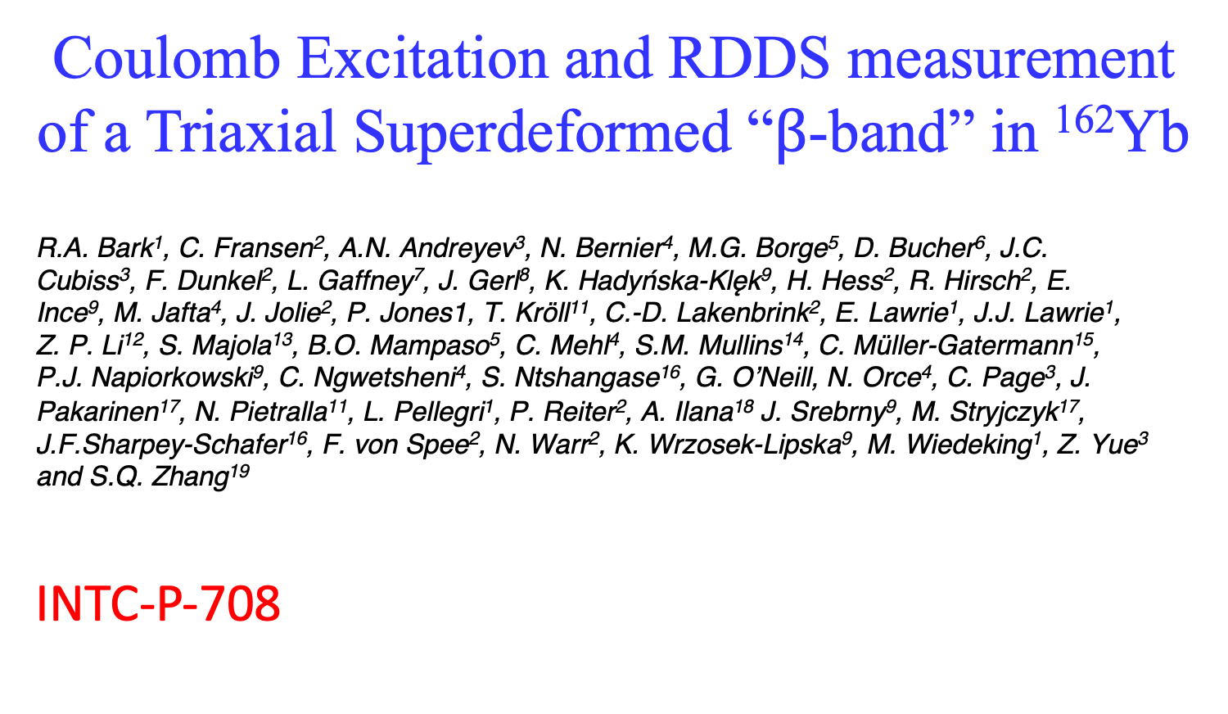
Coulomb Excitation and RDDS measurement of a Triaxial Superdeformed “$β$-band” in ¹⁶²Yb
R.A. Bark¹, C. Fransen², A.N. Andreyev³, N. Bernier⁴, M.G. Borge⁵, D. Bucher⁶, J.C.
Cubiss³, F. Dunkel², L. Gaffney⁷, J. Gerl⁸, K. Hadyńska-Klęk⁹, H. Hess², R. Hirsch², E.
Ince⁹, M. Jafta⁴, J. Jolie², P. Jones1, T. Kröll¹¹, C.-D. Lakenbrink², E. Lawrie¹, J.J. Lawrie¹,
Z. P. Li¹², S. Majola¹³, B.O. Mampaso⁵, C. Mehl⁴, S.M. Mullins¹⁴, C. Müller-Gatermann¹⁵,
P.J. Napiorkowski⁹, C. Ngwetsheni⁴, S. Ntshangase¹⁶, G. O’Neill, N. Orce⁴, C. Page³, J.
Pakarinen¹⁷, N. Pietralla¹¹, L. Pellegri¹, P. Reiter², A. Ilana¹⁸ J. Srebrny⁹, M. Stryjczyk¹⁷, J.F.Sharpey-Schafer¹⁶, F. von Spee², N. Warr², K. Wrzosek-Lipska⁹, M. Wiedeking¹, Z. Yue³
and S.Q. Zhang¹⁹
INTC-P-708

Slide 2
Studying the origin of 0₂⁺ bands in mass 160 region
β vibrations?
shape coexistence?
“pairing isomers” – “second vacuum”?
X(5)….?

Slide 3
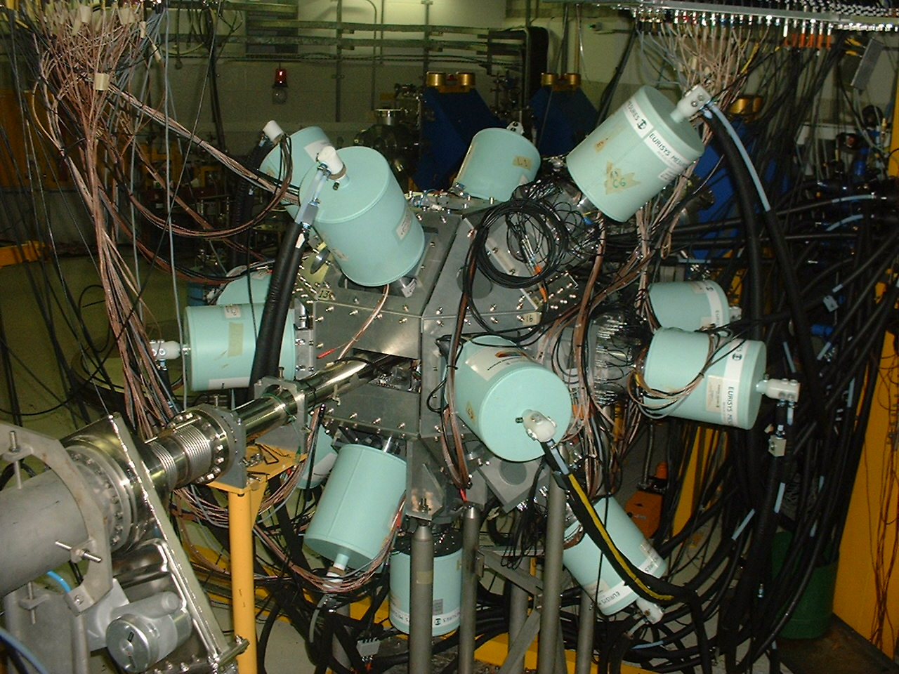
Experiments in mass 160 region using AFRODITE array of 8 or 9 clover detectors + LEP detectors
e.g.
¹⁵²Sm(α,2n)¹⁵⁴Gd
¹⁵²Sm(α,4n)¹⁵²Gd
¹⁴⁷Sm(¹⁶Ο,4n)¹⁶⁰Yb
¹⁴⁴Sm(¹⁷Ο,3n)¹⁵⁸Yb
¹⁵²Sm(¹²C,4n)¹⁶⁰Er
¹⁴⁸Sm(¹²C,4n)¹⁵⁶Er
Experiments optimized to study LOW-SPIN states
Light, low-energy beams – low recoil velocities

Slide 4
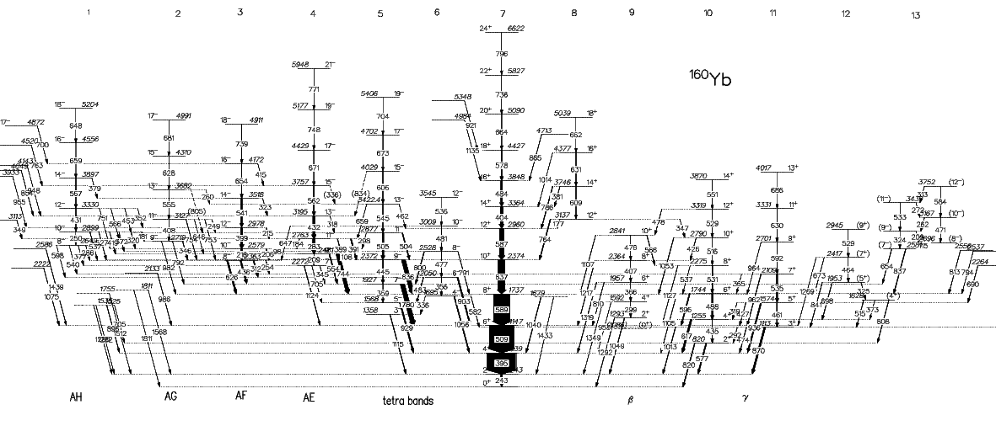
¹⁴⁷Sm(¹⁶Ο,3n)¹⁶⁰Yb
octupole
vib.
g
β
γ

Slide 5
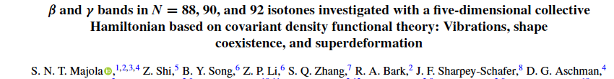
Energy Systematics
ground band
β band
γ band
0₃⁺ band
S-band
γ-band almost always parallel to ground band
β-band not always
parallel, especially in
Er and Yb nuclei

Slide 6
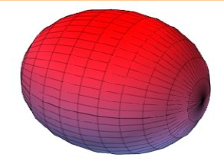
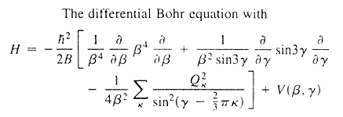
The vibrating nucleus
Vibrating Liquid drop
The Bohr Hamiltonian
T_{vib}
T_{rot}

Slide 7
In reality:
Complicated Potential Energy Surfaces
The Bohr Hamiltonian
T_{vib}
T_{rot}

Slide 8

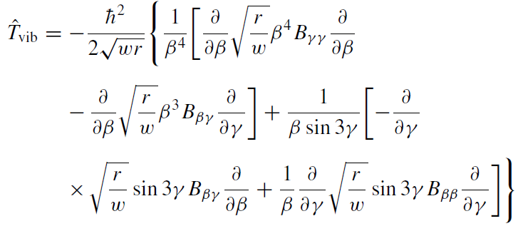
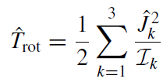
Re-cast Bohr Hamiltonian: 5 Dimensional Collective
Hamiltonian
Need to determine I’s, B’s
T. Niksic et al PRC 79, 034303 (2009)
Z.P. Li et al., PRC 79, 054301 (2009)

Slide 9
N=92
Calculated Energies
(lines) compared to experiment (points)
ground band
β band
γ band
0₃⁺ band

Slide 10
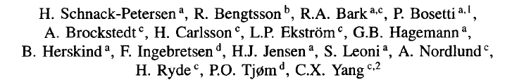
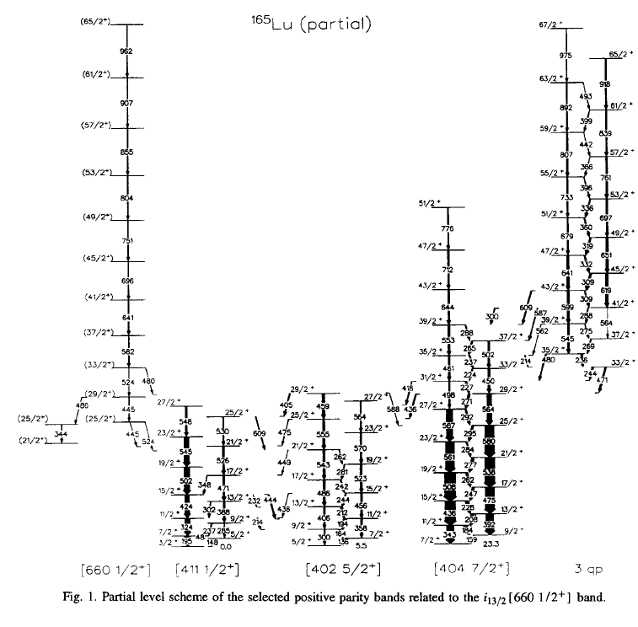
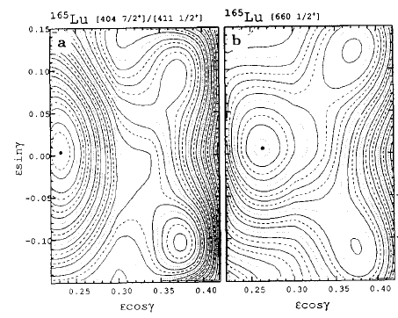

Slide 11
In-band
B(E2)s
ground
band
(theory)
ground
band (exp)
0₂⁺
band
(theory)
0₂⁺
band (exp)

Slide 12
Branching Ratios β-band
β-band B(E2) branching ratios: out/in
I
in
out
I-2
γ
I-2
g

Slide 13
Aim: measure transition rates to test the Superdeformed Triaxial Shape of the “β -bands”
But which nucleus to study?
LoI 226: ^{160,162,164}Yb Yields measured:
A | With LIST on: (pps/μC) | Impurities with LIST off | Yield with LIST off: (pps/μC)
160 | 7×10⁶ | 50% | 3.5×10⁸
162 | 2×10⁷ | 6.5% | 10⁹
164 | 3×10⁷ | 4% | 1.5×10⁹

Slide 14
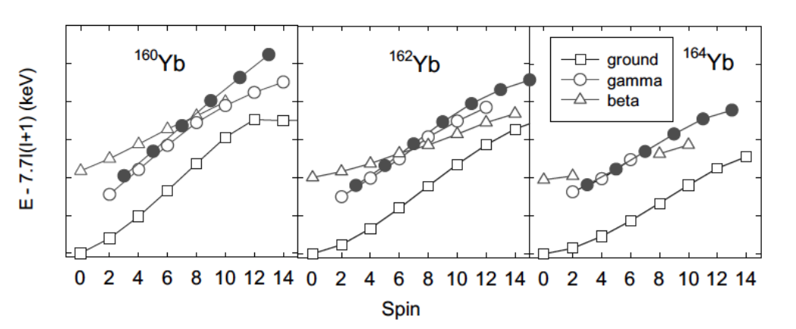
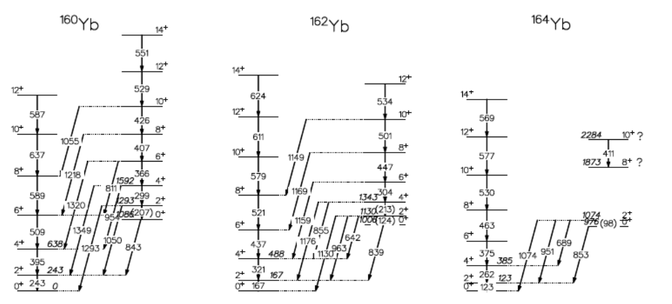
Unknown transitions
Known Least
No E0’s
One E0
No E0’s

Slide 16
Aim: measure transition rates to test the Superdeformed Triaxial Shape of the “β -bands”
Methods to measure transitions rates:
Recoil Distance Doppler Shift
+
Coulomb Excitation Sum Rules

Slide 17
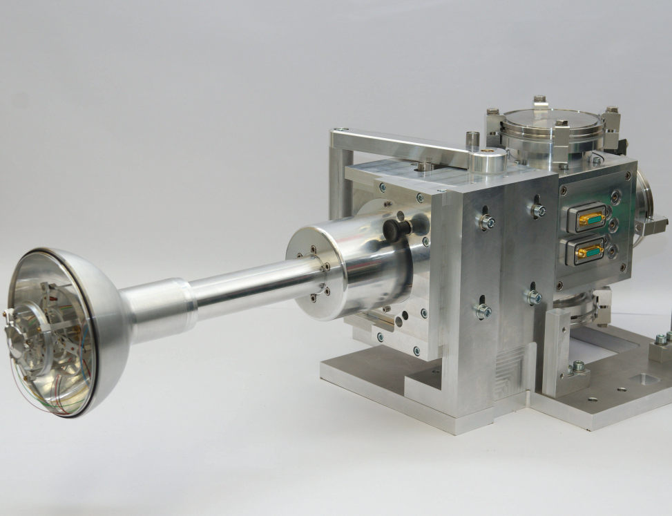


Setup: Coulomb Excitation/RDDS Setup
target
degrader
QQQ2 charged particle detector array (CD detector)
¹⁶²Yb
4.1 MeV/A
5 x 10⁶ pps
¹⁶²Yb
v/c~0.08
v/c~0.05
Safe Coulex
18°
⁹²Mo
Cologne Plunger
⁹²Mo
1 mg/cm²
^{nat}Mg
2.5 mg/cm²
52°
Miniball array
~ 45 ° /135 °
7% eff.

Slide 18
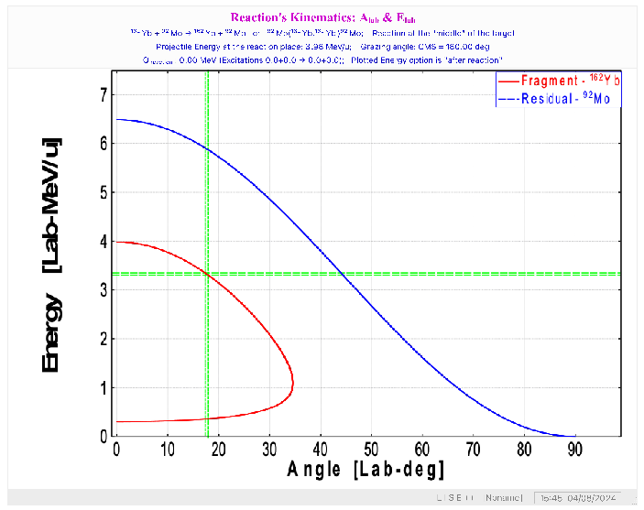
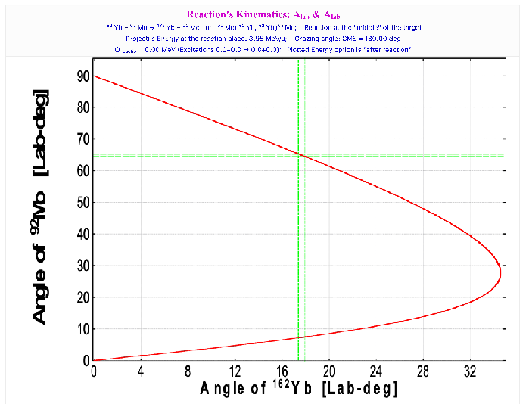
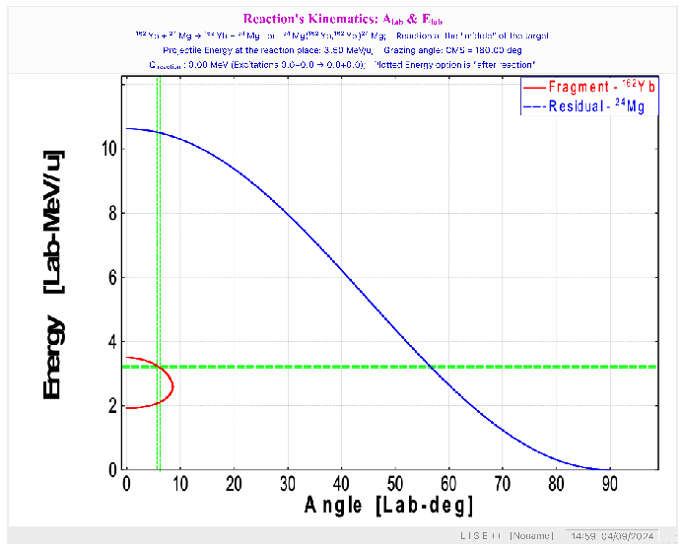
Kinematics
⁹²Mo
¹⁶²Yb
¹⁶²Yb distinguished from ⁹²Mo and Mg in angle-energy
²⁴Mg
¹⁶²Yb

Slide 19
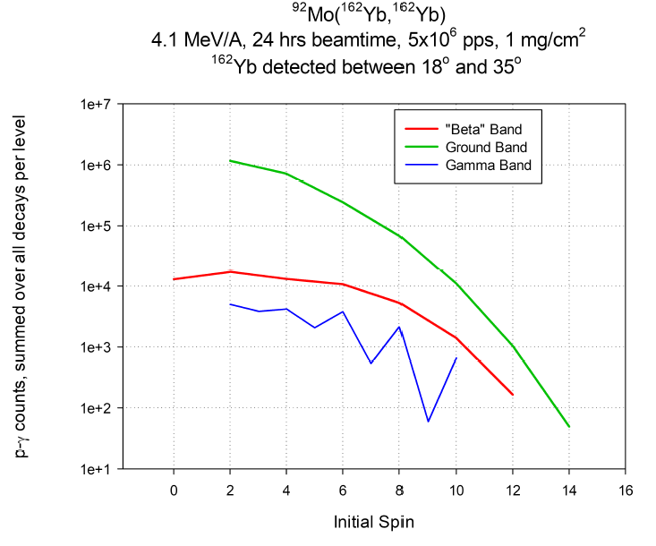
GOSIA Calculation: Coulomb Excitation of ¹⁶²Yb

Slide 20
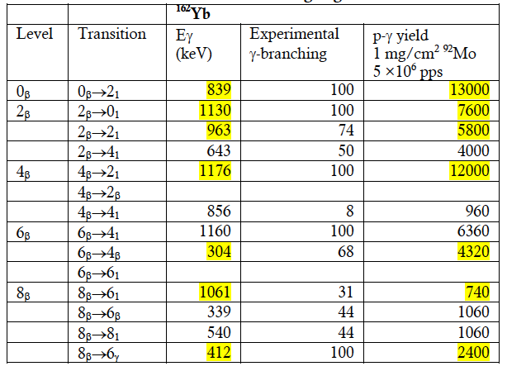
“Clean lines” of ¹⁶²Yb “β -band”
Typical resolution of 12 keV
But RDDS will have shifted and unshifted components with differing v/c’s

Slide 21
Doppler Shift/Width Map 1 MeV “degraded” gamma
0°
Useful Area of QQQ2
Particle detector
Relative to a single Miniball detector at ~ 45 °
33°
29/6 keV
45°
24/9 keV
26/10 keV
18/15 keV
18°
22/14 keV
17/15 keV
90°
“undegraded” gamma’s have ~ 2 keV higher widths

Slide 22
Coulomb Excitation without degrader
Degrader removed – only “undegraded” lines
Necessary to aid interpretation of RDDS spectra
If only one of the degraded/undegraded lines are clean in RDDS, will be provide the total strength of the line
Allows analysis of triaxiality using sum rules

Slide 23




Sum Rules determine shape
Quadrupole tensor
Quadrupole moment
triaxiality
In-band matrix elements most important, e.g.
$〈2_{2}\left\|E2\right\|4_{2}〉〈4_{2}\left\|E2\right\|4_{2}〉〈4_{2}\left\|E2\right\|2_{2}〉$

Slide 24
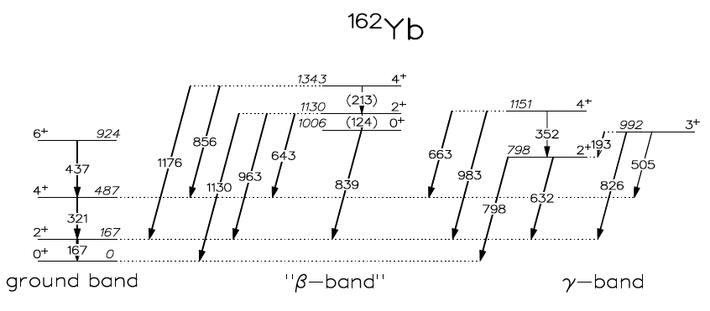
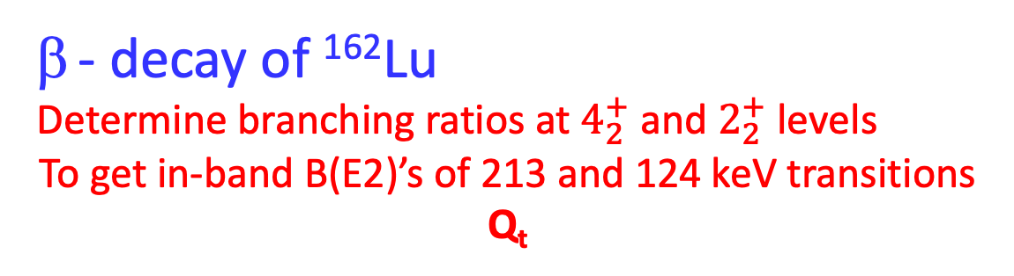
- decay of ¹⁶²Lu
Determine branching ratios at $4_{2}^{+}$ and $2_{2}^{+}$ levels
To get in-band B(E2)’s of 213 and 124 keV transitions Q_{t}
LoI 268 approved to determine yields of ¹⁶²Lu
Estimate need about 3 x 10¹² decays

Slide 25
Summary of beamtime request ¹⁶²Yb
4 days for RDDS
1 day pure Coulomb Excitation
5 days - 15 shifts total
Summary of beamtime request ¹⁶²Lu decay
None – await results of LoI 268

Slide 26
Thank You
16th International Symposium on Capture Gamma-Ray Spectroscopy and Related Topics (CGS16)
18-22 September 2017
Shanghai Jiao Tong University

Slide 27
