Slide 1

Visit at the 19th international conference on Deformation, Yield and Fracture of Polymers in Kerkrade, Netherlands
Polymer laboratory meeting
Dávid Máté Parragh
11/04/2024

Slide 2
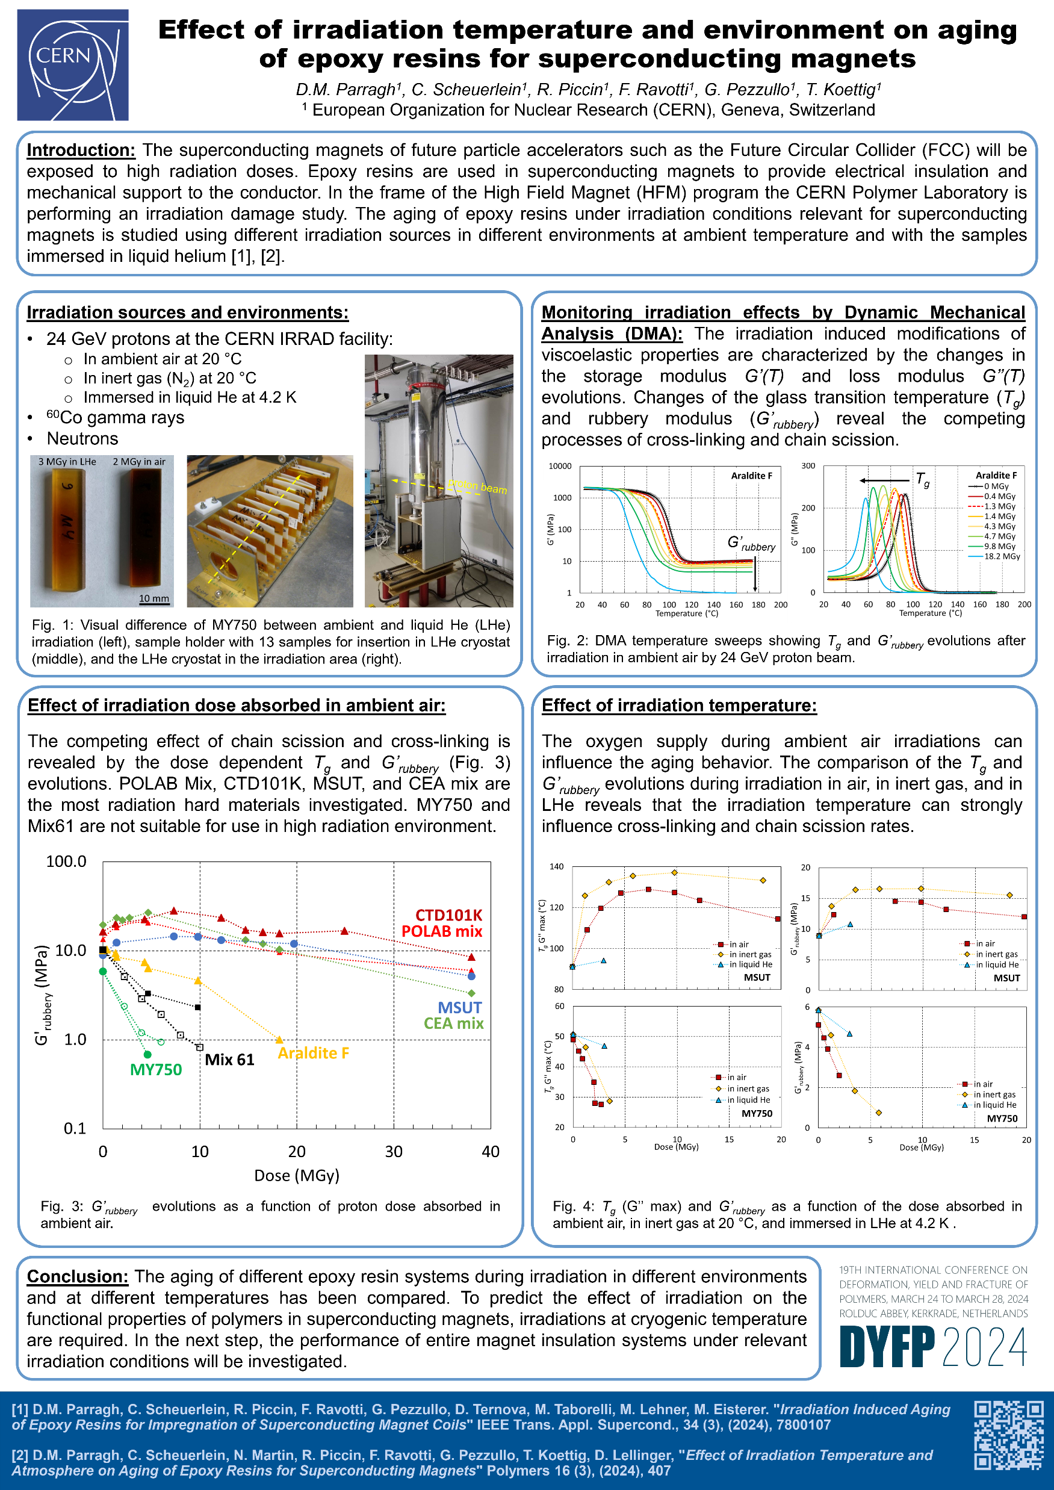
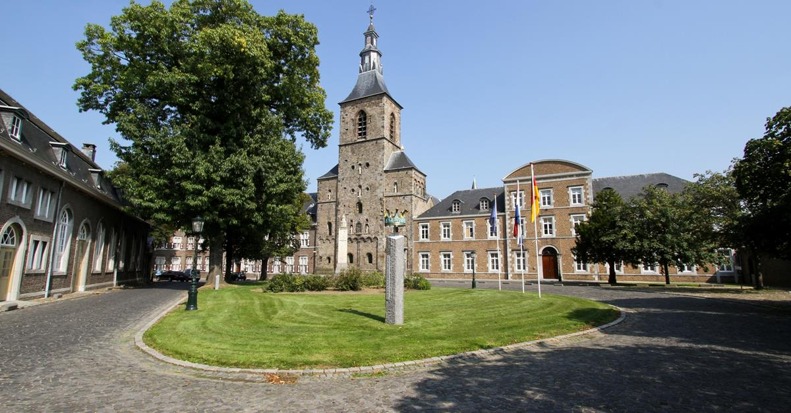
The conference
Internation conference on Deformation, Yield and Fracture of Polymers, 24-28 March 2024, Kerkrade, Netherlands
Poster presentation: Effect of irradiation temperature and environment on aging of epoxy resins for superconducting magnets

Slide 3
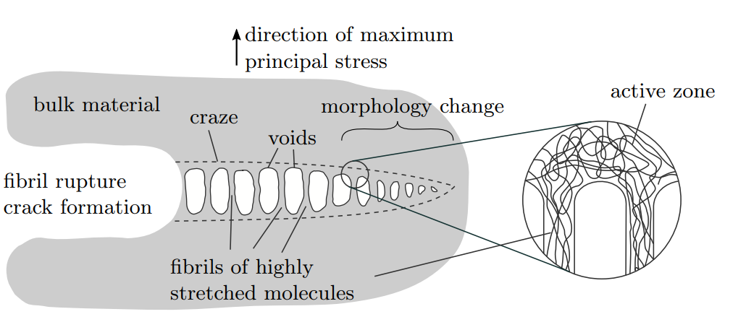
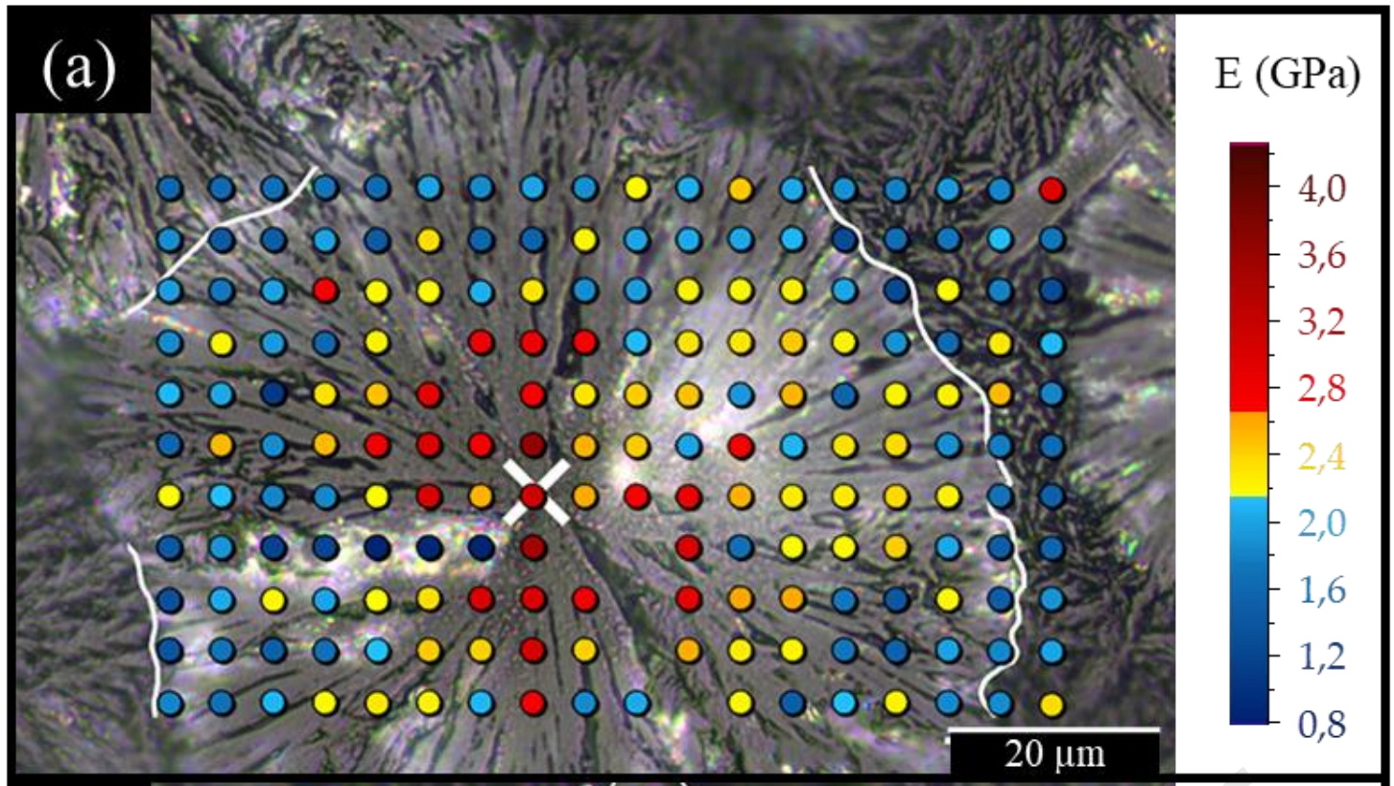
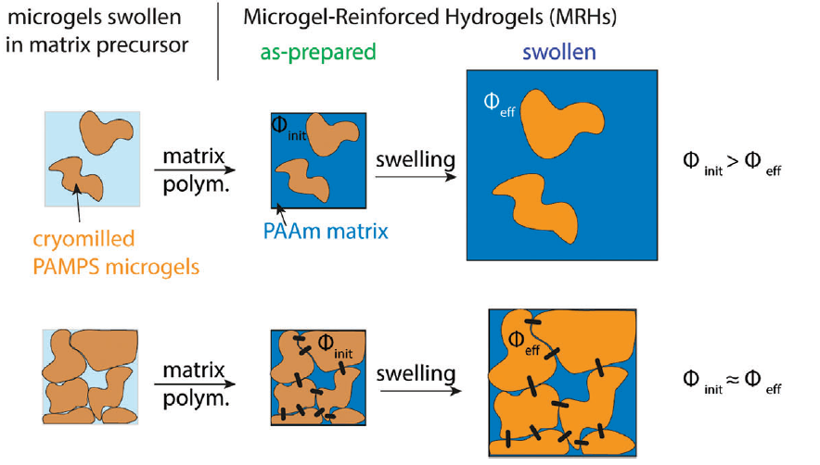
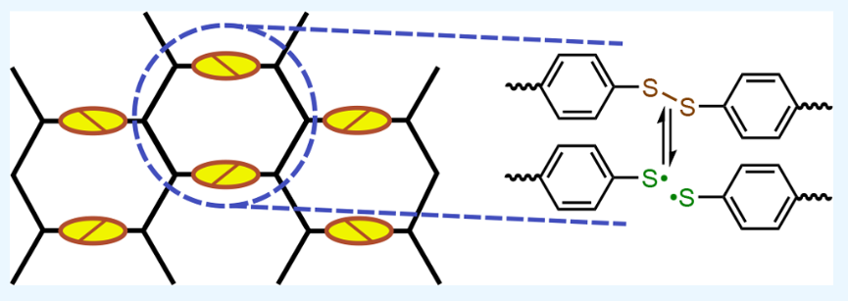
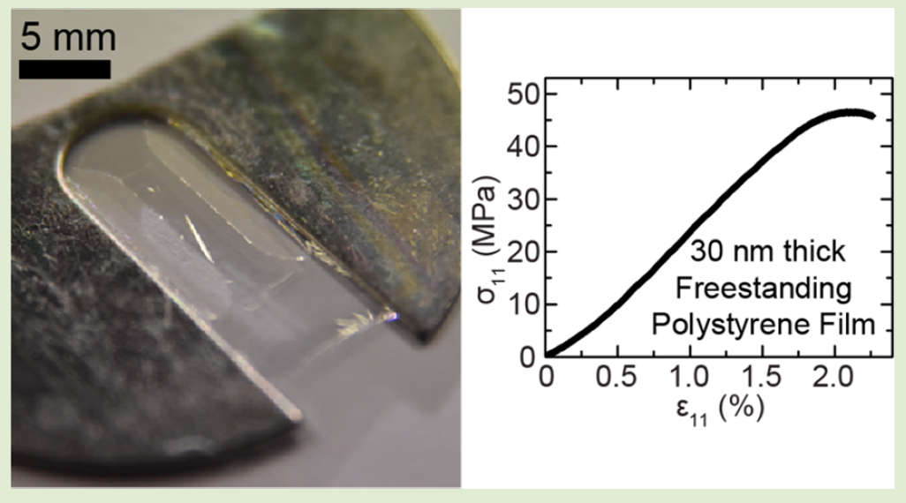
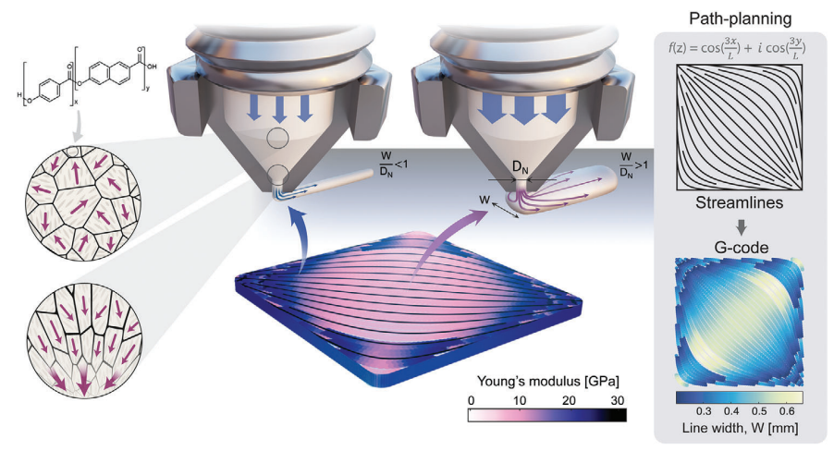
Session topics
Molecular Modeling
Surfaces, Contact & Adhesion
Fracture & Toughness
Physics of Glasses
Biological & Bioinspired
Soft Matter & Rubbers
Fatigue & Durability
In-Situ Observations
Semi-Crystalline Polymers
Laschuetza, Tobias, and Thomas Seelig. "Finite Element Analyses Of Crazing In Glassy Polymers Under Cyclic Mode I Loading."
Grondin, Jérémy, et al. "Intraspherulitic mechanical heterogeneities and microstructure of i-PP highlighted by nanoindentation and atomic force microscopy." Polymer 285 (2023): 126391.
Lewis, Broderick, Joseph M. Dennis, and Kenneth R. Shull. "Effects of dynamic disulfide bonds on mechanical behavior in glassy epoxy thermosets." ACS Applied Polymer Materials 5.4 (2023): 2583-2595.
Kessler, Michael, et al. "Influence of the Degree of Swelling on the Stiffness and Toughness of Microgel‐Reinforced Hydrogels." Macromolecular Rapid Communications 44.16 (2023): 2200864.
Bay, R. Konane, and Alfred J. Crosby. "Uniaxial extension of ultrathin freestanding polymer films." ACS Macro Letters 8.9 (2019): 1080-1085.
Houriet, Caroline, et al. "3D Printing of Flow‐Inspired Anisotropic Patterns with Liquid Crystalline Polymers." Advanced Materials 36.11 (2024): 2307444.

Slide 4


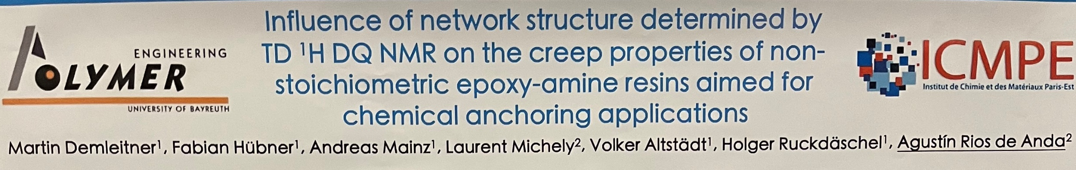

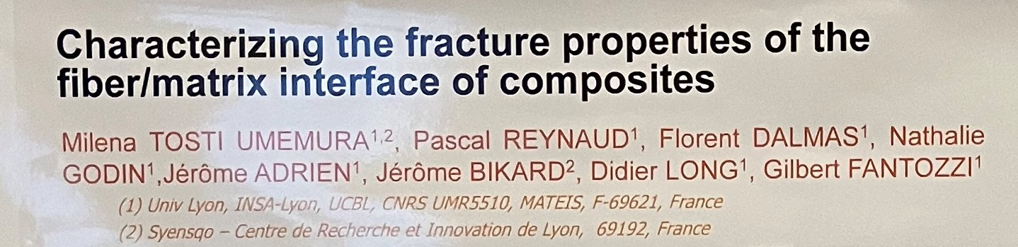
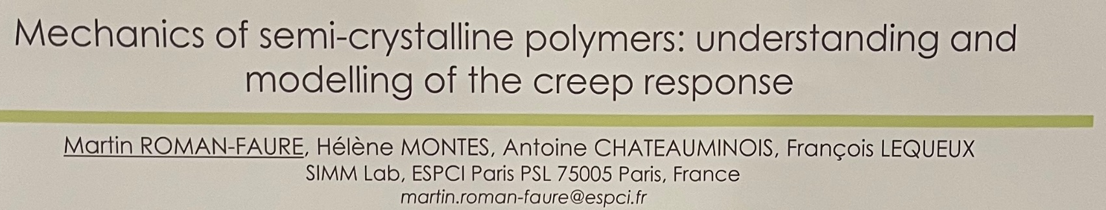
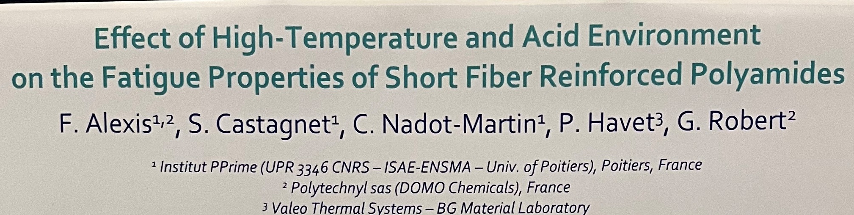
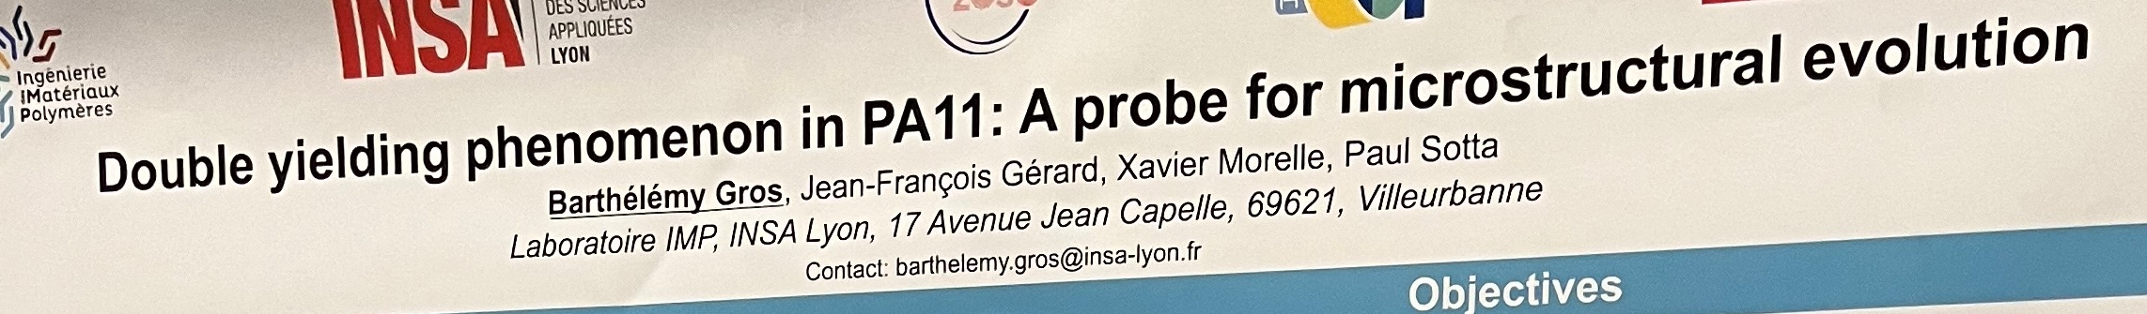
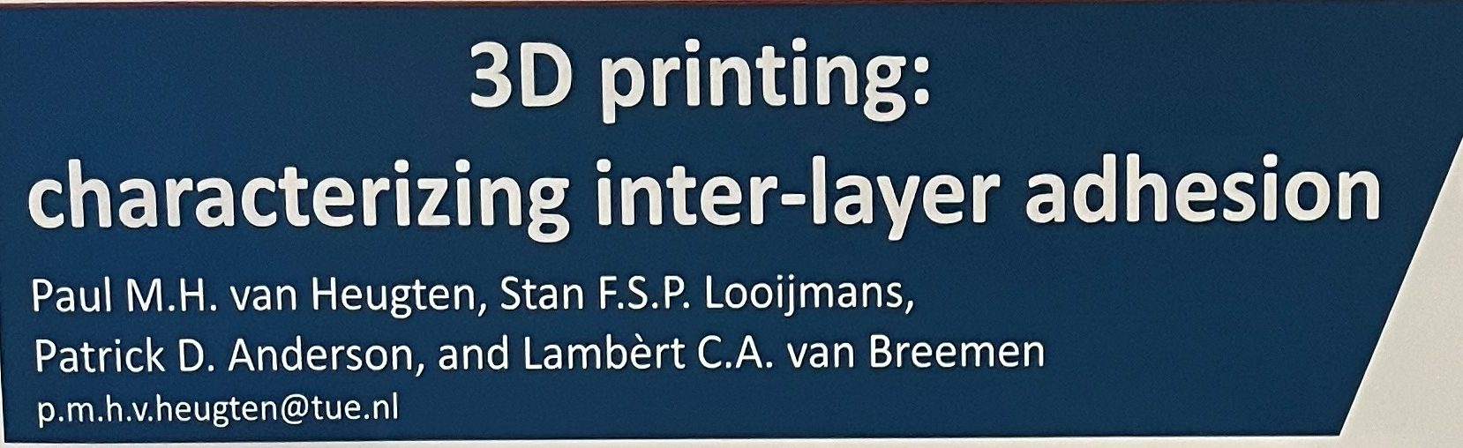
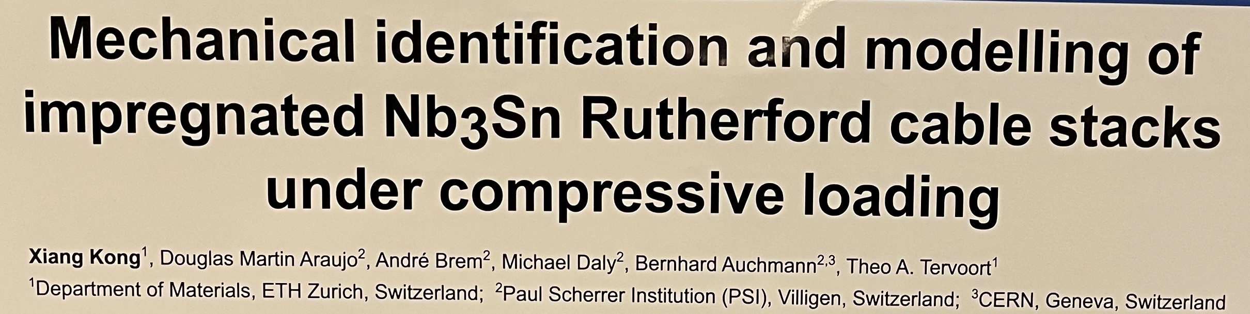
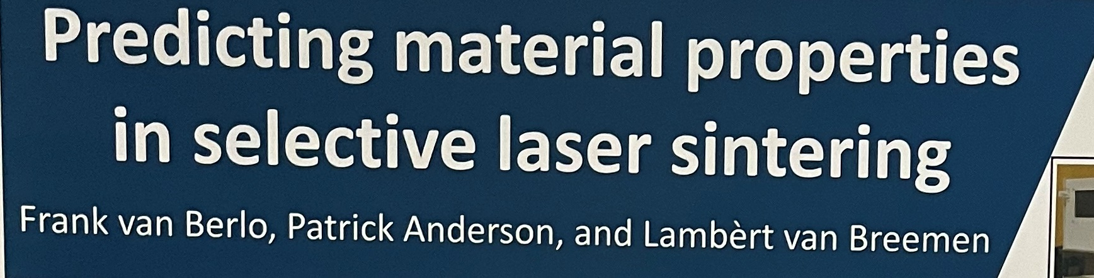
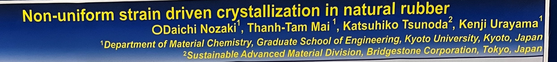

Poster session highlights
Fibre-reinforced polymers
Glassy polymers
3D printing
Semi-crystalline polymers
Miscellaneous

Slide 5
References
https://dyfp-conferences.org/
Oral program
  https://www.dyfp-conferences.org/files/file/%7Be7a6514a-c3ff-41f5-b14e-094cb5290cc5%7D/Program%20DYFP2024.pdf
Poster program
  https://www.dyfp-conferences.org/files/file/%7B21f8e8eb-0e99-4307-90ef-59d6fe00f4ef%7D/DYFP%202024%20posters%20-%20session%20I.pdf
  https://www.dyfp-conferences.org/files/file/%7B54325e2a-4d4a-4325-b927-919ed02f971a%7D/DYFP%202024%20posters%20-%20session%20II.pdf

