Slide 1
WP7-B
Timing Detectors- B
High-rate, large, precise timing MRPCs/RPCs
(M)RPC are still the reference in time resolution when large detectors are needed
Trigg, ToF, PFA-based Calorimetry
Some applications need few hundreds of ps resolution other a few tens of ps

Slide 2
WP7-B
17 institutes from 2 continents with expertise in RPCs/MRPCs and its readout electronics
Institut de la physique des 2 infinis de Lyon (IP2I)
Centro de Investigaciones Energéticas, Medioambientales y Tecnológicas (CIEMAT)
Vrije Universiteit Brussel (VUB)
Gangneung-Wonju National University (GWNU)
Shanghai Jiao Tong University (SJTU)
Organisation de Micro-Électronique Générale Avancée (OMEGA)
Physikalisches Institut, Heidelberg University (HDU)
Kyoto University (KU)
Laboratório de Instrumentação e Física Experimental de Partículas (LIP)
Tsinghua University (THU)
Shenzhen Institute of Advanced Technology (SIAT)
Daegu Gyeongbuk Institute of Science and Technology (DGIST)
Max-Planck Institute for Physics (MPP)
INFN-BARI
Roma Ter Vergata
Hanyang University
CERN EP-DT gas team

Slide 3
WP7
D B.1: Production and comparison of full large (> 1 m2) MRPC detectors with different techniques (24M).
M B.1: production of small detector O(10 cm) of 4-8 gaps prototypes using different technologies.
D B.2: Production of large PCB of strip and PAD-based pickup configuration
equipped with electronics able to reach better than 100 ps time resolution (36 M)
M B.2: Review of the needed electronics components to achieve 100 ps for strips
and pad-like and performance comparison between direct and differential
readout techniques.

Slide 4
WP7-B
D B.3: Production of a stable single cell MRPC with very high-rate capability
(> 150 kHz/cm2) and time resolution better than 100 ps (36M).
M B.3: High-rate tests with small detector prototypes (24M)
D B.4: Construction of large-area double-gap RPC with a time resolution better
than 200 ps (36M).
M B.4: Construction of small prototype (50x50 cm2) reaching 200 ps (24M).
D B.5: Timing and spatial resolution studies versus different gas mixtures (48M).
M B.4: Construction of small prototype (50x50 cm2) reaching 200 ps (24M).
M B.5: preliminary results of timing and spatial resolution with standard gas
Mixture (36)

Slide 5
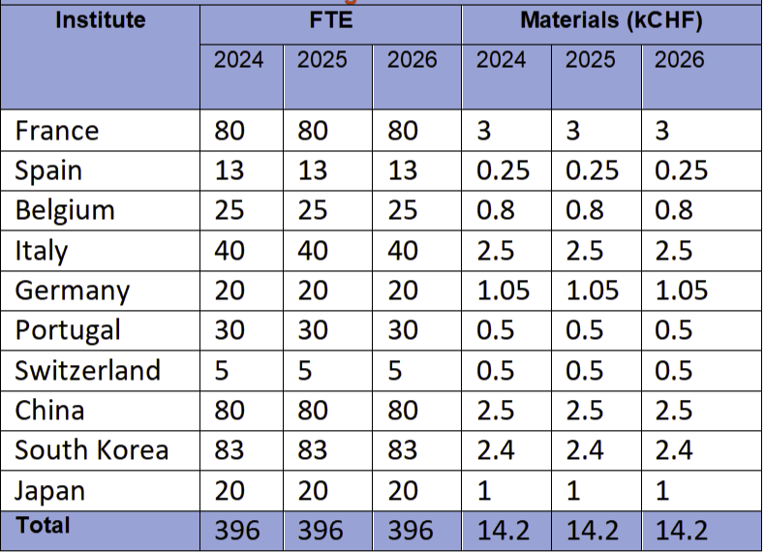
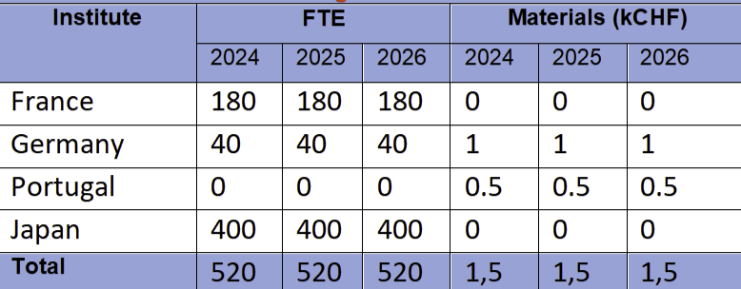
WP7-B
Existing
Materials FTE
Funding comments
→ The most challenging topic is the readout electronics
Two groups (OMEGA & DGIST) will play an important role
but funding is a must
Additional (not existing)
Materials FTE

Slide 6
WP7-B
Next steps
We foresee to have a meeting which will take place by the end of February
Update on the current activities and funding perspectives
Inventory of the available tools within groups and for DRD1 collaborators
Discussion of the common activities across the different technologies
The goal is to build on current R&D activities with available fundings and provide the needed arguments to obtain more fundings and to extend the network to new comers

Slide 7
WP4.2 Discussions

Slide 8
Fundings:
Sources
National, continental and international
Synergy
How to help each other by providing access to facilities and contacts
Facilities, tools, …..

Slide 9
Internal organization
Deliverables responsibilities
WP47B.1 ?
WP47B.2 ?
WP47B. 3?
WP47B.4 ?
WP47B.5 ?
A place to put the presentations → WP7 webpage
Meetings frequency? Every 2 months to start
Reports?

