Slide 1
Institute of two infinities of Lyon IP2I
Group of 4 physicists (1.5 FTE) and 1 engineers (0.5 FTE) collaborating with other institutes (LPCC, OMEGA)
Activities:
Past:
Semi-Digital HCAL: Development of large thin RPC, embedded semi-digital readout electronics (HR) and DAQ
iRPC: Development of readout electronic based on timing and DAQ
tomography: new readout scheme
Recent activities
MRPC: Development of a new technique to build large MRPC
TSDHCAL: Use of MRPC to replace RPC in the SDHCAL in order to use precise time information for Particle Flow Algorithms)
in collaboration with (OMEGA, SJTU, VUB, CIEMAT, GWNU)
Goals:
To build large MRPC with high performances in terms of efficiency and timing using eco-friendly gases
to Develop adapted readout electronics (petiroc, liroc…)
To exploit their timing performance for muon, calorimetry and trigger-based applications

Slide 2
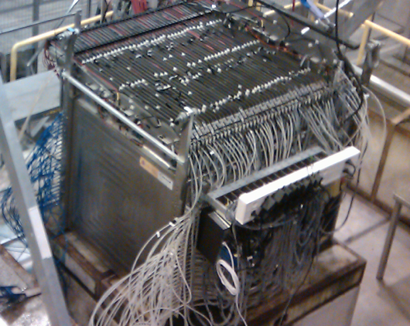
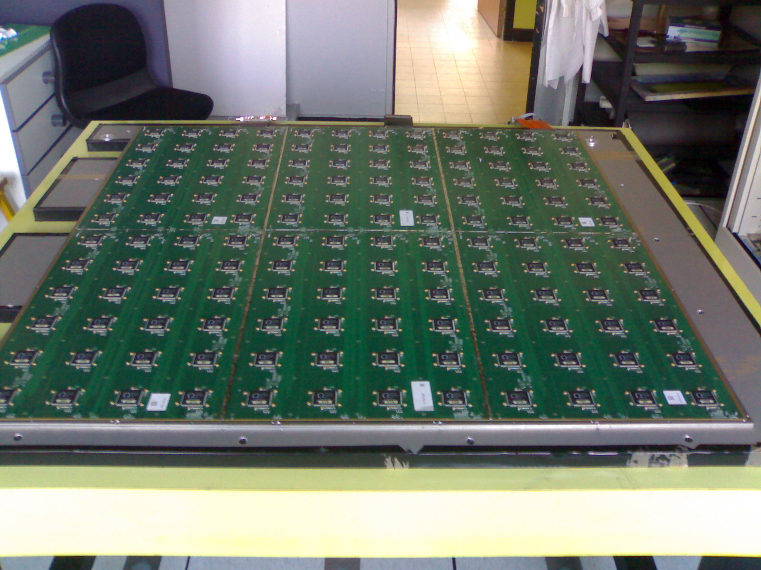
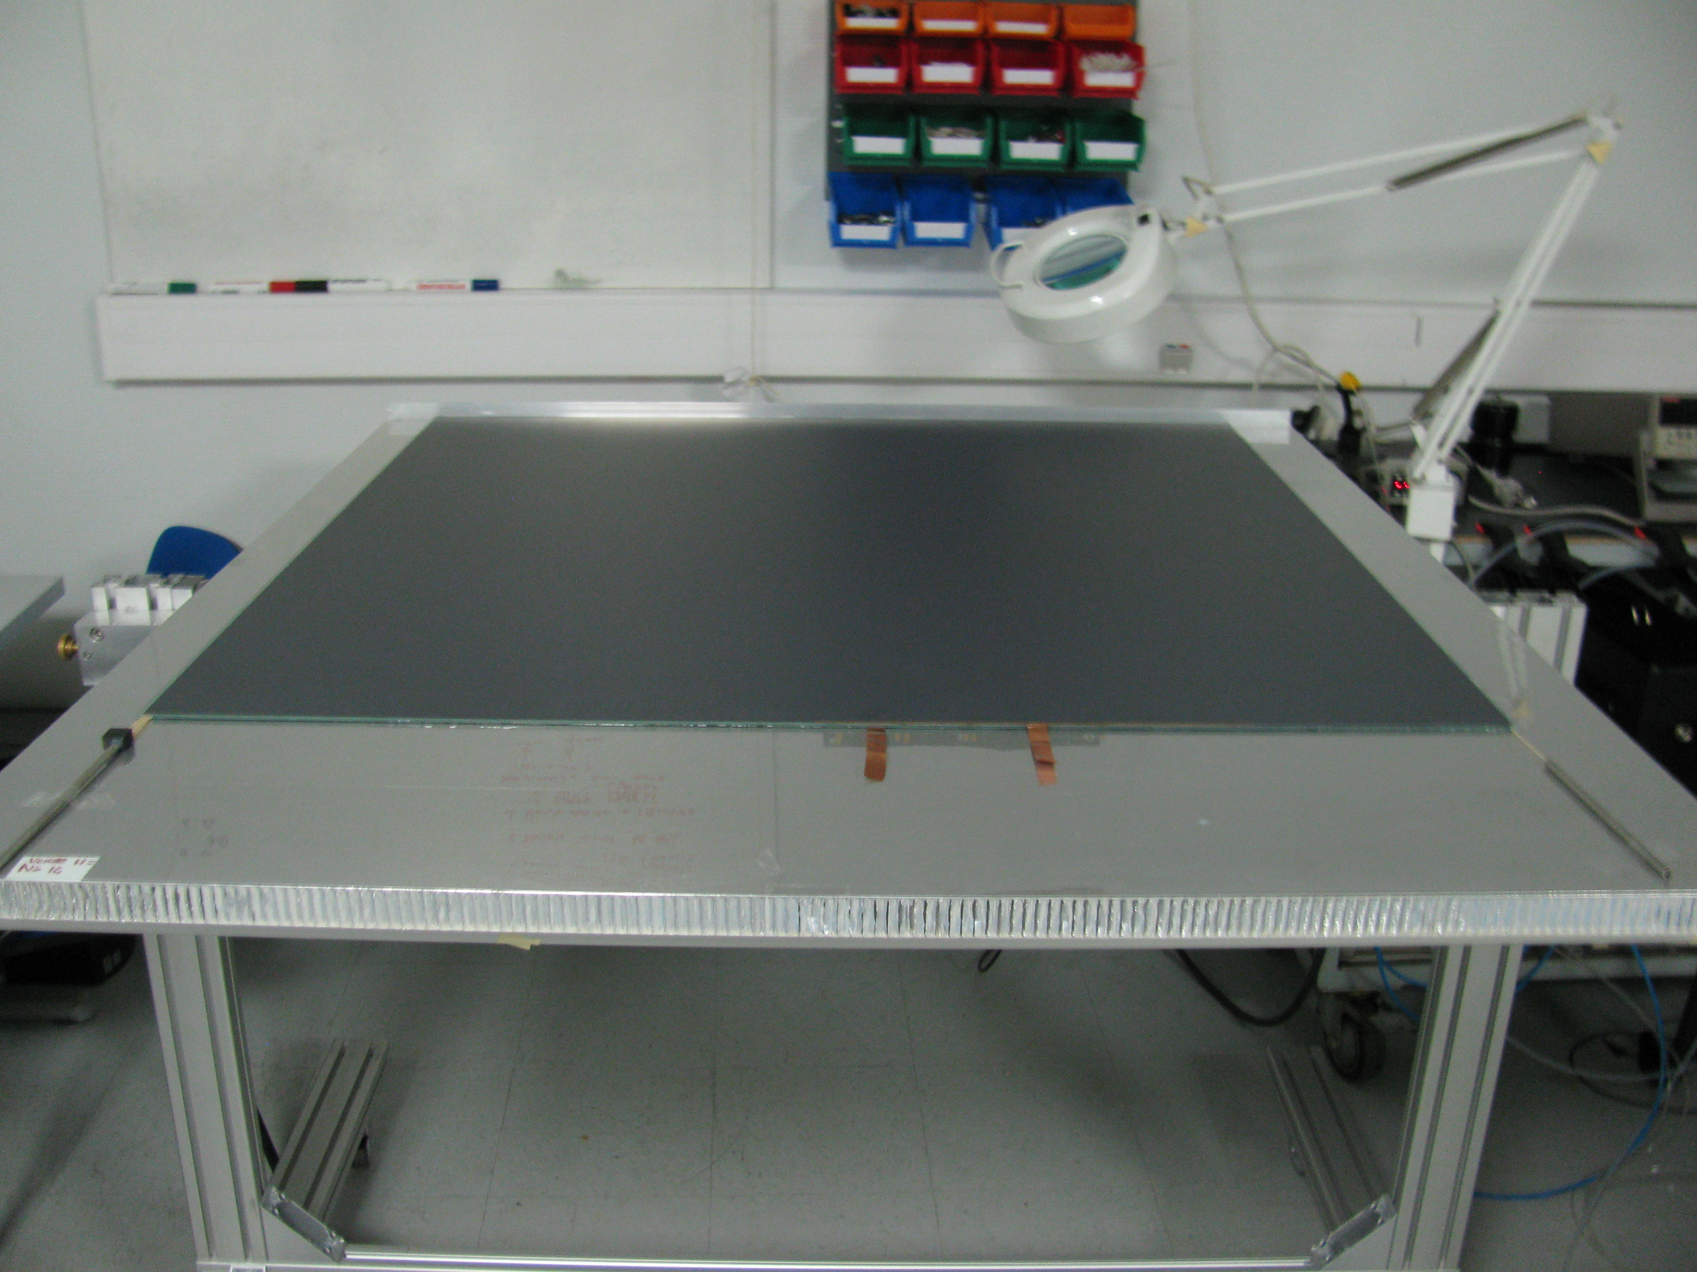
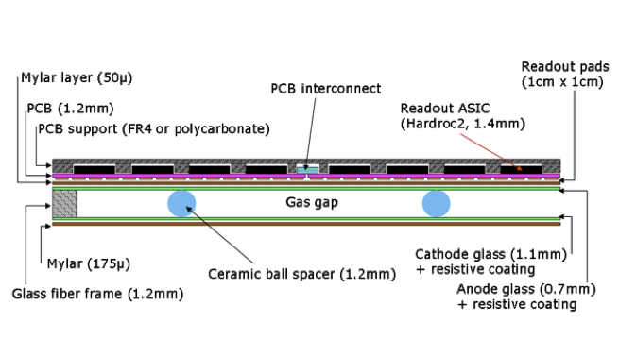
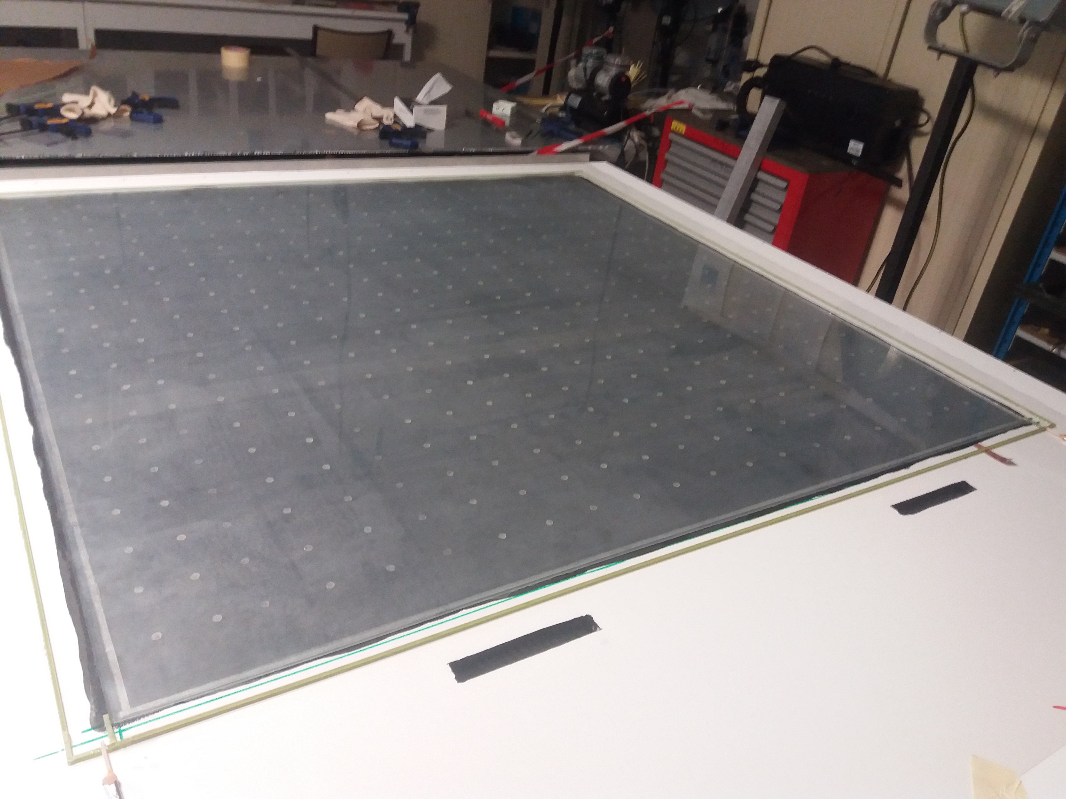
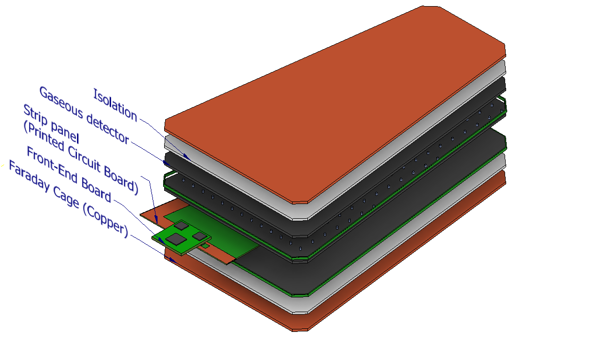
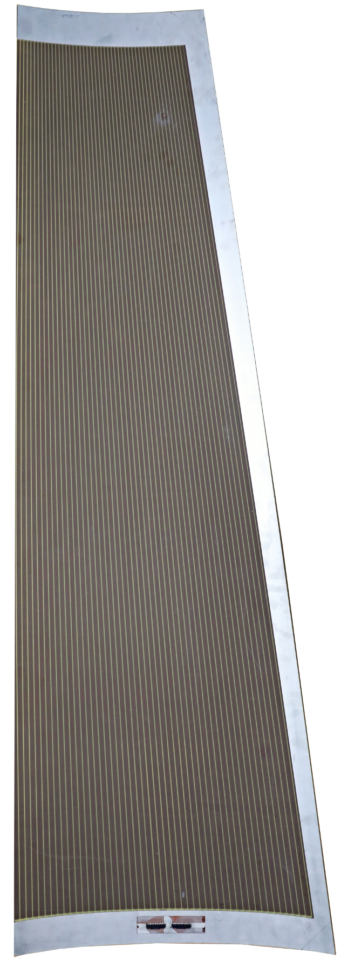
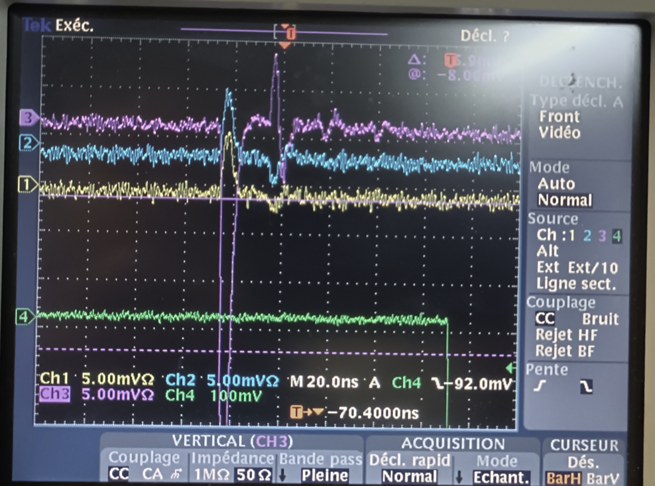
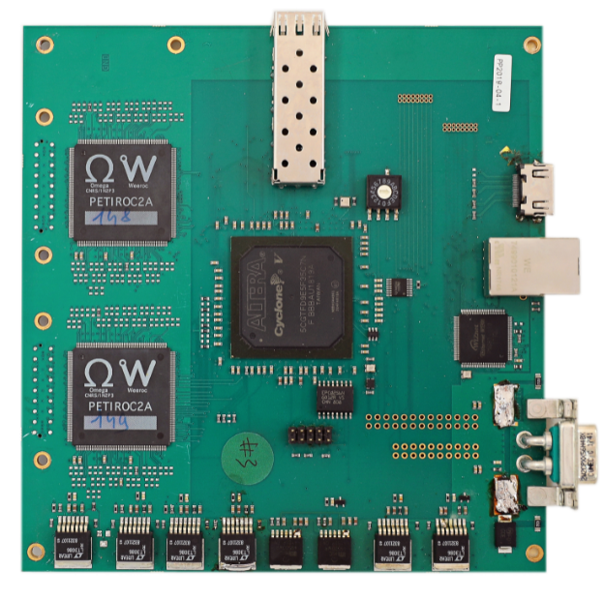

SDHCAL
RPC
strips
Layout of iRPC
4-gap RPC
FEB

