Slide 1
Ultra high rate single cell MRPCs
Ingo Deppner
Heidelberg University

Slide 2
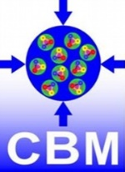
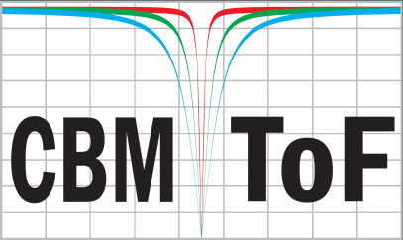
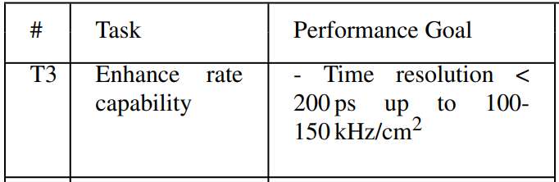
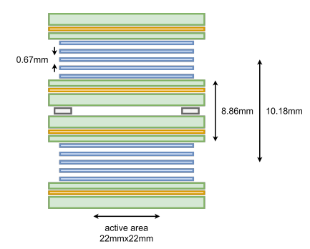
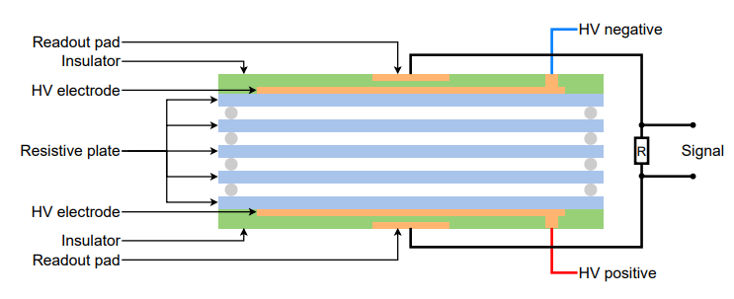
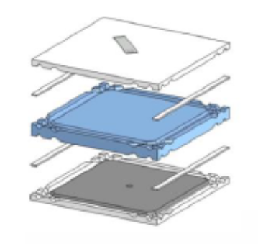
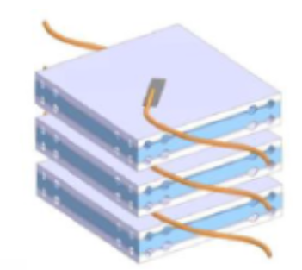
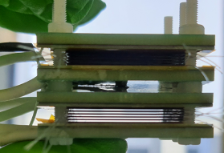
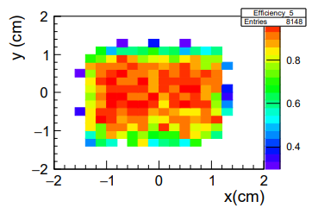
Ultra high rate single cell MRPCs
DRD1 - WP7
Beam Fragmentation T0 Counter (BFTC) @ CBM
Single cells ceramic MRPC with high rate capability
BFTC delivers start time at CBM at high interaction rates
In-kind contribution from Russia to CBM-TOF
Collaboration with Russia suspended
BFTC module
24x
Idea: replace ceramic counter by low resistive glass
First steps done in Heidelberg
Pushing the rate capability to new frontiers
Perfect to educate students
192x
BFTC mounted in in main frame
3x
Requirements
high rate capability > 150 kHz/cm2
Time resolution < 80 ps
Efficiency > 95%
1

Slide 3
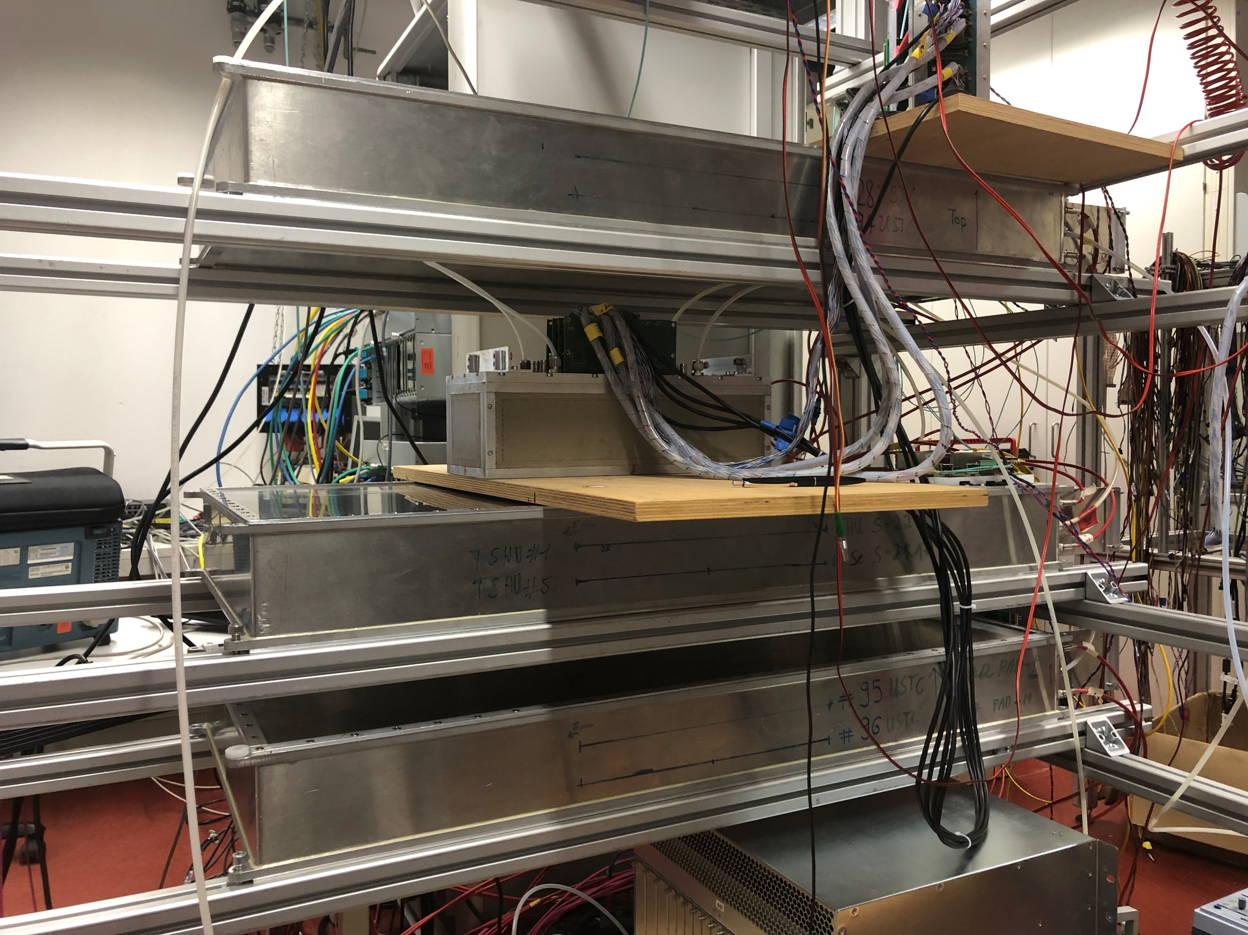
Ultra high rate single cell MRPCs
Ultra high rate single cell MRPC for T0 determination
No funding for this project yet
Currently 0.1 FTE human recourses (myself) for this project
Gas detector consortium founded 2023 among German universities
Applied for funding from BMBF for the period 2024 – 2027 -> No decision yet
Facility/Lab. at Heidelberg University/GSI
Cosmic test stand in Heidelberg
- HV, LV, RPC gas mixing station available (mainly used for own detector tests)
- readout electronics -> integrated in CBM readout
Clean room
Electronic workshop -> free of charge only for our institute
Mechanical workshop -> free of charge only for our institute
mCBM test facility for high rate tests
- up to now only used for CBM detector components
Involvement of Heidelberg group (main project)
Project coordination (CBM TOF)
R&D of high rate counter for CBM (detector test/beam test)
TOF module integration/production for CBM
Cosmic stand in HD
2

Slide 4

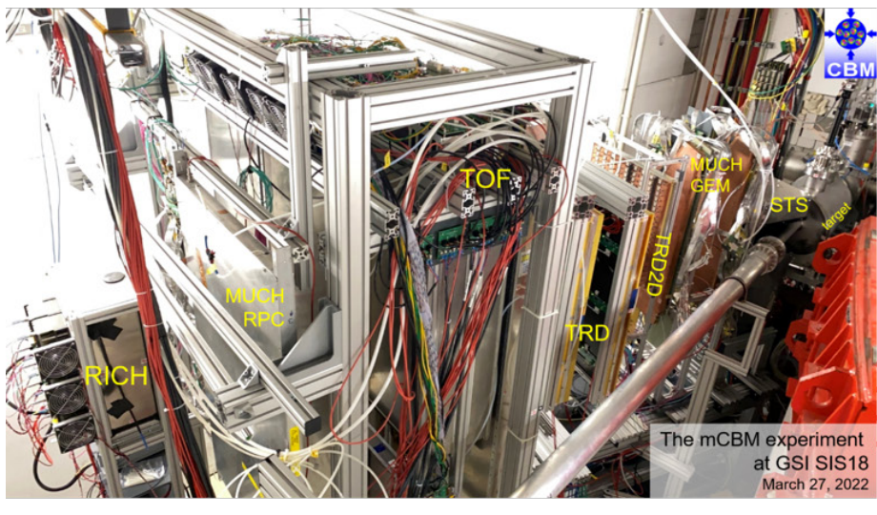
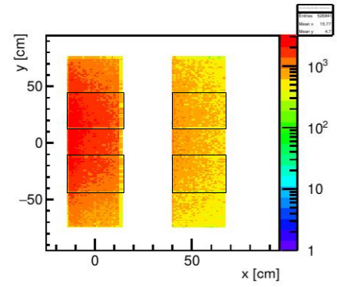
mCBM @ SIS18
FAIR Phase 0: mCBM setup @ SIS18
mTOF
N. Herrmann
mTRD
real Pb on Au collision
mRICH
mMuCH
mSTS
mPSD
Target chamber
Simulation: Au+Au @ 1.24 GeV mbias
mCBM is a full system test setup installed at SIS18/GSI dedicated
for high rate detector and readout test including free streaming
data acquisition and online event selection
Charged particle fluxes of up to 30 kHz/cm²
Having a high rate test stand is highly important for detector development
3

