Slide 1



Report from the MCWG, 5th R2E Project Meeting
M. Calviani on behalf of the MCWG (link), EN/STI

Slide 2
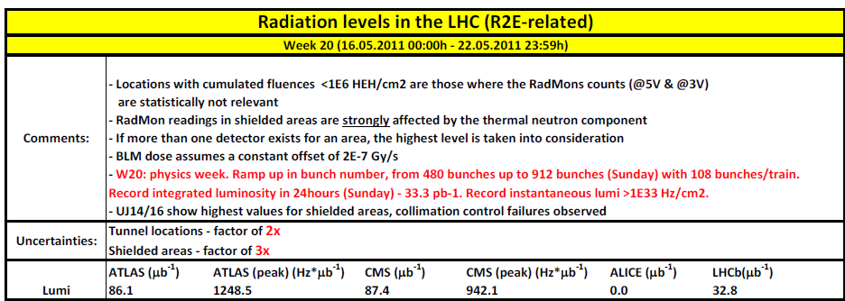


News on the weekly report
Weekly reports distributed through the RadWG: http://radwg.web.cern.ch/RadWG/Pages/Radiation_levels/Weekly_report.htm
Review of R factor for tunnel location (measurement in the UJ13 → R=0.4)
Offset corrected BLM data are now available and provided by BE/BI/BL (A. Nordt) every week → integrated with the weekly report

Slide 3
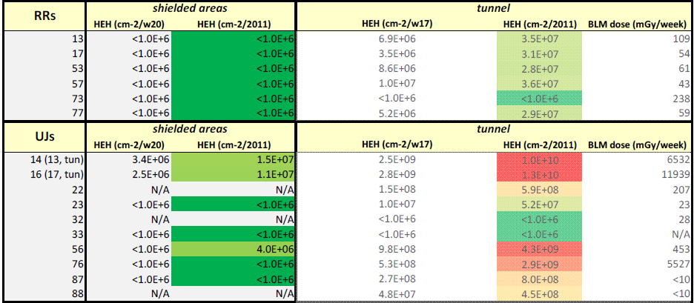
News on the weekly report
prior. 1
prior. 2
The present highest loaded shielding areas are the UJ14/16 (ATLAS lumi driven) where several equipment already failed (collimators, CRYO, biometry…) and for which relocation is under study → link
Inverted asymmetry (!) between the UJ13/17 and UJ14/16 → shielding?
The next priority point is the UJ56 (fluence less by factor of 2x)

Slide 4
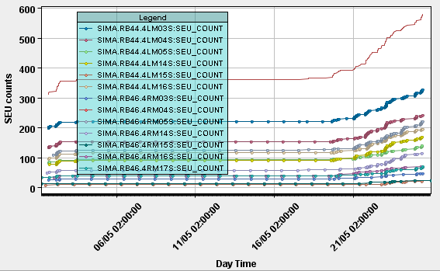
News on the weekly report
PLC failures links in US85 →
  In ~1 month we got ~1-2*10⁶ cm⁻² HEH, sufficient for failure of another device? → test in H4IRRAD to point out whether is radiation or not!
  Up to know (cumulated 2011 operation) is ~5-6*10⁶ cm⁻²/2011
P4 and P6 LSS are also presenting signs of significant beam-gas interaction (vacuum increase/e-cloud)! → radiation effects on the arc detectors? (link)

Slide 5
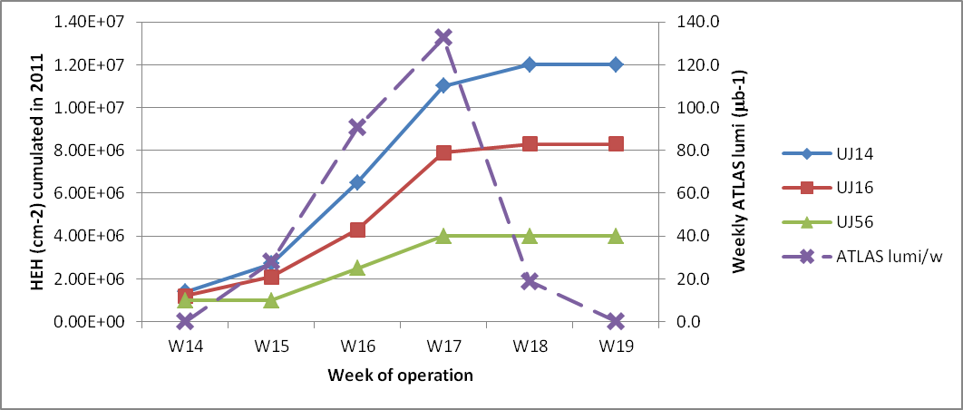
News on the weekly report
W14: scrubbing run
W15+W16+W17: physics, 50ns
W18+W19: MD+TS
TODO list:
  Summing up all the location for which we know the R factor
  Automatic time evolution of radiation levels
  Update of the graphical representation of radiation levels
  Beam intensity in the weekly report
  Calibration of RadMons → effect of RadMon orientation in the radiation field evaluation for shielded areas!

Slide 6
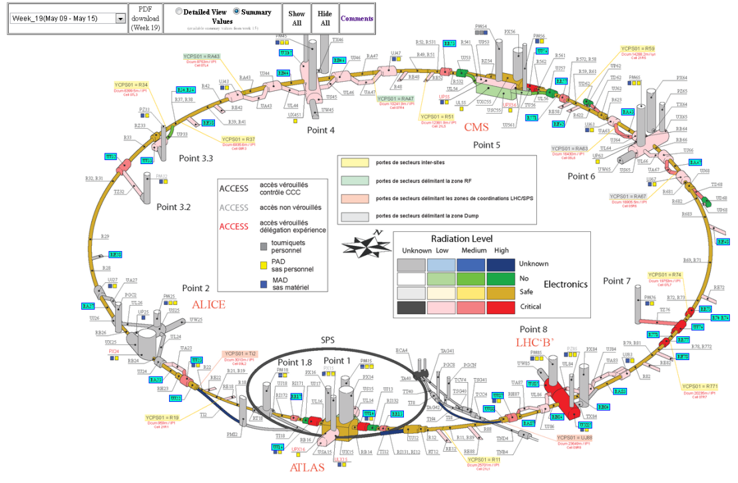
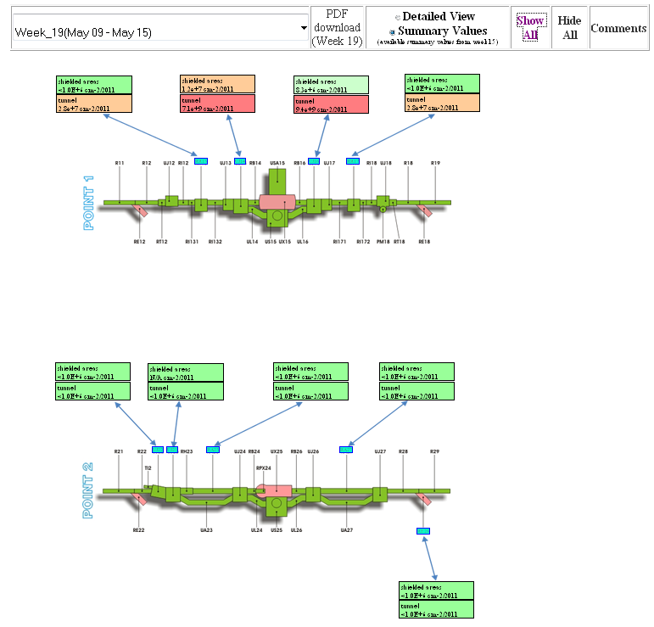
Updated version of the graphical monitoring tool
According to the feedback of the last MCWG Hong Jun have created two versions of the graphical weekly report representation, using two different layout drawings
G:/Projects/R2E/Monitoring/Hongjun/2_Weekly%20Report%2025102010_Test3.html
G:\Projects\R2E\Monitoring\Hongjun\Weekly Report 25102010_version2.html

Slide 7
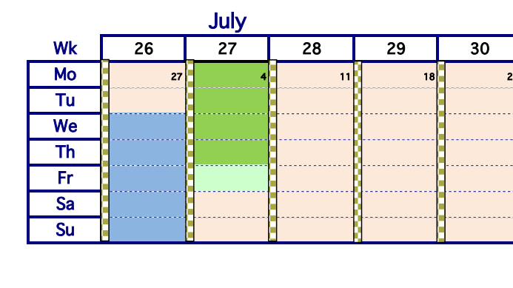
LHC-MD for R2E
TS#3 have been shifted forward by 2 weeks!
Most probably the R2E MD will be performed between the 29th June and 3rd July
TS
MD
An updated version of the request taking into account the updated objective of the test have been uploaded https://espace.cern.ch/lhc-md/Shared%20Documents/2011%20MD%20Requests/LHC-MD-REQUEST_R2E_tests_v2.doc
We have discussed with BE/OP on the details beam parameters for the test
  An accurate planning of the test is needed → TODO list!

Slide 8
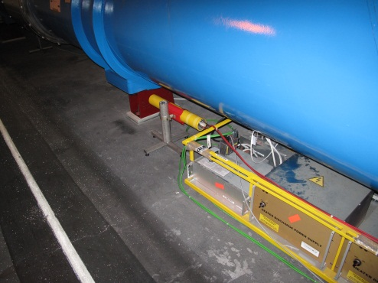
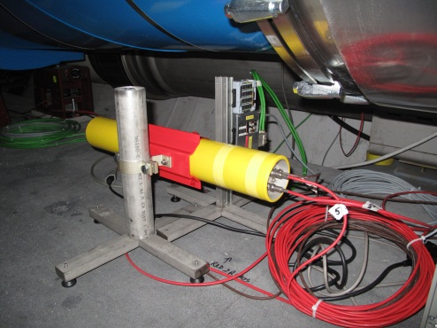
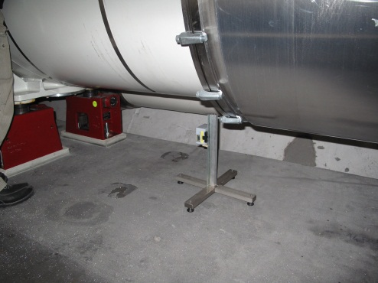
LHC beam tests cell 14R2 – installed configuration
FIP RadMon (5V)
8h requested, 450 GeV/beam requested, 5*10⁹-1*10¹⁰ p/bunch, 1 bunch/beam
BatMon (3V)
BatMon (5V)
i.e.: +1 FIP RadMon (5V) +1 BatMon (3V) +2 BatMon (5V) + 2 BLMs
2RM20S: 3925m
2RM10S: 3913m
23m between the two BLMs
60cm from BLM1 and 2RM10S
3.9m from STD0022 and BLM1
6.6m from STD0023 and 2RM20S
Beam 1
Cell 14
Cell 15
corrector
MBB
MBC
MQ
MBA
MBB
STD0022(5V)
2RM10S(5V)
+STD0021(3V)
+BLM1
STD0023(5V)
2RM20S(5V)
+STD0020(3V)
+BLM2
BLMs

Slide 9
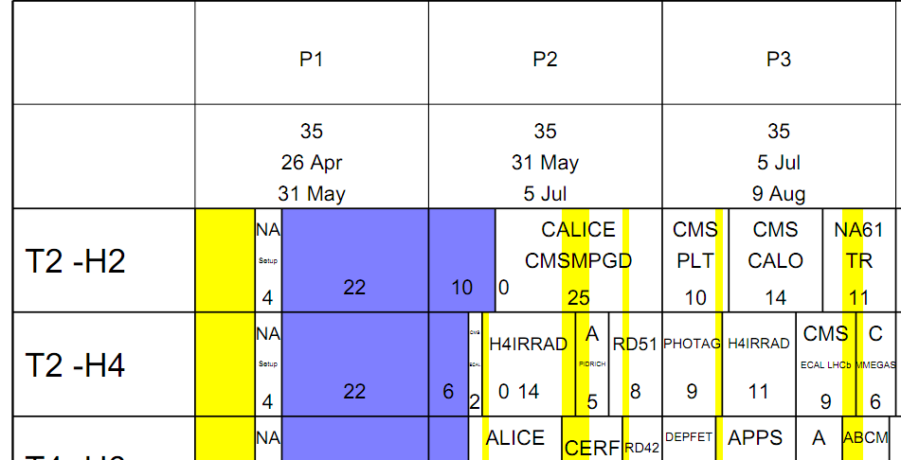
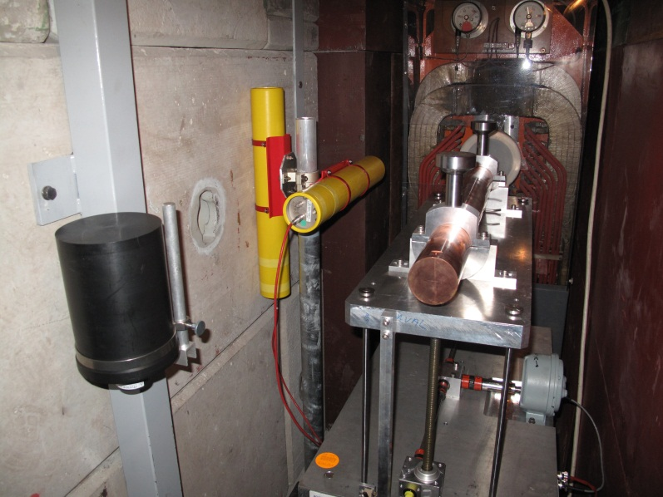
(brief) Status of H4IRRAD
The H4IRRAD test area is almost finished
http://cern.ch/h4irrad up and running → documentation will be uploaded there and on the EDMS node (link)
Documentation for DSOs/RSOs in advanced phase (link)
If TAX intervention will go smoothly, the preliminary plans calls for start of H4IRRAD beam for the 8th June (effectively 9/10th)
SPS Schedule http://spsschedule.web.cern.ch/SPSschedule/schedules/sps/2011/v100/all.pdf
Users meeting this Friday to discuss test schedule
Parallel discussion with PS/SPS coordinator to improve the scheduling and prioritize H4IRRAD tests

