Slide 1




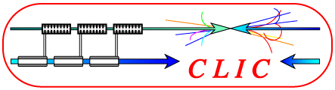
Tracking Efficiency for
& calorimeter Seed tracking for the CLIC SiD
Pooja Saxena, Ph.D. Student
Center of Detector & Related Software Technology
Delhi University, India

Slide 2


Outline
SiD Detector
Track Reconstruction Efficiency
Samples Used
  - @3TeV, Higgs search
- @3TeV
Tracking Algorithm
Results
Calorimeter Seed Tracking (ongoing)
Summary & Future Outlook

Slide 3
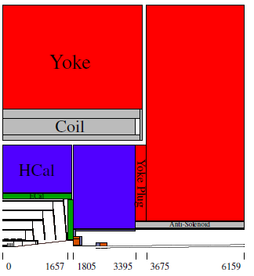
SiD Overview
The CLIC SiD detector model is a concept for a 4π multi purpose detector for a future linear lepton collider
All silicon tracking system is designed to provide excellent point resolution.
Pixel detectors in vertex and forward region
Compact finely segmented EM calorimeter (silicon-tungsten) & hadronic calorimeter.
5T solenoid field is provided by superconducting coil outside of the calorimeter.
One quadrant of the CLIC SiD CDR detector model in the zx-plane

Slide 4
Task01 :
Track reconstruction efficiency study

Slide 5

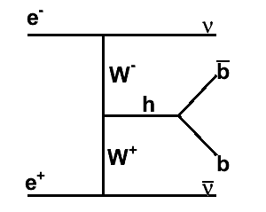
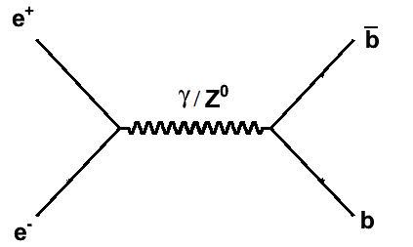
Samples Used@3TeV, 9k events
WW Fusion
At 3TeV CM energy, diboson fusion is the dominant mode of Higgs production
Samples are generated using Whizard & pythia
The tracking system is tasked with finding and reconstructing the trajectories of charged particles with high efficiency and precision.

Slide 6
Seed Tracker Algorithm
Track finding begins by forming all possible 3 hit track seeds in the three “Seed Layers”
  Brute force approach to finding all possible track seeds
Require the presence of a hit in a “Confirmation Layer”
  Significantly reduces the number of candidate tracks to be investigated
Add hits to the track candidate using hits on the “Extension Layers”
  Discard track candidates with fewer than 7 hits (6 hits for barrel only tracks)
  If two track candidates share more than one hit, best candidate is selected
Upon each attempt to add a hit to a track candidate, a helix fit is performed and a global χ² is used to determine if the new track candidate is viable
Seed
Confirm
Extend

Slide 7
Seed Tracker Algorithm
Track finding is controlled by a set of strategies.
Use automated Strategy Builder
  Set required
    SeedHits, ConfirmHits, ExtendHits
    P_{t}, d0, z0 and χ² cuts
    d0 – distance of closest approach (DCA) in xy plane
    z0- z coordinate of DCA
    requirements in the number of hits

Slide 8

Tracking algorithm & Selection cut
Tracking Efficiency =
where,
- findable MC particles: All MC particles that pass the cuts described below
- reco MC particles : fraction of findable MC particles found by the tracking algorithm
Selection criteria :
Theta > 10 degrees
Pt > 250 MeV
Charge different from 0
Distance from IP (originating from the IP) < 50 mm Flight distance (path length) > 50 mm
Stable MC Particles
Studied variation of all selection cuts used

Slide 9
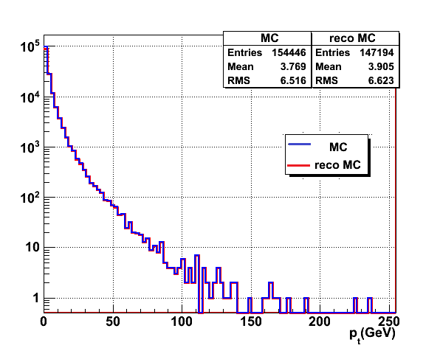
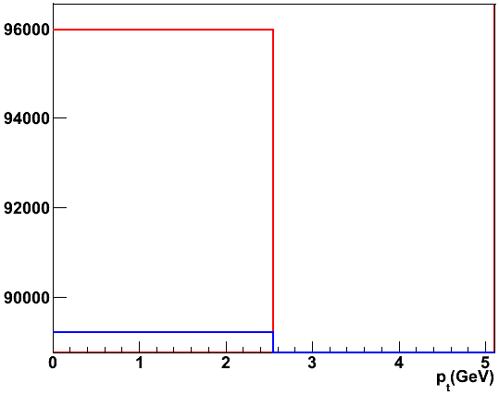
Results:
@ 3 TeV ~9k events
MC – findable MC
Average 95.3% of findable MC’s are effectively reconstructed

Slide 10
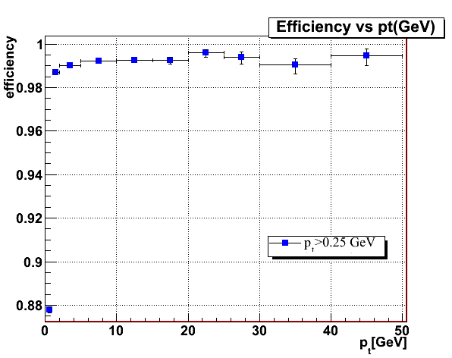
Efficiency plots: (p_{t})
efficiency is ~99% for pt> 1GeV & drops to 88% for 0.25-1 GeV pt particles.

Slide 11
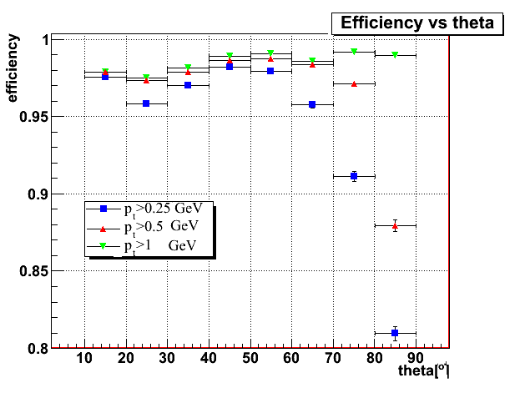
Efficiency plots: (theta)
non reconstructed low pt MC are lying in the central barrel region
efficiency is improving with the pt cut

Slide 12
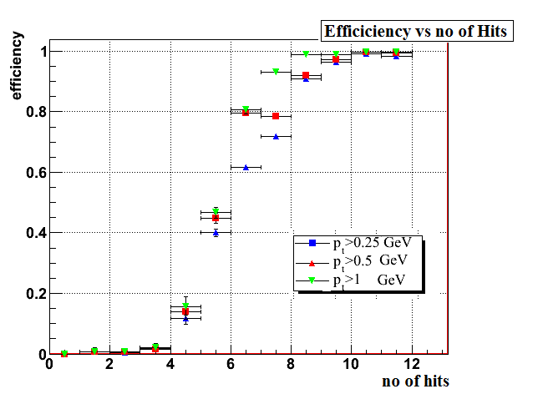
Efficiency plots: (no of hits)
For no of hits= 7
Pt (GeV) | efficiency
0.25 | 73
0.5 | 79
1.0 | 94

Slide 13
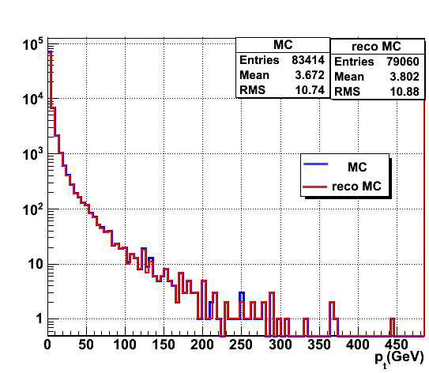
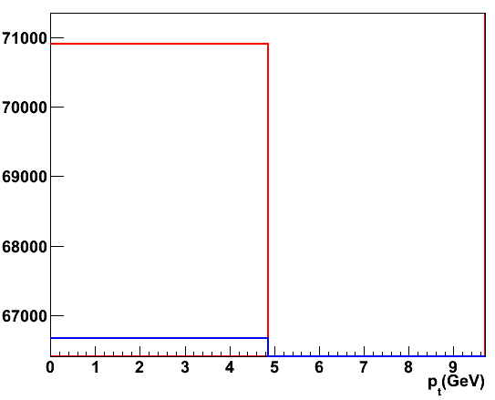
Results:
@3 TeV, 9k event
Average 94.7% of findable MC’s are effectively reconstructed

Slide 14
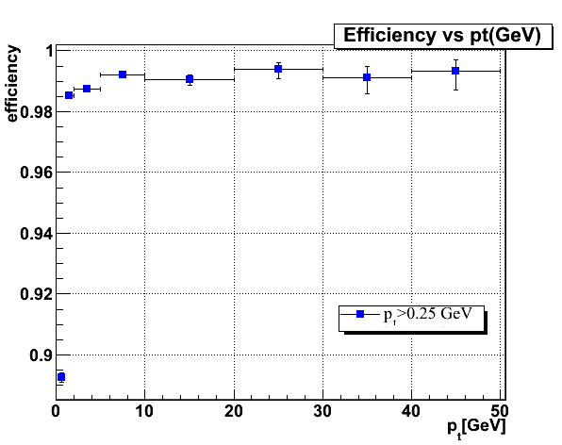
Efficiency plots: (Pt)
0.89
efficiency is ~99% for pt> 1GeV & drops to 89% for 0.25-1.0 GeV pt particles

Slide 15
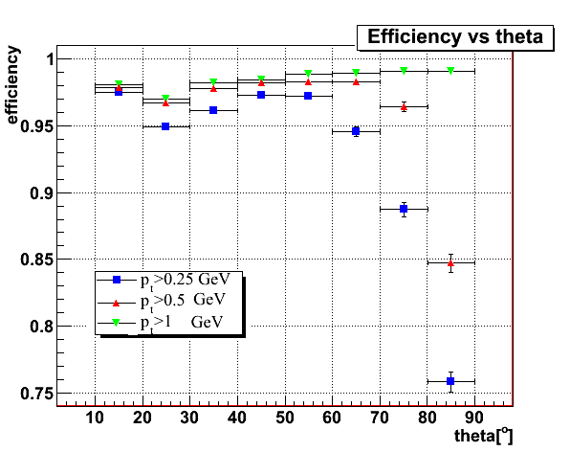
Efficiency plots: (theta)
non reconstructed MC of pt , 0.25-1 GeV are lying in the central region
theta efficiency is improving with the pt cut

Slide 16
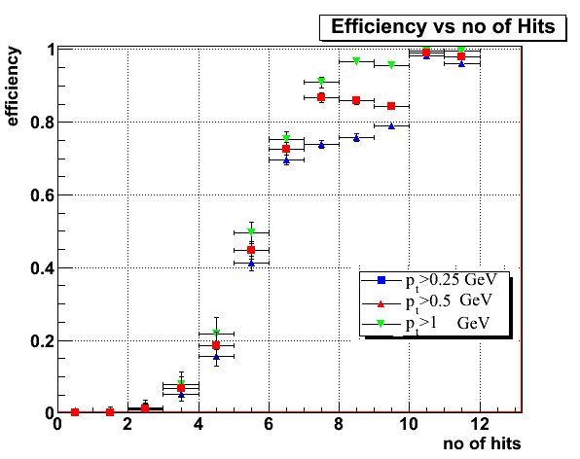
Efficiency plots: (no of hits)
For no of hits= 7
Pt (GeV) | efficiency
0.25 | 75
0.5 | 86
1.0 | 92

Slide 17
Task02 :
Calorimeter Seed Tracking Study

Slide 18
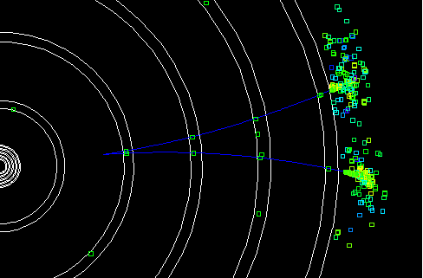

Calorimeter seed Tracking
Tracking code is not meant for the long lived particles like (KS0 , Λ) decaying outside vertex region due to the vertex constraint in the helix fitting
But with the finely segmented ECAL, outside-to-Inside Tracking starting from Calorimeter Clusters is effective
Π+
Π-
JAS3 view,
Particle-Flow algorithms will benefit from calorimeter-seed tracking through
-better tracking,
-better track-cluster matching
“In addition, The algorithm is also able to find calorimeter backscatters”

Slide 19
Calorimeter seed Tracking
Some basic code (Garfield) exist (written in 2005) for cal seed tracking,
- It uses simulated hit (Garfield hit), whereas we have properly digitized hit (helical hit) which encapsulates all the information needed by the standard pattern recognition algorithm
-It uses its own helix (GarfieldHelix) with different definition of helix parameters, want to interface to current version of Helix with proper parameter dependence (HelixSwimmer, written by Jan Strube)
Need to rewrite the code for track finding with the current version of Helix.
Π+
Π-

Slide 20
Calorimeter seed Tracking
Initial Implementation:
Every ECAL cluster is considered to be a seed
Identify such seeds using simple nearest neighbour clustering & calculate position, direction, and curvature radius for each of them.
Extrapolate tracks from seed towards the centre of the detector, picking up tracker hits as we go.
After each new added hit, recalculate track parameters (χ²-Fit). If there are multiple hit candidates in the same layer, branch and create new tracks.
Apply quality cuts & discard duplicate
Find track intersection
Identify particle by reconstructing the invariant mass
Π+
Π+
Π-
Π-

Slide 21
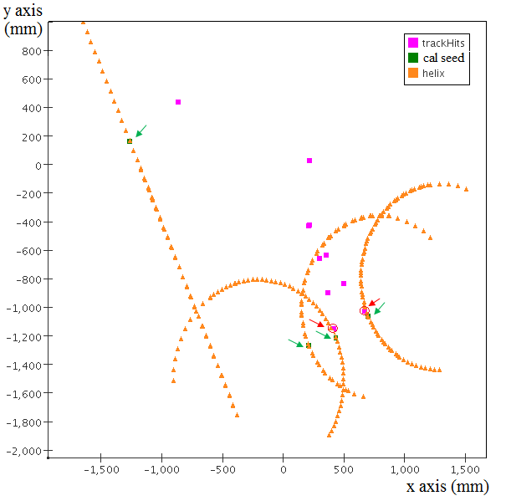
Calorimeter seed Tracking
Progress so far :
have set helix for cal seed
have added hits lying on the last tracker layer
Need to get the modified parameters for the newly added hit
Further hits following χ² cut and helix fit will be added

Slide 22
Summary & Future Plan
TASK 01
Tracking efficiency for H->bb MC’s were studied at 3TeV Center of Mass energy with 9k events.
Tracking efficiency is studied for various selection parameters variation.
Tracking reconstruction efficiency is 88% for pt> 0.25-1.0 GeV MC particle lying in the central region for H-> bb
~ 99% tracking efficiency of both samples for pt > 1GeV & theta ~10 deg
TASK 02
Presently understanding the cal assisted tracking code & trying to modify the code.
Could run the example driver of Garfield track finder & found the K0 for some samples.
Ongoing cal seed tracking study.

Slide 23
Acknowledgement
Thanks to
Christian Grefe for helping me with the understanding of the code & for the discussions.
Stephane Poss & Jan Fridolf Strube for discussions

Slide 24
Backup
SLIDES

Slide 25
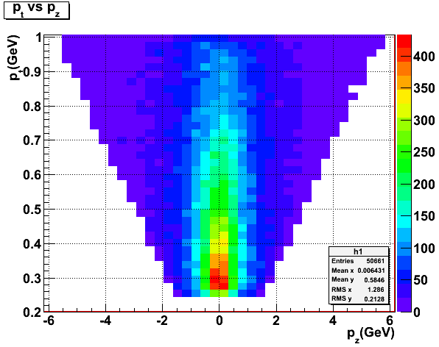
Pt vs Pz for H->bb

Slide 26
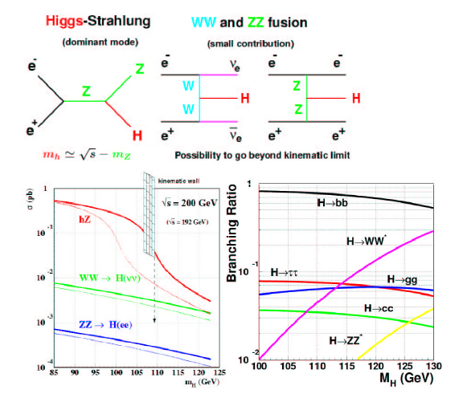

Slide 27
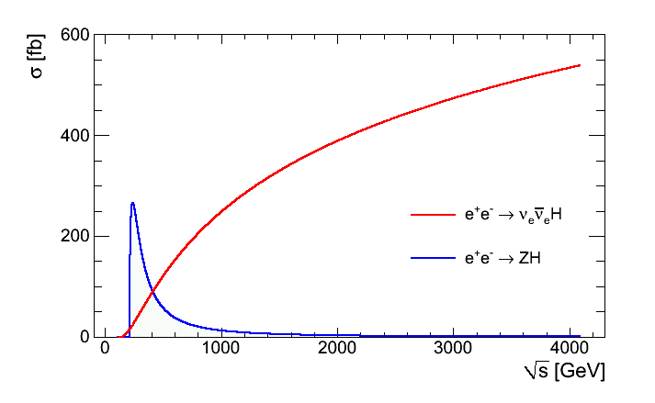
Higgs Cross Section vs CM energy
without beam effects
tree-level diagrams

Slide 28
Tracking algorithm & Selection cut
Convert the digitized hits into a common hit format.
Typically, 6-7 hits are sufficient for finding a track, which allows the standard pattern recognition algorithm to efficiently track particles originating near the interaction point with pT > 200 MeV.
Three types of hits are supported: pixel hits, strip hits & stereo hits
Track finding is controlled by a set of strategies. A strategy consists of the list of detector layers to be used, the role of each layer (seed, confirm, or extend), kinematic constraints (Pt , impact parameters), requirements in the number of hits, and the χ² cut.

Slide 29
Tracking algorithm & Selection cut
Convert the digitized hits into a common hit format.
Typically, 6-7 hits are sufficient for finding a track, which allows the standard pattern recognition algorithm to efficiently track particles originating near the interaction point with pT > 200 MeV.
Three types of hits are supported: pixel hits, strip hits & stereo hits
Track finding is controlled by a set of strategies. A strategy consists of the list of detector layers to be used, the role of each layer (seed, confirm, or extend), kinematic constraints (Pt , impact parameters), requirements in the number of hits, and the χ² cut.

