Slide 2
HI-ECN3 WP6 –
Radiation Protection & Safety
Kick-off meeting
C. Ahdida (HSE-RP), M. Fraser – PL, HI-ECN3 Project Team, et al.
25th April 2024

Slide 3
Content
BDF/SHiP
BDF Comprehensive Design Study
PBC studies for BDF@ECN3
HI-ECN3 project overview
WP6 scope, responsibilities and activities
Administrative aspects
C. Ahdida HI-ECN3 WP6 kick-off 25/04/2024

Slide 4

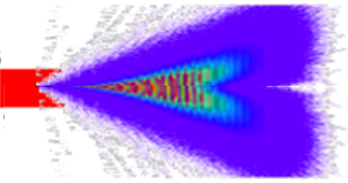

BDF/SHiP
C. Ahdida et al., SPS Beam Dump Facility - Comprehensive Design Study, CERN-2020-002
G. Arduini, C. Vallée, J. Jaeckel (eds.) Post-LS3 Experimental Options in ECN3, CERN-PBC-Report-2023-003
SHiP Collaboration, BDF/SHiP at the ECN3 high-intensity beam facility, CERN-SPSC-2023-033
Beam Dump Facility / Search for Hidden Particles
Physics: explore and directly search for Feebly Interacting Particles at SPS complementary to collider physics
Beam Dump Facility Concept:
  Use high-intensity 400 GeV/c proton beam and absorb it by a thick (12$λ$) high-Z target (W, 19 g/cm³, Molybdenum 10 g/cm³) surrounded by dump (iron 7.9 g/cm³) to maximize production of charmed and beauty mesons
  Employ muon sweeper to clean background for sensitive FIP search
High energy → production of charmed and beauty mesons
High ρ, Z & A → Maximize p+ interaction
Shortest λ → Force absorption of K & π to reduce muon & neutrino background
High ppp & POT → overcome small prod cross-section of extra rare events of hidden particles
p (400 GeV)
Among global infrastructure, ECN3 is unique in intensity and energy allowing for high rate of heavy flavor production with experimental access to feebly interacting and long-lived particles
C. Ahdida HI-ECN3 WP6 kick-off 25/04/2024

Slide 5
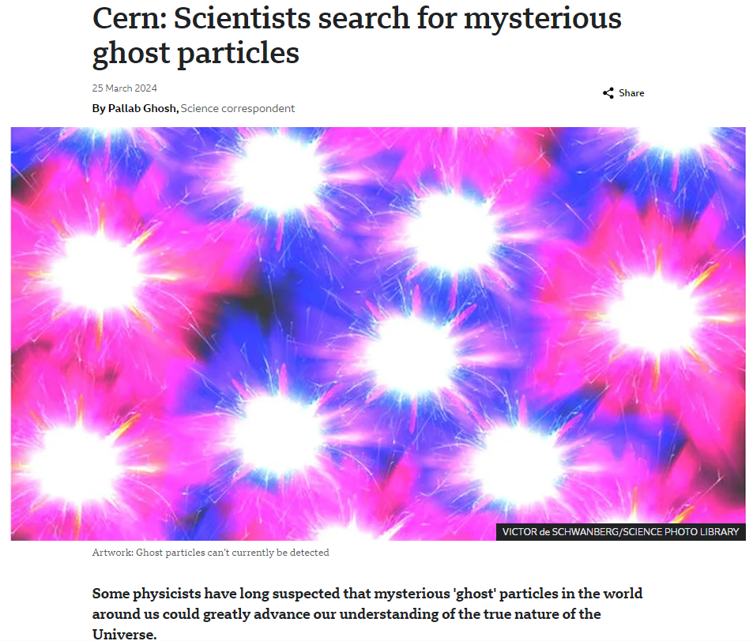
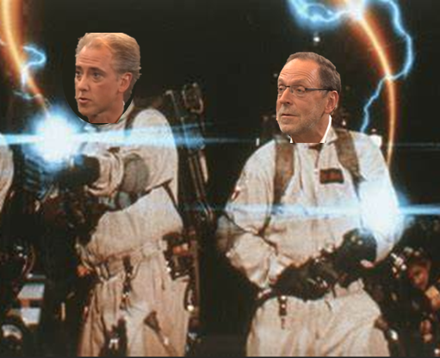
BDF/SHiP
C. Ahdida et al., SPS Beam Dump Facility - Comprehensive Design Study, CERN-2020-002
G. Arduini, C. Vallée, J. Jaeckel (eds.) Post-LS3 Experimental Options in ECN3, CERN-PBC-Report-2023-003
SHiP Collaboration, BDF/SHiP at the ECN3 high-intensity beam facility, CERN-SPSC-2023-033
Beam Dump Facility / Search for Hidden Particles
Physics: explore and directly search for Feebly Interacting Particles at SPS complementary to collider physics
Beam Dump Facility Concept:
  Use high-intensity 400 GeV/c proton beam and absorb it by a thick (12$λ$) high-Z target (W, 19 g/cm³, Molybdenum 10 g/cm³) surrounded by dump (iron 7.9 g/cm³) to maximize production of charmed and beauty mesons
  Employ muon sweeper to clean background for sensitive FIP search
Cern: Scientists search for mysterious ghost particles (bbc.com)
C. Ahdida HI-ECN3 WP6 kick-off 25/04/2024

Slide 6
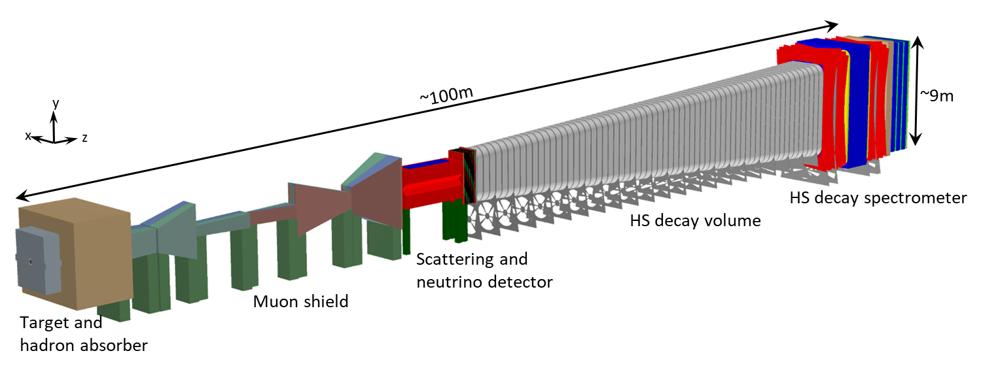
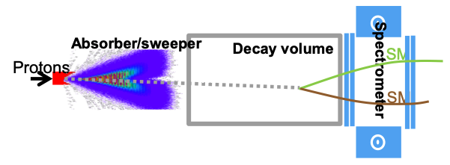
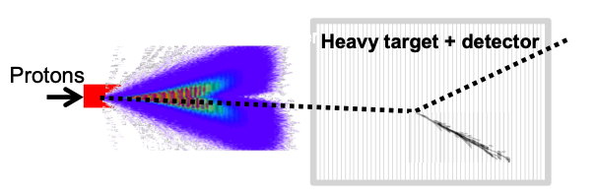
BDF/SHiP
C. Ahdida et al., SPS Beam Dump Facility - Comprehensive Design Study, CERN-2020-002
G. Arduini, C. Vallée, J. Jaeckel (eds.) Post-LS3 Experimental Options in ECN3, CERN-PBC-Report-2023-003
SHiP Collaboration, BDF/SHiP at the ECN3 high-intensity beam facility, CERN-SPSC-2023-033
Beam Dump Facility / Search for Hidden Particles
Physics: explore and directly search for Feebly Interacting Particles at SPS complementary to collider physics
Beam Dump Facility Concept:
  Use high-intensity 400 GeV/c proton beam and absorb it by a thick (12$λ$) high-Z target (W, 19 g/cm³, Molybdenum 10 g/cm³) surrounded by dump (iron 7.9 g/cm³) to maximize production of charmed and beauty mesons
  Employ muon sweeper to clean background for sensitive FIP search
scattering events
decay events
C. Ahdida HI-ECN3 WP6 kick-off 25/04/2024

Slide 7
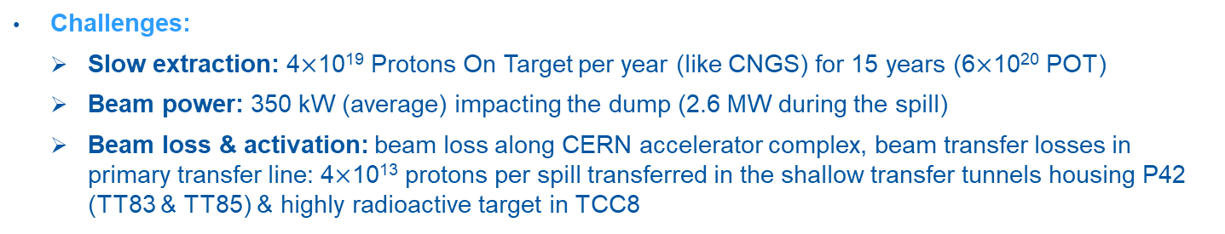
BDF/SHiP
C. Ahdida et al., SPS Beam Dump Facility - Comprehensive Design Study, CERN-2020-002
G. Arduini, C. Vallée, J. Jaeckel (eds.) Post-LS3 Experimental Options in ECN3, CERN-PBC-Report-2023-003
SHiP Collaboration, BDF/SHiP at the ECN3 high-intensity beam facility, CERN-SPSC-2023-033
Beam Dump Facility / Search for Hidden Particles
Physics: explore and directly search for Feebly Interacting Particles at SPS complementary to collider physics
Beam Dump Facility Concept:
  Use high-intensity 400 GeV/c proton beam and absorb it by a thick (12$λ$) high-Z target (W, 19 g/cm³, Molybdenum 10 g/cm³) surrounded by dump (iron 7.9 g/cm³) to maximize production of charmed and beauty mesons
  Employ muon sweeper to clean background for sensitive FIP search
Challenges:
  Slow extraction: 4$×$10¹⁹ Protons On Target per year (like CNGS) for 15 years (6$×$10²⁰ POT)
  Beam power: 350 kW (average) impacting the dump (2.6 MW during the spill)
  Beam loss & activation: beam loss along CERN accelerator complex, beam transfer losses in primary transfer line: 4$×$10¹³ protons per spill transferred in the shallow transfer tunnels housing P42 (TT83 & TT85) & highly radioactive target in TCC8
C. Ahdida HI-ECN3 WP6 kick-off 25/04/2024

Slide 8

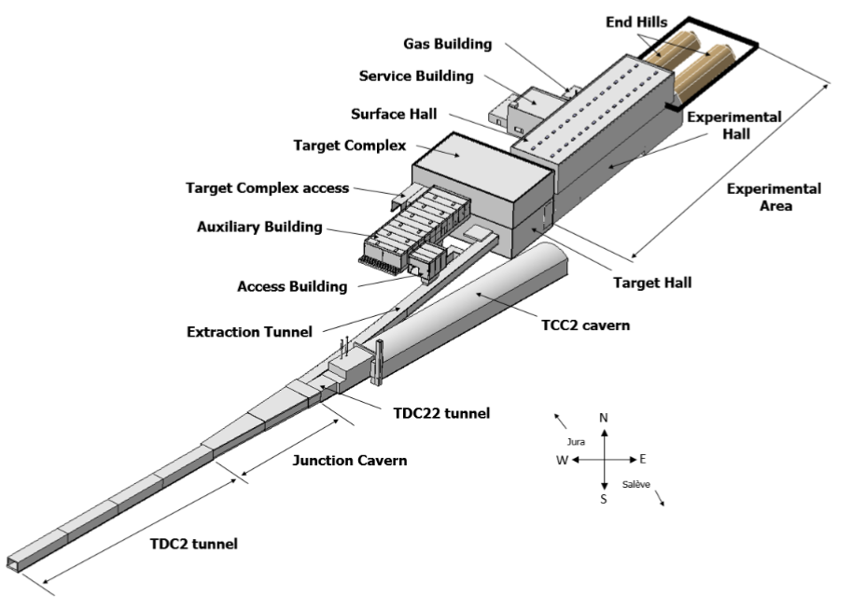
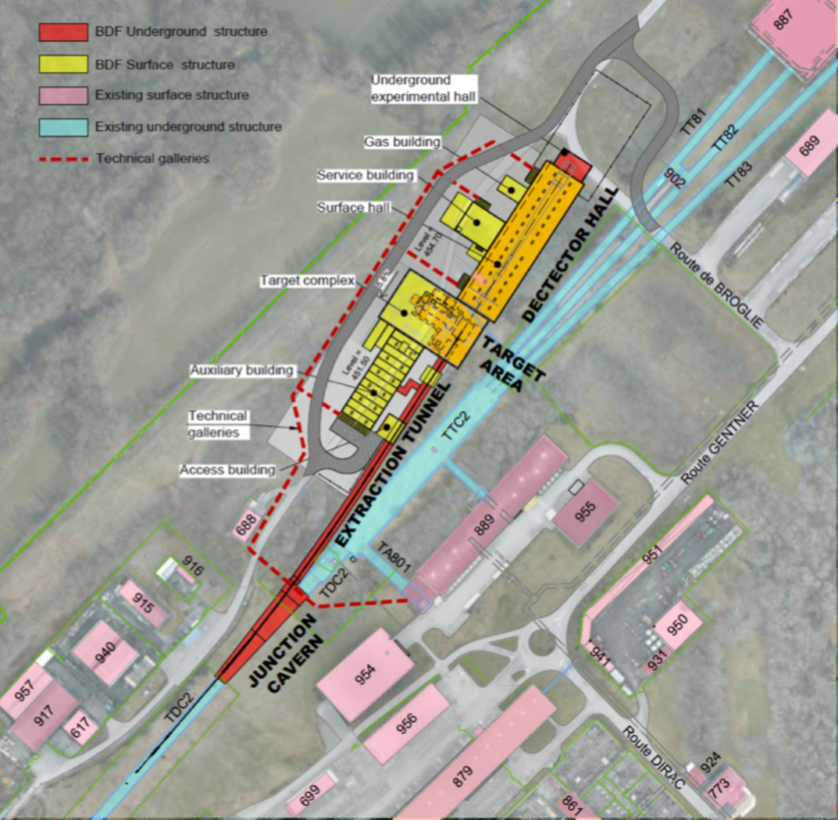
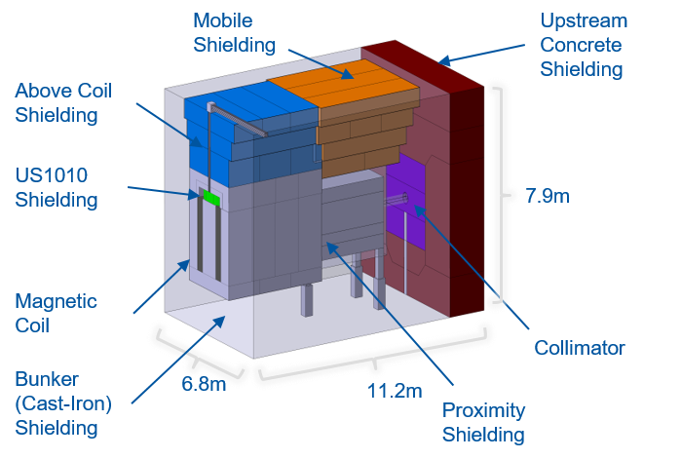
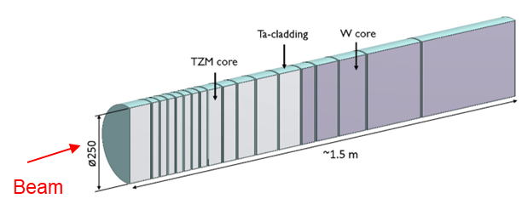
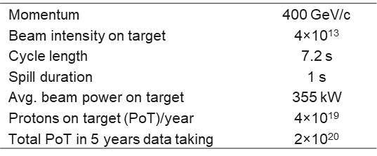
BDF/SHiP History
C. Ahdida et al., SPS Beam Dump Facility - Comprehensive Design Study, CERN-2020-002
BDF/SHiP @ ECN4
  SPS Beam Dump Facility - Comprehensive Design Study CERN-2020-002
600 pages!
BDF layout and surrounding facilities
Target and hadron absorber
EHN1
CERN fence
BDF target
Key beam parameters for SHiP
TZM: 0.08% titanium – 0.05% zirconium – molybdenum alloy
C. Ahdida HI-ECN3 WP6 kick-off 25/04/2024

Slide 9
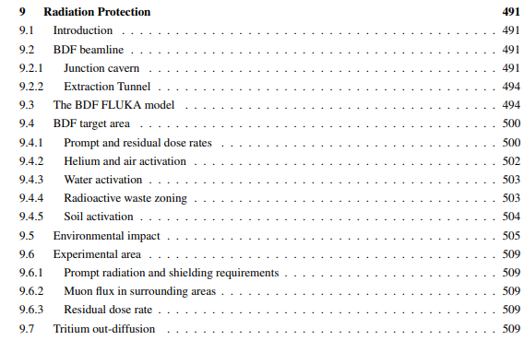
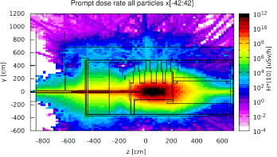
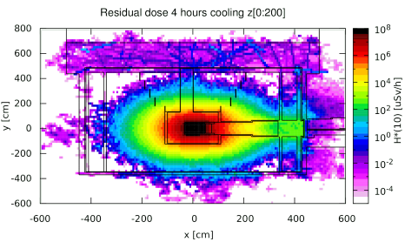
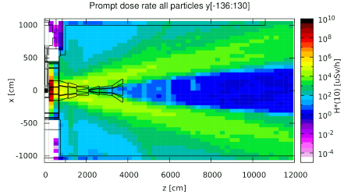
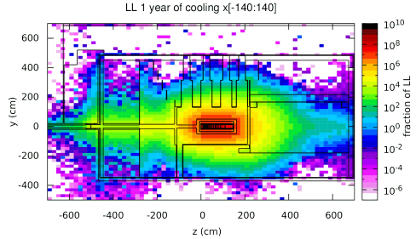
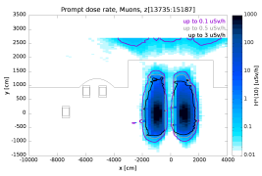
BDF CDS – Radiation Protection
C. Ahdida et al., SPS Beam Dump Facility - Comprehensive Design Study, CERN-2020-002
ALARA approach
Optimization to ensure that exposure of personnel to radiation and radiological impact on environment are As Low As Reasonably Achievable
CDS Studies
Selection of results
Selection of supporting documents and studies:
Radiological Assessment of the Beam Dump Facility at CERN, RP Technical Note, EDMS 2263868
Measurement of the muon flux for the SHiP experiment, CERN-SHiP-NOTE-2019-003
Radiation Protection Studies for the Beam Dump Facility (BDF) Target Prototype Test in T6 during 2018, EDMS 1870669
Radioactive inventory of the BDF prototype target, EDMS 2209174
C. Ahdida HI-ECN3 WP6 kick-off 25/04/2024

Slide 10
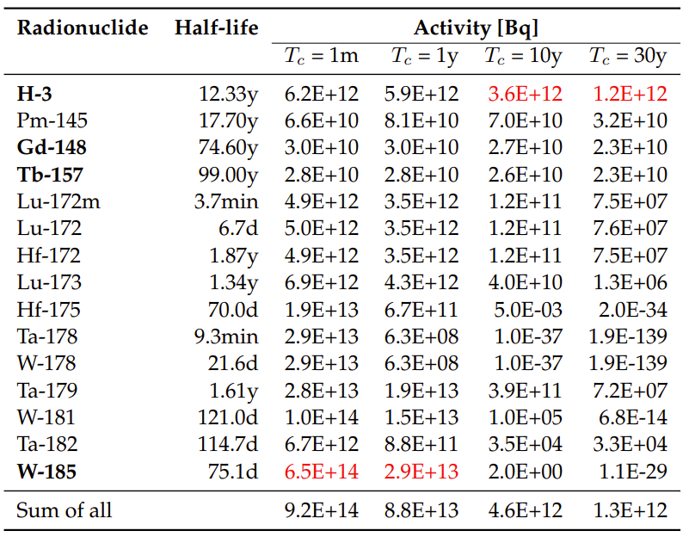
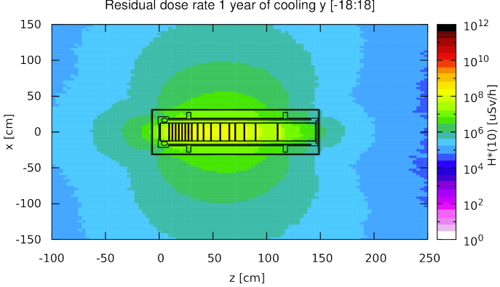
BDF CDS – Target Activation
C. Ahdida et al., SPS Beam Dump Facility - Comprehensive Design Study, CERN-2020-002
Residual dose rates
Radionuclide inventory of W part of target
Main contributors (>1%), sum for all radionuclides
Total PoT 4×10¹⁹ (5 yrs)
Longitudinal cut along the target
1 year cool-down
The residual dose rates of the target after 1 year of cool-down are still of the order of a few Sv/h
Thick iron cask (~30 cm thick) for transportation and storage
Pure alpha/beta emitters are shown in bold
Dominant radionuclide is shown in red
Radiological Assessment of the Beam Dump Facility at CERN, RP Technical Note, EDMS 2263868
C. Ahdida HI-ECN3 WP6 kick-off 25/04/2024

Slide 11
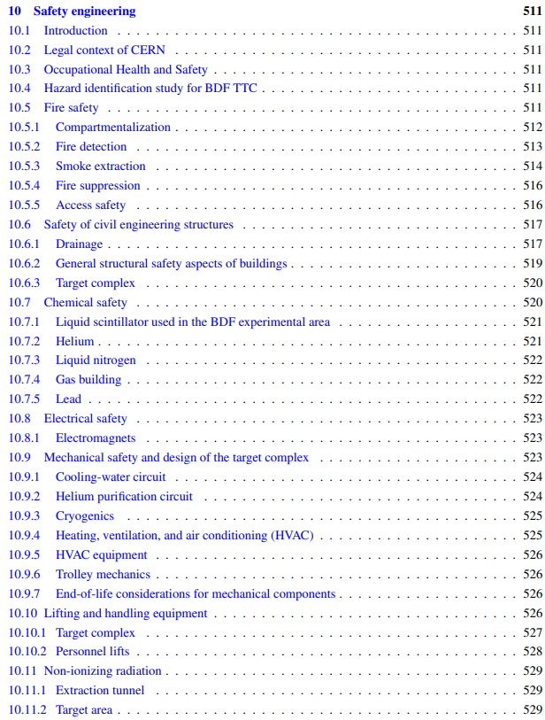
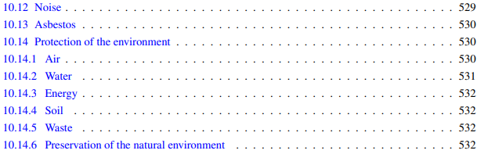
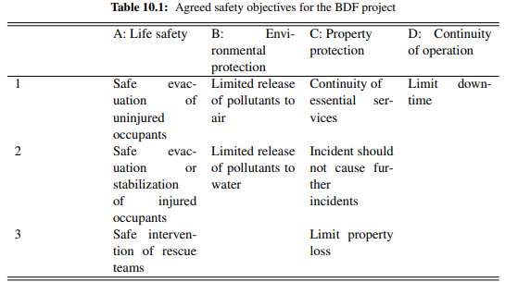
BDF CDS – Safety
C. Ahdida et al., SPS Beam Dump Facility - Comprehensive Design Study, CERN-2020-002
C. Ahdida HI-ECN3 WP6 kick-off 25/04/2024

Slide 12
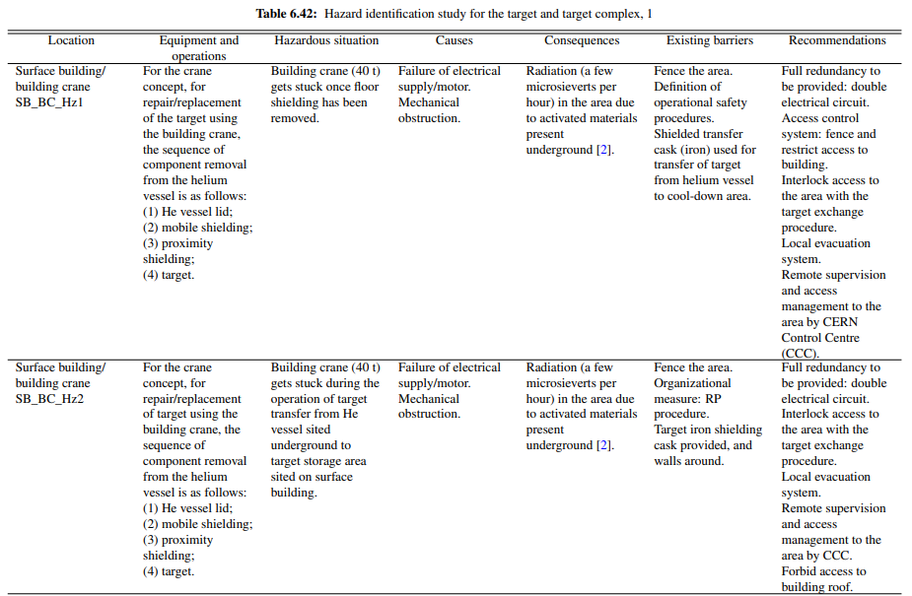
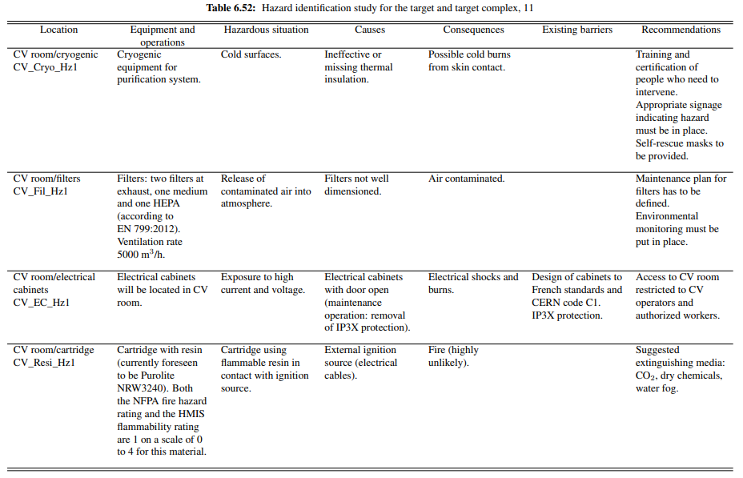
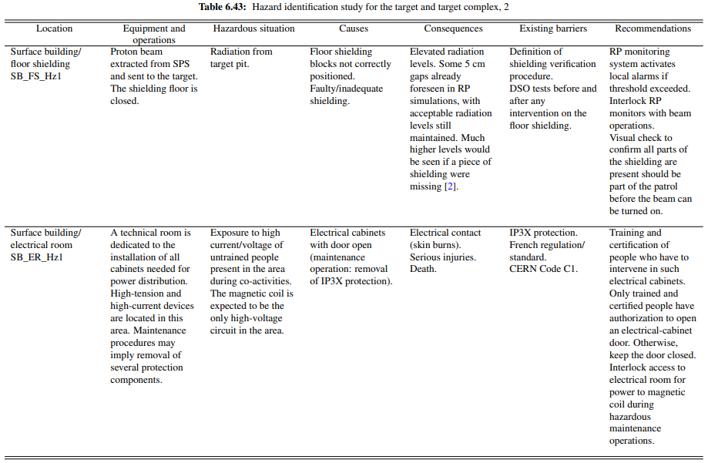
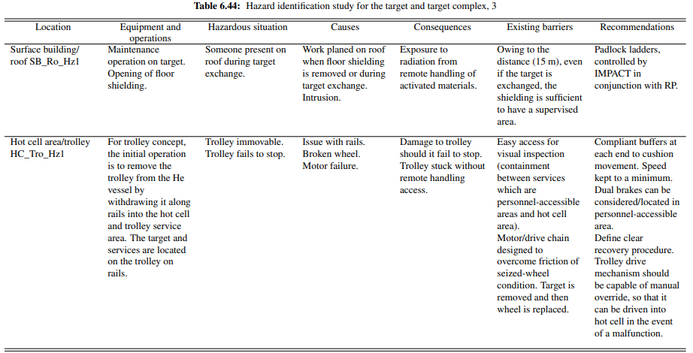
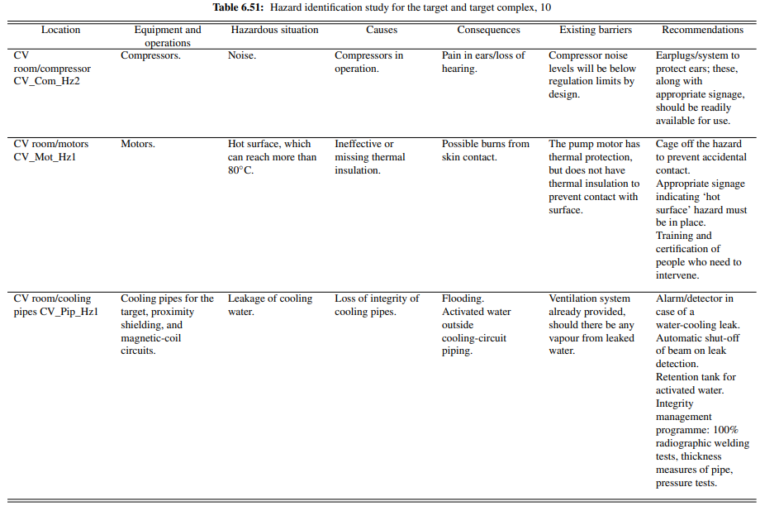
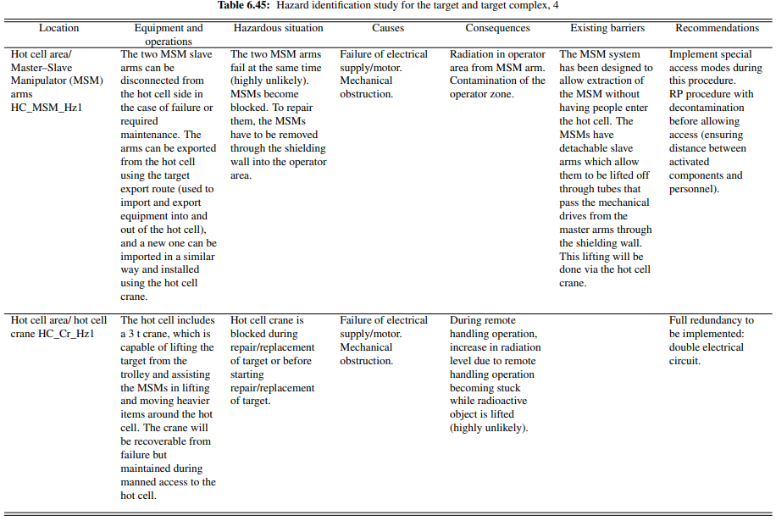
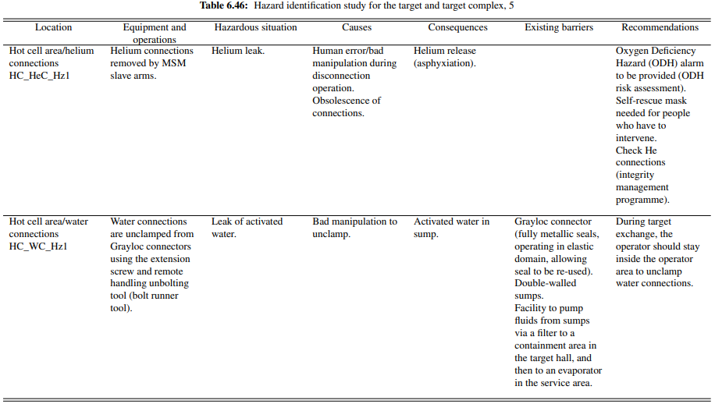
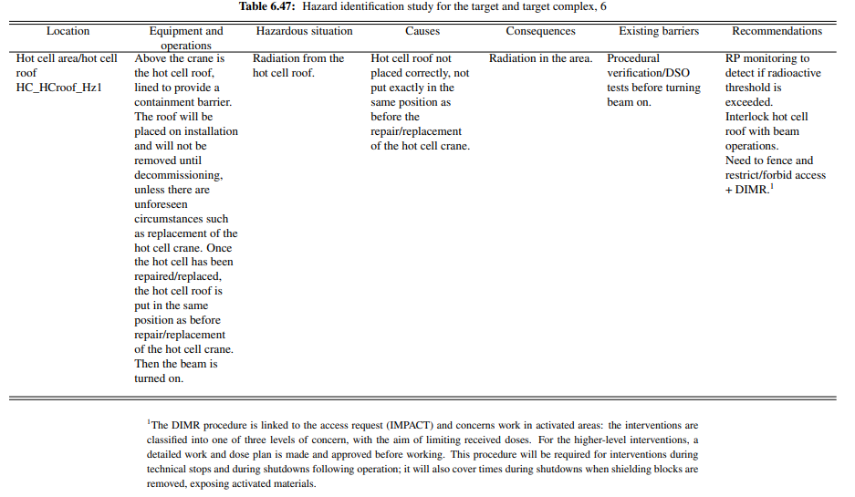
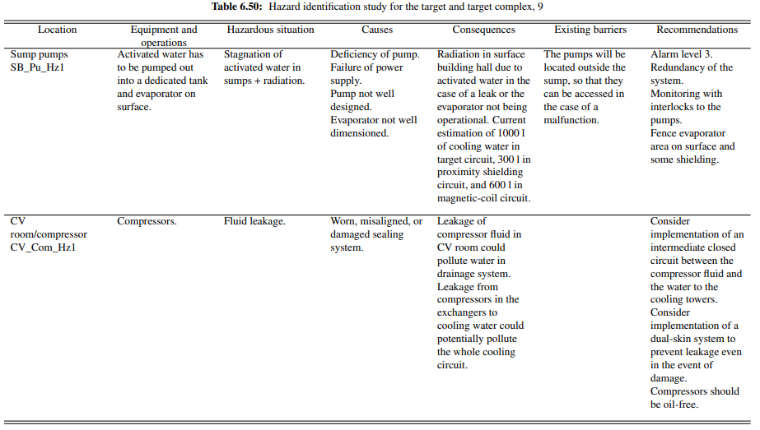
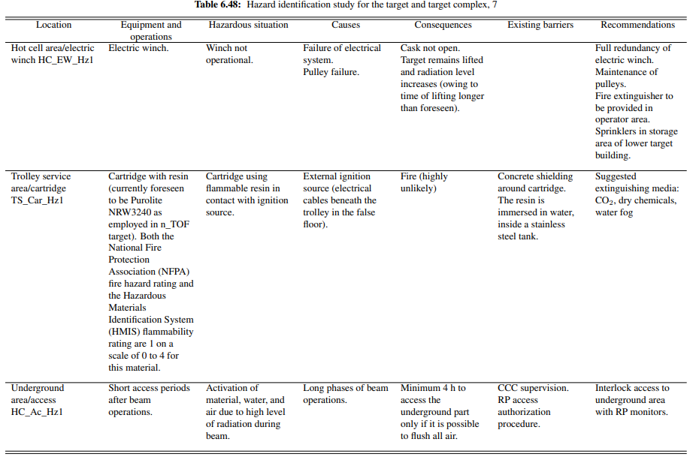
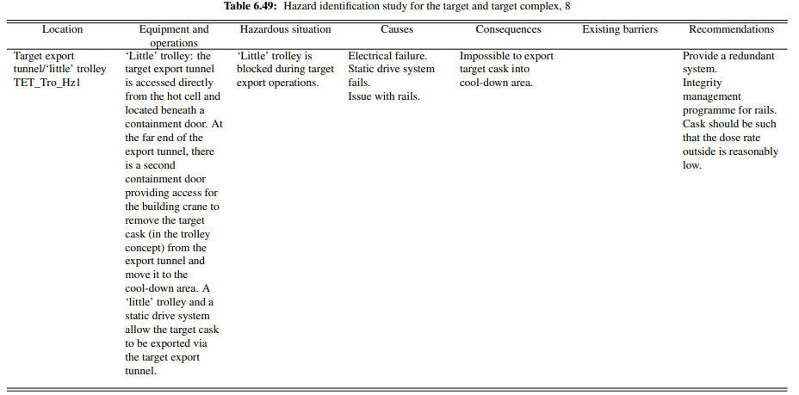
BDF CDS – Hazard ID and risk assessment
C. Ahdida et al., SPS Beam Dump Facility - Comprehensive Design Study, CERN-2020-002
C. Ahdida HI-ECN3 WP6 kick-off 25/04/2024

Slide 13
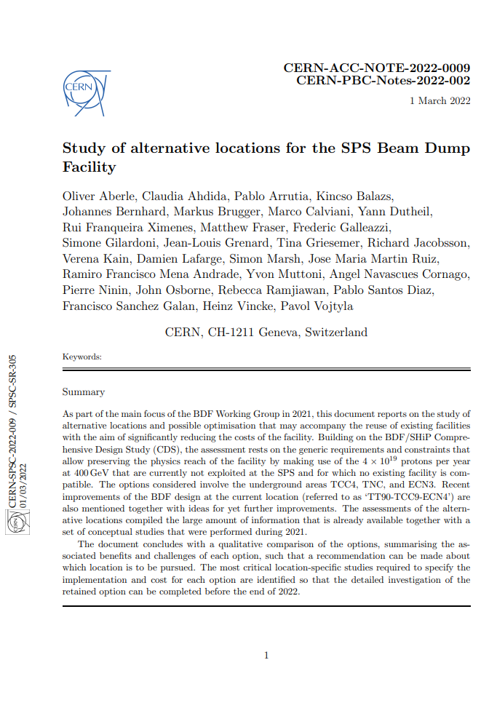
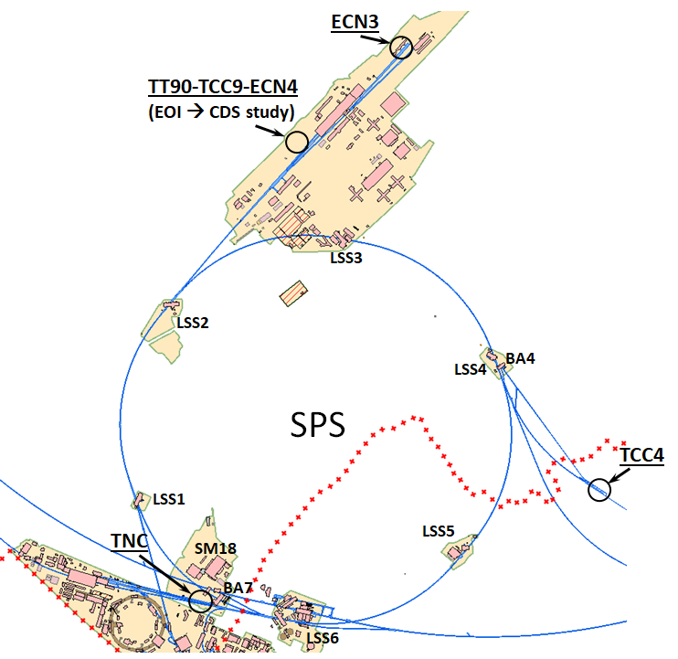
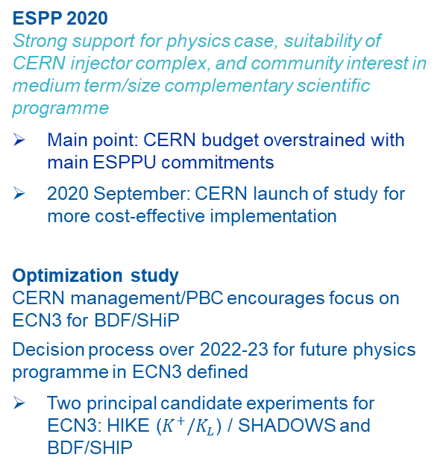
Location and layout optimization study
O. Aberle et al., Study of alternative locations for the SPS Beam Dump Facility, CERN-PBC-Notes-2022-002
ESPP 2020
Strong support for physics case, suitability of CERN injector complex, and community interest in medium term/size complementary scientific programme
Main point: CERN budget overstrained with main ESPPU commitments
2020 September: CERN launch of study for more cost-effective implementation
Optimization study
CERN management/PBC encourages focus on ECN3 for BDF/SHiP
Decision process over 2022-23 for future physics programme in ECN3 defined
Two principal candidate experiments for ECN3: HIKE ($K^{+}/K_{L}$) / SHADOWS and BDF/SHIP
Objective: Preserve SHiP’s original physics reach and scope
CDS design and prototyping studies largely generic
C. Ahdida HI-ECN3 WP6 kick-off 25/04/2024

Slide 14
BDF/SHiP @ ECN3
C. Ahdida et al., Findings of the Physics Beyond Colliders ECN3 Beam Delivery Task Force, CERN-PBC-REPORT-2023-001
G. Arduini, C. Vallée, J. Jaeckel (eds.) Post-LS3 Experimental Options in ECN3, CERN-PBC-Report-2023-003
SHiP Collaboration, BDF/SHiP at the ECN3 high-intensity beam facility, CERN-SPSC-2023-033
ECN3 Beam Delivery Task Force
Investigation of technical feasibility of high intensity beam delivery to ECN3
  Findings of the Physics Beyond Colliders ECN3 Beam Delivery Task Force, CERN-PBC-REPORT-2023-001
BDF WG
Investigation of technical feasibility of BDF at ECN3
  BDF/SHiP at the ECN3 high-intensity facility, CERN-SPSC-2023-033
  Post-LS3 Experimental Options in ECN3, CERN-PBC-Report-2023-003
  For both, synergies with the North Area Consolidation (NA-CONS) programme were investigated together with NA-CONS
Key beam parameters – BDF vs. NA62
 | BDF SHiP | NA62 nominal | BDF / NA62
Intensity (p/spill) | 4×10¹³ | 3.36×10¹² | 12
Spill duration (s) | ≥1 | ≥4.5 | 0.2
Cycle length (s) | ≥7.2 | ≥14.4 | 0.5
Avg. intensity (p/s) | ≤5.6×10¹² | 2×10¹¹ | 28
Annual POT | 4×10¹⁹ | 2.6×10¹⁸ | 15
Duration (years) | 15 | ~12 (2025) | 1.3
Total POT | 60×10¹⁹ | ~1.15×10¹⁹ | 52
C. Ahdida HI-ECN3 WP6 kick-off 25/04/2024

Slide 15
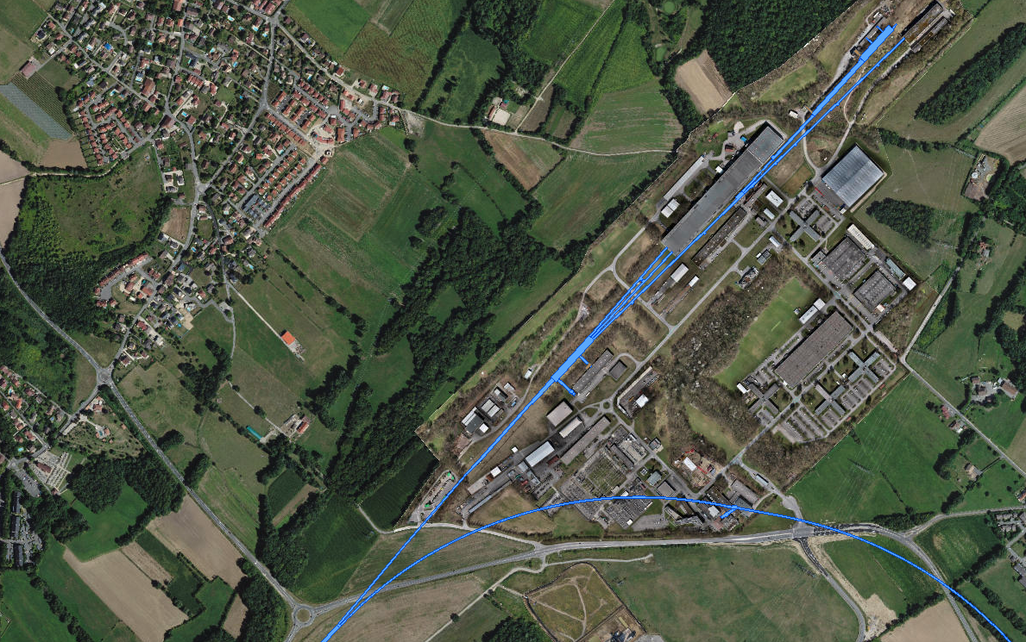
TCC8 & ECN3 today (i)
ECN3
EHN2
TDC85
TT85 (P42)
EHN1
TCC8: T10 / TAX
→ K12
TT83 (P4)
TCC2:
T2 / T4 / T6 / TAX
TDC8
TDC2: TT20 splitters
P42 Beam Dump (TIDVG4)
Transfer Tunnel (TT) 20
SPS LSS2
C. Ahdida HI-ECN3 WP6 kick-off 25/04/2024

Slide 16
Today: Shared Beam Delivery to TCC2
C. Ahdida et al., Findings of the Physics Beyond Colliders ECN3 Beam Delivery Task Force, CERN-PBC-REPORT-2023-001
G. Arduini, C. Vallée, J. Jaeckel (eds.), Post-LS3 Experimental Options in ECN3, CERN-PBC-Report-2023-003
LSS2
TT21
TT22
TT23
T2
H2
H4
SPS
EHN1
H6
TT24
T4
H8
Shared delivery: splitting
P4
P41, P61
Deflected right by B field
Losses
~ 5%
ECN3
TCC8
P42
B
T10
Target
TT25
T6
M2
EHN2
Continues straight, undeflected
C. Ahdida HI-ECN3 WP6 kick-off 25/04/2024

Slide 17
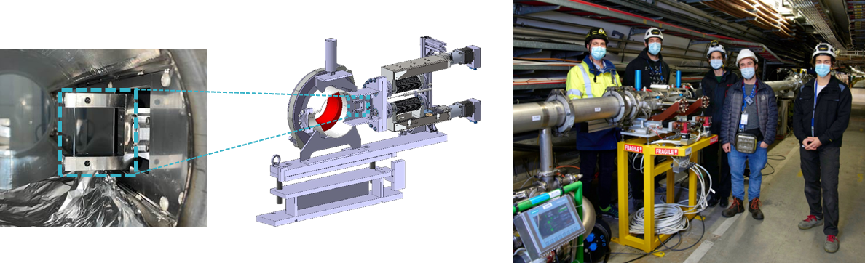
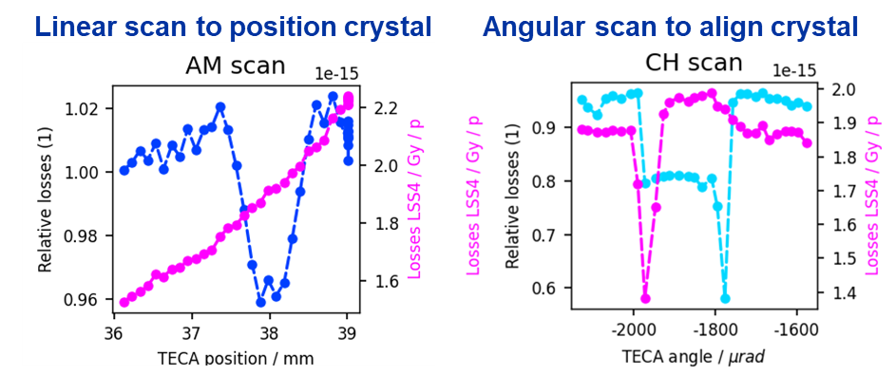
Dedicated Beam Delivery to BDF/SHiP
C. Ahdida et al., Findings of the Physics Beyond Colliders ECN3 Beam Delivery Task Force, CERN-PBC-REPORT-2023-001
G. Arduini, C. Vallée, J. Jaeckel (eds.), Post-LS3 Experimental Options in ECN3, CERN-PBC-Report-2023-003
LSS2
TT21
TT22
TT23
T2
H2
No splitting
in TDC2
H4
SPS
EHN1
H6
TT24
T4
H8
Crystal shadowing: loss reduction
No interaction with TCC2 Target
P4
P41, P61
ECN3
TCC8
P42
BDF/SHiP
Target
TT25
T6
M2
EHN2
C. Ahdida HI-ECN3 WP6 kick-off 25/04/2024

Slide 18
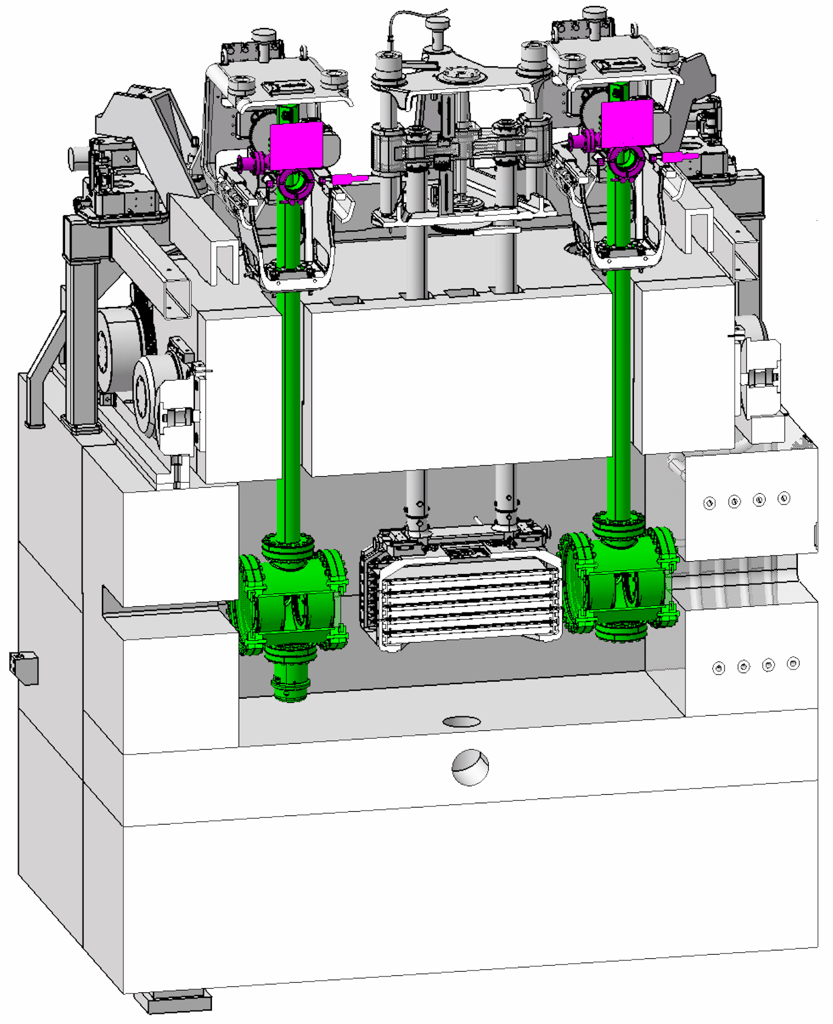
Dedicated Beam Delivery to BDF/SHiP
C. Ahdida et al., Findings of the Physics Beyond Colliders ECN3 Beam Delivery Task Force, CERN-PBC-REPORT-2023-001
G. Arduini, C. Vallée, J. Jaeckel (eds.), Post-LS3 Experimental Options in ECN3, CERN-PBC-Report-2023-003
LSS2
TT21
TT22
TT23
T2
H2
No splitting
in TDC2
H4
SPS
EHN1
H6
TT24
T4
H8
Dedicated delivery: no splitting
P4
P41, P61
No interaction with TCC2 Target
ECN3
No Losses
TCC8
P42
B
TT20 optics changed to transport beam through splitter aperture
BDF/SHiP
Target
TT25
T6
M2
EHN2
C. Ahdida HI-ECN3 WP6 kick-off 25/04/2024

Slide 19
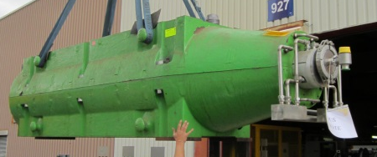
P42 beam dump
LSS2
TT21
TT22
TT23
T2
H2
H4
SPS
HI-ECN3 studies for impact on EHN2 already ongoing (data analysis of past RP monitoring, recent collimator test, FLUKA simulations, access system)
EHN1
H6
TT24
T4
H8
TIDVG4
P4
P41, P61
ECN3
TCC8
P42
Permanently blocking aperture after LS3 for TCC2 beam commissioning (2028 – 2031)
Permanently blocking aperture after Long Shutdown 3 for TCC2 beam commissioning in 2028 – 2031
BDF/SHiP
Target
TT25
T6
M2
EHN2
C. Ahdida HI-ECN3 WP6 kick-off 25/04/2024

Slide 20
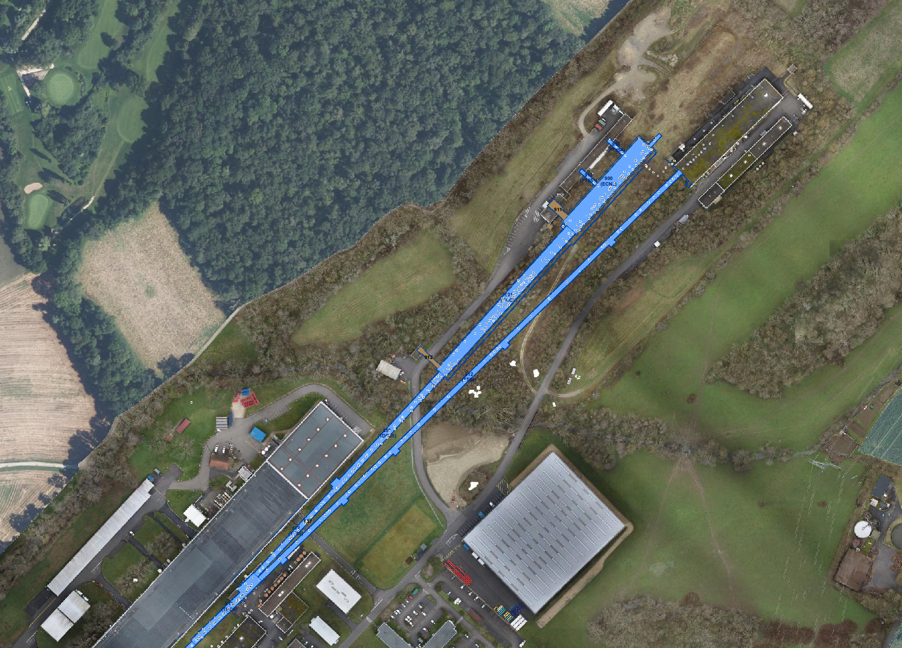
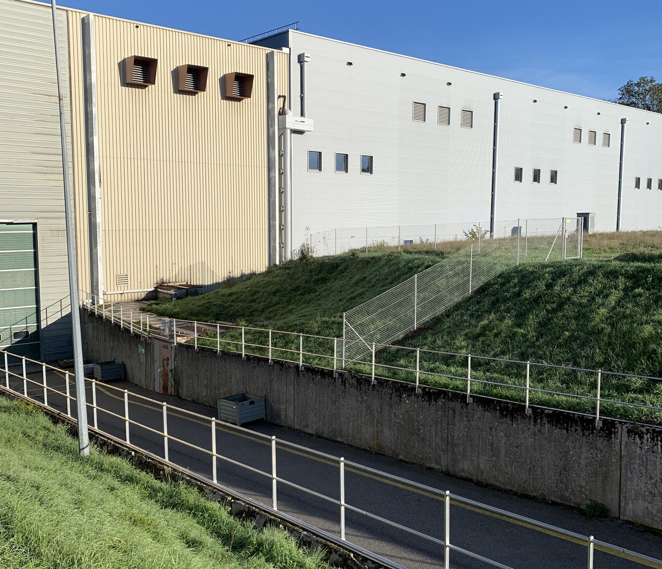
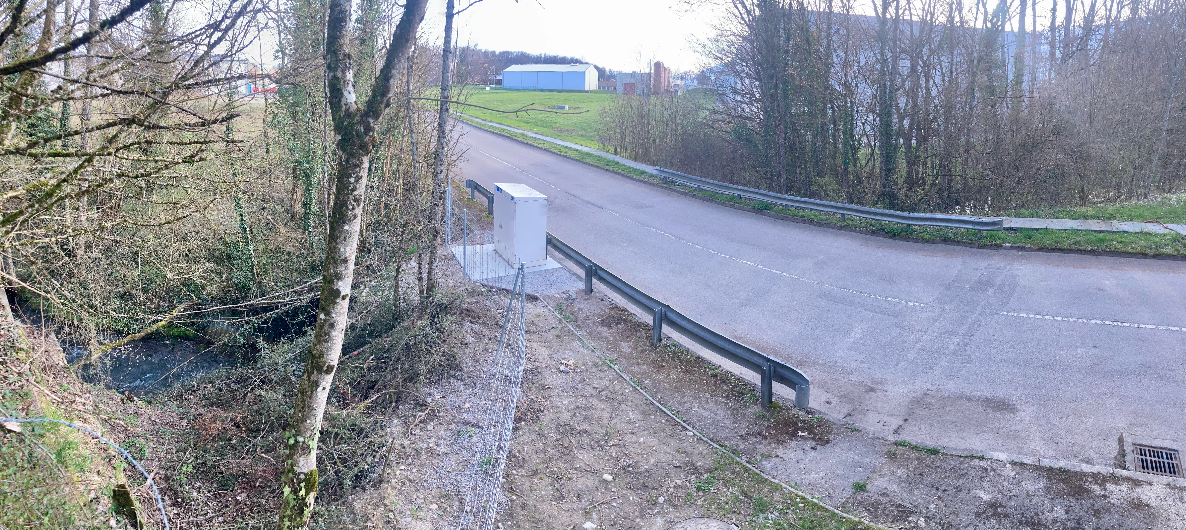
TCC8 & ECN3 today (ii)
ECN3
EHN2
TCC8
BA82
RP Sensitive Areas
TCC8 Bridge
EHN1 Ramp
EHN1
BA81
C. Ahdida HI-ECN3 WP6 kick-off 25/04/2024

Slide 21
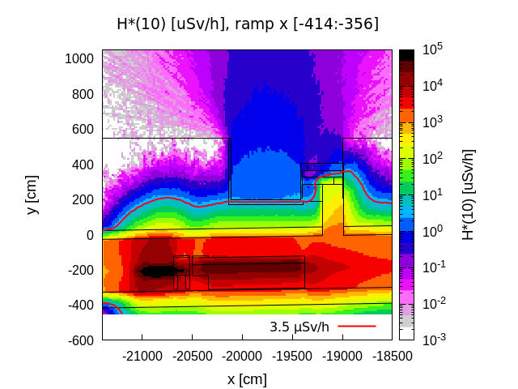
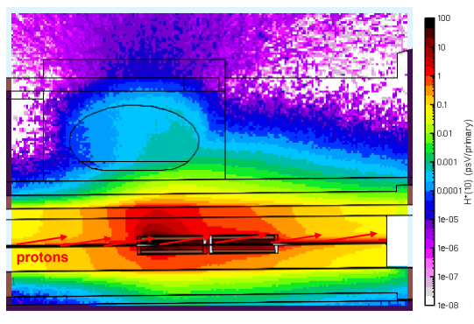
EHN1 ramp & TCC8 bridge
C. Ahdida et al., Radiation Levels at the EHN1 Ramp, EDMS 2931419
Giuseppe Mazzola et al., RP studies at TCC8 bridge – update, EDMS 3053484
F. Philippon et al., RP Survey Measurement ECN3 (TDC85) Bridge, EDMS 2924384
EHN1 ramp
  Several RP surveys in 2022 showed dose rates above given area classification limit (2.5 uSv/h, Non-designated Area)
  FLUKA simulations allowed to better understand the radiation levels (1e-2% beam losses, several local loss points, neutrons dominated)
  Various actions were performed to improve the radiation levels (VXSS, beam instrumentation, shielding reinforcement, etc.) → factor 8 reduction in 2023
  HI-ECN3: Ongoing studies for loss reduction and mitigation methods (e.g. shielding, change of area classification)
TCC8 bridge
  RP survey showed dose rates close to Non-designated Area limit
  FLUKA simulations showed risks for increased radiation for higher beam losses
  HI-ECN3:
  Environmental monitoring station next to bridge dismantled (not at worst location, no interlock) and an RP monitor was installed (worst location, w/ interlock)
  Recent FLUKA studies indicate significant loss reduction when removing magnets below bridge → recent beam loss tests to be compared to simulations
  SCE launched study w/ external consultant for shielding improvement of bridge
EHN1 ramp prompt radiation H*(10)
1e-2% of NA62 nominal beam intensity
z
TCC8 bridge prompt radiation H*(10)
Per primary
C. Ahdida HI-ECN3 WP6 kick-off 25/04/2024

Slide 22
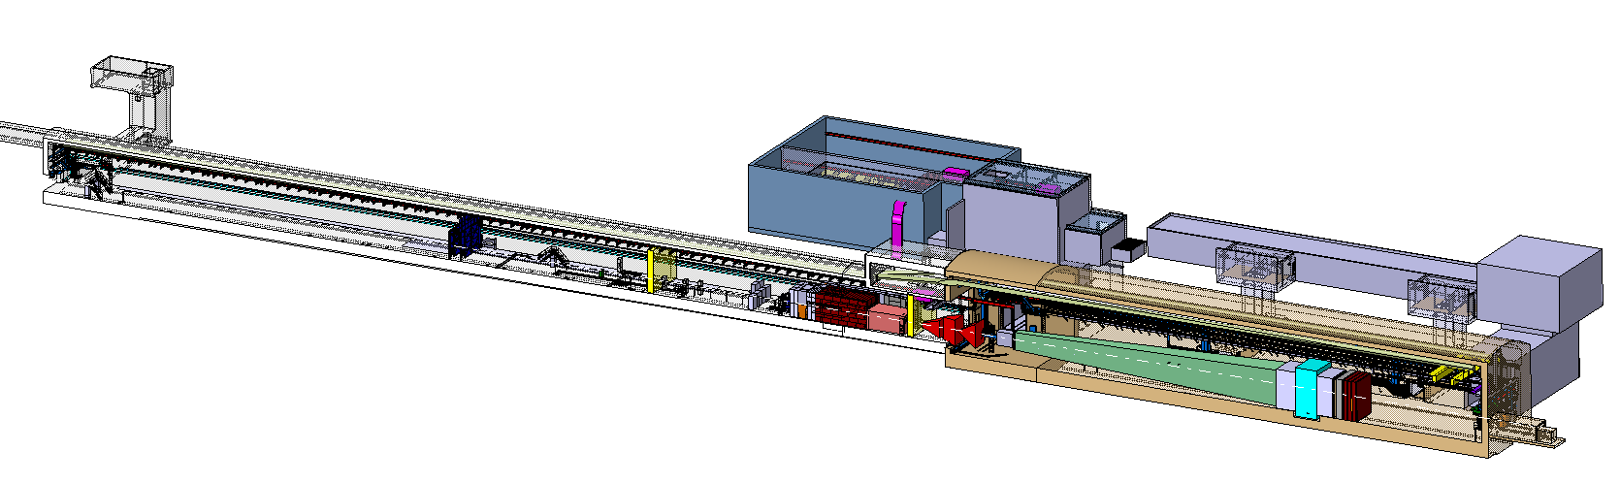
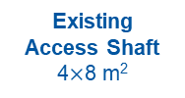

BDF/SHiP @ HI-ECN3
New
Service Building
~ 500 – 700 m²
New
Access Shaft
(material only)
8$×$8 m²
Existing
Access Shaft
4$×$8 m²
B911
B918
Beam Dilution System
TCC8
New Target Complex
containing the Beam Dump Target
ECN3
Floor excavations
C. Ahdida HI-ECN3 WP6 kick-off 25/04/2024
22

Slide 23

BDF Target Complex in TCC8
HI-ECN3 studies already ongoing:
Detailed technical design of complex including handling concept
Reduction of length of magnetized hadron stopper (SHiP requirement)
Investigation of irradiation stations
Investigation of alternative target designs
Etc.
C. Ahdida HI-ECN3 WP6 kick-off 25/04/2024

Slide 24


BDF Target Complex in TCC8
Trolley system on rollers: (i) vacuum tank opened
(ii) target rolled out
C. Ahdida HI-ECN3 WP6 kick-off 25/04/2024

Slide 25

Service Building
Evaporators?
Power converters (on-going investigation ongoing for reusing BA82)
C. Ahdida HI-ECN3 WP6 kick-off 25/04/2024

Slide 26







Giuseppe Mazzola et al., Radiological Assessment of the Beam Dump Facility at ECN3, EDMS 2911154
RP studies for BDF/SHiP @ ECN3
RP studies based on FLUKA MC simulations were performed for a preliminary design optimization of BDF/SHiP
BDF prompt dose rate
BDF residual dose rate
Worst-case immediate air release yields 3 nSv/year
Annual limits on CERN site, the CERN fence and dose objective for members of the public are met
BDF H-3 activity in soil
BDF/SHiP FLUKA model
A hydro-geological study w/ water sampling is underway, which will allow to refine the design limits and possibly allow to reduce the required shielding
C. Ahdida HI-ECN3 WP6 kick-off 25/04/2024

Slide 27


TCC8 & ECN3 today
C. Ahdida HI-ECN3 WP6 kick-off 25/04/2024

Slide 28


TCC8 & ECN3 future
Gas Building
C. Ahdida HI-ECN3 WP6 kick-off 25/04/2024

Slide 29
HI-ECN3 Study Project
ECN3 High Intensity Study Project Mandate, EDMS #2921486
… do not forget this is a TDR Study Project transitioning into a Project simultaneously
(probably after CERN’s Council in June)
HI-ECN3 study project to deliver Facility TDR by end of 2025 including timeline with resource and budget needs
Important aspects to consider in addition to TDR work:
  Updated budget profile (2024 - 2031) already provided for MTP2024
  Safety: documentation, inspections, RP studies for TCC8 activation/dismantling for LS3
  Target R&D / prototyping: beam tests needed before LS3, i.e. in 2025, next year!
  Preparations for Long Shutdown 3:
    Dismantling of TCC8 and ECN3: cable/services identification, decabling, radioactive transport/waste mgmt
    (Radioactive) Storage
    Specification / design / installation: upstream equipment, primary zones inc. NA-CONS equipment and installation of beam dump in P42
    Definition of interfaces with NA-CONS: decouple access system and services so that upgrade work on TCC8/ECN3 can carry on in parallel to North Area operation (EHN1 and EHN2)
  Civil Engineering already on the critical path:
    Pre-studies, hydrogeological survey, IRP Due Diligence and schedule optimization before Design Study
  Cost savings:
    CERN Shielding Recovery & Reuse: launch a CERN project (included in MTP24 for TT7 @ PS)
C. Ahdida HI-ECN3 WP6 kick-off 25/04/2024

Slide 30
Timeline
PBC ECN3 Beam Delivery Task Force presented findings early 2023 to the CERN Research Board
  Our timeline has not changed and its 2024!
  Facility TDR will need to be finalized towards end 2025 to achieve beam on target in 2030
Research Board Decision for SHiP: March 2024
Civil Engineering for ECN3 is the critical path: ~ 3 – 4 years
CERN-PBC-REPORT-2023-001
March 2023
C. Ahdida HI-ECN3 WP6 kick-off 25/04/2024

Slide 31



TCC8/ECN3 dismantling
Francesca Luoni et al., TCC8 Dismantling: RP assessment , EDMS 3055493
T10 target, K12 beamline and NA62 experiment to be dismantled in LS3
Cable identification must start ASAP: YETS24/25
T10
Target
T10
XTAX
Existing
Access Shaft
4$×$8 m²
K12 beam line
B911
B918
TCC8
Residual Dose Rate – April 2026
ECN3
RP studies for TCC8 dismantling #1 on 19/03/24, Indico
Joint WP4/5/6 TCC8 dismantling meeting #1 on 02/05/24, Indico
C. Ahdida HI-ECN3 WP6 kick-off 25/04/2024

Slide 32




TT7 Shielding Recovery
J-L Grenard, Shielding recovery options in view of a new ECN3 experiment and further, EDMS 2868284
C. Ahdida et al., RP Considerations for the TT7 Dump Shielding Recovery, EDMS 3057086
Facility overview
The TT7 tunnel was used for neutrino oscillation experiments (PS169, PS181, BEBC-PS180) with operation in 1983-84
100m³ of standard cast iron blocks + ~50m³ of non-standard cast iron blocks (~3 MCHF)
Investment cost for shielding recovery
~0.7 MCHF
FLUKA studies for residual dose assessment performed
  Dump mostly non-radioactive w/ max. dose rates reaching ~160 uSv/h
  A preliminary estimate of the transport classification
  TT7 Shielding Recovery Kick-off on 26/03/24 – Indico
Dump
Radioactive waste zoning
Preliminary radioactive transport classification
C. Ahdida HI-ECN3 WP6 kick-off 25/04/2024

Slide 33
PSO mandate, EDMS 2975757
HI-ECN3 Study Project Team
Project Leader (PL):
Matthew FRASER
Deputy Project Leader (DPL):
Claudia AHDIDA
Project Safety Officer (PSO):
Melenia AVERNA
Project Radiation Safety Officer (PRSO):
TBC
Project Budget Officer:
Sylvie PRODON
Project Planning Officer (PPO):
Fernando PEDROSA
Configuration & Quality Assurance Manager:
Giulia ROMAGNOLI
Integration Support via ICEA:
Michael LAZZARONI
North Area Operation & Experiment Liason:
Dipanwita BANERJEE
SHiP Experiment Contact Person:
Richard JACOBSSON
SHiP Experiment Safety Correspondent:
Letizia DI GIULIO
Project & Experiment Safety Support (PESS) Correspondant :
James CURRIE
Admin Support:
Katarina SIGERUD & Diane KIVENDA MOKUBA
+ WPLs
DRAFT
WP1 – Project Management
Matthew FRASER
WP2 – Beam Extraction, Transfer and Delivery
Francesco VELOTTI
Deputy Laurie NEVAY
WP3 – Target & Beam Intercepting Devices
Rui XIMENES
WP4 – Target Complex
Jean-Louis GRENARD
WP5 – Exp. Area, Interface & Integration
Francois BUTIN
WP6 – Radiation Protection & Safety
Claudia AHDIDA
WP7 – Infrastructure, Services & Civil Eng.
Fernando PEDROSA
C. Ahdida HI-ECN3 WP6 kick-off 25/04/2024

Slide 34
Project WBS v1
WP1 – Project Management
Matthew FRASER
WP2 – Beam Extraction, Transfer and Delivery
Francesco VELOTTI
Deputy: Laurie NEVAY
WP3 – Target & Beam Intercepting Devices
Rui XIMENES
WP4 – Target Complex
Jean-Louis GRENARD
WP5 – Exp. Area, Interface & Integration
Francois BUTIN
WP6 – Radiation Protection & Safety
Claudia AHDIDA
WP7 – Infrastructure, Services & Civil Eng.
Fernando PEDROSA
DRAFT
Planning, Scheduling & Coord.
Fernando PEDROSA
Extraction
Pablo ARRUTIA
Target Design & Engineering
Rui XIMENES
Target Complex Design & Engineering
Jean-Louis GRENARD
Expt Area Design & Engineering
Francois BUTIN
Safety Files
Melania AVERNA
NA-CONS Synergism
Fernando PEDROSA
Budget & Resources
Sylvie PRODON
Primary Beam Line
Laurie NEVAY / Francesco VELOTTI
BIDs Design & Engineering
Rui XIMENES
TC & Surface Building Integration
Jean-Louis GRENARD
Global Integration (inc. Exp. Area Integration)
Francois BUTIN
Radiation Protection
Claudia AHDIDA
Civil Engineering
John OSBORNE
Procurement
Magnets
Philip SCHWARTZ
XTAX Upgrade
Miguel SANTOS
Containment Systems
Jean-Louis GRENARD
TCC8/ECN3 Dismantling
Nicolas QUINQUIS / Francois BUTIN
Radioactive Transport & Waste Management
Philippe Bertreix
Renaud CHAROUSSET
Gas Distribution
Davide JAILLET
Project Office
Matthew FRASER
Power Converters
Ivan JOSIFOVIC
Experiment Requirements
Richard JACOBSSON
Service Cell Systems
Jean-Louis GRENARD
Shielding Proecurement & Recovery
Michael LAZZARONI
Fire Safety
Oriol RIOS
Cooling & Ventilation
Roberto BOZZI
Technical Coordination
Matthew FRASER
Vacuum Upgrade
Miguel SANTOS
Energy Deposition & Radiation Effects
Luigi ESPOSITO
Robotic Systems
Luca BUONOCORE
Experiment Interfaces
Richard JACOBSSON
Access & Safety Systems
Tomasz LADZINSKI / Anna SUWALSKA
Electrical & Fiber Infrastucture
Eva CANO GONZALEZ
Configuration & Quality Management
Giulia ROMAGNOLI
Instrumentation
Detailled Design & Production
Luca GENTINI
Remote Handling Systems
Roberto RINALDESI
Accelerator Interfaces
Francois BUTIN
Occupational Safety
James CURRIE
Cryogenics
Installation
Machine Protection
Antoine COLINET
Target Instrumentation
Jerome LENDARO
Radioactive Components Storage & Disposal
Jean-Louis GRENARD
Experiment Installation
Francois BUTIN /
Richard JACOBSSON
Survey & Alignment
Camille VENDEUVRE
Operational Controls & Tools
Kevin LI
Material R&D
Stefano SGOBBA
Radiation to Electronics
Ruben ALIA
Experiment Requirements
Richard JACOBSSON
Handling Systems & Operational Support
Roberto RINALDESI
Commissioning
Beamline Shielding Improvements
Laurie NEVAY
Prototype Target Beam Test
Rui XIMENES
Accelerator Interfaces
Jean-Louis GRENARD
Telecom & Network
Experiment Requirements
Richard JACOBSSON
Magnetised Hadron Stopper
C. Ahdida HI-ECN3 WP6 kick-off 25/04/2024

Slide 35
Project Work Breakdown Structure
WP1 – Project Management
Matthew FRASER
WP2 – Beam Extraction, Transfer and Delivery
Francesco VELOTTI
Deputy: Laurie NEVAY
WP3 – Target & Beam Intercepting Devices
Rui XIMENES
WP4 – Target Complex (TC)
Jean-Louis GRENARD
WP5 – Experimental Area & Expt. Interface
Francois BUTIN
WP6 – Radiation Protection & Safety
Claudia AHDIDA
WP7 – Infrastructure, Services & Civil Eng.
Fernando PEDROSA
DRAFT
Planning, Scheduling & Coord.
Fernando PEDROSA
TDR Project Study Team
BE-CEM Jerome LENDARO, Luca BUONOCORE
BE-ABP Hannes BARTOSIK, Tirsi PREBIBAJ (PBC GRAF)
BE-CSS TBC
BE-EA Francois BUTIN, Michael LAZZARONI + ORIGIN, Johannes BERNHARD, Miguel SANTOS + Angelo PETRELLESE (ORIGIN), Laurie NEVAY + Fabian METZGER & Luke DYKES (GRAF), Dipanwita BANERJEE, David JAILLET
BE-GM Camille VENDEUVE
BE-OP Kevin LI, James RIDEWOOD
EN-AA Anna SUWALSKA, Tomasz LADZINSKI
EN-ACE Fernando PEDROSA, Ixone VAQUERO (ORIGIN) + Xavier PALLE (ORIGIN)
EN-CV Roberto BOZZI, Francesca DRAGONI + Nikola ZARIC (ORIGIN)
EN-EL Eva CANO GONZALEZ + Ming LIU (QUEST)
EN-MME Stefano SGOBBA, Ana Teresa PEREZ FONTENIA​, Luca GENTINI
EN-HE Roberto RINALDESI, Cristina DURÁN GUTIÉRREZ (ORIGIN)
SY-ABT Pablo ARRUTIA, Yann DUTHEIL, Matthew FRASER + Aleksandr GORN (PBC GRAF), Francesco VELOTTI, Bruno BALHAN, Friedrich LACKNER
SY-BI Federico RONCAROLO, Christos ZAMANTZAS + ORIGIN + TECH
SY-EPC Ivan JOSIFOVIC, Yves GAILLARD
SY-RF Giulia PAPOTTI
SY-STI Jean-Louis GRENARD, Rui Franqueira XIMENES + Mike PARKIN (QUEST), Luigi ESPOSITO + Guiseppe MAZZOLA (GRAP), Damien GRENIER,
Ruben ALIA, Nicolas QUINQUIS, Melania AVERNA
TE-MSC Philipp SCHWARTZ
TE-VSC Anthony HARRISON
TE-MPE Antoine COLLINET
HSE-RP Claudia AHDIDA+ Olin PINTO (QUEST) + Francesca LUONI (PBC QUEST), Renaud CHAROUSSET, Philippe BERTREIX, Maxime MUNOS
HSE-OHS Simon MARSH + James CURRIE (ORIGIN), Oriol RIOS + QUEST
SCE-SAM-FS John OSBORNE, Kincso PAL (TEMP) + Tamara BUDD (PBC QUEST) → SCE-PPM Natacha LOPEZ, David Rodriguez GOMEZ + QUEST
EP Richard JACOBSSON, Letizia DI GIULIO & NA62 Technical Coordinator
Budget & Resources
Sylvie PRODON
Procurement
Project Office
Matthew FRASER
Technical Coordination
Matthew FRASER
Configuration & Quality Management
Giulia ROMAGNOLI
Installation
Commissioning
C. Ahdida HI-ECN3 WP6 kick-off 25/04/2024

Slide 36

WP6 core team & scope
WP6 core team | Safety Files | Melania AVERNA, Claudia AHDIDA
 | Radiation Protection | Claudia AHDIDA, Frederic ABERLE, Francesca LUONI, Giuseppe MAZZOLA, Olin PINTO, Angelito HERVE (TT7)
 | Radioactive Transport & Waste Management | Philippe BERTREIX, Renaud CHAROUSSET, Gerald DUMONT, Maxime MUNOS
 | Fire studies | Oriol RIOS, Darko PEROVIC, QUEST
 | Access & Safety Systems | Tomasz LADZINSKI, Anna SUWALSKA
 | Occupational Safety | James CURRIE, Simon MARSH
The WP liaise with the other (sub-)WPs, DSOs, other Safety Officers, EP Safety, LEXGLIMOS and NA-CONS
C. Ahdida HI-ECN3 WP6 kick-off 25/04/2024

Slide 37
Main responsibilities & activities – WP6.1
6.1 Safety Files
Establish, in consultation with the Departmental Safety Officers (DSOs) concerned, the Safety documentation for the dismantling of the existing target complex in TCC8
Establish and update, in consultation with the Departmental Safety Officers (DSOs) concerned, the Safety documentation for the Project, including support for the descriptive and demonstrative Safety Files¹ of the new Beam Dump Facility (BDF) (to be finalized before HI-ECN3 commissioning and operation phase)
Collaborate with other Safety Officers and Safety Support Officers, the HSE Unit, the EP-TH Safety Office, NA-CONS PSO, and the Large Experiment Group Leader in Matters of Safety (LEXGLIMOS), as required
DRAFT
¹ WP 6.2 Radiation Protection is responsible for the RP Safety File
C. Ahdida HI-ECN3 WP6 kick-off 25/04/2024

Slide 38
Main responsibilities & activities – WP6.2
6.2 Radiation Protection
Perform a comprehensive radiological assessment¹ and design optimization of the HI-ECN3 facility and activities connected to it (e.g. TCC8/ECN3 dismantling,TT7 shielding recovery) to ensure that the exposure of personnel to radiation and the radiological impact on the environment are As Low As Reasonably Achievable (ALARA)
Propose operational and environmental RP monitoring and shielding requirements
Provide relevant radiological input to other (sub-) WPs (e.g. FIRIA, radioactive transport/waste, access system, WP2/3/4/5/7)
Provide operational RP support (e.g. TCC8/ECN3 decabling/dismantling)
Establish and update together with WP6.3 the RP Safety File of the new Beam Dump Facility (BDF) (to be finalized before HI-ECN3 commissioning and operation phase)
DRAFT
¹ Excluding radioactive transport and waste
See detailed deliverables for WP6.2 in the backup slides
C. Ahdida HI-ECN3 WP6 kick-off 25/04/2024

Slide 39
Main responsibilities & activities – WP6.3
DRAFT
6.3 Radioactive Transport and Waste Management
Study the radioactive transport and waste management aspects for the dismantling of the existing target complex and experiment in TCC8 and ECN3
Study the radioactive transport aspects for the TT7 shielding recovery and prototype target tests
Provide guidance and support related to radioactive transport and waste for the design of the new HI-ECN3 facility
Establish and update together with WP6.2 the RP Safety File of the new Beam Dump Facility (BDF) (to be finalized before HI-ECN3 commissioning and operation phase)
C. Ahdida HI-ECN3 WP6 kick-off 25/04/2024

Slide 40
Main responsibilities & activities – WP6.4
DRAFT
6.4 Fire Safety
Perform a Fire Induced Radiological Integrated Assessment (FIRIA) to evaluate the safety outcome in case of fire of the HI-ECN3 facility (including it’s above-ground buildings) with a given fire protection concept including radiological impact on first responders, environment and public;
Timely provide recommendations to the project to include a state-of –the-art fire concept in the facility design;
C. Ahdida HI-ECN3 WP6 kick-off 25/04/2024

Slide 41
Main responsibilities & activities – WP6.5
DRAFT
6.5 Access & Safety Systems
Perform, in consultation with the safety actors concerned (DSOs, RP), a risk assessment exercise to propose access sectorization modifications for:
beam commissioning phase prior to HI-ECN3 completion
HI-ECN3 commissioning/operation phase
Establish the required extensions and modifications to the access system’s (SPS PPS) TCC8-ECN3 interlocked zone
Establish the design of Safety Systems, including the fire detection, protection and evacuation of the surface and underground, the fire-resistant partition installations, dry risers, and the gas detection systems
C. Ahdida HI-ECN3 WP6 kick-off 25/04/2024

Slide 42
Main responsibilities & activities – WP6.6
DRAFT
6.6 Occupational Safety
Assist the project in identifying potential hazards within the project connected to process safety, occupational health and environmental protection
Provide tailored safety requirements for the project, based on the identified hazards
Provide guidance and support throughout the project’s full life-cycle
Perform relevant safety inspections
HI-ECN3 Project Launch Safety Discussion on 21/03/2024, Indico
C. Ahdida HI-ECN3 WP6 kick-off 25/04/2024

Slide 43
Study Project Milestones
See ECN3 High Intensity Study Project Mandate, EDMS #2921486
… do not forget this is a TDR Study Project transitioning into a Project simultaneously
NA-CONS C&S Review: align for MTP2024 – February 2024
Experiment(s) Decision at Research Board – 6 March 2024
  Launch Safety Discussion: start Initial Enquiry for PESS Process
  Launch preparations for dismantling of TCC8 / ECN3
  Launch CERN TT7 Shielding Recovery Project
  Update MTP2024
Formal HI-ECN3 Project Approval (MTP2024?) – after CERN RB June 2024
  Mandate including transition from Study → Project
First draft TDR “lite” & WBS – by end 2024
IRP Due Diligence – May 2024: draft now circulating EDMS #3075794
IRP Authorisation – Q3 2025 ?
Final TDR & WBS – by end 2025
C. Ahdida HI-ECN3 WP6 kick-off 25/04/2024

Slide 44
Budget
Budget and spending profile need to be iterated in TDR phase
DEP | Group | TDR |  | 2023 | 2024 | 2025 | 2026 | 2027 | 2028 | 2029 | 2030 | 2031 | Total
HSE | HSE-RP | 2 | Add. RP Monitors for Beam Delivery | 35 | 10 |  | 90 |  |  |  |  |  | 135
HSE | HSE-RP | 2 | EHN1 ramp Classification RP |  | 50 | 100 | 250 |  |  |  |  |  | 400
HSE | HSE-RP | 2 | ECN3 bridge shielding |  | 50 | 150 | 200 | 300 |  |  |  |  | 700
EN | EN-AA | 4 | P42/TCC8 Access door modification |  |  |  | 100 |  |  |  |  |  | 100
EN | EN-AA | 4&5 | TCC8/ECN3 access system and fire doors |  |  |  |  |  |  |  |  |  | 300
EN | EN-AA | 4&5 | TCC8/ECN3 Fire Safety System |  |  |  |  |  |  |  |  |  | 750
HSE | HSE-RP | 6 | Radioactive waste package and disposal |  |  |  |  |  | 314 | 750 | 436 |  | 1500
HSE | HSE-RP | 6 | Add. RP monitors for target complex |  |  |  |  |  |  | 145 |  |  | 145
HSE | HSE-RP | 6 | Operational RP support |  |  |  |  |  |  |  |  |  | 326
*Additional 25 kCHF for TT7 shielding recovery operational RP support and road transport
C. Ahdida HI-ECN3 WP6 kick-off 25/04/2024

Slide 45
Pre-LS3 PLAN activities
Activity Description | WP | HI-ECN3 WPL | Plan Number(s) | Timeline | Main Group(s) Implicated
New ECN3 Prototype Target in T6 | 3 | R. XIMENES | 12969 | 2025 | STI
Cable Identification Campaign in TCC8/ECN3 for HI-ECN3 | 5 | F. BUTIN | 13010 | YETS24/25 | EA, EL, RP, EP
TT7 Shielding Recovery | 5 | F. BUTIN | 13787 | < LS3 | EA, HE, RP, SCE, STI
New trench to re-route existing network and services (around new road extension) | 5 | F. BUTIN | 14167 | < LS3 | SCE, CV, EL
C. Ahdida HI-ECN3 WP6 kick-off 25/04/2024

Slide 46
LS3 PLAN activities (i)
Activity Description | WP | HI-ECN3 WPL | Plan Number(s) | Main Group(s) Implicated
Exchange septa ZS21636 with Low Z version LS3 | 2 | F. VELOTTI | 12155 | ABT, HE, GM
Replacement of irradiated cables in SPS TS2- (LSS2-) | 2 | F. VELOTTI | 11715 | ABT, EL
SPS TECA (crystal shadowing) upgrade (LSS4) | 2 | F. VELOTTI | 13917 | STI, GM, HE
T4 P42 XTAX upgrade | 2 | L. NEVAY | 12935 & 12932 | EA, GM, HE
Installation of new BLM system for ECN3 (part 2) | 2 | F. VELOTTI | 13696 | BI, EL
P42 Vacuum Upgrade | 2 | L. NEVAY | 13658 | EA
Replacement of P42 corrector magnets with laminated variants | 2 | L. NEVAY | 14109 | MSC, EA, GM, HE
Exchange of T4 bump vertical bypass magnets in TCC2 for HI-ECN3 | 2 | F. VELOTTI | 14107 | MSC, EA, VSC, EPC
Access System Changes (inc. TCC8 sectorisation door) for post-LS3 operation | 2 | C. AHDIDA | 13838 | AA, RP, EL
Installation of magnets for P42 beam dump | 2 | L. NEVAY | 14108 | MSC, EA, GM, HE
C. Ahdida HI-ECN3 WP6 kick-off 25/04/2024

Slide 47
LS3 PLAN activities (ii)
Activity Description | WP | HI-ECN3 WPL | Plan Number(s) | Main Group(s) Implicated
BID removal of XCHV and TCX42 | 2 | L. NEVAY | TBC | EA, HE
P42 beam dump | 3 | R. XIMENES | 13870 | EA, STI, RP, GM, HE
Upgrade of TCC8 Crane | 4 | JL. GRENARD | 13939 | EA, STI, HE
Road extension in front of new service building | 5 | F. BUTIN | 14166 | SCE
Dismantling of TCC8/ECN3 for HI-ECN3 | 5 | F. BUTIN | 13866 | EP, EA, STI, RP, HE
TCC8/ECN3 Transfer Table Refurbishment | 5 | F. BUTIN | 13941 | EA, STI, HE
HI-ECN3 BDF/SHIP Power Converters Installation | 4 | JL. GRENARD | 14015 | EPC, HE
HI-ECN3 Decabling campaign of ECN3 & TCC8 | 5 | F. BUTIN | 13010 | EA, EL, RP
C. Ahdida HI-ECN3 WP6 kick-off 25/04/2024

Slide 48
Late/post LS3 PLAN activities
Activity Description | WP | HI-ECN3 WPL | Plan Number(s) | Main Group(s) Implicated
Improvement of shielding at ECN3 bridge | 2 | C. AHDIDA | 13850 | EA, SCE, RP
Shift of P42 beamline magnets near TCC8 bridge | 2 | C. AHDIDA | 13840 | EA, HE
BID upgrade between TCC2 and ECN3 for the HI-ECN3 | 3 | R. XIMENES | 13716 | EA,STI
HI-ECN3 Target | 3 | R. XIMENES | 13714 | STI
HI-ECN3 Target Station | 4 | JL. GRENARD | 13710 | STI
HI-ECN3 Service Building | 4 | JL. GRENARD | 13718 | SCE, STI
Preparation of ECN3 for HI-ECN3* | 5 | F. BUTIN | 13944 | EA, STI, RP, SCE
Installation of RP Monitors for Beam Delivery | 6 | C. AHDIDA | 13872 | RP
EHN1 ramp shielding improvement | 6 | C. AHDIDA | 13854 | EA, RP
EHN1 ramp access modifications | 6 | C. AHDIDA | 13855 | EA, AA
HI-ECN3 Access Shaft* | 5 | F. BUTIN | 13948 | EA, SCE
Refurbishment 918 | 5 | F. BUTIN | 13949 | EA, SCE
C. Ahdida HI-ECN3 WP6 kick-off 25/04/2024

Slide 49
e-groups
HI-ECN3 project
Hi-ecn3-project-team (Project team members)
cernbox-project-hi-ecn3-readers
cernbox-project-hi-ecn3-writers
Work package 6
hi-ecn3-wp6-core-team (Sub WP3.x leaders + core-team (ad-hoc))
hi-ecn3-wp6-members (all members of WP + contact people from other WPs)
hi-ecn3-wp6-info (Enlarged “for your information” e-group)
Let me know if you need a dedicated sub-WP e-group (hi-ecn3-wp3.x...)
C. Ahdida HI-ECN3 WP6 kick-off 25/04/2024

Slide 50
Indico, web & data-storage
Indico - https://indico.cern.ch/category/18317/
Central point to all other web directories.
Please, whenever possible, create an indico event with notes/actions for your meetings ☺
Let me know if you need your own category inside managed by you
EOS/Cernbox - https://cernbox.cern.ch/s/xHSYDOaBJteiPAk
Use cernbox to store all project related documentation
EDMS – https://edms.cern.ch/ui/#!master/navigator/project?P:1064786539:101402793:subDocs
Same directory structure as EOS. Use if for reports, documents requiring a release procedure etc. Remember to attach your documentation there.
JIRA – https://its.cern.ch/jira/secure/RapidBoard.jspa?rapidView=9179&projectKey=RPWG
Follow-up of actions. (although recommended, is up to you to use it within your activities)
Gitlab - No specific directory yet. Let me know if you need it.
DFS - No! unless internal to your dep/group
C. Ahdida HI-ECN3 WP6 kick-off 25/04/2024

Slide 51
WP6 Coordination meetings
Every 4 weeks on Wednesday between 16:00-17:00 (may adapt frequency and day/timeslot according to needs)
Objective:
  Streamline coordination efforts (by having everyone together)
  Define priorities
  Follow up on actions
  Present/review/discuss technical aspects if required.
We will cover specific agenda items as needed, but these go in parallel with any other sub-work package, technical meetings and joint meetings with other (sub-)work packages to be arranged ad-hoc by the relevant people
C. Ahdida HI-ECN3 WP6 kick-off 25/04/2024

Slide 52


Target & target complex initial review
Please get involved!
29 April 2024
HI-ECN3 BDF target & target complex initial review, Indico
C. Ahdida HI-ECN3 WP6 kick-off 25/04/2024

Slide 53



Thank you!
Let’s get fully started and work together to provide the optimal conditions for SHiP!
C. Ahdida HI-ECN3 WP6 kick-off 25/04/2024

Slide 54
Backup slides
C. Ahdida HI-ECN3 WP6 kick-off 25/04/2024

Slide 55

Beam Intercepting devices towards ECN3
C. Ahdida HI-ECN3 WP6 kick-off 25/04/2024

Slide 56

BDF Target Complex in TCC8 (iv)
Target system confined in vacuum tank
Pressurised water-cooling circuit, contained inside recirculated He atmosphere
C. Ahdida HI-ECN3 WP6 kick-off 25/04/2024

Slide 57


BDF Target Complex in TCC8 (vi)
Primary water-cooled shielding around target
Connections outside of target vessel
C. Ahdida HI-ECN3 WP6 kick-off 25/04/2024

Slide 58
Project Organisation: Modus Operandi
Strong link to NA-CONS:
  STAFF supporting HI-ECN3 were nominated for their involvement in NA-CONS (exception is EN-CV)
Efficient use of time is a guiding principle:
  WPLs are responsible for targeted meeting agendas and invitations, news / round-table to take place first 10 mins so STAFF experts can leave (if agenda not relevant)
CERN Management
Project Management
Project Coordination & Integration
Technical Design Study
Frequency is choice of WPL ~ Biweekly
Project Team Meetings
Claudia AHDIDA /
Matthew FRASER
~ Weekly
WP2 Coordination Meetings
Francesco VELOTTI
NA-CONS / HI-ECN3
Steering Committee Meetings
Roberto LOSITO
~ Quarterly
HI-ECN3 TCC
Claudia AHDIDA /
Matthew FRASER
~ Monthly
Joint with NA-CONS TCC when relevant
WP3 Coordination Meetings
Rui XIMENES
WP4 Coordination Meetings
Jean-Louis GRENARD
IEFC
Brennan GODDARD
when reporting requested
Project Board Meetings
Matthew FRASER
~ Adhoc
ICEA
Francois BUTIN /
Jean-Louis GRENARD
~ Biweekly
Joint with NA-CONS ICEA when relevant
SHiP Experiment Technical Coordinator (TC)
WP5 Coordination Meetings
Francois BUTIN
GRAD team supported by CERN STAFF experts
NA62 TC
Decommissioning
Reviews:
C&S, Safety, Technical etc.
Joint NA-CONS when relevant
Project Safety Officers
Filipa CARVALHO NACONS
Melania AVERNA
HI-ECN3
Adhoc Meetings
ATS-MB
Mike LAMONT
when reporting requested
WP6 Coordination Meetings
Claudia AHDIDA
ICL
(upstream TCC2)
EN-ACE
WP7 Coordination Meetings
= adhoc NA-CONS WC4
Fernando PEDROSA
C. Ahdida HI-ECN3 WP6 kick-off 25/04/2024

Slide 59


Service Building
WP4 – Target Complex, Jean-Louis Grenard
Control racks
Existing shaft to ECN3
Overhead travelling
crane
Cooling equipment
Nuclear ventilation system of the target area
  Air handling units, filters, dehumidifiers (outside)
Target cooling systems
  Pumps, filters, heat exchanger, cooling instrumentation, He circulation system (target primary confinement)
Target controls systems
  Target monitoring (sensors), target control valves, vacuum vessel confinement
Material
access
Power converters & ancillaries
New lorry access
Shielded buffer zone
Electrical distribution (transformers)
Service cell
with a movable roof
C. Ahdida HI-ECN3 WP6 kick-off 25/04/2024

Slide 60
Deliverables – WP6.2
6.2 Radiation Protection
6.2.1 General RP studies
6.2.2 RP studies for WP2 - Beam Extraction, Transfer & Delivery
6.2.3 RP studies for WP3 - Target and BIDs
6.2.4 RP studies for WP4 - Target Complex
6.2.5 RP studies for WP5 - Experimental Area & Experiment Interface
6.2.6 RP studies for WP7 - Civil Engineering
C. Ahdida HI-ECN3 WP6 kick-off 25/04/2024

Slide 61
6.2 Radiation Protection Deliverables (1/3)
Add FIRIA env. here
Preliminary
6.2.1 General RP Studies & Support
Perform a full radiological assessment based on FLUKA MC simulations of the facility (prompt and residual dose rates, air/He activation, soil activation, environmental impact, waste considerations)
Evaluate soil activation limits based on outcome of hydrogeological study
Define RP monitoring requirements (target complex, handling cell, service building, auxiliary building)
Evaluate the radiological source term for the FIRIA assessment (target complex, handling cell and service building)
Provide relevant RP input for fire and access safety systems
Provide relevant RP input for ventilation and cooling systems
Provide operational RP support
Prepare the Radiation Protection Safety File (to be finalized before HI-ECN3 commissioning and operation phase);
6.2.2 RP input for WP2 - Beam Extraction, Transfer & Delivery
Execute the required RP studies (FLUKA, measurements) for P42 beam transfer losses including nominal beam operation and accident scenarios (EHN1 ramp, ECN3 bridge, EHN2)
Liaise with WP2, WP5 and WP7 to optimize the radiation levels
C. Ahdida HI-ECN3 WP6 kick-off 25/04/2024

Slide 62
6.2 Radiation Protection Deliverables (2/3)
Preliminary
6.2.3 RP input for WP3 - Target and BIDs
Execute the required RP studies (residual dose rates, radionuclide inventories, shielding requirements) for the detailed target design including handling, transport and waste disposal
Perform the required RP studies for optimizing (RP and waste disposal) the BIDs (P42 beam dump (ongoing), TED TT20 and TCSC (mostly done, NACONS), TBSE (done), T4 target (done))
Execute the required RP studies for beam tests with prototype targets
6.2.4 RP input for WP4 - Target Complex
Re-evaluate the target complex shielding requirements depending on the outcome of the hydrogeological study and possibly relaxed soil activation limits
Execute the required RP studies for the design optimization/integration of the target complex including handling considerations
Perform the residual dose rate studies for maintenance scenarios (e.g. target exchange) w/ different irradiation and cool-down scenarios
Perform the required RP studies (residual dose rates, radionuclide inventories, shielding requirements) for target sub-systems including handling, transport and waste disposal
Evaluate RP requirements (e.g. shielding, ventilation, cooling station) for the service building
Liaise with Experiment Technical Coordinator for BDF muon shield design (BDF/SHiP experiment)
C. Ahdida HI-ECN3 WP6 kick-off 25/04/2024

Slide 63
6.2 Radiation Protection Deliverables (2/3)
Preliminary
6.2.5 RP input for WP5 - Experimental Area & Experiment Interface - TCC8 Dismantling
Evaluation of residual dose rates in TCC8 after NA62 operation
FLUKA studies (residual dose rates, radionuclide inventories, shielding requirements) for handling, transport and waste disposal of TCC8 equipment/shielding
Provide input for transport and waste disposal studies (for design optimization and disposal considerations)
FLUKA benchmark studies and concrete sampling
Evaluation of residual dose rates of empty TCC8 cavern
Provide operational RP support
6.2.6 RP input for WP7 – Civil Engineering
Re-evaluate the TCC8 floor shielding requirements depending on the outcome of the hydrogeological study and possibly relaxed soil activation limits
Perform concrete activation studies and define RP constraints for Civil Engineering works
Provide operational RP support
C. Ahdida HI-ECN3 WP6 kick-off 25/04/2024

Slide 64



EHN1 ramp survey in 2023 – NA62 BD
F. Philippon
MD phase 12/07
SWENDI w/ std. calibration
NA62 Beam Dump test on 12/07 was accompanied with SWENDI measurements at worst position (pos. 6)
2 peaks during MD phase with max. 2.5 uSv/h on ramp (w/ field specific calibration) (not w/ highest intensity)
During the test, 7.5E12 particles/spill on T10 reached; 6E12 are ideal for 2 weeks long run
During max. intensity, dose rates on the ramp were on average at 1.1 uSv/h (w/ field specific calibration)
Ratio SWENDI/PAXNA17802 fluctuating, but in view of dose rates and safety margin no change required
Standard NA62 operation
Standard NA62 operation
SWENDI at Position 6
T10 intensity [units on T10]
MD phase
~16:19
~17:20
30-60
60-75
15-50
10-15
Mostly worst-case SC (3 spills/ 42 s)
C. Ahdida HI-ECN3 WP6 kick-off 25/04/2024

Slide 65

BDF Target Complex in TCC8
Target area confinement wall (details under study)
Magnetized hadron stopper (shielding)
Beam instrumentation
Diluted Proton beam from SPS
SHiP muon shield MS1
Access chicane
C. Ahdida HI-ECN3 WP6 kick-off 25/04/2024

Slide 66

BDF Target Complex in TCC8
~4.8 m
~8 m
~12 m
C. Ahdida HI-ECN3 WP6 kick-off 25/04/2024

Slide 67



BDF/SHiP FLUKA model
FLUKA hosted by CERN (FLUKA v4-3.0) [1-3]
Target complex & muon shield, Created using FLAIR [4]
Moraine
8 m
A detailed BDF/SHiP target complex together with the muon shield was implemented in FLUKA
It was integrated in a FLUKA geometry including the full underground TCC8/ECN3 cavern and surrounding galleries, tunnels, rooms, etc.
Ground profile data from CERN’s Geographic Information System and technical drawings were used to model the surrounding ground
TCC8
Muon shield
1.6 m
11 m
1.6 m
W-TZM target
4.8 m
Magnetic part of hadron stopper
1 m
ECN3
Floor shielding (13.3 m³)
Stainless steel
US1010
Concrete
Moraine
Cast iron
C. Ahdida HI-ECN3 WP6 kick-off 25/04/2024

Slide 68




Facility design optimization
RP studies based on FLUKA MC simulations were performed for a preliminary design optimization of BDF/SHiP @ ECN3
ALARA approach
Optimization required to ensure that exposure of personnel to radiation and radiological impact on environment are As Low As Reasonably Achievable
Prompt radiation
Reduce prompt radiation to comply with radiation area classification in the surrounding accessible areas as well as the 1 mSv limit at the CERN fence
Radiation area classification
residual radiation
Limit activation of target and experimental area to reduce residual dose rates to be compatible with an adequate area classification
Air and soil activation
Reduce activation of air and its releases into the environmental. Limit soil activation (³H<1000 Bq/kg, ²²Na<50 Bq/kg) and transfer to groundwater
Environmental impact
Reduce environmental impact from prompt radiation and releases of activated air to fulfill CERN’s dose objective for the public of <10 uSv/year
C. Ahdida HI-ECN3 WP6 kick-off 25/04/2024

Slide 69




Prompt radiation
Avg. intensity of 5.6×10¹² p/s
Cross-sectional view
Side view
Along y-axis
Shielding design is optimized for the prompt radiation
Thanks to shielding reinforcements towards the bottom, no increase of soil activation expected
C. Ahdida HI-ECN3 WP6 kick-off 25/04/2024

Slide 70




Residual radiation
Total PoT 6×10²⁰ (15 yrs)
Cross-sectional view, target level
Along x-axis, working height
Upstream of vessel w/o upstream shielding
Preliminary worst case manual intervention scenario
1 month cool-down
No shielding
x [0,40]
x_beam = 26 cm
After removal of the shielding upstream of the vessel, residual dose rates are within a Limited Stay Controlled Radiation Area
Supervised Radiation Area on the sides
Further optimization by movable shielding
The shielding design contains well the high residual dose rates reaching in the central target region several 10 Sv/h after 1 month of cool-down
The residual dose rates outside the shielding are < 1 µSv/h
C. Ahdida HI-ECN3 WP6 kick-off 25/04/2024
Notes:
Field of magnetized iron block, 1.6 T
1.7 T of muon shield

Slide 71



Air and soil activation
Total PoT 6×10²⁰ (15 yrs)
PoT 4×10¹⁹ per year
Specific activity of ³H and ²²Na in the soil below TCC8 (most critical area)
Air activation
Activation of air in target complex area were studied
Production of radionuclides evaluated with FLUKA in combination with ActiWiz [5]
³H
²²Na
¹
CASE 1: build-up of radionuclides during operation w/o air extraction and 30 min cooldown time before air release
CASE 2: constant immediate release of air (worst-case for upper limit of environmental impact)
Thanks to floor iron shielding, ³H and ²²Na activity concentrations in the soil are below respective design limits
A hydro-geological study w/ water sampling is underway, which will allow to refine the design limits and possibly allow to reduce the required shielding
Flush of target complex with fresh air before any access to reduce specific airborne radioactivity to be compatible with 0.1 CA
¹ Person working 40h/w, 50w/y with standard breathing rate in activated air with CA = 1 receives 20 mSv
C. Ahdida HI-ECN3 WP6 kick-off 25/04/2024

Slide 72




Environmental impact
Dose from air releases
Dose from stray radiation
Used max. dose coefficients from different age groups [6]
Positions of nearby population groups
Effective dose estimates
Muon prompt radiation aboveground downstream ECN3
Release point
CERN fence
H-3 release due to air activation of ~80 kBq
Worst-case immediate air release (CASE 2) yields 3 nSv/year and is thus well below the annual dose objective of CERN
Exposure of members of the public due to air releases is negligible
Annual limit of Non-designated Area on CERN domain (5 mSv/y) and at CERN fence (1 mSv/y) as well as dose objective for members of the public
(10 uSv/y) by far met
C. Ahdida HI-ECN3 WP6 kick-off 25/04/2024

Slide 73
Study Project Master Schedule
Civil Engineering timeline defines the critical path for the Project:
  Lead-time of 4 years from IRP authorization to finished construction needs optimization as this severely restricts time for the TDR phase
  Readiness for installation in 2029 would mean starting with a frozen design Q3 2025
C. Ahdida HI-ECN3 WP6 kick-off 25/04/2024

Slide 74
Study Project Master Schedule (ii)
C. Ahdida HI-ECN3 WP6 kick-off 25/04/2024

