Slide 1
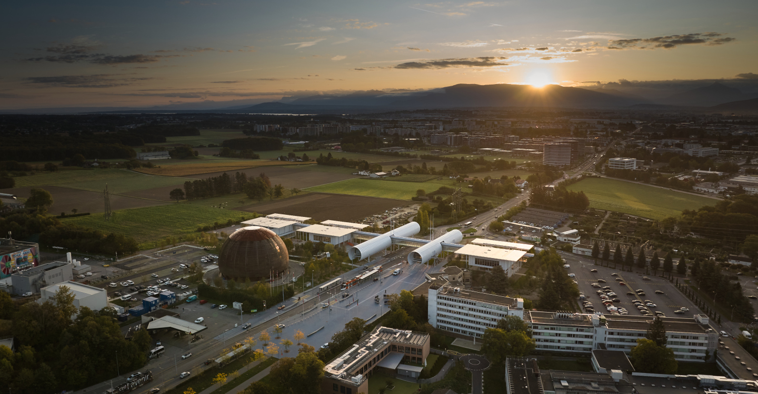
TE Department Technical Meetings
Introduction
to new format
Monday, 22nd April 2024
Credit: CERN-PHOTO-202310-230-4

Slide 2
Introduction
Welcome to the 210th TE Technical Meeting!
We adopted a new format, driven by the will to refresh this series of meetings to foster participation and interaction.
We have opened the invitation (and Indico page) also to fellows, graduates, and doctoral students
Meetings to be held exclusively in-person
Representatives of each TE group in the committee
Allocated more time for discussions

Slide 3
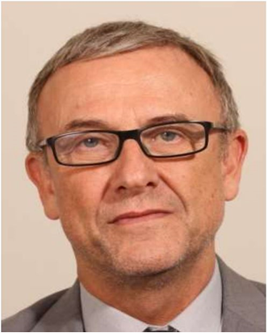

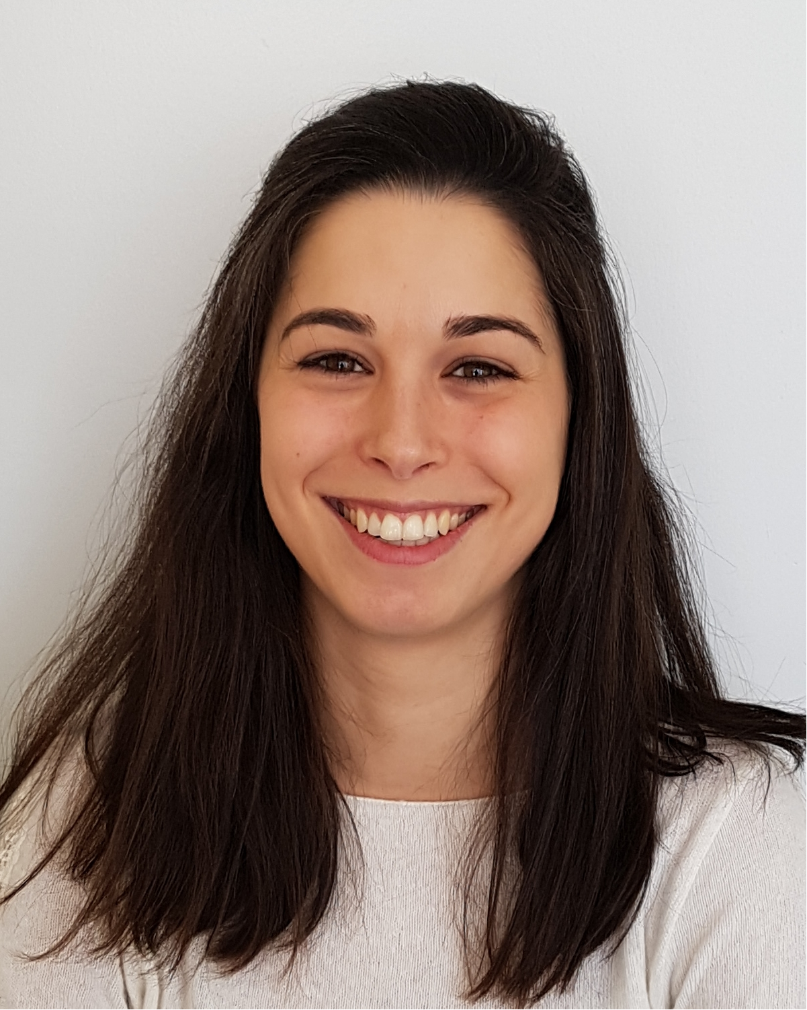
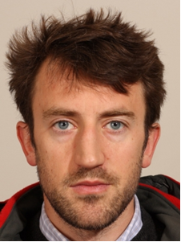
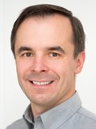
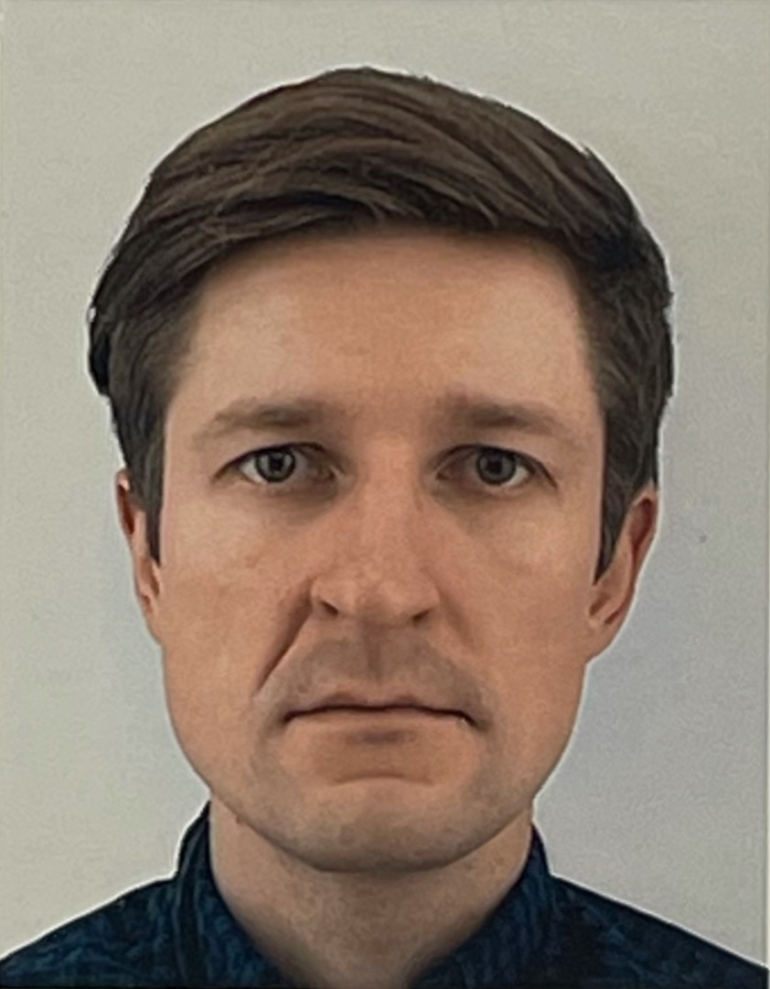
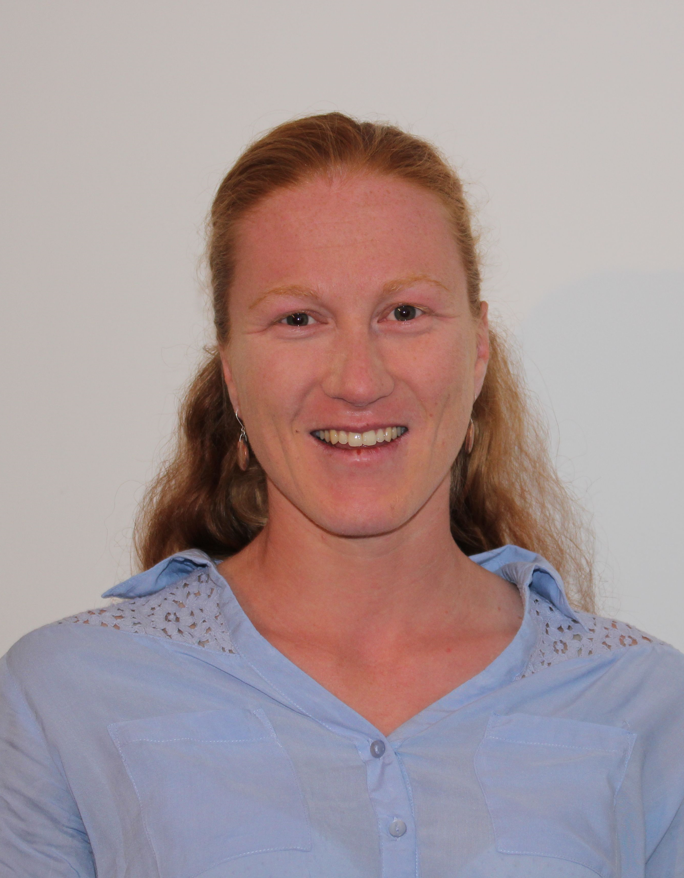
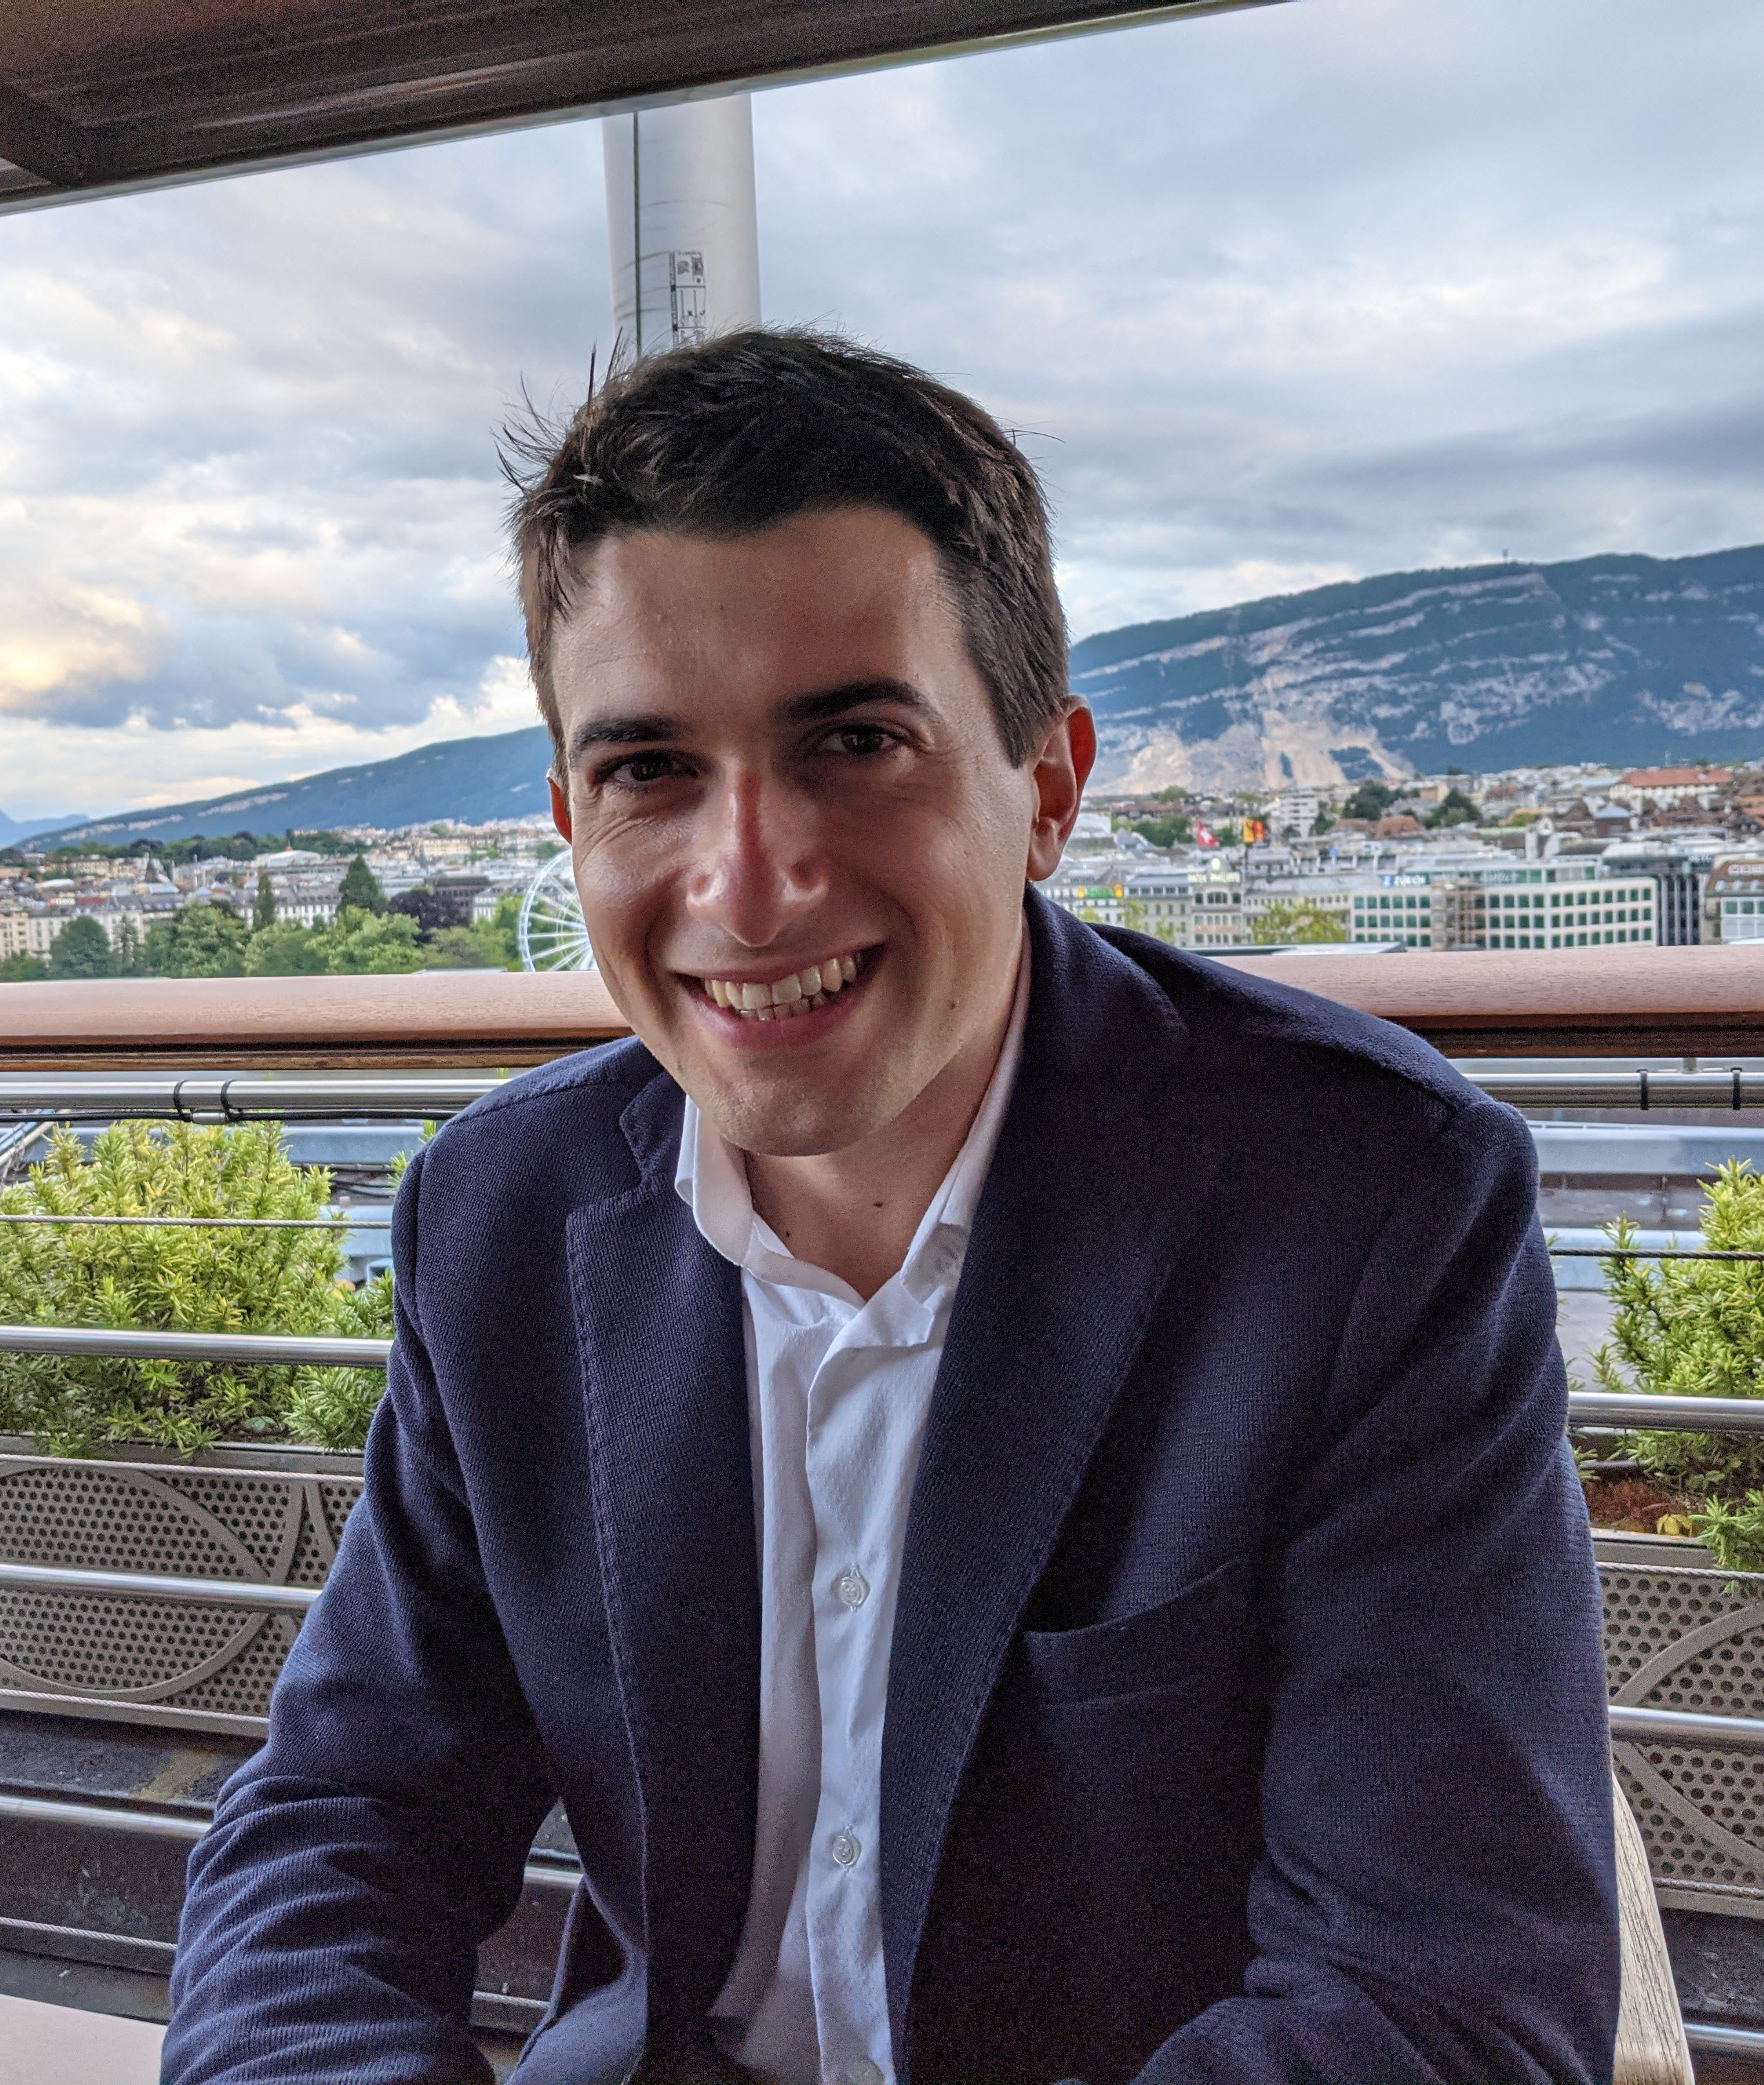
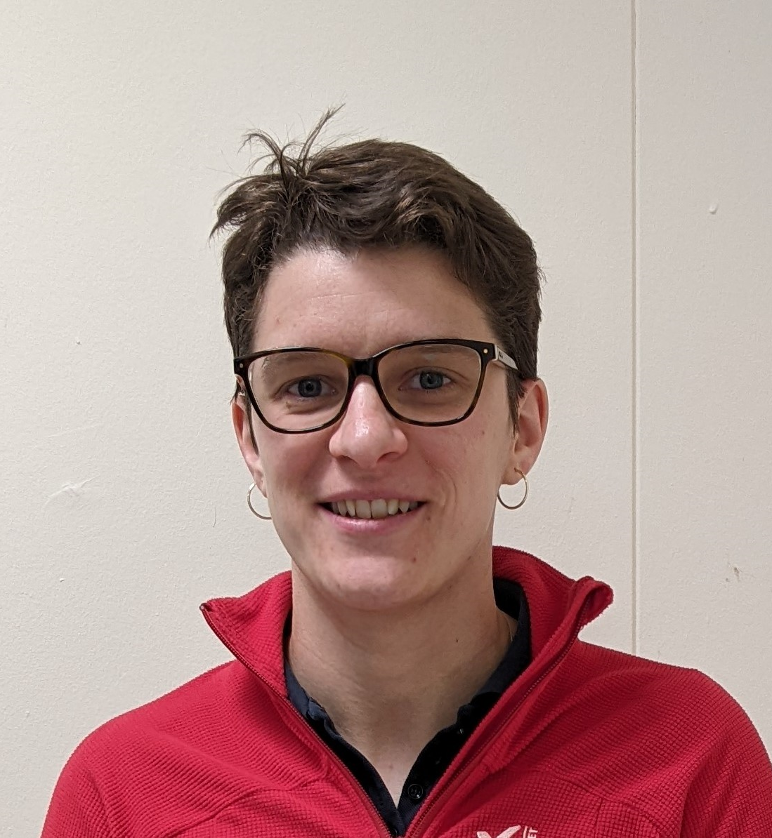
TE-TM Program Committee
Chair:
Arnaud Devred
Laurent Delprat
Patricia
Borges de Sousa
Cedric Hernalsteens
Mariusz Wozniak
Algirdas Baskys
Lucie Baudin
Marco Morrone
Valentine Petit
TE/CRG
TE/MPE
TE/MSC
TE/VSC

Slide 4
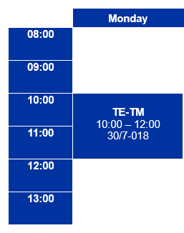






Practical information
When: | Monday 10:00 to 12:00
Where: | 30/7-018 Kjell Johnsen Auditorium
How often: | once a month – “save the date” will be sent for dates up to summer
Who takes part: | Scientific & Engineering staff, graduates, doctoral students
Indico page: | Technical Meeting · Indico (cern.ch) Agenda, links to the materials stored in EDMS
Contact: | TE-TM-ProgramCommittee@cern.ch
save
the date!

Slide 5
New structure
Operations
1-2 talks per TE-TM (15’ + 5’)
Status updates and lessons learned from both LHC and non-LHC operation
Engagements
1-2 talks per TE-TM (30’ + 5’)
Showcase projects that TE is directly involved with that might be transversal to several groups
Mini-workshops
Full morning, once per trimester
Technology-oriented ‘mini-retreats’ on topics that are common to all groups within TE and that can benefit from a forum where knowledge can be shared
Issue-oriented
Special focus on collaborations with external partners
Should be the platform where future developments get proposed, accepted, organised

Slide 6
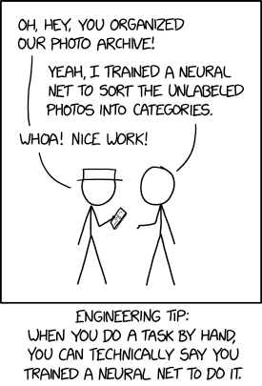
Mini-workshops
When: | 1st workshop planned for mid-September
Topic: | Artificial Intelligence (AI) and Machine Learning (ML), and its applications within TE
Speakers: | to be confirmed, suggestions for talks/speakers are welcome!
https://xkcd.com/2173/

Slide 7
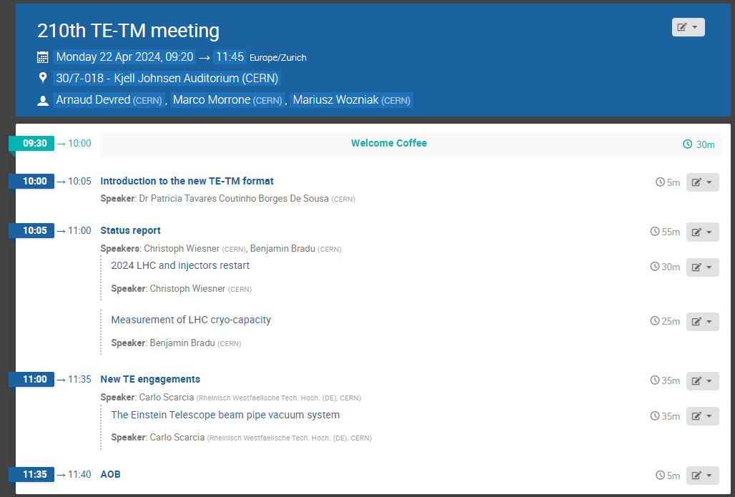
Today’s agenda

Slide 8
Thank you for your participation!

