Slide 1



A3D3 Postbac: Multimodal Classification of Astronomical Transients
By Alexandra Junell

Slide 2
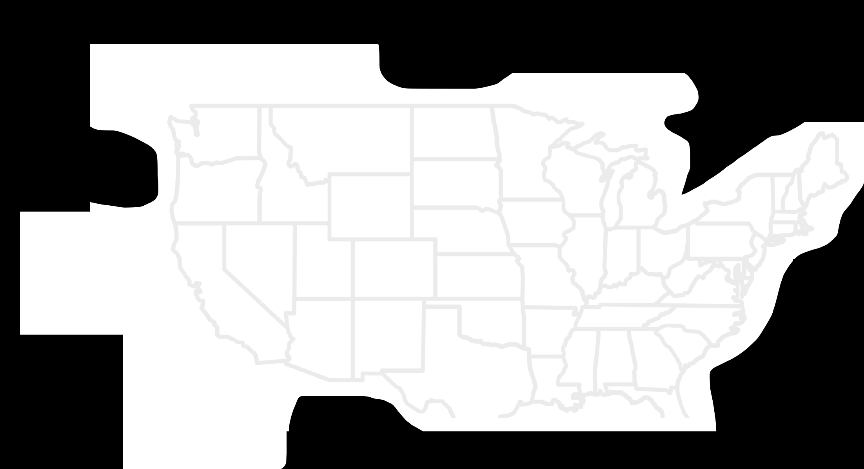
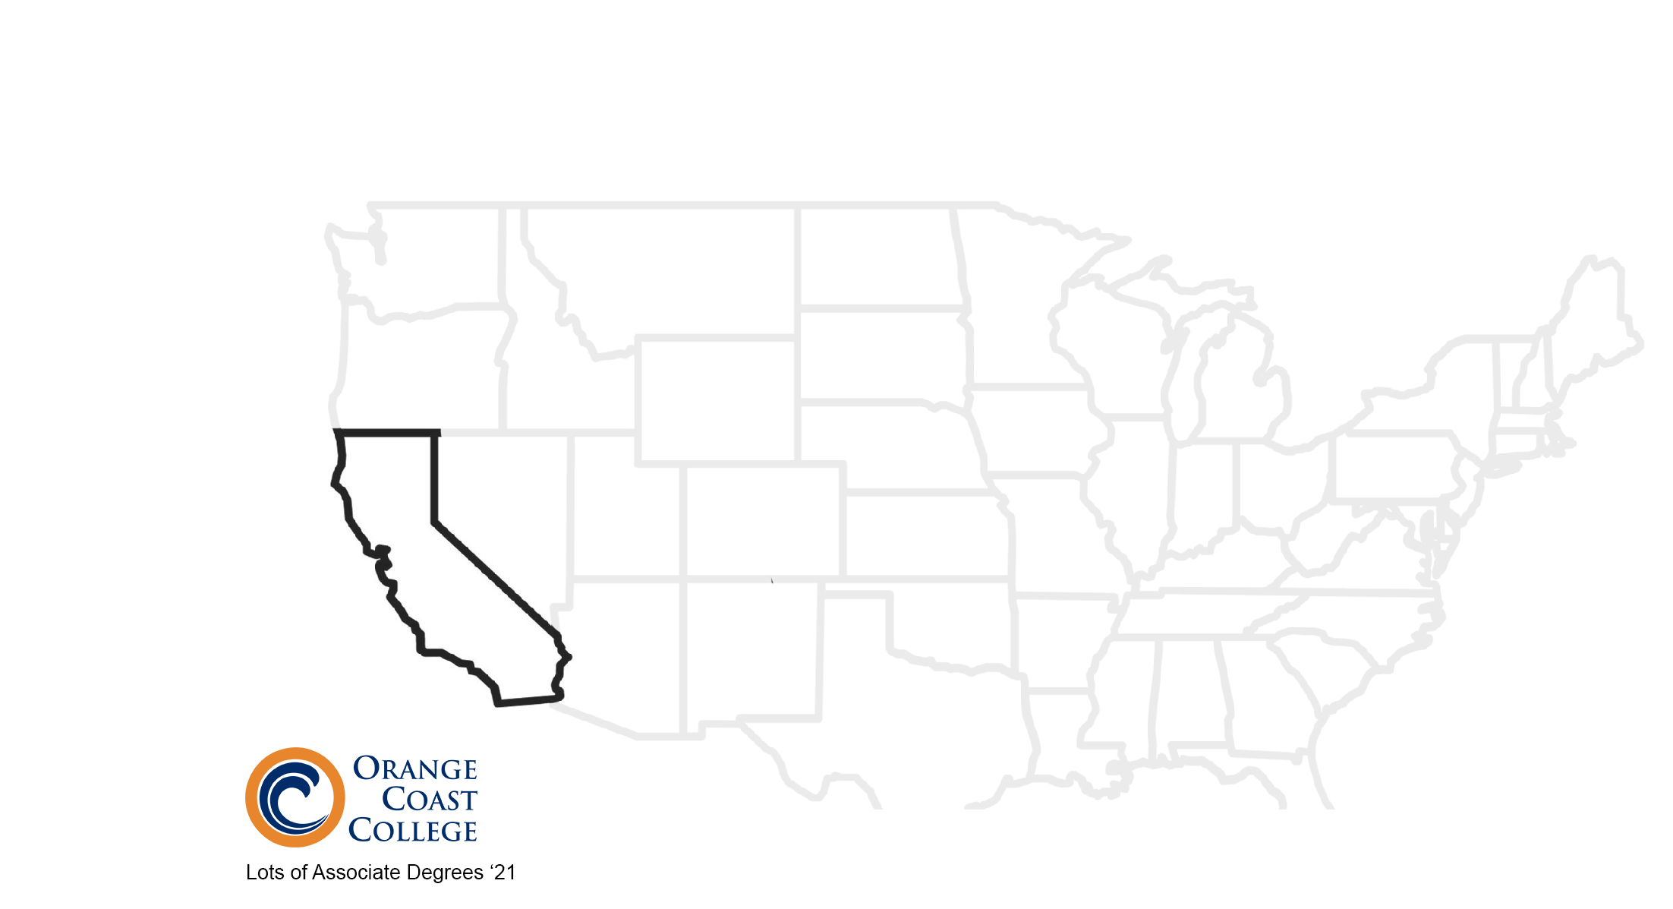
Road Trip with AJ

Slide 3
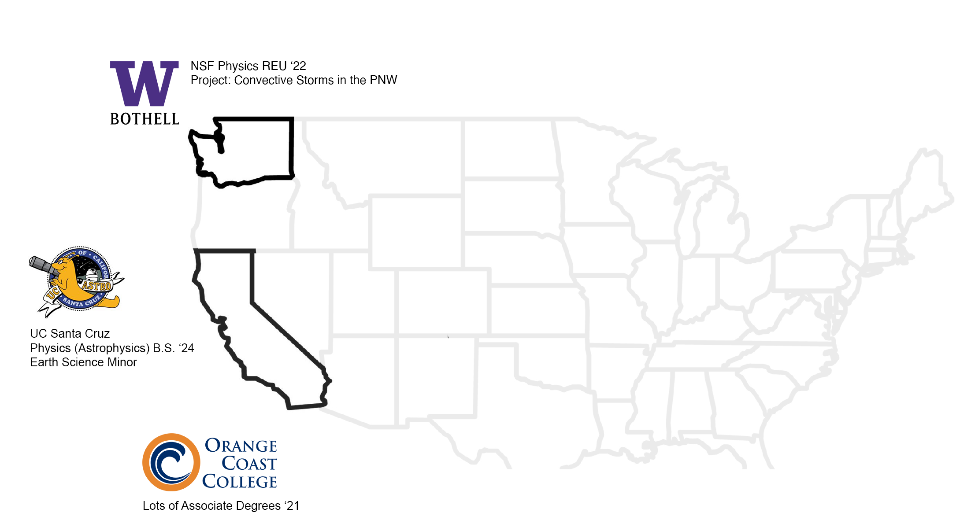
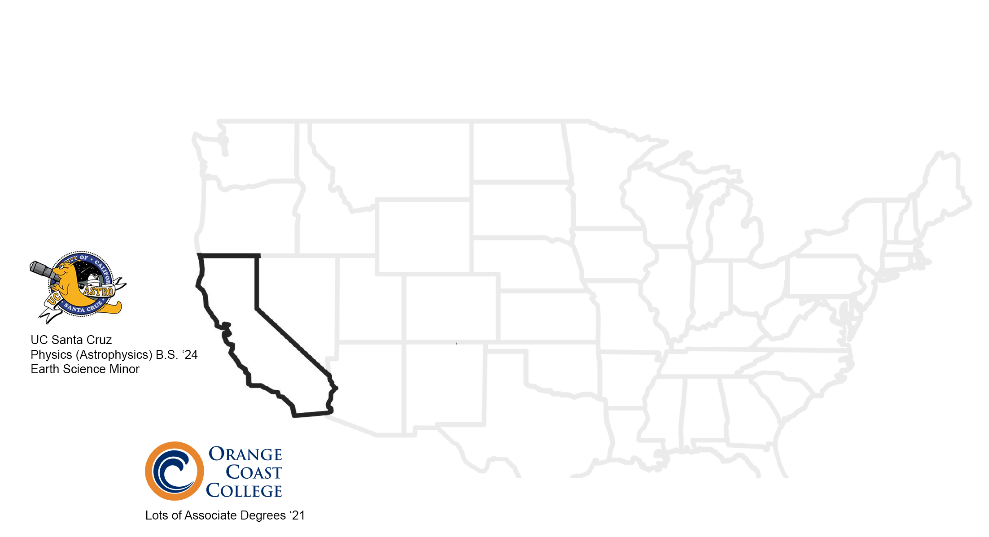
Road Trip with AJ

Slide 4
Road Trip with AJ

Slide 5
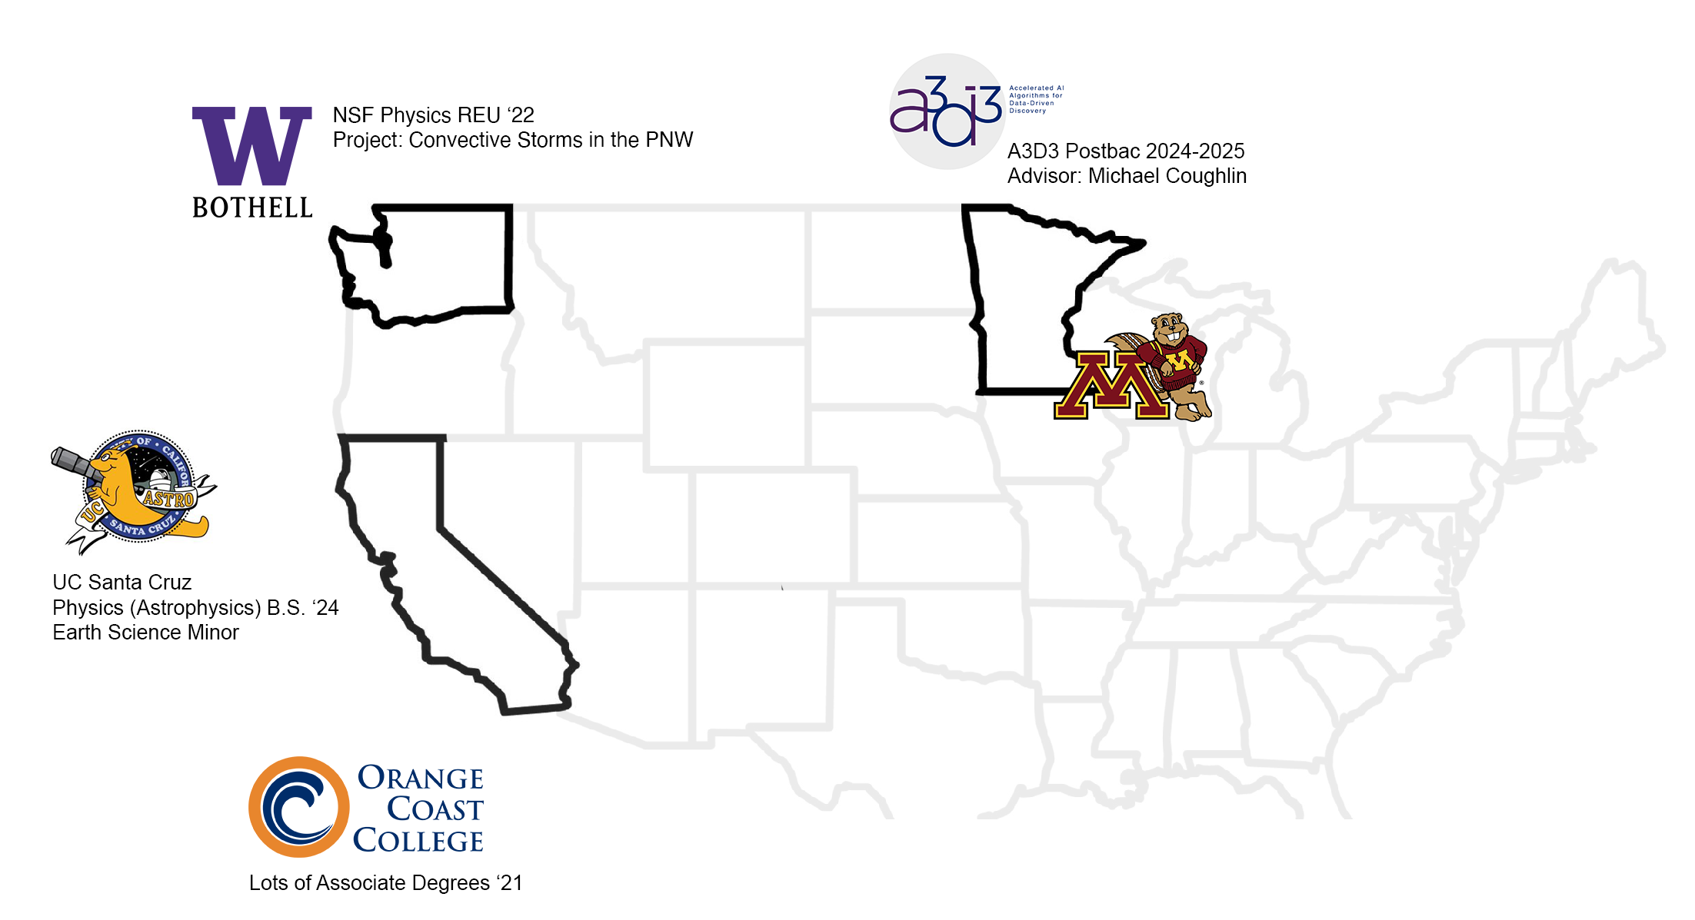
Road Trip with AJ

Slide 6
Scientific Goal: build a multimodal model capable of classifying astronomical transients from the Zwicky Transient Facility (ZTF) Survey as supernova or non-supernova, based on photometric data, image time series data, and metadata

Slide 7
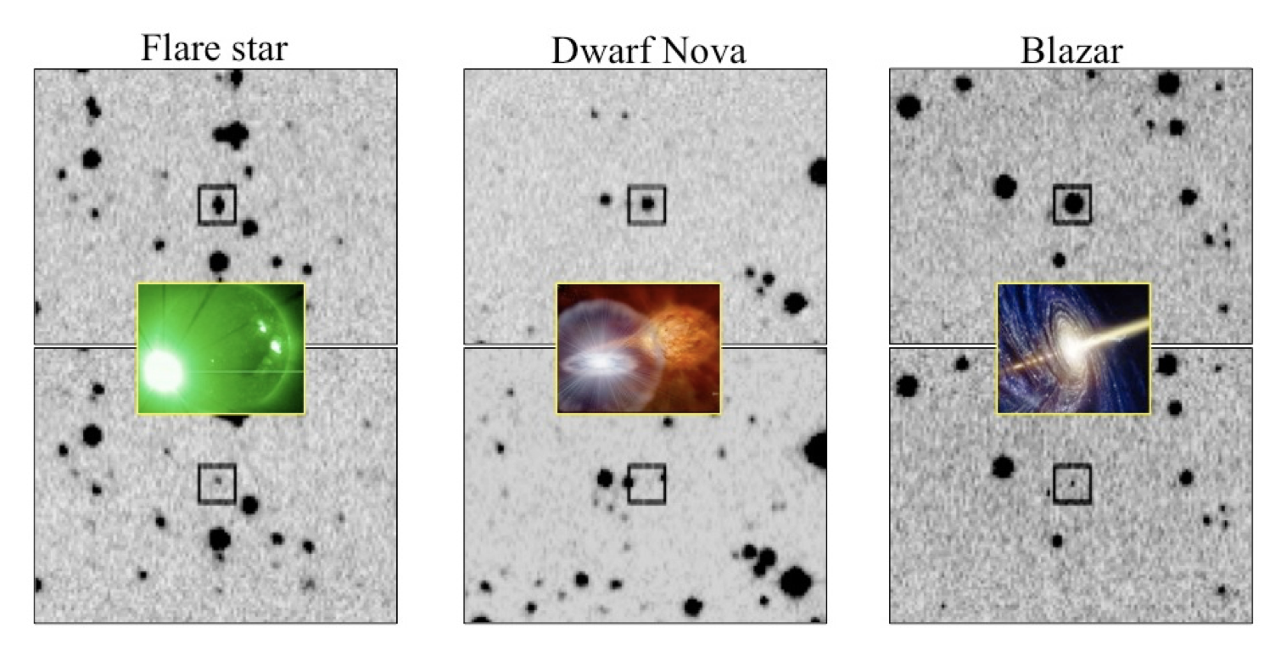
Background
Astronomical Transients: objects that temporarily change in brightness
  Supernova, tidal disruption events, variables stars
  Timescales range from seconds to years
Why do we care about transients?
  SN Ia – standard candle
  Optical counterparts of gravitational waves
Fig: Transients from the Catalina Real-time Transient Survey (Djorgovski et al. 2012)
Reference: Djorgovski et al 2012 DOI 10.1109/eScience.20216404437

Slide 8
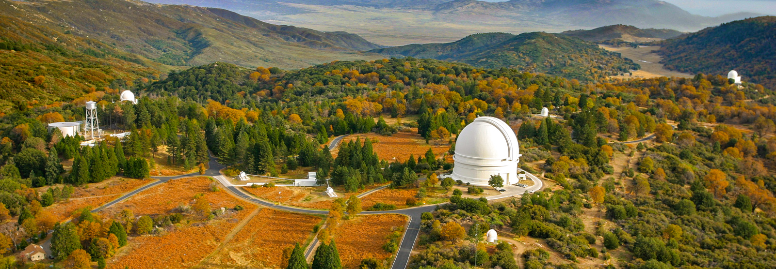
Scientific Motivation
Astronomy has a data “problem”
  ZTF can trigger hundreds of thousands of alerts a night
  Upcoming Legacy Survey of Space and Time (LSST) expects millions of alerts a night
Early classification is critical
  Identify unique candidates
  Informs follow-up observations
Classifiers using astronomical image time series (Bairouk et al. 2023), photometric time series data (Revsbech et al. 2017, Boone 2019, Allam et al. 2024) have shown success
Image Source: https://www.ztf.caltech.edu/

Slide 9
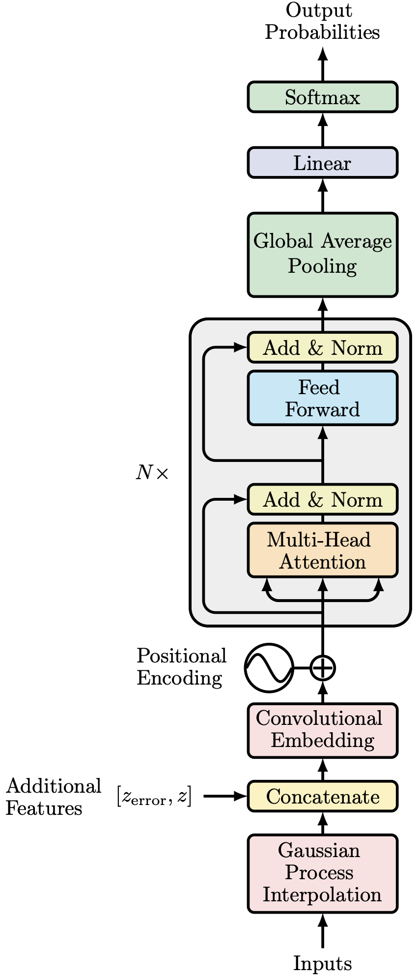
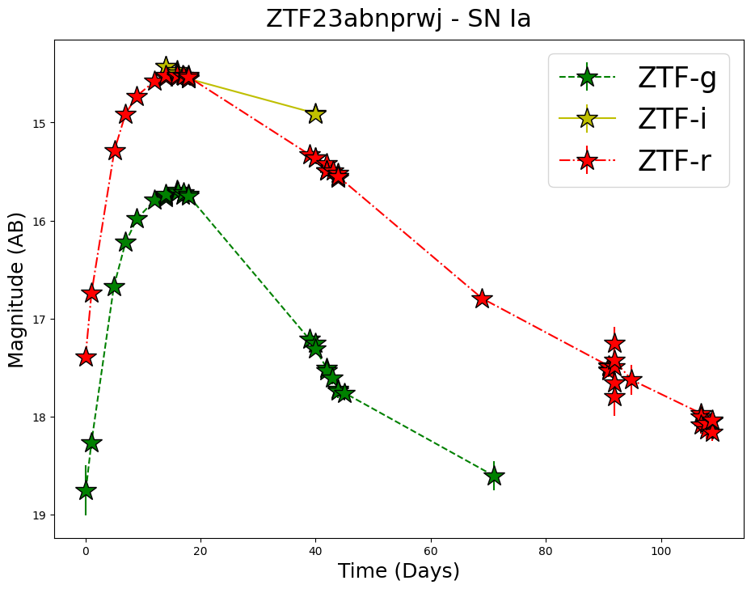
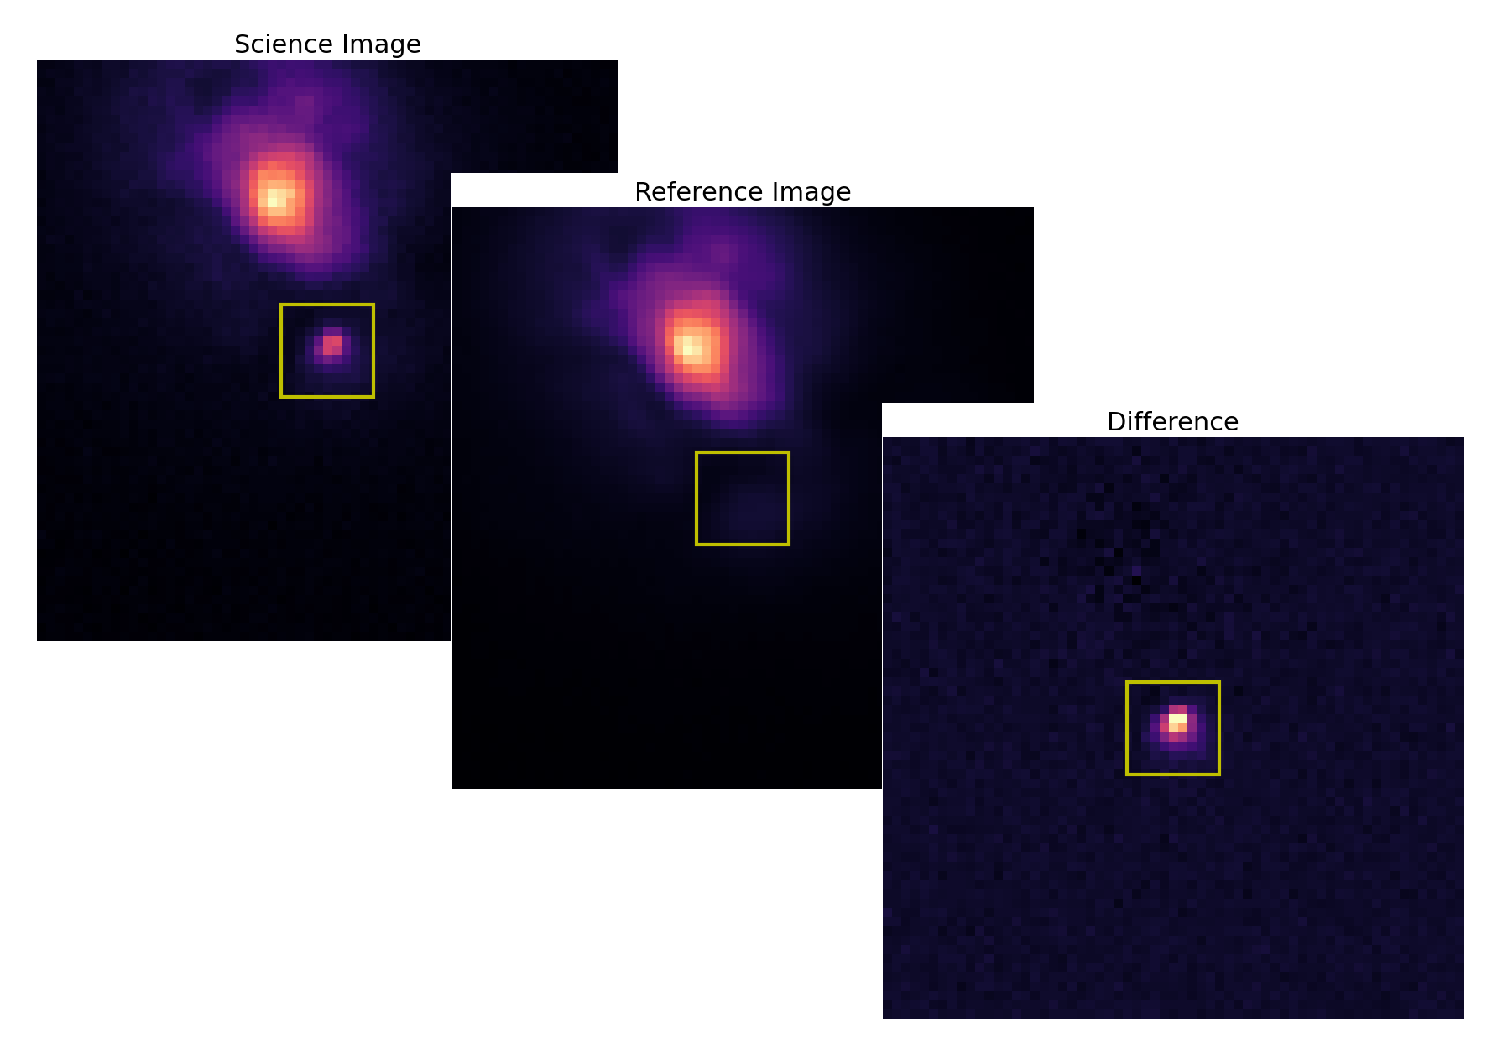
Model
Basis: time-series transformer with multihead attention from Allam et al. 2024
  Gaussian Process interpolation of raw time series photometric data
Images, additional metadata added to the model
Reference: Allam et al. 2024 DOI 10.1093/rasti/rzad046, github.com/tallamjr/astronet

Slide 10
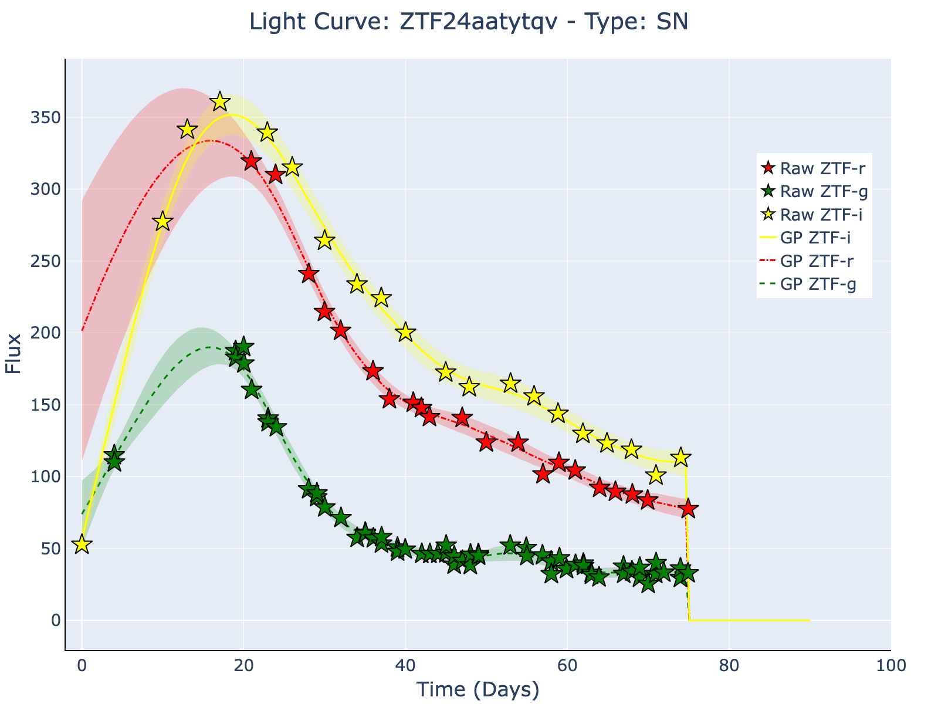
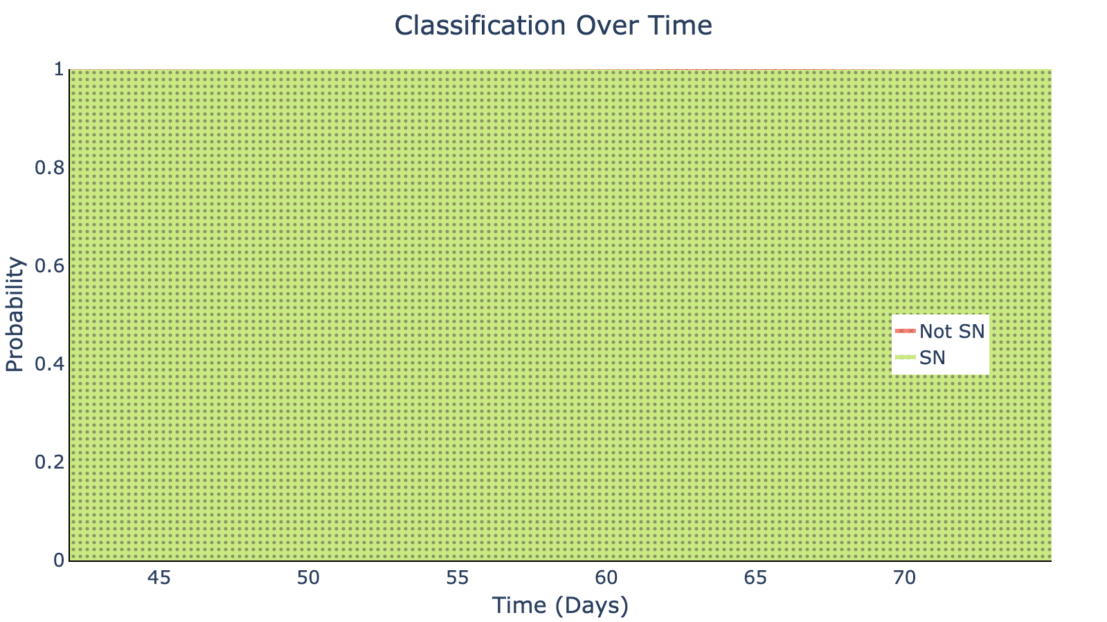
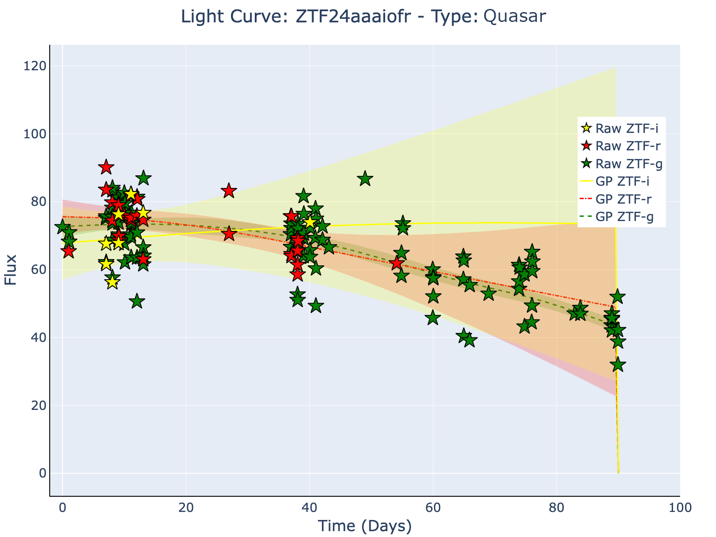
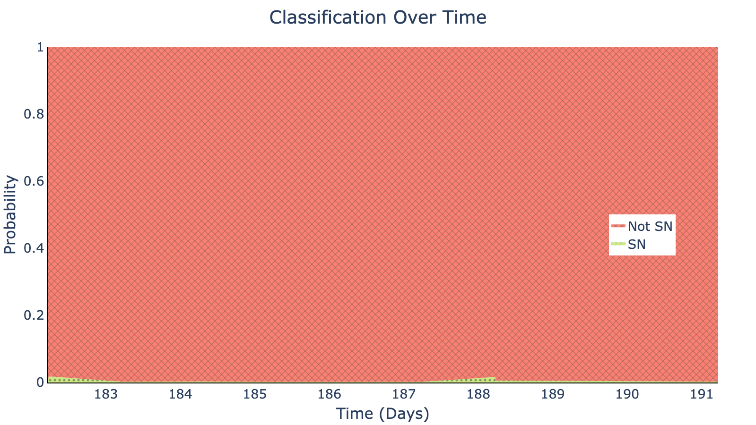
Results
Supernova:
Non-Supernova:

Slide 11
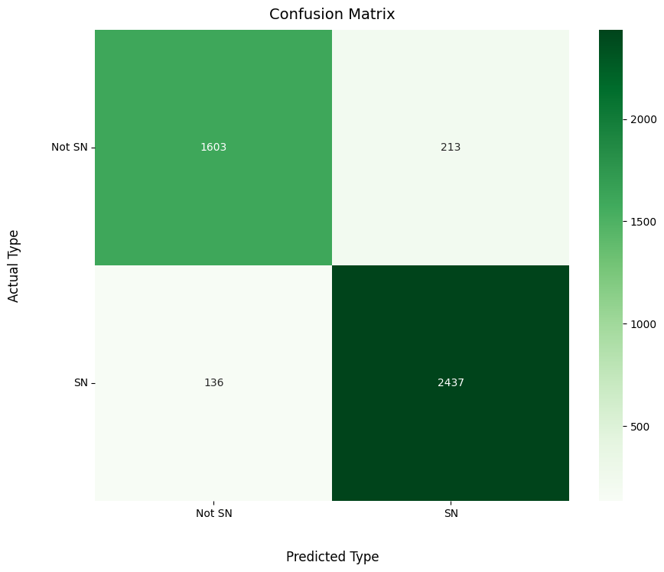
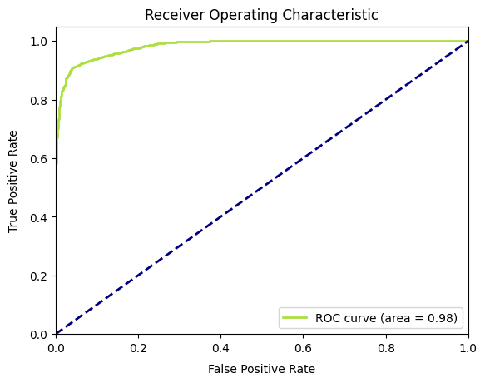
Results

Slide 12
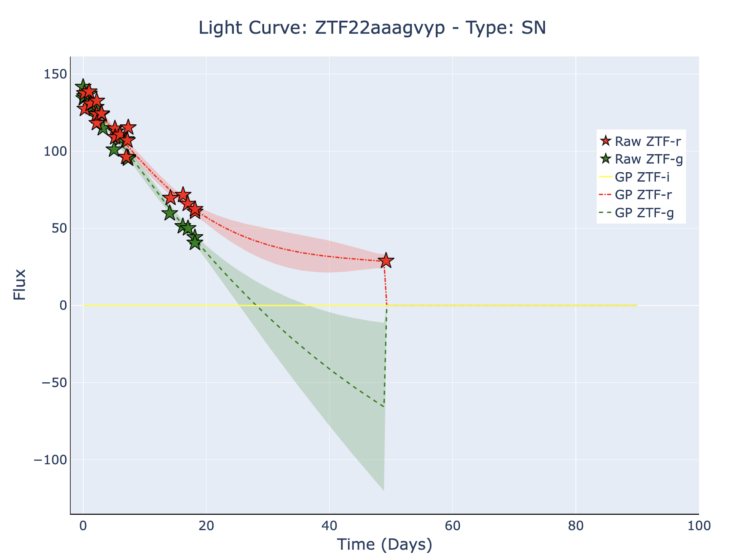
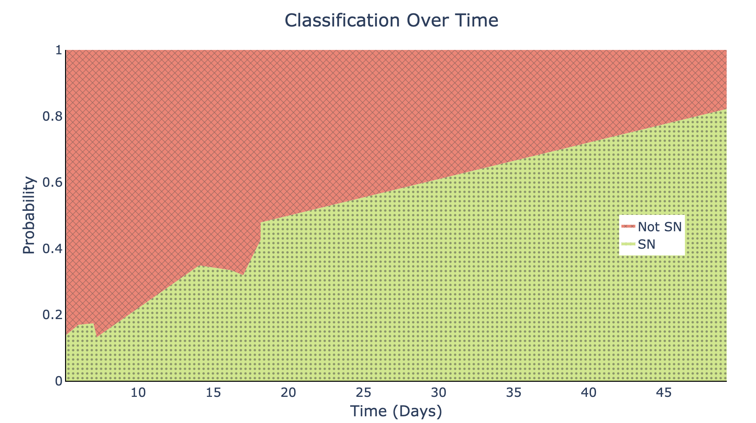
Future Work
Improve final predictions of model
  Ex: ZTF22aaagvyp final prediction was Not SN
Classify non-SN transients:
  Tidal disruption events, active galactic nuclei, stellar variables, etc
Incorporate spectral data into model
Refine model to make early time classifications

Slide 13
References
Djorgovski et al 2012 DOI 10.1109/eScience.20216404437
Revsbech, et al. DOI 10.1093/mnras/stx2570 (2017)
Boone DOI 10.3847/1538-3881/ab5182 (2019)
Ivezić, et al. DOI 10.3847/1538-4357/ab042c (2019)
Bellm, et al. DOI 10.1088/1538-3873/aaecbe (2019)
Masci, et al. DOI 10.1088/1538-3873/aae8ac (2019)
Mahabal, et al. DOI 10.1088/1538-3873/aaf3fa (2019)
Bairouk DOI 10.1051/0004-6361/202244657 (2023)
Allam, et al. DOI 10.1093/rasti/rzad046 (2024)
Ahumada, et al. arXiv:2405.12403
Rehemtulla, et al. 10.3847/1538-4357/ad5666 (2024)

Slide 14

Questions?
(You can also come talk to me at my poster presentation later today!)

