Slide 1



Distribution Shifts and Graph Domain Adaptation
Pan Li
ECE at Georgia Tech
Affiliated to CSE at Georgia Tech and CS at Purdue
Talk at A3D3 All handing meeting on 10/14/2024
Notes:
Good morning, everyone.
Thanks for the invitaiton
Today, I would like to introduce our recent work that studies distribution shift problem in graph machine learning.
I pick this topic because the motivation for us to study this problem comes from our collaborative project in A3D3.
Now let me get started.

Slide 2








Shikun Liu¹ Tianchun Li² Yongbin Feng³ Nhan Tran³ Han Zhao⁴ Qiu Qiang²
¹ Gatech ² Purdue ³ FermiLab ⁴ UIUC
Liu, Shikun, et al. "Structural re-weighting improves graph domain adaptation." ICML. 2023.
Liu, Shikun, et al., “Pairwise Alignment Improves Graph Domain Adaptation,” ICML 2024.
Notes:
These are my great collaborators.

Slide 3
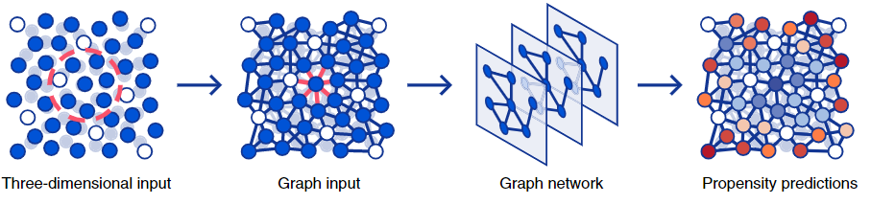
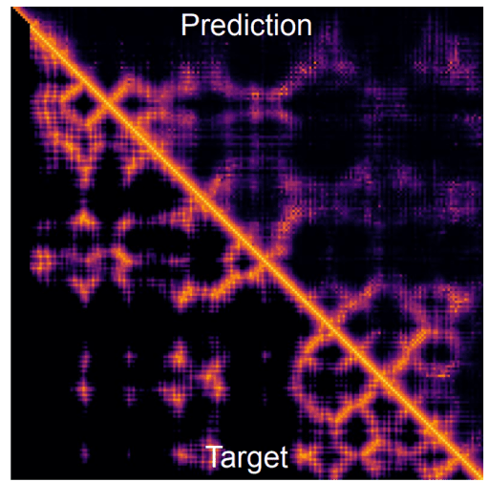
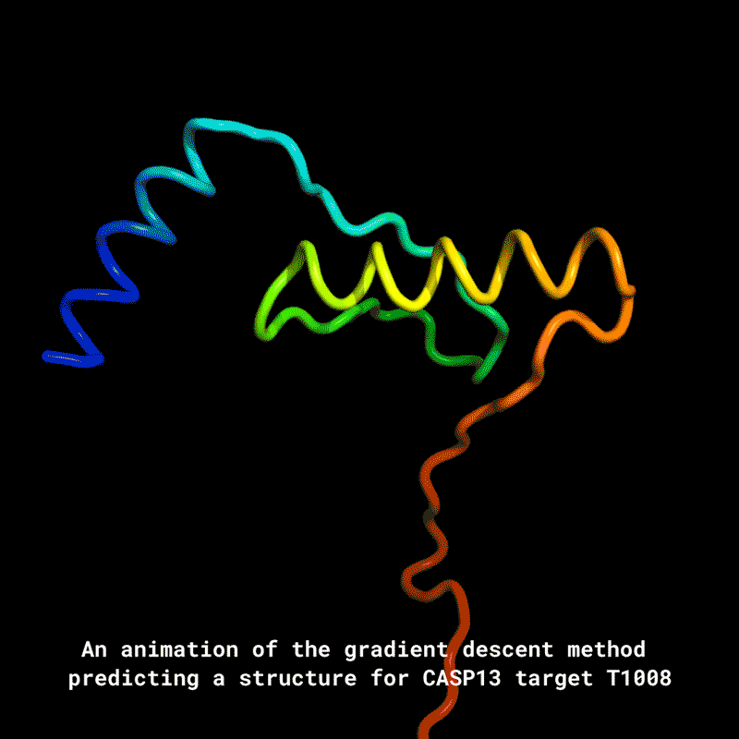
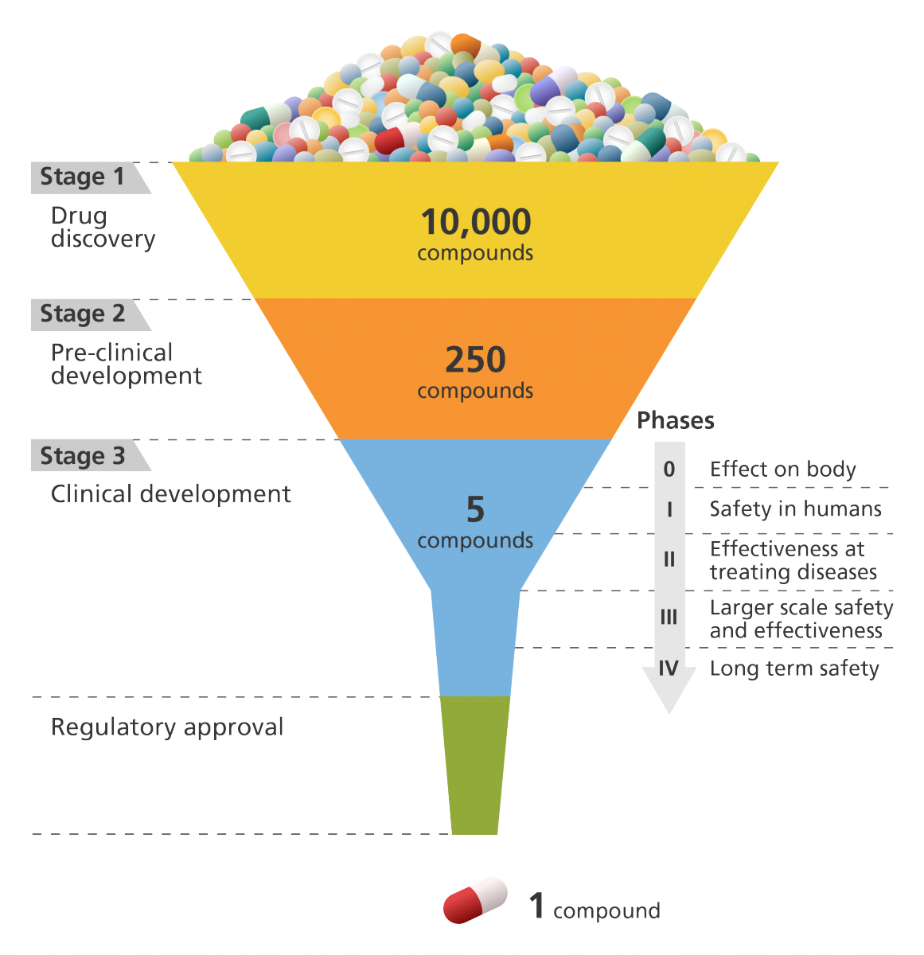
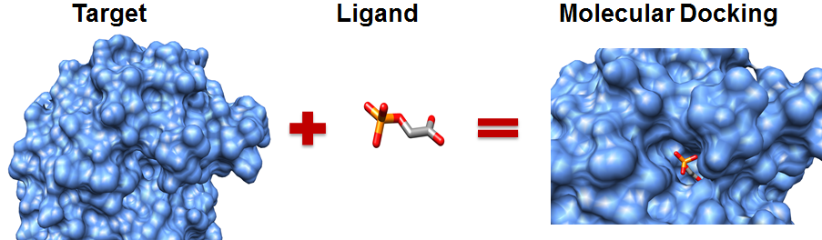
AI for Science with Graph and Geometric Data
– Learning the Representations of Particles, Materials, Proteins, RNAs
Simulation of glass dynamics
[Baspt et al, Nature Physics 2021]
Protein folding
[Senior et al., Nature 2019]
[Jumper et al., Nature 2021]
Drug Discovery
An illustration showing the different stages involved in developing a drug.
Image credit: Genome Research Limited
(Figure:Hernández-Santoyo et al. and Reiser et al.)
Notes:
We know that AI for science has recently attracted a lot of attention.
In scientific problems, data in many cases can are represented as graphs and with complex geometric features.
AI approaches are used to learn the representations of these data, which can be further leveraged to solve relevant prediction and inference tasks.
Examples includes such as to learn the molecule representations for molecular dynamic simulation, to learn the protein representations for protein folding and unfolding problems, so on and so forth.

Slide 4
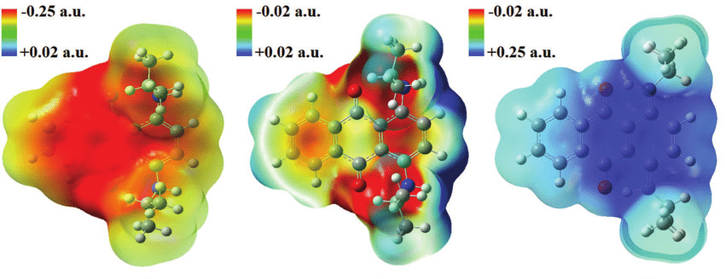
Challenges in Scientific Applications --- Distribution Shift
A common issue in science:
Model Training: Data from well-explored parameter regimes
Real-world Evaluation: Under-explored regimes of scientific interest
Data Distribution Shifts
In high energy physics, multi-messenger astronomy and many other areas:
Simulation data for training v.s. experiment data for evaluation
Simulation may not reflect the potential variation in actual experiments.
Notes:
Actually, a common issue when we are to apply AI methods in science is to deal with distribution shifts
Because in scientific applications, often the data we use for training the model comes from well-studied regimes, which may not align well with that from the regime we are interested in that is often under-explored.
In particular, for hep, and mma, we often have to rely on simulation data for model training and evaluate them in actual experiment.
Simulation often cannot cover all the variation in actual experiments.
So, the model trained based on simulation may encounter distribution shifts in data.

Slide 5
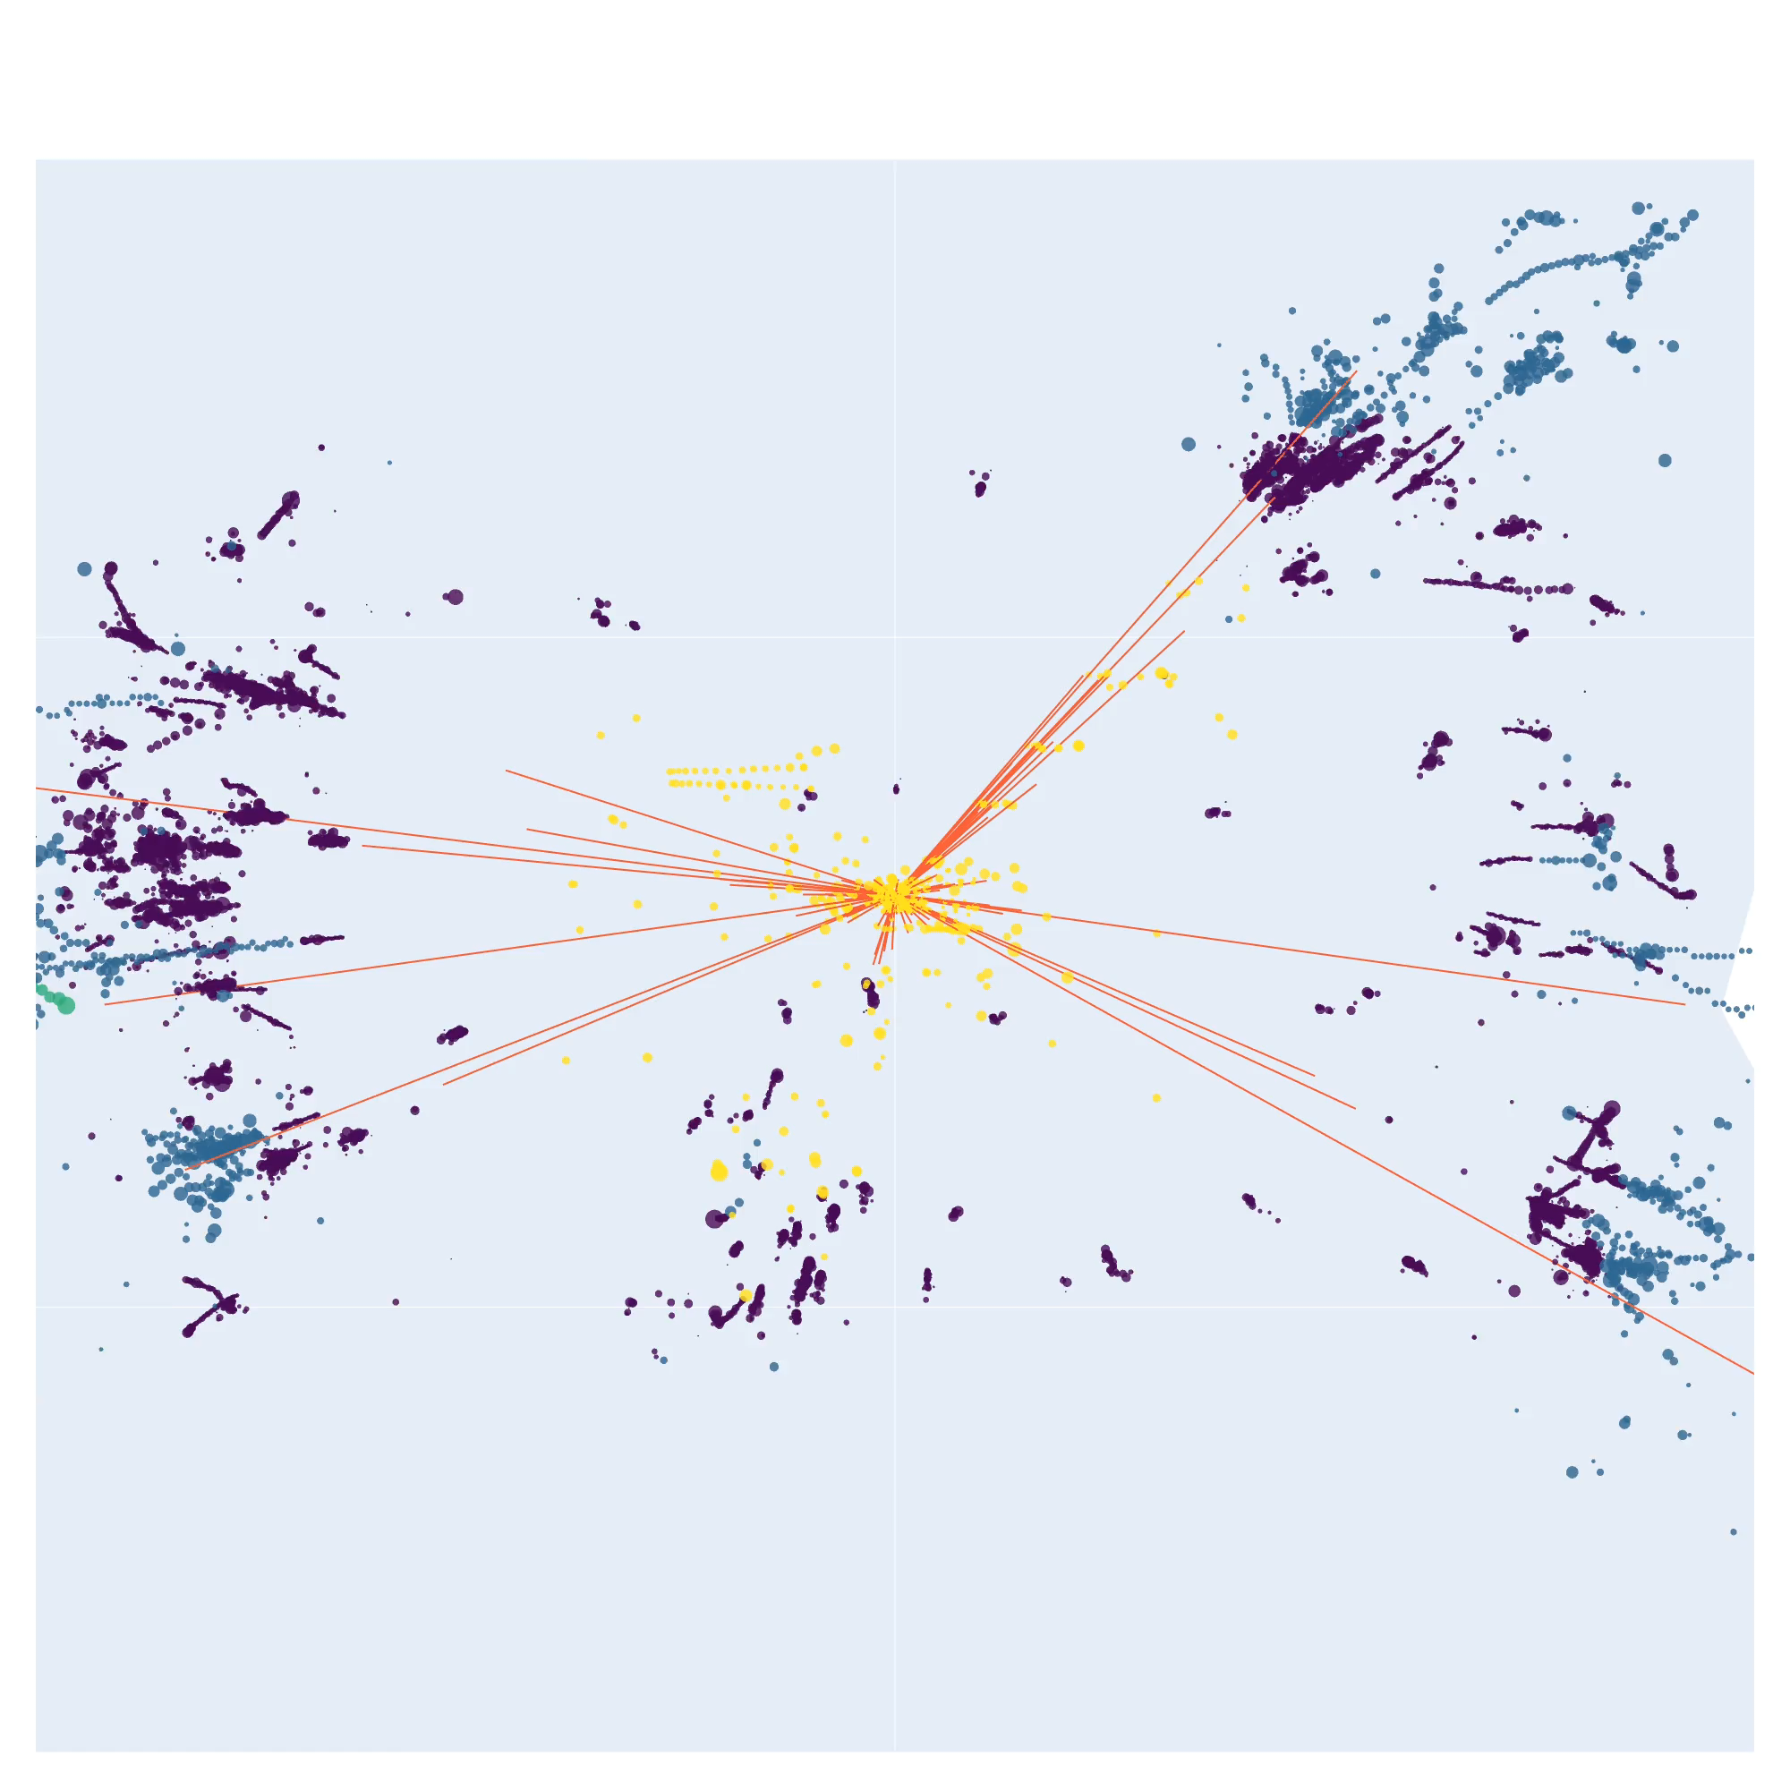
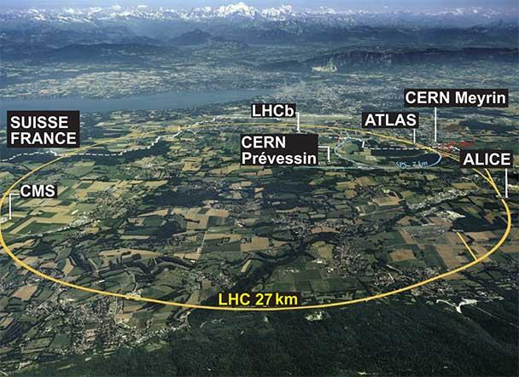
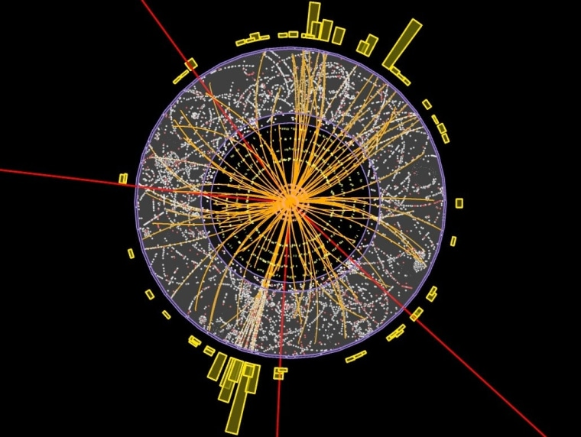
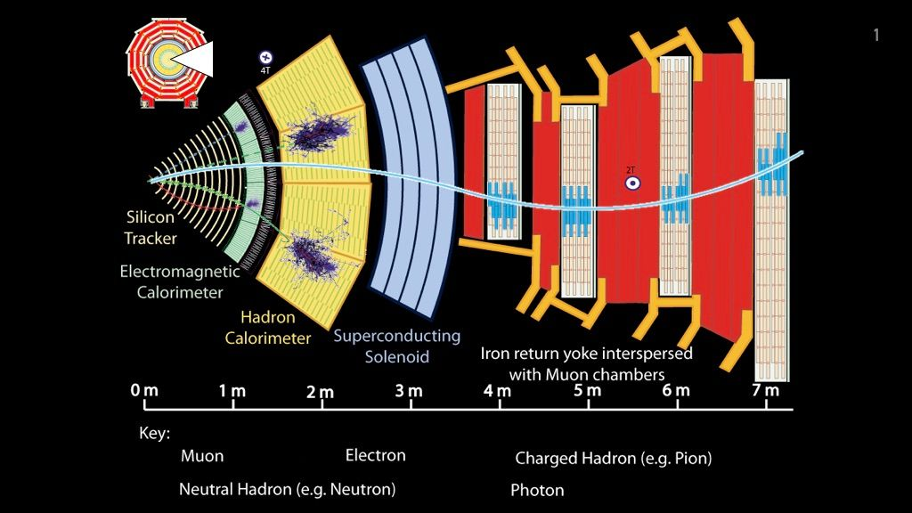
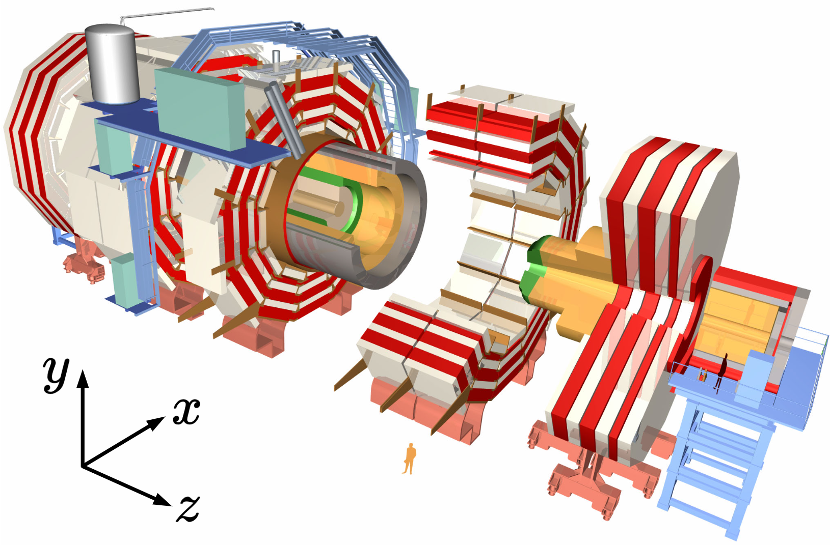
Graph and Geometric Machine Learning in HEP
Large Hadron Collider Experiments
Graph construction:
geometric proximity + relationship between hits and detectors
--- detector layers
Graph neural networks in particle physics, Shlomi et al., MLST, 2020
Graph neural networks at the Large Hadron Collider, DeZoort et al., Nature Physics Review, 2023
Notes:
As I am now working on some collaborative projects on AI for high energy physics, let us use an example in high energy physics to illustrate the distribution shifts.
The primary applications of AI in high energy physics is to process the date in the large hadron collider experiments.
Specifically, in these experiments, when we have particle collision, new particles may be generated in the collision and decay in the scattering process.
When generated these particles pass through the detectors, they may leave signals on the detectors.
The signals can be represented as point cloud as illustrated in the picture. .

Slide 6
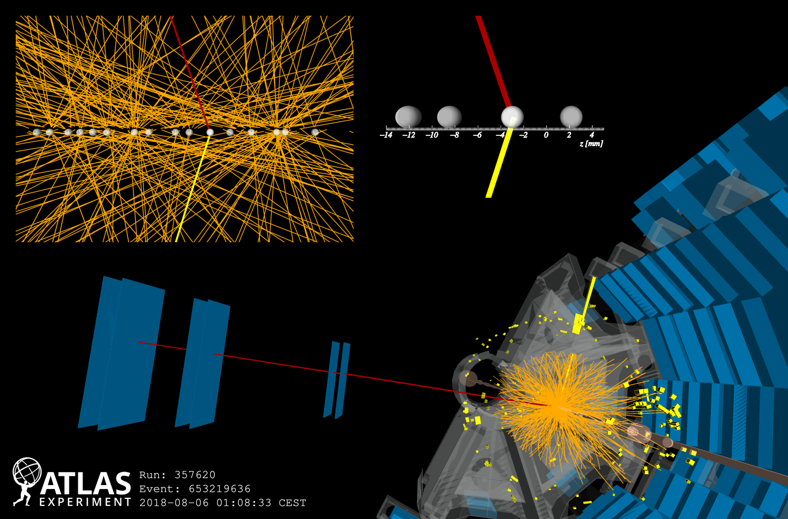
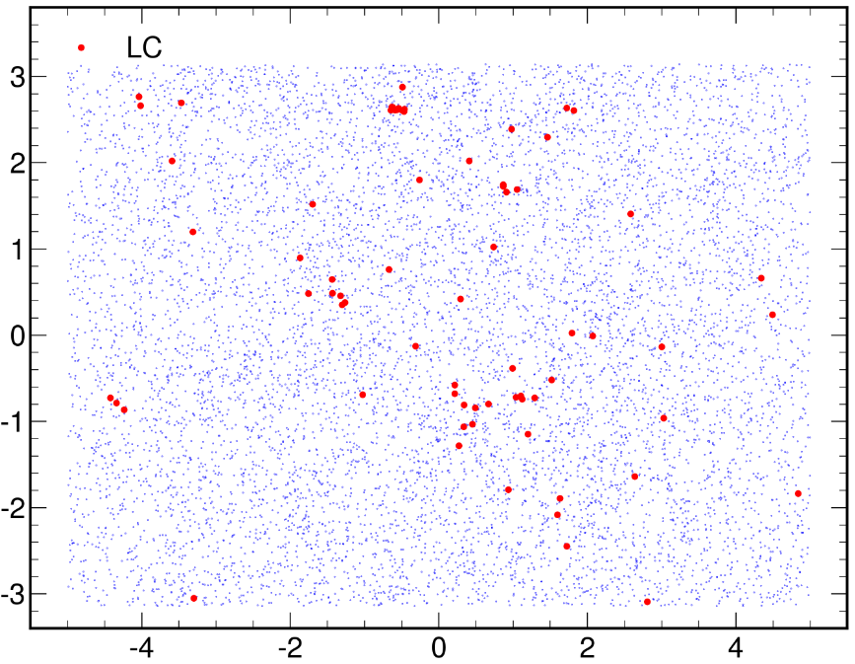
Pileup Mitigation and Distribution Shifts
Leading Collision (LC)
Leading Collision (LC)
Pileup (PU)
Pileup (PU)
Pileup Mitigation:
  Noise for downstream analysis
Leading Collision v.s. Pileup to be identified (a node classification task)
Notes:
In HEP data, one important type of distribution shifts is pileup shift.
What is pileup?
Actually, in each collision event, often the leading collision with the highest energy is what we need.
While in the same time, there could be other collisions happening around the leading collision. We call them as pileups.
A data example is shown here.
In this 2-d projection of the particle hits, particles from leading collision and pileup are shown in red and blue respectively.
One of the important data processing steps in HEP is to mitigate pileups
That is, we aim to identify the particle hits from these pileups and aim to remove them.

Slide 7
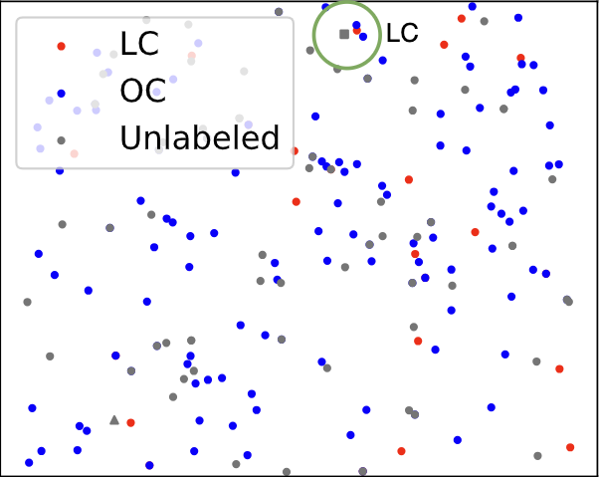
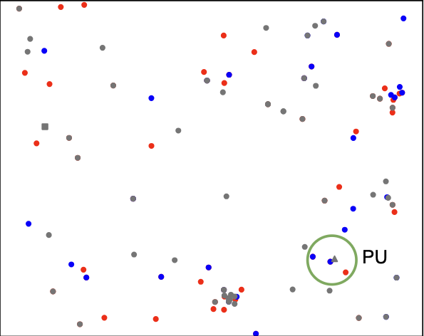
Pileup Mitigation and Distribution Shifts
Leading Collision (LC)
Leading Collision (LC)
Pileup (PU)
Pileup (PU)
PUU
Pileup levels
Pileup Mitigation:
Training Data
Training Data
  Noise for downstream analysis
PU level = 30
PU level = 10
Leading Collision v.s. Pileup to be identified (a node classification task)
Pileup shifts:
Pileup levels (# pileup collisions) may shift in real-world experiments
Notes:
Pileup level means the expected number of pileup collisions that happens in an event.
Pileup levels may shift from the dataset used for training and in actual experiments.
.Here is an example that shows the data we may have when there is a shift in the pileup level.
You may see the difference in the density of pileups.

Slide 8
Pileup Mitigation and Distribution Shifts
Leading Collision (LC)
Leading Collision (LC)
Pileup (PU)
Pileup (PU)
PUU
Using features of nearby particles to identify the labels
Training Data
PU level = 30
PU level = 10
Effective pileup mitigation algorithms need to leverage the dependence between the particles.
Such a dependence (non-IID) is shifted!
Bertolini et al., “Pileup Per Particle Identification,” JHEP 2014
Li et al., “Semi-supervised Graph Neural Networks for Pileup Noise Removal”, EPJC, 2023
Notes:
Why is handling the pileup shifts challenging?
Actually, when processing HEP data, using pileup mitigation as an example, we need to use not only the features on one particle hit but the features of the nearby particle hits to make predictions.
Traditionally, people adopted handcrafted features based on the nearby particle hits.
And recently, more advanced methods have been built upon graph neural networks.
However, the difficulty in handling distribution shifts in pileups is that the dependence between the particles violates the data independent assumption adopted by the existing approaches that can address distribution shifts.

Slide 9
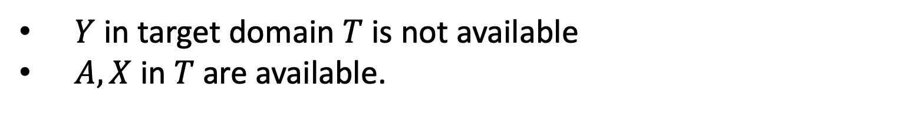
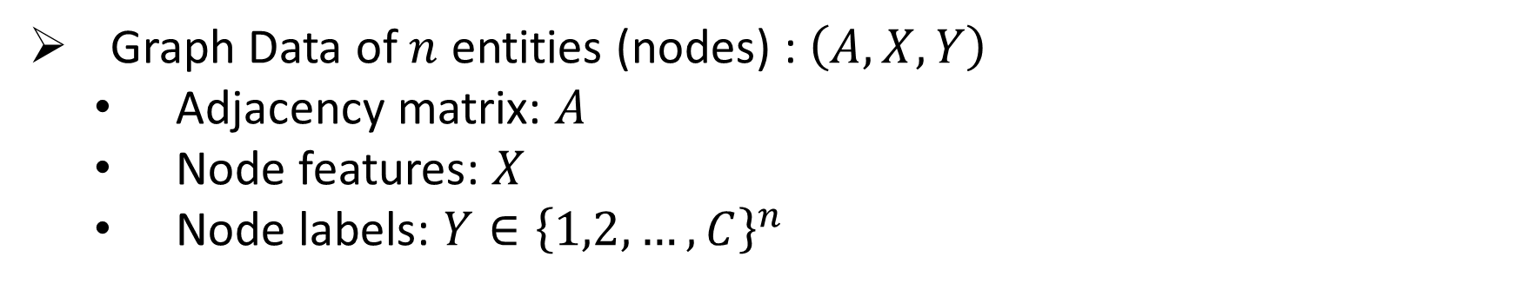
Graph (Non-IID) Modeling and Problem Formulation
Graph construction:
Nodes <-> Particle hits in HEP
Graph Data of $n$ entities (nodes) : $\left(A, X, Y\right)$
  Adjacency matrix: $A$
  Node features: $X$
  Node labels: $Y∈{\left\{1,2,…,C\right\}}^{n}$
geometric proximity + relationship between hits and detectors
--- detector layers
Node classification tasks
Two domains
$$ℙ_{S}\left(A, X, Y\right)≠ℙ_{T}\left(A, X, Y\right)$$
Source domain $S$ with distribution $ℙ_{S}\left(A, X, Y\right)$--- for training
Target domain $T$ with distribution $ℙ_{T}\left(A, X, Y\right)$--- for test
$Y$ in target domain $T$ is not available
$A, X$ in $T$are available.
Domain Adaptation
Notes:
Next, let me formalize the problem.
Here come the graph modeling.
Specifically, we view particle hits as nodes in the graph.
And connect two nodes if their particle hits are close to each other.
Each particle hit also has some features such as particle type, momentum, etc.
Then, Pileup shifts can be modeled as the shifts in graph structures.
Mathematically, we use Ps and Pt to denote the data distribution used for training and for test, respectively.
They are different.
Suppose we know the unlabeled target/test domain data and aim that the model can be generalized to the test domain.
This is called domain adaptation.

Slide 10
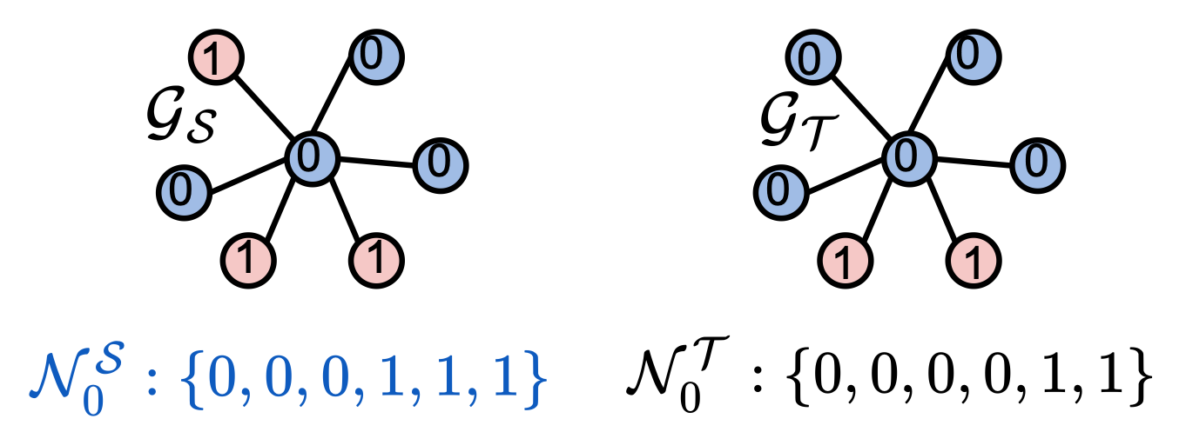
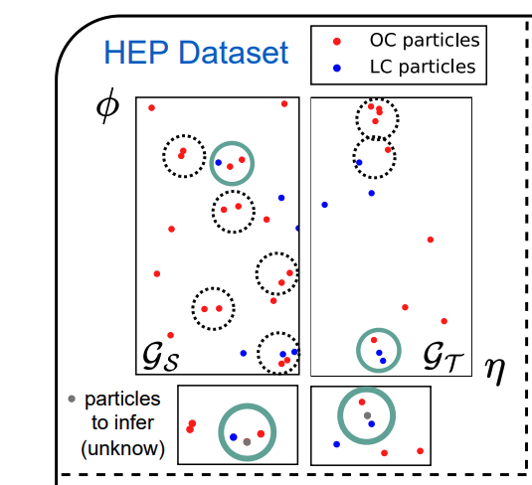
Decomposition of The Shift
$$ℙ_{S}\left(A, X, Y\right)≠ℙ_{T}\left(A, X, Y\right)$$
PU
In PU/LC particles’ neighborhoods, #PU/LC particle may change
PU vs. LC portion different
Particle features change
Structure shift
$$ℙ_{S}\left(A|Y\right)≠ℙ_{T}\left(A|Y\right)$$
$$ℙ_{S}\left(A,Y\right)≠ℙ_{T}\left(A,Y\right)$$
$$ℙ_{S}\left(Y\right)≠ℙ_{T}\left(Y\right)$$
Feature shift
PU level = 30 vs. PU level = 10
$$ℙ_{S}\left(X|Y\right)≠ℙ_{T}\left(X|Y\right)$$
Circles denote the neighborhood in the constructed graphs
Notes:
To proceed, we would like to simplify the problem a bit.
We may decompose the distribution shift into two parts:
One part is related to the graph structure, named structure shift, which often presents as the shift of the connecting patterns between nodes.
For example, given a node from a certain class, the distributions of its labels may shift.
This is a type of structural shift
Another type of shift is irrelevant to the graph structure.
This describes the shift in node features.

Slide 11
New Challenges - The Mutual Dependence
Non-independent & unique to graph (mutually dependent) data
Structure shifts
$$ℙ_{S}\left(A,Y\right)≠ℙ_{T}\left(A,Y\right)$$
Need dedicated solutions
Can be handled by viewing each node independently via existing methods
Feature shift
$$ℙ_{S}\left(X|Y\right)≠ℙ_{T}\left(X|Y\right)$$
We mainly discuss how to address structure shifts.
Notes:
The structure shift is unique to graph data.
It reflects the dependence between the data points.
To handle it, we definitely need to develop new solutions dedicated to graph data
In contrast, the feature shift can be handled by existing methods by viewing each node as an independent object.
So, we mainly talk about the structure shifts.

Slide 12
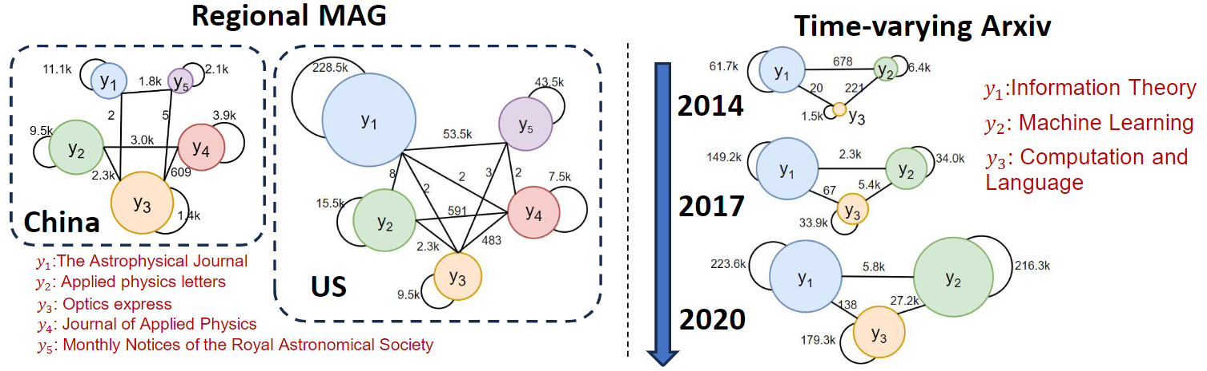
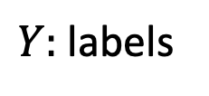
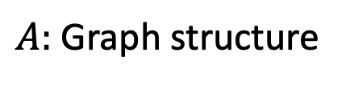
More Structure Shifts in Graph (Non-IID) Data
The Time-varying Arxiv Citation Network
$Y:$ labels
$A:$ Graph structure
[Label ratio] Computation and Language, Machine Learning grow much faster than Information Theory
$$ℙ_{S}\left(Y\right)≠ℙ_{T}\left(Y\right)$$
[Connection] Recently, Machine Learning tended to cite Computation and Language more than Information Theory
$$ℙ_{S}\left(A|Y\right)≠ℙ_{T}\left(A|Y\right)$$
The area of circle indicates the number of nodes in the particular class
Lines across indicates the number of edges between nodes in those two classes
Notes:
Such structure shifts widely exist in graph data, beyond the high energy physics example we showed.
This figure illustrates how different research communities shift by tracking the arxiv citation network over time.
Here the node sizes are proportional to the numbers of the papers published by the corresponding communities in each time period.
The lines that connect nodes are the counted numbers of citations.
Two interesting observations are related to the structure shift in this graph.
First the community of xxx
Second, machine learning tended to cite the community of information theory more than computation and language ten years ago, while this trend has got reversed recently.
All of these reflect the structure shifts in this citation network.

Slide 13
Methodology
Notes:
Next, we will introduce our proposed method to address the issue of structure shifts.

Slide 14
The Key Idea: Calibrate Edge Probabilities
$$ℙ_{S}\left({∃e}_{uv} | Y_{u}=i, Y_{v}=j\right)$$
$$ℙ_{T}\left({∃e}_{uv} | Y_{u}=i, Y_{v}=j\right)$$
Step 1: Estimate the edge probabilities between nodes from different classes
1
1
1
0
0
0
0
$$S$$
0
$$T$$
0
Step 2: Bootstrap/Add weights the neighbors based on the difference in edge probabilities between two domains
Step 3: Train $f$ over the adjusted source graph $\hat{S}$ and apply it to the target graph $T$
1
1
$$γ_{10}$$
0
$$γ_{00}$$
0
$$γ_{00}$$
$$\hat{S}$$
0
Question: Which distribution may properly characterize the structure shift and how to estimate it? Any performance guarantees?
Notes:
Our core idea for solving this problem is quite intuitive.
If we can estimate some quantity that characterizes the structural shift, we can then adjust the training graph by mitigating this shift,
so that the model trained on the adjusted graph can perform better on the test graph.
In the figure, we should one example to characterize the structural shift that is the edge probability between different classes.
Suppose we have these probabilities.
We can use these probabilites to adjust the graph structure.
However, the key question here is whether adjusting the edge probabilities is sufficient.
Also, whether the proposed method may have some performance guarantees?

Slide 15
More Details on Graph Neural Networks
Graph Neural Networks
$$h_{a}^{(2)}$$
a
$$UPT(…)$$
$$h_{e}^{(1)}$$
$$\left[\begin{matrix}0.2 \\ 0.5 \\ …\end{matrix}\right]$$
$$h_{d}^{(1)}$$
e
Sum or mean
d
$$AGG(…)$$
$$h_{a}^{(1)}$$
$$h_{b}^{(1)}$$
…
a
$$h_{f}^{(1)}$$
b
c
e
f
$$h_{c}^{(1)}$$
Graph neural network: one layer
c
b
$$h_{a}^{(0)}$$
a
$$h_{b}^{(1)}$$
$$h_{c}^{(0)}$$
c
f
f
a
b
d
a
$𝒩_{u}$: Neighborhood of node $u$
$$h_{f}^{(0)}$$
$$h_{u}^{\left(k+1\right)}=\operatorname{UPT}\left(h_{u}^{\left(k\right)}, \operatorname{AGG}\left(\left\{h_{v}^{\left(k\right)}:v∈𝒩_{u}\right\}\right)\right)$$
$$h_{u}^{\left(1\right)}=x_{u}$$
The last layer node representation $h_{u}^{\left(L\right)}$ is used for downstream predictions
bootstraping/resampling edges -> a weighted aggregation of neighbors.
Notes:
One note is that if we adopt GNNs, given GNNs leverage the neighbors by performing some aggregation, either sum or mean, the bootstrap/resampling edges can be reduced to performing a weighted aggregation of neighbors in the sense of expectation.
In case you may be not familiar with graph neural network, let me briefly introduce it here.
…

Slide 16
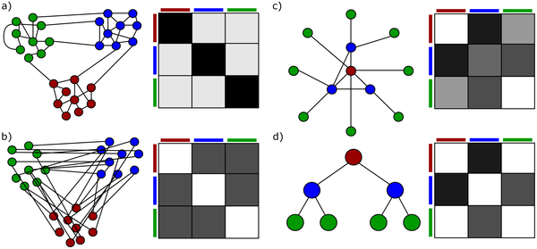

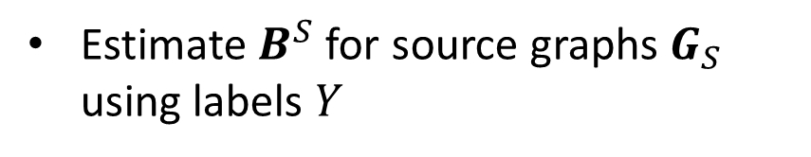
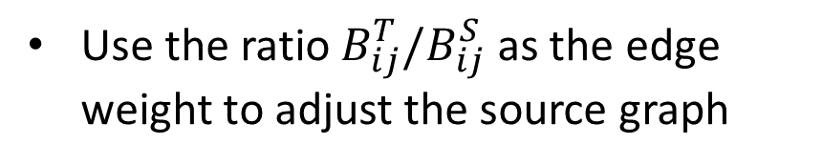
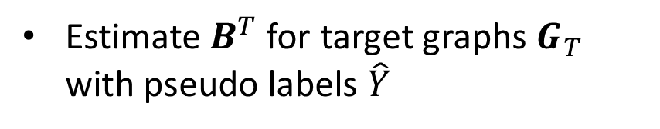
Structure Reweighting (StrucRW)
Heuristic methods to estimate the edge weights
Assume Contextual stochastic block models ${ℙ\left({∃e}_{uv} | Y_{u}=i, Y_{v}=j\right)≜B}_{ij}$
Estimate $B^{S}$ for source graphs $G_{S}$ using labels $Y$
Estimate $B^{T}$ for target graphs $G_{T}$ with pseudo labels $\hat{Y}$
Use the ratio $B_{ij}^{T}/B_{ij}^{S}$ as the edge weight to adjust the source graph
Require no label distribution shift
$ℙ_{S}\left(Y\right)=ℙ_{T}\left(Y\right)$
Deshpande, et al. “Contextual stochastic block models.” NeurIPS 2018.
Liu, et al. “Structural re-weighting improves graph domain adaptation,” ICML 2023
Notes:
The first solution is very simple.
Its name is StruRW.
We assume the graph data satisfies contextual stochastic block model. Then, edges are conditionally independent of each other given the node labels.
Then, we may just estimate the edge probabilities for the source and target graphs.
Note that in the target graph, we do not have labels so we use pseudo labels to do the estimation of B_T
Then, we compute the ratio between them and use this ratio as the edge weight on the source graphs.
The performance that will be shown later indicates that this operation improves the performance somehow.
However, we notice that this approach may only work when we assume there is not label distribution shift.
Here, I skip the detailed explanation.
If you are interested, you may check our next paper.

Slide 17
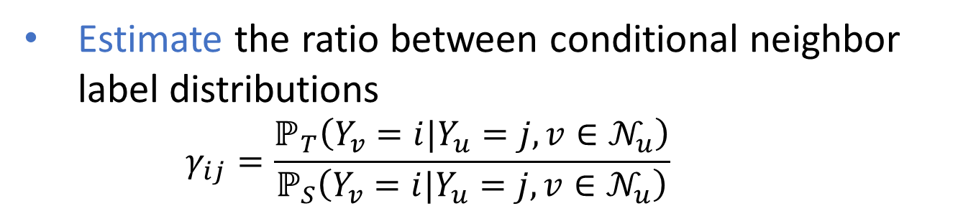
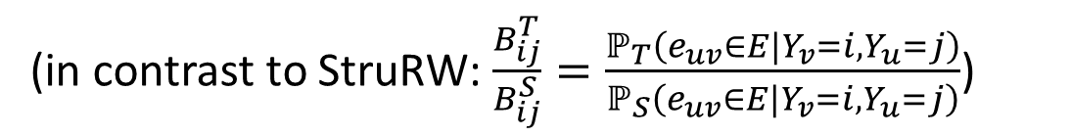
Pair-Align: Pairwise Edge-label Distribution Alignment
Estimate the ratio between conditional neighbor label distributions
      $$γ_{ij}=\frac{ℙ_{T}\left(Y_{v}=i|Y_{u}=j, v∈𝒩_{u}\right)}{ℙ_{S}\left(Y_{v}=i|Y_{u}=j, v∈𝒩_{u}\right)}$$
(in contrast to StruRW: $\frac{B_{ij}^{T}}{B_{ij}^{S}}=\frac{ℙ_{T}\left(e_{uv}∈E|Y_{v}=i,Y_{u}=j\right)}{ℙ_{S}\left(e_{uv}∈E|Y_{v}=i,Y_{u}=j\right)}$)
--- We may prove that with some weak assumptions, PairAlign can achieve
$$ℙ_{S}\left(H^{\left(k\right)}|Y\right)=ℙ_{T}\left(H^{\left(k\right)}|Y\right)→ℙ_{S}\left(H^{\left(k+1\right)}|Y\right)=ℙ_{T}\left(H^{\left(k+1\right)}|Y\right)$$
$H^{\left(k\right)}:$ k-layer node representation given by GNNs
Liu, Shikun, et al., Pairwise Alignment Improves Graph Domain Adaptation, ICML 2024.
Notes:
This is also why we propose the second approach named pair-align.
We notice that naively estimating the edge probabilities between two classes cannot address the problem.
What actually needs to be estimated and adjust is this value.
That is conditioning on one node label, the distribution of labels of its neighbors.
In our paper, we proved that by using this value to adjust the edge weights, if the node’s k-th layer representations’ distributions are aligned, after gnn mixes the neighbors’ representations, the next-layer reresentations still keep aligned given on some moderate assumption.
This means what.
This means if we may align the node representations at the very beginning then by performing graph neural networks/message passing way to aggregates features from the neighbors, the distributions can keep aligned.
Also, as we do not know the target domain node labels, we want to estimate P_T.
This requires us to xxx
As this part is slightly too technical, I am not going to discuss the details.
If you are interested in the details, please check our paper or I am happy to discuss it offline.

Slide 18
Evaluation in Practice
Significant empirical performance on real applications
  High energy physics datasets for the pileup mitigation task
  Regional MAG datasets to simulate the region shift
    Newly curate a large-scale real-world MAG dataset to simulate the region shift scenarios (US, CN, DE, JP, RU, and FR)
  Temporal networks of Arxiv papers that simulate the time shift
Theoretical analysis verification using synthetic CSBMs
Notes:
Finally, we evaluate our methods on several real-world datasets including the pileup mitigation datasets.
Also, we also curated datasets to mimic some real-world distribution shifts in graph data.
We use them to further demonstrate the wide-range applicability of our methods.
One is to partition Microsoft academic graph according to the countries the papers’s leading institutes are in.
The other one is to track arxiv data across time.
We also verify our results on CSBM to test our theory.
In the paper, we have more extensive studies.
Here, we just highlight some results.

Slide 19
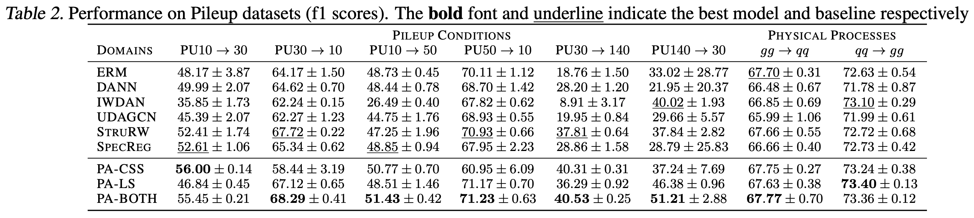



Evaluation --- Pileup Mitigation
$$ℙ_{S}\left(A,Y\right)≠ℙ_{T}\left(A,Y\right)$$
Pileup conditions: shift in the PU level (mainly structure shift)
Only address
1). Conditional Structure Shift
2). Label Shift
3). Both two shifts
PA-CSS
$$ℙ_{S}\left(A|Y\right)≠ℙ_{T}\left(A|Y\right)$$
Only address
PA-LS
$$ℙ_{S}\left(Y\right)≠ℙ_{T}\left(Y\right)$$
PA-BOTH
Notes:
We first consider pileup mitigation datasets.
Actually, structure shifts are obvious when the pileup level changes.
Pair-align has three variants which address only conditional structure shift, or only label shift, or both.

Slide 20
Evaluation --- Pileup Mitigation
StruRW achieves improvements (-1%-10%, ave. 3%+) compared to other baselines (other than SpecReg, a contemporary work)
PairAlign achieves 1% - 14% improvement (average: 6%) in F1 score compared to StruRW
Notes:
We first consider pileup mitigation datasets.
Actually, structure shifts are obvious when the pileup level changes.
Pair-align has three variants which address only conditional structure shift, or only label shift, or both.
Overall, pair-align achieves around 1% to 10% improvement.
In average, there is about 4% improvement.

Slide 21
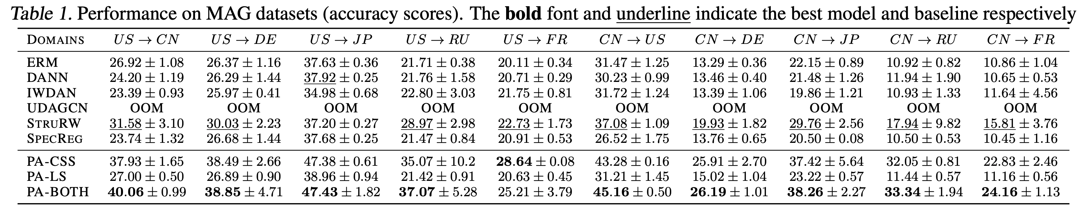
Evaluation --- Region Shift
Regional MAG: papers published in different countries
Due to the major structure shift, Pair-Align (PA-Both and PA-CSS but not PA-LS) works better than the baseline
StruRW is the second best
5% - 16% improvement (ave: 9%) in accuracy (vs StruRW)
(ave: 4%) in accuracy (vs other baselines)
Notes:
For evaluation on other datasets, I will not go into the details.
If you would like to know more, please check the paper.
Both StruRW and PA achieve much performance, and PA’s improvement is much more obvious.

Slide 22
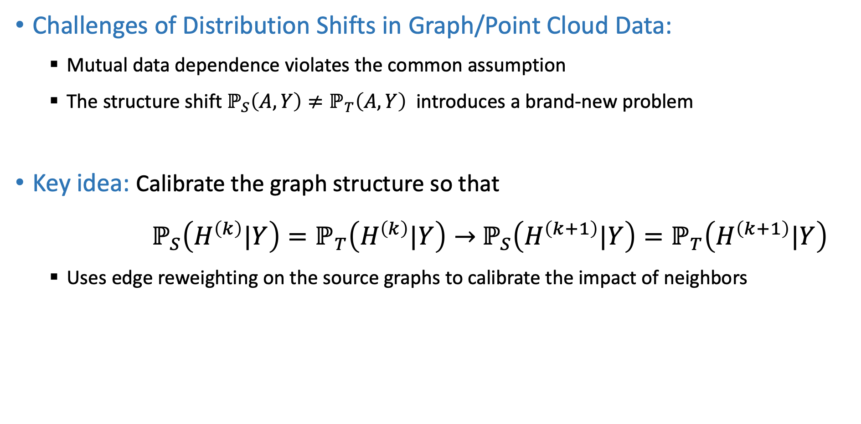
Summary
Challenges of Distribution Shifts in Graph/Point Cloud Data:
  Mutual data dependence violates the common assumption
  The structure shift $ℙ_{S}\left(A,Y\right)≠ℙ_{T}\left(A,Y\right)$ introduces a brand-new problem
Key idea: Calibrate the graph structure so that
$ℙ_{S}\left(H^{\left(k\right)}|Y\right)=ℙ_{T}\left(H^{\left(k\right)}|Y\right)→$ $ℙ_{S}\left(H^{\left(k+1\right)}|Y\right)=ℙ_{T}\left(H^{\left(k+1\right)}|Y\right)$
  Uses edge reweighting on the source graphs to calibrate the impact of neighbors
Notes:
Okay, that’s the first part of the talk.
Before we go to the second part of the talk, let me give a quick summary.
We introduced the data distribution shift problem in irregular data like graphs or point clouds, motivated by the application in high-energy physics.
For this problem, the mutual dependence between data points violates the common assumption adopted by existing works.
In particular, the structure shift formulates a new problem, which requires new algorithmic tools.
Our key idea is to adopt edge reweighting on the source graphs to calibrate the impact of the neighbors.
If we may achieve that in the two consecutive iterations of the algorithm, if the alignment of node representations/particular representation can be kept.
Then, we say that we have addressed the structure shift problem

Slide 23

Thanks!
Shikun Liu¹ Tianchun Li² Yongbin Feng³ Nhan Tran³ Han Zhao⁴ Qiu Qiang²
¹ Gatech ² Purdue ³ FermiLab ⁴ UIUC
Structural re-weighting improves graph domain adaptation. (code)
Pairwise Alignment Improves Graph Domain Adaptation. (code)
A new benchmark (NeurIPS 2024) for GDL with distribution shifts:
Pan Li¹
GeSS: Benchmarking Geometric Deep Learning under Scientific Applications with Distribution Shifts. (code)
Notes:
Thanks for your attention.
Next, I would like to take questions.

