Slide 1

Closed Loop Brain Stimulation in NHPs
Using Hardware Accelerated Machine Learning
Rajeev B. Botadra
Department of Electrical & Computer Engineering,
University of Washington

Slide 2
Outline
Background & Motivations
The Decoder model & Latency Constraints
Hardware Acceleration using FPGAs & System Design
Results & Future Works

Slide 3
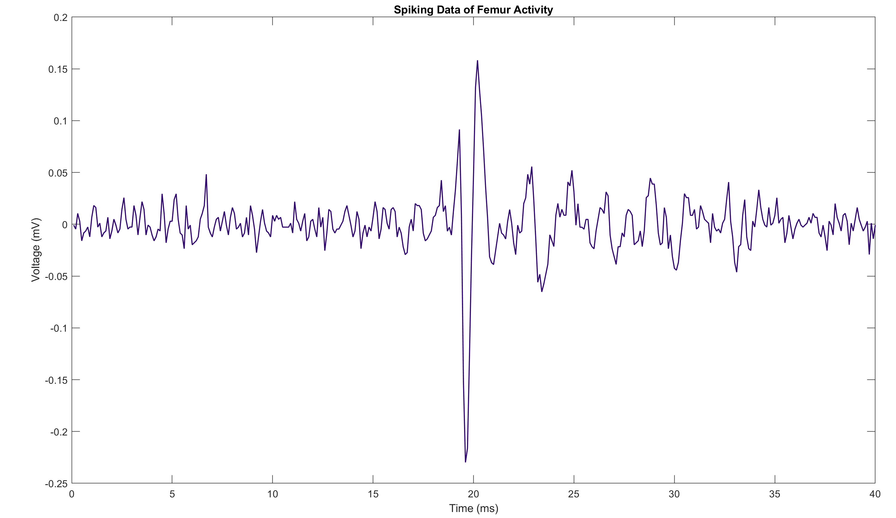
A Brief Background on Neurons
Neurons transmit information using electric fields via electrochemical ionization channels
This electrical activity can be recorded outside the cell
  Occurs on the order of milliseconds
External electrical stimuli can incite or inhibit activity of a neighborhood of neurons
Figure 1: Spiking data muscle activity from a Cockroach femur

Slide 4
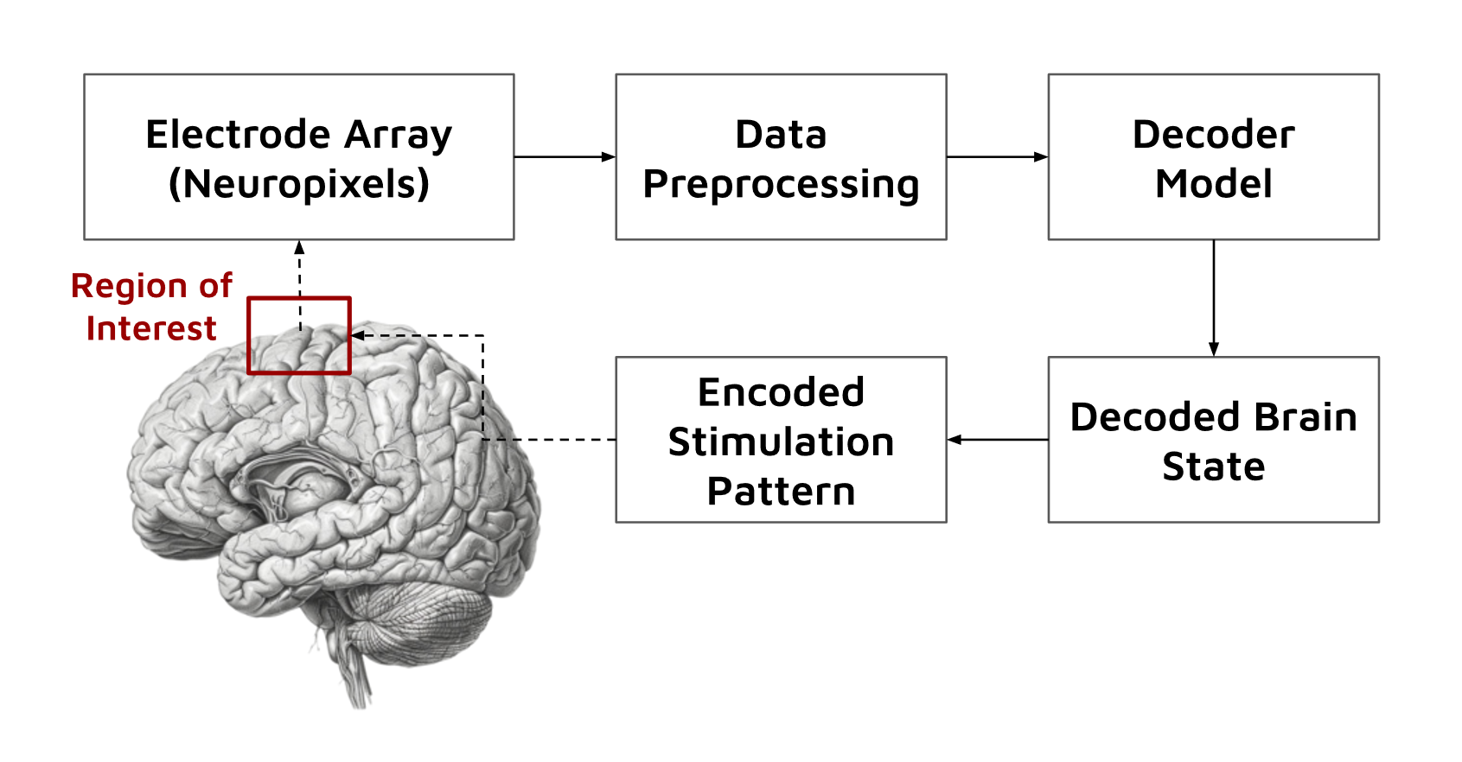

Closed-Loop Brian Stimulation
Closed-loop systems decode neural activity to control some mechanism
  I.E. Prosthetic device, neural implant, keyboard
The mechanism triggers a response in the brain through some method
  I.E. Tactile stimulation, electrophysiological stimulation, visual stimulation
Figure 2: Example Closed-Loop system with electrophysiological stimulation

Slide 5
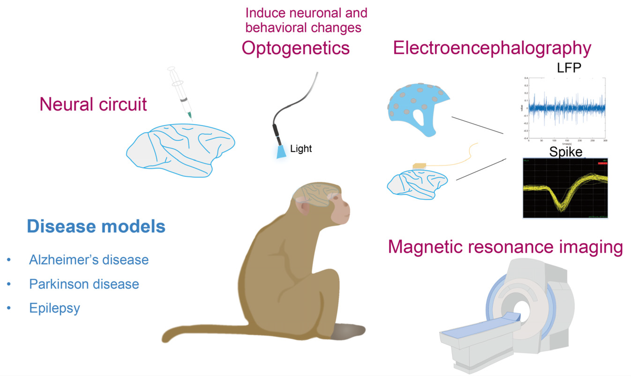
Applications
Closed-loop Brain-Computer Interfaces (BCIs) are studied for many physical and neural treatments:
  1. Neurotherapy (I.E. treating Parkinson's disease)
  2. Neuroprosthetics (I.E. artificial limbs, quadriplegia)
  3. Treating anxiety and depressive disorders
Figure 3: Example BCI System to treat neural diseases

Slide 6
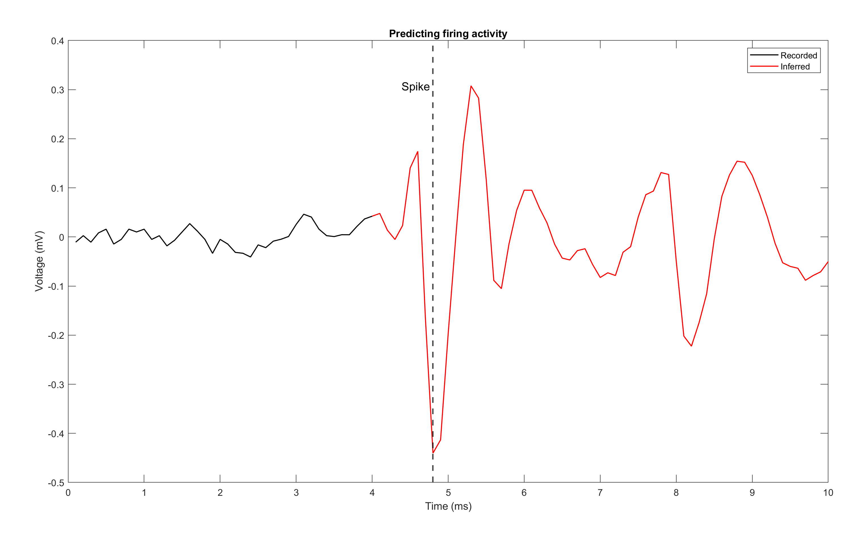
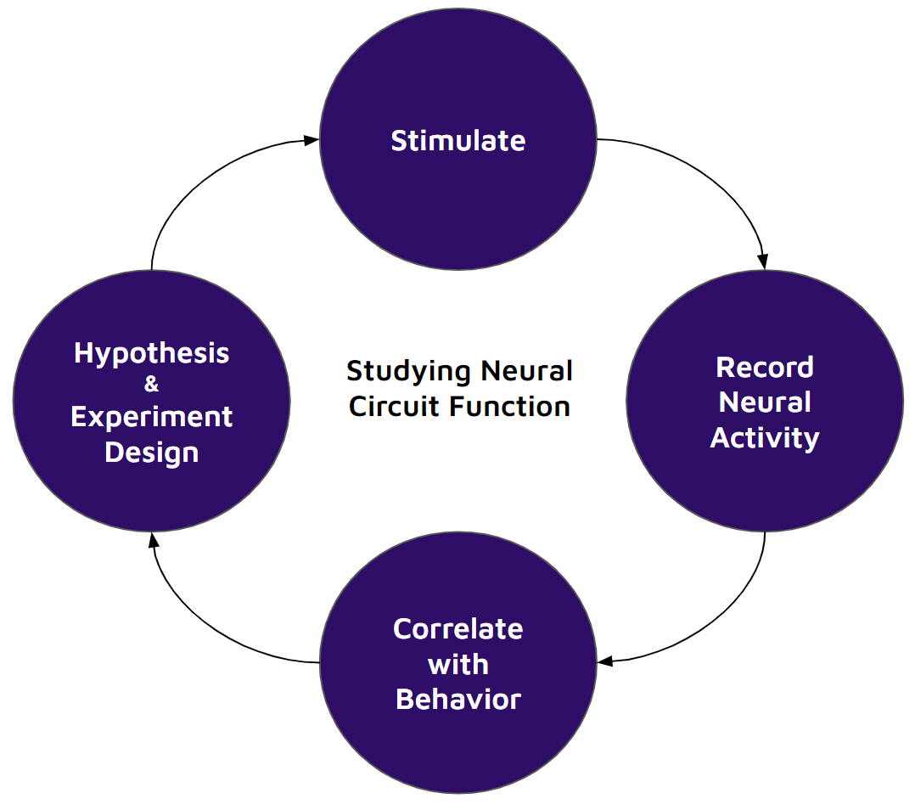
Decoding Neural Activity
Inferred neural activity is used to determine timing and pattern of inhibitory stimulation
Enables isolation of the neuron population’s role in observed behavior
Figure 5: Example of inferred neural signal given previous activity
Figure 4: Studying Neural Function

Slide 7
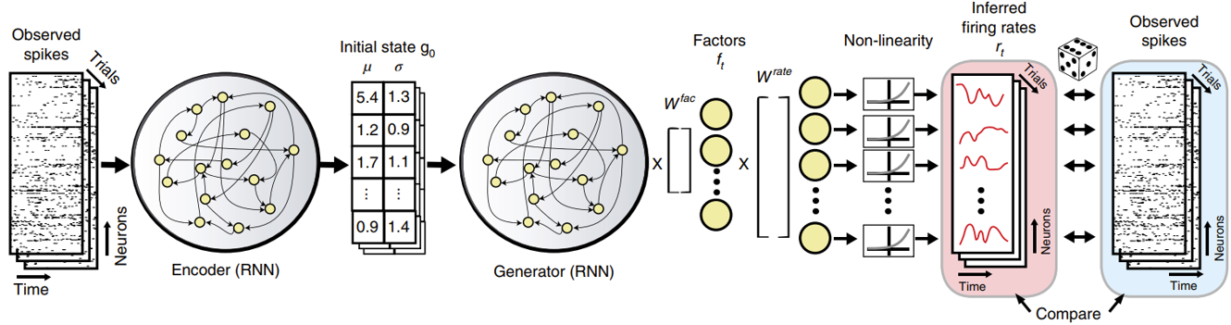
The LFADS Model
Latent Factor Analysis via Dynamical Systems (LFADS)
  Variational Sequential Autoencoder model
  Predicts firing activity of brain region using latent model of neighborhood
[1] Figure 6: The LFADS model architecture

Slide 8
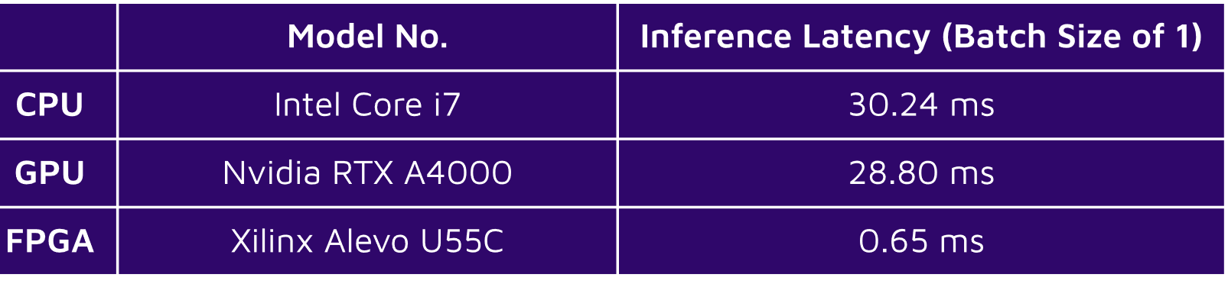
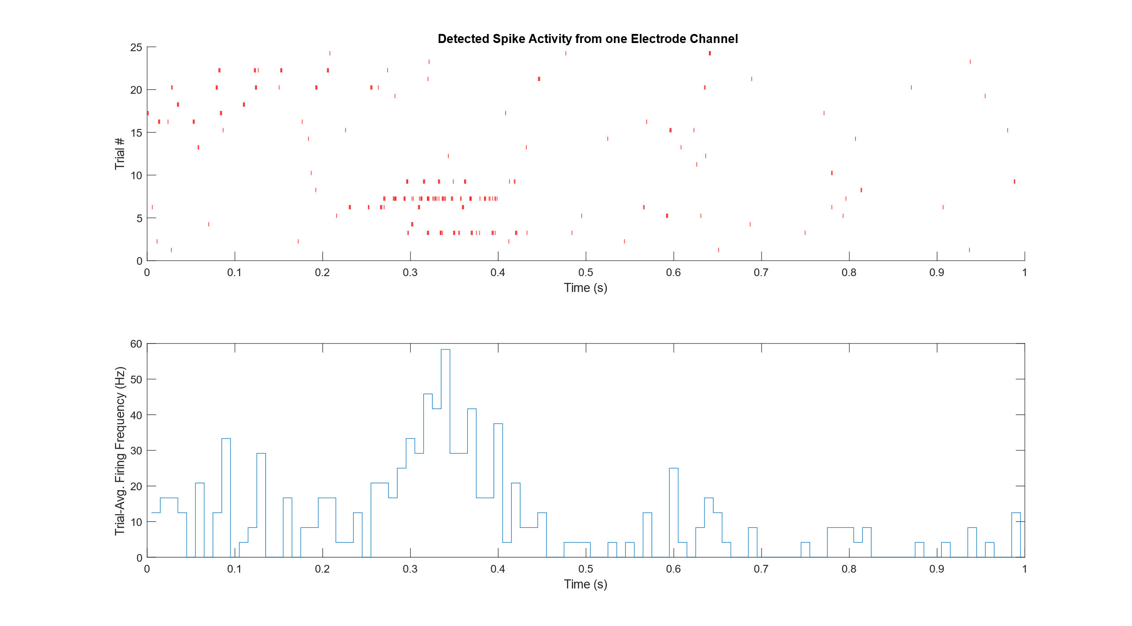
Latency Constraint
The processing and communication latency of the system must not exceed (1/F)
Table 1: Inference latency for LFADS on a single batch of data
Maximum average firing rate of ~60Hz – constraint of ~17ms on system latency
Figure 7: Raster Plot and Firing frequency from neurons in cockroach femur

Slide 9
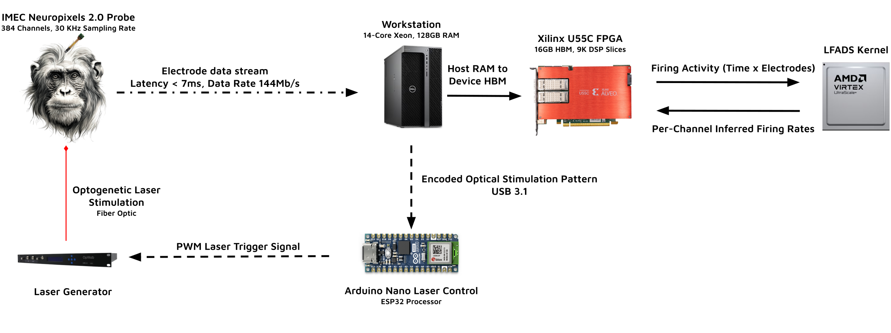
System Design
* The signal is pre-processed by Neuropixels before heading to PC
** LFADS kernel deploys a fine-tuned and quantized model
Figure 8: Experimental Apparatus

Slide 10
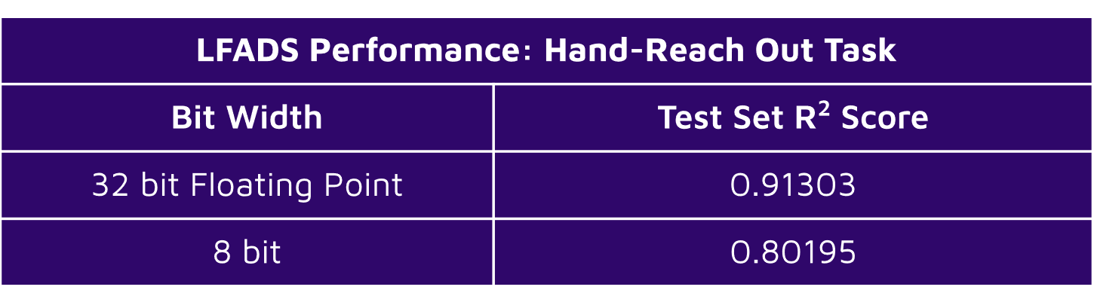
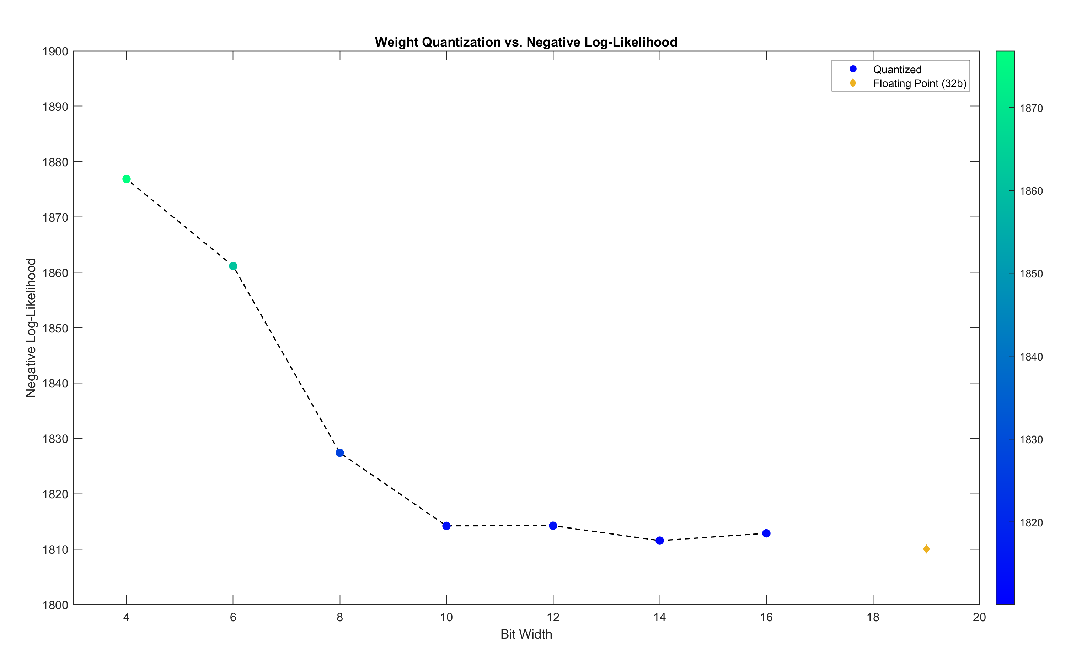
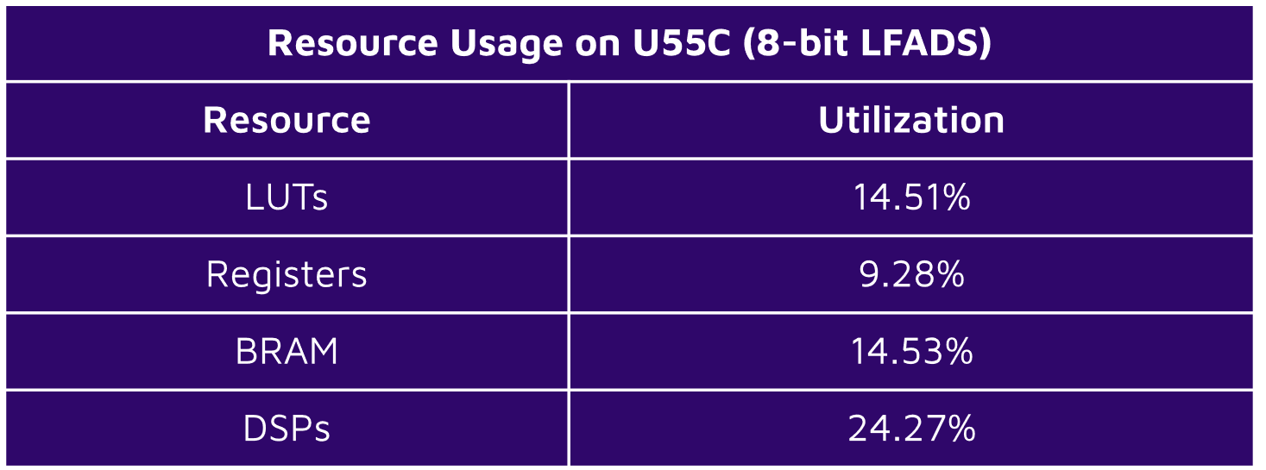
Quantized Model Performance
The pre-trained LFADS model weights were quantized with QAT
Table 2: R^2 Score for Floating point and 8-bit LFADS
Table 3: Resource usage on an Alevo U55C FPGA
Figure 9: Raster Plot and Firing frequency from neurons in cockroach femur

Slide 11
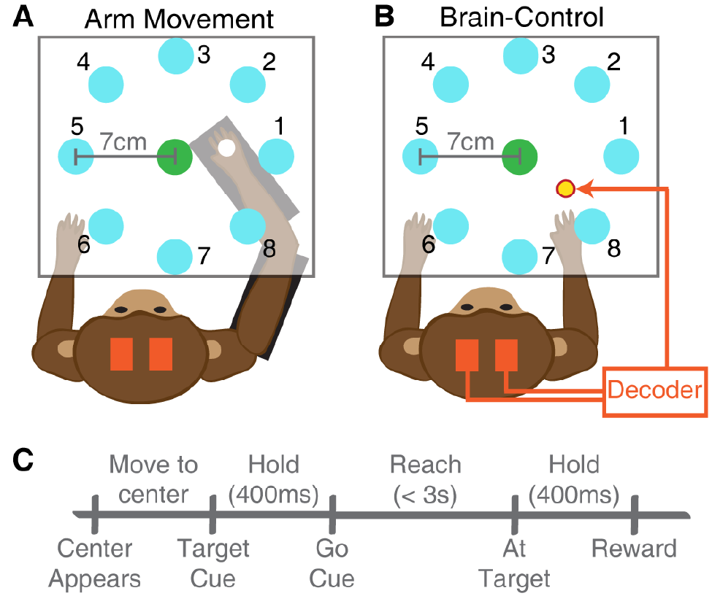
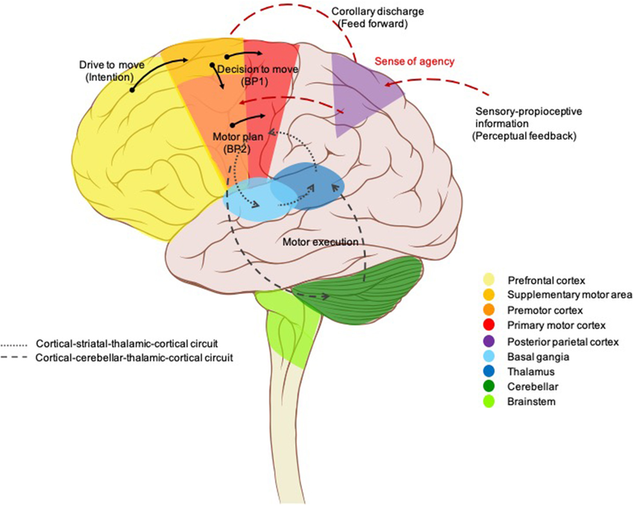
Future Works
Test and deploy additional model architectures (NDT, MRAE, modified LFADS)
Leverage closed-loop capability in experiment design
  Investigating motion pre-planning through the hand-reach-out task
Figure 10: Overview of the hand reach-out task
Figure 11: Active areas of study in different brain regions

Slide 12
Thanks for listening!
Questions?

